Slide 1
Cooking with Sloan
Hypervelocity Stars
Jordan Raddick
The Johns Hopkins University
American Astronomical Society summer meeting
Calgary, AB

Slide 2
Outline
Welcome and introduction
Set the table
Introduce the kitchen
Gather the ingredients
Enjoy the feast

Slide 3
Welcome
Purpose: Teach how to use SDSS data access tools for research
Rationale: Best to learn in specific context
Focus: Specific research questions
  Rediscover recent interesting findings
Method: Interactive demo
  Ask questions
  Follow along on your laptop
Mood: fun

Slide 4
Scientific problems
Asteroid weathering
  Nesvorny et al. 2005
Hypervelocity stars
  Brown et al. 2006
Color-magnitude diagram for galaxies
  Baldry et al. 2004
Measuring the Hubble constant
  Hubble 1929

Slide 5
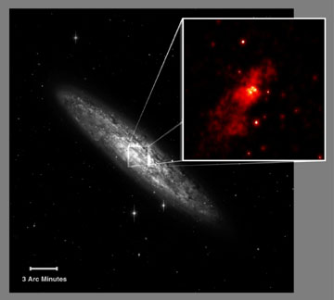
The Problem
Giant black hole at the
center of our galaxy
  2-3 million solar masses
How does it affect
its local neighborhood?

Slide 6
Giant Black Hole vs. Stars
(The black hole wins)
Hills (1988) predicted:
When a binary star passes close (within a few AU) to the black hole…
The black hole can capture one star and send the other one away
Extra gravitational potential of BH becomes kinetic energy of star
  Newtonian effect

Slide 7
“Hypervelocity” stars
Velocities > 500 km/s, maybe as high as 5,000 km/s
Faster than escape velocity of galaxy
  So they’re on their way out
They’re rare
  Estimated about 1,000 in entire galaxy (Yu & Tremaine 2003)
How do you increase your chance of finding one?

Slide 8
Finding Hypervelocity Stars
Search a large area to great depth
  SDSS covers 6,670 sq. deg.
  SDSS limiting magnitude in g: 22.2
Look in galactic halo
  BH ejects stars in all directions equally
Look for stars with lifetimes similar to their travel times from the galactic center
  They’ll stand out among old stars from the halo

Slide 9
Strategy
First, examine the (only) three already known
  SDSS J090745.0+024507
  US 708
  HE 0437-5439
Then, let’s search for candidates buried in SDSS data
Then, let’s find their velocities with follow-up from magic telescope
Then, let’s study the new stars we find

Slide 10
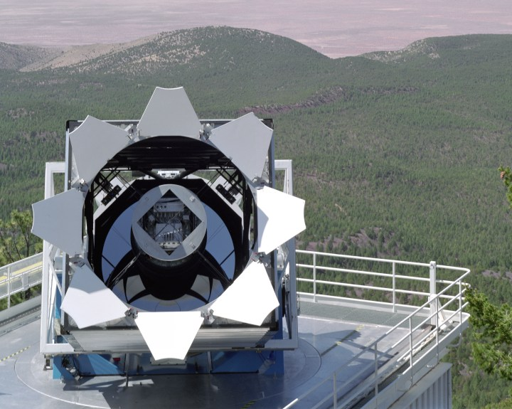
Introducing the SDSS

Slide 11
Participating Institutions
The American Museum of Natural History
Astrophysical Institute Potsdam
University of Basel
Cambridge University
Case Western Reserve University
University of Chicago
Drexel University
Fermilab
The Institute for Advanced Study
The Japan Participation Group
Johns Hopkins University
The Joint Institute for Nuclear Astrophysics
The Kavli Institute for Particle Astrophysics and Cosmology
The Korean Scientist Group
The Chinese Academy of Sciences (LAMOST)
Los Alamos National Laboratory
The Max-Planck-Institute for Astronomy (MPIA)
The Max-Planck-Institute for Astrophysics (MPA)
New Mexico State University
Ohio State University
University of Pittsburgh
University of Portsmouth
Princeton University
The United States Naval Observatory
The University of Washington
(there are a lot of us)

Slide 12
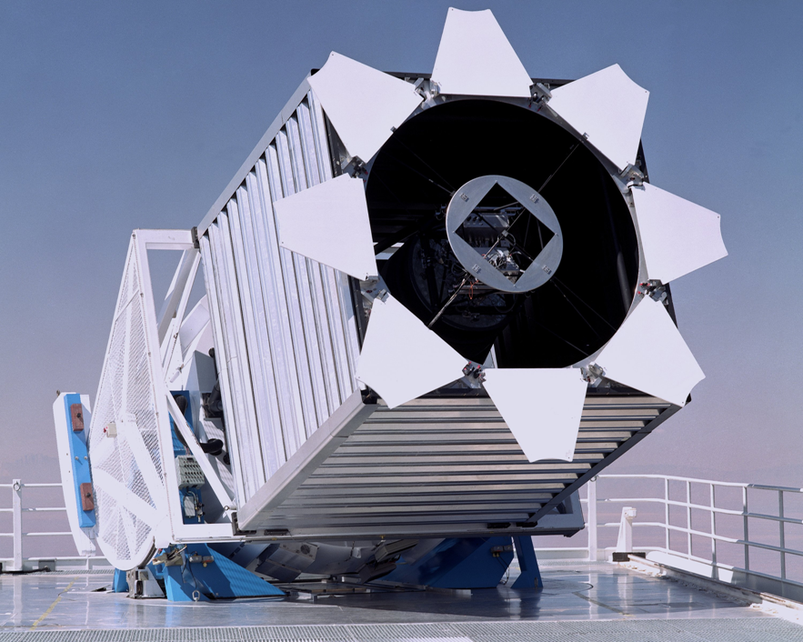
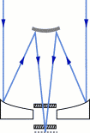
The Telescope
2.5 meter F/5 reflector
Very wide
(~3 degree)
field of view
Alt-az mount
Drift scanning

Slide 13
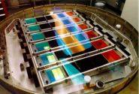
The Camera
CCD Imaging
  30 chips
  2048 x 2048 pixels
  Arranged in six
  columns
Five rows for five
filters: u, g, r, i, z
54 second exposure
time in each filter

Slide 14
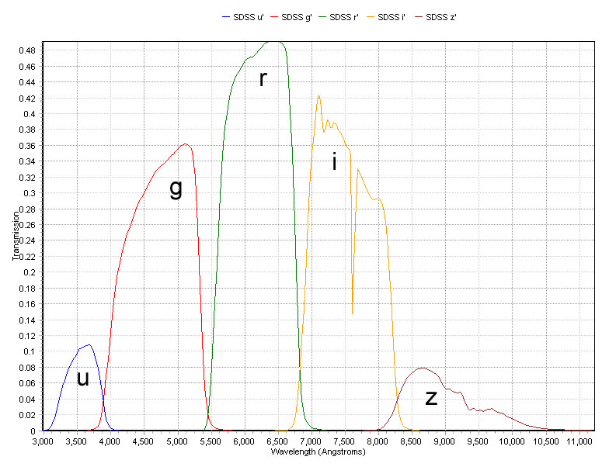
Filter Profiles

Slide 15
Spectral Target Selection
All galaxies brighter than g < 17.77
A luminous red galaxy sample
Quasar Candidates
  “stars” with unusual colors
Objects with VLA FIRST or ROSAT matches

Slide 16
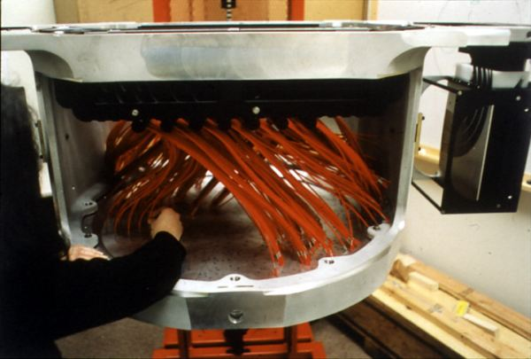
Spectrographs
Two fiber-fed spectrographs
Telescope tracks stars with plug plate in focal plane
Records
640 spectra
simultaneously

Slide 17
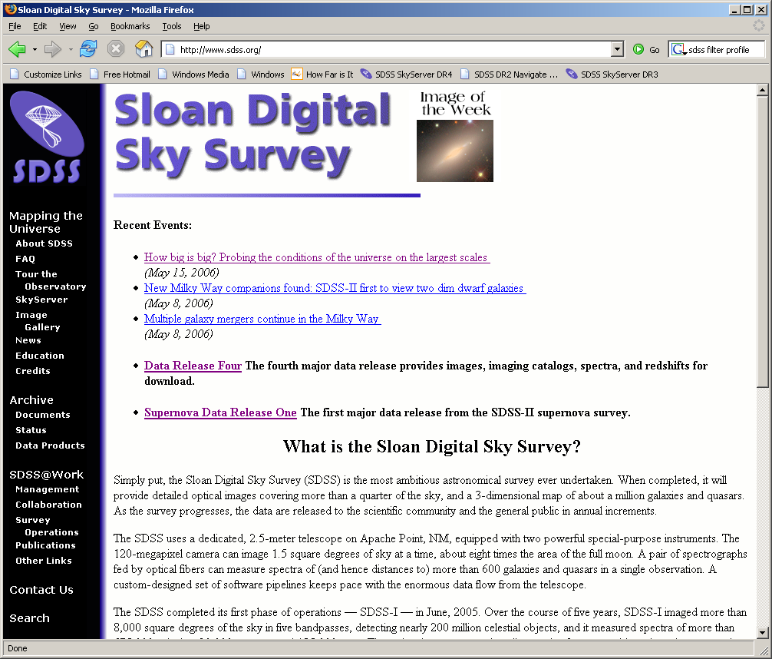
Let’s start cooking…
Go to
www.sdss.org
Read News
See Education
Click on
Data Release 4

Slide 18
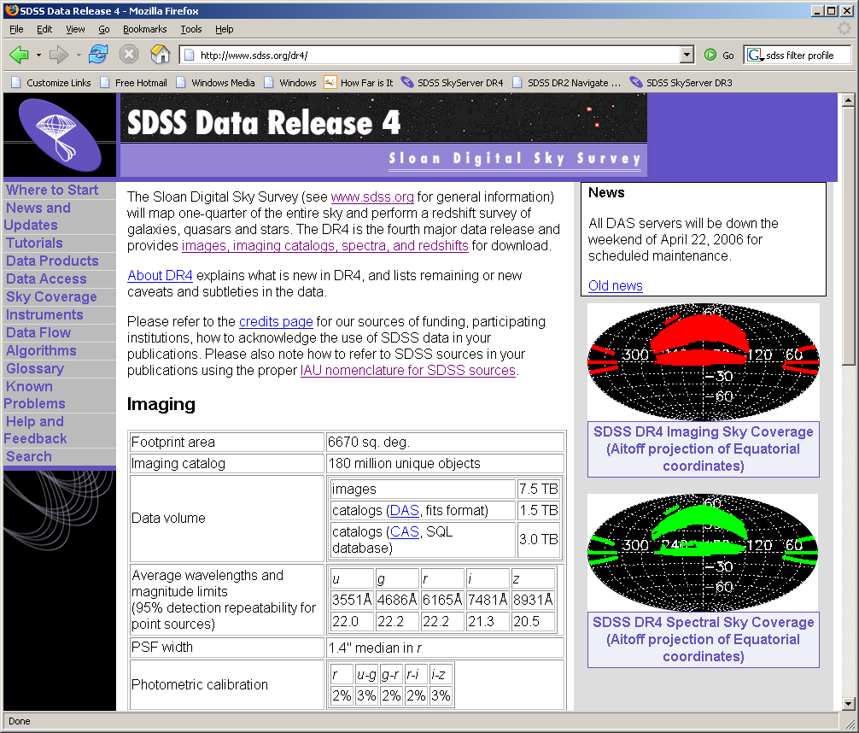
Demo of DR4 site

Slide 19
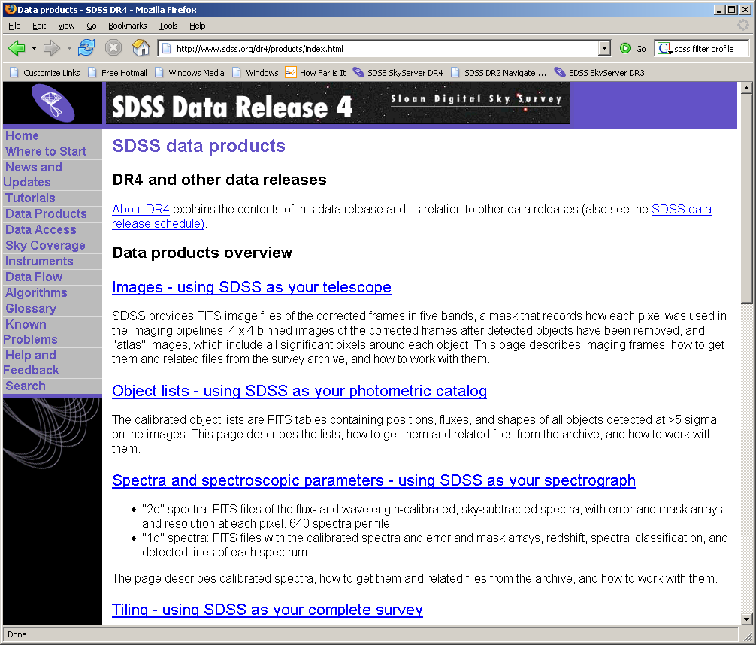
Data Products

Slide 20
Data Access Methods
Data Archive Server (DAS)
  http://das.sdss.org/DR4/data/ (or replace with DRx)
  All the FITS data
  Accessible via rsync, wget
Catalog Archive Server (CAS)
  http://cas.sdss.org/
  All the catalog data (i.e. numbers)
  Back end: MS SQL Server database management
Two distinct sites, both hosted at Fermilab
We’ll focus on the CAS

Slide 21
Why use databases?
Tycho Brahe’s notebooks
  lifetime of work (1570-1601)
  About 500 kB
POSS – 1950s
  About 10 GB
SDSS – today
  3 TB
LSST – 2012
  5 PB or more

Slide 22

Today’s tools, tomorrow’s data
You can…
  GREP 1 MB in 1 second, FTP for < 1¢
  GREP 1 GB in 1 minute, FTP for $1
  GREP 1 TB in 2 days, FTP for $1,000
  GREP 1 PB in 3 years, FTP for
  $1,000,000
  …and 1 PB is 5,000 disks

Slide 23
Large-database science
Data in a database
Bring tools to data, not data to tools
Link data to literature

Slide 24
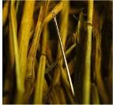
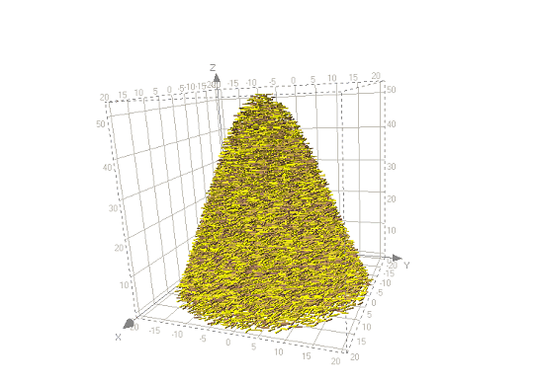
Types of Problems
Needles in haystacks
  Brown dwarfs
  Higgs particle
  Disease-causing genes
Haystacks
  Dark matter
  Dark energy
  Protein folding models
Needles are easier!
Our problem is “needle”

Slide 25
Let’s see those stars…
Go to Catalog Archive Server (CAS)
  Click “CAS” link on SDSS DR4 site
  Go to http://cas.sdss.org
  Go to www.google.com, type “CAS SDSS”
Notice Projects – great for your teaching!
Important: click “For Astronomers”
  Now the site is optimized for you

Slide 26
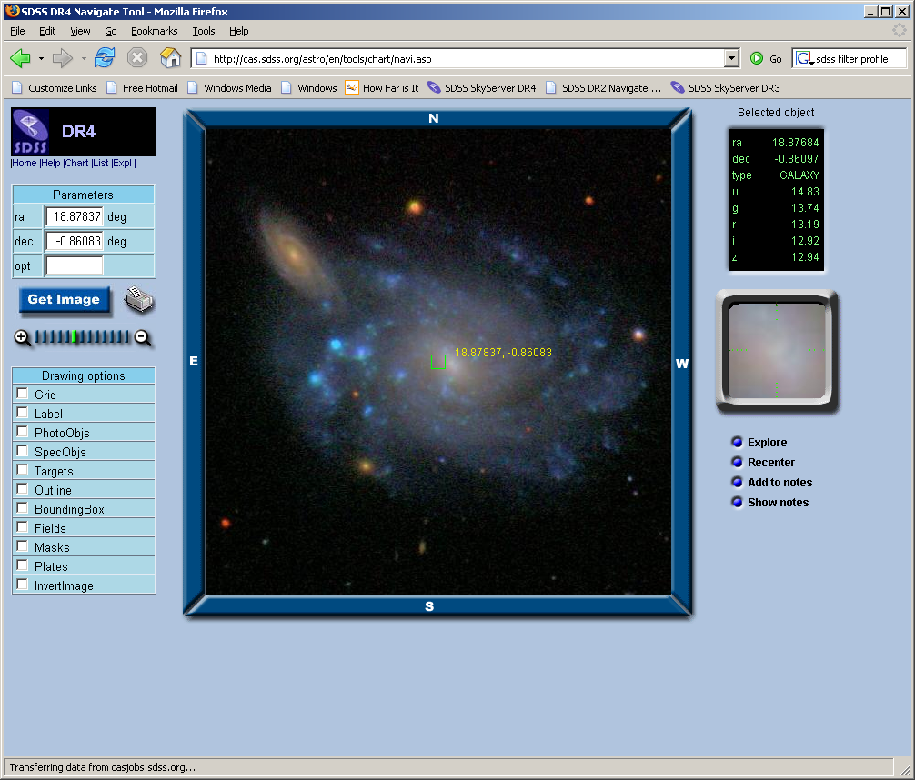
Browse for Known HVSs
http://cas.sdss.org/astro/
Click on “Navigate”
Mapquest-like
interface
Click on any
object for data
Online notebook

Slide 27
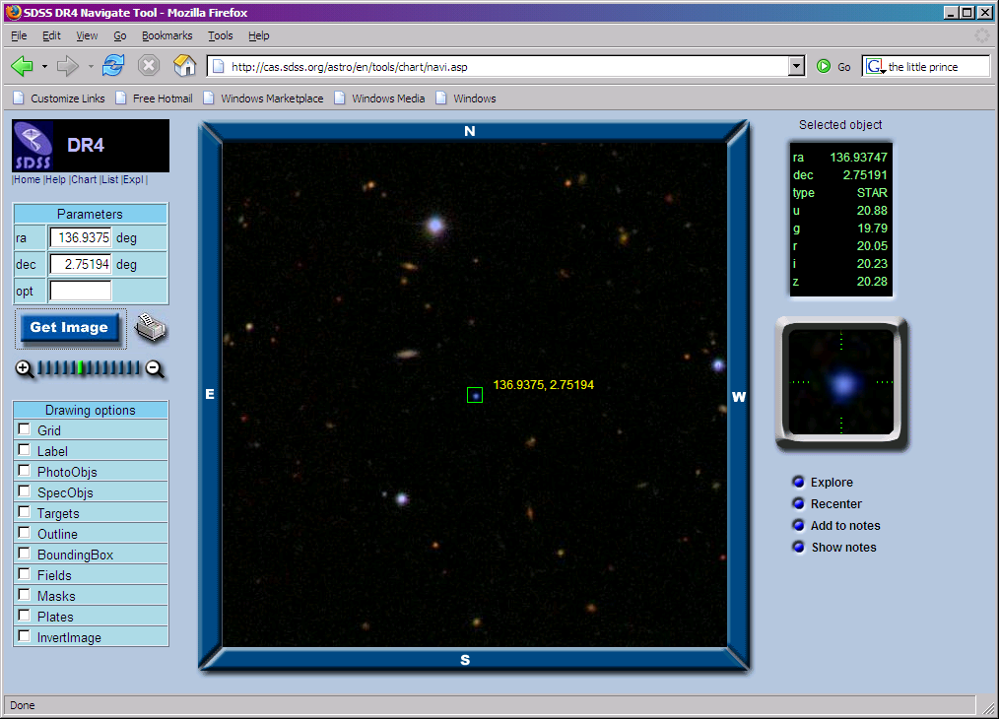
SDSS J090745.0+024507
First known HVS (Brown et al 2005)

Slide 28
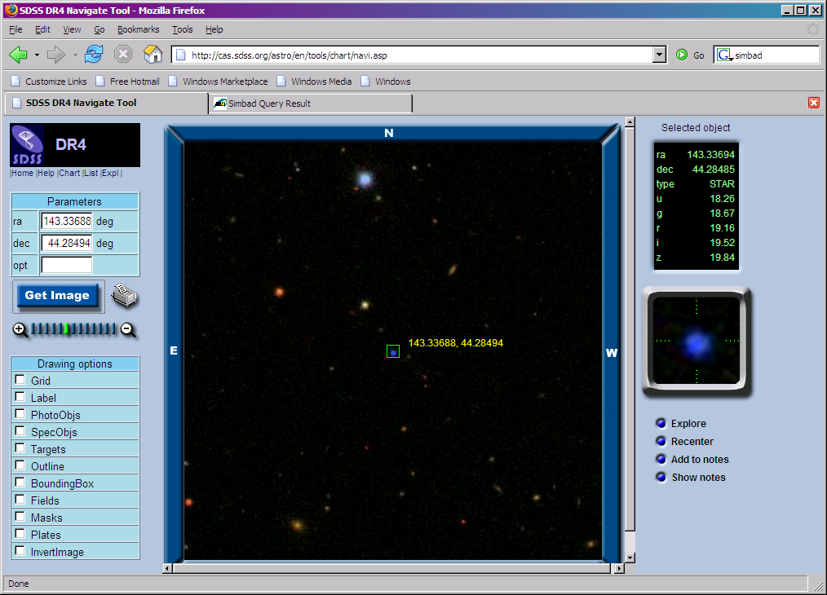
US 708
Coordinates from SIMBAD:
  RA = 09 33 20.85 Dec = +44 17 05.8

Slide 29
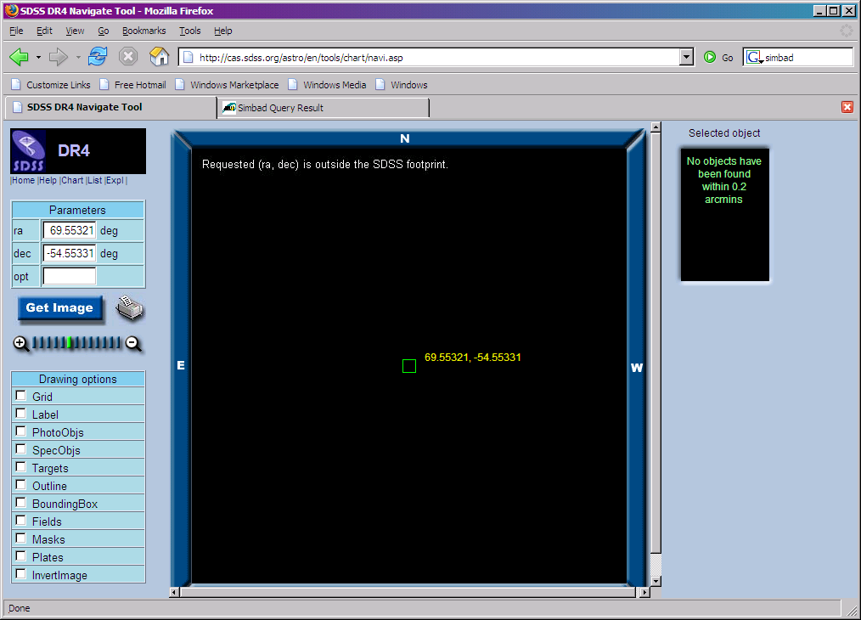
HE 0437-5439
Coordinates from SIMBAD
  RA = 04 38 12.77 Dec = -54 33 11.9

Slide 30
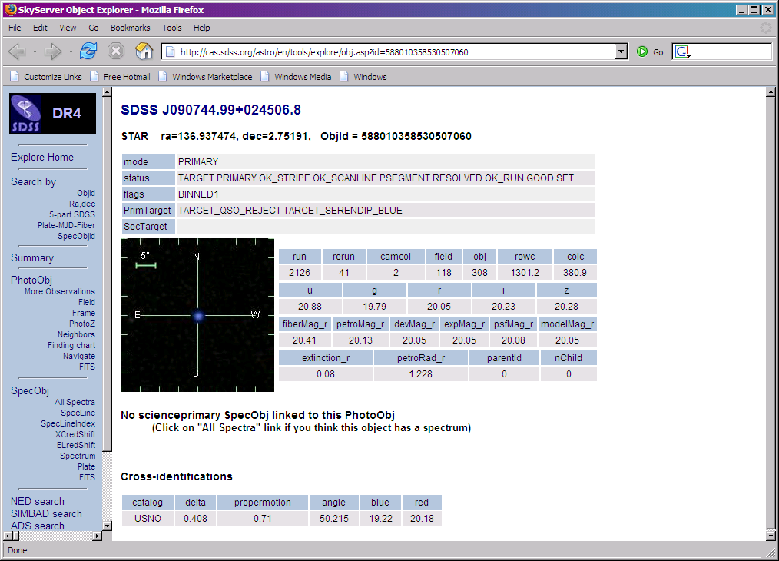
Explore an HVS
Summary of
image data and
(if available)
spectral data
Links to
complete data
Get FITS of
images (5 filters),
spectrum

Slide 31
Explore an HVS
Links to NED,
SIMBAD, ADS
Links to
multiple SDSS
observations
Print

Slide 32
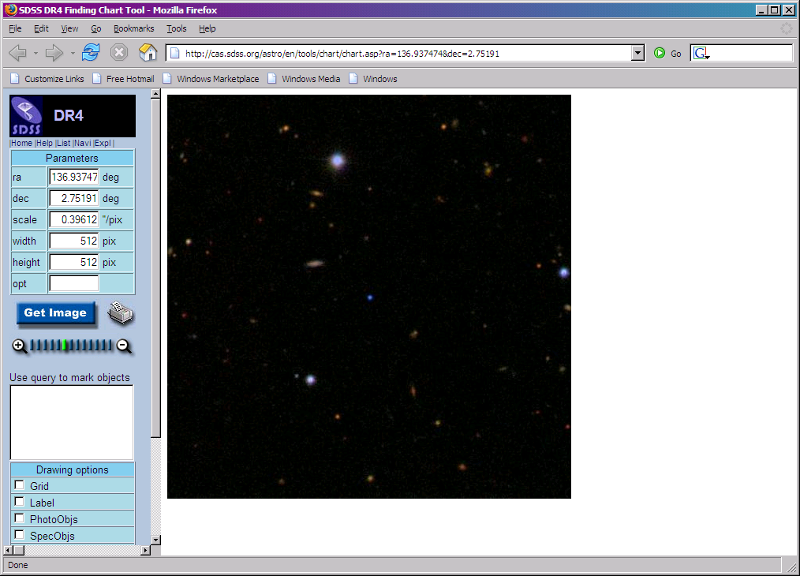
Observe this HVS
Click image to go
to Finding Chart
Enter ra, dec,
scale (arcsec /
pixel), image
width
Print (inverted)
Point your
telescope!

Slide 33
Searching the Database
Are there others out there?
But… there are 70 million stars!
How do you search the database?

Slide 34
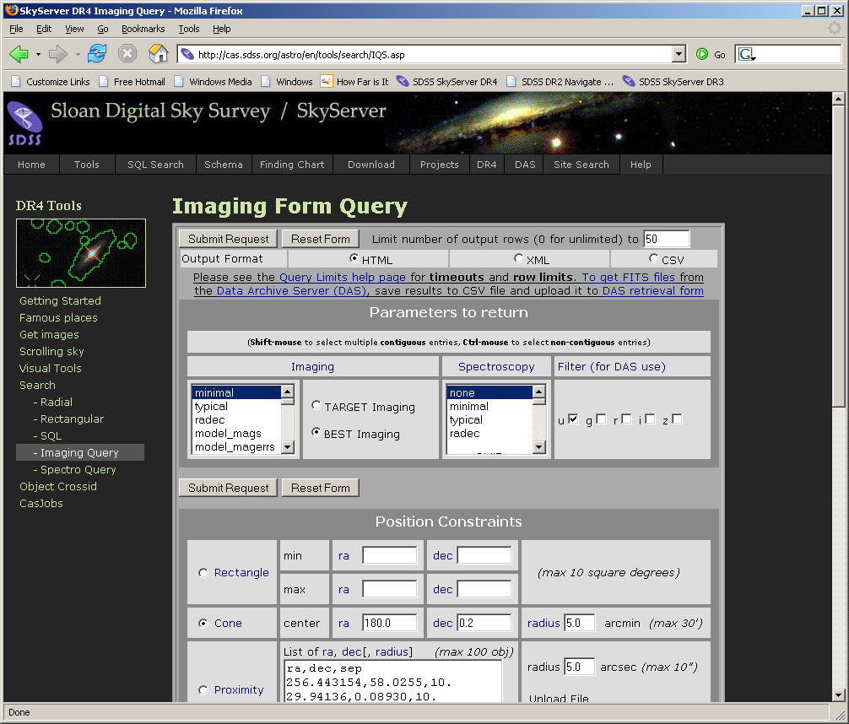
Imaging Query

Slide 35
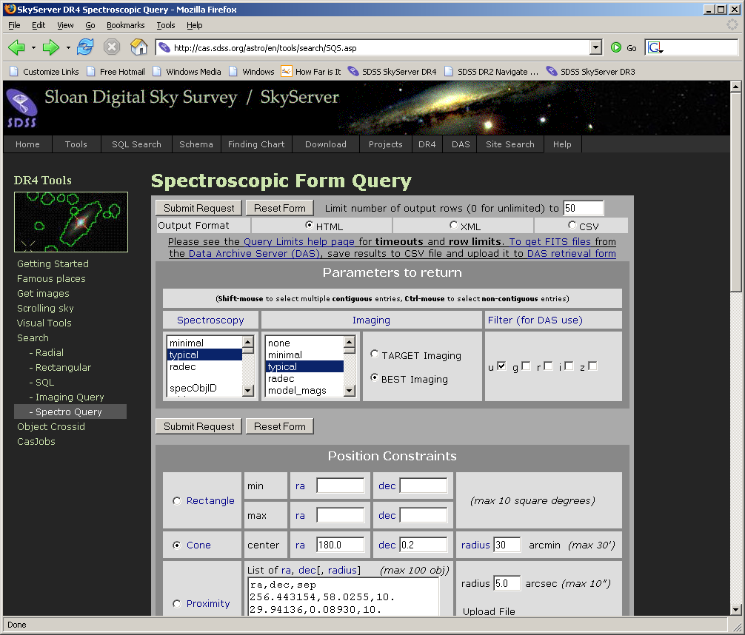
Spectro Query

Slide 36
Searching for HVS candidates
Constraints from Brown et al (2006):
Position constraints
  7h40m < RA < 10h50m [115 < RA < 162.5]
  dec > 15º
Color cuts
  Correspond to late B-type stars
  -0.42 < (g-r) < -0.27
  2.67(g-r) +1.33 < (u-g) < 2.67(g-r) + 2
  (parallelograph in g-r, u-g space)
But you can’t do color parallelogram in the IQS!

Slide 37
SQL Searching
SQL – Structured Query Language
  Common database access language
  Industry standard (not just astronomy)
Allows advanced searches (“queries”) of data
Search using constraints on any variable
Return any or all types of data

Slide 38
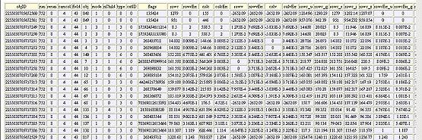
SQL Concepts
Data are stored in a database
Similar data types are stored in tables
  photoObj (photometry), specObj (spectroscopy), etc.
A VERY small part of the photoObj table:

Slide 39
SQL Concepts
Within a table:
  Horizontal rows are individual data points, or records
  Vertical columns are types of data, or columns
A request to a database to return data is called a query
Queries usually request data that meets certain constraints

Slide 40
SQL as a foreign language
Languages have grammar and vocabulary
Dutch grammar
  With modal verb, auxiliary verb goes at the end
English:
  I want TO SEE star positions.
Dutch:
  Ik wil de posities van de sterren ZIEN.

Slide 41
SQL Grammar
Select – choose which columns of data you want to see
From – choose the table(s) from which you want to retrieve data
Where – set constraints on the search

Slide 42
Dutch vocabulary
INFINITIVE | PAST | PAST PART. | MEANING
beginnen | begon, begonnen | begonnen | to begin
begrijpen | begreep, begrepen | begrepen | to understand
bieden | bood, boden | geboden | to offer

Slide 43
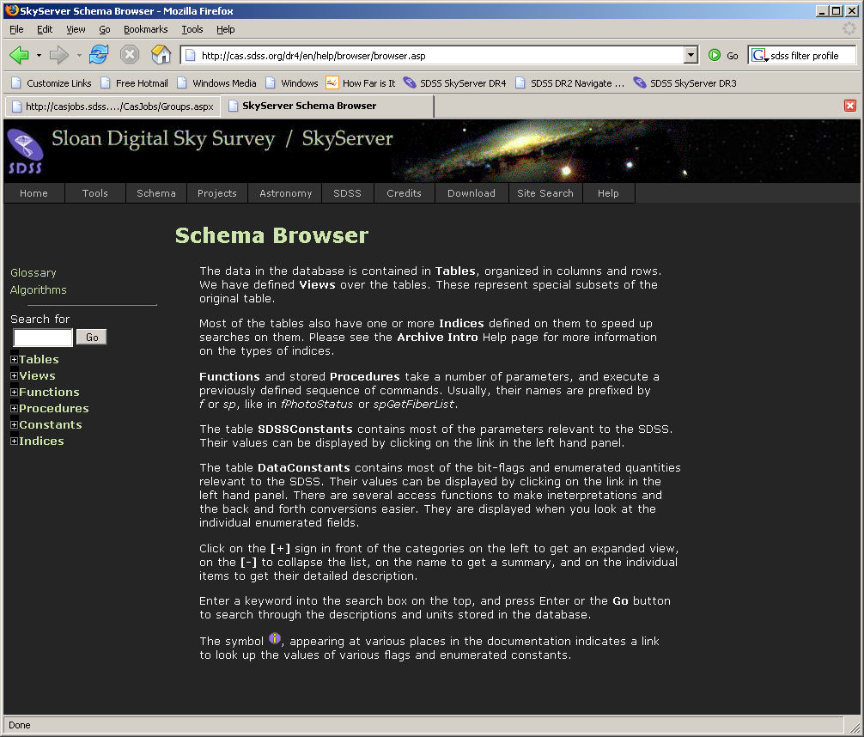
SQL Vocabulary

Slide 44
Translations
English:
  I want to see positions of 15th magnitude stars.
Dutch:
  Ik wil de posities van de 15de magnitude sterren zien.
SQL:
  select ra, dec
  from star
  where r between 15 and 16

Slide 45
SQL Help Resources
See Help link on SkyServer
  Introduction to SQL
  How-to -> Searching for Data
  Sample SQL Queries
  Query Limits
To submit a query, go to Tools -> Search -> SQL Search

Slide 46
HVS Query
select
objid, ra, dec, psfMag_u, psfMag_g, psfMag_r, psfMag_i, psfMag_z
from
phototag
where
type = 6
AND RA between 115 and 162.5
AND Dec > 15
AND (psfMag_g-psfMag_r) between -0.42 and -0.27
AND psfMag_u-psfMag_g between 2.67*(psfMag_g-psfMag_r) + 1.33 and 2.67*(psfMag_g-psfMag_r) +2

Slide 47
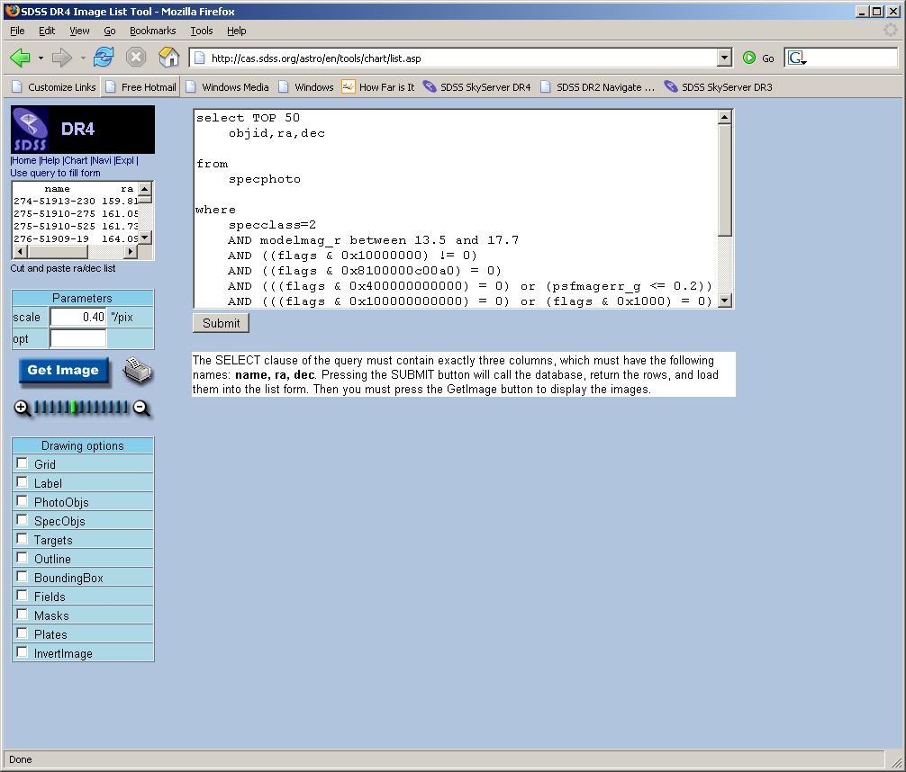
First, a sanity check…
Advanced Tools ->
Image Lists
Use query to fill
form
Two changes
  Add “TOP 50”
  Select block must
  be ONLY
  name, ra, dec

Slide 48
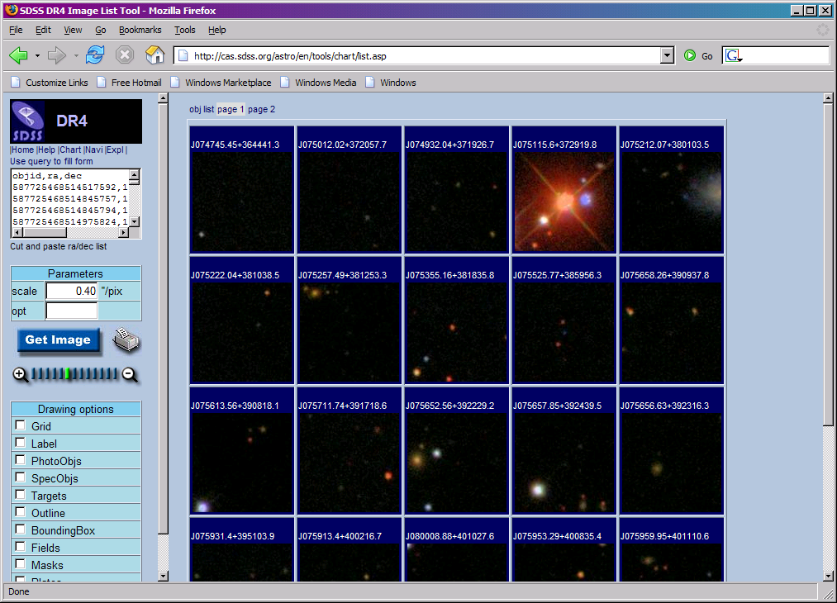
We’re sane!
Some noise, but most look like blue stars

Slide 49
Running the Query
How many stars will we get?
Select count(*) ->
n = 44,572
That’s too many to use web browser
Solution: CasJobs

Slide 50
CasJobs
Advanced Tools -> CasJobs
  Best method for fairly long, complex queries
  Personal user DB (MyDB)
  Quick mode: 1 minute cutoff (don’t need to register)
  Register for…

Slide 51
CasJobs
Advanced Tools -> CasJobs
  Submit mode: up to 8 hours in “long” queue
  MyDB database to save results of your queries
    Define your own functions, procedures
    Share tables with collaborators (groups)
  Job history, plotting, FITS/CSV/VOTable output

Slide 52
Run the Query in CasJobs
Go to “Query”
Select “DR4” as “Context”
Give results table a name (for your MyDB)
Give your query a name
Wait until it says “started”
Go play outside
When you return, results will be in MyDB

Slide 53
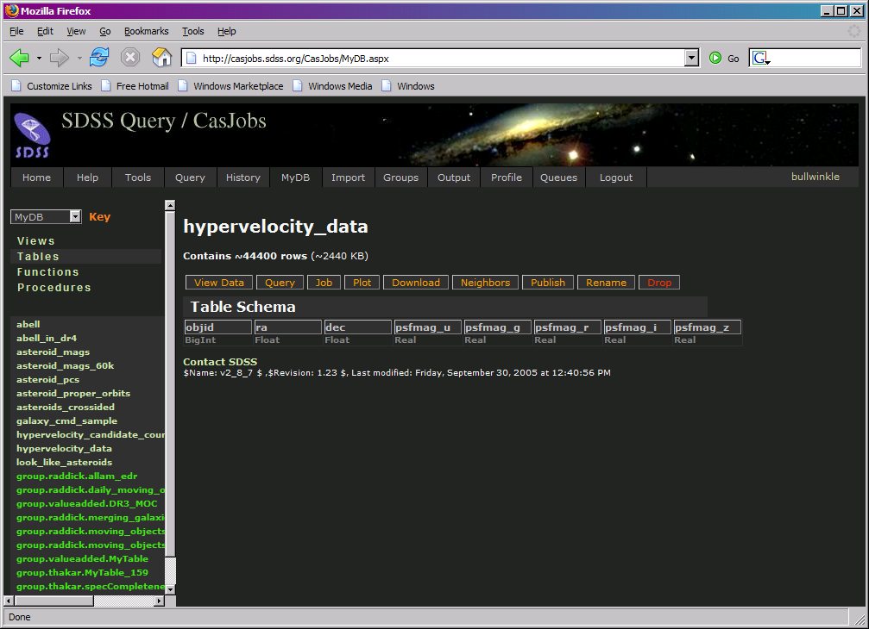
Results
Query ran in 3 min. 14 sec.
  Varies due to server load

Slide 54

CasJobs Options
View data
(preview)
Query your MyDB (just like SDSS tables)
  Change context to “MyDB”
Job shows how table was created
Plot creates a simple x-y plot
Download lets you download data
  CSV, FITS, XML
Neighbors lets you search around each object

Slide 55
CasJobs Options
Publish lets you
share table with
colleagues (see Groups feature)
Rename
Drop (delete)

Slide 56
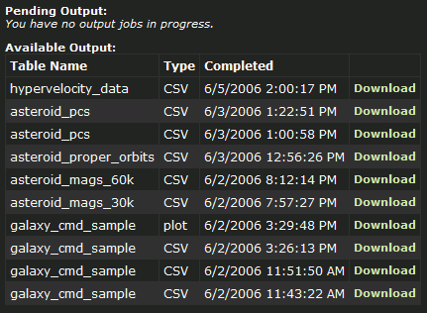
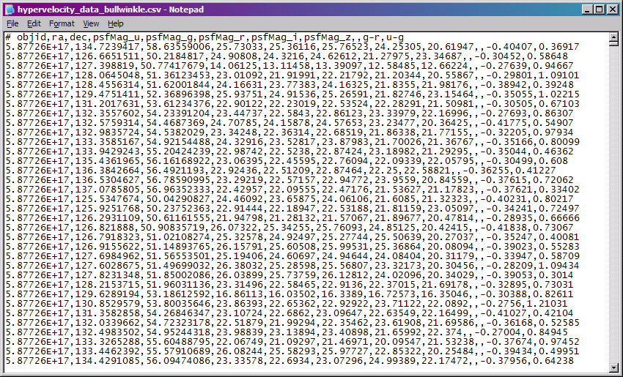
Download HVS Table
I’ll get it as CSV

Slide 57
Plot Graph
g-r vs. u-g
Use your favourite program
I used Excel
The plot is…

Slide 58
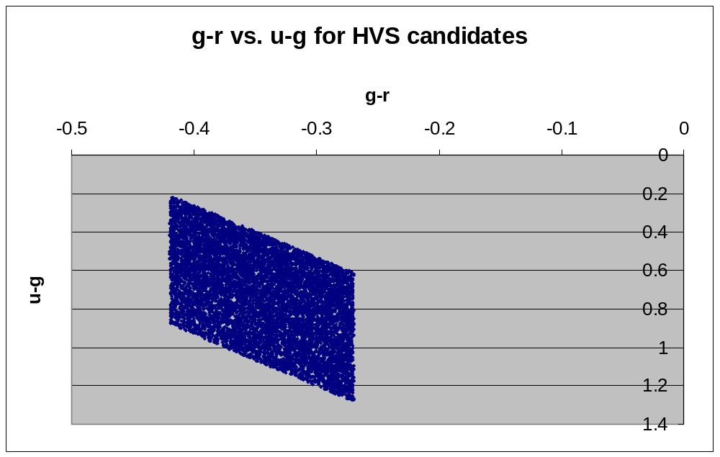
Plot Results

Slide 59
Follow-up spectroscopy
Use magic telescope to take follow-up spectra of candidates
Calculate stellar velocity from spectra
Two stars have > 500 km/s velocity
  See figure 3 in paper
Let’s examine those two stars…

Slide 60
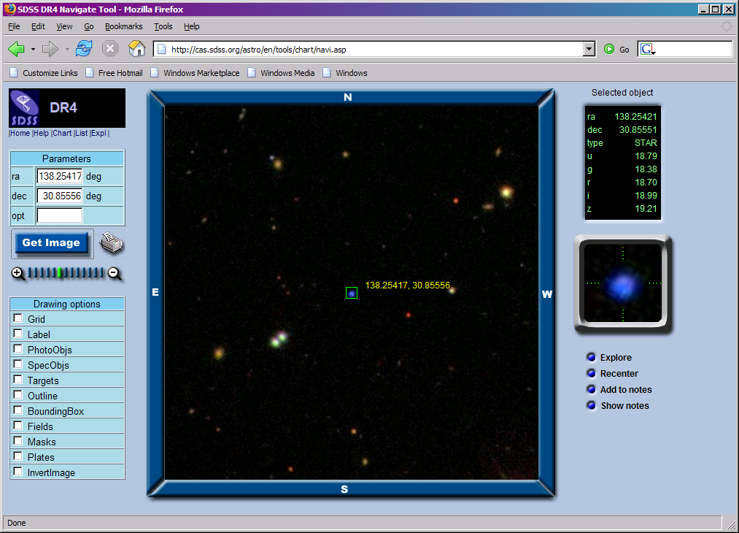
SDSS J091301.0+305120

Slide 61

SDSS J091759.5+672238

Slide 62
Further questions
How many more can we find?
Can we cross-correlate HVSs in other surveys
  National Virtual Observatory (NVO)
Can we get a statistical sample?
How do HVSs constrain galaxy BH properties?

Slide 63
Tips
Use astronomers’ site
  All tools linked directly from main page
  More generous query limits (timeouts, row limits)
  Imaging/Spectro form query
Each release has separate sites
  http://cas.sdss.org/DR4/ (current site)
  http://cas.sdss.org/DR3/ … etc…
Teach yourself SQL by modifying sample queries

Slide 64
Tips
Use CasJobs for anything complex
Use Image List to sanity-check your queries
Use PhotoTag table whenever possible
Start with simple problems, learn more complex features later

Slide 65
For more help
E-mail the SDSS Helpdesk
  sdss-helpdesk@fnal.gov
Or talk to any SDSS person here

Slide 66

Bon Appétit!

