Slide 1
Planning
Ewa Deelman
USC Information Sciences Institute
deelman@isi.edu
GriPhyN NSF Project Review
29-30 January 2003
Chicago

Slide 2
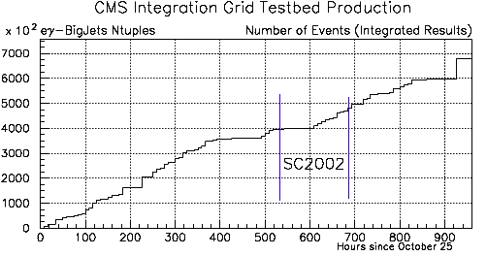
GriPhyN Architecture
Virtual
Data
Production
Analysis
discovery
params
exec.
Science
sharing
Review
data
composition
discovery
Researcher
Applications
Planning
Chimera virtual data system
Pegasus planner
DAGman
Globus Toolkit
Condor
Ganglia, etc.
Performance
instrument
planning
data
Production
Manager
storage
storage
element
element
Execution
Services
Services
storage
element
Grid
Virtual Data
Toolkit
Grid Fabric

Slide 3
People Involved
University of Chicago: Ian Foster, Catalin Dumitrescu, Kavitha Ranganathan, Jens Voeckler, Mike Wilde, Yong Zhao
UCSD: Keith Marzullo, Xianan Zhang
USC: Carl Kesselman, Ewa Deelman, Gaurang Mehta, Gurmeet Singh, Karan Vahi
  James Blythe and Yolanda Gil
University of Wisconsin: Miron Livny, Doug Thain, Peter Courvares
LIGO: Caltech, UW Milwaukee, GEO600: Staurt Anderson, Masha Barnes, Kent Blackburn, Philip Ehrens, Albert Lazzarini, Greg Mendell, Peter Shawhan, Roy Williams, Bruce Allen, Scott Koranda, Maria Alessandra Papa, Alicia Sintes

Slide 4
Application Workflow Characteristics
Experiment | #workflows per analysis | # of jobs in workflow | Data Size per job | Compute Time per job
LHC | O(100K) | 7 | ~300MB | ~12CPU hours
LIGO | O(1K) | 100-400 | ~1MB | ~2min
SDSS | O(20K) | 10 | ~1MB | ~1-5 min
Number of resources:
currently several condor pools and clusters
with 100s of nodes

Slide 5
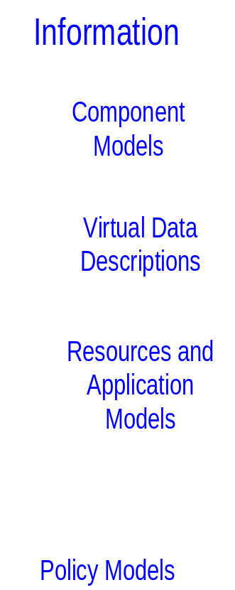
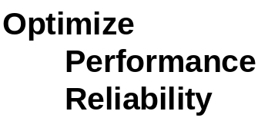
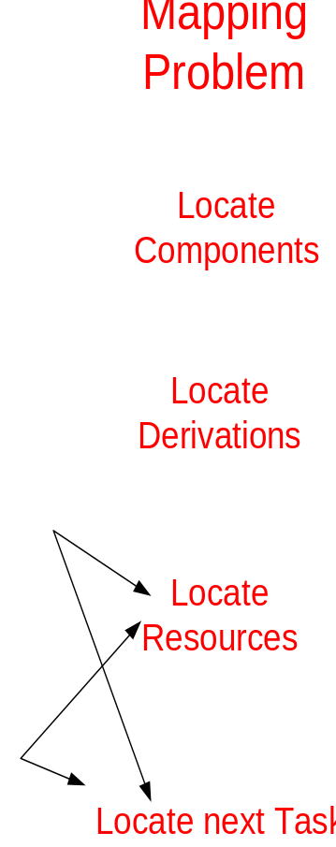
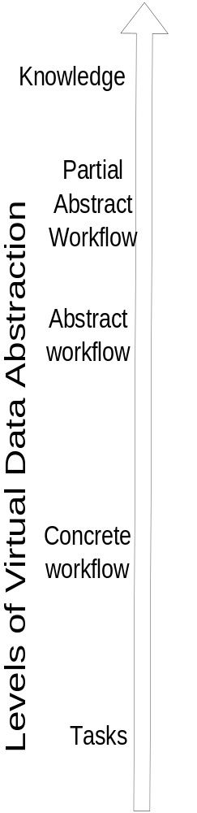
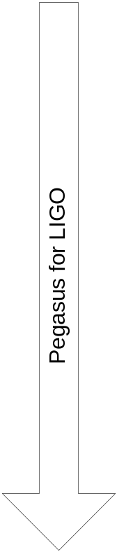
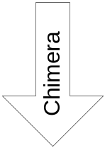
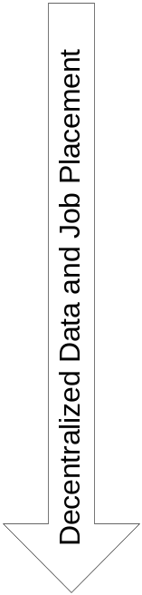
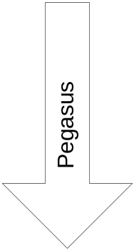
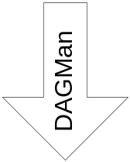
Notes:
Talk about various levels of abstraction in Virtual data and that the user can come in at any level
Various levels of information that is available and needed at the various levels
The mapping that needs to be done between the levels, for example from the abstract to the concrete---locate the resources
The space we explored so far with chimera, pegasus and dagman
Also the experimental pegasus/ligo work
And the data placement which is at the other end of the spectrum
Divide the levels of abstraction and talk about them individually

Slide 6
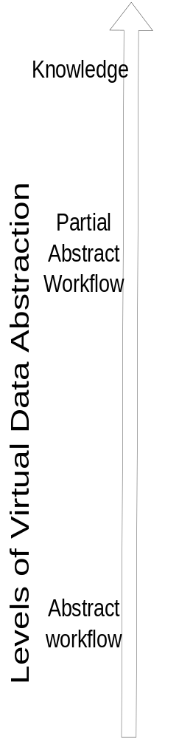
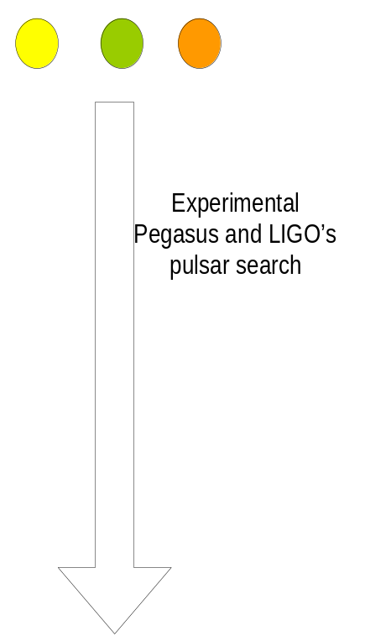
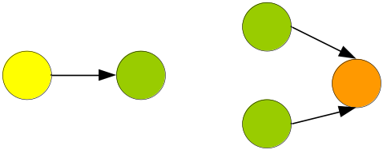
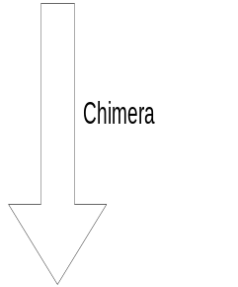
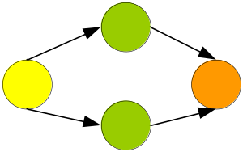
Notes:
Chimera—takes a partial workflow description—derivations and maps it to an abstract workflow
Experimental pegasus takes a metadata description of the pulsar search components and maps it to an abstract workflow

Slide 7
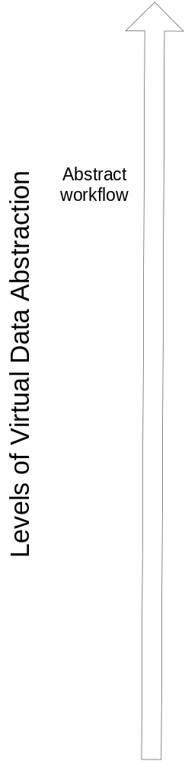
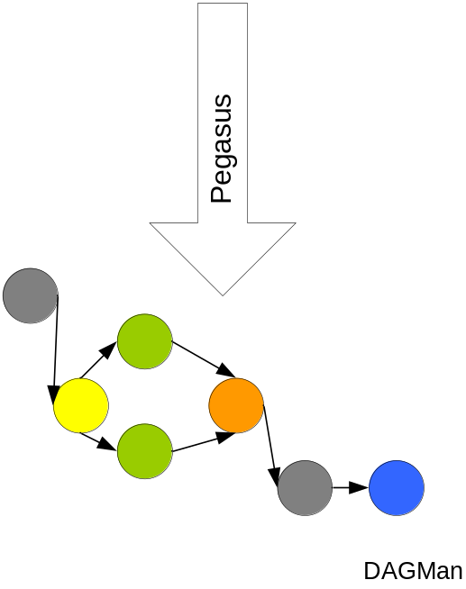
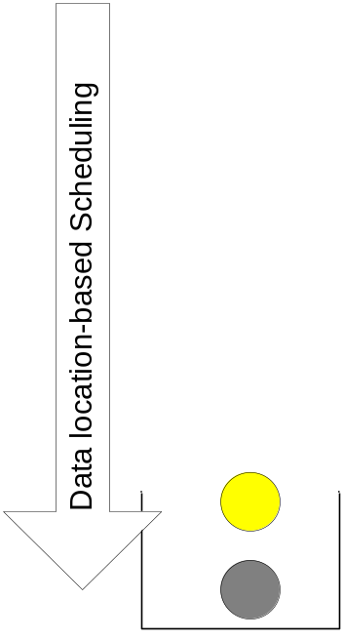





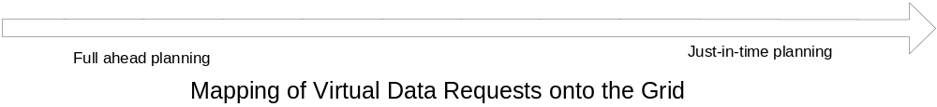
ChicagoSim
Notes:
Second level
full ahead planning—pegasus mapping of abstract workflow to the concrete
the other side of the spectrum—UC data placement work—just in time scheduling, based on data location
Future—looking somewhere in between, map part of the workflow down to the concrete level, keep planning at a more abstract level, but not give it to the execution environment
Next slides will talk about the data placement work and the couple incarnations of pegasus

Slide 8
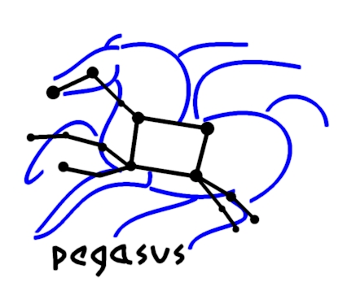
Pegasus-a framework for planning for execution in grids
Framework for experimentation
Generates executable workflows (DAGMan)
Isolates the user from many Grid details
Automatically locates physical locations for both transformations and data
Finds appropriate resources to execute the transformations
Publishes newly derived data products
Reuses existing data products where applicable
Currently supports two configurations
  Abstract workflow driven
    a feasible solution
    not necessarily a low-cost one
  Knowledge and Metadata driven (uses AI planning technologies)

Slide 9
Engagement of the AI community
Work with the AI scientists at ISI (Yolanda Gil and Jim Blythe) on applying AI planning techniques to the Grid workflow generation domain
  Models behavior of transformations as operators
    Can include such notions as available memory and storage space
  Makes local decisions—selects “best replica”
  Evaluates alternative plans globally
“The Role of Planning in Grid Computing” Jim Blythe, Ewa Deelman, Yolanda Gil, Carl Kesselman, Amit Agarwal, Gaurang Mehta, Karan Vahi, accepted to ICAPS 2003
“Transparent Grid Computing: a Knowledge-Based Approach”
Jim Blythe, Ewa Deelman, Yolanda Gil, Carl Kesselman, submitted to IAAI 2003

Slide 10
ChicagoSim
Exploration of task and data scheduling
Job Scheduling algorithms
Run job:
at a Random site
at Least Loaded Site
where Input Data is already Available
Locally
Dataset Scheduling algorithms
Do nothing (only caching of files)
Replicate popular files at a random site
Replicate popular files at the least loaded neighbor
Best performing in terms of response time and overall workflow execution time

Slide 11
Status and Accomplishments
Built a framework for mapping abstract workflows onto the Grid resources (ISI)
  Transformation Catalog
Integrated Chimera Virtual Data System and Pegasus (UC and ISI)
  Used it to define and execute LHS, LIGO and SDSS workflows
  Will be in the next release of the VDT
Took first steps in defining workflows based on application component models (ISI)
  LIGO
  Metadata Catalog Service
Built a simulation framework for evaluating task (compute and data movement) scheduling algorithms (UC)
  Evaluated a spectrum of algorithms
Built a policy-based task scheduling prototype
  Resource level and VO level

Slide 12
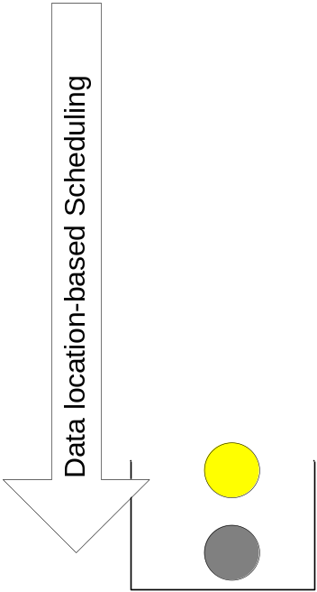
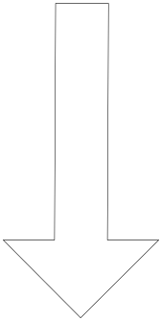
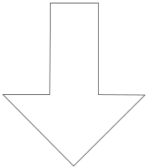

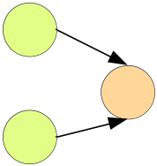
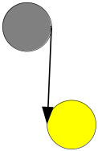

Benefits:
Can optimize entire workflows
Enables easy data prestaging
Can optimize across multiple workflows
Drawbacks:
Things change, resources go away, data can be deleted, or created
Cannot adapt to these changes
Benefits:
Adapts to changing environment
Less costly
Can optimize across multiple tasks
Drawbacks:
Can result in less optimal workflows
Can result in costly data movements
Notes:
Second level
full ahead planning—pegasus mapping of abstract workflow to the concrete
the other side of the spectrum—UC data placement work—just in time scheduling, based on data location
Future—looking somewhere in between, map part of the workflow down to the concrete level, keep planning at a more abstract level, but not give it to the execution environment
Next slides will talk about the data placement work and the couple incarnations of pegasus

Slide 13
Plans
Planning at all levels of abstraction
  Further exploration of component model driven workflows
Planning across multiple requests
Further exploration and evaluation of AI planning technologies and others
Integration with policy research, applying polices at the resource and VO levels (UC)
Integration with performance models (Northwestern)
Integration with fault tolerant execution environment (UCSD)
Integration of decentralized job and data placement strategies (UC)
Integration with data placement work (UW)

