Slide 1

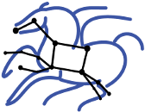
Experiences Using Cloud Computing for A Scientific Workflow Application
Jens Vöckler, Gideon Juve, Ewa Deelman, Mats Rynge, G. Bruce Berriman
Funded by NSF grant OC 0910812

Slide 2
This Talk
Experience in cloud computing talk
  FutureGrid:
    Hardware
    Middlewares
  Pegasus-WMS
  Periodograms
  Experiments
    Periodogram I
    Comparison of clouds using periodograms
    Periodogram II

Slide 3
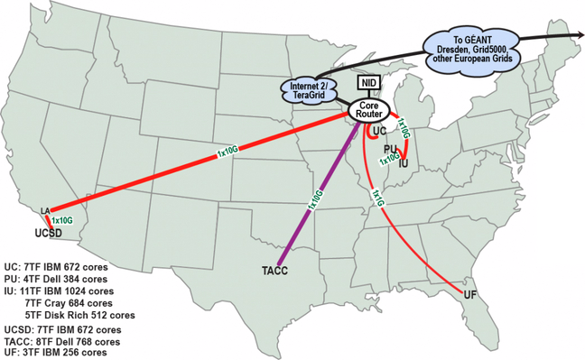
What is FutureGrid
Something Different For Everyone
  Test bed for Cloud Computing (this talk).
6 centers across the nation
  Nimbus
  Eucalyptus
  Moab “bare metal”
Start here:
  http://www.futuregrid.org/
Notes:
Portal, plenty of man pages, and online references
many frequent questions already have an answer!

Slide 4
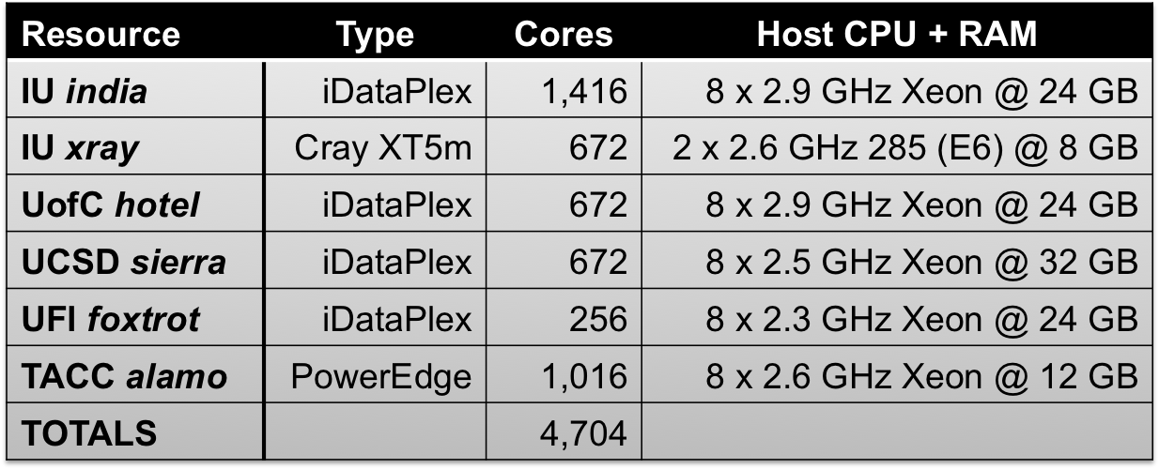
What Comprises FutureGrid
Proposed:
  16 x (192 GB + 12 TB / node) cluster
  8 node GPU-enhanced cluster
Notes:
First proposed is a large memory cluster.

Slide 5
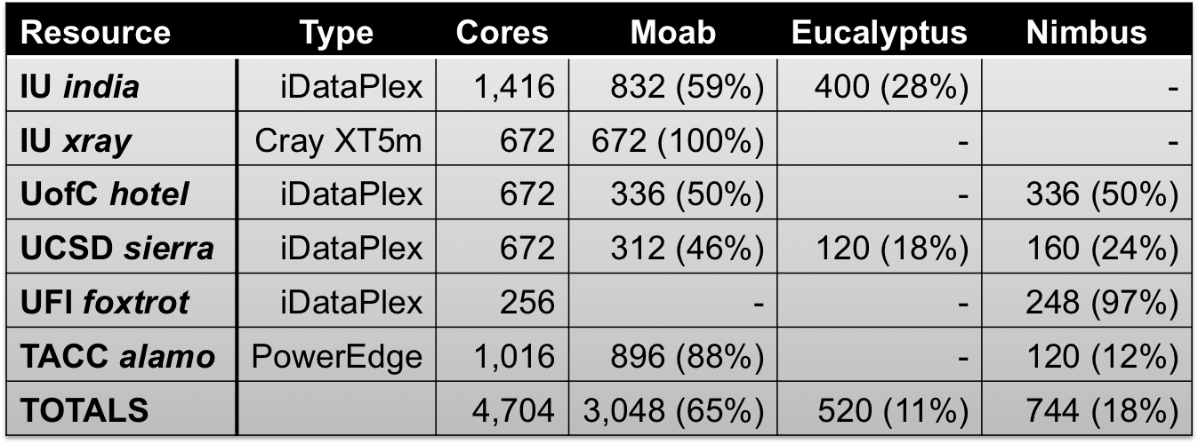
Middlewares in FG
Available resources as of 2011-06-06
Notes:
Certain low percentage for management nodes.

Slide 6
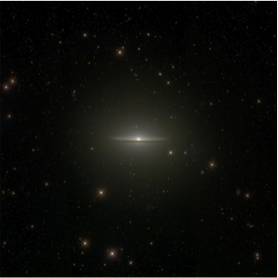
Pegasus WMS I
Automating Computational Pipelines
Funded by NSF/OCI, is a collaboration with the Condor group at UW Madison
Automates data management
Captures provenance information
Used by a number of domains
  Across a variety of applications
Scalability
  Handle large data (kB…TB), and
  Many computations (1…10⁶ tasks)

Slide 7
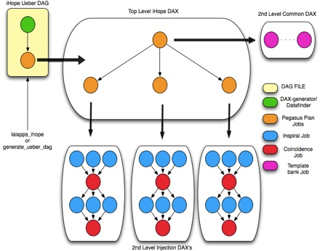
Pegasus WMS II
Reliability
Retry computations from point of failure
Construction of complex workflows
  Based on computational blocks
  Portable, reusable WF descr.
Can run pure locally, or
Distributed among institutions
  Laptop, campus cluster, grid, cloud

Slide 8
How Pegasus Uses FutureGrid
Focus on Eucalyptus and Nimbus
  No Moab “bare metal” at this point
During Experiments in Nov’ 2010
  544 Nimbus cores
  744 Eucalyptus cores
  1,288 total potential cores
    across 4 clusters
    in 5 clouds.
  Actually used 300 physical cores (max).

Slide 9
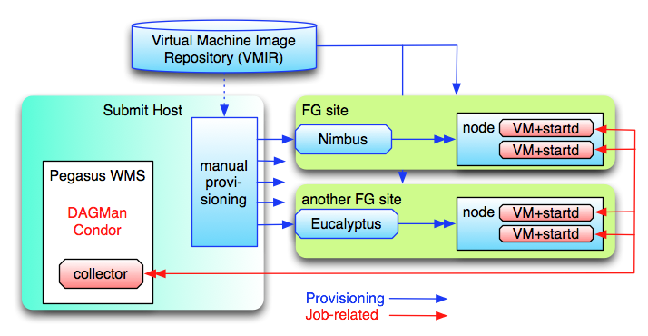
Pegasus FG Interaction
Notes:
The blue arrows, dealing with the provisioning of resources, are currently executed manually.
The red arrows are automatic, i.e. once the provision request starts remote resources, the Condor startd embedded into the image will report back to the submit machine.
Once the resource becomes part of the Condor pool, jobs can be staged to the resource. The Pegasus planner and Condor DAGMan will execute a workflow utilizing remote machines.
File staging is currently dependent on Condor-I/O.
Manual provisioning will be replaced by on-demand provisioning as part of the planned workflow.

Slide 10
Periodograms
Find extra-solar planets by
  Wobbles in radial velocity of star, or
  Dips in star’s intensity
Star
Planet
Star
Planet
Time
Brightness
Light Curve
Red Blue
Time
Notes:
I’m no domain scientist.

Slide 11
Kepler Workflow
210k light-curves released in July 2010
Apply 3 algorithms to each curve
Run entire data-set
  3 times, with
  3 different parameter sets
This talk’s experiments:
  1 algorithm, 1 parameter set, 1 run
  Either partial or full data-set
Notes:
Embarrassingly parallel.

Slide 12
Pegasus Periodograms
1st experiment is a “ramp-up”
  Try to see where things trip
    16k light curves
    33k computations (every light-curve twice)
  Already found places needing adjustments
2nd experiment also 16k light curves
  Across 3 comparable infrastructures
3rd experiment runs full set
  Testing hypothesized tunings
Notes:
We also ran the real science for them.

Slide 13
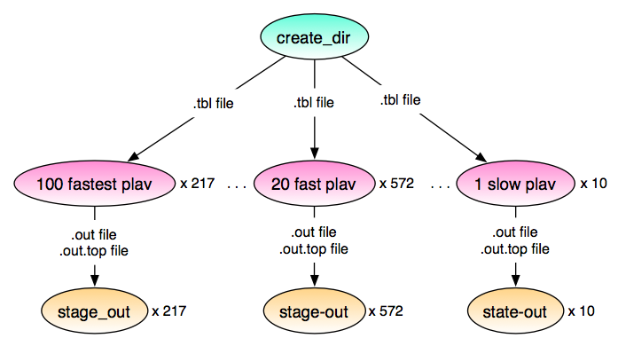
Periodogram Workflow
Notes:
Independent computations – embarrassingly parallel.
Using clustering to reduce communication overhead: fastest plav computations run in sub-second time, but remote grids work best, if you have several minutes of work for them.
“stage-out” is an artificial step required by Pegasus planning that we are working on removing. However, it is neither harmful nor slow.
“True” periodogram computations run 3 algorithms (“ls”, “bls”, “plav”) on all 210k light curves. Estimated 1000 hours of work (41 days).

Slide 14
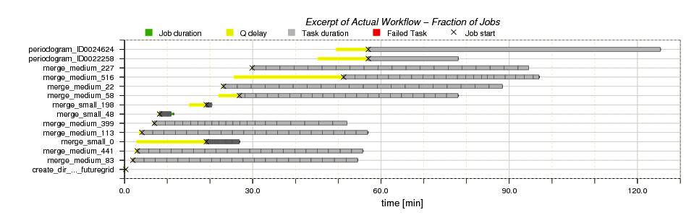
Excerpt: Jobs over Time

Slide 15
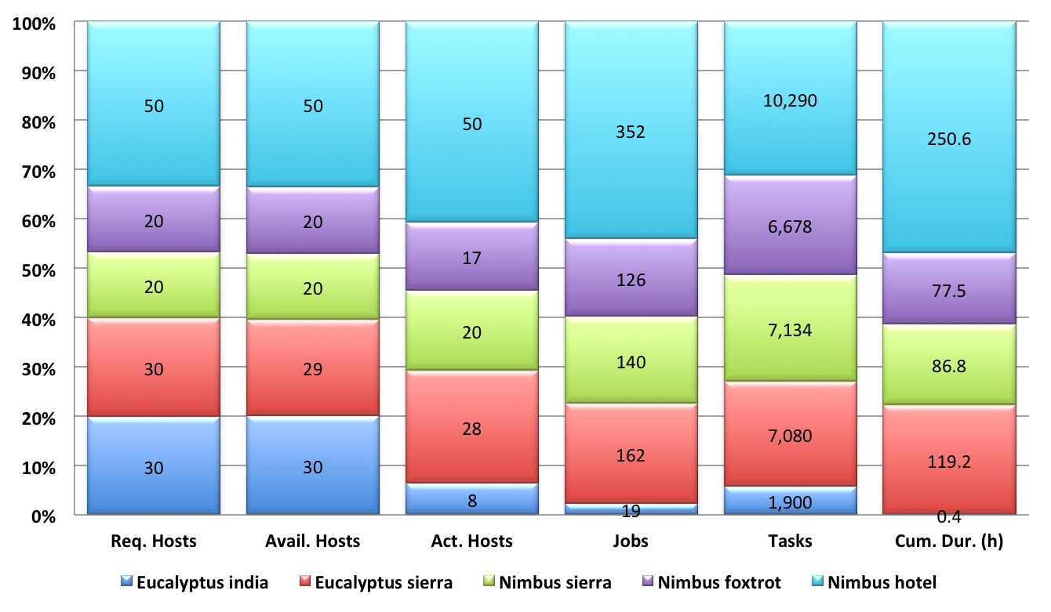
Hosts, Tasks, and Duration (I)
Notes:
Running across multiple clouds is sky computing.
30 euca-india + 30 euca-sierra + 20 nimbus-sierra + 20 nimbus-foxtrot + 50 nimbus-hotel = 150 resources
Available Hosts: Machines that actually reported back (149)
Active Hosts: Machines that actually partook in the workflow (123)
Jobs: Number of Condor jobs completed (799)
Tasks: Number of Periodogram tasks computed (33082)
Duration: Cumulative duration (in hours) for tasks – (534.5 h) over 22 days!

Slide 16
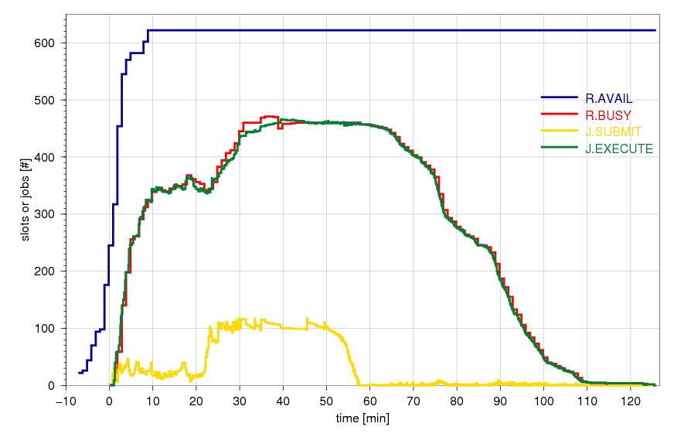
Resource- and Job States (I)
Notes:
Workflow completed in a little over 2 hours with all tasks, including staging.
Condor slot count = 2 * core count = 4 * machine count – over-subscribing remote CPUs on purpose.
Blue curve: shows the resources as they report back, tops out at 622 resources, 596 FG cloud resources.
Red curve: shows the slots that Condor thinks are “busy”
Yellow curve: tops out at ~100 idle jobs in Condor Q. Configured that way for scalability and local resource frugality.
Green curve: tops out at ~466 parallel executing tasks, jobs that Condor has in state “running”.

Slide 17
Cloud Comparison
Compare academic and commercial clouds
  NERSC’s Magellan cloud (Eucalyptus)
  Amazon’s cloud (EC2), and
  FutureGrid’s sierra cloud (Eucalyptus)
Constrained node- and core selection
  Because AWS costs $$
  6 nodes, 8 cores each node
  1 Condor slot / physical CPU
Notes:
This is the 2nd experiment.

Slide 18
Cloud Comparison II
Given 48 physical cores
  Speed-up ≈ 43 considered pretty good
  AWS cost ≈ $31
  7.2 h x 6 x c1.large ≈ $29
  1.8 GB in + 9.9 GB out ≈ $2
Site | CPU | RAM (SW) | Walltime | Cum. Dur. | Speed-Up
Magellan | 8 x 2.6 GHz | 19 (0) GB | 5.2 h | 226.6 h | 43.6
Amazon | 8 x 2.3 GHz | 7 (0) GB | 7.2 h | 295.8 h | 41.1
FutureGrid | 8 x 2.5 GHz | 29 (½) GB | 5.7 h | 248.0 h | 43.5
Notes:
Amazon performance:
Lower CPU speed, and
Poor WAN performance (inter-state staging)
Magellan and sierra are in same state as submit machine!
1st experiment: 534.5 / 2 ≈ 256 h – in line with above results and explanations.

Slide 19
Scaling Up I
Workflow optimizations
  Pegasus clustering ✔
  Compress file transfers
Submit-host Unix settings
  Increase open file-descriptors limit
  Increase firewall’s open port range
Submit-host Condor DAGMan settings
  Idle job limit ✔
Notes:
Good ideas, but … we are not there (yet)! Some didn’t quite work.

Slide 20
Scaling Up II
Submit-host Condor settings
  Socket cache size increase
  File descriptors and ports per daemon
    Using condor_shared_port daemon
Remote VM Condor settings
  Use CCB for private networks
  Tune Condor job slots
  TCP for collector call-backs
Notes:
Good ideas, but … we are not there (yet)! Some didn’t quite work.

Slide 21
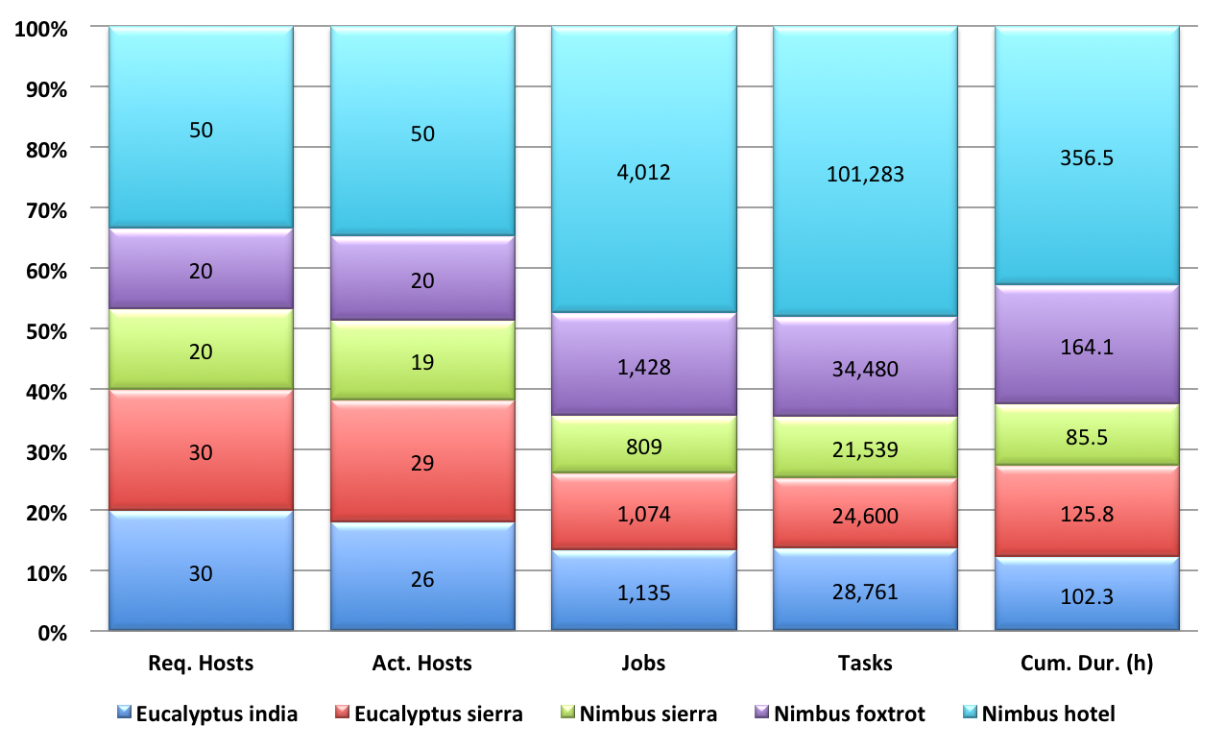
Hosts, Tasks, and Duration (II)
Notes:
Again, same set of requested hosts:
30 euca-india + 30 euca-sierra + 20 nimbus-sierra + 20 nimbus-foxtrot + 50 nimbus-hotel = 150 resources
Available Hosts: All available also participated, i.e. “active” (144)
Active Hosts: Machines that actually partook in the workflow (144)
Jobs: Number of Condor jobs completed (8,458)
Tasks: Number of Periodogram tasks computed (210,663)
Duration: Cumulative duration (in hours) for tasks (834.2) – over 34 days!

Slide 22
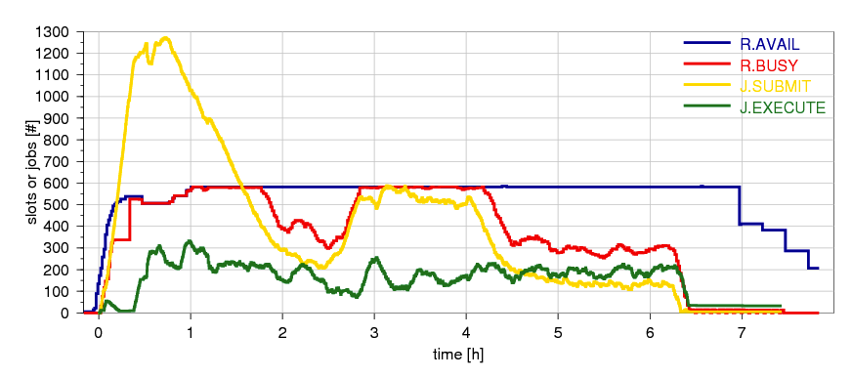
Resource- and Job States (II)
Notes:
Slide shows that our tunings were not successful yet.
Results further hampered by run-away submissions due to change in parameter naming.
Glaring disparity between busy resources and running jobs!
and available resources versus busy resources
In part due to differences how Condor accounts a resource to be busy, i.e
job finished, but stage-out keeps resource busy.
May still have run against limit on open fw ports and submit host open FDs
to be measure next time with new, improved monitoring.
Some of the “tunings” may have disimproved things
More future research and engineering challenges.

Slide 23
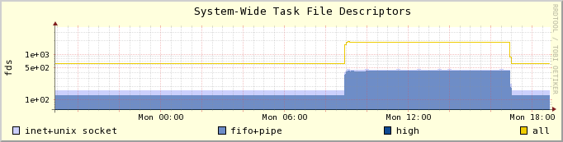
Lose Ends
Saturate requested resources
Clustering
Better submit host tuning
  Requires better monitoring ✔
Better data staging
Notes:
Increase number of jobs running, communication overhead caveats
Explore different clustering strategies and –sizes
Tuning system settings, host load, and overall performance
Explore alternative staging mechanisms, protocols, storage solutions
Diagram for monitoring is an example for two dozen monitored system counters.

Slide 24



Acknowledgements
Funded by NSF grant OC 0910812
Ewa Deelman,
Gideon Juve,
Mats Rynge,
Bruce Berriman
FG help desk ;-)
http://pegasus.isi.edu/

