Slide 1

A General Approach to Real-time Workflow Monitoring
Karan Vahi , Ewa Deelman, Gaurang Mehta, Fabio Silva
USC Information Sciences Institute
Ian Harvey, Ian Taylor, Kieran Evans, Dave Rogers, Andrew Jones, Eddie El-Shakarchi
School of Computer Science, Cardiff University
Taghrid Samak, Dan Gunter, Monte Goode
Lawrence Berkeley National Laboratory

Slide 2
Outline
Background
Stampede Data Model
Triana and Stampede Integration
Experiments and Analysis Tools
Conclusions and Future Work

Slide 3
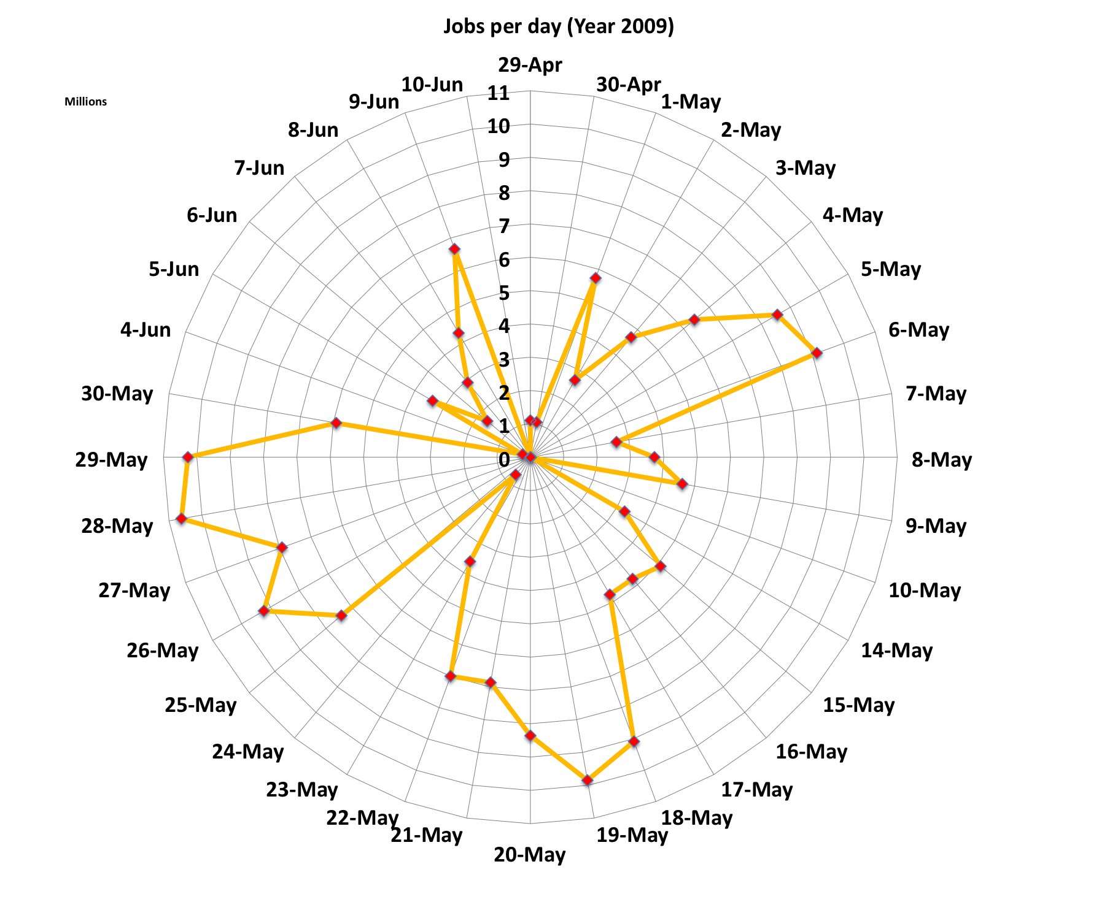
Domain: Large Scientific Workflows
SCEC-2009: Millions of tasks completed per day
Radius = 11 million

Slide 4
Goal: Real-time Monitoring and Analysis
Monitor Workflows in real time
  Scientific workflows can involve many sub-workflows and millions of individual tasks
  Need to correlate across workflow and job logs
  Provide realtime updates on the workflow – how many jobs completed, failed etc
Troubleshoot Workflows
  Provide users with tools to debug workflows, and provide information of why a job failed
Visualize Workflow performance
  Provide a workflow monitoring dashboard that shows the various workflows run
Provide Analysis tools
  Is a given workflow going to “fail”?
  Are specific resources causing problems?
  Which application sub-components are failing?
  Is the data staging a problem?
Do all of this as generally as possible: Can we provide a solution that can apply to all workflow systems?

Slide 5
Outline
Background
Stampede Data Model
Triana and Stampede Integration
Experiments and Analysis Tools
Conclusions and Future Work

Slide 6
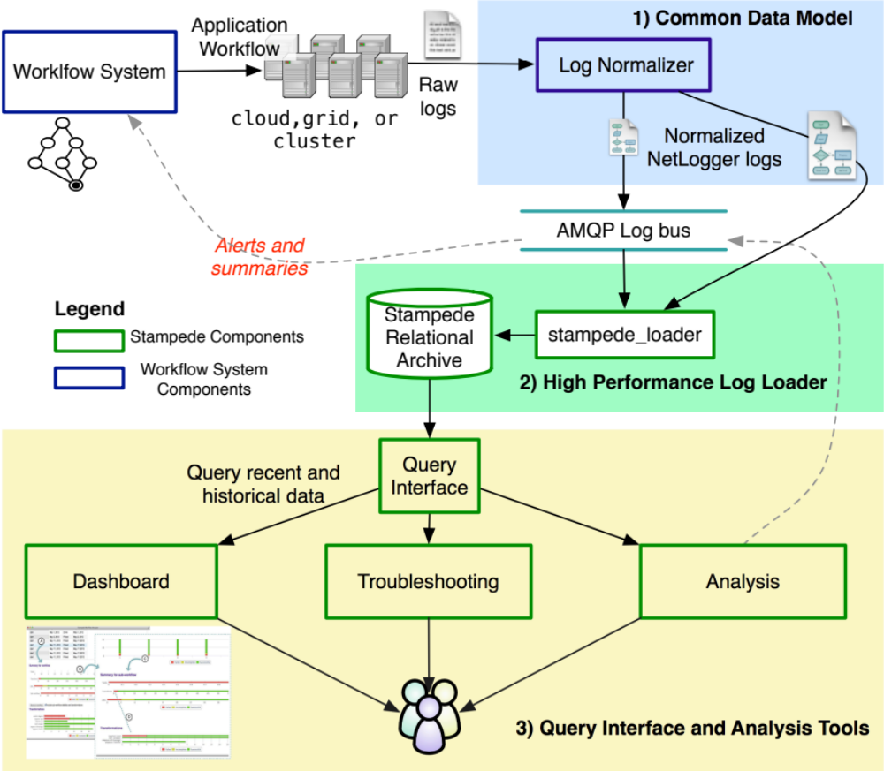
How Does Stampede Provide Interoperability

Slide 7
Abstract and Executable Workflows
Workflows start as a resource-independent statement of computations, input and output data, and dependencies
  This is called the Abstract Workflow (AW)
For each workflow run, workflow systems may plan the workflow, adding helper tasks and clustering small computations together
  This is called the Executable Workflow (EW)
Note: Most of the logs are from the EW but the user really only knows the AW. The model allows us to connect jobs in the user specified (AW) with the jobs in EW executed through Workflow Systems

Slide 8
Entities in Stampede Data Model
Workflow: Container for an entire computation
Sub-workflow: Workflow that is contained in another workflow
Task: Representation of a computation in the AW
Job: Node in the EW
  May represent one or more tasks in the AW. Or can represent jobs added by Workflow System (e.g., a stage-in/out),
Job instance: Job scheduled or running by underlying system
  Due to retries, there may be multiple job instances per job
Invocation: captures actual invocation of an executable on
  When a job instance is executed on a node, one or more invocations can be associated. The invocations capture the runtime execution of tasks specified in the AW

Slide 9
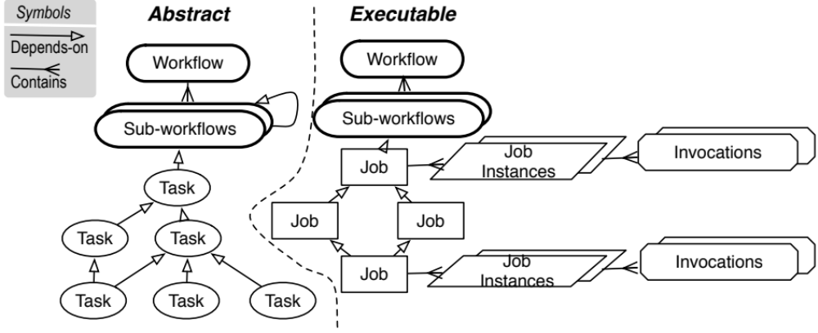
Relationship between Entities in Stampede Data Model

Slide 10
Logs Normalization
Logging Methodology
  Workflow Systems generate logs in the netlogger format
    Timestamped, named, messages at the start and end of significant events, with additional identifiers and metadata in a std. line-oriented ASCII format (Best Practices or BP)
    APIs are provided
Yang schema to describe the events in netlogger format
  YANG schema documents and validates each log event
  http://acs.lbl.gov/projects/stampede/4.0/stampede-schema.html
ts=2012-03-13T12:35:38.000000Z event=stampede.xwf.start
level=Info xwf.id=ea17e8ac-02ac-4909-b5e3-16e367392556
restart_count=0
Example Log Message
container stampede.xwf.start {
description “Start of executable workflow”;
uses base-event;
leaf restart_count {
type uint32;
description "Number of times workflow was restarted (due to failures)”; }}
Snippet of schema
Notes:
YANG is a data modeling language originally developed to model configuration state data manipulated by the Network Configuration Protocol
(NETCONF).

Slide 11
Outline
Background
Stampede Data Model
Triana and Stampede Integration
Experiments and Analysis Tools
Conclusions and Future Work

Slide 12
Pegasus Workflow Management System
A collaboration between USC and the Condor Team at UW Madison (includes DAGMan)
Takes in a workflow description and can map and execute it local desktops, condor pool, campus clusters, grids, commerical and academic clouds
Builds on top of Condor DAGMan.
  Provides reliability—can retry computations from the point of failure
  Provides scalability—can handle many computations ( 1- 10⁶ tasks)
Automatically captures provenance information
Can handle large amounts of data ( order of Terabytes)
Provides workflow monitoring and debugging tools to allow users to debug large workflows

Slide 13
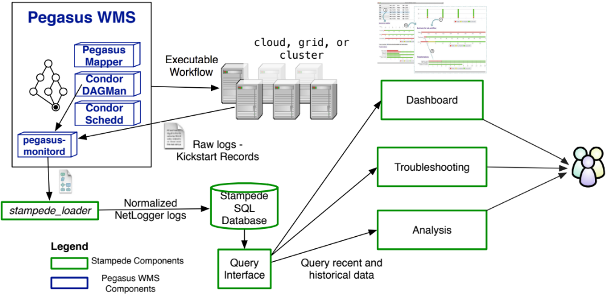
Pegasus Integration with Stampede

Slide 14
Triana Workflow System
Workflow and Data Analysis Environment
Interactive GUI to enable workflow composition
Focused on data flows of Java components
Has a wide range palette of tools that can be used to design applications
Can distribute workloads to remote Cloud VM’s

Slide 15
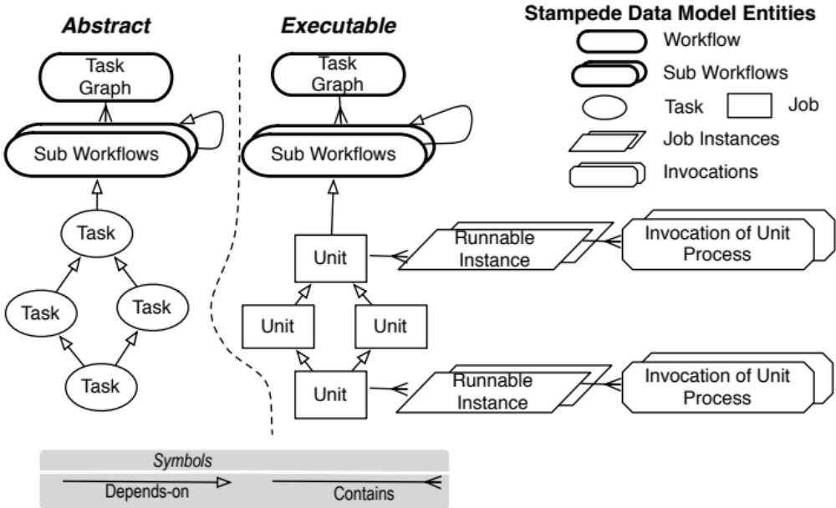
Mapping With Stampede Data Model

Slide 16
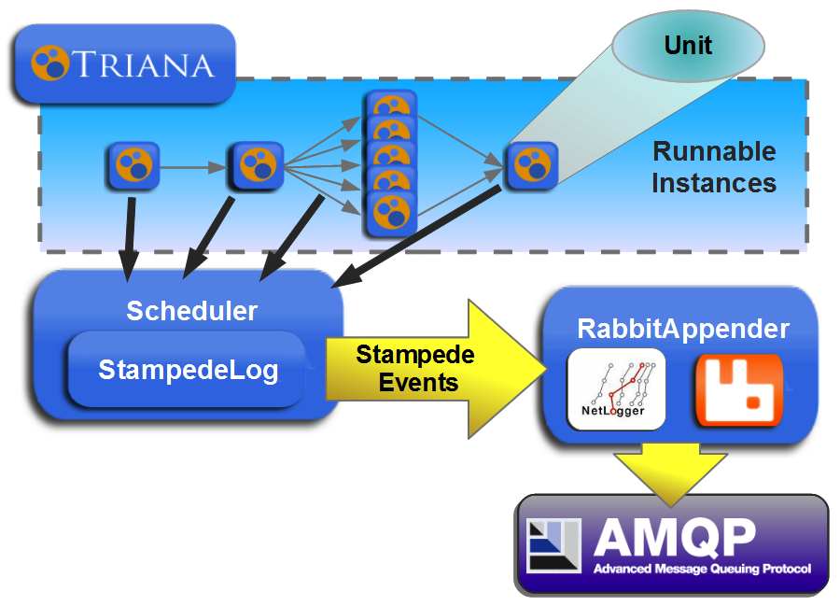
Triana Integration With Stampede

Slide 17
Outline
Background
Stampede Data Model
Triana and Stampede Integration
Experiments and Analysis Tools
Conclusions and Future Work

Slide 18
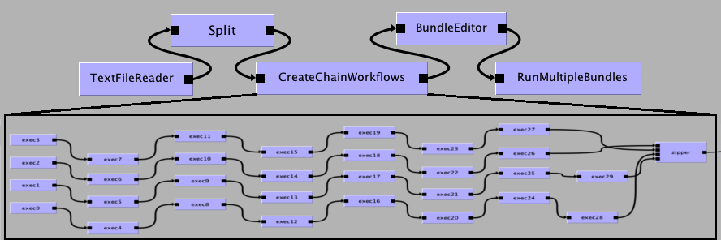
Scientific Experiment
DART Audio Processing Workflow
  DART algorithm is portable and package as a jar file.
  Parameter sweep resulting in 306 DART application invocations
  Executed on a Triana Cloud Deployment in Cardiff

Slide 19
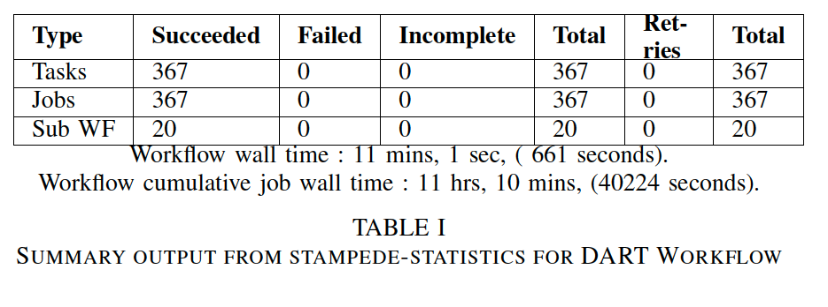
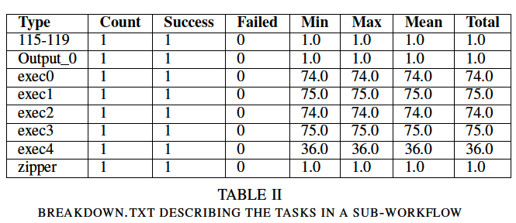
Performance Statistics - stampede-statistics
Workflow Statistics
TASK Statistics Per Sub Workflow

Slide 20
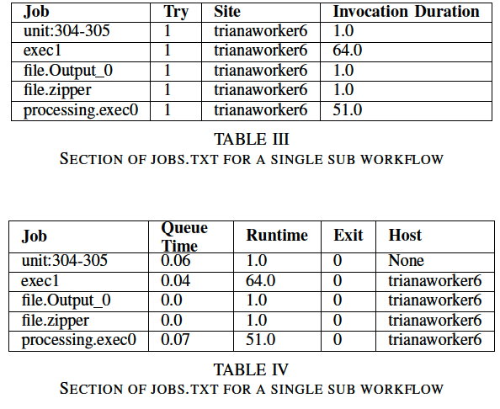
Performance Statistics - stampede-statistics
Job Level Statistics

Slide 21
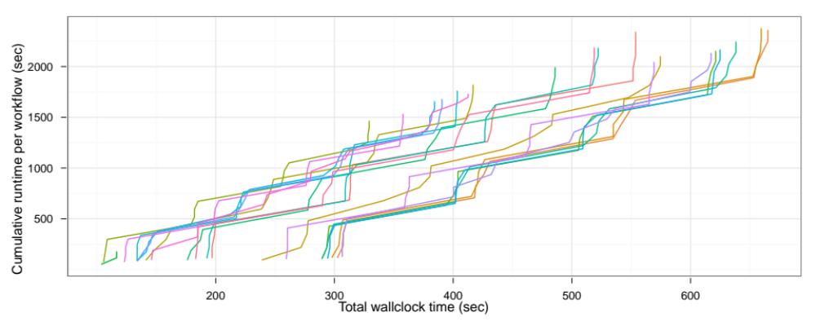
Workflow Analysis using R

Slide 22
Troubleshooting and Dashboard
Stampede-analyzer
Interactive debugging tool
Identifies what jobs failed and why they failed
Drill down functionality for hierarchal workflows
Stampede Dashboard – Available Soon
Lightweight Performance Dashboard
Online monitoring and status of workflows
Troubleshoot failed jobs
Charts and statistics online

Slide 23
Outline
Background
Stampede Data Model
Triana and Stampede Integration
Experiments and Analysis Tools
Conclusions and Future Work

Slide 24
Conclusions and Future Work
Real-time failure prediction for scientific workflows is a challenging and important task
Stampede provides a 3 layer model for integration with different workflow systems
  Has been integrated with Pegasus WMS and now with Triana
  Provides users useful real-time monitoring , debugging and analysis tools
Apply Workflow and Job Failure prediction models to Triana Runs
Dashboard for easier visualization of collected data

Slide 25





Thank you!

