Slide 1
AI Workflows on Laguna using Pegasus
SCITECH GROUP · USC ISI
Karan Vahi · USC Information Sciences Institute

Slide 2
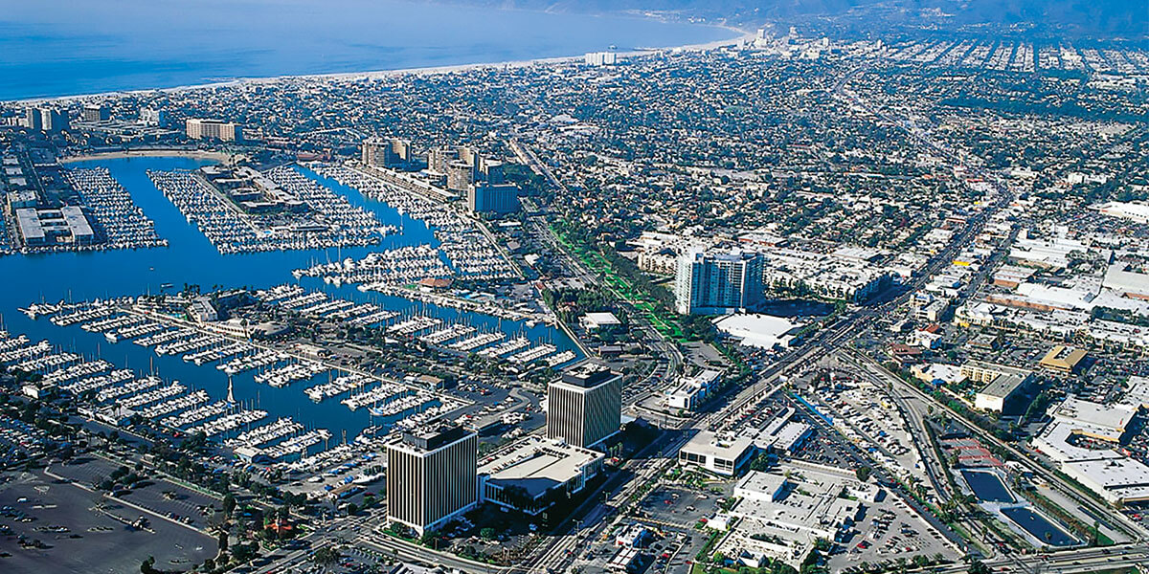
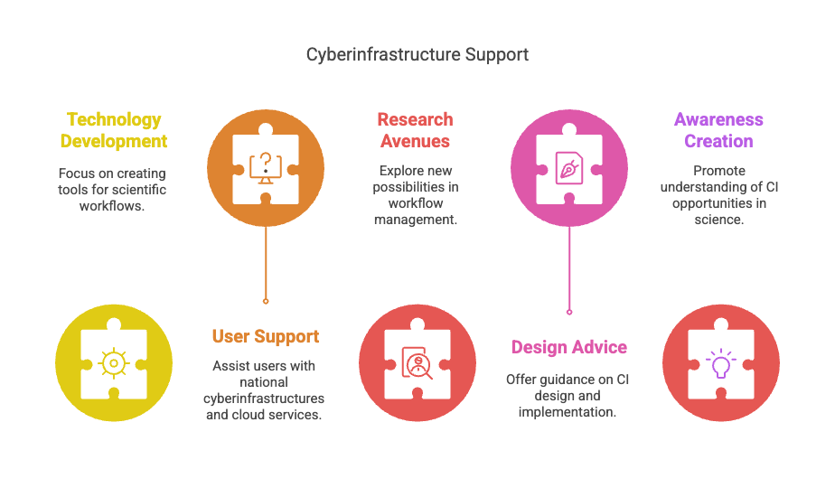
SciTech Activities
ABOUT US
Develop technologies to support scientific workflows
Provide user support on national cyberinfrastructures and clouds
Research new avenues in the workflow management space
Provide advice on the design, implementation and use of Cyberinfrastructure (CI) for the Research Infrastructure lifecycle
Create awareness and understanding of opportunities in CI for Science
USC/ ISI
Marina del Rey, CA
Most projects are collaborative across 4-6 organizations

Slide 3
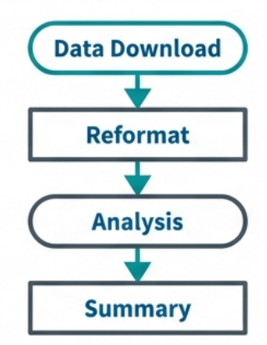

THE PROBLEM
The Challenge: Moving Beyond the Laptop
The Scripting Trap
The Workflow Advantage
Quick to code, but hard to scale
Difficult to maintain and error-prone
Hard to move between resources (Laptop vs. Cluster)
“Works on my machine” syndrome
Declarative: Describe what to do, not how
Automated: Minimizes human involvement
Provenance: Tracks history for reproducibility
Portable: Runs on ACCESS, NAIRR, cloud, …

Slide 4
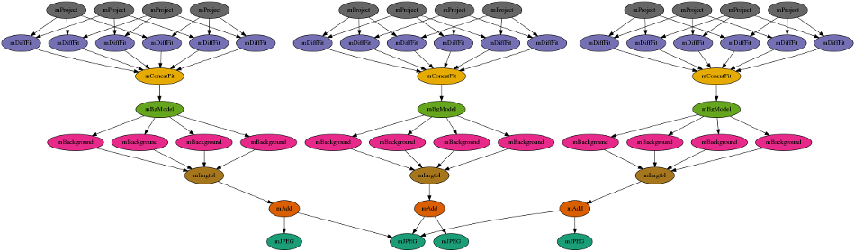
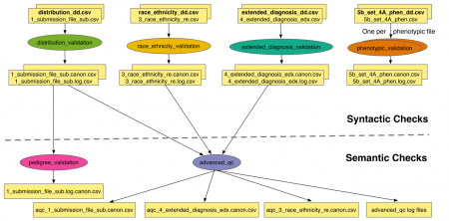
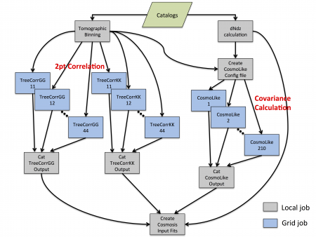
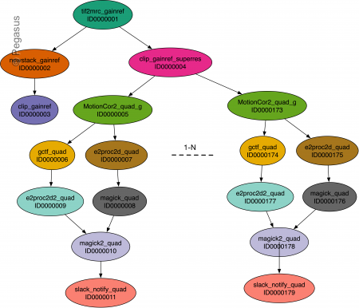
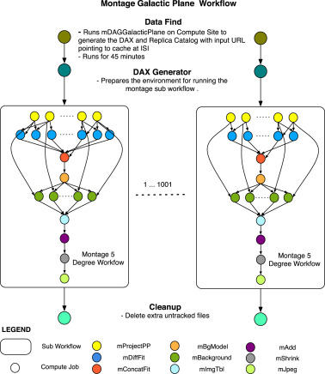
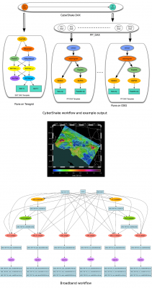
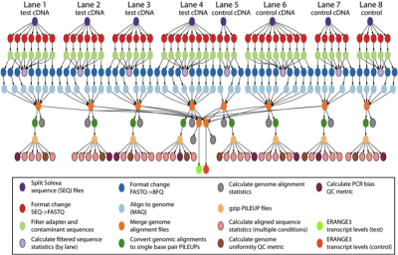
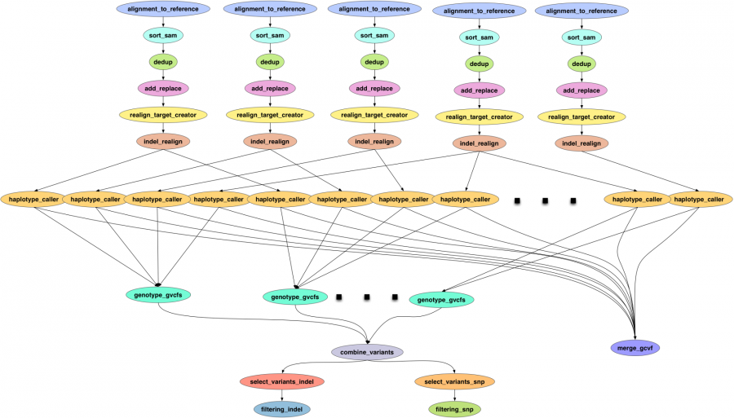
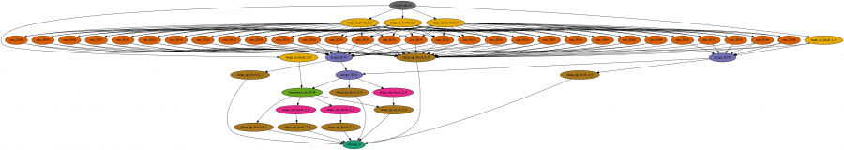
Workflows Built with Pegasus Across Science Domains
PEGASUS IN PRACTICE

Slide 5
Pegasus Workflow Management System, est. 2001
PEGASUS WMS
Workflow Challenges
Across Domains
Our Focus
Describe complex workflows in a simple way
Access distributed, heterogeneous data and resources (heterogeneous interfaces)
Deal with resources/software that change over time
Ease of use. Ability to monitor and debug large workflows
Separation between workflow description and workflow execution
Workflow planning and scheduling (scalability, performance)
Task execution (monitoring, fault tolerance, debugging, web dashboard)
Workflow optimization, restructuring for performance and fault tolerance.

Slide 6
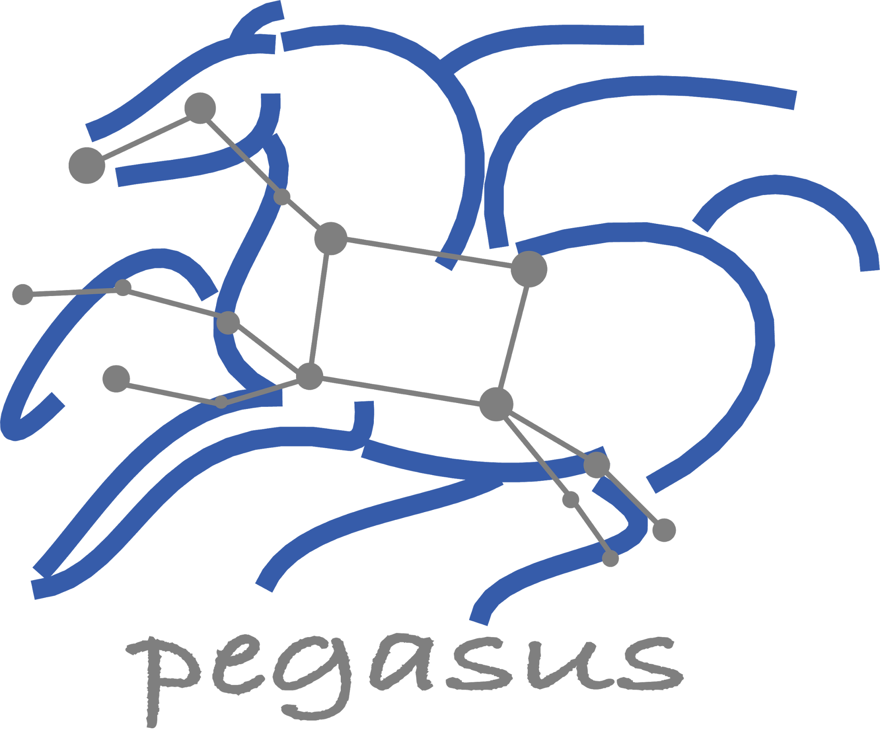
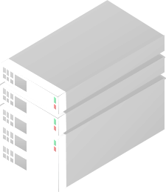
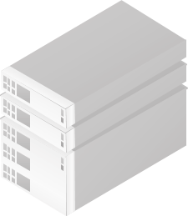
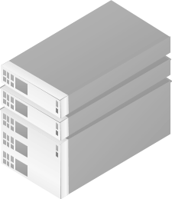
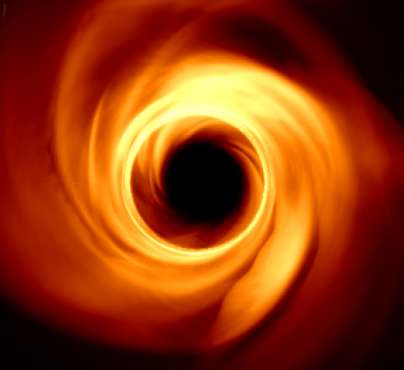

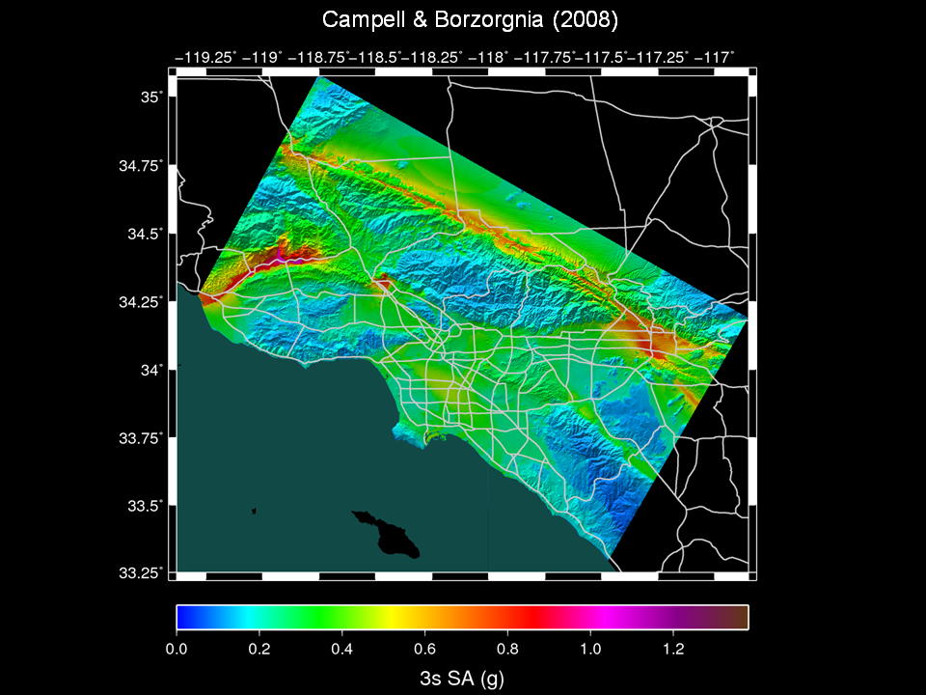
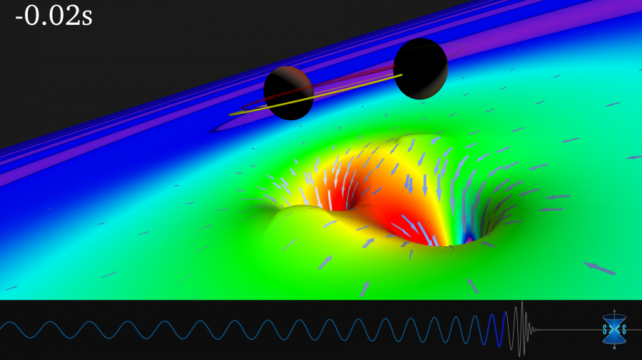
Pegasus Workflow Management System
PEGASUS WMS
End to End Workflow Management & Execution
Pegasus
WMS
Develop portable scientific workflows in Python and Java
Compile workflows to be run on heterogeneous resources
Monitor and debug workflow execution via CLI and web-based tools
Recover from failures with built-in fault tolerance mechanisms
Regular release schedule incorporating latest research and development
Planner
Monitoring & Provenance
Engine
Scheduler
Job
Queue
jN
> Cloud Resources
> OSG OSPool
> HPC Systems
> HTCondor Pools
j2
j1
Event Horizon Telescope
Submit Node
Compute Resources
Laser Interferometer Gravitational Wave Observatory (LIGO) develops large scale analysis pipelines used for gravitational wave detection.
Southern California Earthquake Center (SCEC) CyberShake project generates hazard maps using hierarchical workflows .
The Event Horizon Telescope uses Pegasus to orchestrate and scale complex distributed computing pipelines for data calibration, massive synthetic data generation, and deep learning inference
Pegasus
in practice
LIGO observation
of colliding black holes
Hazard map indicating maximum amount of shaking at a particular geographic location generated from SCEC’s CyberShake Pegasus workflow
Application Showcase: https://pegasus.isi.edu/application-showcase/

Slide 7

Submit Locally, Run Globally
HOW IT WORKS
SUBMIT HOST
Compute Site 1
Pegasus WMS ==
Pegasus planner (mapper) + DAGMan workflow engine + HTCondor scheduler/broker
F.in
Pegasus Lite
Instance
Input Data Site
F.in
J1
T1
T1
Pegasus maps workflows to target infrastructure (1 or more resources)
DAGMan manages dependencies and reliability
HTCondor is used as a broker to interface with different schedulers
F.int
WN
WN
T2
Compute Site n
Staging Site
Pegasus Lite
Instance
F.int
F.out
J2
T2
Output Data Site
F.out
Planning converts an abstract workflow
into a concrete, executable workflow
WN
WN
Planner is like a compiler
Optimized performance
Provides fault tolerance
LEGEND
Task flow +
Checksums
Directory
Setup Job
Data
Stageout Job
Check
Integrity Job
J
Pegasus Lite Compute Job
Data Flow
Data
Stagein Job
Directory
Cleanup Job
Checksum Generation Job
Worker Node
(WN)
Can leverage distributed and heterogeneous CI
WN

Slide 8
Key Pegasus Concepts
HOW IT WORKS
Pegasus WMS ==
Pegasus planner (mapper) + DAGMan workflow engine + HTCondor scheduler/broker
Pegasus maps workflows to infrastructure
DAGMan manages dependencies and reliability
HTCondor is used as a broker to interface with different schedulers
Task
Data dependency
Workflows are DAGs
Nodes: jobs, edges: dependencies
No while loops, no conditional branches
Jobs are standalone executables
Planning occurs ahead of execution
Planning converts an abstract workflow into a concrete, executable workflow
Planner is like a compiler

Slide 9
Defining Workflows in Python
DEFINING WORKFLOWS
from Pegasus.api import *
# Create abstract workflow
wf = Workflow("pipeline")
# Track the data
page = File("page.html")
# Create a Job
curl_job = Job("curl")\
.add_args("-o", page, "https://pegasus.isi.edu")\
.add_outputs(page)
# Create a Dependent Job
wc_job = Job("wc")\
.add_args("-l", page)\
.add_inputs(page)
# Add jobs and dependencies
wf.add_jobs(curl_job, wc_job)
wf.add_dependency(wc_job, parents=[curl_job])
wf.write("pipeline.yml")
Declarative job addition
Simple dependency definition
Generates the abstract workflow (DAG)

Slide 10
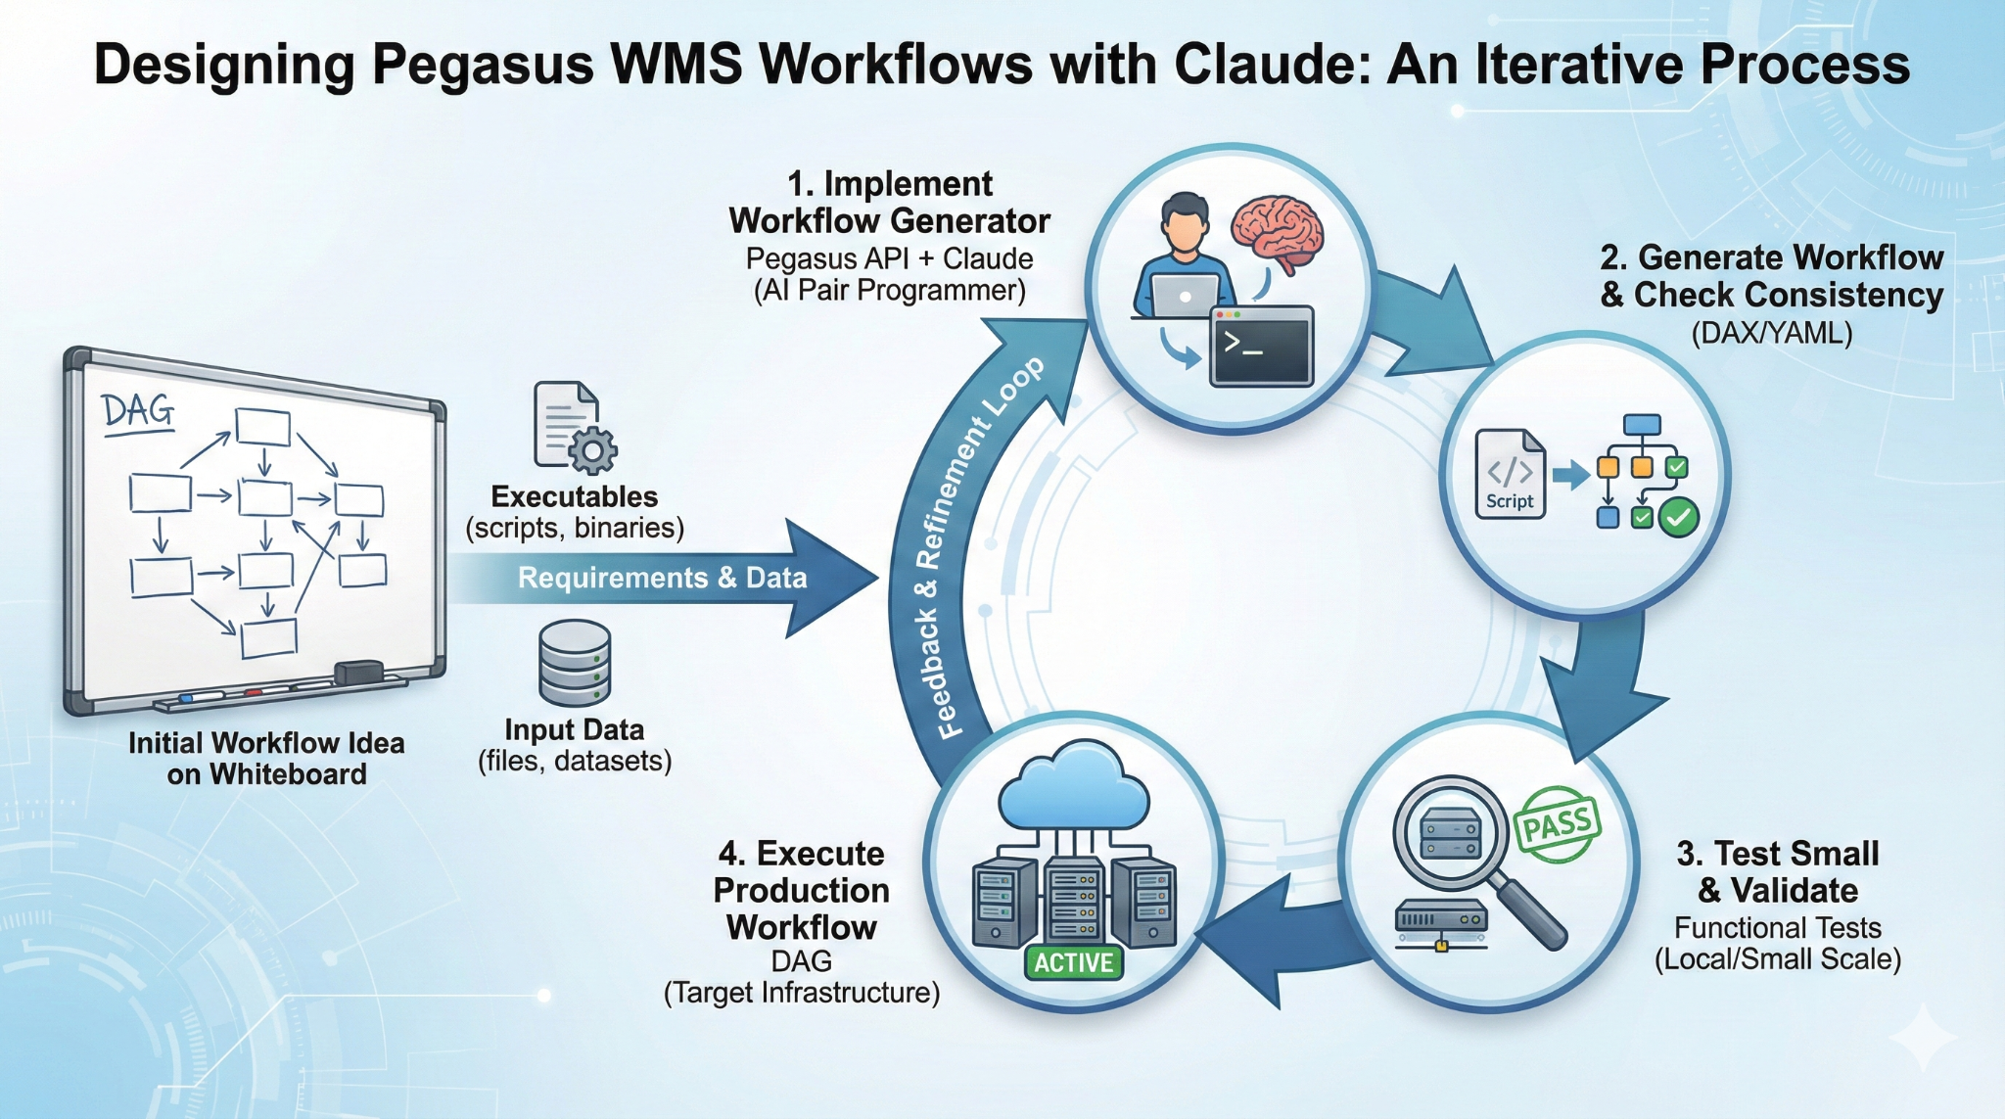
Designing Pegasus WMS Workflows with Claude
AI-ASSISTED DESIGN

Slide 11
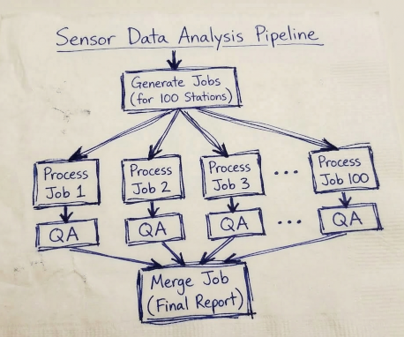
From Napkin Sketch to Executable Workflow
Claude reads the image directly
Vision analysis
Identifies 4 processing stages, decision diamonds, fork/join points, data-flow arrows
Topology extraction
Maps fan-out/fan-in DAG: generate → 100 parallel process+QA branches → merge report
Code generation
Produces workflow_generator.py with Pegasus API calls, infer_dependencies=True
Script scaffolding
Creates 4 standalone bin/ scripts — generate, process, QA, merge for 100 stations
Container + tests
Generates Docker config, test_workflow.py, and parameterized station count
No manual transcription needed. The AI reads the visual spec the way a human collaborator would.
Domain scientists draw what they know — AI translates it into executable workflow code
More on this in the poster session on
Pegasus AI Studio

Slide 12


Input Workflow Specification OUTPUT WORKFLOW
Portable Description
Users do not worry about low level execution details
YAML formatted
Stage-in Job
Transfers the workflow input data
Logical Filename (LFN)
platform independent (abstraction)
ABSTRACT WORKFLOW
EXECUTABLE WORKFLOW
Cleanup Job
Transformation
Removes unused data
Executables (or programs)
platform independent
Stage-out Job
Stage-out generated output data
Registration Job
Registers the workflow output data

Slide 13
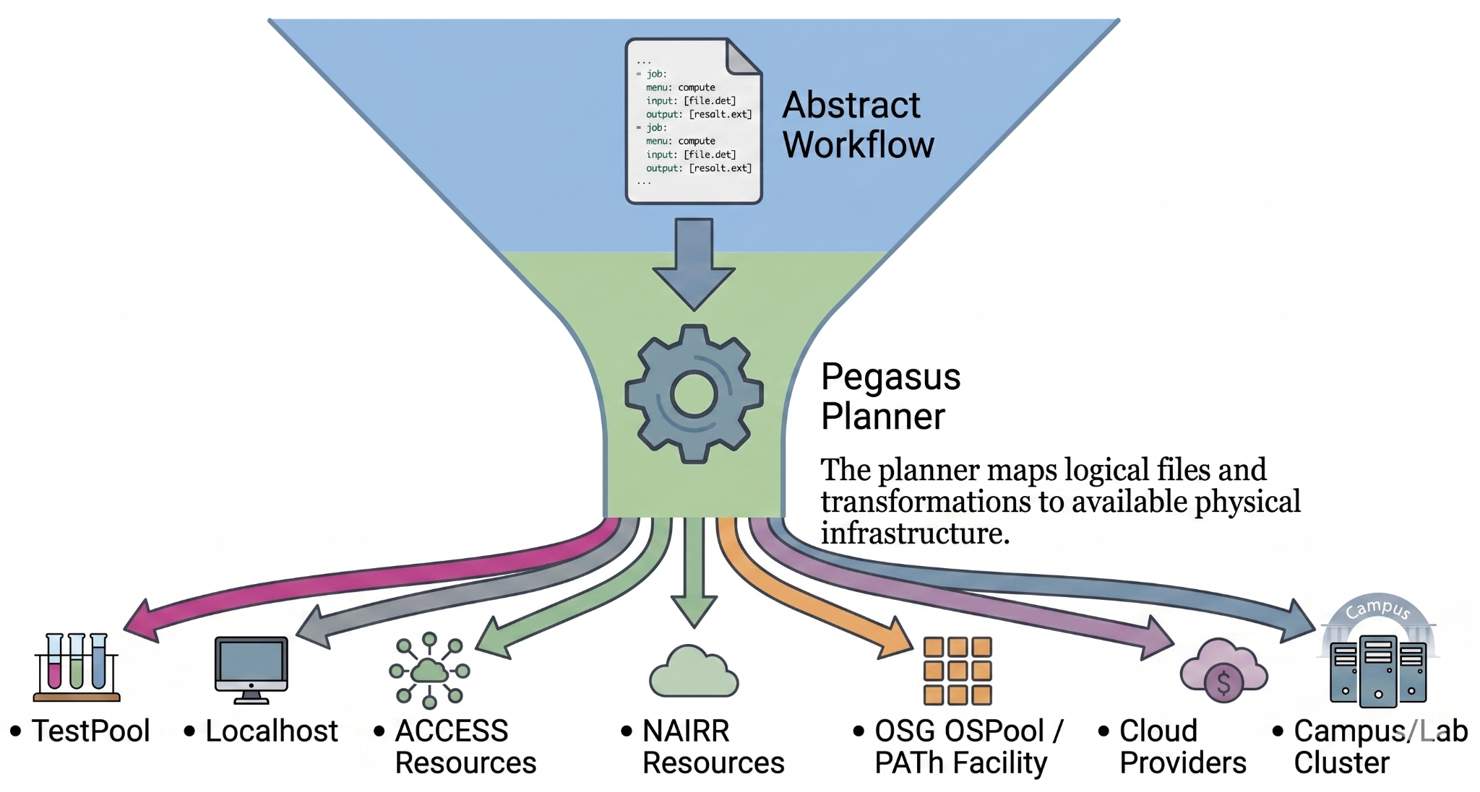
Write Once, Run Anywhere
Requirement: Any HPC/cloud/… system with outbound network connectivity. Includes your own campus cluster or lab machines!

Slide 14
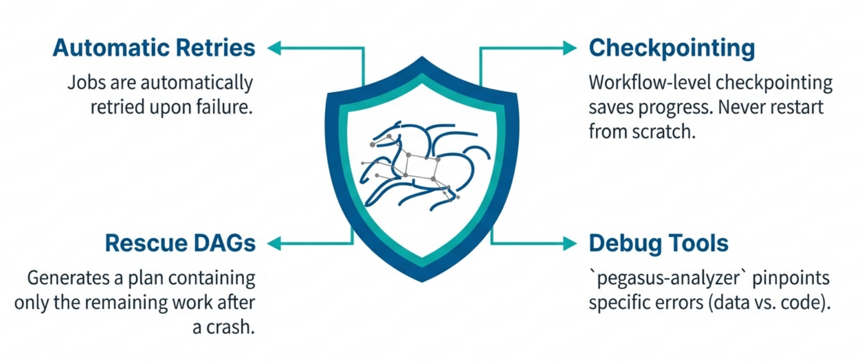
Resilience: When Things Go Wrong

Slide 15
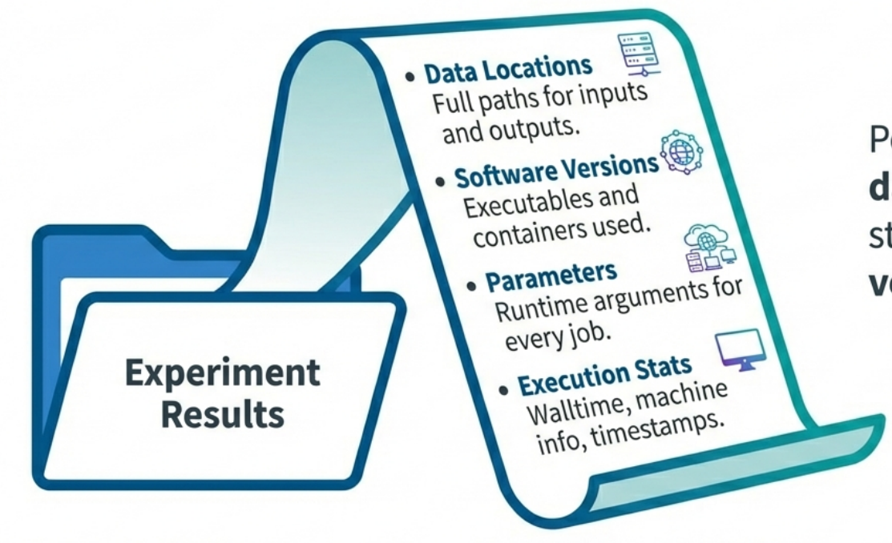
Provenance & Reproducibility
Good science requires proof
Pegasus tracks every bit of data and every compute step, ensuring your results are verifiable and reproducible.

Slide 16
Success Stories

Slide 17
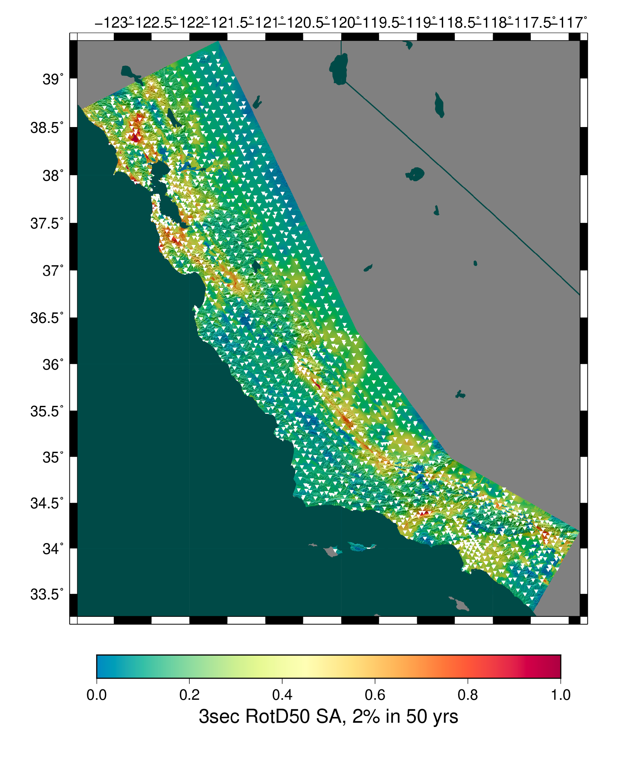

Pegasus for Seismic Hazard Applications
45
55K
125K
Days
Frontier
Frontera
Duration of 24/7 operation
Node-hours
Node-hours
GPUs
CPUs
High-water marks were 4130 nodes on Frontier (44%) and 1029 nodes on Frontera (12%)*
1 PB
9M
945
Useful information
for:
Data
Files
Workflows
Building engineers
Disaster planners
Insurance agencies
Managed by Pegasus
Staged to USC CARC
27,720 jobs
Two new Northern California hazard models were produced.
Slide Courtesy of Scott Callaghan, USC
* Neither used a reservation or priority bump.
Notes:
We ran for 45 days, around the clock.
The study used about 55k node-hours on Frontier and 125k node-hours on Frontera.
Our high-water marks were 4130 nodes on Frontier (44%) and 1029 nodes on Frontera (12%). Neither used a reservation or priority bump.
Pegasus managed about 1 PB of data.
We staged about 9 million output files totaling 36 TB back to long-term storage at USC CARC.
We ran 945 top-level workflows, with an average of 15 running at a time.
We ran approximately 27,720 jobs. Of these, 7245 were remote, 8190 were local, 5985 were directory creation, 5355 were staging, and 945 were registration.
We produced two new hazard models for Northern California.
For each of 315 sites, we are executing 3 workflows. The first calculates the Strain Green Tensors, the wave propagation output. Since the wave propagation code, AWP-ODC, is a GPU code (with CUDA and HIP implementations), we run these workflows on Frontier, and Pegasus stages the SGTs from Frontier to Frontera, approximately 330 TB in total staged data. Next we run a low-frequency seismogram synthesis workflow on Frontera; this uses a manager-worker tightly coupled MPI CPU code. Lastly we run a broadband seismogram synthesis workflow, also on Frontera. This uses PMC to run a wide but shallow set of tasks with some dependencies. These codes are all CPU.
We ran the SGT workflows first. As they finished, we used the SGTs to generate the low-frequency seismogram synthesis, and prioritized finishing up all the low-frequency calculations first. Then, we ran the broadband workflows for all the sites.
Most of the remote jobs were MPI jobs, either GPU (wave propagation) or CPU (seismogram synthesis). There are a handful of serial jobs run as part of the pre- and post-processing before the large MPI jobs.

Slide 18
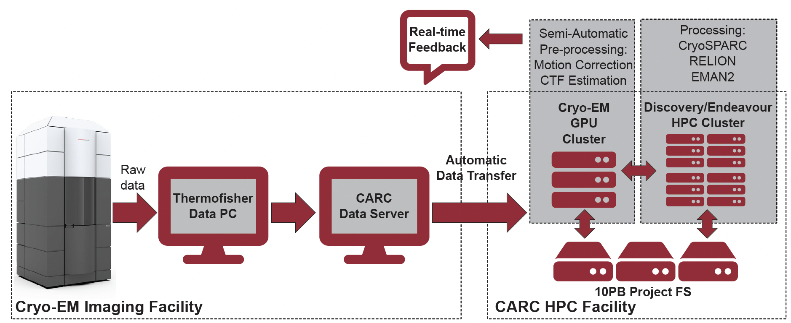
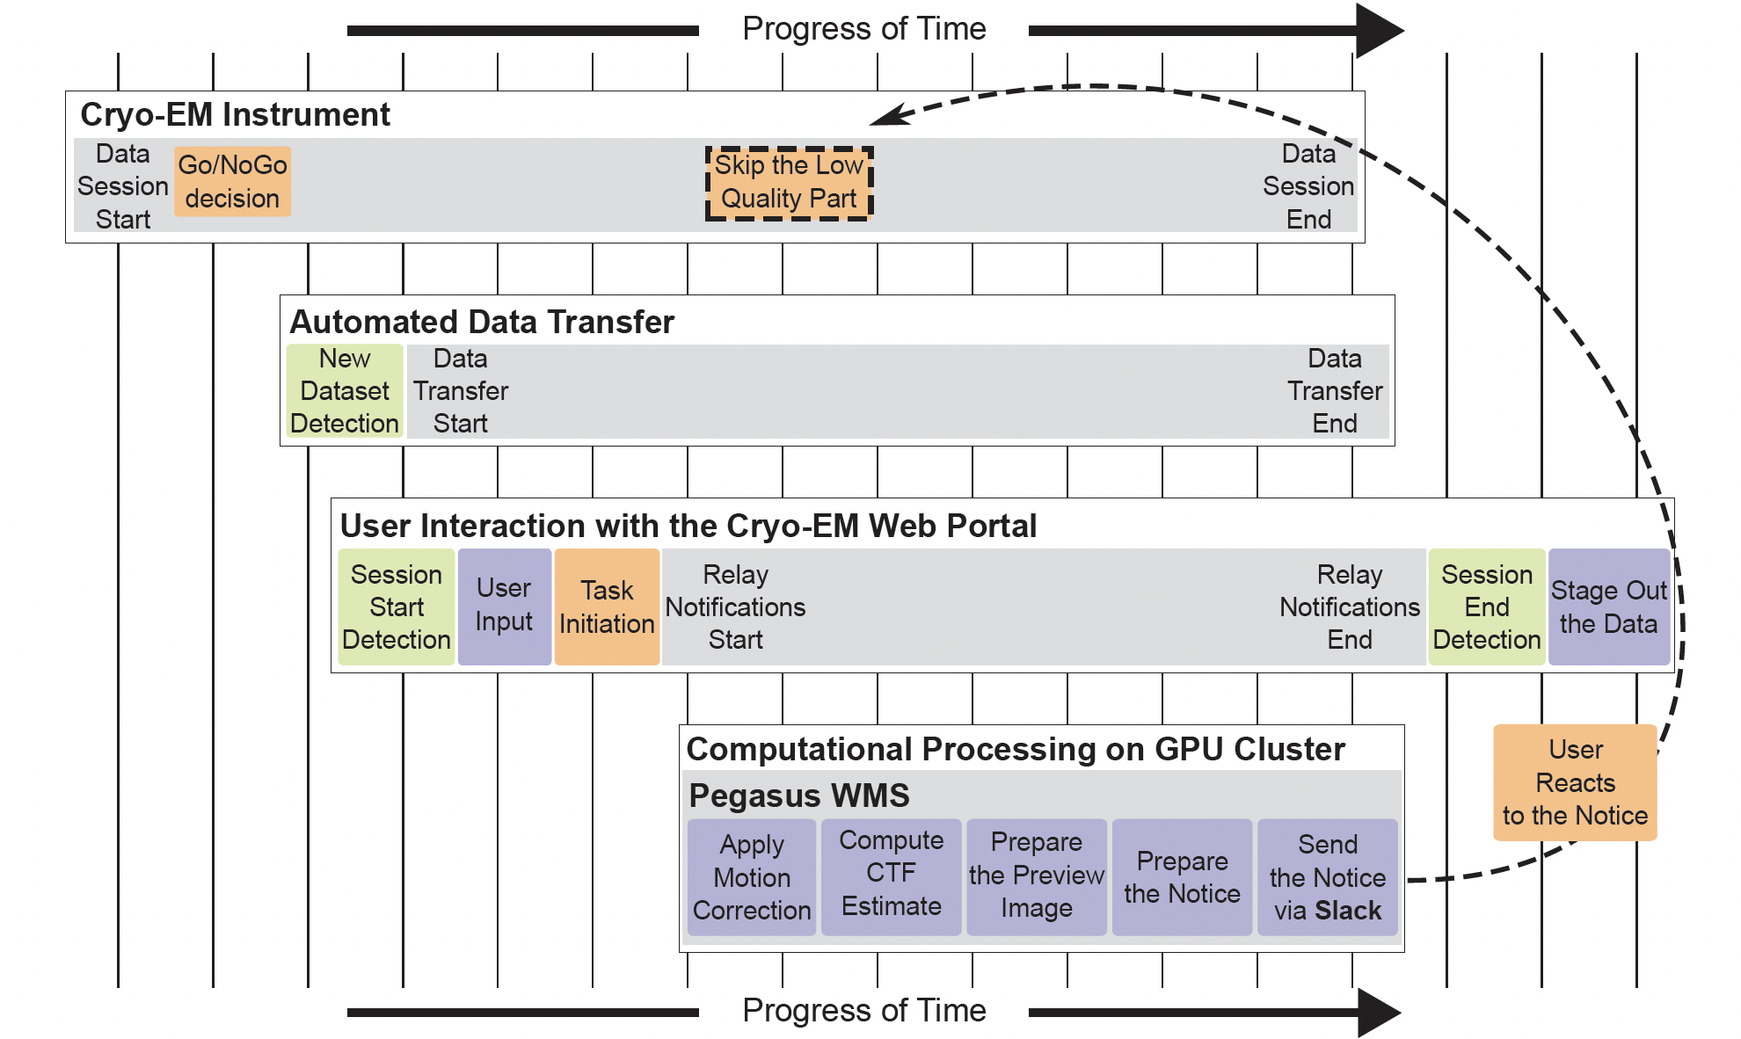
Applications
Processing Data in Realtime

Slide 19

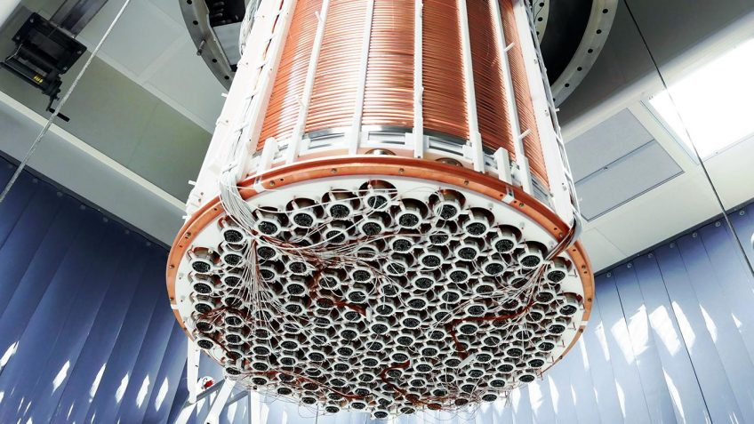
XENONnT - Dark Matter Search
Applications
Two Workflows
Monte Carlo simulations and the main processing pipeline.
Workflows execute across
Open Science Grid (OSG) &
European Grid Infrastructure (EGI)
Rucio for data management
MongoDB instance to track science runs and data products.
------------------------------------------------------------------------------
Type Succeeded Failed Incomplete Total Retries Total+Retries
Tasks 4000 0 0 4000 267 4267
Jobs 4484 0 0 4484 267 4751
Sub-Workflows 0 0 0 0 0 0
------------------------------------------------------------------------------
Workflow wall time : 5 hrs, 2 mins
Cumulative job wall time : 136 days, 9 hrs
Cumulative job wall time as seen from submit side : 141 days, 16 hrs
Cumulative job badput wall time : 1 day, 2 hrs
Cumulative job badput wall time as seen from submit side : 4 days, 20 hrs

Slide 20

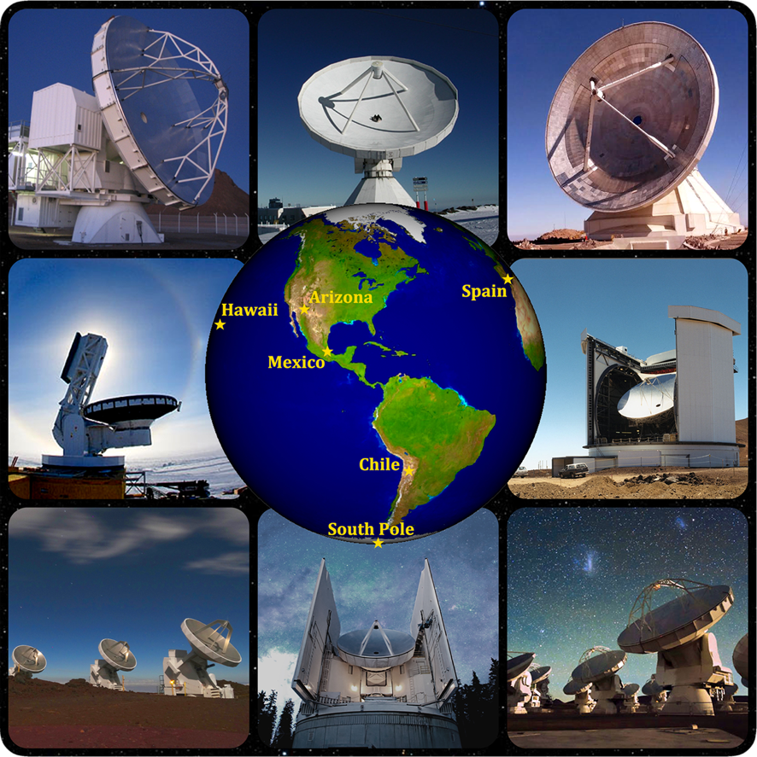
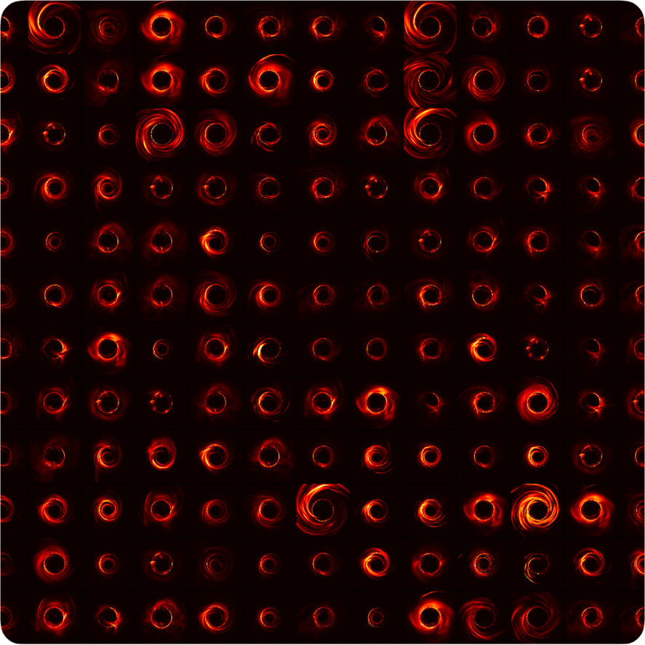

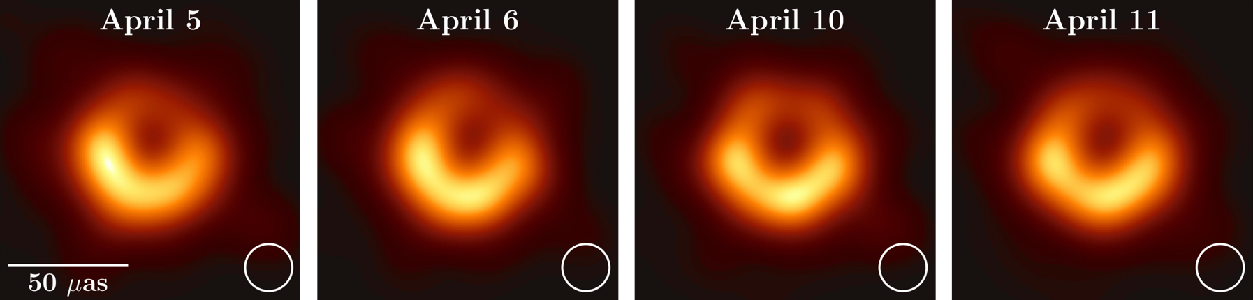

Event Horizon Telescope Bringing
Black Holes into Focus
480,000 jobs - 2,600,000 core hours
Applications
#15 in all OSG projects in last 6 months
8 telescopes: 5 PB of data
60 simulations: 35 TB data
#2 in all OSG astronomy projects in the last 6 months
Pegasus-SYMBA Pipeline
Physically accurate synthetic observation data from simulations are keys to develop calibration and imaging algorithms, as well as comparing the observation with theory and interpreting the results.
Pull simulated image
from CyVerse Data Store
1
Push synthetic
observation data
back to CyVerse
6
2
Model interstellar scattering
3
Synthetic interferometry data
4
Model observation systematics
5
Calibrate synthetic observation
First images of black hole at the center of the M87 galaxy
Improve constraints on Einstein's theory
of general relativity by 500x
Notes:
Numbers current as of Dec 2020. Bag of task workflow. Inputs are downloaded from the CyVerse datastore via WebDAV, and after processing results are uploaded back to the datastore.
Usually we have ~1000 jobs active jobs running in parallel on the OSG. This is also limited by I/O limitations from CyVerse. The total number of jobs in a single workflow is relatively arbitrary. At the moment we usually run with 50-100k. So far we had no problems scaling this with Pegasus.

Slide 21
Advanced LIGO
SUBMIT HOST
Input data
hosted at
LIGO Sites
Nebraska GridFTP Data staging server
GridFTP, HTTP, SRM
LIGO output
data server
Data Flow for LIGO Pegasus Workflows
in OSG
Abstract Workflows
X
J
W
60,000 Compute Tasks
Input Data: 5000 files (10GB total)
Output Data: 60,000 files (60GB total)
Processed Data: 725 GB
Y
Input Files
Intermediate Files
Produced Dataser
1
Workflow stagein Job
stages in the input data for workflow from user server
2
PegassusLife instance looks up input data on the compute node/ CVMFS
If not present, stage-in data from remote data staging server
4
Workflow Stageout Job stages produced data from data staging server to LIGO Output Data Server
Pegasus Planner
HTTP Squid Cache
Workflow Setup
Job
Nodes from OSG &
LIGO Sites managed
By Glidein WMS
3
Pegasus lite instance stages out job output data from worker node to data staging server
Workflow Stagein
Job
Laser Interferometer
Gravitational Wave Observatory
X
Executable
Workflow
J
J
W
J
Y
WN
WN
Workflow Stageout
Job
Condor Schedd
Queue
CVMFS
WN
WN
WN
WN
WN
WN
Data
Cleanup
Job
J
Directory
Setup Job
Data
Stageout Job
J
Pegasus Lite Compute Job
First Detection Runs executed on LIGO Data Grid, EGI, Open Science Grid and XSEDE
W
LEGEND
Condor DAGMan
Data
Stagein Job
Directory
Cleanup Job
Woorker Node

Slide 22
Try Pegasus?
An easy and convenient way to try out Pegasus and submit workflows to Laguna is to use the Laguna Open OnDemand Instance. https://laguna-ood.carc.usc.edu/
Hosted, web-based
Open OnDemand and Jupyter, with no local install.
Single sign-on with your University Credentials
Training Notebooks
Try out Pegasus training examples
https://github.com/pegasus-isi/ACCESS-Pegasus-Examples
Log in: pegasus.access-ci.org
Help: support.access-ci.org/tools/pegasus

Slide 23
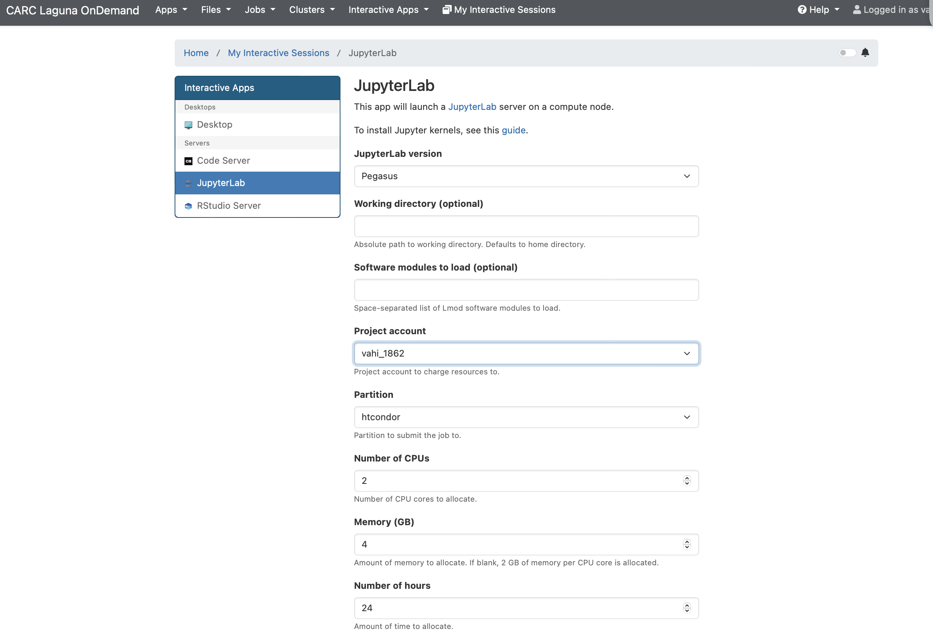
Laguna Open OnDemand – Launch Workflows
Ensures Pegasus Workflow API is accessible via notebooks.
Your project account on Laguna
Launch the notebook on the workflow submission node.

Slide 24
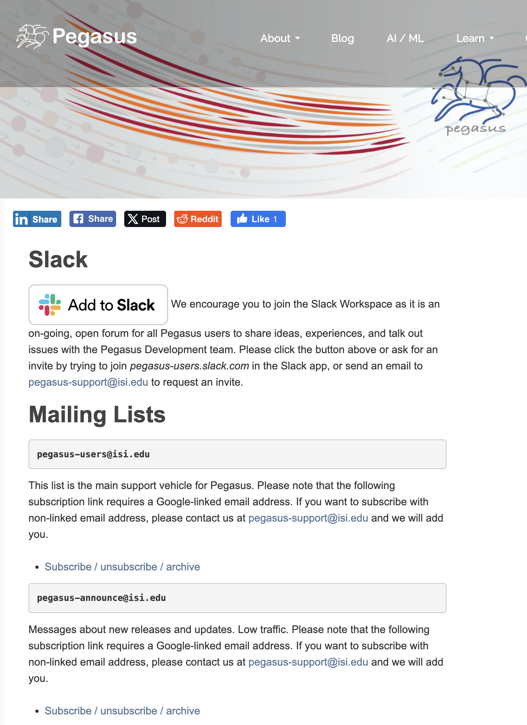
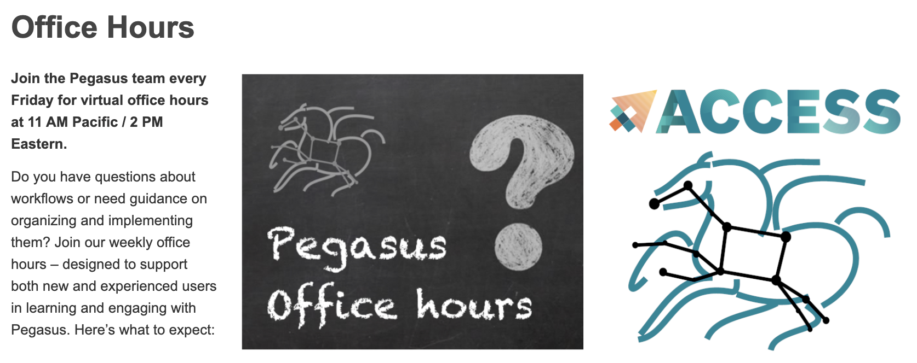
We are here to help!
Slack channel: find at https://pegasus.isi.edu/contact/
Email: pegasus-support@isi.edu
Office hours every friday, 11am PT
Tutorial walkthrough first Friday of the month
https://pegasus.isi.edu

Slide 25
Thank you!
Questions?
Karan Vahi | vahi@isi.edu
Acknowledgments
For support on making Pegasus available at Laguna
TO
Tomek Osinski
Research Computing Facilitator. CARC. USC
BH
Bret Harry
Systems Administrator. ITS. USC.
JH
James Hong
Cold Front Developer. CARC. USC

