Slide 1
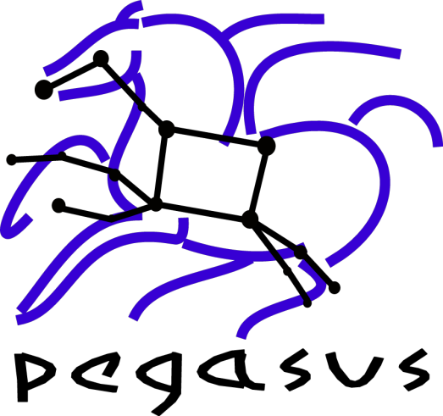


SSI: Distributed Workflow Management Research and Software in Support of Science
Ewa Deelman, USC Information Sciences Institute, deelman@isi.edu
Miron Livny, University of Wisconsin, Madison, miron@cs.wisc.edu
Pegasus WMS: http://pegasus.isi.edu
Pegasus is a system for mapping and executing abstract application workflows over a range of execution environments.
The output is an executable workflow that can be executed over a variety of resources ( Clouds, XSEDE, OSG, Campus Grids, Clusters, Workstation)
Pegasus can run workflows comprising of millions of tasks.
Pegasus WMS consists of three main components: the Pegasus mapper, Condor DAGMan, and the Condor schedd.
The mapping of tasks to the execution resources is done by the mapper based on information derived from static and/or dynamic sources. Pegasus adds and manages data transfer between the tasks as required.
DAGMan takes this executable workflow and manages the dependencies between the tasks and releases them to the Condor schedd for execution.
Large Scale Hierarchal Workflows
Nodes in a workflow can be tasks or another workflow ( DAX ).
Scales up-to order of millions of tasks
Each sub workflow is mapped when it is ready for execution.
Composing Workflows
Software Availability
Workflows are expressed in DAX (Directed Acyclic graph in XML)
DAXes can be generated using Java, Perl or Python API’s
Support for higher level workflow composition tools like Wings, Triana
Integrated with HUBZero
Scientists can use application-specific portals such as CGSMD
http://portal.nimhgenetics.org
Download Options
YUM repository with RPM packages
APT repository with DEB packages
Binary packages for various linux and Mac platforms.
Training Materials
Quickstart Guide
Virtual Machine based Tutorial.
Prepackaged Application VM’s
RNASeq Pegasus VM available at http://genomics.isi.edu/rnaseq
Applications Using Pegasus
Pegasus Features
Astronomy and Physics
Galactic Plane for generating mosiacs from the Spitzer Telescope
LIGO workflows for detecting gravitational waves.
Periodogram Workflows for detecting extra solar planets .
Earthquake Sciences
Cybershake workflows for seismic hazard analysis for LA Basin.
Broadband worklfows for accurate predictions of ground motions.
Bioinformatics
Brain span workflows to find where in the brain a gene’s expressed
Workflows to compute RNA Seq for generating Cancer Genome Atlas
SIPHT workflows to predict sRNA encoding genes in bacteria.
Proteomics workflows for mass spectrometry based proteomics.
Others
http://pegasus.isi.edu/applications
Clustering of small tasks into large clusters for performance.
Optimized data transfers and ability to use different protocols.
Data reuse in case intermediate data products are available
workflow-level checkpointing
Automatic data cleanup
reduces data footprint
Support for Workflow and Task level notifications
Workflow Progress can be tracked through a database.
Stores provenance of data used, produced and which software was used with what parameters
Retries computations in case of failures.
Monitoring and Debugging tools to debug large scale workflows.
Integrates with Resource Provisioners like GlideinWMS.
Support for Shell Code Generator
Pegasus WMS is funded by the National Science Foundation OCI SDCI and SI2 program grants 0722019 and 1148515.

