Slide 1

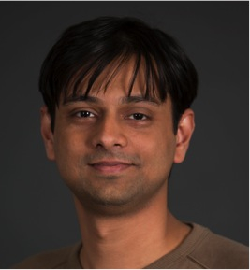

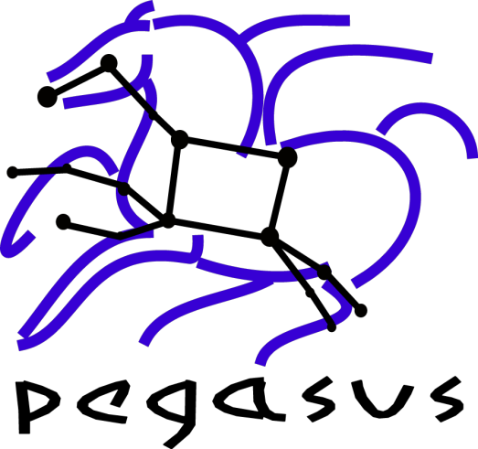
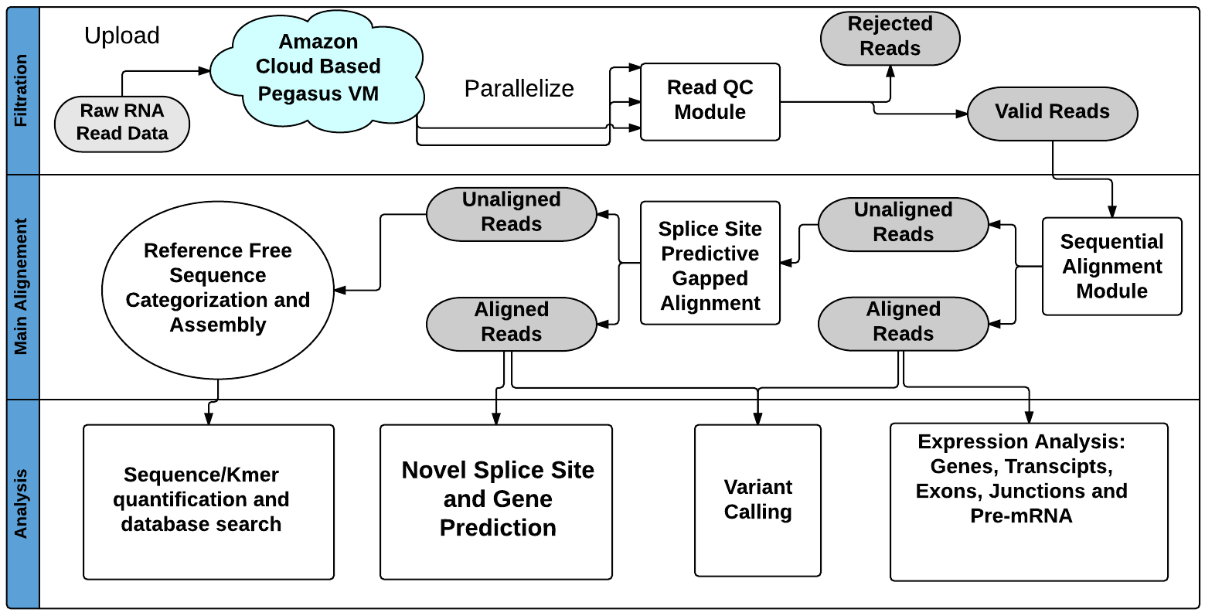
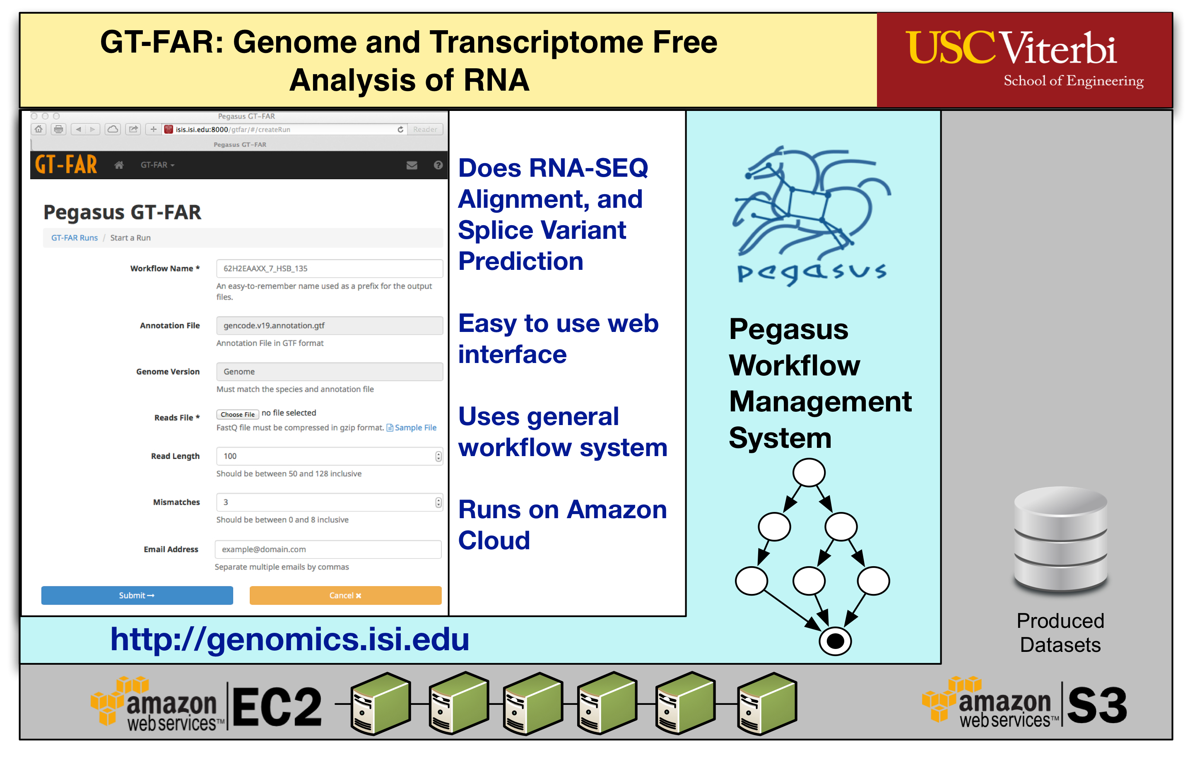
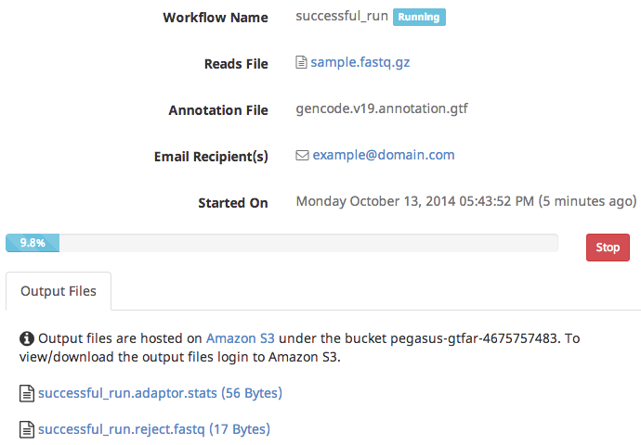
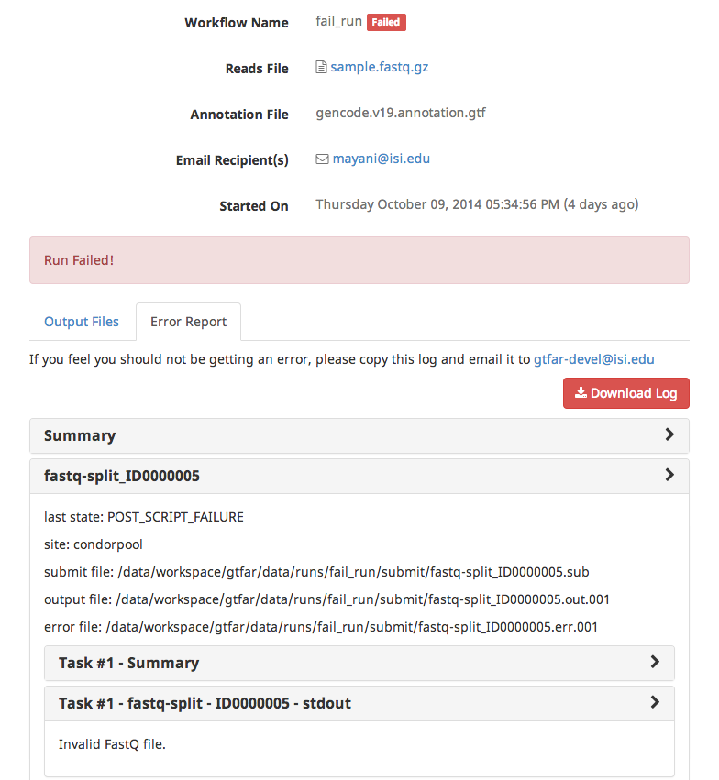
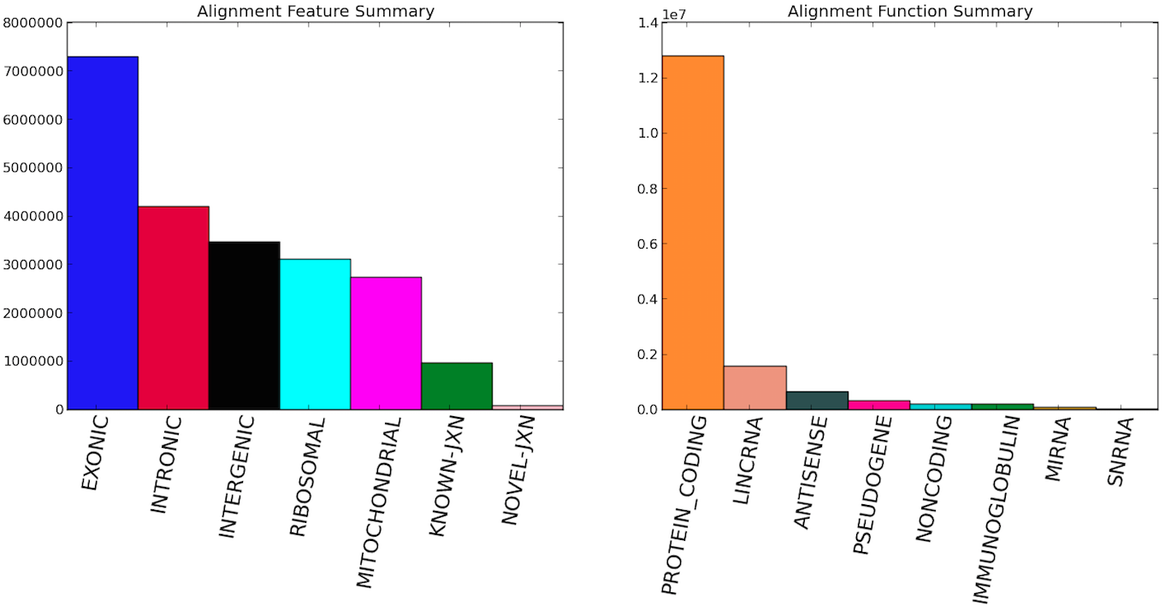


Genome and Transcriptome Free Analysis of
RNA-Seq Data using Cloud Computing
T. Souaiaia¹, R. Mayani², K. Vahi², J. Herstein¹, O. Evagrafov¹,
T. Chen³, E. Deelman², D. Briggs², J. Knowles¹
¹Zilkha Neurogenetic Institute, USC, ²Information Sciences Institute, USC, ³Dept. Of Molecular and Computational Biology, USC
GT-FAR Pipeline
Pegasus Workflow Management System
GT-FAR is an easy to use pipeline
RNA-seq QC, Alignment, Quantification, and Splice Variant Calling.
Does reference free quantification.
Sequentially aligns reads to gene models and predicts and validates new splice junctions
Quantifies expression for each gene, exon, and known/novel splice junction
General, open source solution for describing and executing workflows on laptops, clusters and clouds
Provides Python, Java, and Perl APIs for workflow creation
Provides portability, reliability, performance
Can handle workflows with millions of tasks, TB of data
Can optimize the workflow from the point of view of performance, can handle data management across local and wide area networks, leveraging parallel file systems and object stores
Used in a number of domains: astronomy, bioinformatics, earthquake science, helioseismology, gravitational-wave physics, seismology, etc..
Detailed documentation on workflow design and execution at http://pegasus.isi.edu
Pegasus Tutorial VM on AWShttp://pegasus.isi.edu/wms/docs/latest/vm_amazon.php
User support available pegasus-users@isi.edu
Layered Architecture
GT-FAR Web UI ( Custom interface that generates Pegasus workflow description and interfaces with Pegasus WMS)
Pegasus WMS ( manages the workflows and distributes computation on Amazon EC2)
Amazon EC2 ( the underlying compute infrastructure )
Allows users to upload input files using web browser
GT-FAR + Pegasus on Amazon EC2
Outputs
On successful completion of the pipeline a SAM file is generated.
Users have option of downloading to local machine
Outputs are also made available in S3 for persistent storage
GT-FAR Science Outputs
Workflow Tracking and Error Reporting
For each sample fastq file that passes through the sequential alignment module gtfar produces:
Workflow progress can be monitored through the dashboard, or the user can wait for workflow completion email notification.
Generates an error report when things go wrong.
Error reports indicate the source of error and what tasks failed.
The log can emailed to pipeline developers
a) Genome space sam file
b) QC summary data with respect to adaptor
sequences and read
trimming.
c) Quantification data at exon, junction, pre-mRNA, intergenic and sequence level.
d) A selection of splice candidates and the level of evidence for each one.
e) Summary data with respect to alignment to different transcriptomic features* (exons, introns, etc) as well as each annotation class.*
* Shown in figure
Acknowledgments:
Pegasus GT-FAR cloud based solution is funded NIH/NHGRI grant number 1U01 HG006531-01,
Pegasus WMS is funded by the National Science Foundation OCI SDCI program grant #1148515.

