Slide 1
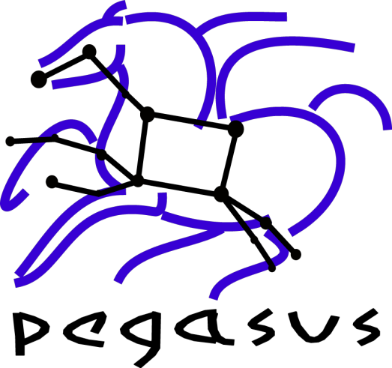

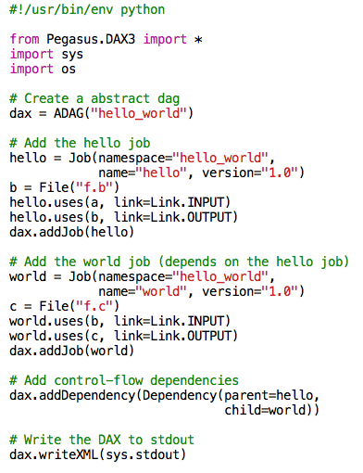
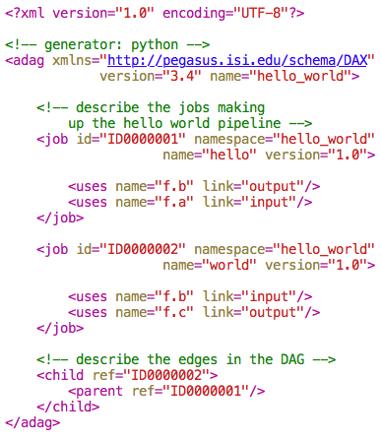
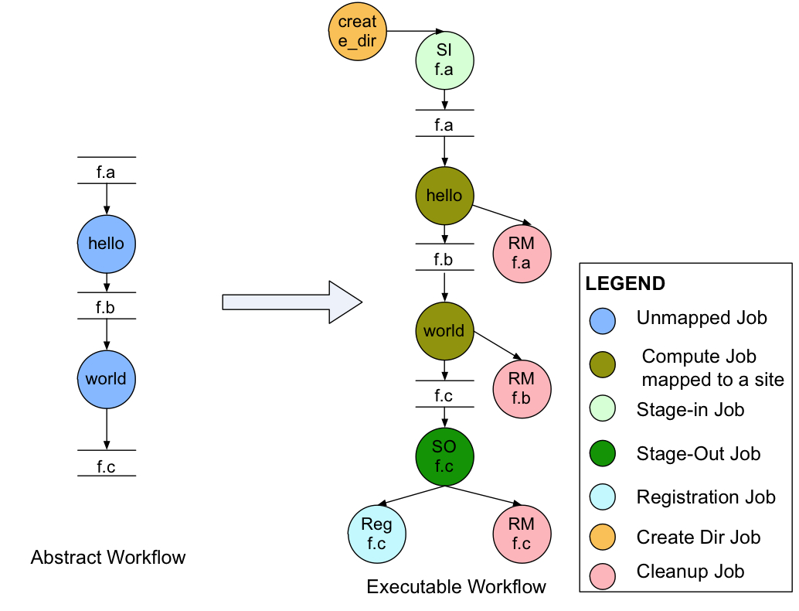
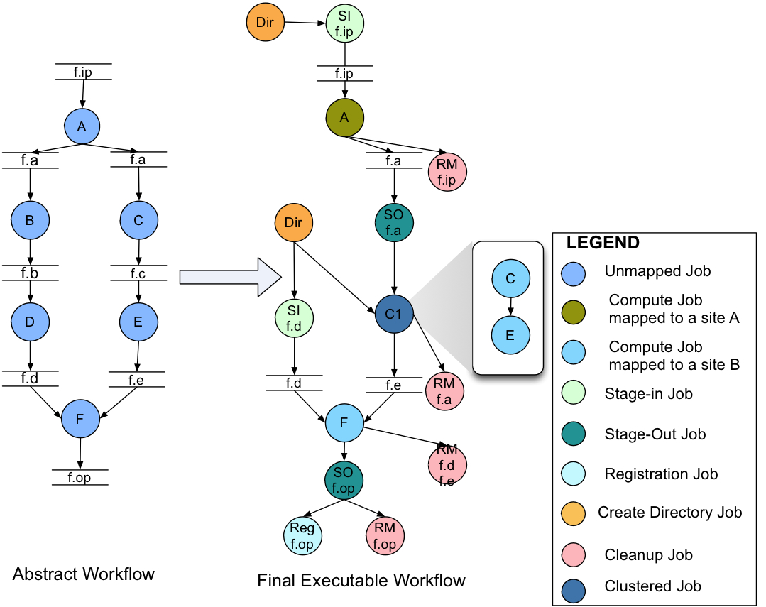
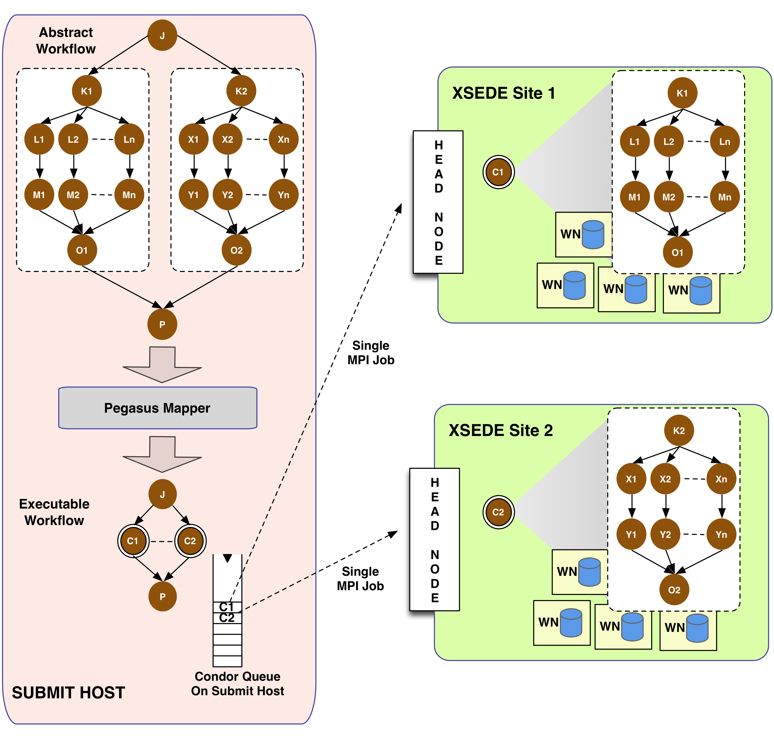
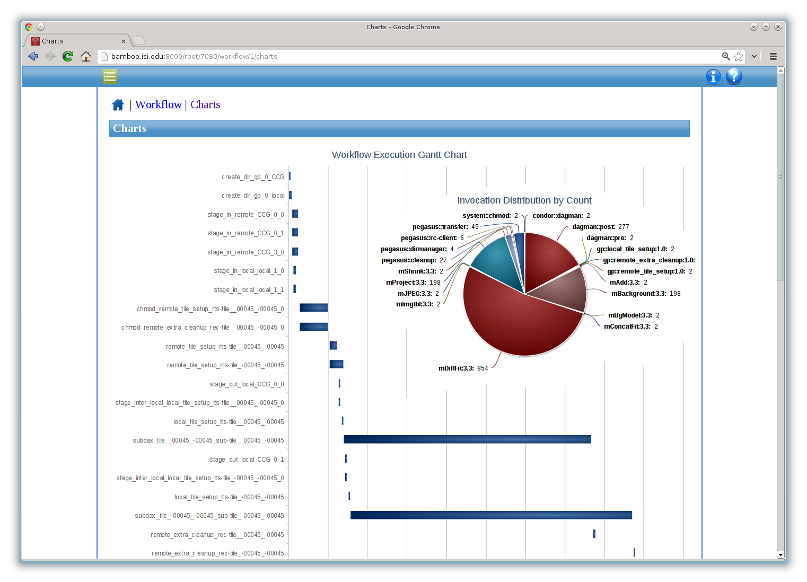
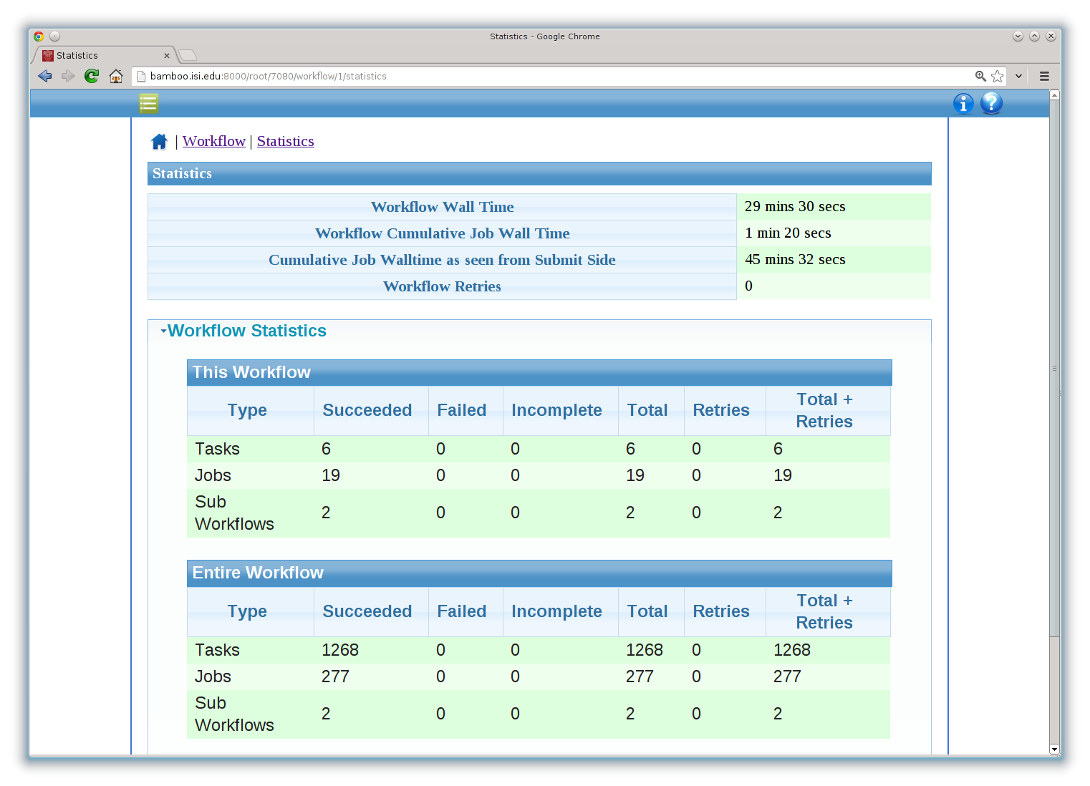



Pegasus WMS: Enabling Large Scale Workflows on National Cyberinfrastructure
Karan Vahi, Ewa Deelman, Gideon Juve, Mats Rynge, Rajiv Mayani, Rafael Ferreira da Silva
University of Southern California / Information Sciences Institute
Overview
Workflow Design and Mapping
Canonical Workflow Example
Pegasus is a system for mapping and executing abstract application workflows over a range of execution environments.
The same abstract workflow can, at different times, be mapped different execution environments such as XSEDE, OSG, commercial and academic clouds, campus grids, and clusters.
Pegasus Workflow Management System (WMS) consists of three main components: the Pegasus Mapper, HTCondor DAGMan, and the HTCondor Schedd.
Features
Abstract Workflow (DAX)
The abstract workflow rendered as XML . It only captures the computations the user wants to do and is devoid of any physical paths. Input and output files are identified by logical identifiers. This representation is portable between different execution environments.
Abstract to Executable Workflow Mapping
The DAX is passed to the Pegasus Mapper and it generates an executable workflow that can be run on actual resource.
The above example highlights addition of data movement nodes to staging in the input data and stage out the output data; addition of data cleanup nodes to remove data that is no longer required; and registration nodes to catalog output data locations for future discovery.
Portability / Reuse - User created abstract workflows can easily be run in different environments without alteration. The same workflow can run on a single system or across a heterogeneous set of resources.
Performance - The Pegasus Mapper can reorder, group, and prioritize tasks in order to increase the overall workflow performance.
Scalability - Pegasus can easily scale both the size of the workflow, and the resources that the workflow is distributed over. Pegasus runs workflows ranging from just a few computational tasks up to 1 million.
Data Management - Pegasus handles replica selection, data transfers and output registrations in data catalogs. These tasks are added to a workflow as auxiliary jobs by the Pegasus Mapper.
Reliability - Jobs and data transfers are automatically retried in case of failures. When errors occur, Pegasus tries to recover when possible by retrying tasks, by retrying the entire workflow and by providing workflow-level checkpointing, by re-mapping portions of the workflow
Monitoring and Debugging– Command line monitoring and debugging tools to debug large scale workflows. Debugging tools such as pegasus-analyzer helps the user to debug the workflow in case of non-recoverable failures.
Workflow and Task level notifications (email, instant messenger, user defined script callout)
DAX Generator API
Easy to use APIs in Python, Java and Perl to generate an abstract workflow describing the users computation.
Above is a simple two node hello world example.
Additional Capabilities Highlighted
Data Reuse: Jobs B and D are removed from the workflow as file f.d already exists. The f.d is staged in , instead of regenerating it by executing jobs B and D.
Job Clustering: Jobs C and E are clustered together into a single clustered job.
Cross Site Run: Single Workflow can be executed on multiple sites, with Pegasus taking care of the data movement between the sites.
Fine-grained Workflows on XSEDE Using MPI Clustering
Problem: How can you efficiently execute fine-grained workflows on HPC resources? These workflows can have a large number of tasks which cannot all be submitted to the HPC resource’s queue, and the tasks can have a mix of different core and memory requirements.
Solution: The workflow is partitioned into independent sub graphs, which are submitted as self-contained Pegasus MPI Cluster (PMC) jobs to the remote sites.
A PMC job is expressed as a DAG and PMC uses the master-worker paradigm to farm out individual tasks to worker nodes. PMC acts a scheduler and considers core and memory requirements of the tasks when making scheduling decisions.
PMC can be easier to setup than pilot jobs / glideins as no special networking is required. PMC relies on standard MPI constructs.
Monitoring and Debugging
At runtime, a database is populated with workflow and task runtime provenance, including which software was used and with what parameters, execution environment, runtime statistics and exit status.
Pegasus comes with command line monitoring and debugging tools. A web dashboard now allows users to monitor their running workflows and check jobs status and output.
Acknowledgments:
Pegasus WMS is funded by the National Science Foundation OCI SDCI program grant #1148515.
HTCondor : Miron Livny, Kent Wenger, University of Wisconsin Madison
http://pegasus.isi.edu

