Slide 1
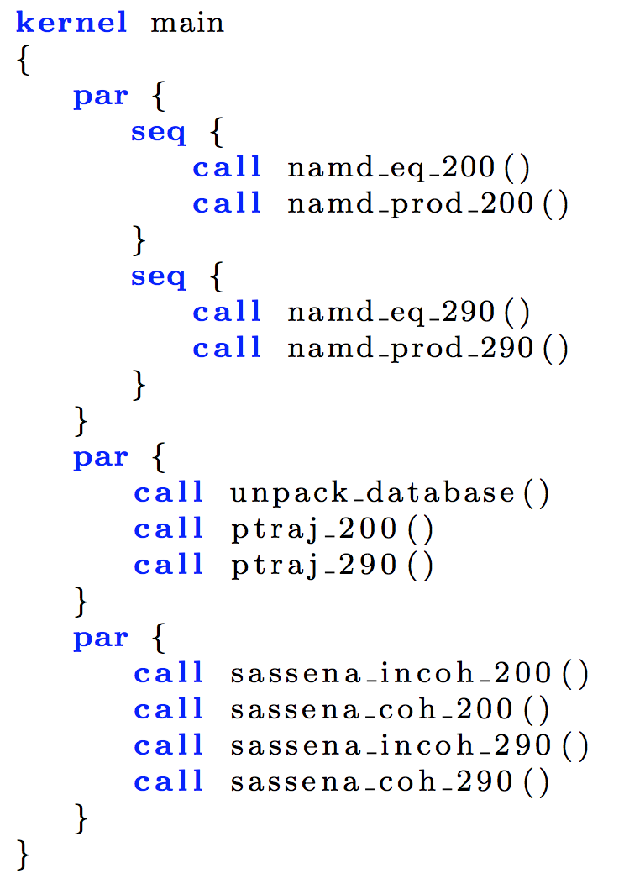
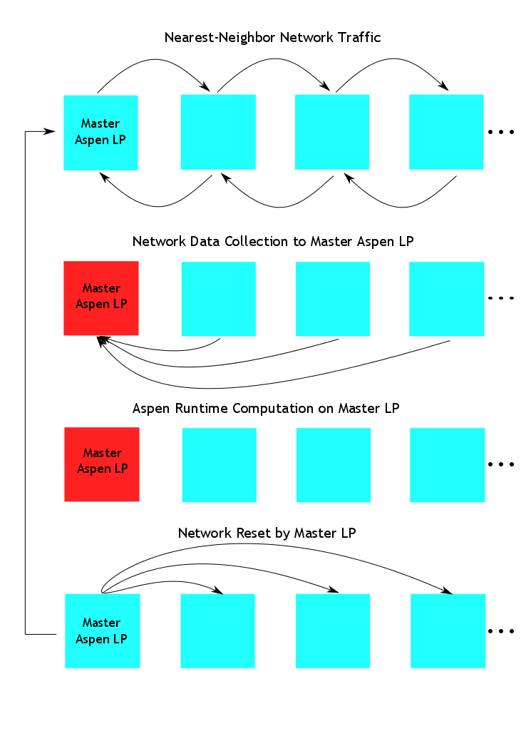
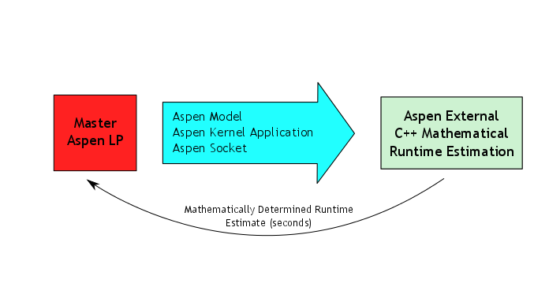
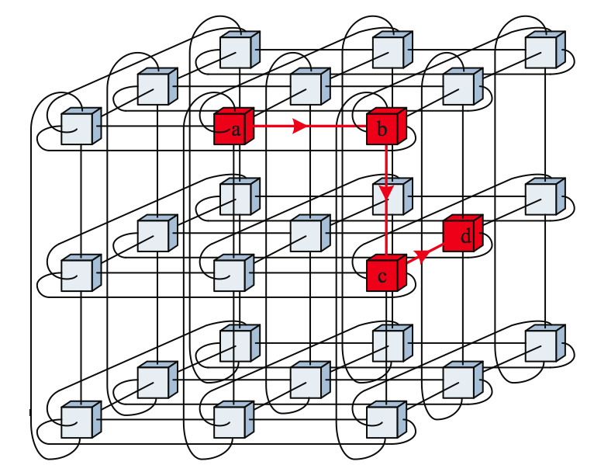
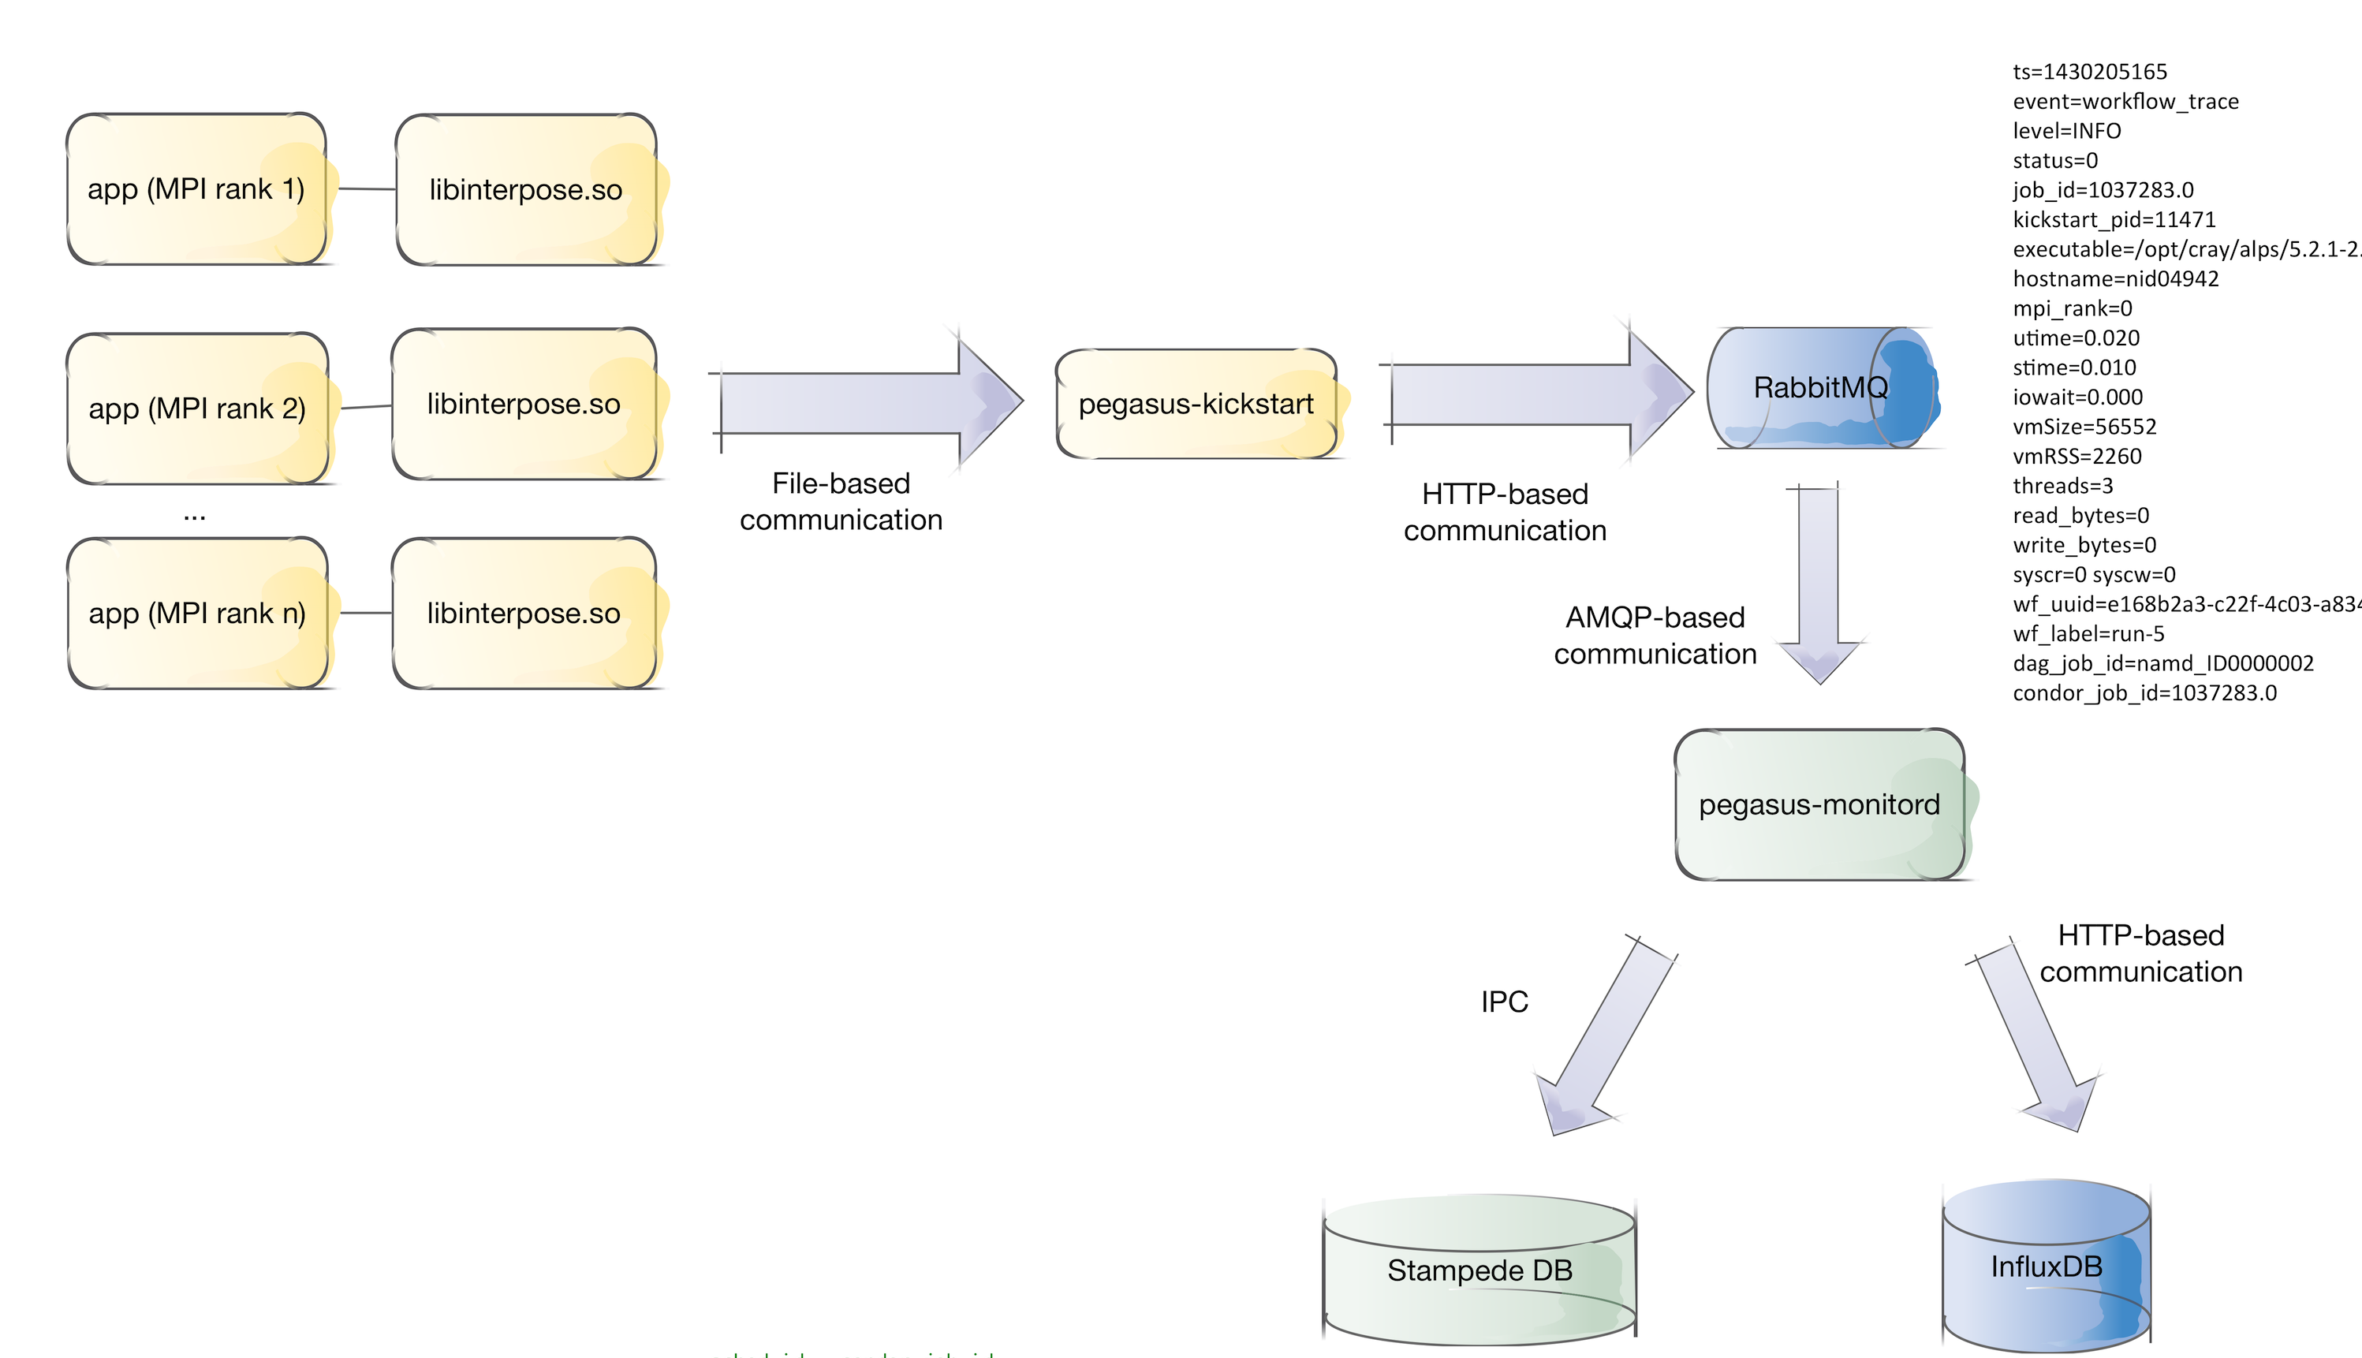


Panorama: Modeling the Performance of Scientific Workflows
Ewa Deelman, Christopher Carothers, Anirban Mandal, Brian Tierney, Jeffrey Vetter, Ilya Baldin, Claris Castillo, Gideon Juve, Dariusz Król, Vickie Lynch, Ben Mayer, Jeremy Meredith, Thomas Proffen, Paul Ruth, Rafael Ferreira da Silva
Panorama
Modeling
The Panorama project aims to further the understanding of the behavior of scientific workflows as they are executing in heterogeneous environments. Panaroma’s approach to modeling and diagnosing the runtime performance of complex scientific workflows is to integrate extreme-scale systems testbed experimentation, structured analytical modeling and parallel systems simulation into a comprehensive workflow framework that can characterize the end-to-end workflow performance on today’s and future generation architectures, which can be used to improve the overall workflow performance and reliability. We first present the Panaroma architecture, including the individual framework components: the Aspen analytical application modeling software, the ROSS simulation framework, the Pegasus workflow management system and how they are used to model the behavior of DOE-relevant applications. We then describe how analytical models can be augmented with detailed simulations. By having a coupled model of the application and execution environment, decisions can be made about resource provisioning, application task scheduling, data management within the application, etc. Finally, our approach for correlating the real time application and infrastructure monitoring data is presented and how it can be used to verify application behavior, perform anomaly detection and diagnosis, and support adaptivity during workflow execution.
Aspen Modeling and Analysis Toolkit
Aspen bridges the gap between structured analytical performance modeling methods and functional simulation tools
DSL approach to analytical modeling allows more accurate capture of control flow and algorithmic resource usage
Aspen provides a suite of modeling, analysis, and prediction tools
C++, C, Python, and Java interface to the Aspen library can be used to create custom queries and novel analysis tools
Workflow Modeling with Aspen
Panorama tools transform Pegasus workflow description to Aspen model including control flow and subtask parallelism (on right)
Black-box modeling tool derives machine-independent resource usage from data collected from prior runs and automatically creates an Aspen application model for each task in a workflow, allowing predictive analysis for new machines and parameter settings
System Design
Aspen/CODES Integration
Dragonfly Network Topology
Dragonfly group
Above: Overall network simulation to computation estimation cycle employed by composite simulator
Left: More detail concerning multi-round runtime of simulator
Dragonfly group
Torus Network Topology
Implementation: Aspen is encapsulated as a ROSS/CODES Logical Process (LP). There is one Aspen “compute node” LP per network endpoint. A master Aspen LP kicks-off each “network” phase once it completes a “compute” phase. The “network” phase performs a packet-level event-driven model and measures time which is report to each Aspen “compute” LP. A reduction determines the max, min and average time in the network which is added to the compute phase time estimate. Currently, runs in parallel. Scaling study for large-scale compute/network configurations for different topologies using a Blue Gene/Q is underway.
Pegasus interfaces with Aspen to estimate resource requirements of individual workflow tasks as well as the entire workflow
Aspen interfaces with ROSS/CODES to simulate network behavior not easily modeled using analytical techniques
Workflow and infrastructure monitoring data is stored in InfluxDB and Pegasus DB
Anomaly detection process monitors data stream and generates anomaly notifications, which are displayed in the web dashboard
Monitoring
Workflow Monitoring
Real-time collection of time-series of workflow performance metrics
Targeting: I/O (read, write), memory, CPU
Supports serial, multi-threaded, MPI jobs with without recompiling code
In the process of implementing data collection for CPU performance counters using PAPI
Applications
Spallation Neutron Source (SNS)
Parameter sweep of molecular dynamics and neutron scattering
Used to identify parameters that fit experimental data from SNS
Currently being used for real science problems
Large runs use 20 parameter values and require ~400,000 CPU hours
Running on Hopper @ NERSC
Infrastructure Monitoring
Collecting time series of infrastructure behavior
Focusing on network behavior (throughput, packet loss, etc), storage (disk I/O), load, etc.
Working on integration with PerfSONAR
Experimental Runs
Have collected data for many different SNS runs on Hopper at NERSC
Multiple runs using different application parameters (inputs, timesteps, #cores, etc).
Currently analyzing this data to understand correlations for modeling
Accelerated Climate Modeling for Energy (ACME)
Coupled climate models with ocean, land, atmosphere and ice
Climatologies and diagnostics give summaries of data
Each stage of the workflow runs the ACME model for a few timesteps—helps keep simulations within batch queue limits
Running on Hopper @ NERSC and Titan @ OLCF
Collaborating with IPPD project @ PNNL to integrate with end-to-end, production ACME workflow system
Anomaly Detection
Correlating Monitoring of Workflows and Infrastructure
Preliminary Experiments
Concentrating on I/O performance
Infrastructure monitoring tools: ‘sar’ for monitoring I/O
Infrastructure measurements pushed to InfluxDB store
Correlating with workflow monitoring metrics relevant to I/O performance – iowait, write_bytes, etc.
Using the ExoGENI testbed as a controlled environment
SNS workflow runs on the testbed using Pegasus
Anomaly injection w/“stress” tool
The time series data reveal spikes at anomaly injection points
MG-RAST
Detection and Alerting
Workflow for metagenomic analysis
Replicates functionality of the workflow used by the MG-RAST science gateway
Working on online analysis of time series data for detection of anomalies
Comparison of observed time series signature with baseline signatures
Comparison with ASPEN models
Alerting using persistent queries
http://sites.google.com/site/panoramaofworkflows
Panorama was funded by the US Department of Energy under Grant #DE-SC0012636
Notes:
Aspen was designed to bridge the gap between structured analytical performance models and functional simulation. Aspen takes a domain-specific language (DSL) approach to analytical modeling to allow more accurate capture of control flow and algorithmic resource usage than traditional frameworks. Aspen contains a suite of modeling, analysis, and prediction tools, as well as a library with C++, C, Python, and Java interfaces that can be used to create custom queries.

