Slide 1




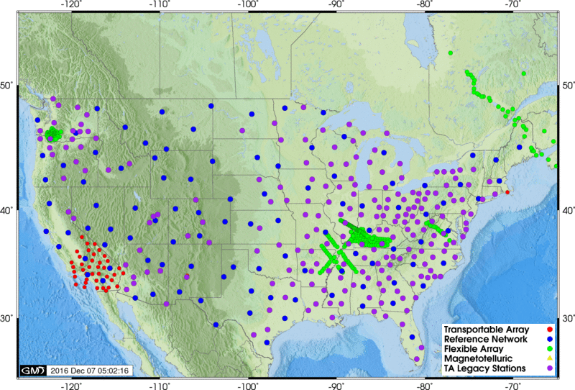
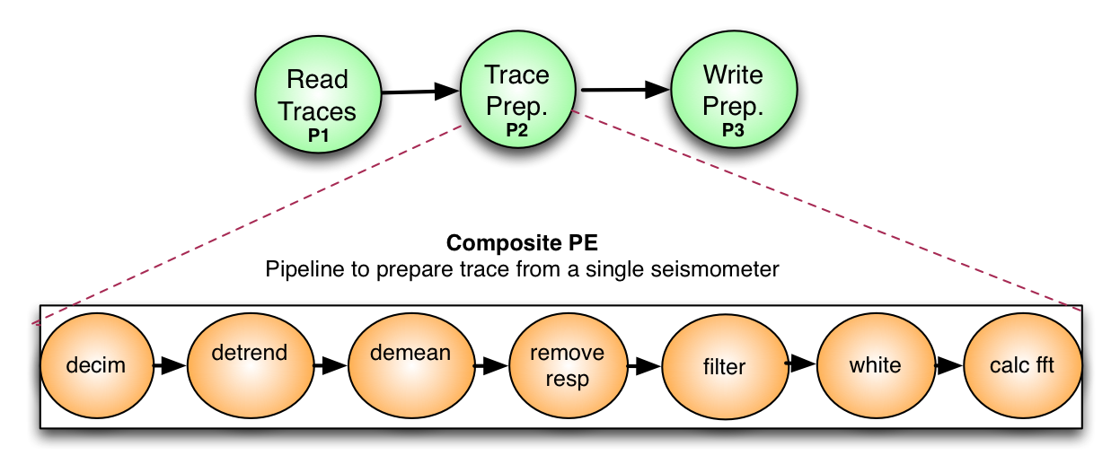


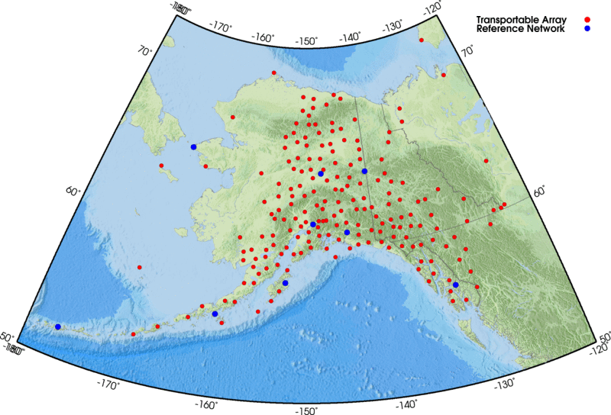



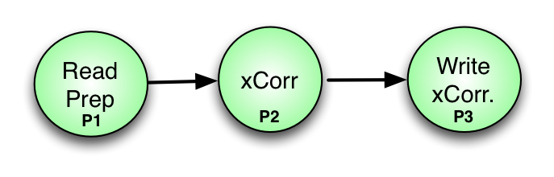
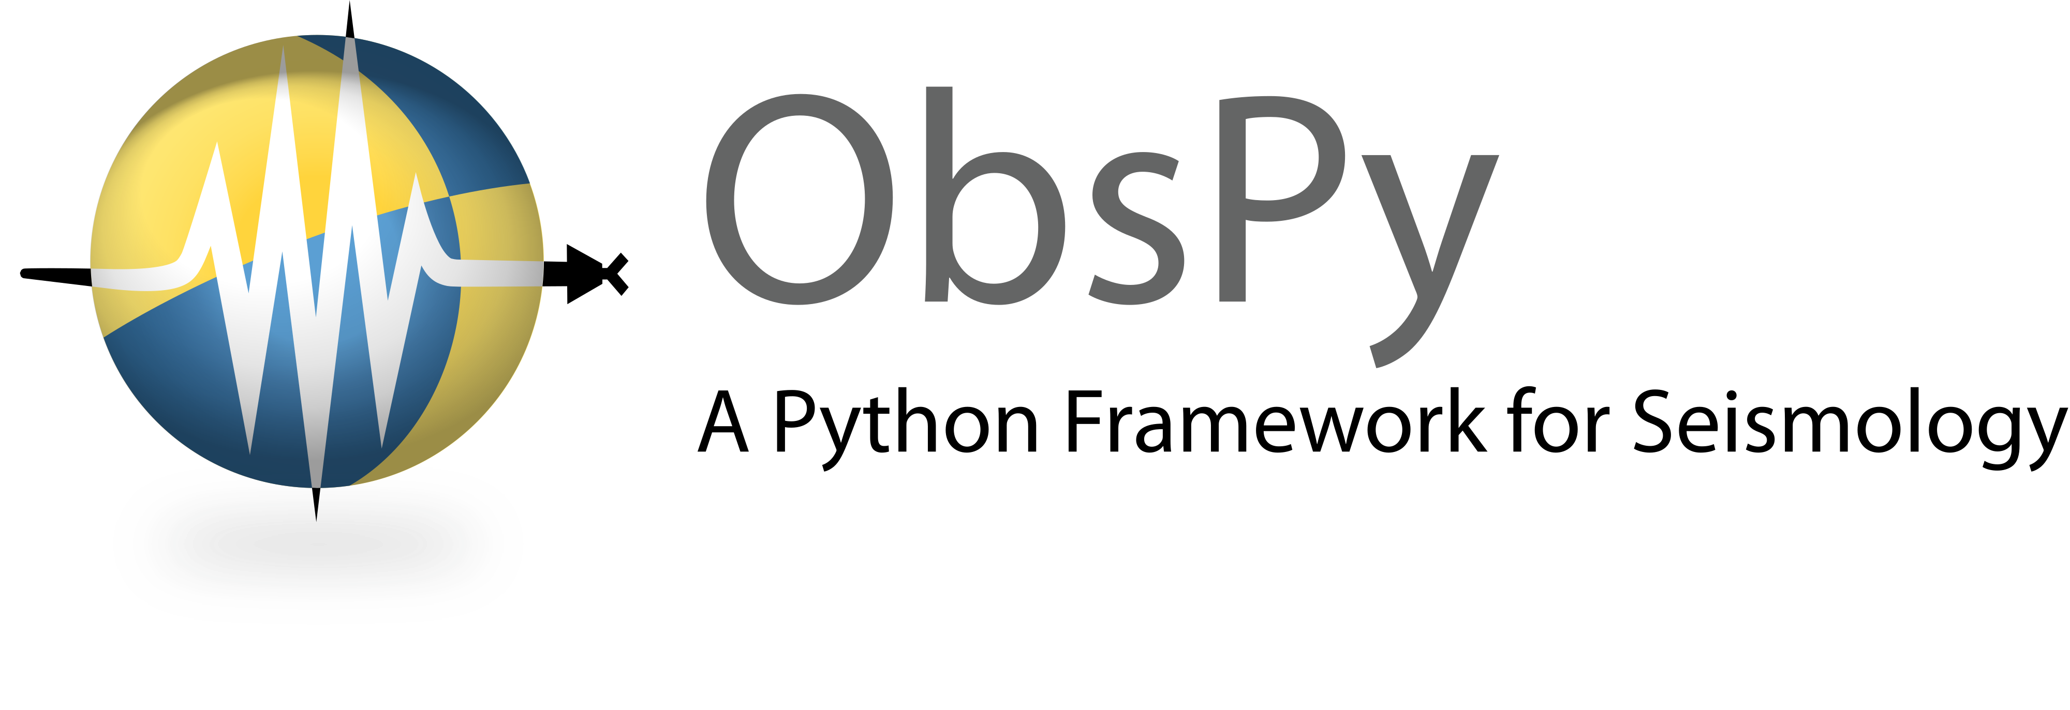

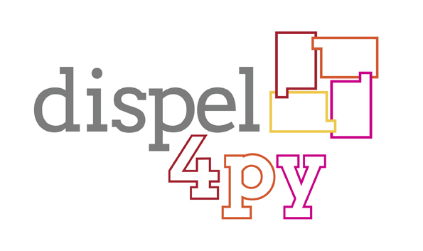
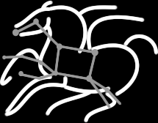
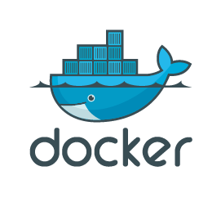
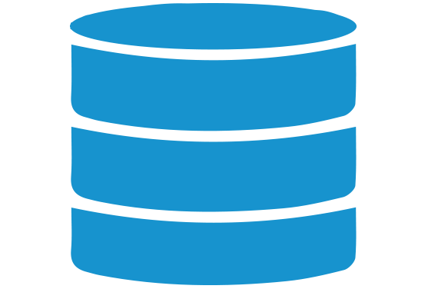
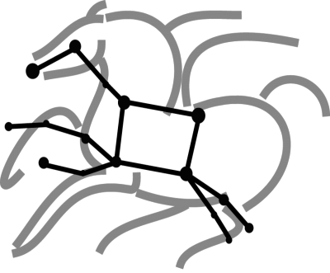



ASTERISM
an integrated, complete, and open-source approach for running seismologist continuous data-intensive analysis on heterogeneous systems
Rafael Ferreira da Silva rafsilva@isi.edu
WORKFLOW APPLICATION
Seismic Ambient Noise Cross-Correlation
Rafael Ferreira da Silva¹, Rosa Filgueira², Ewa Deelman¹, Malcolm Atkinson³
¹University of Southern California, Information Sciences Institute, USA
²NERC-British Geological Survey, Lyell Centre, UK
³University of Edinburgh, DIR, UK
Scientific workflow requests data from IRIS services (USArray TA)
Pre-Process (Phase 1)
Each time series from a seismic station (each trace), is subject to a series of data- preparation treatments chosen and parameterized by seismologists; and the processing of each trace is independent from other traces. (complexity O(n), where n is the number of stations)
Seismic Ambient Noise Cross-Correlation
WHY SCIENTIFIC WORKFLOWS?
General Features and Workflow Management Systems
Abstraction, scientists can focus on their research and not computation management
Automate
Cross-Correlation (Phase 2)
Easy composition and execution
For all pairs of stations compute the correlation, essentially identifying the time for signals to travel between them, and hence infer some, as it turns out time varying, properties of the intervening rock. The complexity of this phase is O(n²)
Enables parallel, distributed computations
Recover
The USArray TA has a list of 836 stations–394 of them have online data available.
Many scientific workflow management systems (WMS) have been developed, and they have been intensively used by various research communities, e.g., Earth sciences, astronomy, biology, computational engineering,
climate modeling, etc.
Debug
EXECUTION OF THE
SEISMIC AMBIENT NOISE WORKFLOW
EVALUATION
1 instance as Container 2
(MPI head node)
16 instances as Container 2
(MPI workers)
IRIS Data Services, Containers, and Cloud Computing
ASTERISM FRAMEWORK
IRIS Data Services, Containers, and Cloud Computing
Experiment 1
Open-source Platform-independent Framework
Data from IRIS services (394 stations)
Greatly simplifies the effort required to develop data-intensive applications that run across multiple heterogeneous resources distributed in the wide area:
Manages the data-distribution across systems
Parallelizes the user’s methods
Co-places and schedules methods with computing resources
Stores and transfers large/small volumes of data
Performance
Data Statistics
Phase 1: 8 minutes
Phase 2: 2 hours
Data Movement: less than 1 minute
Input Data: 150 MB
Output Data: 40GB
Experiment 2
Workflow runs for 3 days requesting data every 2 hours
How ?
Traditional Workflow Management Systems
Container 2
input data (~150MB)
By combining the strengths of
+
MPI Cluster
New stream-based data-flow systems
Pegasus
Phase 1
IRIS database
(stations)
Automation
data transfers between sites performed by Pegasus
Automated pipeline executions
Parallel, distributed computations
Automated data transfers
Heterogeneous resources
Recovery & Debug
Container 1
Phase 2
Job failure detection
Job Retry
Real-time monitoring
Submit host
Storm Cluster
Pegasus
output data (~40GB)
Container 3
Optimization
Scope of the Work
Job clustering
Data cleanup
1 instance as
Container 1
Automated execution and parallelization of data-intensive applications in heterogeneous systems with different enactment engines
Automation
LEARN MORE
Mapping
Automated pipeline executions
Concurrent, distributed computations
Stream-based model
Sequential
Multiprocessing
MPI
Apache Storm and Spark (Prototype)
Pegasus Website
dispel4py
3 instances as Container 3
(zookeper, nimbus, Storm UI)
16 instances as Container 3 (Supervisors)
https://pegasus.isi.edu
Optimization
Dispel4py GitHub
Multiple streams
Avoids I/O operations
https://github.com/dispel4py

