Slide 1
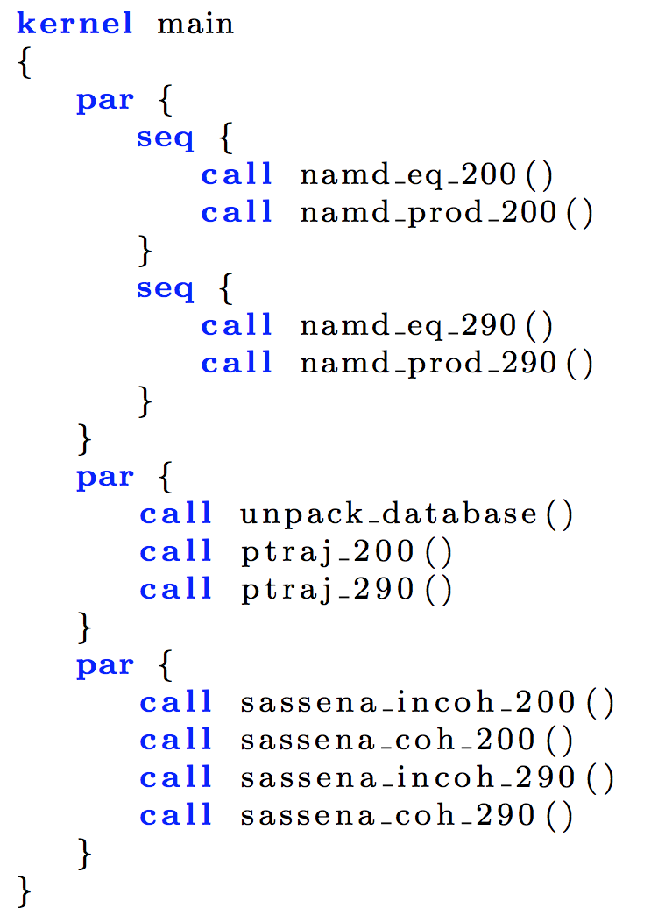
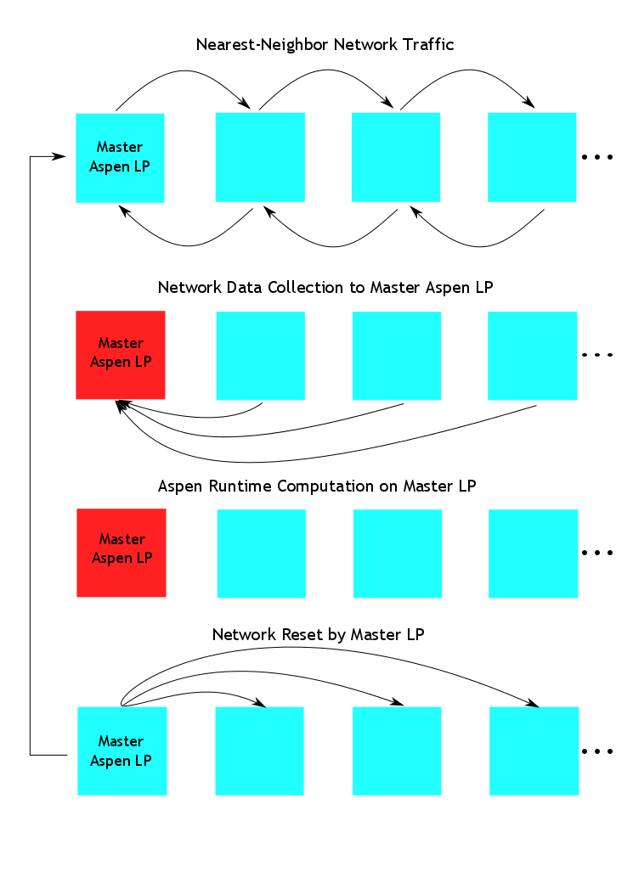
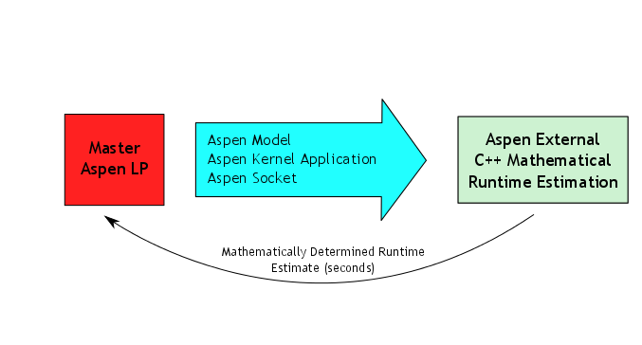
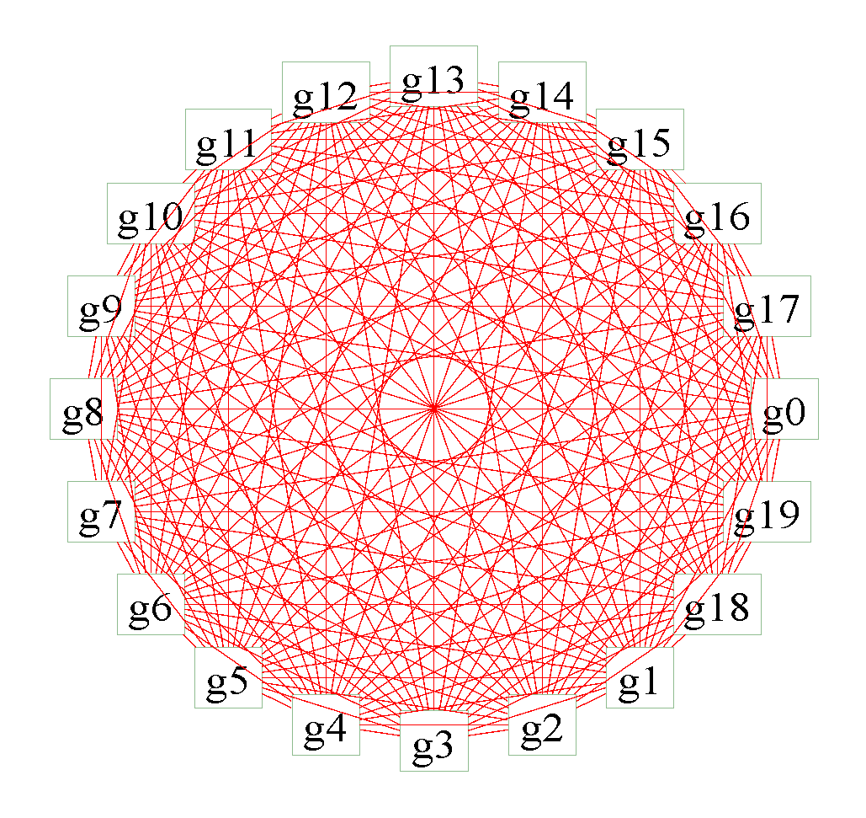
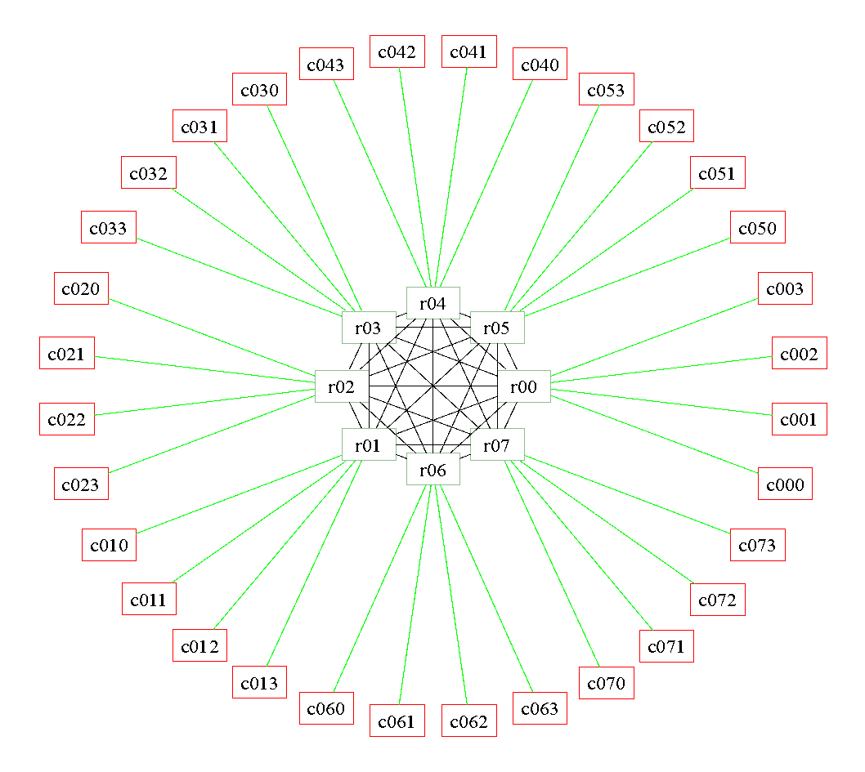
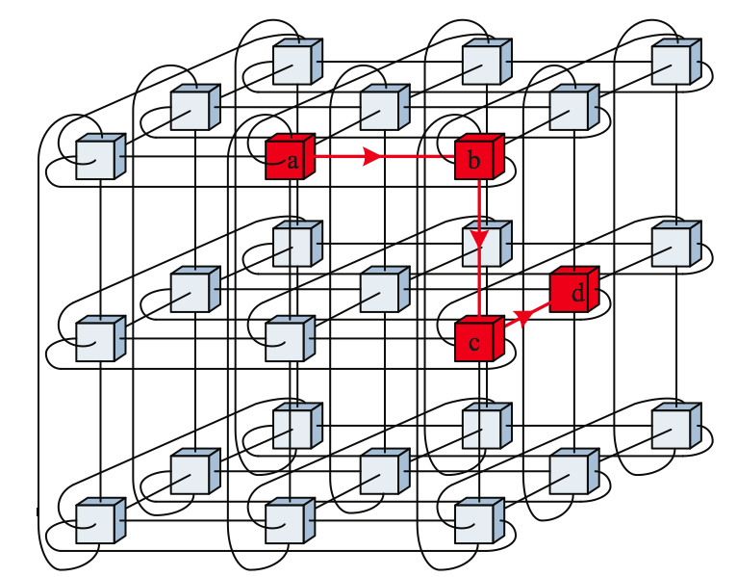
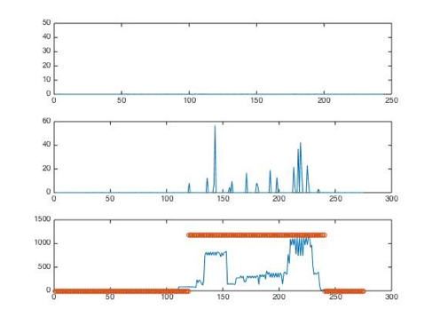
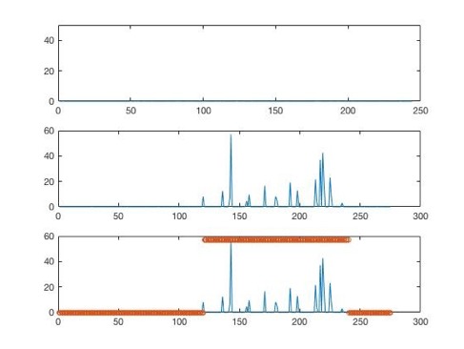
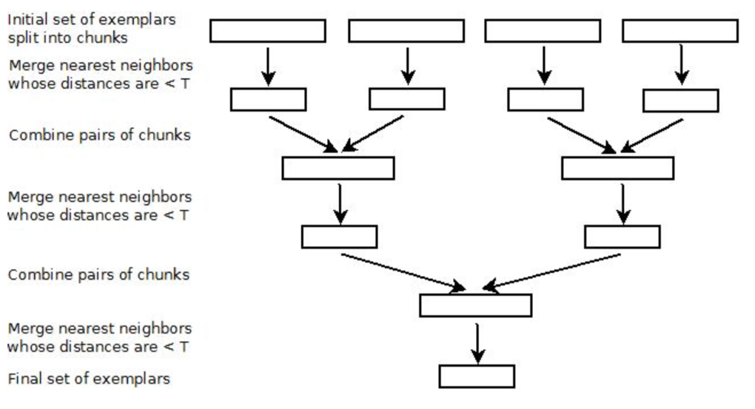
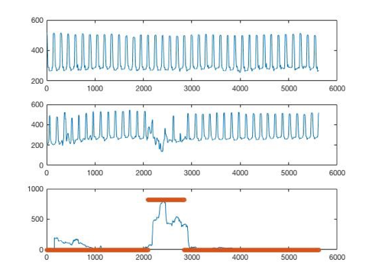
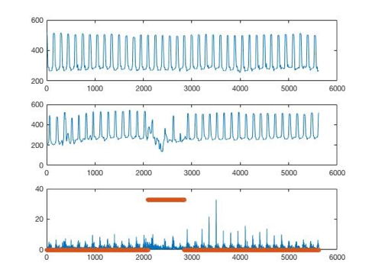
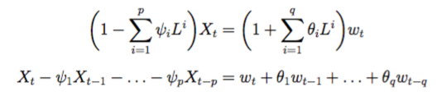


Panorama: Tools for Modeling, Monitoring, and Anomaly Detection in Scientific Workflow Execution
Ewa Deelman, Anirban Mandal, Jeffrey Vetter, Christopher Carothers, Brian Tierney, Ilya Baldin, Paul Ruth,
Meng Yang, Vickie Lynch, Ben Mayer, Jeremy Meredith, Rajiv Mayani, Rafael Ferreira da Silva
Panorama
Modeling
The Panorama project aims to further the understanding of the behavior of scientific workflows as they are executing in heterogeneous environments. Panaroma’s approach to modeling and diagnosing the runtime performance of complex scientific workflows is to integrate extreme-scale systems testbed experimentation, structured analytical modeling and parallel systems simulation into a comprehensive workflow framework that can characterize the end-to-end workflow performance on today’s and future generation architectures, which can be used to improve the overall workflow performance and reliability. We first present the Panaroma architecture, including the individual framework components: the Aspen analytical application modeling software, the ROSS simulation framework, the Pegasus workflow management system and how they are used to model the behavior of DOE-relevant applications. We then describe how analytical models can be augmented with detailed simulations. By having a coupled model of the application and execution environment, decisions can be made about resource provisioning, application task scheduling, data management within the application, etc. Finally, our approach for correlating the real time application and infrastructure monitoring data is presented and how it can be used to verify application behavior, perform anomaly detection and diagnosis, and support adaptivity during workflow execution.
Aspen Modeling and Analysis Toolkit
Aspen bridges the gap between structured analytical performance modeling methods and functional simulation tools
DSL approach to analytical modeling allows more accurate capture of control flow and algorithmic resource usage
Aspen provides a suite of modeling, analysis, and prediction tools
C++, C, Python, and Java interface to the Aspen library can be used to create custom queries and novel analysis tools
Aspen/CODES Integration
Dragonfly Network Topology
Dragonfly group
System Design
Above: Overall network simulation to computation estimation cycle employed by composite simulator
Left: Aspen, encapsulated as a ROSS/CODES Logical Process (LP) at each network endpoint, generates computation estimates which integrate with runtimes in a network simulation.
Dragonfly group
Right: Application models in Aspen are succinct descriptions of algorithms, resource usage, and control flow. A new extension to Aspen allows descriptions of communication patterns at a high level, e.g., “three dimensional periodic nearest neighbor”. Using these descriptions, a new Aspen-based tool is capable of synthesizing MPI calls from an application model. This synthetic communication pattern can take the place of a real application and interface with the ROSS/CODES network simulation framework. Initial experiments output synthetic executables to generate real MPI traces which are pulled into the ROSS/CODES trace replay. Future work will bypass the (potentially unwieldy) trace mechanism and connect the tools directly via inter-process communication.
Torus Network Topology
Application Parameters
Aspen
Synthetic
Architecture Parameters
Aspen Synthetic Trace
Writer
Aspen Synthetic Executable
Application
Execution Driven
Executable
Harness
Network
Simulator
(CODES/ROSS)
Network Simulation Results
Trace
Trace Driven
Trace
Reader
Pegasus interfaces with Aspen to estimate resource requirements of individual workflow tasks as well as the entire workflow
Aspen interfaces with ROSS/CODES to simulate network behavior not easily modeled using analytical techniques
Workflow and infrastructure monitoring data is stored in InfluxDB and Pegasus DB
Anomaly detection process monitors data stream and generates anomaly notifications, which are displayed in the web dashboard
Anomaly Detection
Exemplar-based Anomaly Detection
Experimental Runs with SNS Workflow
Exemplar method represents observations in the same window (subsequence) as a trajectory component that captures the trend of time series, and a stochastic component (a vector of statistics that describe the stochastic properties like mean, variance, etc.); 2 step process
Initial merging and Hierarchical exemplar learning; compare test series with exemplars to get anomaly score
Applications
Spallation Neutron Source (SNS)
Parameter sweep of molecular dynamics and neutron scattering
Used to identify parameters that fit experimental data from SNS
Large runs use 20 parameter values and require ~400,000 CPU hours
Running on Cori @ NERSC
Exemplar
ARIMA
Experimental Runs with Synthetic Data
Spallation Neutron Source (SNS)
Neutron Experiment Comparison
Anomaly Detection Using ARIMA Models
New workflow to compare virtual neutron experiments with real neutron experiments data from SNS
Based on Monte Carlo neutron ray tracing codes (e.g., MCViNE)
Estimates complex effects like absorption, multiple scattering, geometry, resolution function, etc.
Fit ARIMA training model: find p, d, q and coefficients
Use the fitting model to refit the test time for outliers
Exemplar
ARIMA
Adaptation
Virtual SDX
Panorama modeling/simulation tools enable Pegasus to monitor and manipulate network connectivity & performance
Virtual SDX transparently arbitrates prioritized data flows communicated by Pegasus ShadowQ++
Advanced SDX capabilities can monitor and detect network anomalies, and take adaptation actions.
Accelerated Climate Modeling for Energy (ACME)
Coupled climate models with ocean, land, atmosphere, and ice
Each stage of the workflow runs the ACME model for a few timesteps—helps keep simulations within batch queue limits
Running on Cori @ NERSC, Titan @ OLCF, and Mira @ ANL (in process)
Collaborating with IPPD project @ PNNL to integrate with end-to-end, production ACME workflow system
MG-RAST
SDX – meeting point of networks to exchange traffic, securely and with QoS, using SDN protocols
Virtual SDX – virtual overlay acting as SDX without persistent physical location
ExoGENI virtual SDX can modify compute, network storage to support changing demands of SDX
Workflow for metagenomic analysis
Replicates functionality of the workflow used by the MG-RAST science gateway
http://sites.google.com/site/panoramaofworkflows
Panorama was funded by the US Department of Energy under Grant #DE-SC0012636
Notes:
Aspen was designed to bridge the gap between structured analytical performance models and functional simulation. Aspen takes a domain-specific language (DSL) approach to analytical modeling to allow more accurate capture of control flow and algorithmic resource usage than traditional frameworks. Aspen contains a suite of modeling, analysis, and prediction tools, as well as a library with C++, C, Python, and Java interfaces that can be used to create custom queries.

