Slide 1
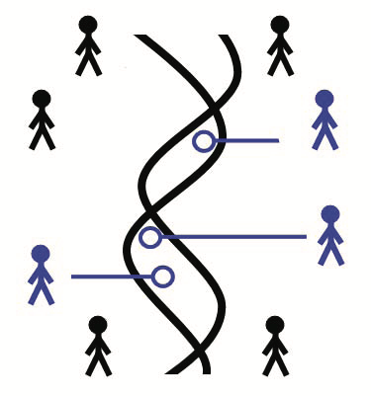

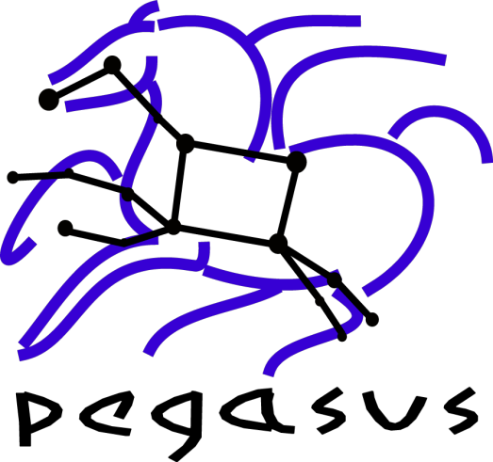










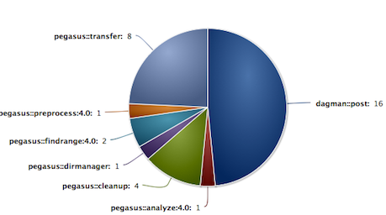
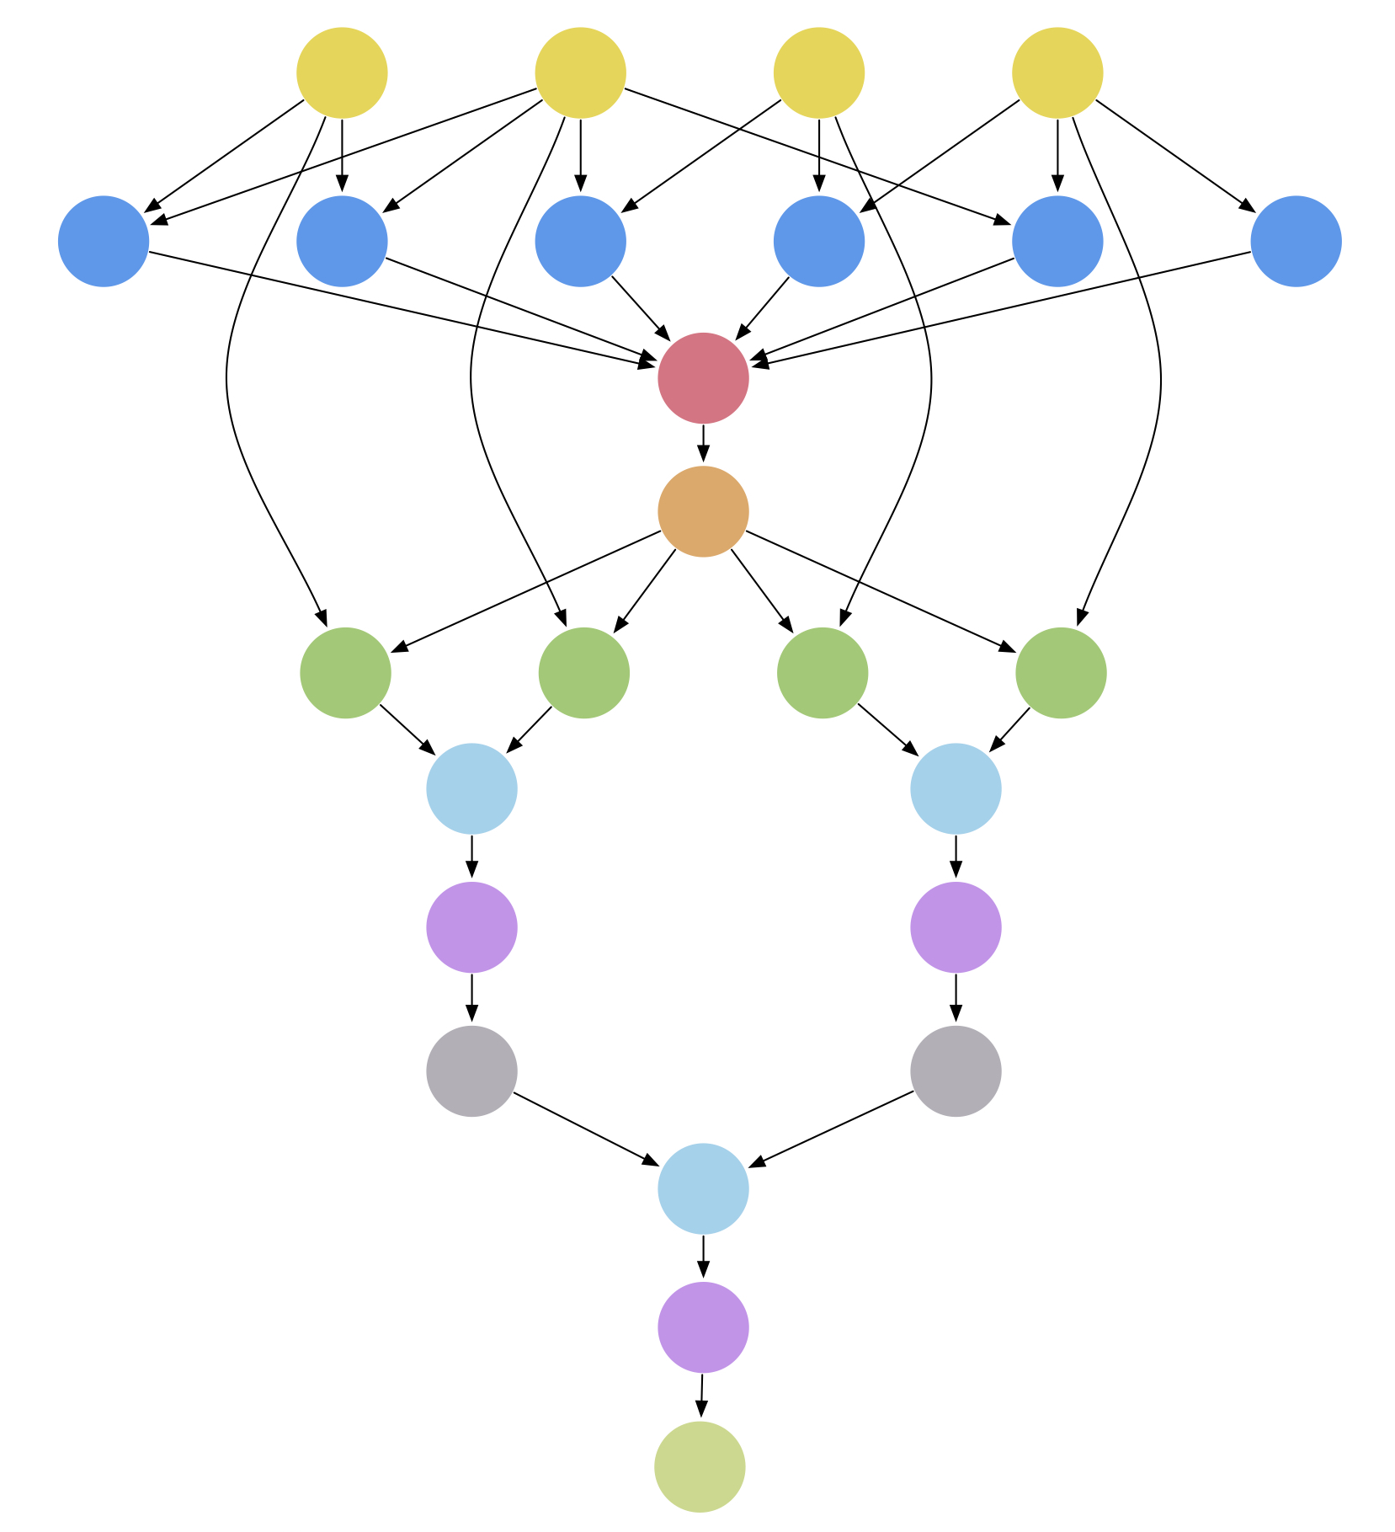

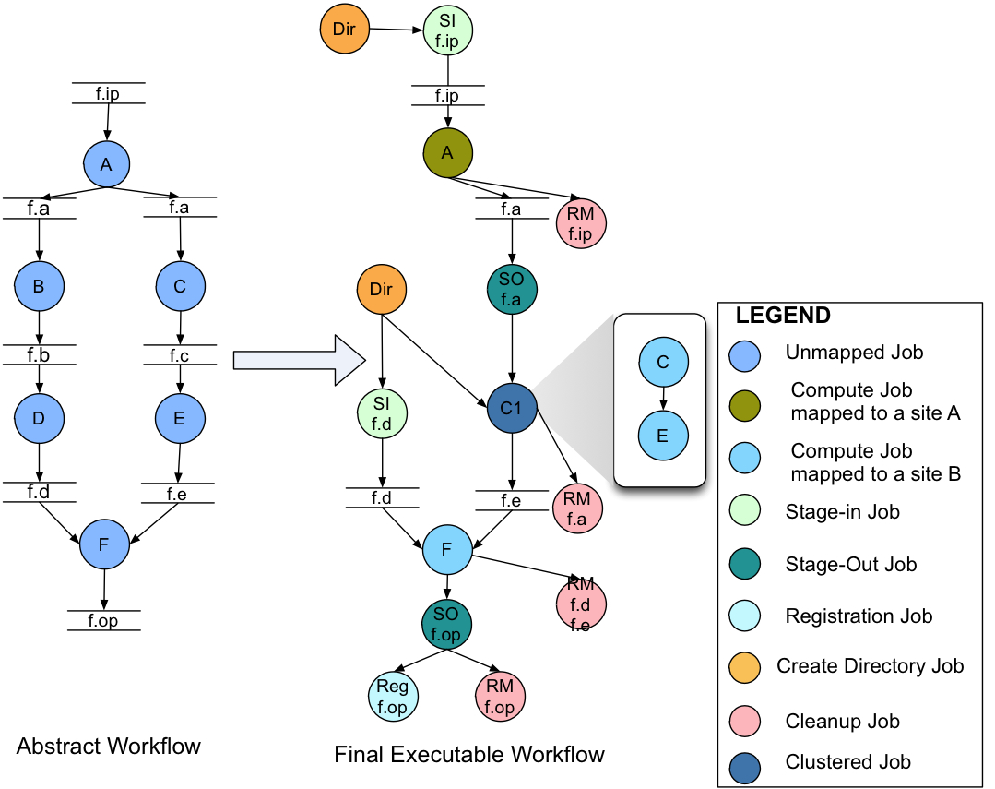






Automated Genotypic Imputation of
PAGE II Data using Scientific Workflows
Karan Vahi¹, Steve Buyske², Lisheng Zhou³, Tara Matise³, Ewa Deelman¹
¹Science Automation Technologies, USC Information Science Institute
²Department of Statistics & Biostatistics, Rutgers University ³Department of Genetics, Rutgers University
PAGE
www.pagestudy.org
Background
Pegasus Workflow Management System
PAGE II (Population Architecture using Genomics and Epidemiology) study has genotyped 50,000 samples using MEGA, an Illumina high density consortium-built array array.
We are also imputing an additional 50,000 subjects genotyped in 20 different GWAS studies.
Imputation is done using SHAPEIT and IMPUTE2 with 1000 Genomes Project Reference Panel.
Imputation can be parallelized by chromosome to reduce total processing time.
We decided to use the Pegasus Workflow Management System to do runs on the Rutgers Genetics Cluster.
General, open source solution for describing and executing workflows on laptops, clusters and clouds.
Provides Python, Java, and Perl APIs for workflow creation.
Provides portability, reliability, performance.
System Architecture
Users
Interfaces
Other workflow composition tools:
Documentation
http://pegasus.isi.edu
Applications
https://pegasus.isi.edu/application-showcase/
User Support
pegasus-users@isi.edu
Can handle workflows with millions of tasks, TB’s of data.
APIs
Pegasus Dashboard
Pegasus WMS
Transformation catalog
Mapper
Monitoring & Provenance
Notifications
Capabilities Highlighted
Replica catalog
Execution Engine
Logs
Site catalog
Scheduler
j₁
Workflow DB
Data Management
Data Management
Data Reuse
Job Clustering
Cross Site Runs
j₂
Submit Host
…
A Scientific Workflow
Allows users to easily express multi-step computational tasks.
Describes the dependencies among the tasks.
Manages data flow.
Clouds
Campus Clusters
Local Clusters
Open Science Grid
XSEDE
j_{n}
Job Queue
Distributed Resources
Cloudware
OpenStack
Middleware
C O M P U T E
Storage
Compute
Amazon EC2, Google Cloud, RackSpace, Chameleon
HTCondor GRAM
GridFTP
HTTP
PBS
LSF
SGE
FTP
SRM
Storage
Amazon S3, Google Cloud Storage, OpenStack
IRODS
SCP
Can optimize the workflow from the point of view of performance, can handle data management across local and wide area networks, leveraging parallel file systems and object stores.
Used in a number of domains: astronomy, bioinformatics, earthquake science, helioseismology, gravitational-wave physics, seismology, etc.
PAGE II Imputation Pipeline
Tools used
Plink
liftOver
LiftRsNumber.py
HRC-check-bim.pl
vcftools
SHAPEIT
IMPUTE2
Inputs
53536 samples across 17 studies (71MB to 2.6GB)
Outputs
Range from 21GB to 204GB
Made available via the PAGE FTP Server
Pipeline available at https://github.com/pegasus-isi/page-imputation
Many resources have been put into dense genotyping - we want to maximize the utility of that data.
Multi-center consortia have heterogenous collections of GWAS array data.
Benefits of Pegasus Workflows for Imputation
Workflow Tracking and Error Reporting
Imputation results offer a common data framework, but the heterogeneity of the inputs can present difficulties.
Future updates to imputation reference panels mean that the entire process may need to be repeated.
This workflow is agnostic as to array, strand, and build of the input data
If components of the imputation fail (in our case, usually because of our heterogeneous compute cluster), PEGASUS can automatically resume the required components while not repeating the completed components.
Pegasus keeps the many component files distinct and prevents filename collisions.
Once constructed, the workflow requires almost no analyst effort -literally a few minutes per dataset.
To re-impute with a new panel therefore also requires almost no analyst effort.
Workflow progress can be monitored through the pegasus dashboard, or the user can wait for workflow completion email notification.
Generates an error report when things go wrong.
Error reports indicate the source of error and what tasks failed.
Failure Reasons
Jobs failed because of incorrect memory estimates or low memory available on nodes.
Input data not clean. Some allele names are recorded as 0, scripts were modified to use PLINK to generate cleaned datasets from the bim files.
Recovery Semantics
Ability to recover and resubmit pipeline from point of last failure.
Automatic job retries.
If everything else failed, memory requirements were increased and workflow was submitted again, pruning the jobs that were successfully executed part of the previous failed run.
For the largest study, impute jobs took about 42GB of memory.
PAGE II
www.pagestudy.org
Population Architecture Using
Genomics and Epidemiology

