Slide 1
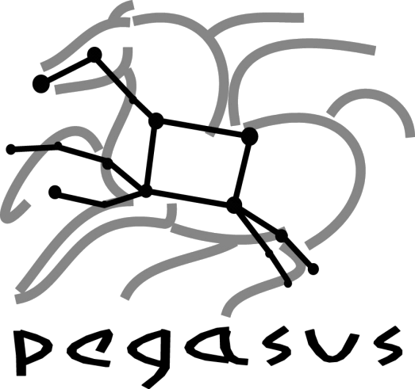

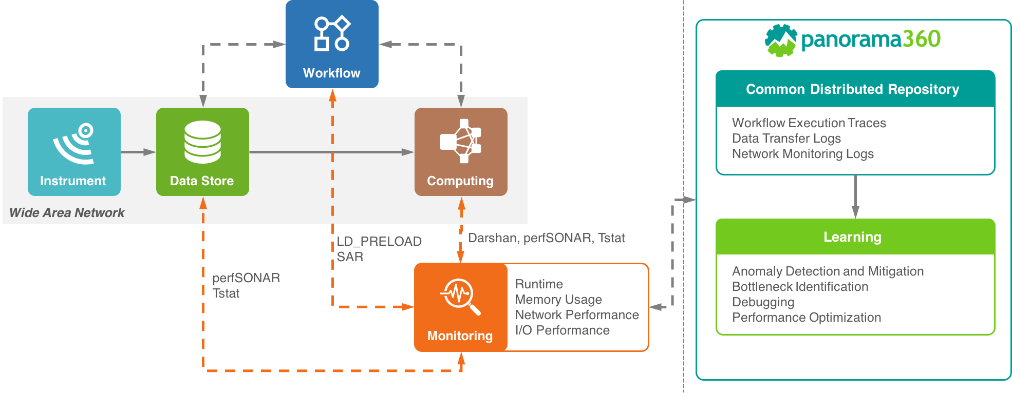

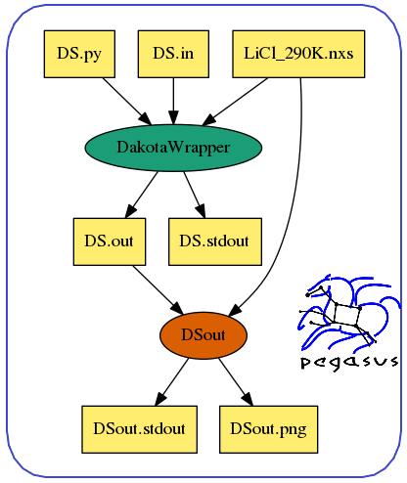







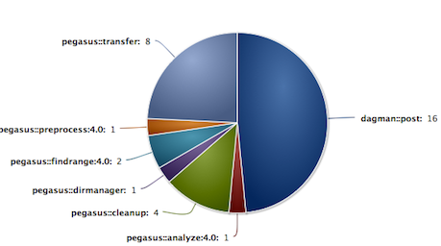
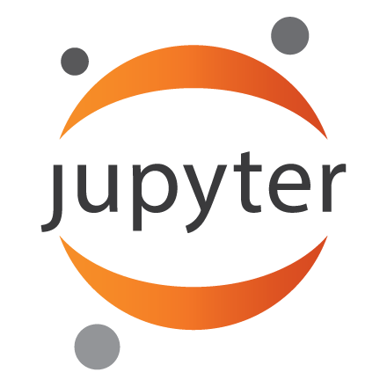



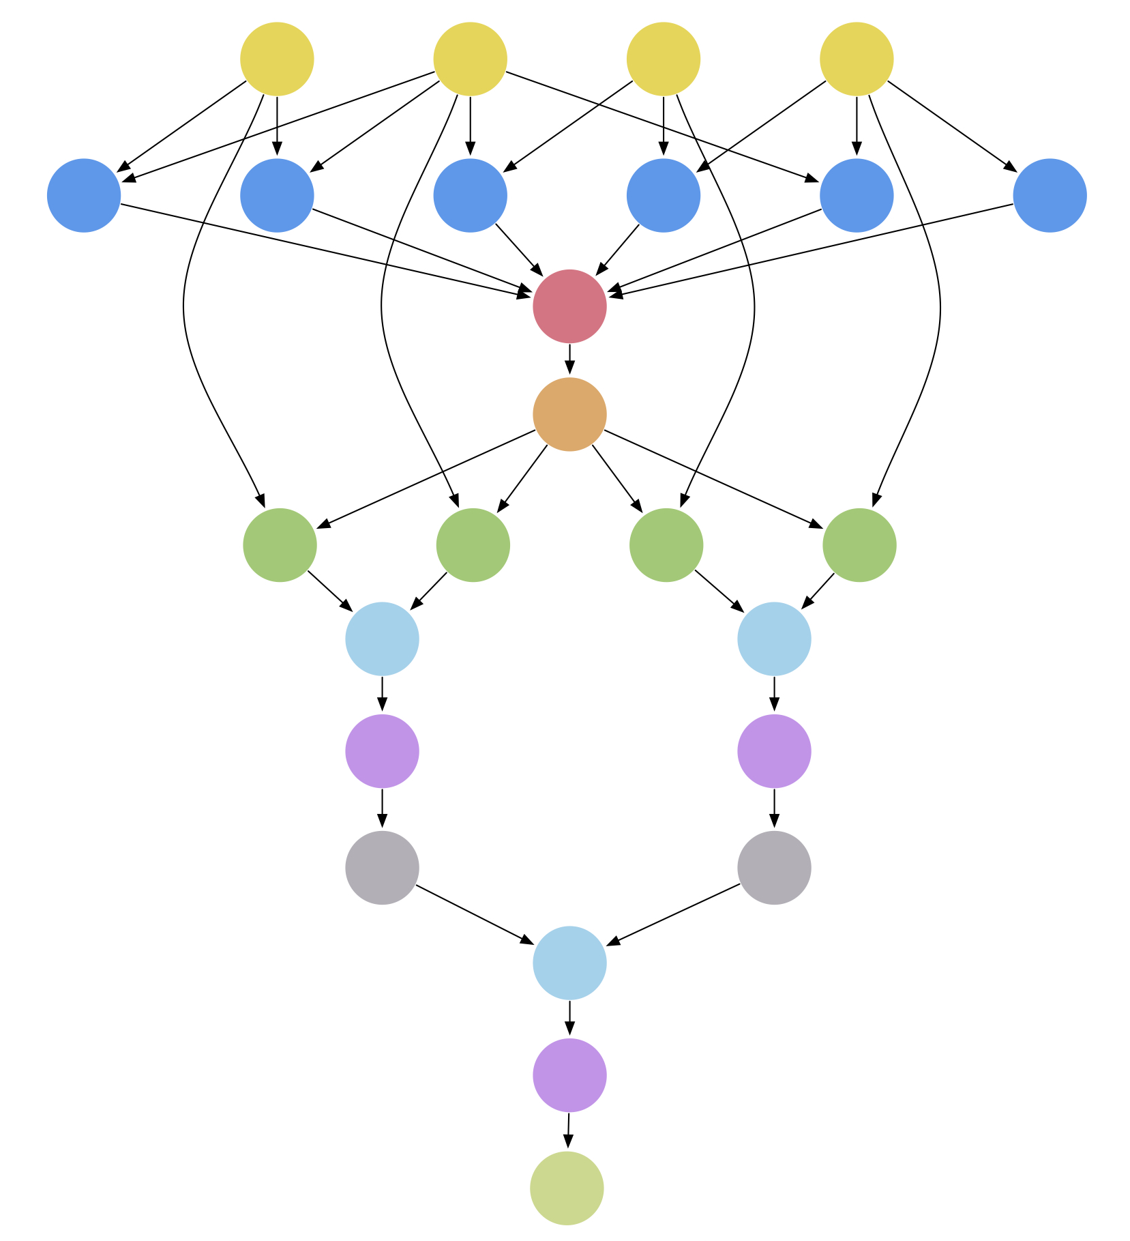

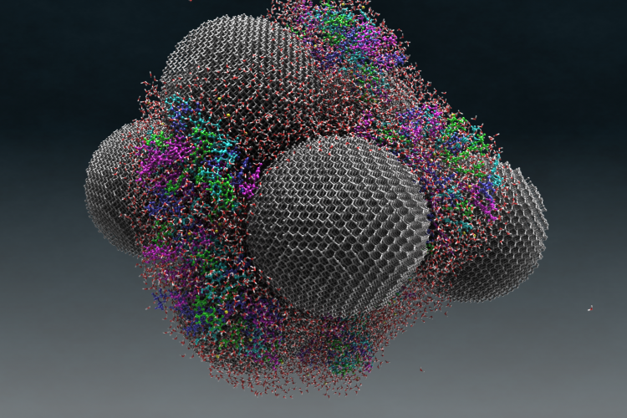
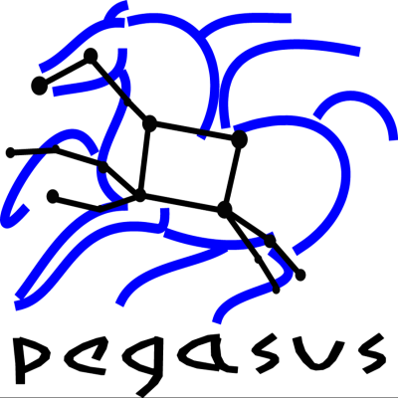

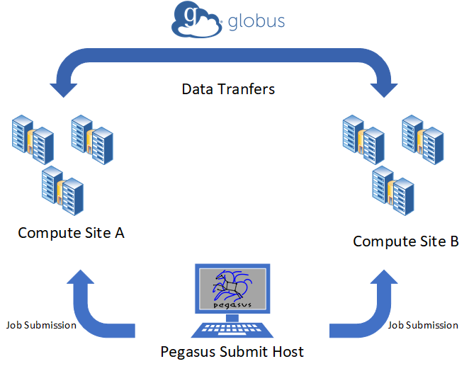
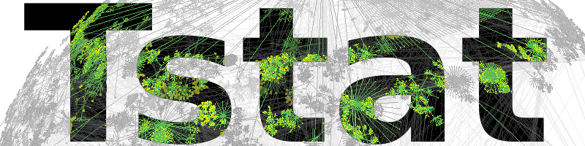


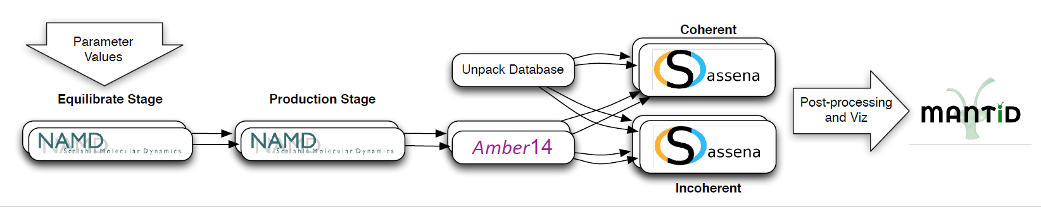


Pegasus WMS and Panorama 360
George Papadimitriou¹, Ewa Deelman¹, Rafael Ferreira da Silva¹, Rosa Filgueira², Vickie Lynch³, Anirban Mandal⁴, Cong Wang⁴, Jeffrey Vetter³ ¹University of Southern California – Information Sciences Institute ²British Geological Survey ³Oak Ridge National Laboratory ⁴Renaissance Computing Institute
PEGASUS WORKFLOW MANAGEMENT SYSTEM
PANORAMA 360
DAKOTA IN PEGASUS WORKFLOWS
Overview of the Pegasus WMS
Architecture and Project Goals
Exploring simulation parameter space with Dakota
Pegasus (https://pegasus.isi.edu) is a system for mapping and executing abstract application workflows over a range of execution environments
The same abstract workflow can, at different times, be mapped different execution environments such as XSEDE, OSG, commercial and academic clouds, campus grids, and clusters
Pegasus can easily scale both the size of the workflow, and the resources that the workflow is distributed over. Pegasus runs workflows ranging from just a few computational tasks up to 1 million
Stores static and runtime metadata associated with workflow, files and tasks. Accessible via command line tools and web based dashboard
Pegasus-MPI-Cluster enables fine-grained task graphs to be executed efficiently on HPC resources
Dakota (https://dakota.sandia.gov/) can be used for Parameter Studies, Design of Experiments, Uncertainty Quantification, Optimization, Calibration.
It also supports the implementation of Surrogate models and Nested models and has been designed to exploit parallel computing, when possible.
Simulations that rely on Dakota, can benefit from the integration with Pegasus. This integration could be implemented with several ways.
Pegasus managing and executing Dakota Jobs, that handle the simulations themselves
Dakota using Pegasus to execute the simulation workflows
In all cases Dakota studies can benefit from the staging capabilities of Pegasus (input files and executables), and from the ability to access supercomputing infrastructure.
System Architecture
Interfaces
Users
DATA CAPTURE
Characterization of instrument data capture, data summarization, and publication
REPOSITORY
An open access common repository for storing end-to-end workflow performance and resource data captured using a variety of tools
LEARNING
Development of ML techniques for workflow performance analysis and infrastructure troubleshooting
Other workflow composition tools:
APIs
Submit Host
Pegasus Dashboard
Pegasus WMS
Mapper
Notifications
Engine
Monitoring & Provenance
Logs
Scheduler
j₁
Workflow DB
j₂
…
WORKFLOW EXECUTION MONITORING
IMPACT ON DOE SCIENCE
Clouds
Campus Clusters
Local Clusters
Open Science Grid
XSEDE
j_{n}
Job Queue
Distributed Resources
Towards complete characterization of scientific workflows
Diamonds that deliver!
Cloudware
OpenStack, Eucalyptus, Nimbus
Middleware
COMPUTE
GridFTP
Storage
Compute
Amazon EC2, Google Cloud, RackSpace, Chameleon
HTCondor GRAM
HTTP
FTP
SRM
With the Panorama 360 we are targeting in capturing data from every aspect of a scientific workflow.
Either it is a compute job or a transfer job, we take advantage of a number of monitoring tools in order to capture the statistics we are interested in.
Pegasus contains a module called Kickstart, which wraps the execution of jobs and provides execution statistics, such as duration, I/O, memory usage, which are available after the job completion.
Panorama enabled cutting-edge domain science research and development that has the potential to solve some of the challenges associated with drug discovery and delivery:
The motions of a tRNA (or transfer RNA) model system can be enhanced when coupled with nanodiamonds, or diamond nanoparticles approximately 5 to 10 nanometers in size
Storage
Amazon S3, Google Cloud Storage, OpenStack
PBS
LSF
SGE
IRODS
SCP
TRANSFERS WITH GLOBUS
Inter-site Data Transfers with Globus Transfer
Globus (https://www.globus.org/) lets you efficiently, securely, and reliably transfer data directly between systems.
We have upgraded support for Globus Transfer in Pegasus, and pegasus-transfer can connect to Globus API in order to submit transfer tasks and facilitate the execution of scientific workflows.
All these, can happen remotely from the machine that as Pegasus submit host
Water is seen as small red and white molecules on large nanodiamonds spheres. The colored tRNA can be seen on the nanodiamond surface. Image :Michael Mattheson, ORNL (https://www.ornl.gov/news/diamonds-deliver).
We have developed an SNS Pegasus workflow to confirm that nanodiamonds enhance the dynamics of tRNA when in the presence of water. The workflow calculates the epsilon which best matches experimental data. These calculations used almost 400,000 CPU hours on a Cray XE6at NERSC.
The workflow runs NAMD parallel simulations, which varies the epsilon between -0.01 and -0.19 for each temperature specified (it requires 800 cores: equilibrium runs take ~1.5hs and production runs 12-16hs). AMBER’s cpptraj removes global translation and rotation, and SASSENA calculates neutron scattering intensities from the trajectories (400 cores, 3-6hs). This workflow was used to computer 4 temperatures between 260K and 300K, which generated ~3TB of data.
We have been running tests between NERSC and OSG, where workflows run part of their execution on one site and transfer intermediate data to the other site, to complete the run. This scenario can be useful in cases where the existence of a particular resource can significantly expedite the workflow execution.
Additionally there is an extension to Kickstart’s functionality in Pegasus Panorama Branch which enables us to collect more refined traces with frequency as low as 1 second.
Apart from Pegasus statistics we are compiling MPI-Jobs with Darshan, which provides us with POSIX and MPI I/O file access statistics. By default Darshan generates a summary, but by enabling the Darshan-Extended-Module we can collect traces from file accesses.
On the network front, in order to acquire statistics related to data transfers we are using TSTAT logs and Globus logs. Globus service logs can provide us with transfer summaries (start time, throughput, etc.) and events during data transfers (failures, transfer completion, etc.). On the other hand TSTAT can give us low level network statistics, such as packet loss, which can reveal network related issues that affected the performance of a transfer.
In Collaboration With

