Slide 1




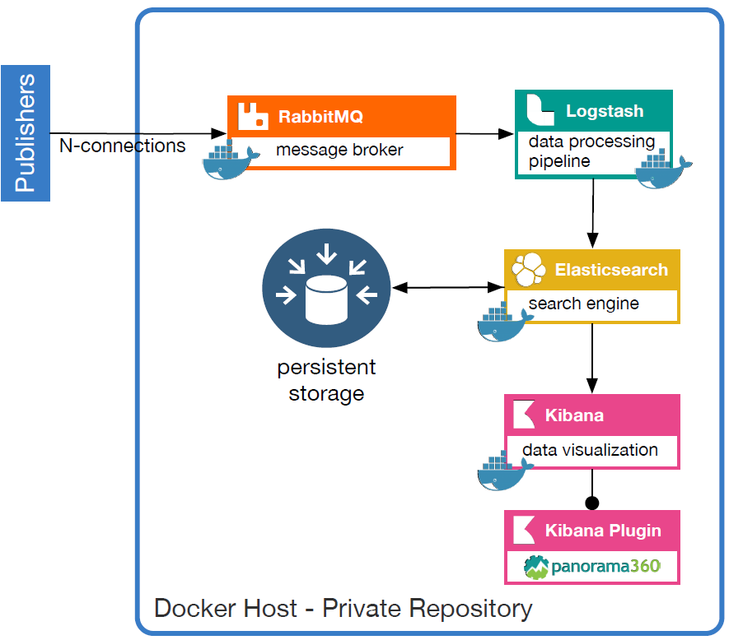
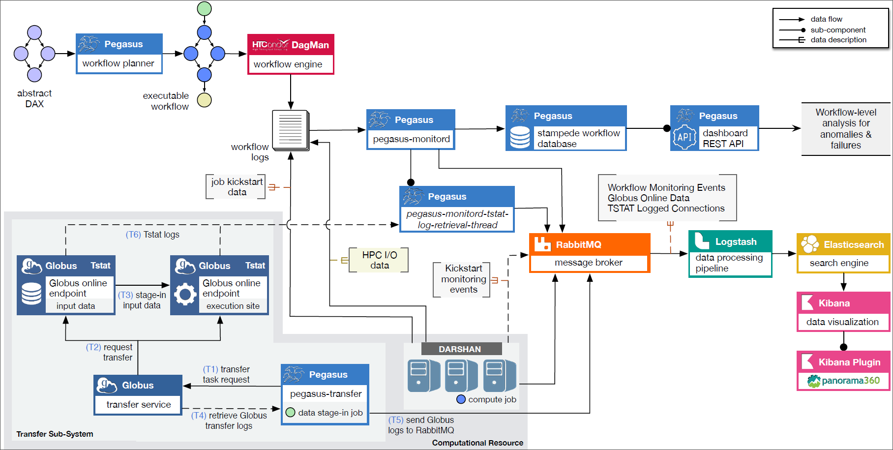
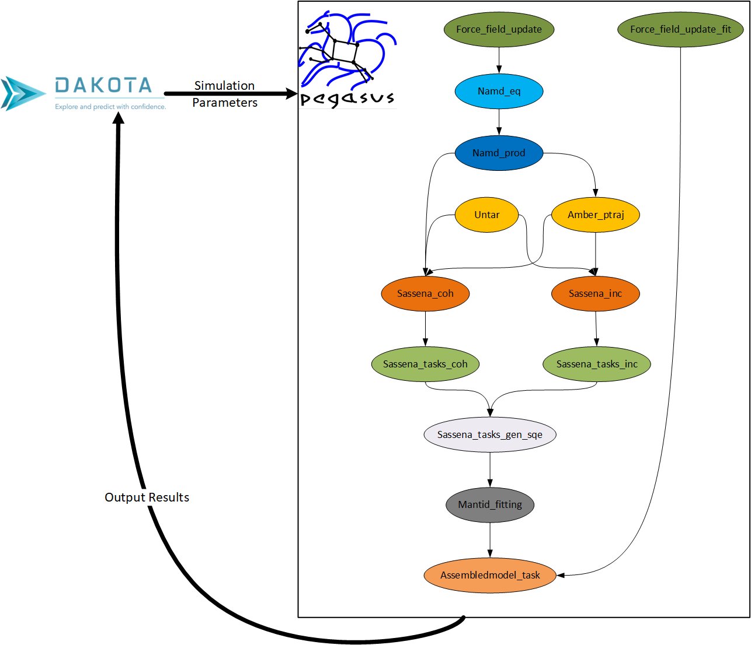


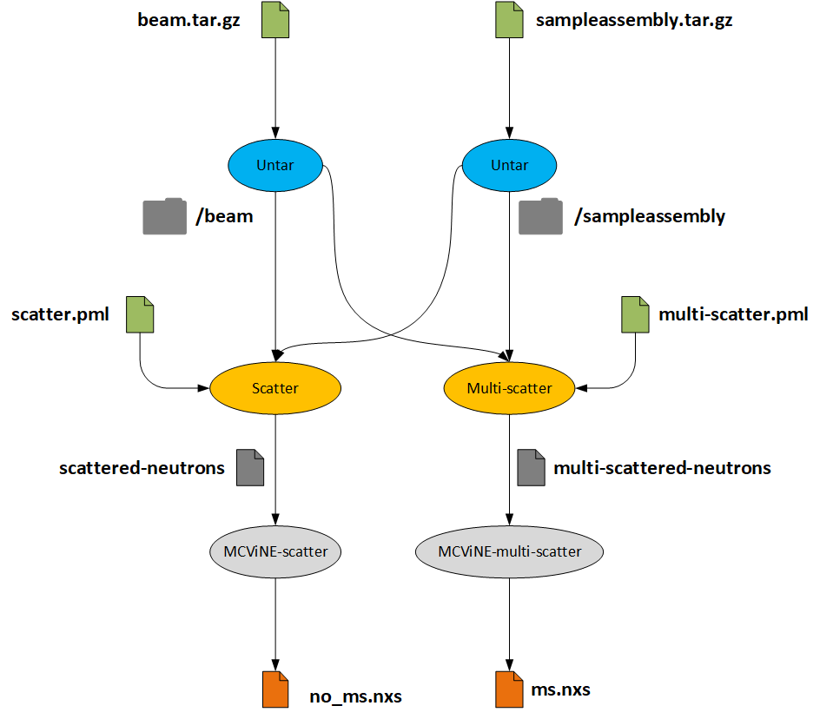
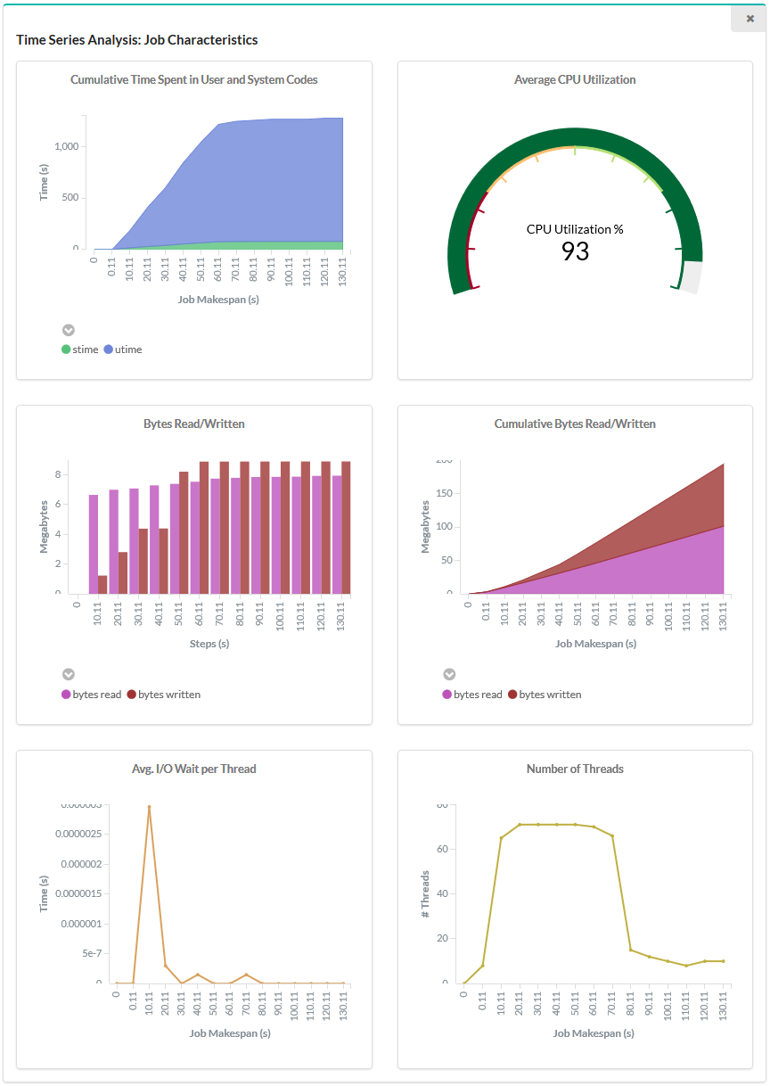
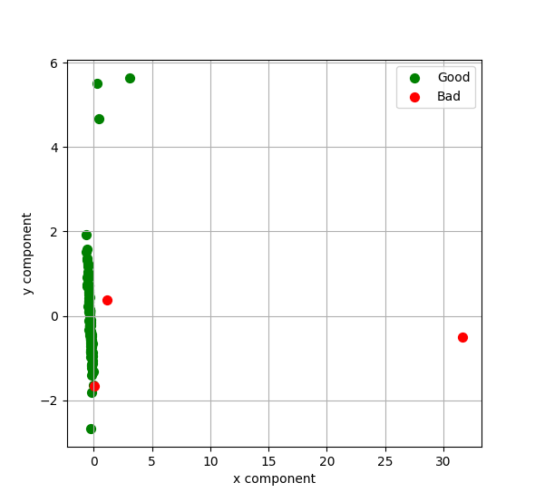
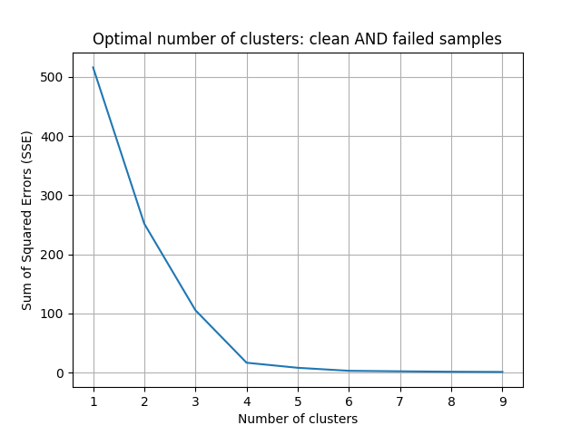
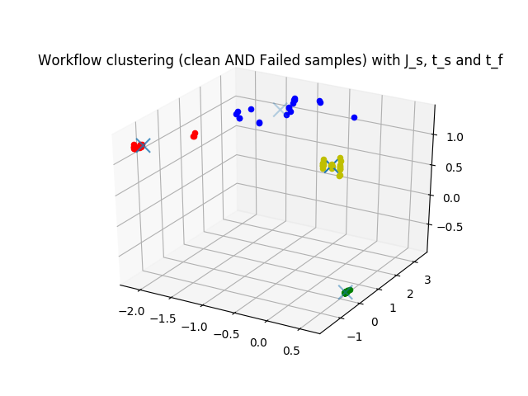
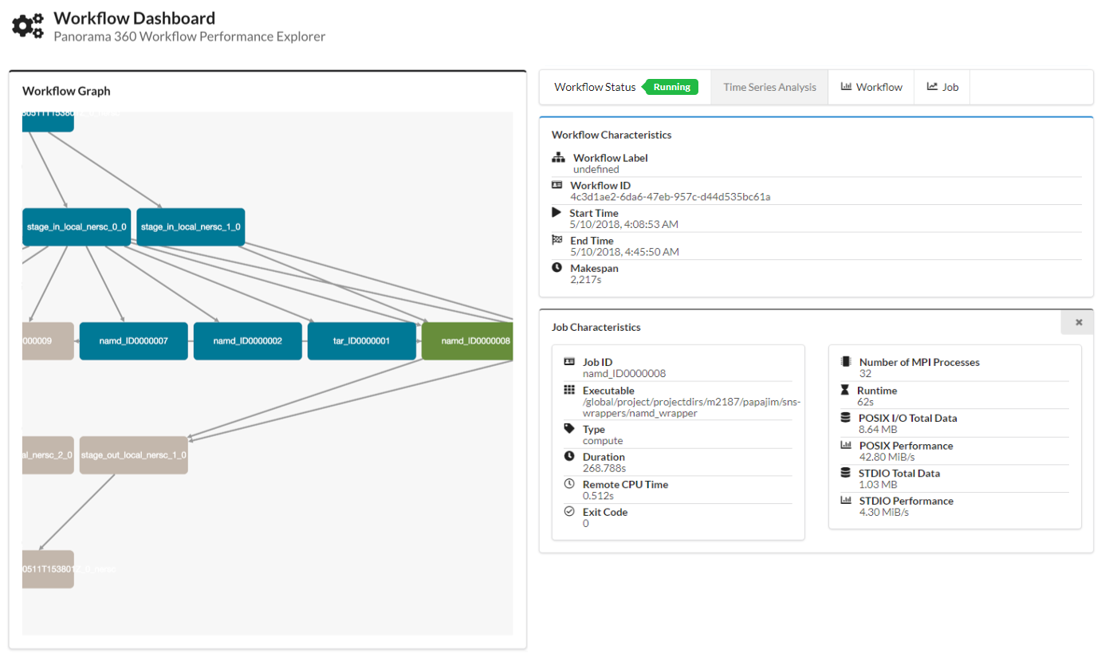




Panorama 360: End-to-End Online Performance Data Capture and Analysis of Scientific Workflows
George Papadimitriou¹, Rafael Ferreira da Silva¹, Karan Vahi¹, Rajiv Mayani¹, Mats Rynge¹, Ewa Deelman¹, Anirban Mandal², Cong Wang², Mariam Kiran³, Vickie Lynch⁴, Jeffrey Vetter⁴ ¹University of Southern California – Information Sciences Institute ²Renaissance Computing Institute ³Lawrence Berkeley National Laboratory ⁴Oak Ridge National Laboratory
PANORAMA 360
PERFORMANCE DATA CAPTURE
LOCAL DEPLOYMENT
Overview of the Project Description
Overview of the Data Capture Architecture
Deploying the Data Collection Back-End Using Containers
The Panorama 360 aims to further the understanding of the behavior of scientific workflows as they are executing in heterogeneous environments. Panorama 360 collects and correlates workflow performance data into a comprehensive view, that can characterize the end-to-end workflow performance on today’s systems and drive the design of the future generation systems.
The Panorama 360 architecture collects data from these individual data sources: the Pegasus WMS, the Globus Online service, the TCP STatistics and Analysis Tool (Tstat) and the DARSHAN HPC I/O Characterization Tool.
Our approach for correlating the real time application and infrastructure monitoring data can be used to verify application behavior, perform anomaly detection and diagnosis, and support adaptivity during workflow execution, in an online manner. This can lead to improved performance and stability of scientific workflows and benefit the DOE-relevant applications.
Ultimately, by having all these data and analysis tools in our disposal, we envision the creation of a workflow performance data repository and a collection of tools that will be publicly available and can drive science forward.
Panorama 360’s data capture architecture can be divided into 5 entities:
The workflow management system (Pegasus)
The data sources (Pegasus, Globus, Tstat, Darshan)
The search (ElasticSearch) and visualization (Kibana) engines
Configuring the monitoring back-end, even though it relies on well established tools, can turn out to be a cumbersome and challenging process.
We have automated the deployment of the data collection backend using Docker and Docker-Compose.
We provide pre-configured container recipes that can collect and store persistently all the data the Panorama 360 architecture produces.
The message broker (RabbitMQ)
The data processing pipeline (Logstash)
https://github.com/Panorama360/data-collection-arch
OPEN ACCESS DATA
Overview of the Open Access Data Endpoints
IMPACT ON DOE SCIENCE
We have created an open access repository containing data from over 40 workflow executions of a data-intensive (1000Genome¹) and a compute-intensive (SNS²) workflow.
Globus facilitated the transfers, while ExoGENI³ and Cori at NERSC⁴ were used to execute the computational tasks.
Nanodiamond and MCViNE Workflows
We have extended the SNS-Nanodiamond workflow with (a) parameter sweep, and (b) feedback loop capability, using Dakota (https://dakota.sandia.gov).
Dakota based on an internal model generates the Simulation Parameters and triggers a Pegasus analysis driver that initiates a new workflow.
Dakota can instantiate multiple simulation workflows in parallel and by using the Pegasus Ensemble Manager we can have more control over their execution.
ElasticSearch Index | # Records | Description
panorama_transfer | 1,150 | Logs retrieved from the Globus transfer service
panorama_kickstart | 78,600 | Resource utilization traces collected by Pegasus-Kickstart
panorama_stampede | 34,400 | Workflow execution events and Darshan logs
Pegasus, apart from executing the workflow, is the entity that orchestrates the data movement between the data sources and the analysis framework.
Pegasus-monitord reports events about the status of the workflow, and extracts Darshan reports from the job’s stdout.
Pegasus-kickstart wraps the execution of jobs and provides aggregated execution statistics (duration, I/O, memory usage), after job completion. Additionally it has an online monitoring feature that allows us to collect refined traces with an interval, as low as 1 second.
Darshan provides POSIX and MPI I/O file access statistics. It tracks the application’s file access patterns and the performance of the underlying file system.
Globus reports back overall transfer statistics and information about each individual transfer (throughput, files transferred, errors etc.)
Tstat captures low level TCP statistics and apart from revealing network issues, it can help us understand the reason behind an underperforming network connection.
Can be accessed programmatically at:
Can be accessed via a web browser at:
https://data.panorama.isi.edu
https://kibana.panorama.isi.edu
[1] 1000Genome: https://github.com/pegasus-isi/1000genome-workflow
[2] SNS: https://github.com/pegasus-isi/SNS-Workflow
[3] ExoGENI: http://www.exogeni.net/
[4] NERSC: https://www.nersc.gov/
MACHINE LEARNING EXPLORATIONS
MCViNE (http://www.mcvine.org) is a Monte Carlo neutron ray-tracing program for computer modeling and simulations that mirror real neutron scattering experiments.
MCViNE is used to study data from many SNS instruments, and some of them are ARCS and SEQUOIA.
We collaborate closely with SNS scientists and explore ways to support MCViNE workflows with Pegasus.
Workflow Level Analysis and Infrastructure’s Network Performance Analysis
Detecting anomalous TCP file transfers using Isolation Forest. We were able to find transfers experiencing packet reordering (Exp.7-8) with very good accuracy.
But, we got poor performance on packet loss (Exp.2-4) and packet duplication (Exp.5-6).
Workflow-level analysis using Unsupervised Clustering with unlabeled data. Using feature vectors such as:
DATA VISUALIZATION
J_s = #job_instances_succeeded/#job_instances_done
J_f = #job_instances_failed/#job_instances_done
t_s = Sum(local_duration(successful_job_instances))/#job_instances_succeeded
t_f = Sum(local_duration(failed_job_instances))/#job_instances_failed
o_i_s = #job_instances_succeeded/#total_workflow_jobs
Network Anomaly Part 1
Panorama 360 Kibana Plugin
In order to visualize the collected data in a meaningful and compact way, we have created a Kibana Visualization Plugin that correlates the information provided by pegasus-monitord with the monitoring data and compiles a custom dashboard with per workflow and per job level information, that is updated automatically during the workflow execution.
Cumulative Time Spent In User and System Code
Job Time Series Analysis
Average CPU Utilization
Isolation Forest Controlled
Isolation Forest Error Rate
Elbow at 4 clusters
Workflow runs with
Failure injection
Workflow Characteristics
Average Bytes Read/Written
Cumulative Bytes Read/Written
Clean workflow runs
LEARN MORE
COLLABORATIONS
Website
Job Characteristics
We collaborate with the DOE RAMSES project in collecting xfer statistics from Globus transfers and discussing ideas about network research on workflows.
We are working with the DOE BigPanda project to allow Pegasus workflows to be executed using BigPanda’s pilot job submission mechanisms. http://news.pandawms.org/bigpanda.html
https://panorama360.github.io
Average I/O Wait
per Thread
Number of Threads
RAMSES
GitHub Repository
https://github.com/Panorama360
Kickstart Statistics
Darshan Statistics
We are working closely with the Advanced Data and Workflows group at OLCF, to provide an easy way of accessing Summit and RHEA with Pegasus using Kubernetes and containers.
In collaboration with the DOE X-SWAP project we are working on a benchmark workflow for current and next generation systems, based on the ZTF astrophysics pipeline. https://www.ztf.caltech.edu/
Pegasus Office Hours
https://pegasus.isi.edu/blog/online-pegasus-office-hours
Panorama 360 is funded by the US Department of Energy under Grant #DE-SC0012636M

