Slide 1
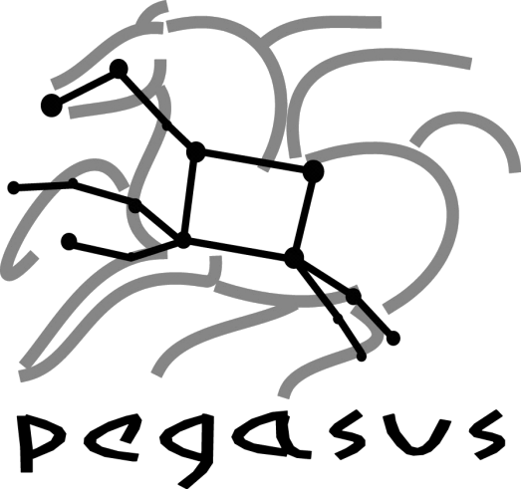












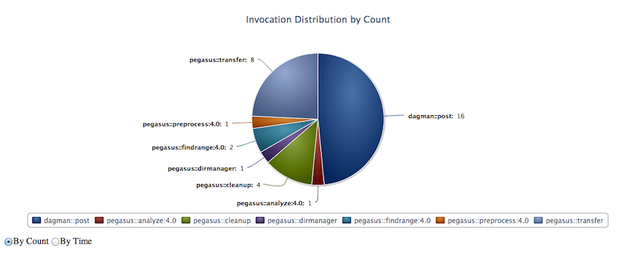
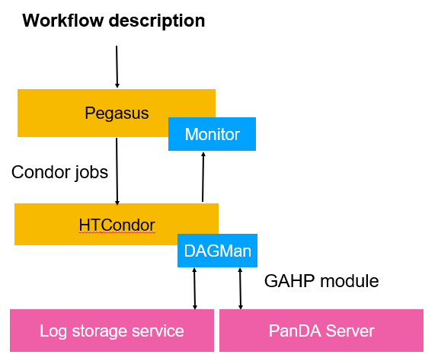
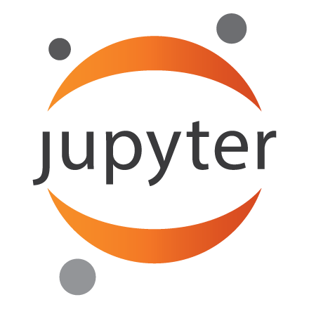

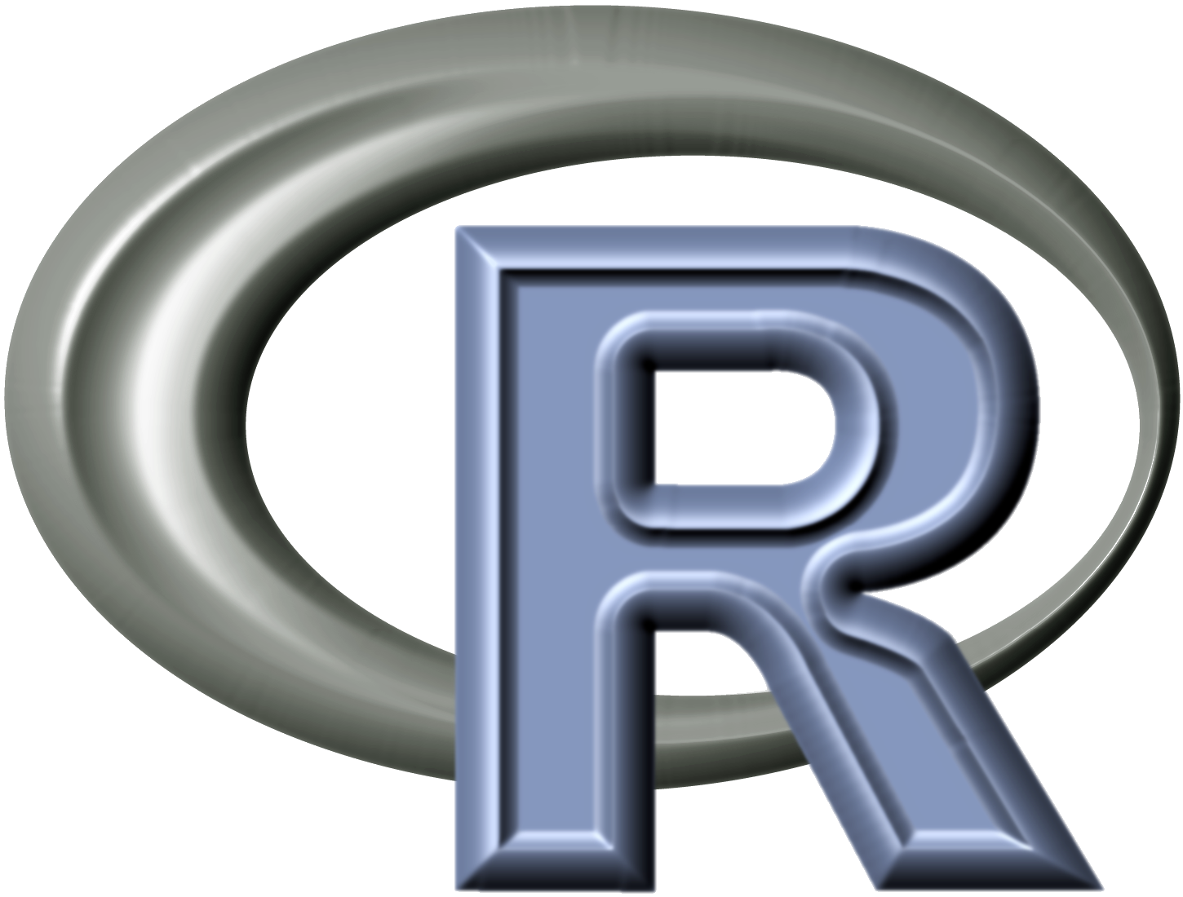


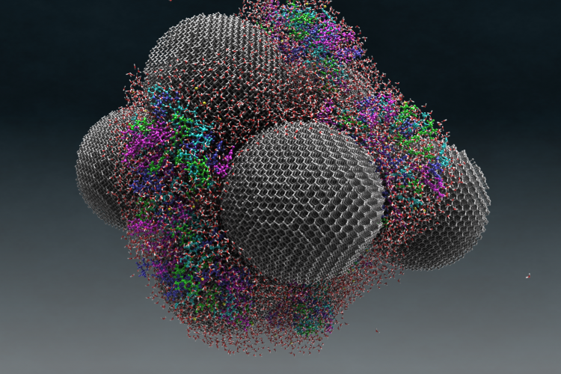
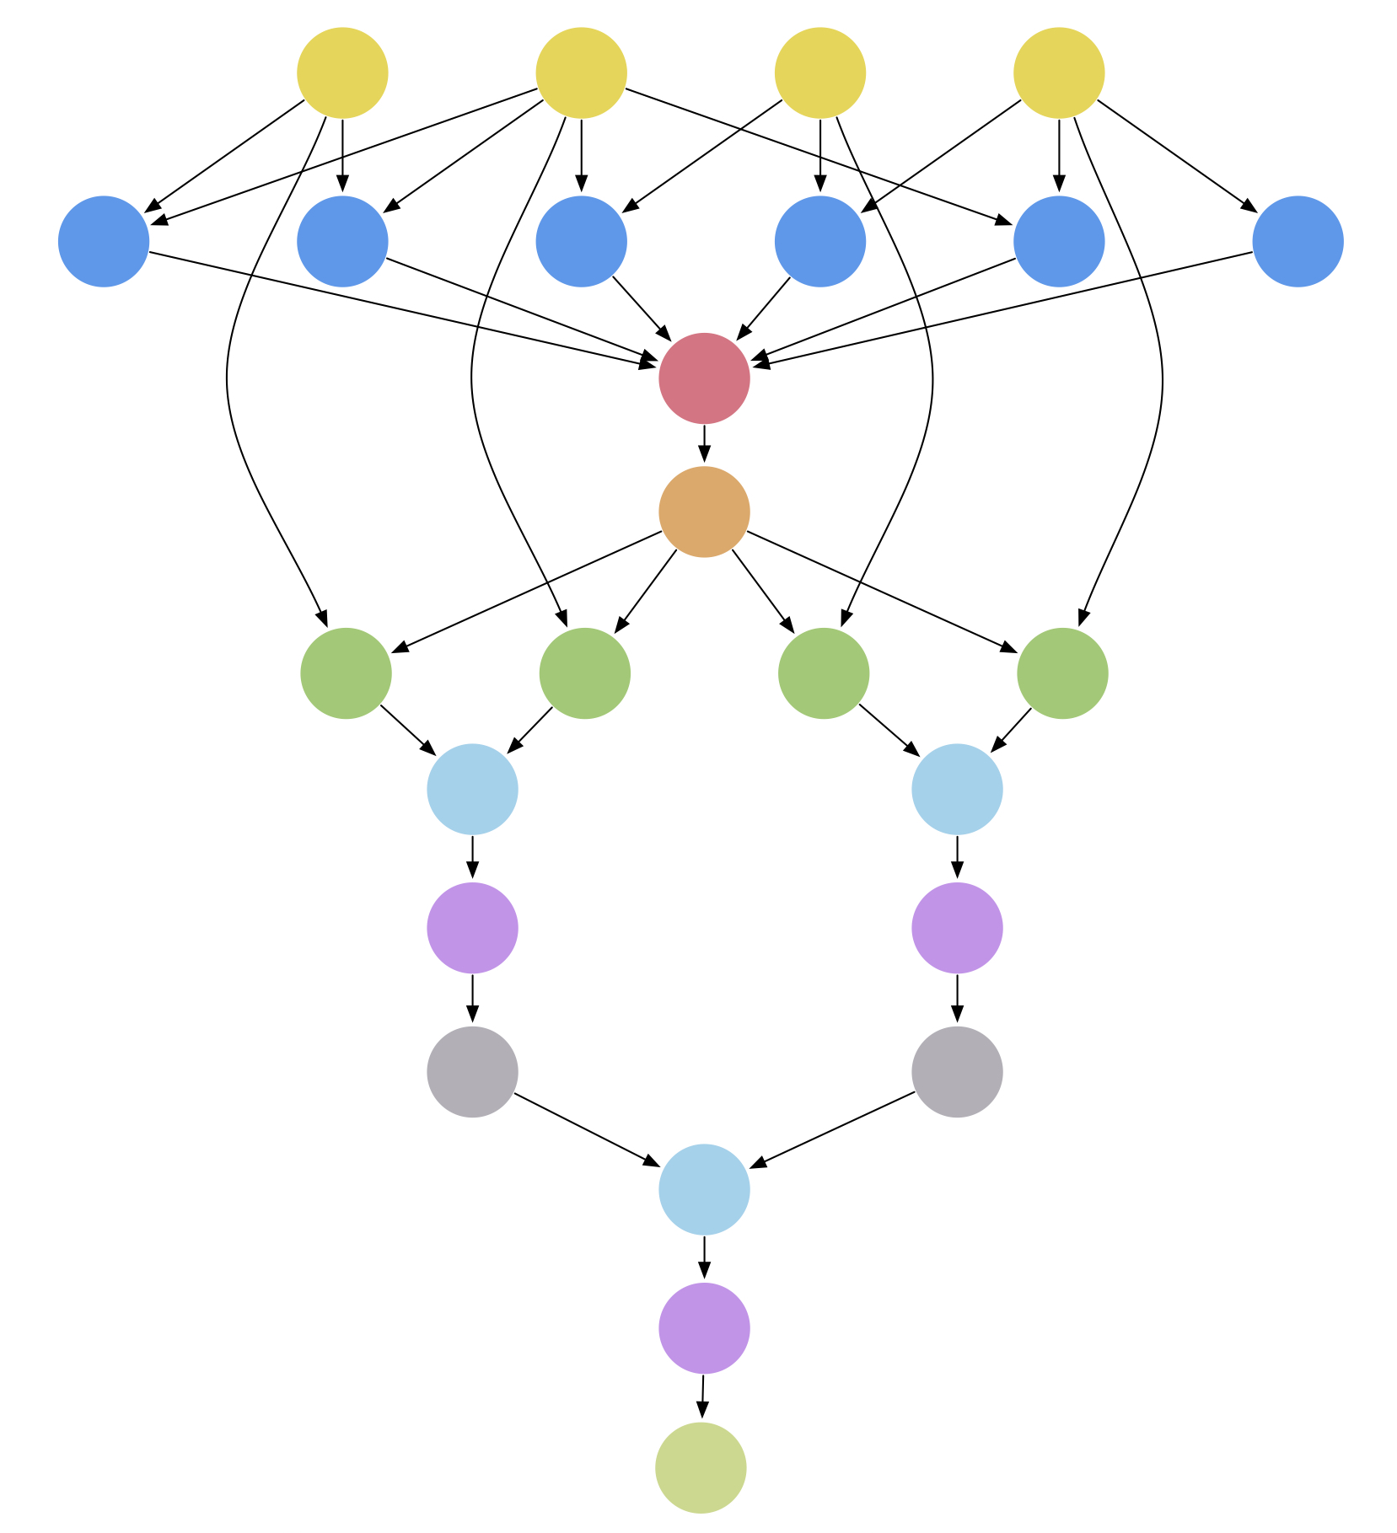
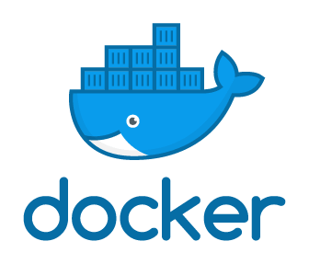


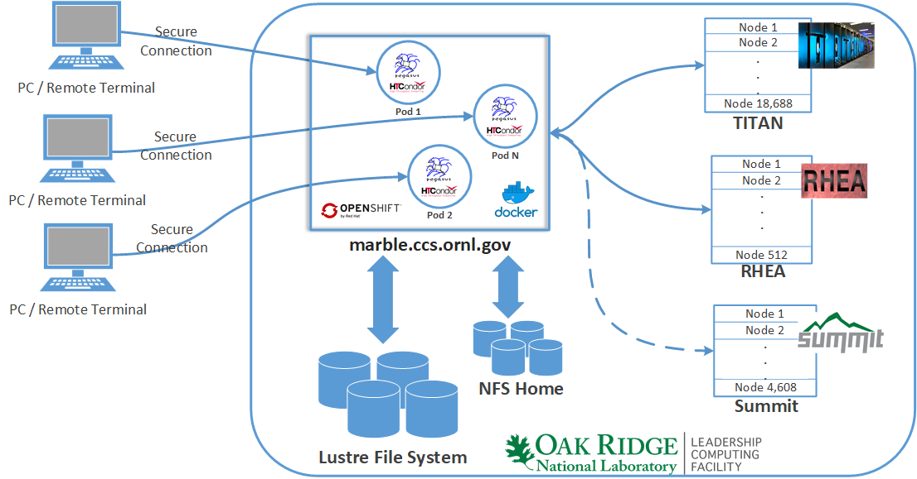
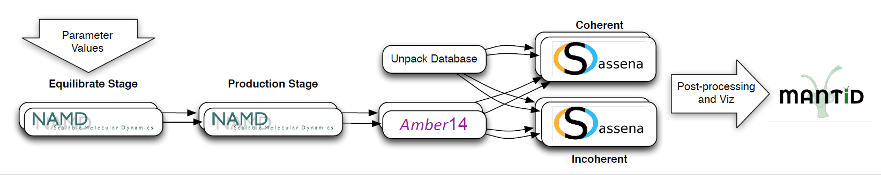

Accessing OLCF Resources Using Pegasus WMS
George Papadimitriou¹, Pavlo Svirin², Karan Vahi¹, Mats Rynge¹, Rafael Ferreira da Silva¹, Jason Kincl⁴, Vickie Lynch⁴, Ewa Deelman¹, Anirban Mandal³, Jeffrey Vetter⁴, Valentine Anantharaj⁴, Jack Wells⁴, Alexei Klimentov⁵, Kaushik De⁶
¹University of Southern California – Information Sciences Institute ²CERN ³Renaissance Computing Institute ⁴Oak Ridge National Laboratory ⁵Brookhaven National Laboratory
⁶University of Texas at Arlington
Pegasus Workflows on OLCF
Pegasus Workflow Management System
Panda Workload Management System
Problem definition - Motivation
Overview of the Pegasus WMS
Overview of the Panda WMS
Accessing OLCF resources with Pegasus WMS has been difficult for DOE scientists in the past, because of either the need to install and configure Pegasus’ software stack (Pegasus and High Throughput Condor) for different types of head nodes or handle issues arising from 2-factor authentication when they wanted to orchestrate remote submissions. Previous solutions included approaches like the rvGAHP, but when a new machine arrives (eg. Summit), all the steps of setting up the workflow submit environment have to be done once again.
Creating a workflow submission environment shouldn’t discourage users from using a workflow management system. It should be an easy and well defined process that motivates them to take advantage of all the benefits a workflow management system has to offer, such as portability, automated data management, better application tracking, or making complex workflows easier to capture.
With this work we present two new approaches to support local submissions and remote submissions of Pegasus workflows, on OLCF’s computing resources.
Pegasus (https://pegasus.isi.edu) is a system for mapping and executing abstract application workflows over a range of execution environments
The same abstract workflow can, at different times, be mapped to different execution environments such as OLCF(Titan, Rhea, Summit), XSEDE, OSG, commercial and academic clouds, campus grids, and clusters
Pegasus can easily scale both the size of the workflow, and the resources that the workflow is distributed over, ranging from just a few computational tasks up to 1 million
Stores static and runtime metadata associated with workflow, files and tasks.
Pegasus-MPI-Cluster enables fine-grained task graphs to be executed efficiently on HPC resources
The PanDA workload management system was developed for the ATLAS experiment at the Large Hardon Collider as a new approach to distributed computing.
Some of its core ideas are:
make hundreds of distributed sites appear as local,
by providing a central queue to the users
reduce site related errors and reduce latency
hide middleware while supporting diversity and evolution
hide infrastructure variations
System Architecture
Remote Submissions of Pegasus Workflows at OLCF
Users
Submit workflows using Panda
Interfaces
Other workflow composition tools:
PanDA, by leveraging local automation features and exposing a modern REST API, can enable Pegasus’ remote submissions.
In order to support execution of Pegasus workflows via PanDA we had to extend Condor’s GAHP module.
The extended module allows HTCondor to interface with the Panda Server, submit and track jobs to the exposed resources.
Pegasus Impact on DOE Science
APIs
Pegasus Dashboard
Diamonds that deliver!
Pegasus WMS
Submit Host
IMPACT ON DOE SCIENCE
Mapper
Notifications
Panorama and Pegasus enabled cutting-edge domain science research and development that has the potential to solve some of the challenges associated with drug discovery and delivery:
The motions of a tRNA (or transfer RNA) model system can be enhanced when coupled with nanodiamonds, or diamond nanoparticles approximately 5 to 10 nanometers in size
Engine
Monitoring & Provenance
Scheduler
Logs
j₁
Workflow DB
j₂
…
Job Queue
Clouds
j_{n}
Distributed Resources
Harvester is a new-generation edge service for PanDA which resides on a front node of an HPC resource and interacts between the PanDA Server, where the payloads are stored, and the compute nodes.
Cloudware
OpenStack, Eucalyptus, Nimbus
Campus Clusters
Local Clusters
Open Science Grid
XSEDE
Middleware
COMPUTE
GridFTP
Storage
HTTP
Water is seen as small red and white molecules on large nanodiamonds spheres. The colored tRNA can be seen on the nanodiamond surface. Image: Michael Mattheson, ORNL (https://www.ornl.gov/news/diamonds-deliver).
Compute
Amazon EC2, Google Cloud, RackSpace, Chameleon
HTCondor GRAM
GLOBUS
FTP
Storage
Amazon S3, Google Cloud Storage, OpenStack
PBS
LSF
SGE
HPSS
SCP
PanDA Server
Log storage service
Storage elements
We have developed an SNS Pegasus workflow to confirm that nanodiamonds enhance the dynamics of tRNA when in the presence of water. The workflow calculates the epsilon which best matches experimental data. These calculations used almost 400,000 CPU hours on a Cray XE6at NERSC.
The workflow runs NAMD parallel simulations, which varies the epsilon between -0.01 and -0.19 for each temperature specified (it requires 800 cores: equilibrium runs take ~1.5hs and production runs 12-16hs). AMBER’s cpptraj removes global translation and rotation, and SASSENA calculates neutron scattering intensities from the trajectories (400 cores, 3-6hs). This workflow was used to computer 4 temperatures between 260K and 300K, which generated ~3TB of data.
IRODS
SRM
Local Submissions of Pegasus Workflows at OLCF
Summit
1
7
Preparatory node
4
Workflow submit host as a service
Front node
3
Harvester
pegasus-lite 1
Submitter
2
Monitor
Messenger
Worker
nodes
LSF batches
6
Useful payloads
Shared FS
5
P2 Workdir
P1 Workdir
P4 Workdir
…
P3 Workdir
P5 Workdir
PN Workdir
disk interaction
network interaction
When job description(s) are fetched (1) the Submitter module of Harvester creates batches (2) which are then submitted to the LSF batch system of Summit (3). The monitor module keeps watching (2) the life cycle of a batch until it finishes.
Every Pegasus/PanDA payload for Summit has a pegasus-lite wrapper which has the following steps:
Data stage-in: executed on preparatory nodes (4)
Execution of a useful payload: wrapped with jsrun and executed on worker nodes
Data stage-out: executed on preparatory nodes
Output data and logs for a payload are written to a working directory (5) on the shared filesystem. When batch completes Harverster’s Messenger module identifies (6) whether the payload was successful or no and uploads the logs to Log Storage Service where they can be fetched by HTCondor’s modules and then analyzed by Pegasus.
LEARN MORE
Pegasus:
https://pegasus.isi.edu/
In order to support local submissions and make the creation of the environment simpler we are leveraging the container orchestration support on OLCF, based on Openshift, using Docker containers.
The CCS Marble cluster provides access to the Lustre FS, the NFS Home, Titan, Rhea and Summit via cross submission.
We have prepared recipes that are ready to submit on Titan and Rhea, and in the future Summit as well (https://github.com/pegasus-isi/pegasus-olcf-kubernetes).
Users can authenticate themselves on the marble cluster, build and spawn new pods, preconfigured as workflow submit nodes. After connecting to a Pegasus submit pod, the experience of submitting jobs is similar to that of a dedicated login node of each system.
Pegasus GitHub:
https://github.com/pegasus-isi/pegasus
Panorama360:
https://panorama360.github.io
BigPanda:
http://news.pandawms.org
Pegasus is funded by the National Science Foundation under the OAC SI2-SSI program, Grant #1664162
Panorama 360 is funded by the US Department of Energy under Grant #DE-SC0012636M

