Slide 1
Peer-to-Peer Data Sharing for Scientific Workflows on Amazon EC2
Rohit Agarwal
Indian Institute of Technology, Ropar
ragarwal@iitpr.ac.in
Gideon Juve, Ewa Deelman
USC Information Sciences Institute
{gideon,deelman}@isi.edu

Slide 2
Workflows in the Cloud
Advantages
Provisioning (compute and storage)
Elasticity
Reproducibility
Appliances (e.g. Galaxy)
Control over environment (esp. for legacy)
Disadvantages
Administration
Virtualization overhead
Resource limitations (not really infinite, no queuing)
Cost relative to alternatives (campus clusters, grid)
Cost/Performance tradeoffs

Slide 3
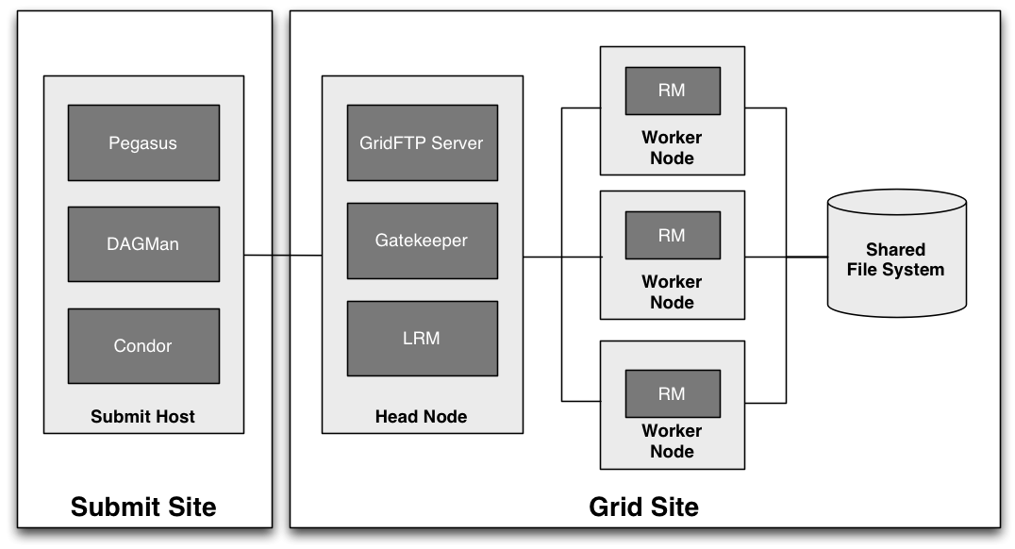
Deploying Workflows in the Cloud
Could develop Workflow as a Service (PaaS or SaaS)
Can deploy existing software on IaaS clouds
“Virtual Clusters”
New tools: Nimbus Broker, cloudinit.d, Wrangler, Precip

Slide 4
Motivations for this Work
Data-intensive workflows are limited by I/O performance
I/O is becoming the bottleneck rather than throughput
Many workflows share data using files
Task A writes a file, task B reads it
File management is critical
Write-once
Typically, files are only written once, never updated
Can replicate files without worrying about consistency
Three ways to share files
Use a shared storage system (POSIX or non-POSIX)
Transfer files from submit host to workers and back
Transfer files directly from one worker to the next

Slide 5
Previous Study on Data Sharing Options
Goal
Better understand how storage systems affect performance
Compare storage costs on commercial clouds
Deployed several different storage systems
Local, NFS, S3, PVFS2, GlusterFS (distribute and NUFA)
Used three different workflow applications with different resource requirements
Montage (astronomy, data-intensive)
Broadband (seismology, memory-intensive)
Epigenome (bioinformatics, CPU-intensive)
Compared performance and cost of different file system options
G. Juve, et al., “Data Sharing Options for Scientific Workflows on Amazon EC2”, Supercomputing, 2010.

Slide 6
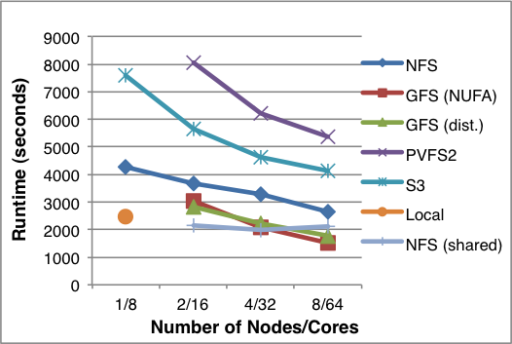
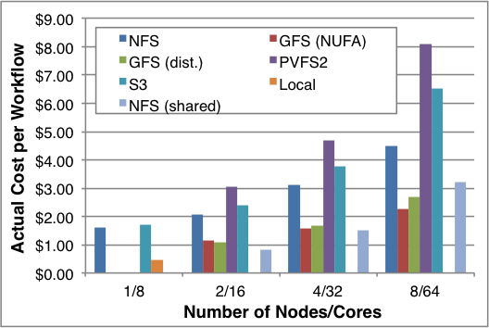
Results for Montage
Makespan
Cost
PVFS didn’t handle small files well
S3 had too much overhead
NFS did comparatively well
GlusterFS came out on top
NFS and S3 have extra costs
Performance improvement does not offset increased cost

Slide 7
Approach
Develop storage service to facilitate peer-to-peer transfers
Applies to environments other than clouds
New files are written to the local disk
No network I/O for writes
Files are replicated on-demand
Each time a task runs on a worker, all of its input files are replicated to that worker
Files cached on each worker node
Enabled by write-once, no consistency issues
Workflow tasks are wrapped by I/O operations
Fetch input files
Run task
Register output files

Slide 8
System Design
Replica Index Server
Stores mappings of logical file names to URLs
Cache Daemon
Manages local storage on each worker
Serves local replicas to peers
Retrieves remote replicas from peers
Command-line Client
Get files from remote storage
Put files into local storage

Slide 9
Replica Index Server Throughput Benchmark
Set up RIS on m1.xlarge, issued 1000 add operations each from 1-16 clients on m1.medium instances
RIS achieved a peak throughput of ~650 ops/sec

Slide 10
Benchmarked vs. Observed RIS Throughput
Average requests per second observed for a 10-degree Montage workflow
Nodes / Cores | Entries in RIS | Workflow runtime (sec) | Average put requests/second
2 / 8 | 63558 | 6699 | 9.5
4 / 16 | 76688 | 4705 | 16.3
8 / 32 | N/A | 3690 | N/A
16 / 64 | 87073 | 3704 | 23.5
Ran 10 degree workflow using 8-64 cores (m1.xlarge)
Observed RIS throughput (10-25 ops/sec) is much less than benchmarked throughput (650 ops/sec)
RIS should not be the bottleneck for workflows and resource pools of this size

Slide 11
Cache Daemon Benchmarks
Put Latency (sec)
Get Latency (sec)
Get Bandwidth (MB/sec)
Disk performance: ~38 MB/s write, ~109 MB/s read
Network performance: ~89 MB/s
Bottom line: Latency limits performance for smaller files

Slide 12

Workflow Performance Comparison
Reprojection
Background Rectification
Co-addition
Reformatting
Application: Montage
Creates science-grade astronomical image mosaics
Test workflow
10 degree square area
19,320 tasks
13 GB input, 88 GB output
Image: John Good, Caltech

Slide 13
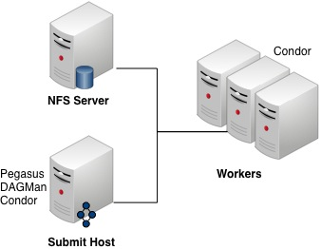
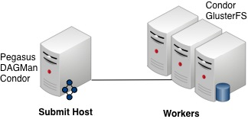
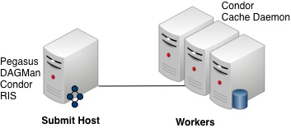
Storage Systems
NFS
Centralized file system
Used a dedicated m1.xlarge instance
GlusterFS
Distributed file system
Used “distribute” mode
Each worker participates in the file system
P2P
Our approach
RIS co-located with submit host

Slide 14
Experiment Setup

Slide 15
Performance Comparison
NFS performance is flat, as expected
Performance flattens out due to workflow structure
GlusterFS performs 13-16% better than P2P

Slide 16
Discussion
Bottlenecks
Main problem with NFS
GlusterFS has no central server
P2P RIS is not a bottleneck based on benchmarks
Latency
P2P query overhead harms small file performance
Not an issue for GlusterFS (just a hash to find the host)
Load Balancing
P2P does not try to control data placement
GlusterFS distributes data more evenly
Small reads
P2P always fetches the entire file
GlusterFS can fetch only the blocks required
Can overlap communication and computation

Slide 17
Conclusion
Our experiment did not work out as we hoped, but produced some valuable results
RIS server was not a bottleneck
Overheads were significant for small files
We now have a better understanding of the problem
Partial reads may be important for some workflows
Locality and load balancing are important
Need to consider planning and scheduling data movement

Slide 18
Future Work
Experiment with more workflows
Compare with alternative data storage solutions
e.g. SRM, IRODS
Study the I/O patterns of different workflows
e.g. partial reads
Optimize the system, especially latencies
Investigate techniques for planning data placement
Make use of data-aware scheduling heuristics

