Slide 1

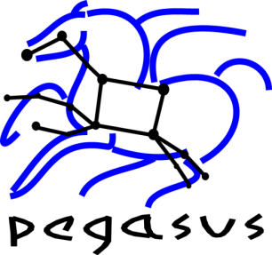
High Throughput Computing for Astronomers
Mats Rynge
Information Sciences Institute, University of Southern California
rynge@isi.edu

Slide 2
Outline
High Throughput Computing
Condor
DAGMan
Pegasus Workflow Management System
Periodogram Workflow / Open Science Grid
Galactic Plane Workflow / XSEDE
Cloud

Slide 3
Why High Throughput Computing?
For many experimental scientists, scientific progress and quality of research are strongly linked to computing throughput. In other words, they are less concerned about instantaneous computing power. Instead, what matters to them is the amount of computing they can harness over a month or a year --- they measure computing power in units of scenarios per day, wind patterns per week, instructions sets per month, or crystal configurations per year.
Slide credit: Miron Livny

Slide 4
High Throughput Computing is a 24-7-365 activity
FLOPY ≠ (60*60*24*7*52)*FLOPS
Slide credit: Miron Livny

Slide 5
HTC Toolbox
Condor
Matchmaking and scheduler for HTC workloads
DAGMan
Directed Acyclic Graph Manager – workloads with structure
Pegasus
Workflow Management System

Slide 6
Condor
Users submit their serial or parallel jobs to Condor, Condor places them into a queue, chooses when and where to run the jobs based upon a policy, carefully monitors their progress, and ultimately informs the user upon completion.
Job queuing mechanism
Scheduling policy
Priority scheme
Resource monitoring
Resource management

Slide 7
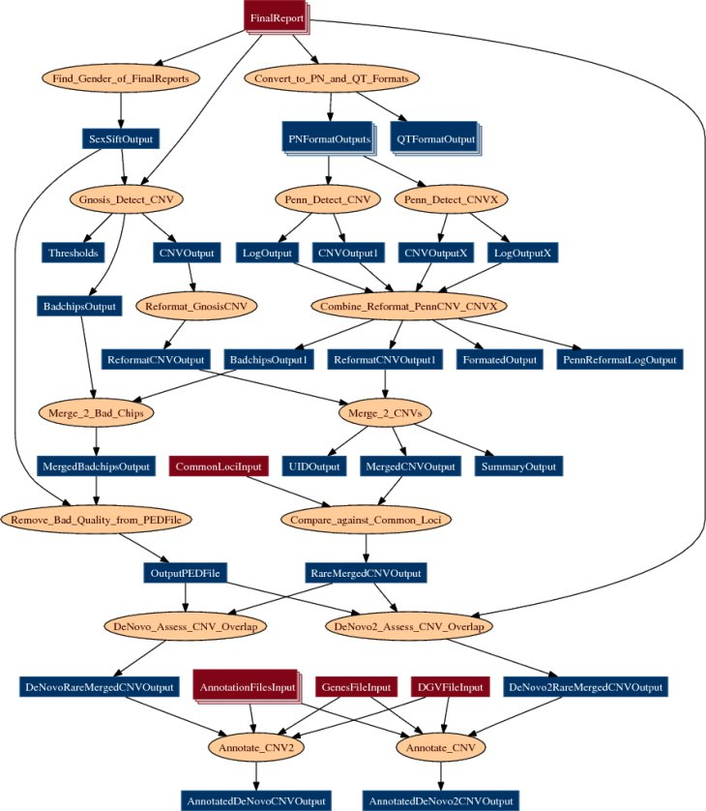
DAGMan
Directed Acyclic Graph Manager
Handles tasks with dependencies

Slide 8
Pegasus Workflow Management System
Abstract Workflows - Pegasus input workflow description
Workflow “high-level language”
Only identifies the computation, devoid of resource descriptions, devoid of data locations
Pegasus
Workflow “compiler” (plan/map)
Target is DAGMan DAGs and Condor submit files
Transforms the workflow for performance and reliability
Automatically locates physical locations for both workflow components and data
Provides runtime provenance

Slide 9
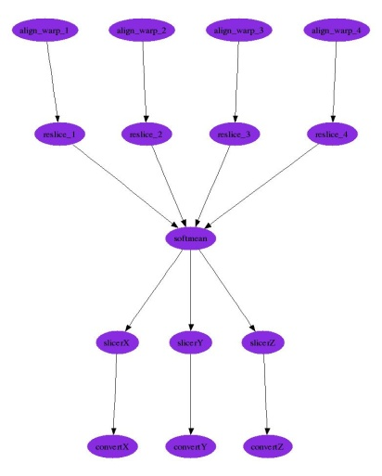
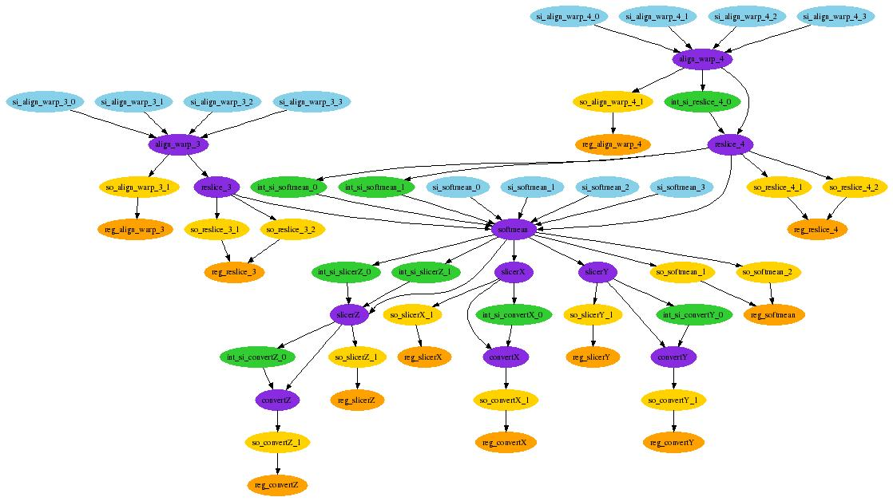
1
4
Original workflow: 15 compute nodes
devoid of resource assignment
5
8
9
4
10
12
13
15
3
8
7
Resulting workflow mapped onto 3 Grid sites:
13 data stage-in nodes
11 compute nodes (4 reduced based on available intermediate data)
8 inter-site data transfers
14 data stage-out nodes to long-term storage
14 data registration nodes (data cataloging)
9
12
10
15
13

Slide 10
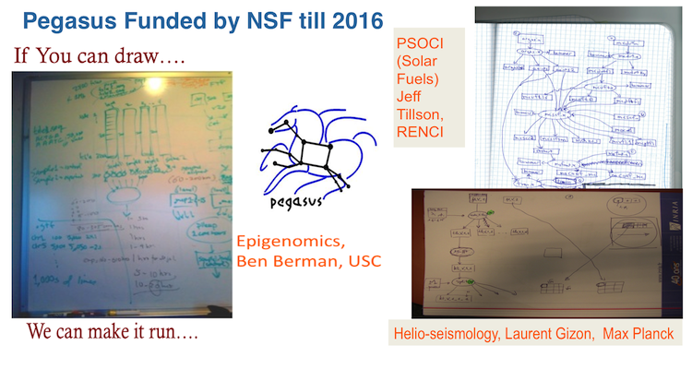
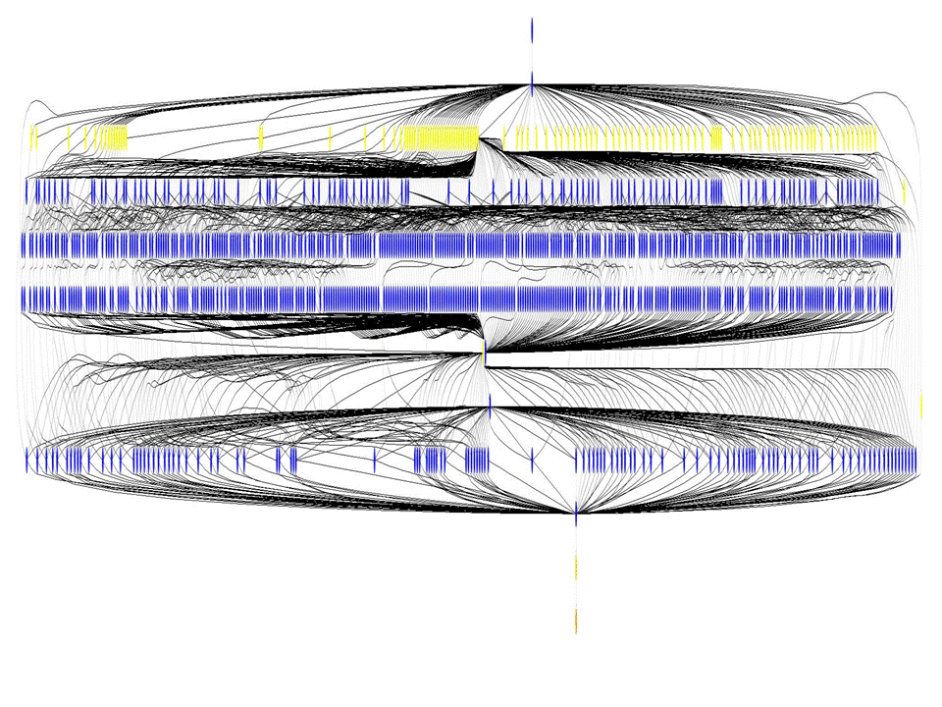

Slide 11
Periodogram Workflow
Scientific goal is to generate an atlas of periodicities of the public Kepler data. The atlas will be served through the NASA Star and Exoplanet Database (NStED) , along with a catalog of the highest-probability periodicities culled from the atlas.
1.1 million total tasks
108 sub workflows
Input: 323 GB
Outputs: 2 TB
100,000 CPU hours
Wall time based job clustering
Simple binning
Target: 1 hour

Slide 12
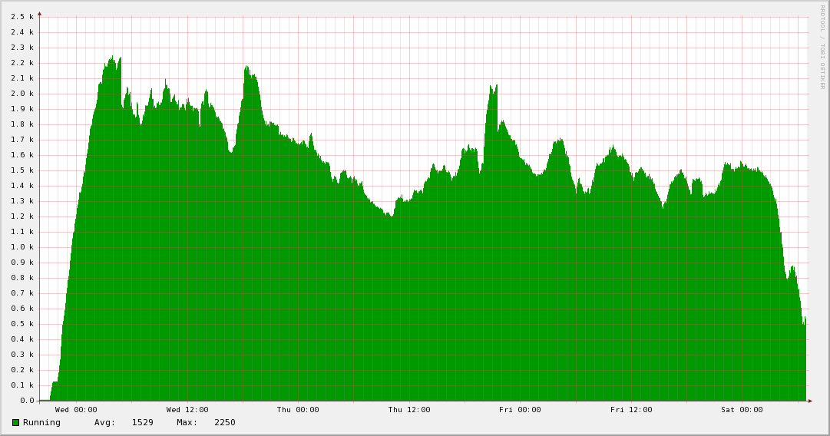
Periodogram Jobs Running on the Open Science Grid
5.5 CPU years in 3 days

Slide 13
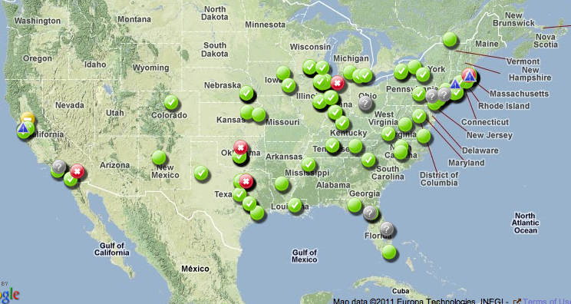
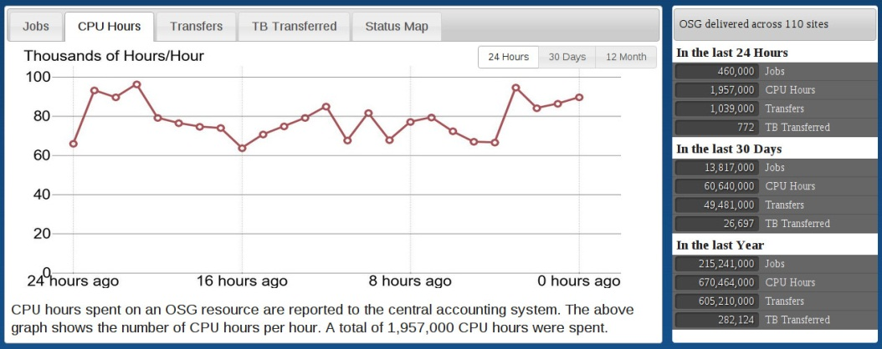
The Open Science Grid
A framework for large scale distributed resource sharing
addressing the technology, policy, and social requirements of sharing
OSG is a consortium of software, service and resource providers and researchers, from universities, national laboratories and computing centers across the U.S., who together build and operate the OSG project. The project is funded by the NSF and DOE, and provides staff for managing various aspects of the OSG.
Brings petascale computing and storage resources into a uniform grid computing environment
Integrates computing and storage resources from over 100 sites in the U.S. and beyond
Notes:
Open Science Grid is a framework for distributed resource sharing. One way of thinking of OSG can be a grid of grids, that is, your campus and regional grids come together into one national grid.
Also note that OSG is a consortium, and that OSG does not own any compute resources. Not that we are picky, but it is actually incorrect to call something a OSG resource. The correct way is to say for example, the UNM_HPC resource which is available using OSG.
OSG today has over 70 resources online.

Slide 14
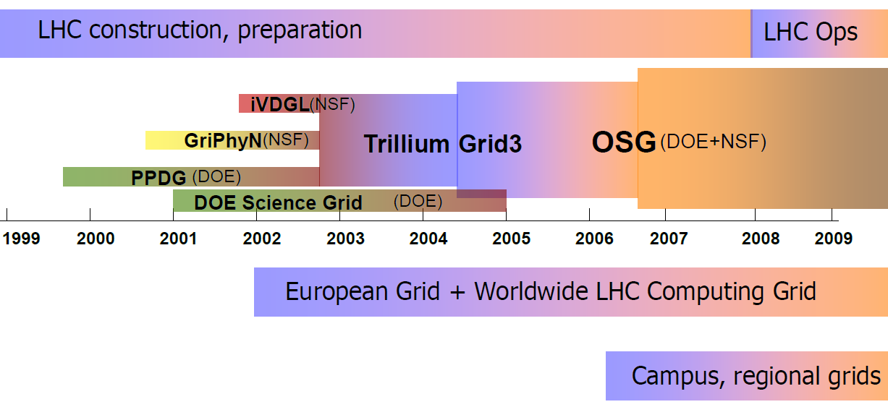


The Evolution of OSG

Slide 15
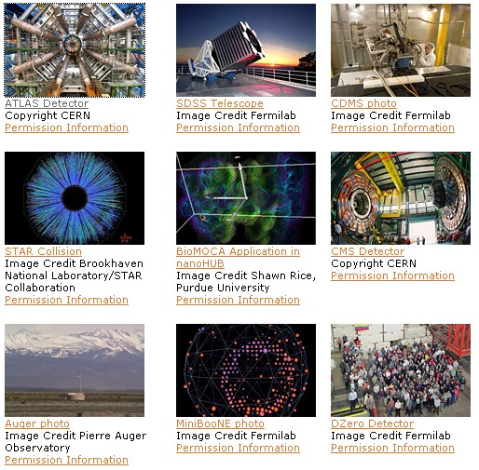
Using OSG Today
Astrophysics
Biochemistry
Bioinformatics
Earthquake Engineering
Genetics
Gravitational-wave physics
Mathematics
Nanotechnology
Nuclear and particle physics
Text mining
And more…

Slide 16
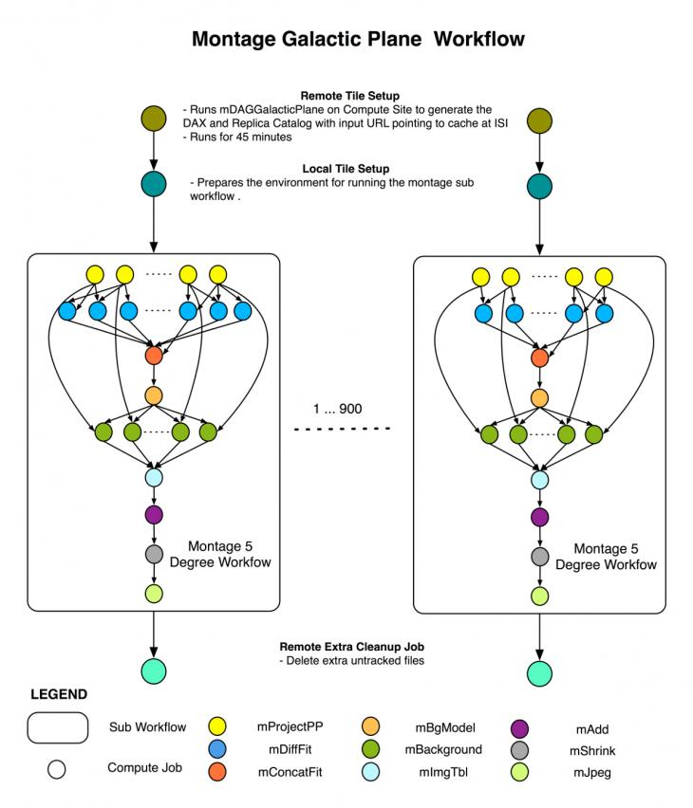
Galactic Plane Workflow
A multiwavelength infrared image atlas of the galactic plane, composed of images at 17 different wavelengths from 1 µm to 70 µm, processed so that they appear to have been measured with a single instrument observing all 17 wavelengths
360° x 40 ° coverage
18 million input files
86 TB output dataset
17 workflows, each one with 900 sub workflows
Survey | Wavelengths (µm)
Spitzer Space Telescope
GLIMPSE I, II and 3D | 3.6, 4.5, 5.8. 8.0
MIPSGAL I, II | 24, 70
All Sky Surveys
2MASS | 1.2, 1.6, 2.2
MSX | 8.8, 12.1,14.6, 21.3
WISE † | 3.4, 4.6, 12, 22
† Galactic Plane data scheduled for release Spring 2012

Slide 17
The Extreme Science and Engineering Discovery Environment (XSEDE)
9 supercomputers, 3 visualization systems, and 9 storage systems provided by 16 partner institutions
XSEDE resources are allocated through a peer-reviewed process
Open to any US open science researcher (or collaborators of US researchers) regardless of funding source
XSEDE resources are provided at NO COST to the end user through NSF funding (~$100M/year).
Slide credit: Matthew Vaughn

Slide 18
Clouds
Run your own custom virtual machines
But what is provided? What is missing?
Science Clouds
FutureGrid
Commercial Clouds
Amazon EC2, Google Compute, RackSpace

Slide 19
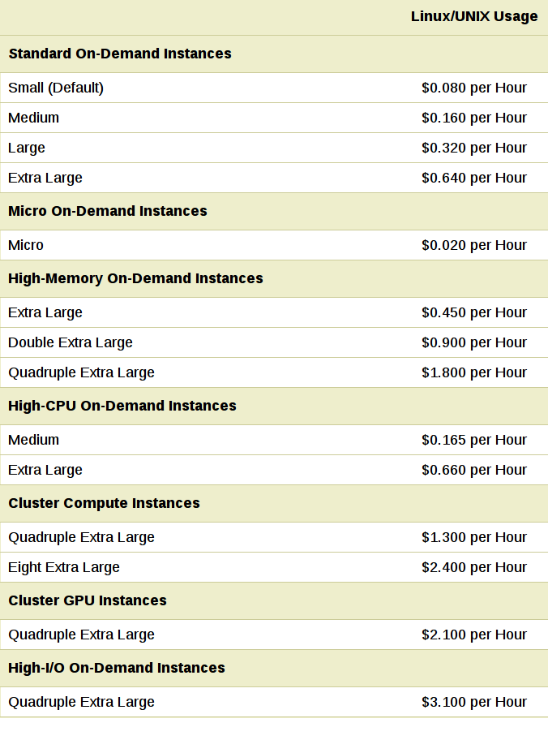
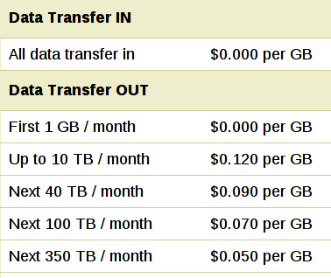
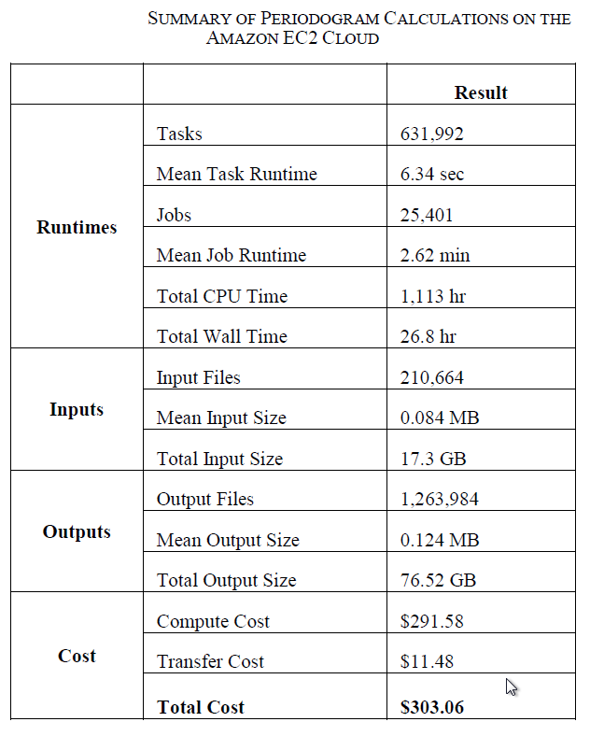
The application of cloud computing to astronomy: A study of cost and performance
Berriman et.al.

Slide 20
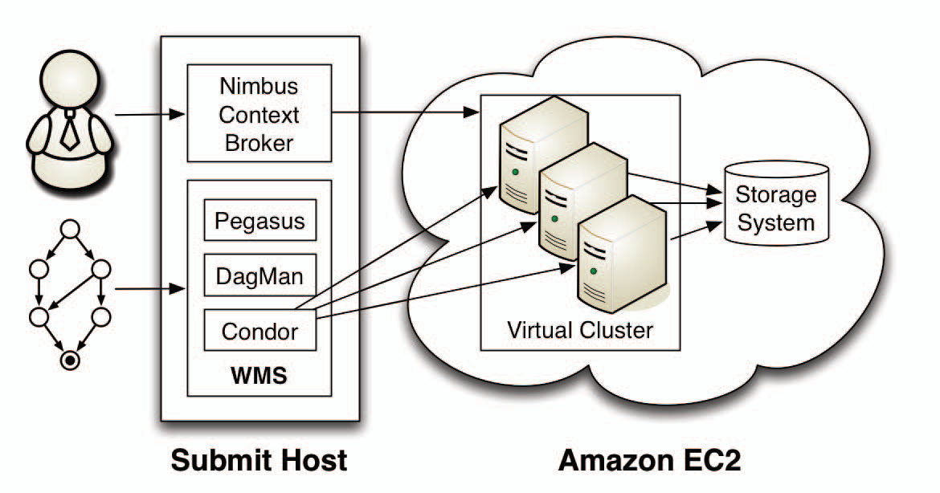
Cloud – what do I have to provide?
Resource Provisioning

Slide 21
Cloud – Tutorial
This tutorial will take you through the steps of launching the Pegasus Tutorial VM on Amazon EC2 and running a simple workflow. This tutorial is intended for new users who want so get a quick overview of Pegasus concepts and usage. A preconfigured virtual machine is provided so that minimal software installation is required. The tutorial covers the process of starting the VM and of creating, planning, submitting, monitoring, debugging, and generating statistics for a simple workflow.
Oregon datacenter
Image: ami-8643ccb6
http://pegasus.isi.edu/wms/docs/tutorial/

Slide 22
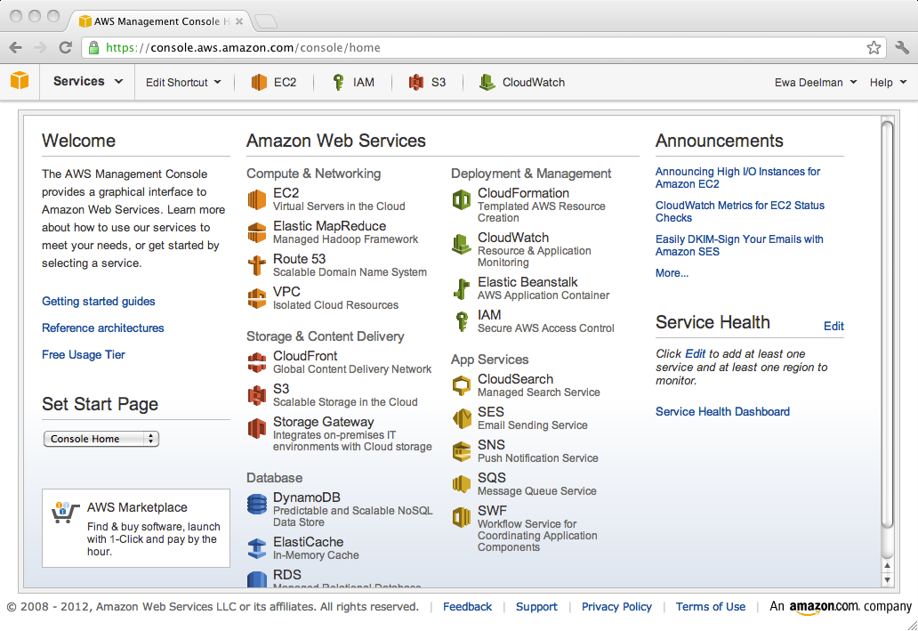

Slide 23
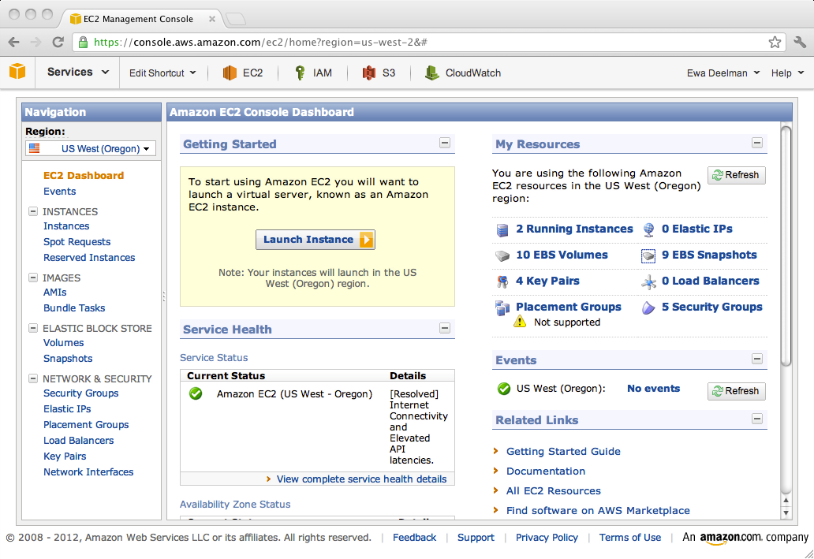

Slide 24
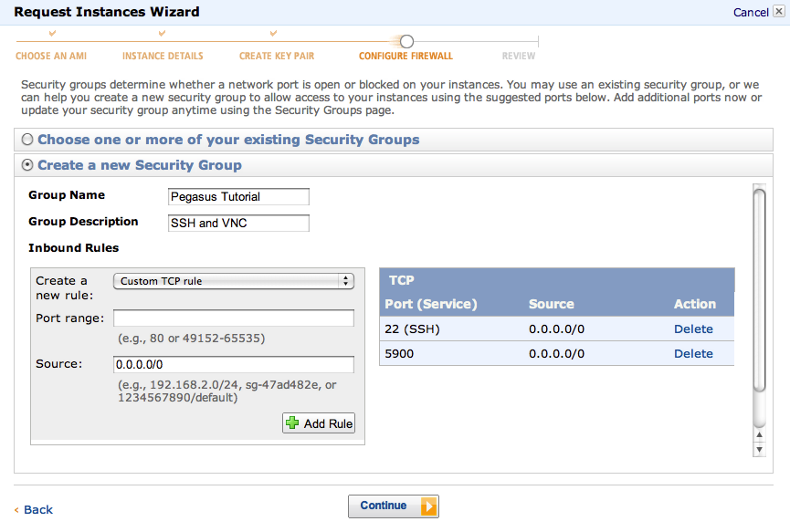

Slide 25
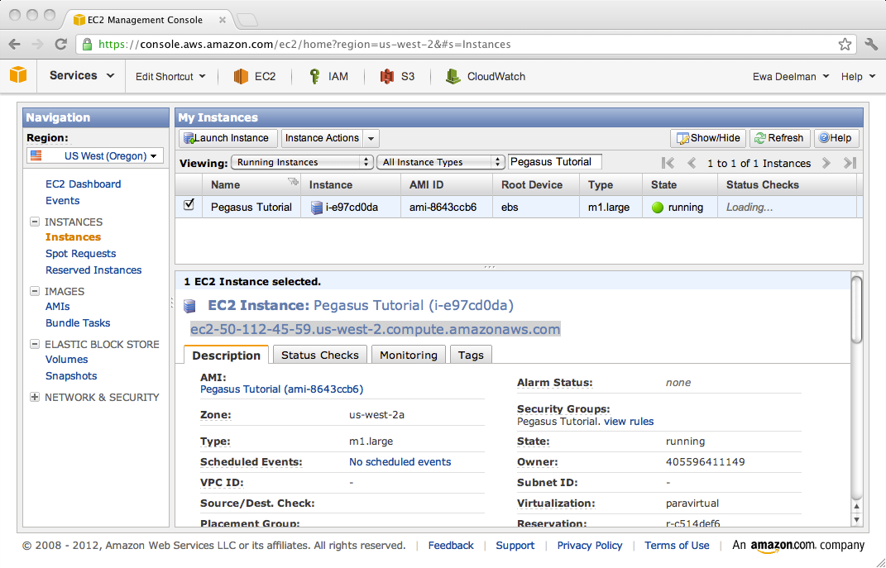

Slide 26
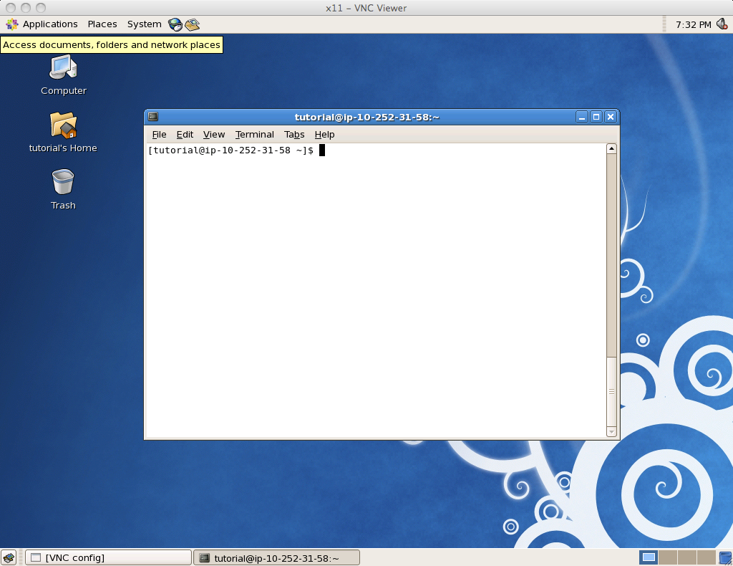

Slide 27
Thank you!
Pegasus: http://pegasus.isi.edu
pegasus-support@isi.edu

