Slide 1

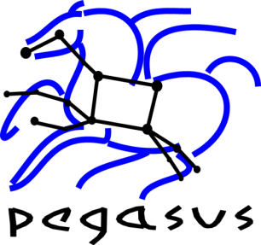

Enabling Large-scale Scientific Workflows on Petascale Resource Using MPI Master/Worker
Mats Rynge, Gideon Juve, Karan Vahi, Gaurang Mehta, Ewa Deelman
Information Sciences Institute, University of Southern California
Scott Callaghan, Philip J. Maechling
Southern California Earthquake Center, University of Southern California
Funded by the NSF OCI program grants OCI-0722019 and OCI-0943725

Slide 2
Outline
Introduction
Pegasus Workflow Management System
pegasus-mpi-cluster
Integration
SCEC Cybershake – Example application
Conclusions

Slide 3
Introduction
Loosely coupled applications structured as scientific workflow, containing mix of parallel and serial tasks
Petascale systems are optimized for parallel jobs
Common solution: Condor glideins for the serial tasks

Slide 4
Glideins on NICS Kraken?
Cray XT System Environment / ALPS / aprun
Login node
aprun node
Compute node

Slide 5
Approach
Partition workflow into subgraphs
Execute partition as a self-contained MPI job

Slide 6
Pegasus Workflow Management System
Abstract Workflows - Pegasus input workflow description
Workflow “high-level language”
Only identifies the computation, devoid of resource descriptions, devoid of data locations
Pegasus
Workflow “compiler” (plan/map)
Target is DAGMan DAGs and Condor submit files
Transforms the workflow for performance and reliability
Automatically locates physical locations for both workflow components and data
Provides runtime provenance

Slide 7
pegasus-mpi-cluster
Master/worker paradigm
Master manages the subgraph tasks, handing out work to the workers
Efficient scheduling / handling of input/outputs
Subgraph described in a DAG-similar format
Failure management / rescue DAG

Slide 8
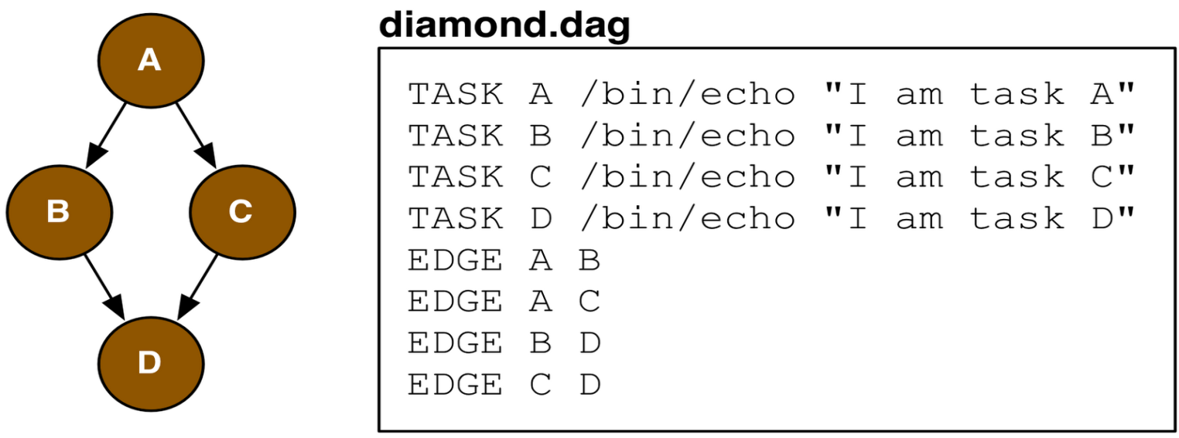

Slide 9
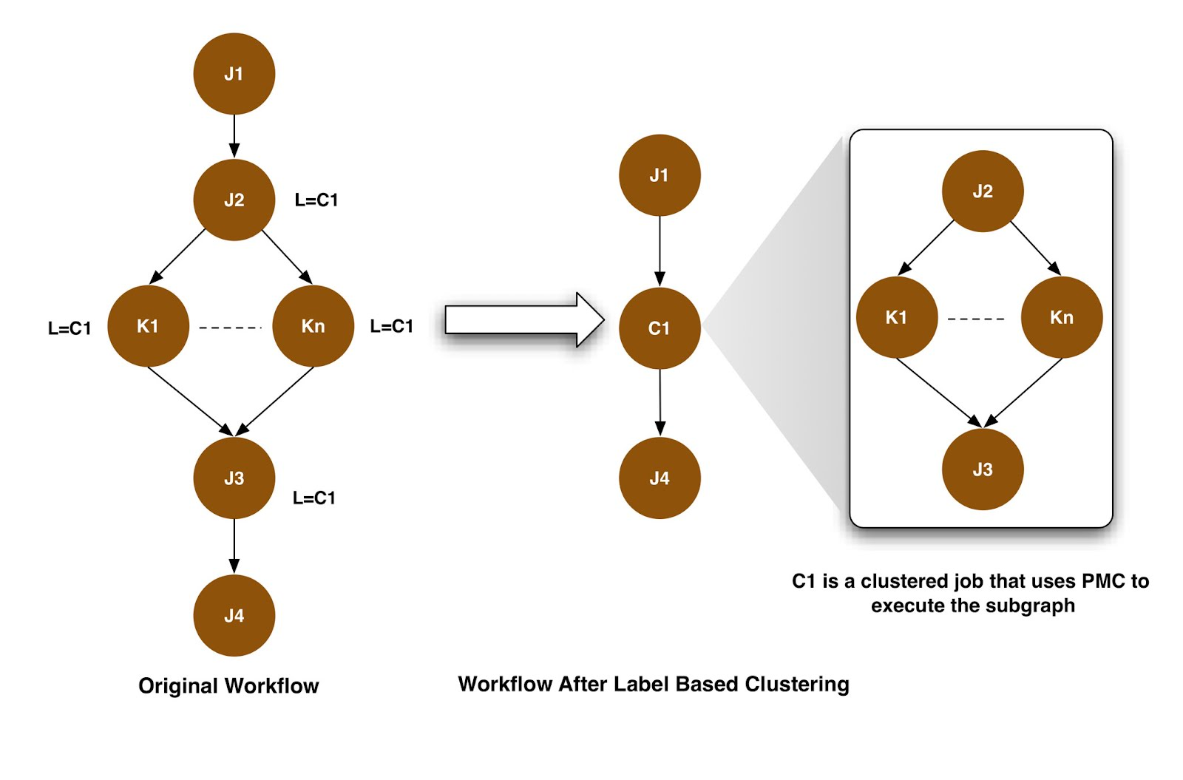
Pegasus Mapper / pegasus-mpi-cluster integration

Slide 10
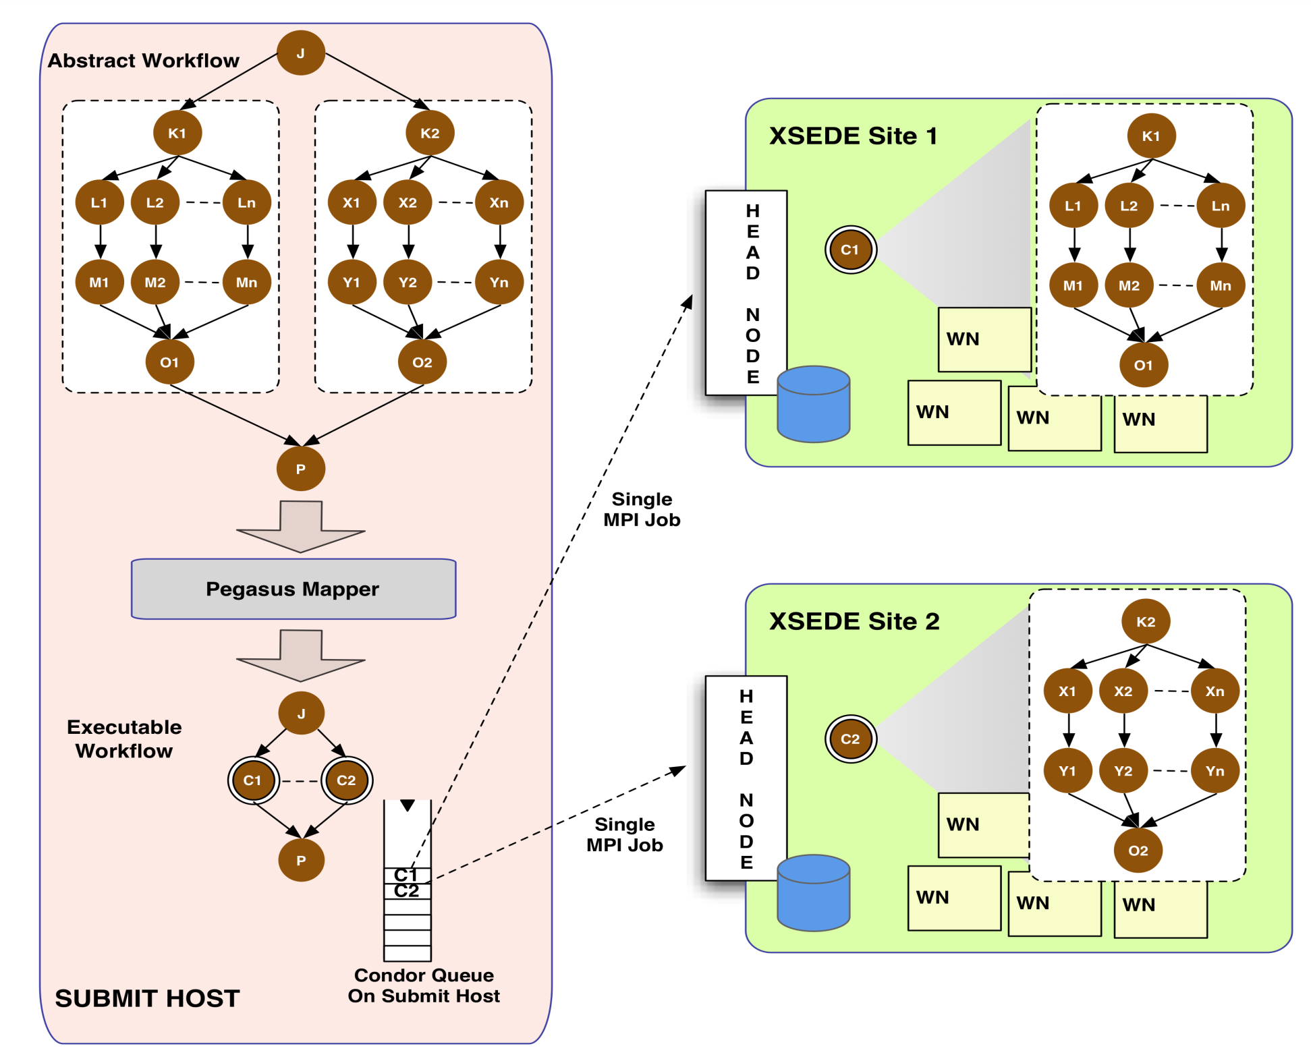

Slide 11

Southern California Earthquake Center CyberShake
Example Application

Slide 12
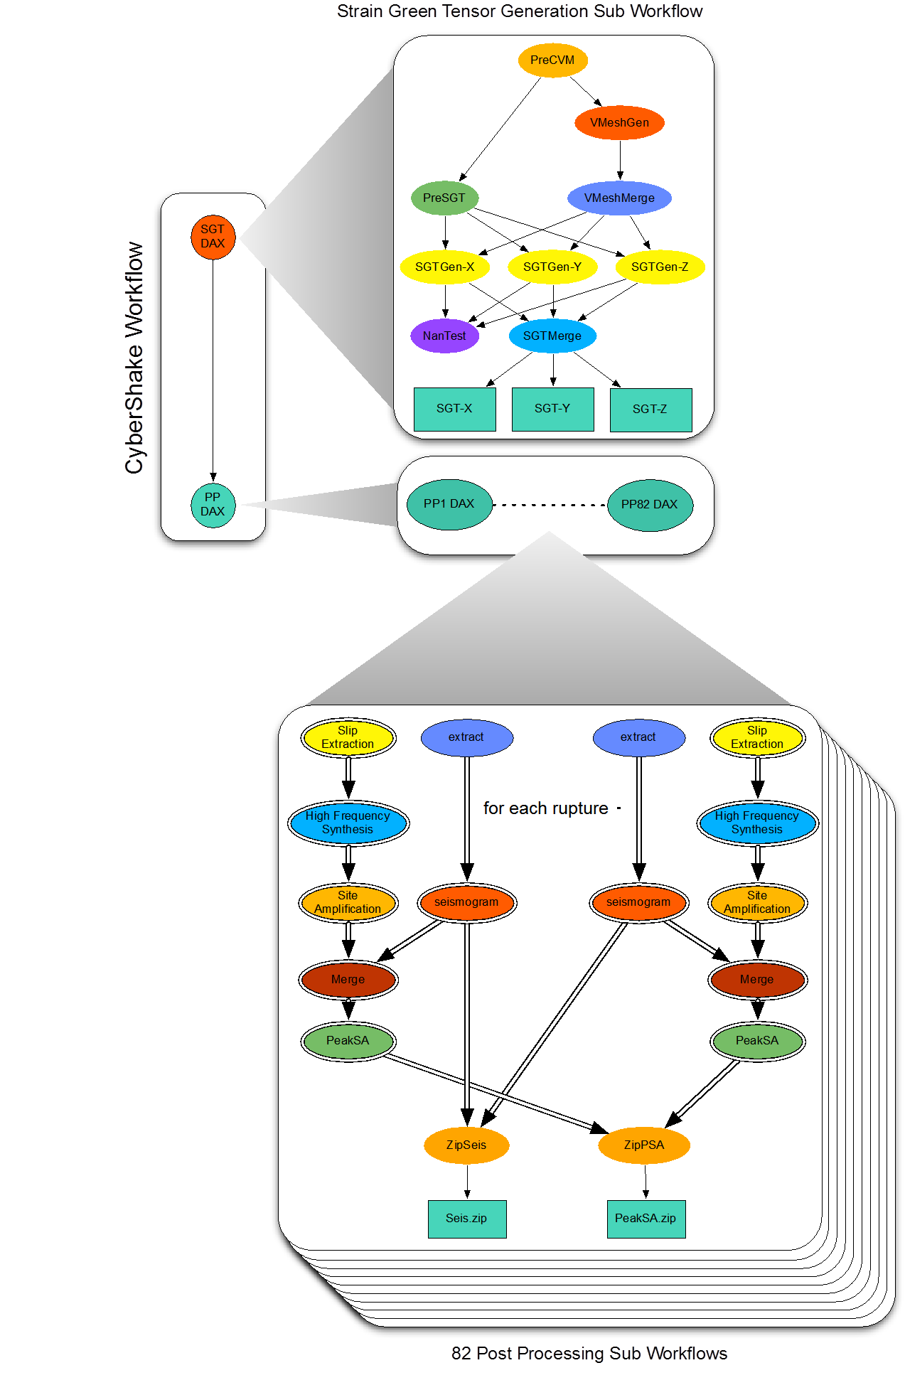
CyberShake
Probabilistic seismic hazard analysis workflow
How hard will the ground shake in the future?
Considers a set of possible large earthquakes
415,000 earthquakes is typical
Uses Pegasus and Condor DAGMan for workflow management
Hierarchal workflows
Small set of large parallel jobs
840,000 serial jobs, in 78 sub workflows

Slide 13
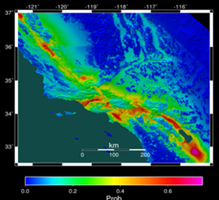
Probabilistic Seismic Hazard Analysis (PSHA) curve. Estimates the probability that earthquake ground motions will exceed some intensity measure.
Set of PSHA curves interpolated creates hazard map for an area

Slide 14
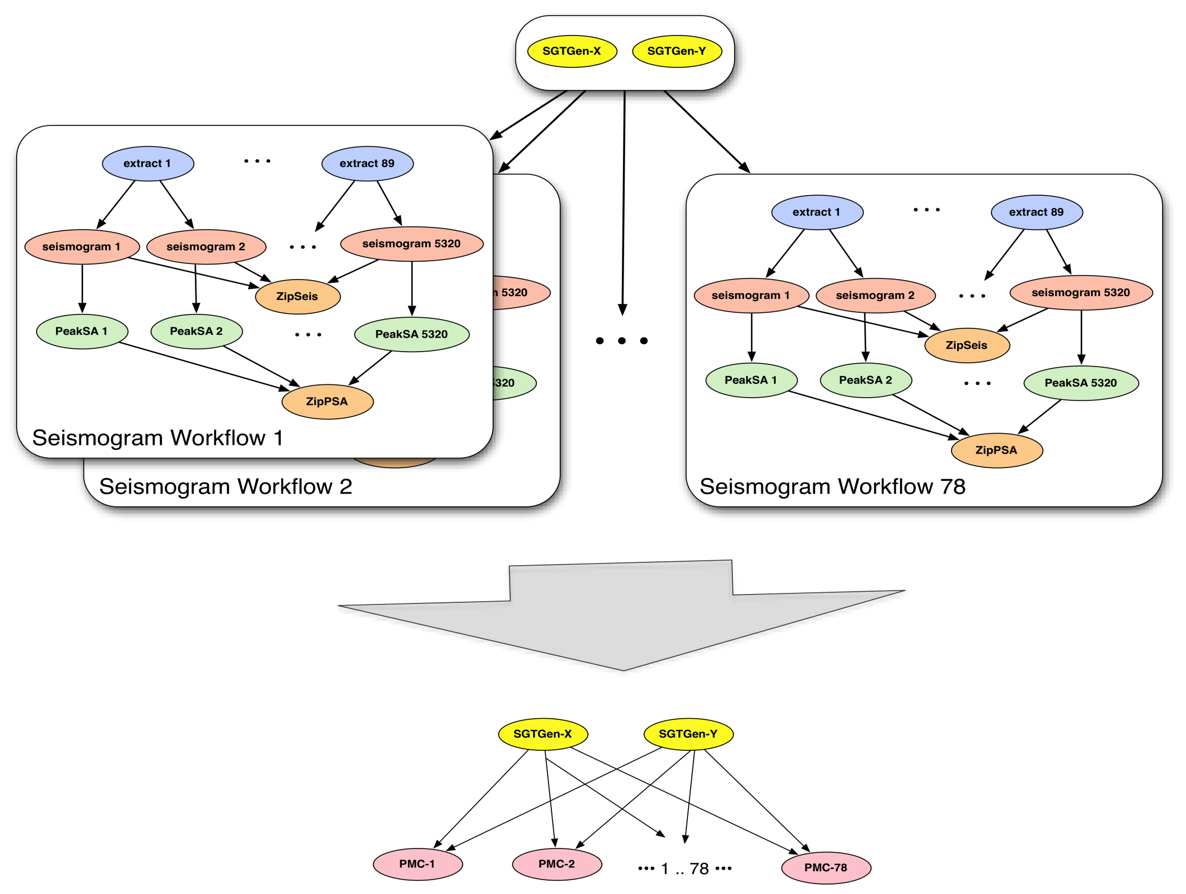

Slide 15
Conclusions and Future Work
Demonstrated efficient execution of fine-grained workflows on petascale resources by partitioning workflow into MPI master/worker jobs
Size of partition?
Size of MPI job?
Handing tasks with mixed requirements?
pegasus-mpi-cluster now considers memory to be a consumable resource

Slide 16
Thank you!
Pegasus: http://pegasus.isi.edu
SCEC: http://www.scec.org

