Slide 1
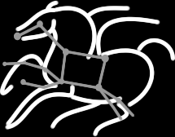
Toward Fine-Grained Online Task Characteristics Estimation in Scientific Workflows
Rafael Ferreira da Silva^{1,2}, Gideon Juve², Ewa Deelman², Tristan Glatard^{1,3}, Frédéric Desprez⁴, Douglas Thain⁵, Benjamín Tovar⁵, Miron Livny⁶
¹University of Lyon, CNRS, INSERM, CREATIS, Villeurbanne, France
²University of Southern California, Information Sciences Institute, Marina Del Rey, CA, USA
³McConnell Brain Imaging Centre, Montreal Neurological Institute, McGill University, Canada
⁴INRIA, University of Lyon, LIP, ENS Lyon, Lyon, France
⁵University of Notre Dame, Notre Dame, IN, USA
⁶University of Wisconsin Madison, Madison, WI, USA

Slide 2
Outline
Introduction
Workflow Characterization
Task Estimation Process
Experiments and Evaluation
Conclusions

Slide 3
Outline
Introduction
Workflow Characterization
Task Estimation Process
Experiments and Evaluation
Conclusions

Slide 4
Context
Task Characteristics:
Runtime
Disk Space
Memory Consumption
Scheduling and Resource Provisioning
Algorithms
Methods assume that accurate estimations are available
It is hard to compute accurate estimations in production systems
A successful workflow execution mainly depends on how tasks are planned and executed
We propose a method to online estimate fine-grained task characteristics

Slide 5
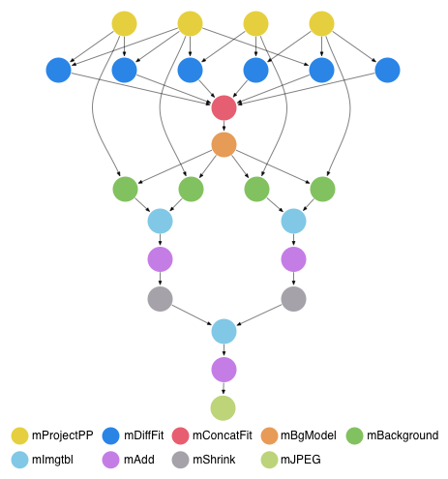
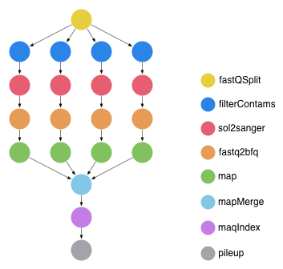
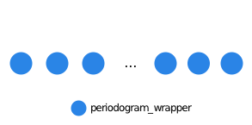
Scientific Workflows
Directed Acyclic Graph (DAG)
Nodes denote tasks
Edges denote task dependencies
Periodogram Workflow
Small (20 node) Montage Workflow
Epigenomics Workflow

Slide 6
Outline
Introduction
Workflow Characterization
Task Estimation Process
Experiments and Evaluation
Conclusions

Slide 7
Workflow Execution Profiling
Workflows were executed using Pegasus WMS
and profiled using Kickstart profiling tool
Monitors and records fine-grained data
E.g. process I/O, runtime, memory usage, CPU utilization
3 runs of each workflow with different datasets
16-core cluster
5 Dual core MP OpteronTM Processor 250 2.4GHz / 8GB RAM
3 Dual core MD AMD OpteronTM Processor 275 2.2 GHz / 8GB RAM

Slide 8
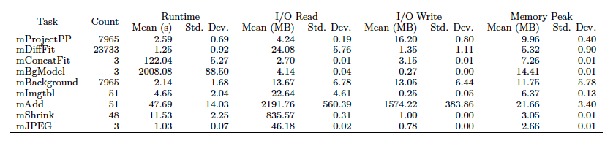
Execution Profile: Montage Workflow
Task estimation could be based on mean values
Task estimation based on average may lead to significant estimation errors

Slide 9
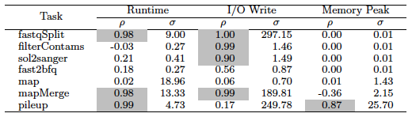
Automatic Workflow Characterization
Characterize tasks based on their estimation capability
Runtime, I/O write, memory peak ➔ estimated from I/O read
Enforces correlation statistics to identify statistical relationships between parameters
High correlation values yield accurate estimations
Constant values
Correlated if ρ > 0.8
Epigenomics workflow

Slide 10
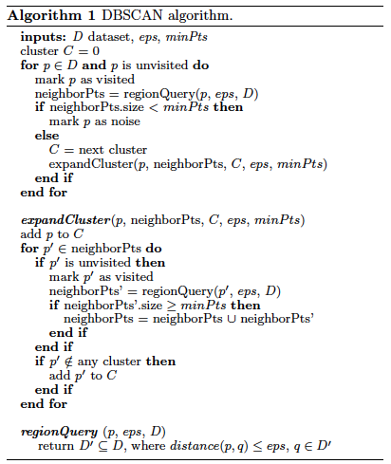
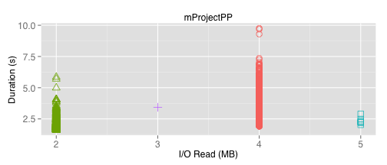
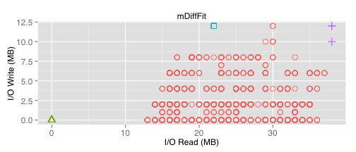
Density-Based Clustering
Identifies groups of high density areas where no correlation is found
Notes:
The value of the distance is chosen by using a k-distance graph, plotting the distance to the minPts nearest neighbors; good values of are where this plot shows a strong bend.

Slide 11
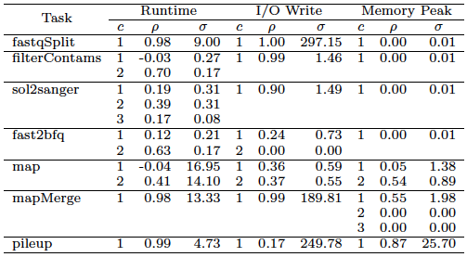
Density-Based Clustering: Epigenomics workflow
Datasets with high correlation values are not clustered
Higher correlation values
Smaller standard deviation values
Constant values
c: clusters per task type
ρ: correlation value
σ: standard deviation

Slide 12
Outline
Introduction
Workflow Characterization
Task Estimation Process
Experiments and Evaluation
Conclusions

Slide 13
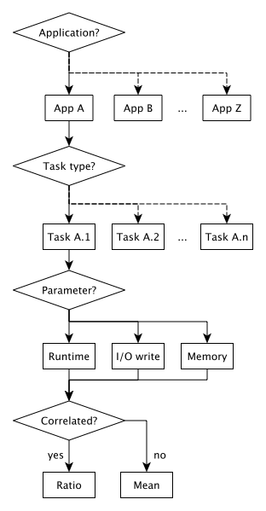
Task Estimation Process
Based on Regression Trees
Built offline from historical data analyses
Tasks are classified by application, then task type
Estimation of runtime, I/O write, or memory peak
If strong correlated to the input data:
Estimation based on the ratio parameter/input data size
Otherwise, estimation based on the mean

Slide 14
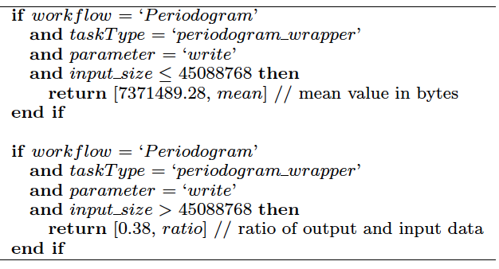
Example of Estimation Rules
Rules for I/O write estimation of the Periodogram workflow

Slide 15
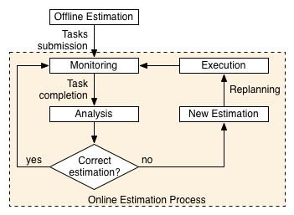
Online Estimation Process
Based on the MAPE-K loop
Task executions are constantly monitored
Estimated values are updated, and a new prediction is done

Slide 16
Outline
Introduction
Workflow Characterization
Task Estimation Process
Experiments and Evaluation
Conclusions

Slide 17
Experiment Conditions
Trace analysis of 3 workflow applications
Montage
Epigenomics
Periodogram
Leave-one-out cross-validation
Evaluate the accuracy of our online estimation process
3 different workflow execution traces for each workflow
Simulator
Simple DAG analyzer
Replays workflow executions

Slide 18
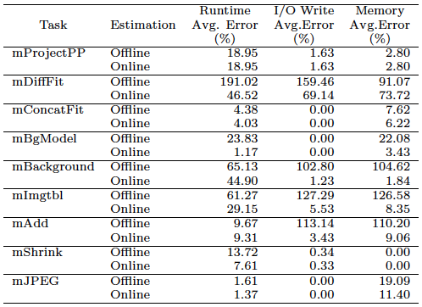
Results: Average Estimation Errors - Montage
Online Process
Avg. Runtime Error: 18%
Avg. I/O Write Error: 9%
Avg. Memory Error: 13%
Offline Process
Avg. Runtime Error: 43%
Avg. I/O Write Error: 56%
Avg. Memory Error: 53%
Poor output data estimations leads to a chain of estimation errors in scientific workflows

Slide 19
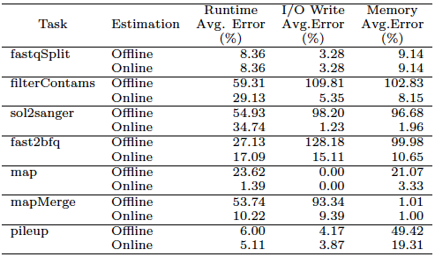
Results: Average Estimation Errors - Epigenomics
Online Process
Avg. Runtime Error: 13%
Avg. I/O Write Error: 5%
Avg. Memory Error: 8%
Offline Process
Avg. Runtime Error: 29%
Avg. I/O Write Error: 57%
Avg. Memory Error: 48%
Poor output data estimations leads to a chain of estimation errors in scientific workflows

Slide 20

Results: Average Estimation Errors - Periodogram
BoT: the online approach produces the same result as the offline
Experiment Conclusions
Online strategy counterbalances the propagation of estimation errors
Estimation of first-level tasks have strong influence in subsequent estimations

Slide 21
Outline
Introduction
Workflow Characterization
Task Estimation Process
Experiments and Evaluation
Conclusions

Slide 22
Conclusions
Summary of contributions
Automated method that characterizes scientific workflow executions
Fine-grained characterization of 3 real scientific workflows
An online estimation process to predict fine-grained task needs
Future Work
Analysis of the impact of re-planning a workflow when using an online estimation strategy
Sensitivity analysis of the correlation value ρ
Increase the number of workflow samples
Compare the results with other monitoring tools

Slide 23
Toward Fine-Grained Online Task Characteristics Estimation in Scientific Workflows
Thank you.
Questions?
^{rafsilva@isi.edu} ^{http://pegasus.isi.edu}

