Slide 1
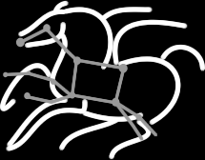
Pegasus 4.2 on the Open Science Grid
Mats Rynge
USC Information Sciences Institute

Slide 2
Workflows on OSG: What do users care about?
Data Management
How do you ship in the small/large amounts data required by the workflows?
Can I use SRM? How about GridFTP? HTTP and Squid proxies?
Debug and Monitor Workflows
Users need automated tools to go through the log files
Need to correlate data across lots of log files
Need to know what host a job ran on and how it was invoked
Restructure Workflows for Improved Performance
Short running tasks?
Data placement?
Integrate with existing OSG infrastructure for provisioning resources such as GlideinWMS, BOSCO, and higher level tools such as HubZero

Slide 3
Pegasus Workflow Management System
NSF funded project and developed since 2001 as a collaboration between USC Information Sciences Institute and the Condor Team at UW Madison
Builds on top of Condor DAGMan.
Abstract Workflows - Pegasus input workflow description
Workflow “high-level language”
Only identifies the computation, devoid of resource descriptions, devoid of data locations
Pegasus is a workflow “compiler” (plan/map)
Target is DAGMan DAGs and Condor submit files
Transforms the workflow for performance and reliability
Automatically locates physical locations for both workflow components and data
Collects runtime provenance

Slide 4
Pegasus WMS

Slide 5
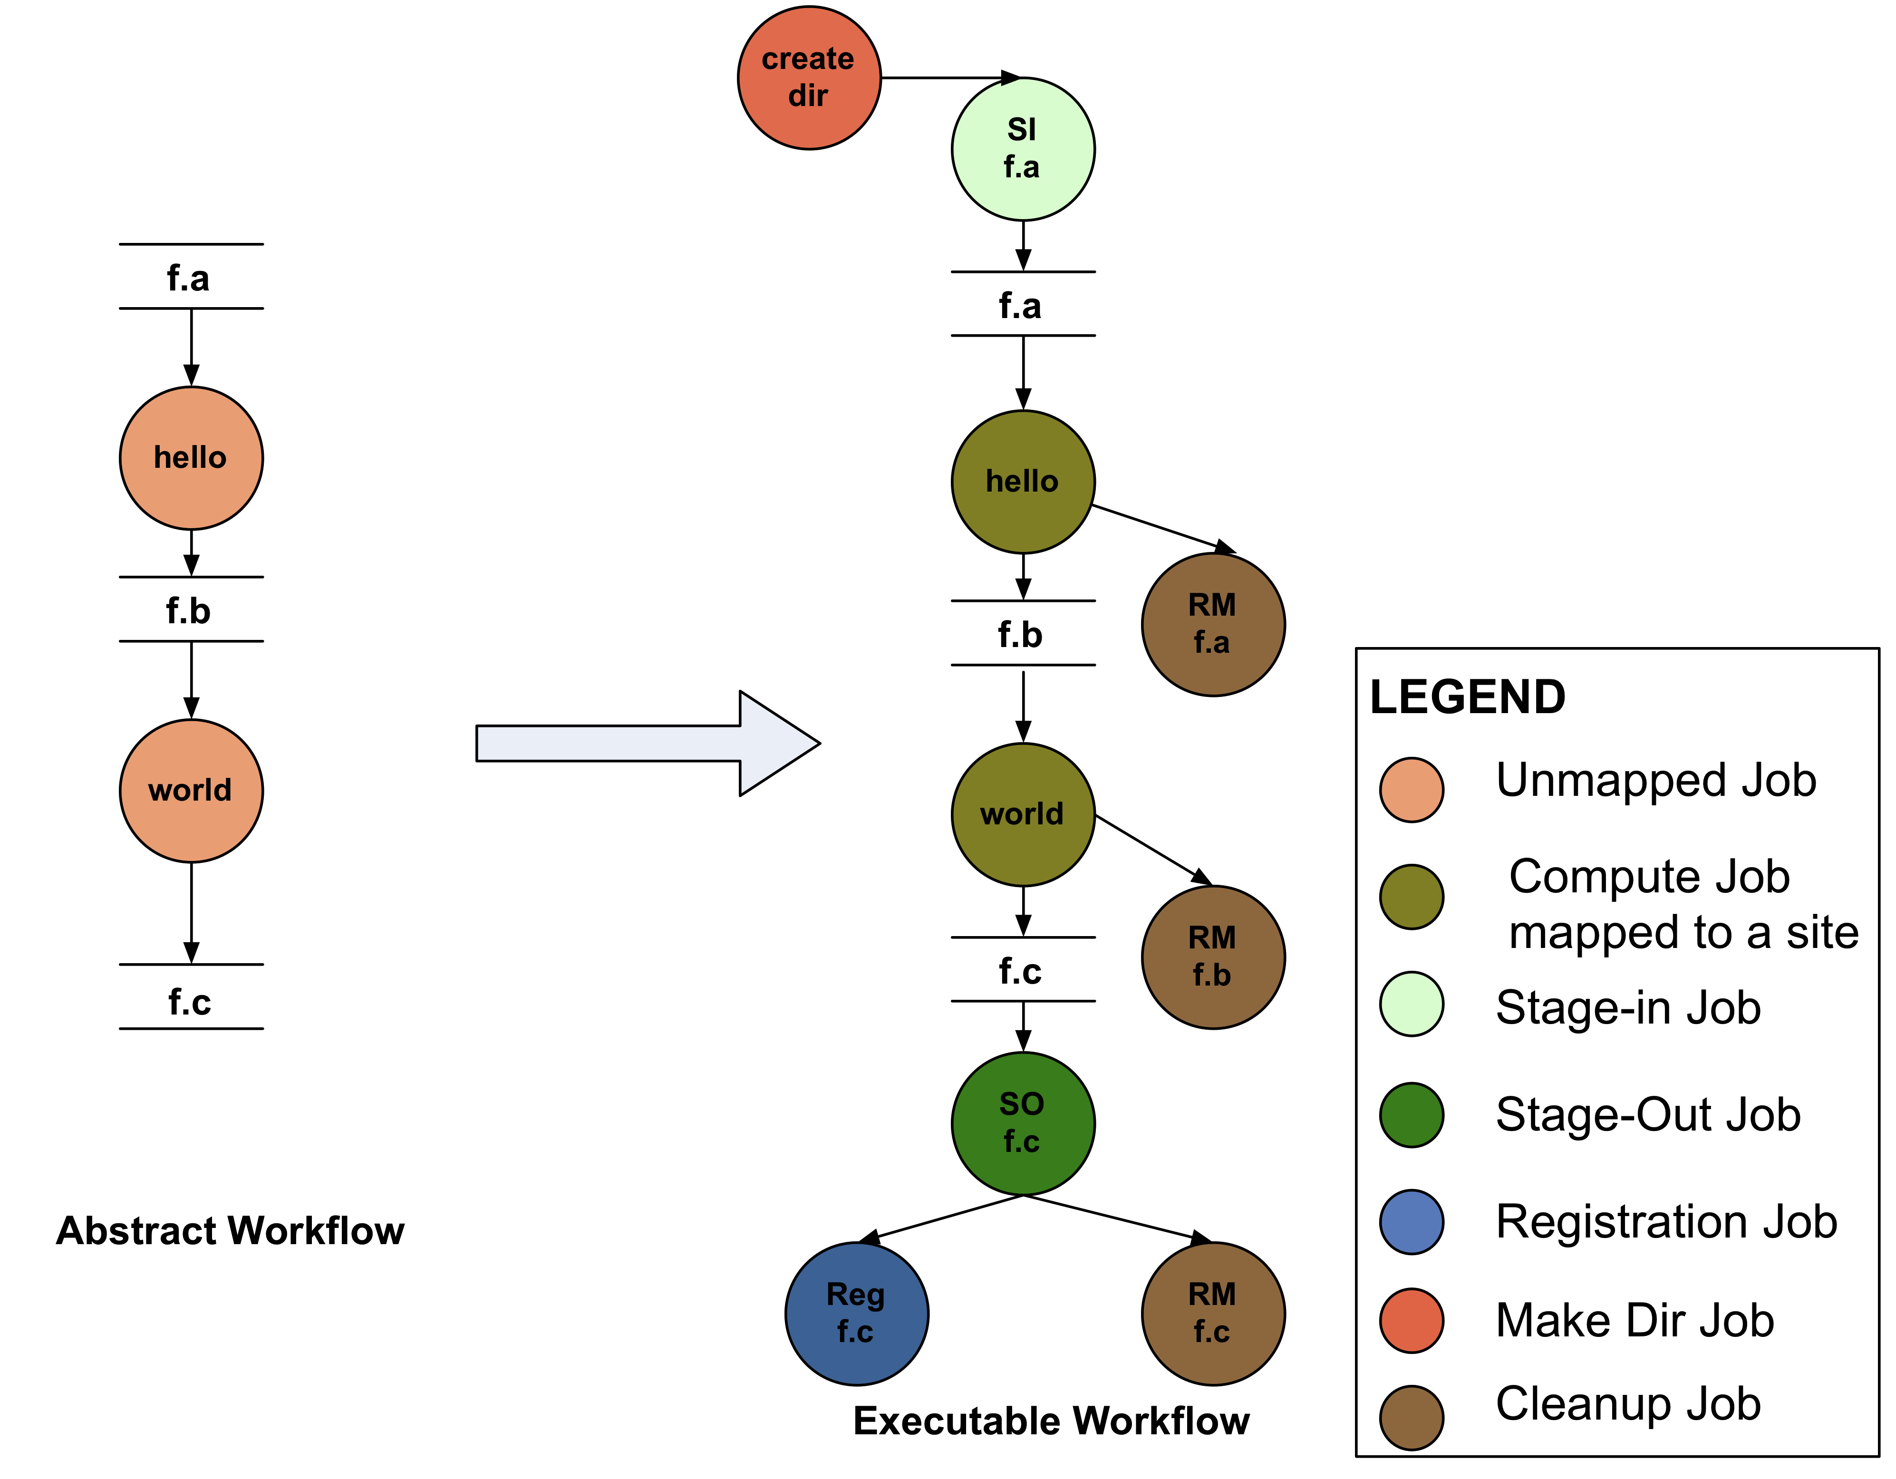
Abstract to Executable Workflow Mapping
Abstraction provides
Ease of Use (do not need to worry about low-level execution details)
Portability (can use the same workflow description to run on a number of resources and/or across them)
Gives opportunities for optimization and fault tolerance
automatically restructure the workflow
automatically provide fault recovery (retry, choose different resource)

Slide 6
Workflows can be simple

Slide 7
Supported Data Staging Approaches
NonShared filesystem setup using an existing storage element for staging (typical of OSG and campus Condor pools)
Worker nodes don’t share a filesystem.
Data is pulled from / pushed to the existing storage element.
(Pictured on the next slide)
Condor IO
Worker nodes don’t share a filesystem
Data is pulled from / pushed to the submit host via Condor file transfers
Shared Filesystem setup (typical of XSEDE and HPC sites)
Worker nodes and the head node have a shared filesystem, usually a parallel filesystem with great I/O characteristics
Can leverage symlinking against existing datasets
Notes:
Kent changed 080501 – removed periods

Slide 8
Notes:
On of the things we have done to handle big datasets is created this notion of a staging site or intermediate data site. Since most compute resources may or may not have large data storage capability. This allows us to use a mixture of resources when executing workflows and using the various high performance data protocols that may be available to fetch the data to the compute node for execution as and when its needed.

Slide 9
Workflow Reduction (Data Reuse)
Notes:
Sometimes it is cheaper to access the data than to regenerate it
Keeping track of data as it is generated supports workflow-level checkpointing
Kent changed 080501 – added period

Slide 10
File cleanup
Problem: Running out of disk space during workflow execution
Why does it occur
Workflows could bring in huge amounts of data
Data is generated during workflow execution
Users don’t worry about cleaning up after they are done
Solution
Do cleanup after workflows finish
Does not work as the scratch may get filled much before during execution
Interleave cleanup automatically during workflow execution.
Requires an analysis of the workflow to determine, when a file is no longer required
Notes:
Kent changed 080501

Slide 11
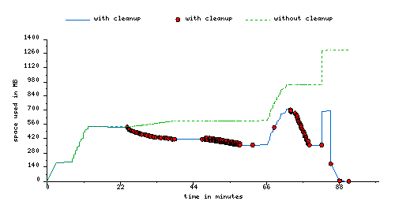
File cleanup (cont)
Montage 1 degree workflow run with cleanup

Slide 12
Workflow Restructuring to improve application performance
Cluster small running jobs together to achieve better performance
Why?
Each job has scheduling overhead – need to make this overhead worthwhile
Ideally users should run a job on the grid that takes at least 10/30/60/? minutes to execute
Clustered tasks can reuse common input data – less data transfers
Level-based clustering

Slide 13
Workflow Monitoring - Stampede
Leverage Stampede Monitoring framework with DB backend
Populates data at runtime. A background daemon monitors the logs files and populates information about the workflow to a database
Stores workflow structure, and runtime stats for each task.
Tools for querying the monitoring framework
pegasus-status
Status of the workflow
pegasus-statistics
Detailed statistics about your finished workflow
pegasus-plots
Visualization of your workflow execution
------------------------------------------------------------------------------
Type Succeeded Failed Incomplete Total Retries Total+Retries
Tasks 135002 0 0 135002 0 135002
Jobs 4529 0 0 4529 0 4529
Sub-Workflows 2 0 0 2 0 2
------------------------------------------------------------------------------
Workflow wall time : 13 hrs, 2 mins, (46973 secs)
Workflow cumulative job wall time : 384 days, 5 hrs, (33195705 secs)
Cumulative job walltime as seen from submit side : 384 days, 18 hrs, (33243709 secs)

Slide 14
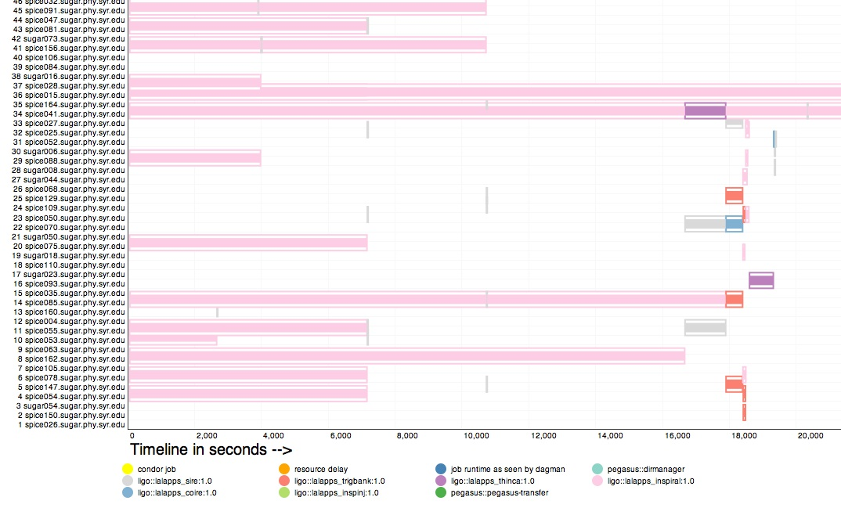
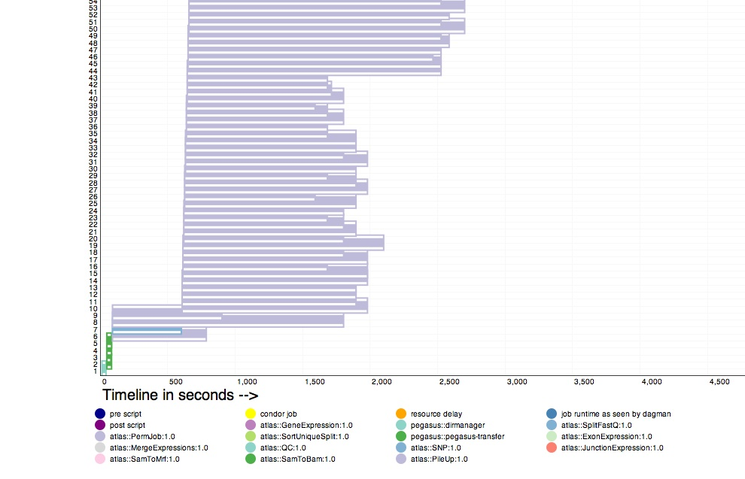
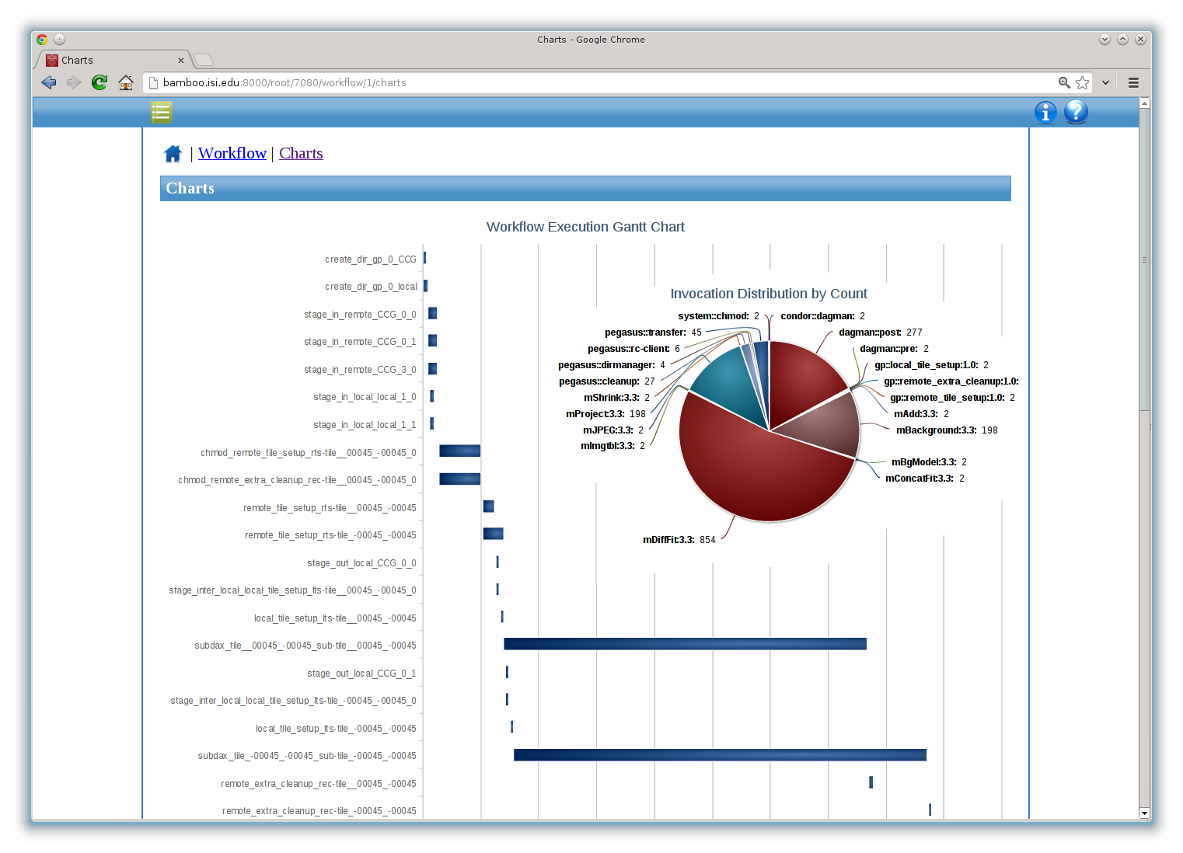
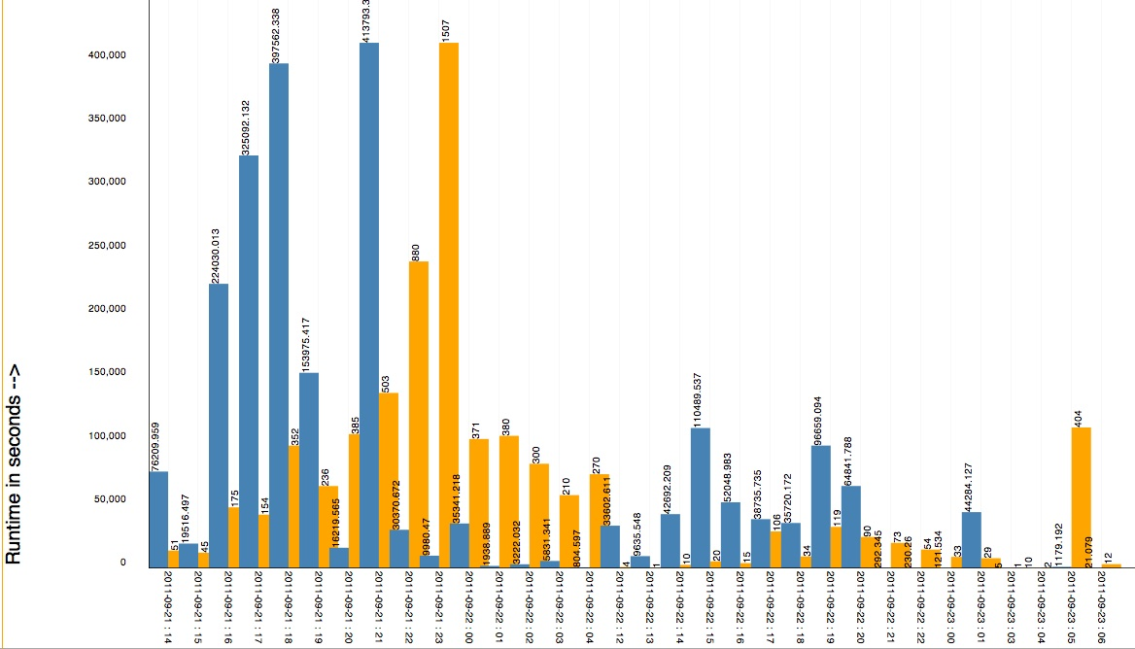
Workflow Monitoring - Stampede
Workflow Gantt Chart
Hosts Over Time – Distribution of Different Job Types on Hosts
Jobs and Runtime over Time

Slide 15
Workflow Debugging Through Pegasus
After a workflow has completed, we can run pegasus-analyzer to analyze the workflow and provide a summary of the run
pegasus-analyzer's output contains
a brief summary section
showing how many jobs have succeeded
and how many have failed.
For each failed job
showing its last known state
exitcode
working directory
the location of its submit, output, and error files.
any stdout and stderr from the job.

Slide 16
Workflow and Task Notifications
Users want to be notified at certain points in the workflow or on certain events.
Support for adding notification to workflow and tasks
Event based callouts
On Start, On End, On Failure, On Success
Provided with email and jabber notification scripts
Can run any user provided scripts
Defined in the DAX

Slide 17
Summary – What Does Pegasus provide an Application - I
All the great features that DAGMan has
Scalability / hierarchal workflows
Retries in case of failure.
Portability / Reuse
User created workflows can easily be mapped to and run in different environments without alteration.
Performance
The Pegasus mapper can reorder, group, and prioritize tasks in order to increase the overall workflow performance.
Notes:
Kent changed 080501 – removed period

Slide 18
Summary – What Does Pegasus provide an Application - II
Provenance
Provenance data is collected in a database, and the data can be summaries with tools such as pegasus-statistics, pegasus-plots, or directly with SQL queries.
Reliability and Debugging Tools
Jobs and data transfers are automatically retried in case of failures. Debugging tools such as pegasus-analyzer helps the user to debug the workflow in case of non-recoverable failures.
Data Management
Pegasus handles replica selection, data transfers and output registrations in data catalogs. These tasks are added to a workflow as auxiliary jobs by the Pegasus planner.
Notes:
Kent changed 080501 – removed period

Slide 19
Relevant Links
Pegasus: http://pegasus.isi.edu
Tutorial and documentation: http://pegasus.isi.edu/wms/docs/latest/
Acknowledgements
Pegasus Team, Condor Team, funding agencies, NSF, NIH, and everybody who uses Pegasus.

