Slide 1
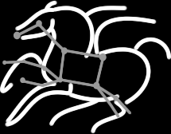
Managing HTC workflows with Pegasus OSG Campus Infrastructures Community Webinar 4/26/13
Mats Rynge
USC Information Sciences Institute

Slide 2
Outline
Overview
What is Pegasus?
Components of a Pegasus workflow
Abstract workflow
Replica, transformation and site catalogs
Common workflow transformations
Debugging and statistics
Demo
Our first workflow
Failure / debugging
OSG-XSEDE example
Task clustering
Data management

Slide 3
Pegasus Workflow Management System
NSF funded project and developed since 2001 as a collaboration between USC Information Sciences Institute and the Condor Team at UW Madison
Builds on top of Condor DAGMan.
Abstract Workflows - Pegasus input workflow description
Workflow “high-level language”
Only identifies the computation, devoid of resource descriptions, devoid of data locations
Pegasus is a workflow planner/mapper (“compiler”)
Target is DAGMan DAGs and Condor submit files
Transforms the workflow for performance and reliability
Automatically locates physical locations for both workflow components and data
Collects runtime provenance

Slide 4
Workflows can be simple

Slide 5
Pegasus WMS

Slide 6
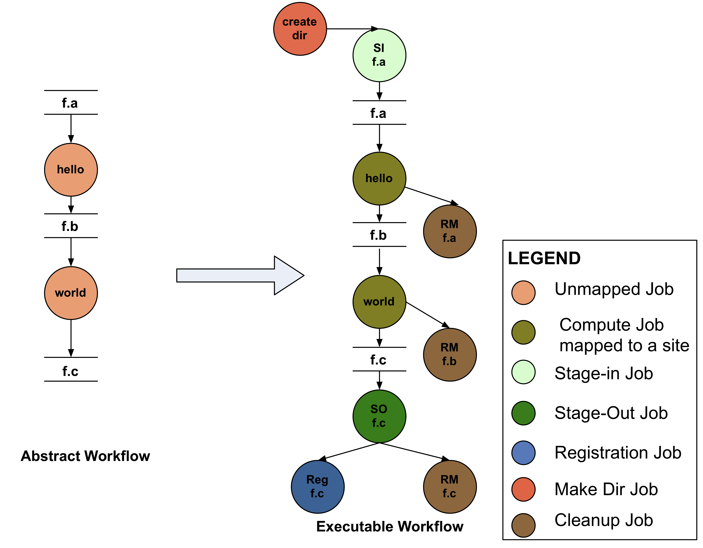
Abstract to Executable Workflow Mapping
Abstraction provides
Ease of Use (do not need to worry about low-level execution details)
Portability (can use the same workflow description to run on a number of resources and/or across them)
Gives opportunities for optimization and fault tolerance
automatically restructure the workflow
automatically provide fault recovery (retry, choose different resource)

Slide 7
Catalogs
Site catalog
Defines the execution environment and potential data staging resources
Simple in the case of Condor pool, but can be more complex when running on grid resources
Transformation catalog
Defines executables used by the workflow
Executables can be installed in different locations at different sites
Replica catalog
Locations of existing data products – input files and intermediate files from previous runs

Slide 8
Supported Data Staging Approaches
NonShared filesystem setup using an existing storage element for staging (typical of OSG and campus Condor pools)
Worker nodes don’t share a filesystem.
Data is pulled from / pushed to the existing storage element.
(Pictured on the next slide)
Condor IO
Worker nodes don’t share a filesystem
Data is pulled from / pushed to the submit host via Condor file transfers
Shared Filesystem setup (typical of XSEDE and HPC sites)
Worker nodes and the head node have a shared filesystem, usually a parallel filesystem with great I/O characteristics
Can leverage symlinking against existing datasets
Notes:
Kent changed 080501 – removed periods

Slide 9
Notes:
On of the things we have done to handle big datasets is created this notion of a staging site or intermediate data site. Since most compute resources may or may not have large data storage capability. This allows us to use a mixture of resources when executing workflows and using the various high performance data protocols that may be available to fetch the data to the compute node for execution as and when its needed.

Slide 10
Workflow Restructuring to improve application performance
Cluster small running jobs together to achieve better performance
Why?
Each job has scheduling overhead – need to make this overhead worthwhile
Ideally users should run a job on the grid that takes at least 10/30/60/? minutes to execute
Clustered tasks can reuse common input data – less data transfers
Level-based clustering

Slide 11
Workflow Reduction (Data Reuse)
Notes:
Sometimes it is cheaper to access the data than to regenerate it
Keeping track of data as it is generated supports workflow-level checkpointing
Kent changed 080501 – added period

Slide 12
Workflow Monitoring - Stampede
Leverage Stampede Monitoring framework with DB backend
Populates data at runtime. A background daemon monitors the logs files and populates information about the workflow to a database
Stores workflow structure, and runtime stats for each task.
Tools for querying the monitoring framework
pegasus-status
Status of the workflow
pegasus-statistics
Detailed statistics about your finished workflow
pegasus-plots
Visualization of your workflow execution
------------------------------------------------------------------------------
Type Succeeded Failed Incomplete Total Retries Total+Retries
Tasks 135002 0 0 135002 0 135002
Jobs 4529 0 0 4529 0 4529
Sub-Workflows 2 0 0 2 0 2
------------------------------------------------------------------------------
Workflow wall time : 13 hrs, 2 mins, (46973 secs)
Workflow cumulative job wall time : 384 days, 5 hrs, (33195705 secs)
Cumulative job walltime as seen from submit side : 384 days, 18 hrs, (33243709 secs)

Slide 13
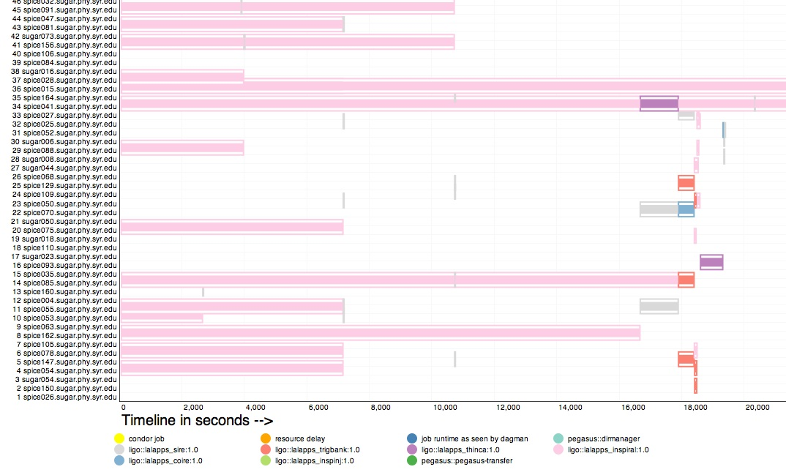
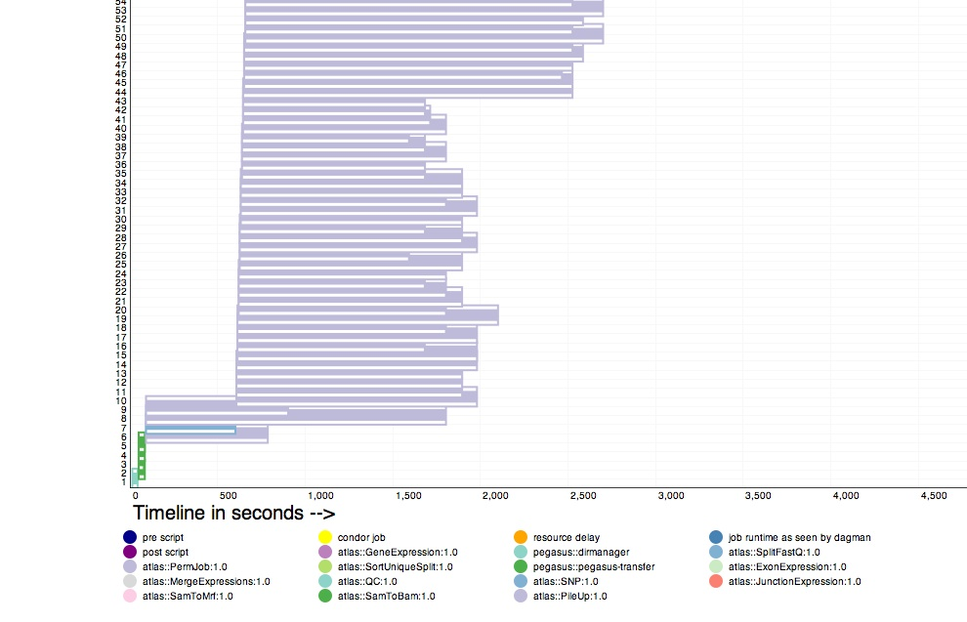
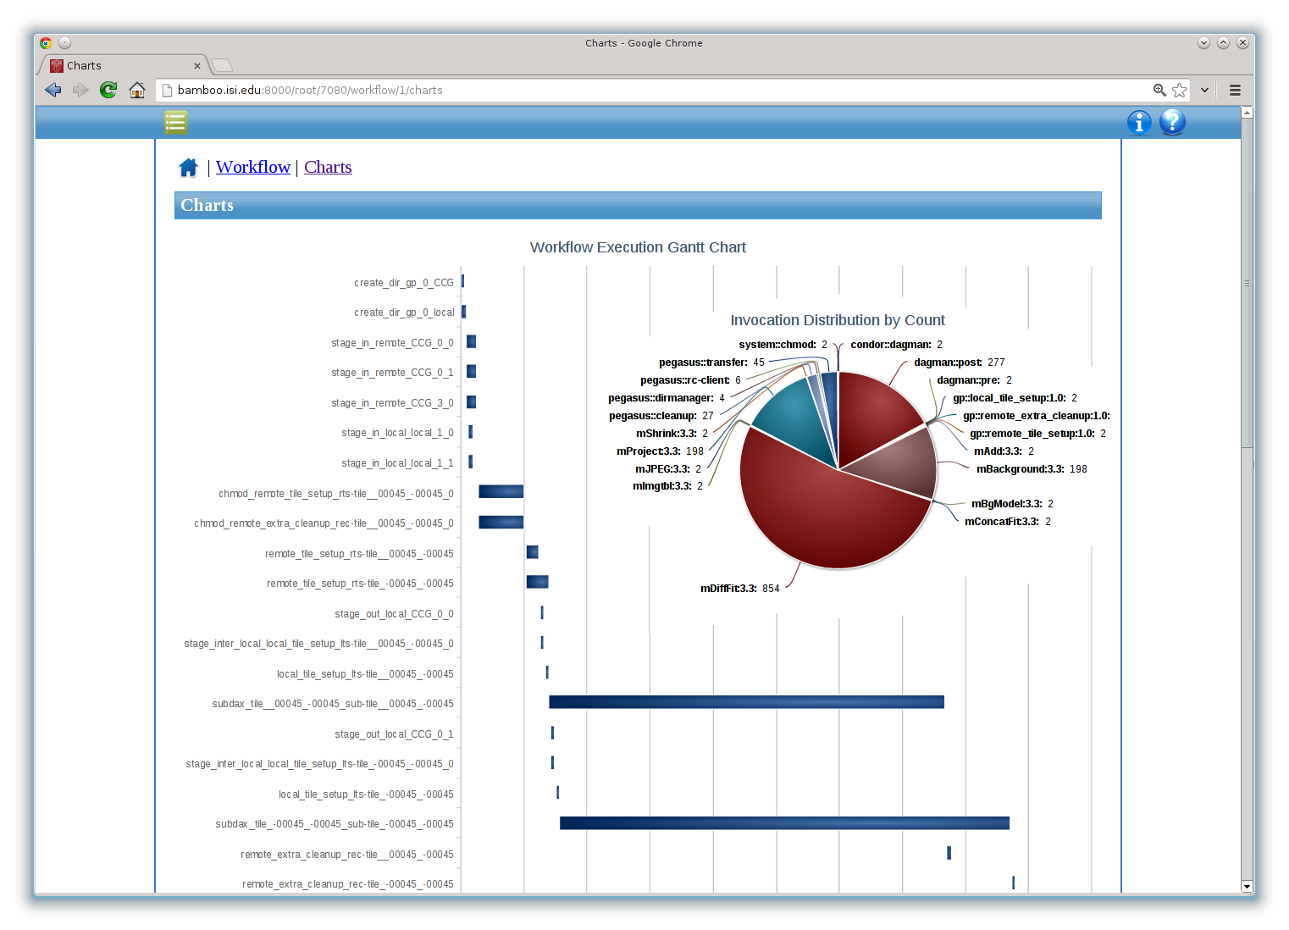
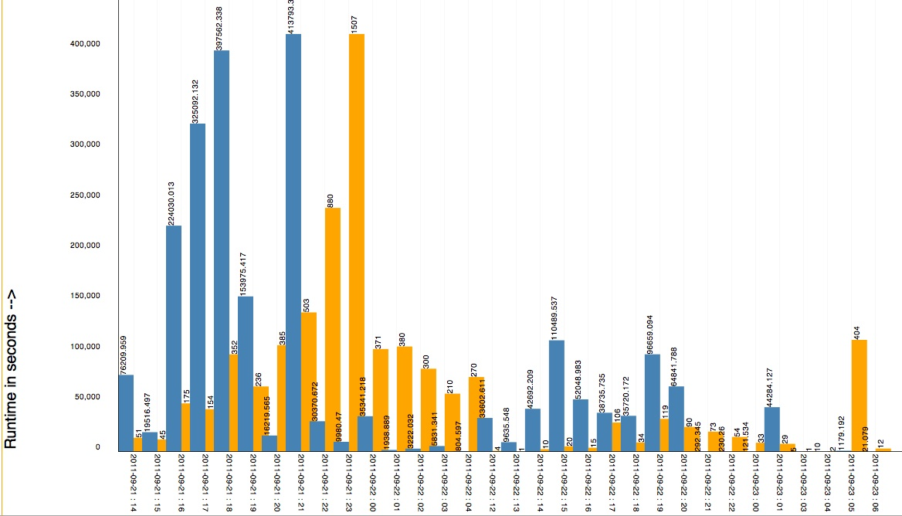
Workflow Monitoring - Stampede
Workflow Gantt Chart
Hosts Over Time – Distribution of Different Job Types on Hosts
Jobs and Runtime over Time

Slide 14
Workflow Debugging Through Pegasus
After a workflow has completed, we can run pegasus-analyzer to analyze the workflow and provide a summary of the run
pegasus-analyzer's output contains
a brief summary section
showing how many jobs have succeeded
and how many have failed.
For each failed job
showing its last known state
exitcode
working directory
the location of its submit, output, and error files.
any stdout and stderr from the job.

Slide 15
Relevant Links
Pegasus: http://pegasus.isi.edu
Tutorial and documentation: http://pegasus.isi.edu/wms/docs/latest/

