Slide 1
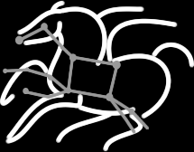
Pegasus Workflow Management System
Gideon Juve
USC Information Sciences Institute

Slide 2
Scientific Workflows
Orchestrate complex, multi-stage scientific computations
Often expressed as directed acyclic graphs (DAGs)
Can execute in parallel on distributed resources
Capture analysis pipelines for sharing and reuse
Setup
Split
Filter & Convert
Map
Merge
Analyze
Epigenomics Workflow

Slide 3
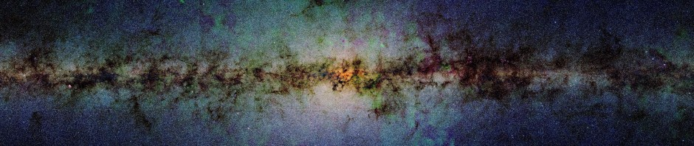
Large, Data-intensive Workflows
John Good (Caltech)
Montage Galactic Plane Workflow
18 million input images (~2.5 TB / wf)
1000 output images (2.5 GB each, 2.4 TB / wf)
10.5 million tasks (34,000 CPU hours)
× 17

Slide 4
Pegasus Workflow Management System (WMS)
A collaboration between USC/ISI and the Condor Team at UW Madison
Pegasus plans the workflow
DAGMan is the workflow engine
Condor schedules jobs and manages resources
Started in 2001
Actively used by many applications in a variety of domains
Earth science, physics, astronomy, bioinformatics, others
http://pegasus.isi.edu/applications

Slide 5
Pegasus WMS

Slide 6
DAGMan – Directed Acyclic Graph Manager
A
Enables dependencies between jobs
Provides reliability
Retries for job-level failures
Rescue DAGs for workflow-level failures
Other features
Throttling
Priorities
Pre- and Post-Scripts
Workflow of workflows
B
C
D
JOB A a.submit
JOB B b.submit
JOB C c.submit
JOB D d.submit
PARENT A CHILD B C
PARENT B C CHILD D
Notes:
What is DAGMan and what are its benefits? (throttling, retries, rescue DAGs, etc.)

Slide 7
Pegasus Planner
Pegasus planner compiles abstract workflows into executable workflows
Adds data management jobs (transfer, cleanup, registration)
Performs optimizations (task clustering, reduction, etc.)
Generates executable artifacts (DAG, submit scripts, etc.)
Enables portability and optimization
Catalogs
Scripts
Condor
Catalogs
Scripts
Information
Catalogs
Submit
Scripts
Pegasus
Planner
DAX
DAG
DAGMan
Notes:
Workflows are expressed as DAXes, which contain no information about resources
Pegasus maps the workflow into a DAG, which is executable
Process involves: 1. Site selection, 2. Replica selection,

Slide 8
Other Pegasus WMS Features
Monitoring and Troubleshooting
Web GUI and command-line tools for reporting and investigating workflow progress and failures
Hierarchical Workflows
“Workflow of Workflows”
Provenance
Generates a database with information about when and where jobs were executed
Others
MPI task clustering (pegasus-mpi-cluster)
Script generation
Notifications
…

Slide 9
Distributed Workflow Challenges/Requirements
Security and identity management
Different credentials on different sites / clusters
Complexity of grid security, X.509
Firewall and network issues, e.g. when using Glideins
Job submission
Local: Dedicated login node / submit host
Remote: Middleware, e.g. Globus GRAM
Data transfer
Need high-performance transfer tools, e.g. GridFTP
Many different protocols/tools (scp, GridFTP, http, irods, srm, s3)
Complex storage configurations

Slide 10
Job Submission in Pegasus
Personal Condor
Local Condor pool
Local Batch (PBS, SGE, etc.)
Remote Condor pool (Condor-C, flocking)
Batch using GRAM, UNICORE, ARC
Glideins with BOSCO or glideinWMS
Batch using SSH w/ BOSCO (scalability?)
Notes:
The point: Pegasus supports many different job submission mechanisms

Slide 11
Distributed Data Management in Pegasus
Pegasus supports many different data configurations
Complex data flows
Many protocols and tools
Push, pull, and 3rd party transfers
Inter-site transfers
Squid, get http, put !http
Site Types
Local site: Pegasus WMS
Storage site: inputs and outputs
Staging site: intermediate
Compute site: compute jobs
Input Site
Local Site
(submit host)
Staging Site
Compute Site
Output Site

Slide 12
Data Management Configurations
Non-shared File System
Shared File System
Condor IO
Submit
Host
Submit
Host
Submit
Host
Local FS
Compute Site
Compute Site
Jobs
Data
WN
WN
WN
WN
Compute Site
Shared
FS
WN
WN
Staging
Site
e.g HPC Cluster
e.g Amazon EC2 w/ S3
e.g. Open Science Grid

Slide 13
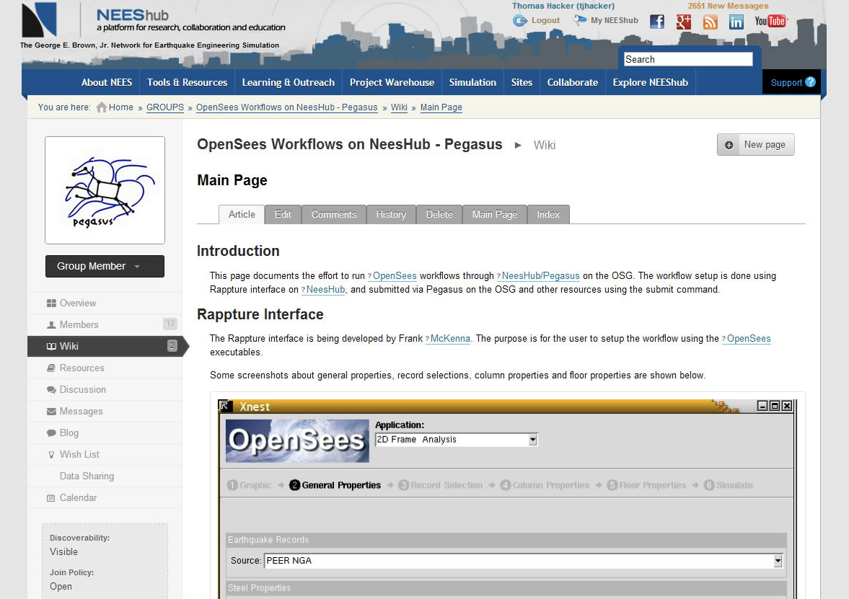
Workflows and Science Gateways
HubZero
Pegasus as a Service
Credit: Frank McKenna, UC Berkeley, NEES, HUBzero
Notes:
How can the Pegasus service make it easier to integrate workflows into science gateways?

Slide 14
More Information
Website: http://pegasus.isi.edu
Email:
pegasus-users@isi.edu
pegasus-support@isi.edu
Pegasus Team @ ISI
Ewa Deelman, Karan Vahi, Gideon Juve, Mats Rynge, Rajiv Mayani

Slide 15
CC-NIE: ADAMANT
Pegasus
ORCA
Jeff Chase, Duke
Ewa Deelman, USC/ISI
Ilya Baldin, UNC CH/RENCI
Charles Schmitt, UNC CH/RENCI

