Slide 1
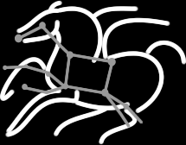
Resource provisioning for high throughput workloads on the national cyberinfrastructure
Mats Rynge
USC Information Sciences Institute

Slide 2
Outline
Workloads HTC / HPC
National cyberinfrastructures
Corral and GlideinWMS
Example applications
NASA IPAC Kepler
SCEC
pegasus-mpi-cluster
OSG as an XSEDE service provider

Slide 3
High Throughput Computing
Sustained computing over long periods of time. Usually
serial codes, or low number of cores threaded/MPI.
vs.
High Performance Computing
Great performance over relative short periods of time.
Large scale MPI.

Slide 4

Why High Throughput Computing?
For many experimental scientists, scientific progress and quality of research are strongly linked to computing throughput. In other words, they are less concerned about instantaneous computing power. Instead, what matters to them is the amount of computing they can harness over a month or a year --- they measure computing power in units of scenarios per day, wind patterns per week, instructions sets per month, or crystal configurations per year.
Slide credit: Miron Livny

Slide 5
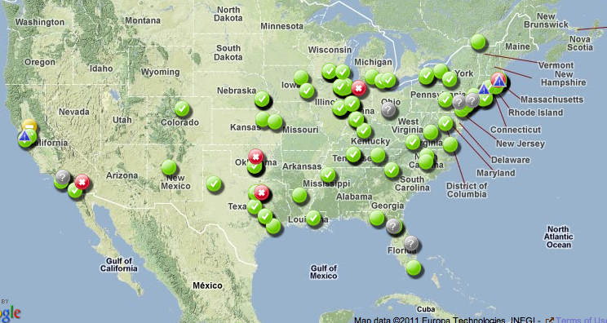
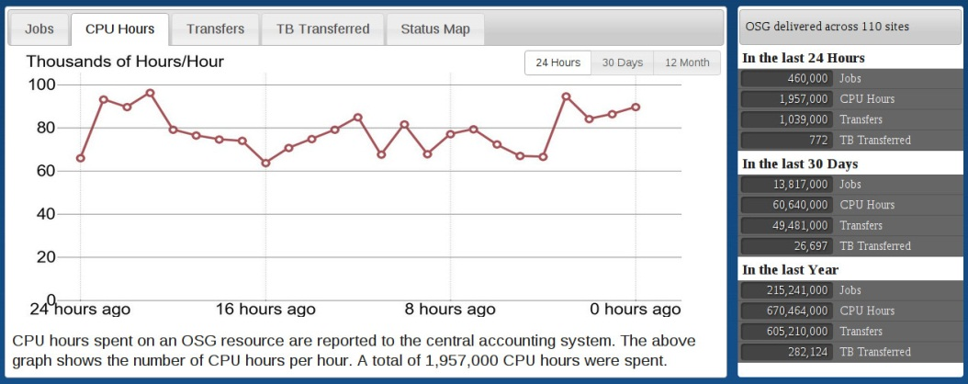
The Open Science Grid
A framework for large scale distributed resource sharing
addressing the technology, policy, and social requirements of sharing
OSG is a consortium of software, service and resource providers and researchers, from universities, national laboratories and computing centers across the U.S., who together build and operate the OSG project. The project is funded by the NSF and DOE, and provides staff for managing various aspects of the OSG.
Brings petascale computing and storage resources into a uniform grid computing environment
Integrates computing and storage resources from over 100 sites in the U.S. and beyond
Notes:
Open Science Grid is a framework for distributed resource sharing. One way of thinking of OSG can be a grid of grids, that is, your campus and regional grids come together into one national grid.
Also note that OSG is a consortium, and that OSG does not own any compute resources. Not that we are picky, but it is actually incorrect to call something a OSG resource. The correct way is to say for example, the UNM_HPC resource which is available using OSG.
OSG today has over 70 resources online.

Slide 6

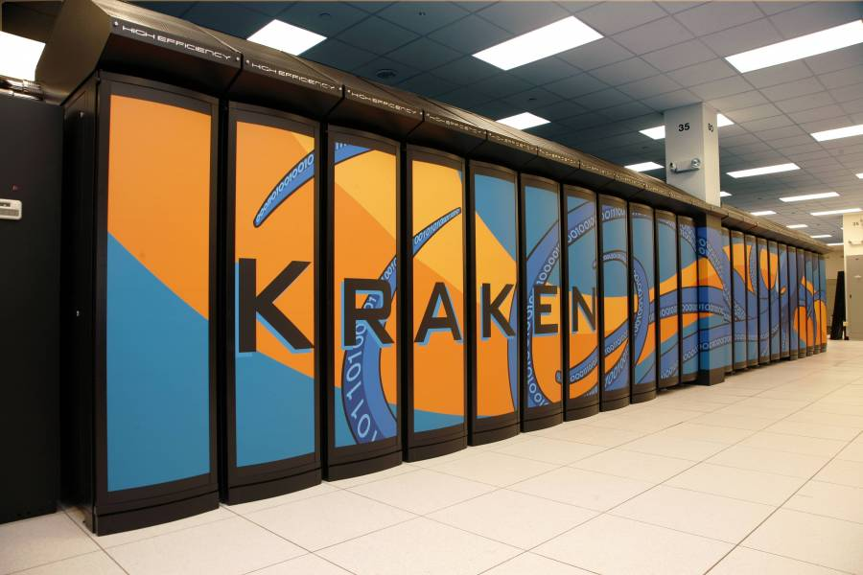
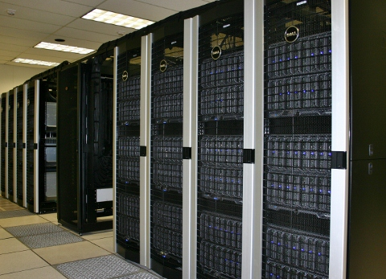
XSEDE
XSEDE supports 16 supercomputers and high-end visualization and data analysis resources
Follow-on to TeraGrid
17 institutions (NCSA, SDSC, TACC, PSU, NICS, …)
120 FTE
Funded by NSF OCI

Slide 7
Bringing National Cyberinfrastructure Resources to the Scientist’s Desktop
Traditional HPC/HTC
Desktop anchored Virtual Resource
ssh/scp access
Grid interfaces?
Copy data / log in to head node / set up environment / submit jobs
Using more than one resource? Repeat.
Familiar environment
Access to local data
Output location?
Flexibility
Running across multiple infrastructures protects the scientist from downtimes, technical site problems, allocation issues, and resource availability

Slide 8
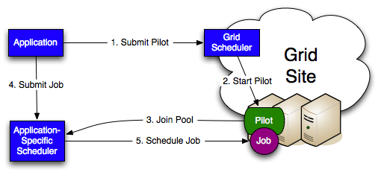
Pilot Jobs
Overlay a personal cluster on top of grid resources
Condor based pilots:
Glideins
Notes:
MLS: Grid scheduler is used to setup an application-specific scheduler

Slide 9
GlideinWMS Overview
Developed to meet the needs for the CMS (Compact Muon Solenoid) experiment at the LHC (Large Hadron Collider)
Frontend watches job queue for demand
Factory uses grid interface to submit jobs (Condor startds)
>100,000 concurrent jobs in production

Slide 10
Corral - History
Corral was a standalone provisioning tool targeting HPC resources
Developed by Pegasus Workflow Management System team
Short jobs
Mixed HPC/HTC workloads
Repurposed as a glideinWMS frontend
Single user mode

Slide 11
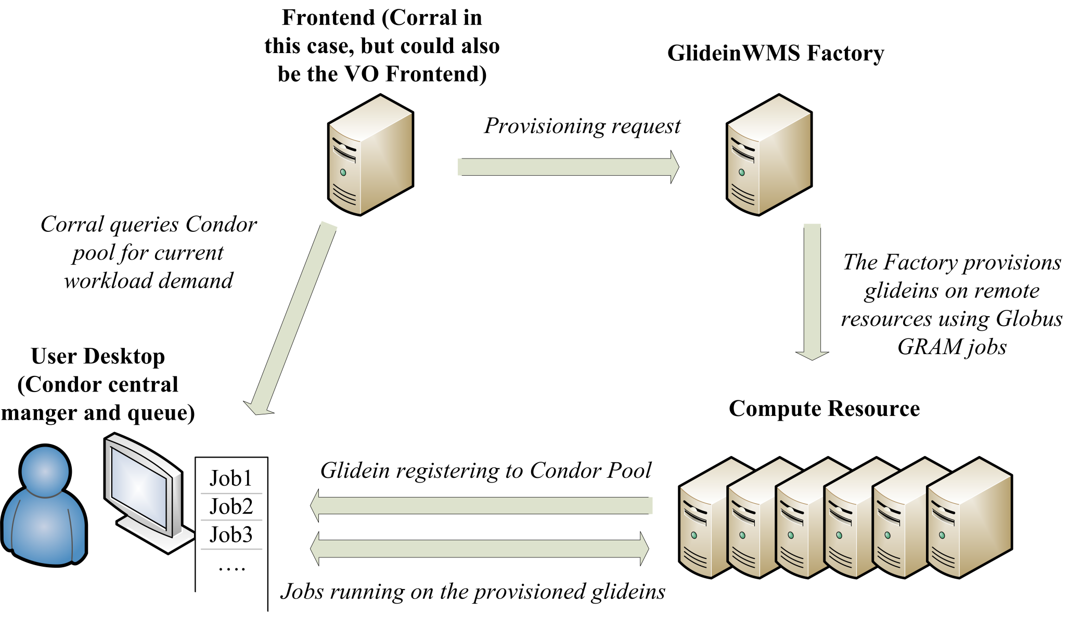

Slide 12
glideinWMS Frontends
VO Frontend
Corral
Concept of VOs
Service certificates
Glideins shared/reused between users
Individual users
Personal certificates
Glideins tied to user
This flexibility allows Corral to acquire a mix of resources with different user/group mappings when running across infrastructures

Slide 13
Desktop Setup
Condor central manager
Collector – for the glideins to register to
Schedd – submit jobs
X.509 security
10 sub collectors
From the users point of view:
Standard Condor pool

Slide 14
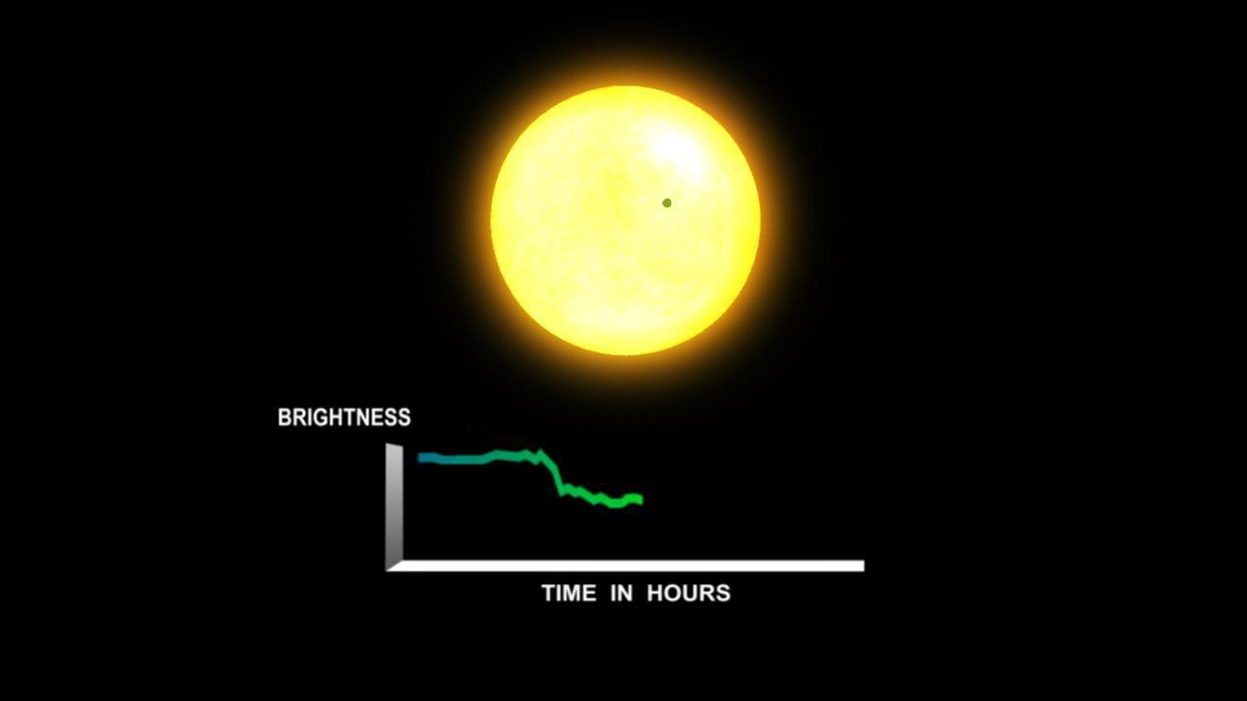
Credit: NASA

Slide 15
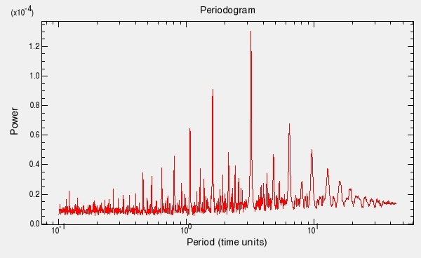
Periodograms
Dataset: ~210,000 stars
Calculates the significance of different frequencies in time-series data to identify periodic signals.
Light curve -> Periodogram -> Event -> Event database
FFT
Three different algorithms
BLS periodogram for Kepler -4b, the smallest transiting exoplanet discovered by Kepler to date.

Slide 16
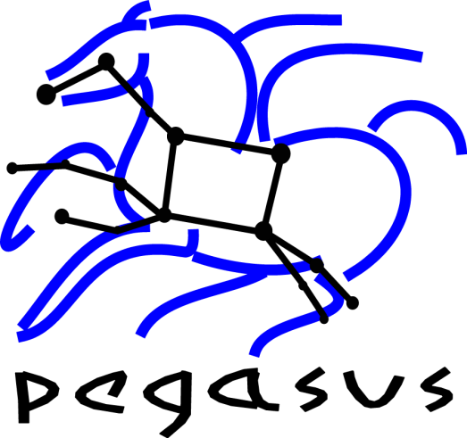
Workflow Details
11 sub workflows, ~ 50000 tasks each
Wall time based job clustering
Simple binning
Target: 1 hour
~ 800 jobs per sub workflow
Execute across available resources: Local, Open Science Grid, TeraGrid

Slide 17
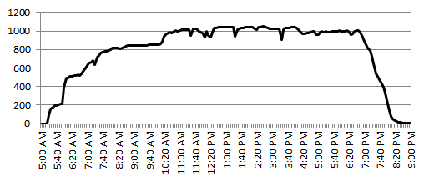
Size of Condor Pool

Slide 18
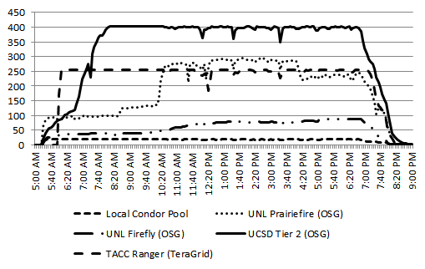

Slide 19
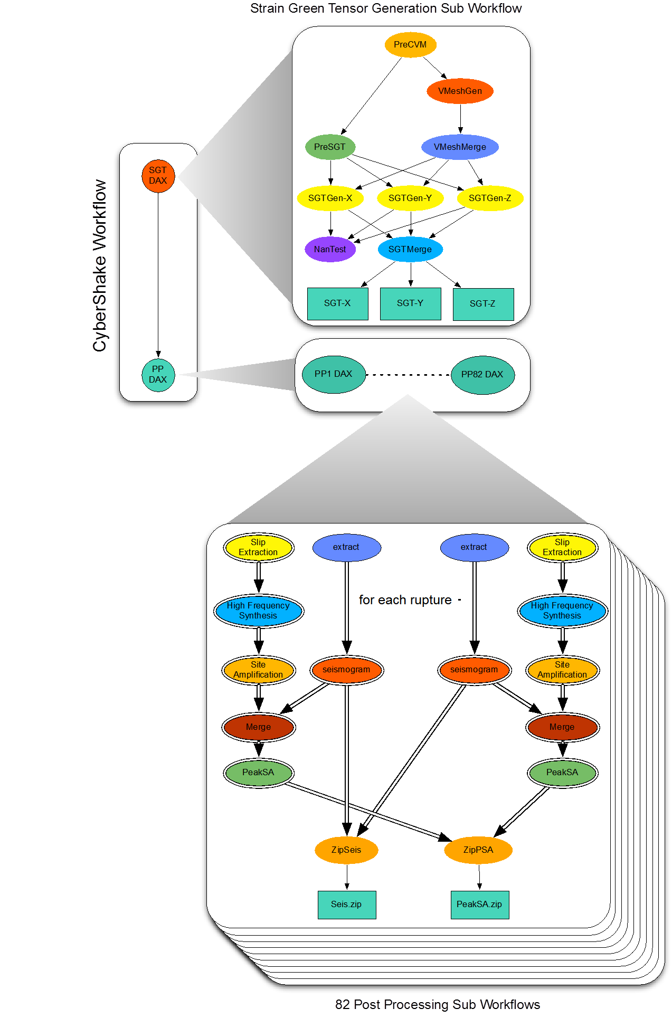
CyberShake
Probabilistic seismic hazard analysis workflow
How hard will the ground shake in the future?
Considers a set of possible large earthquakes
415,000 earthquakes is typical
Uses Pegasus and HTCondor DAGMan for workflow management
Hierarchal workflows
Small set of large parallel jobs
840,000 serial jobs, in 78 sub workflows

Slide 20
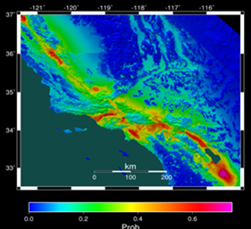
Probabilistic Seismic Hazard Analysis (PSHA) curve. Estimates the probability that earthquake ground motions will exceed some intensity measure.
Set of PSHA curves interpolated creates hazard map for an area

Slide 21
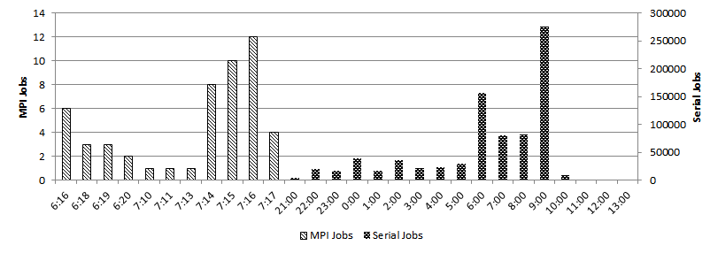
A mix of MPI and serial jobs

Slide 22
Glideins on NICS Kraken?
Cray XT System Environment / ALPS / aprun
Login node
aprun node
Compute node

Slide 23
Approach
Partition workflow into subgraphs
Execute partition as a self-contained MPI job

Slide 24
pegasus-mpi-cluster
Master/worker paradigm
Master manages the subgraph tasks, handing out work to the workers
Efficient scheduling / handling of input/outputs
Subgraph described in a DAG-similar format
Failure management / rescue DAG

Slide 25
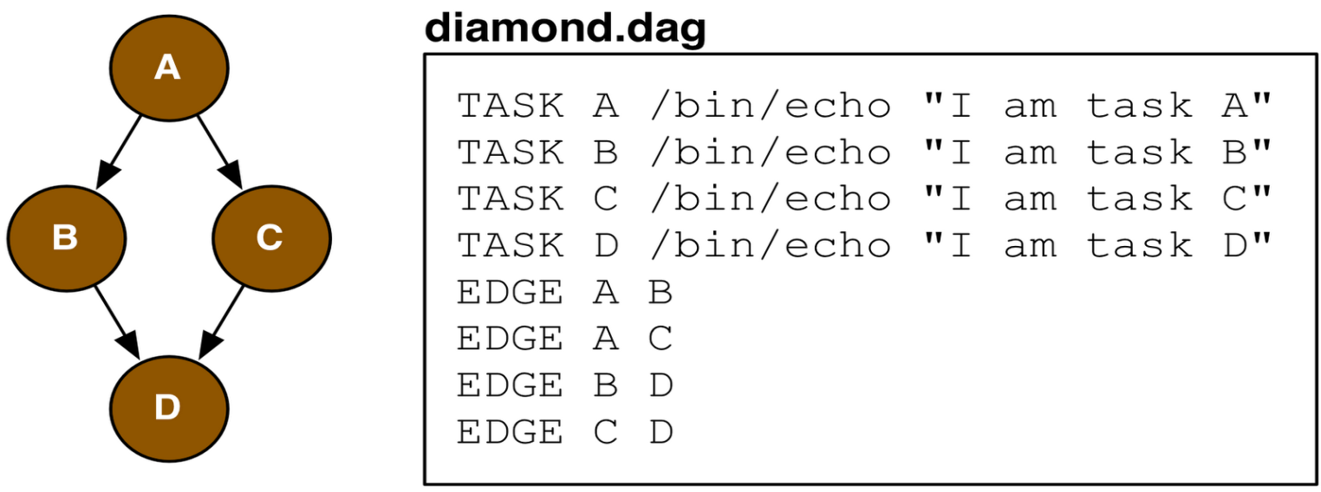

Slide 26
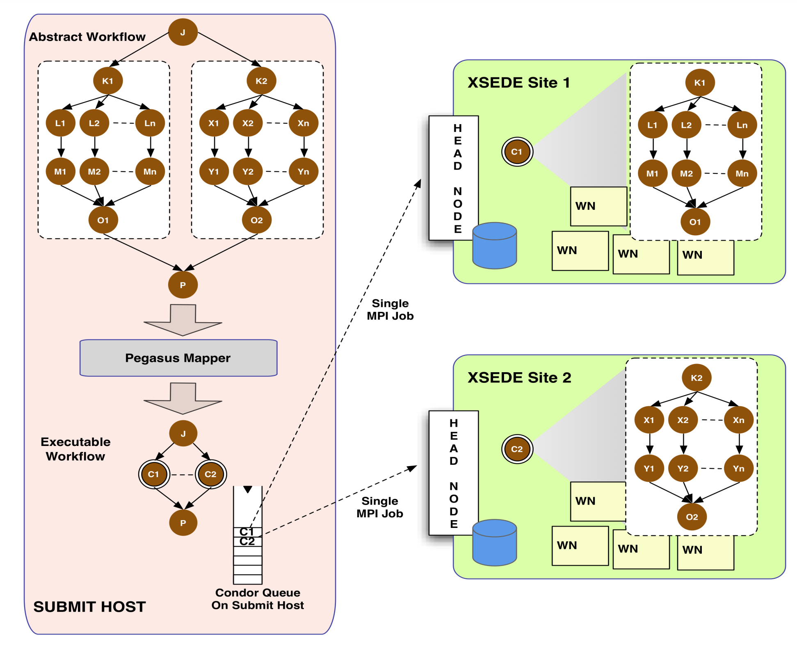

Slide 27
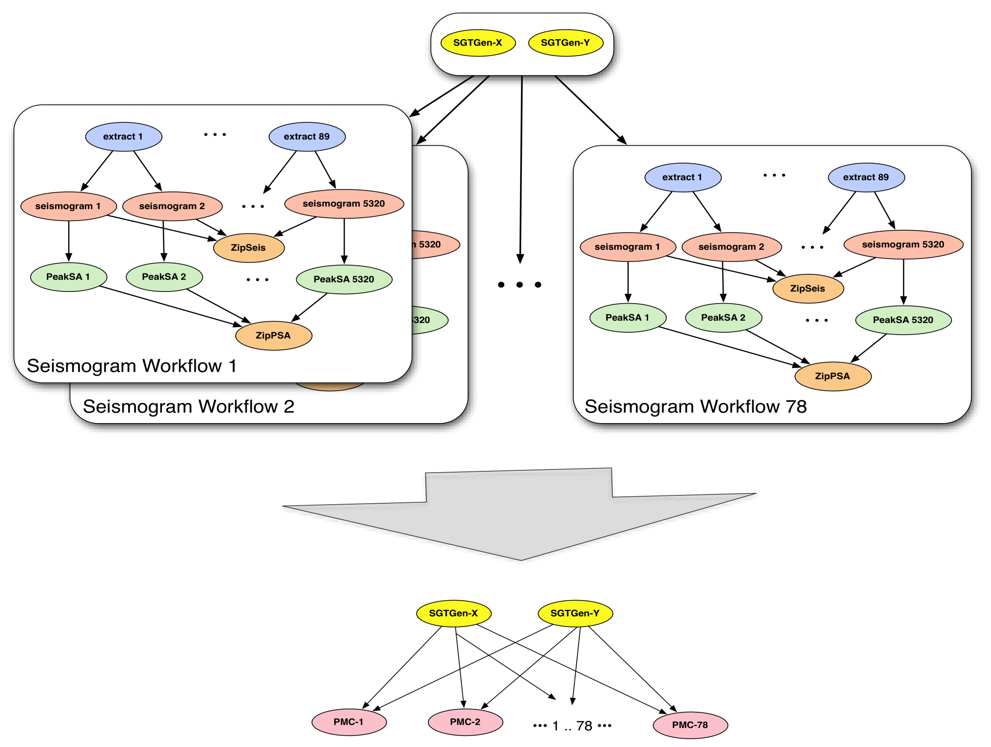

Slide 28
PMC - Future Work
Demonstrated efficient execution of fine-grained workflows on petascale resources by partitioning workflow into MPI master/worker jobs
Size of partition?
Size of MPI job?
Handing tasks with mixed requirements?
pegasus-mpi-cluster now considers memory to be a consumable resource

Slide 29
OSG is now an XSEDE service provider
HTC / HTPC
Implemented as a login host with a dynamically sized Condor pool drawn from opportunistic cycles available at OSG sites
(i.e. a GlideinWMS frontend)
Currently contributing 2M SUs / quarter
Challenges
XSEDE is based on allocations / OSG on opportunistic use
XSEDE has a central database with allocations and users / OSG has distributed VOs
Collecting and aggregating usage data to both XSEDE and OSG

Slide 30

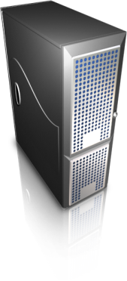
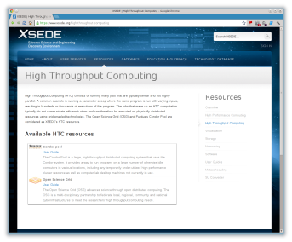
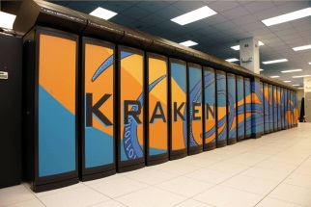

OSG-XSEDE Interface
OSG Sites
Login host
osg-xsede.grid.iu.edu
Flocking / user submit hosts
workflow.isi.edu
XSEDE users login to the “OSG Virtual Cluster”, which provides an abstraction layer to access the distributed OSG fabric. This interface allows XSEDE users to view the OSG as one resource where they submit their jobs, provide the inputs and retrieve the outputs.
XSEDE
Service
Providers

Slide 31
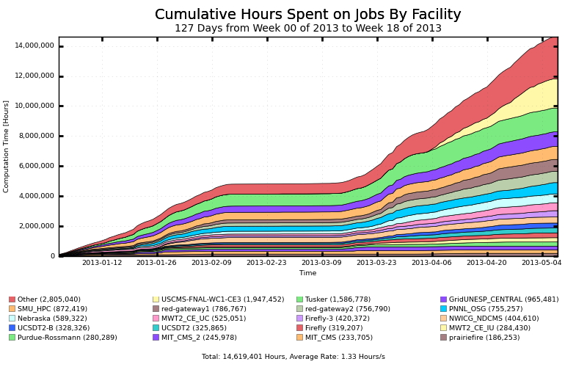
OSG-XSEDE: Where do the resources come from?

Slide 32
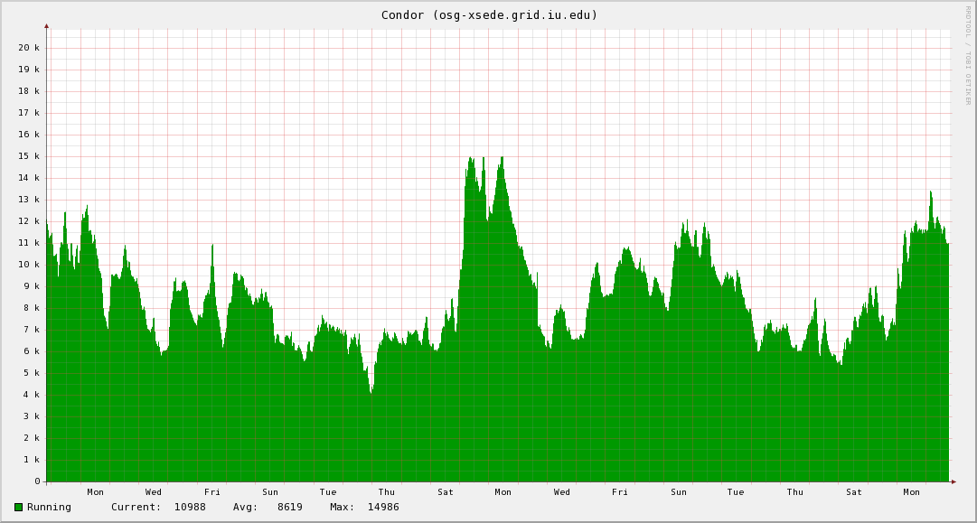
OSG-XSEDE Running jobs

Slide 33
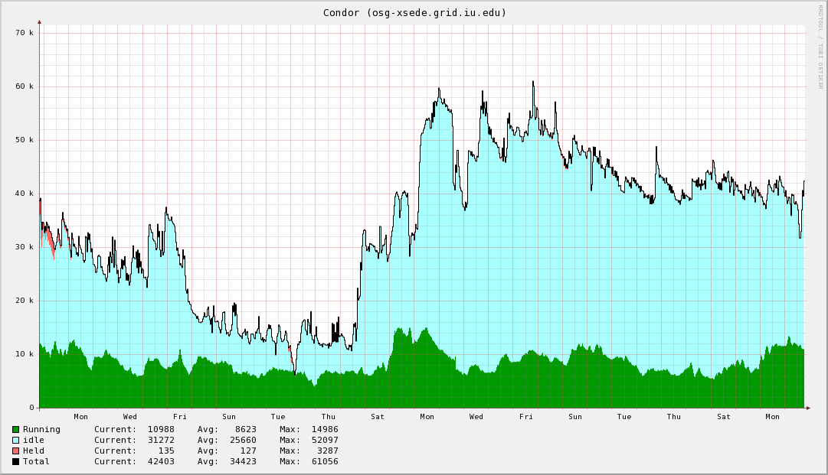
OSG-XSEDE Running and pending jobs

Slide 34
Looking forward
GlideinWMS
3.1 release
Clouds
Pegasus-mpi-cluster sizing advanced features
Continue to operate and evolve OSG-XSEDE
Questions?

Slide 36
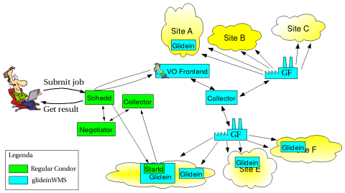
GlideinWMS

Slide 37
GlideinWMS groups and two-level matching
First level to determine what type of glidein is needed
Maps job to a group: main, large memory, long job, HTPC, …
Second level to match a job to a provisioned glidein
Startd limits jobs to a particular group
User can use job requirements to limit within the group

Slide 38
Multislot Requests
Mapping demand from user job queue to a factory request to a single grid job requesting N slots
Efficiency – grow the pool quickly
Queue limits – only allowed 7 jobs in the queue

Slide 39
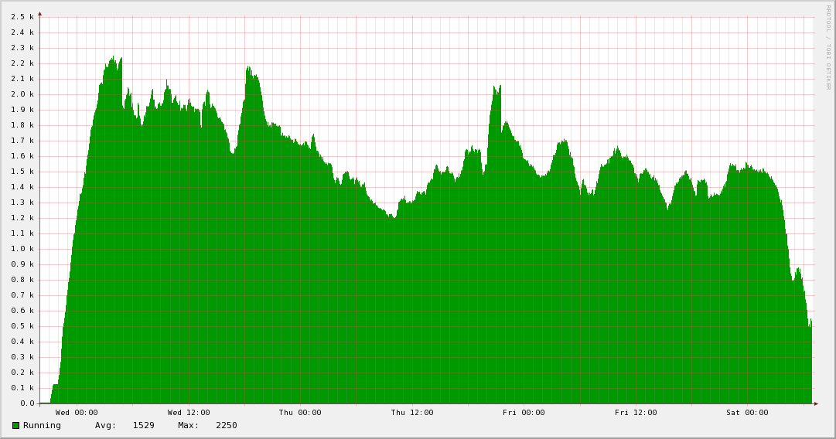
Periodogram Jobs Running on the Open Science Grid
5.5 CPU years in 3 days

