Slide 1

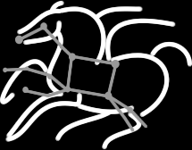

Producing a Multiwavelength Galactic Plane Atlas Using Montage, Pegasus and Amazon Web Services
Mats Rynge¹, Gideon Juve¹, Jamie Kinney², John Good³, Bruce Berriman³, Ann Merrihew², Ewa Deelman¹
¹USC Information Sciences Institute
²Amazon Web Services
³Infrared Processing and Analysis Center, Caltech

Slide 2
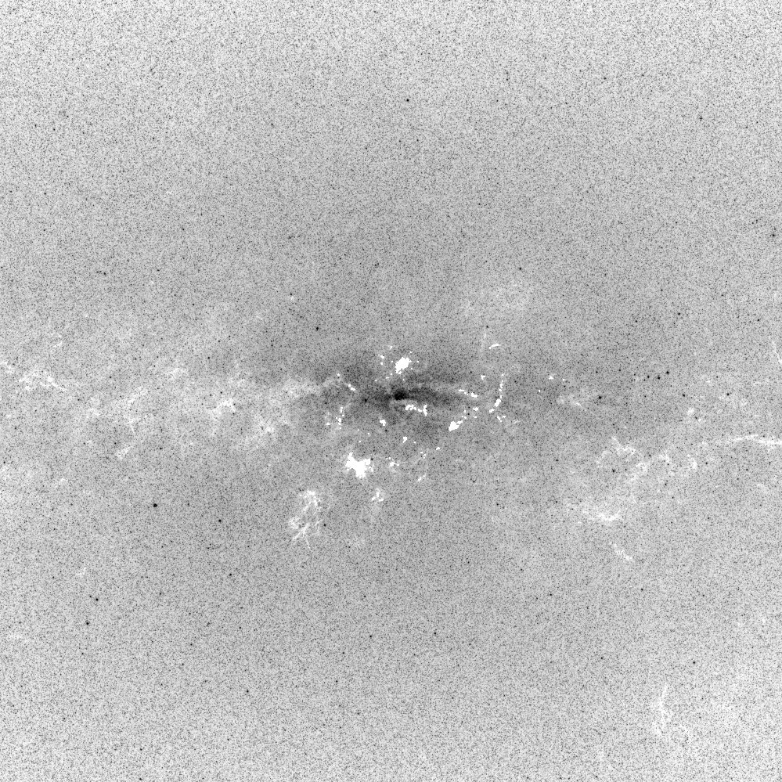
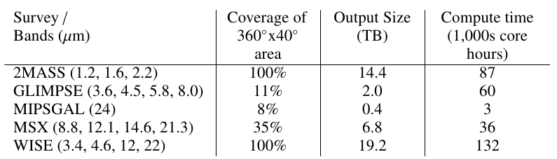
Science Goal
Multiwavelength image atlas of the Galactic Plane, with coverage of 360° along the galactic plane and ±20° on either side
16 different wavelengths from 1 µm to 24 µm
Each output image is 5° by 5° in size, and have an overlap of 1° with neighboring tiles
Processed so that they appear to have been measured with a single instrument observing all 16 wavelengths - Cartesian projection
When complete, the data will be released to the community via an API

Slide 3
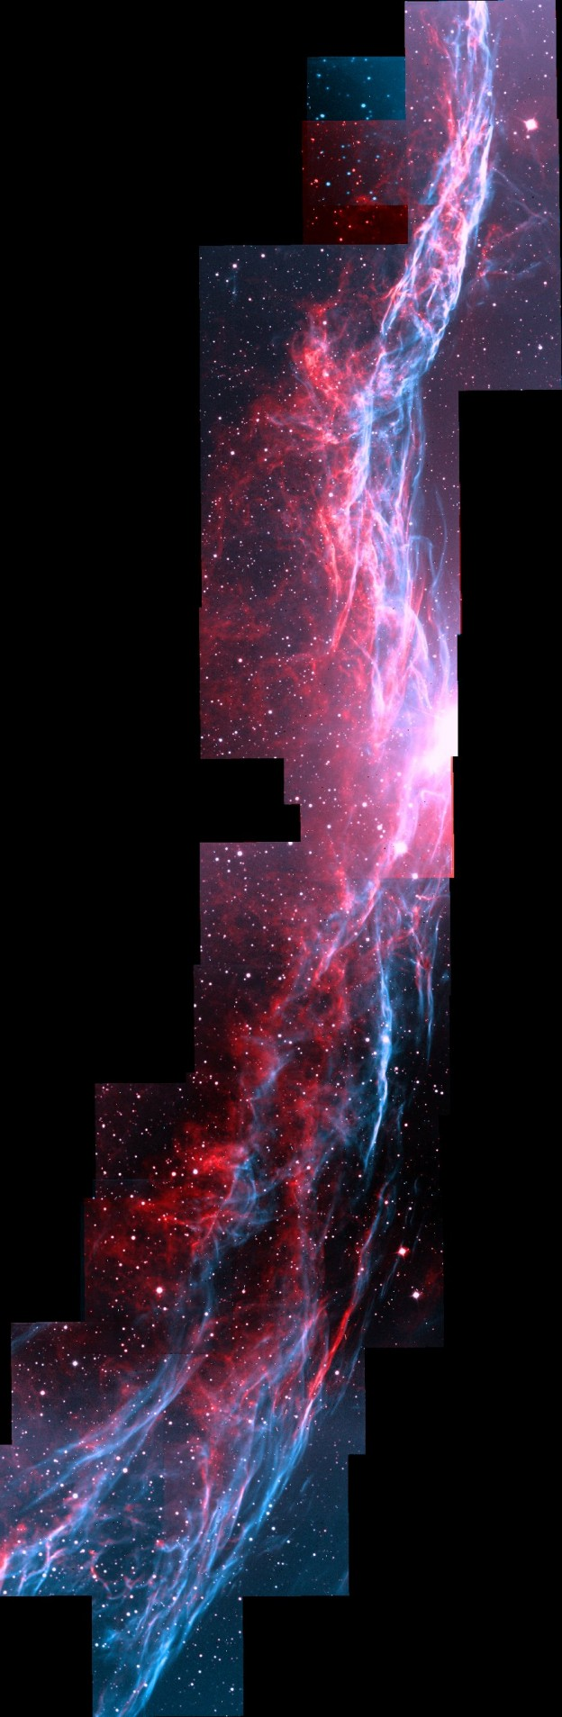
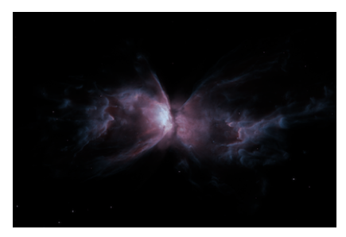
The Montage Image Mosaic Engine
Toolkit written in ANSI-C for creating and managing image mosaics in FITS format.
Portable and scalable – runs on desktops, grids and cloud computing platforms under *nix platforms.
Code available through clickwrap license at Caltech.
Widely adopted by astronomy and IT communities: used on desktops, integrated into processing pipelines, used in development cyber-infrastructure

Slide 4
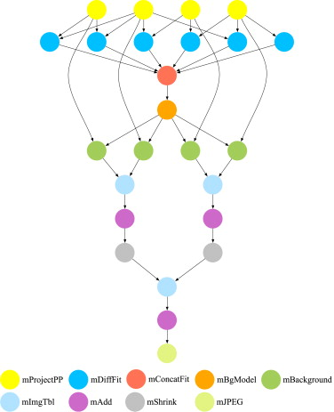
Pegasus Workflow Management System
Builds on top of HTCondor and DAGMan.
Abstract Workflows - Pegasus input workflow description
Workflow “high-level language”
Only identifies the computation, devoid of resource descriptions, devoid of data locations
Pegasus is a workflow planner/mapper (“compiler”)
Transforms the workflow for performance and reliability
Automatically locates physical locations for both workflow components and data
Collects runtime provenance

Slide 5
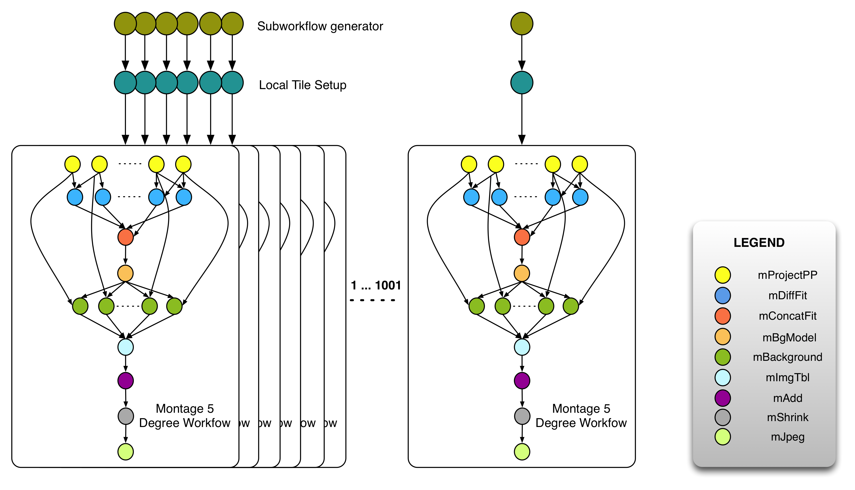
Galactic Plane Workflow
16 hierarchal workflows
Each one with 1,001 subworkflows
Over 10M input files
45 TB output dataset

Slide 6
System Overview

Slide 7
Numbers
Amazon Web Services contributed the computations and storage
hi1.4xlarge instance (the one we used)
Memory optimized, with 2 x SSD ephemeral drives
318,000 core hours
Spot instance price: $5,950
cc2.8xlarge instance (benchmarked)
Compute cluster optimized, with 4 ephemeral drives (2 used)
274,000 core hours
Spot instance price: $2,200

Slide 8
Questions?
rynge@isi.edu
Pegasus - http://pegasus.isi.edu/
NSF funded
Open Source
Documentation, tutorial, and support available on website
Montage - http://montage.ipac.caltech.edu/
Amazon Web Services - http://aws.amazon.com/

