Slide 1
Rethinking Data Management For Big Data
Scientific Workflows
Karan Vahi , Mats Rynge, Gideon Juve,
Rajiv Mayani, Ewa Deelman
USC Information Sciences Institute

Slide 2
Outline
Introduction
Object Stores for Workflows
Pegasus Data Management
Experiments
Conclusions and Future Work

Slide 3
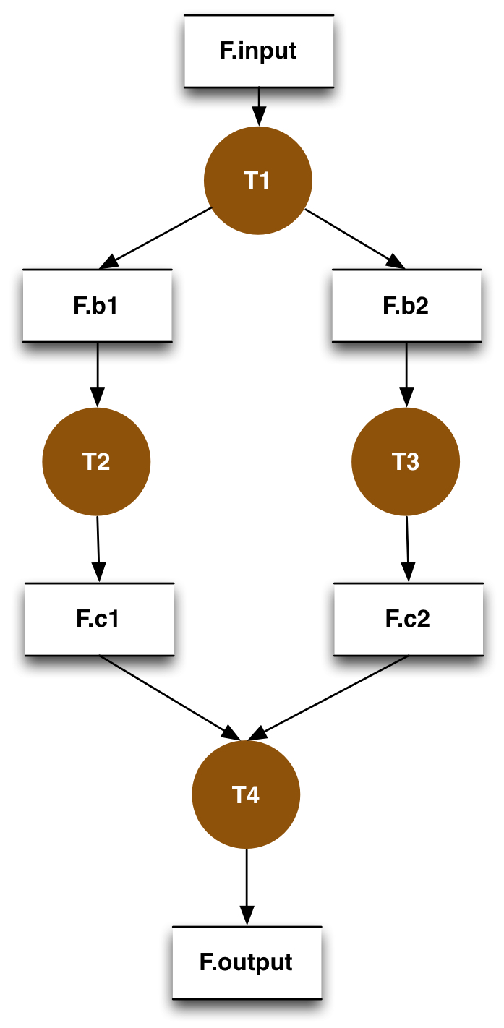
Scientific Workflows
Capture individual data transformation and analysis steps
Large monolithic applications broken down to smaller jobs
Smaller jobs can be independent or connected by some control flow/ data flow dependencies
Usually expressed as a Directed Acyclic Graph of tasks
Files are classified as
  Input Files: ( F.input ) not generated by any task.
  Intermediate Files: (F.b1,F.b2,F.c1,F.c2) generated during workflow execution
  Output Files: ( F.output ) – files generated that are of interest to the user.

Slide 4
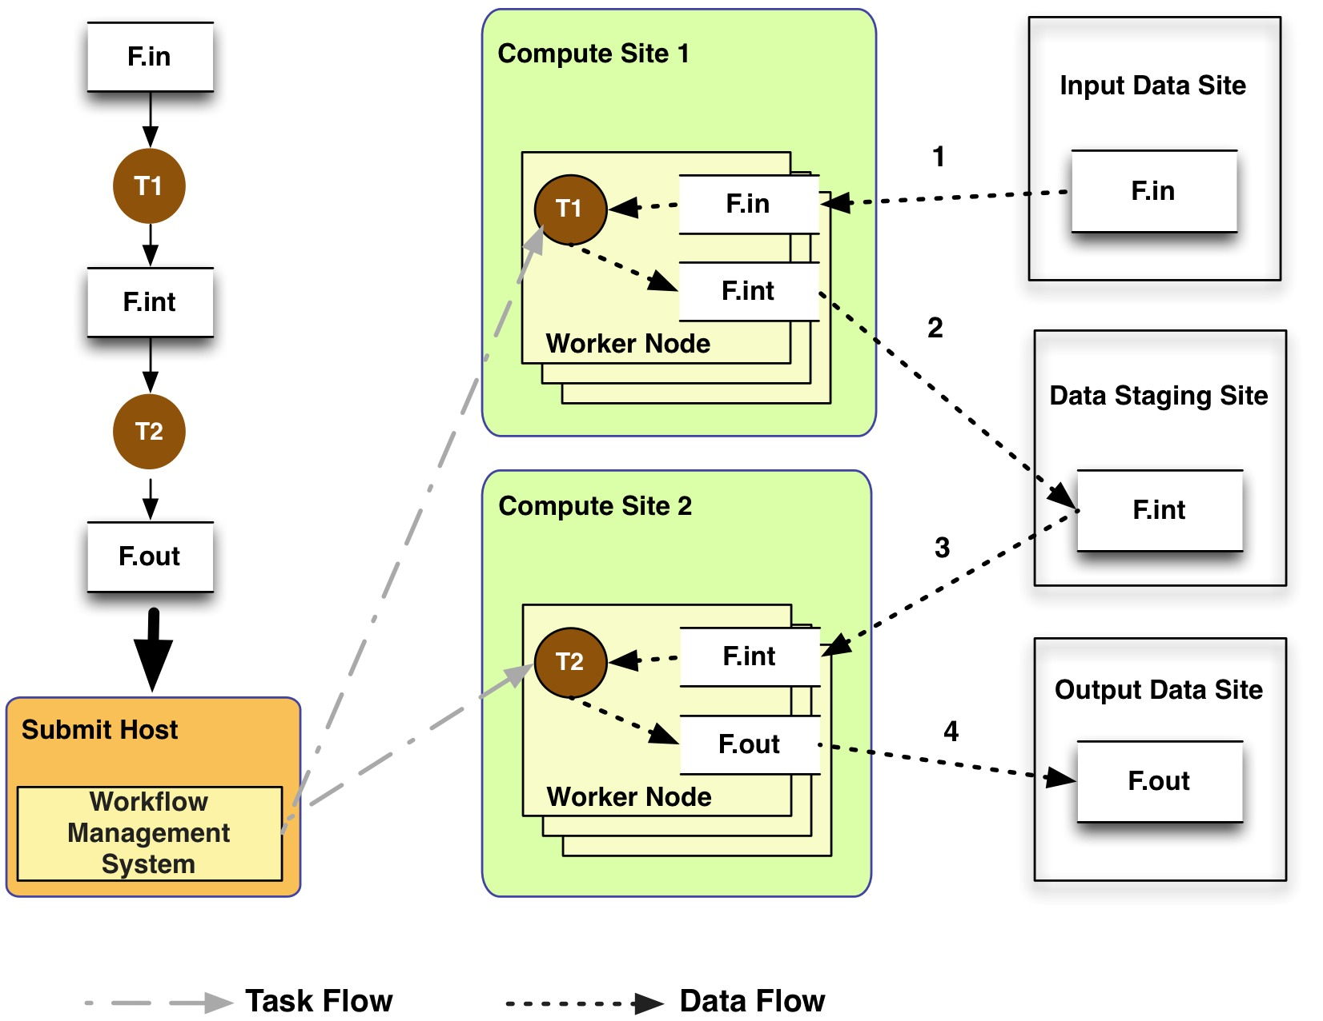
General Workflow Execution Model
Most of the tasks in scientific workflow applications require POSIX file semantics
  Each task in the workflow opens one or more input files
  Read or write a portion of it and then close the file.
Input Data Site, Compute Site and Output Data Sites can be co-located
  Example: Input data is already present on the compute site.
Notes:
Remember to describe each type of site

Slide 5
Posix Access for Tasks in the workflow
How do you ensure posix access for the tasks?
  Place it directly on local filesystem of the worker node from the input site.
  Place it on a shared filesystem shared across nodes.
Direct Transfers to local filesystem
  Job starts and retrieves input data from input site.
  Not efficient for large datasets that are shared across jobs.
Shared Filesystem sounds appealing but problems for Big Data workflows
  Shared storage at a computational site maybe limited. Cannot accommodate all files required for a large workflow.
  In some cases, shared filesystem may have limited scalability NFS
  Harder to setup a shared filesystem in a dynamic environment like computational clouds.
    Users are not going to configure a shared FS across their VMs

Slide 6
Outline
Introduction
Object Stores for Workflows
Pegasus Data Management
Experiments
Conclusions and Future Work

Slide 7
Object Storage for Workflows
Object Store: high level storage service with limited operations
  Store, retrieve and delete data objects(files)
  Don’t provide byte level access
    Cannot open a file in an object store, read and update it and then close it.
    Instead a client needs to download the file, update it and then store as a new object.
  Highly scalable and available such as Amazon S3
Highly appealing for workflow systems to integrate object stores.
  Support both late and early binding of tasks.
  Do all of this as generally as possible: Can we still support shared filesystem approach and traditional grid storage services and protocols?

Slide 8
Leveraging Object Stores in Workflow Systems
View traditional grid services like GridFTP, SRM, IRODS as object stores
  Store, retrieve and delete data (files)
  Don’t support random read or writes like object stores.
  This generalization is important to lay out the different data management models.
Two general options for using object stores
  Use object stores for storing all 3 types of data
  When, available use a shared filesystem as a data staging site.

Slide 9
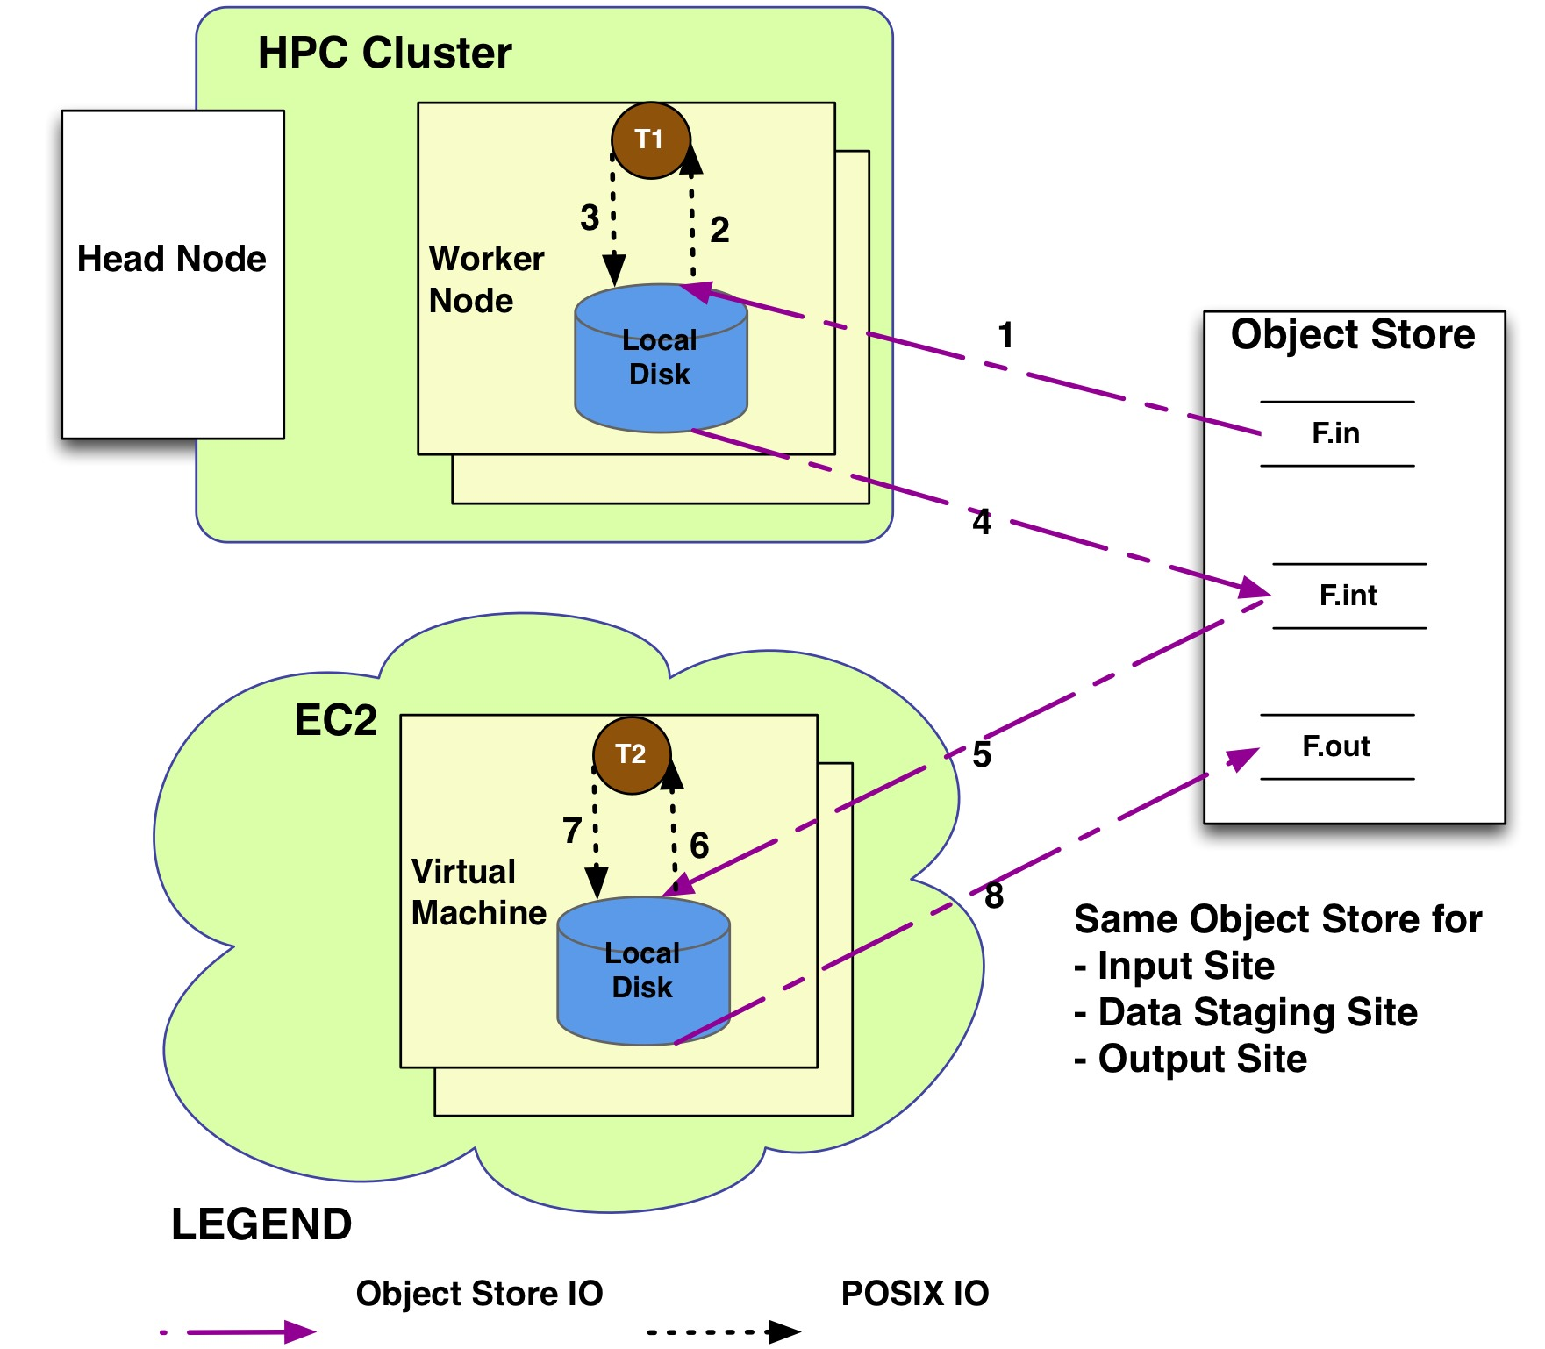
Exclusive Use of Object Stores
Advantages
  Can leverage scalable stores
  Distribute computations across resources, such as supporting spillover from local resources to cloud resources.
  Great bandwidth
Disadvantages
  Duplicate Transfers
  Latencies in transferring large number of files.
  Added costs for duplicate transfers.
Workflow System retrieves files from Object Store and makes it available to the workflow task on the local disk on a worker node.
Notes:
Remember to describe each type of site

Slide 10
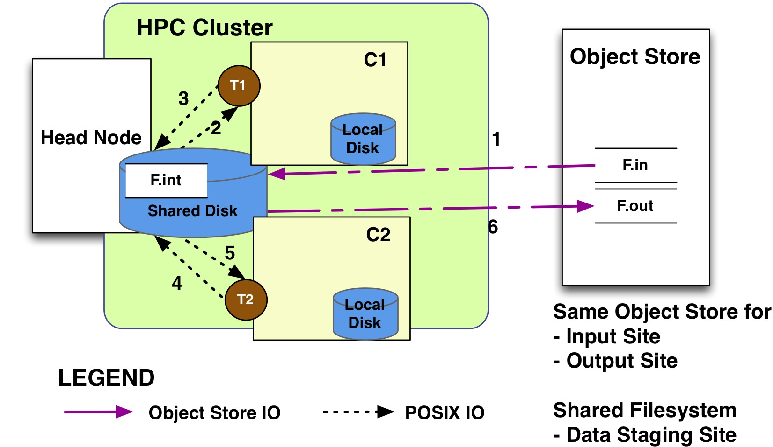
Use of Shared Filesystem as Data Staging Site
Advantages
  No duplicate transfers for intermediate and input files
  Lowers costs against a commercial object store as intermediate files are not put in the store
  Works well in traditional supercomputing environment such as XSEDE.
Disadvantages
  Loss of flexibility where to place the tasks.
  Setup not easy to recreate in the cloud.
Workflow stages the input data on demand to a shared POSIX compliant filesystem shared across worker nodes. Acts as data staging site.
Notes:
Remember to describe each type of site

Slide 11
Outline
Introduction
Object Stores for Workflows
Pegasus Data Management
Experiments
Conclusions and Future Work

Slide 12
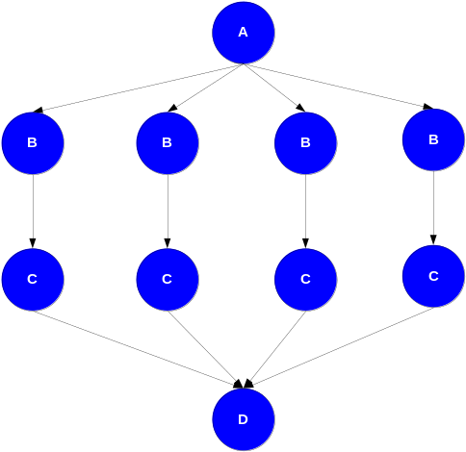
Pegasus Workflow Management System
Abstract Workflows - Pegasus input workflow description
  Workflow “high-level language”
  Only identifies the computation, devoid of resource descriptions, devoid of data locations
  File Aware
Pegasus is a workflow “compiler” (plan/map)
  Target is DAGMan DAGs and Condor submit files
  Transforms the workflow for performance and reliability
  Automatically locates physical locations for both workflow
  components and data
  Collects runtime provenance

Slide 13
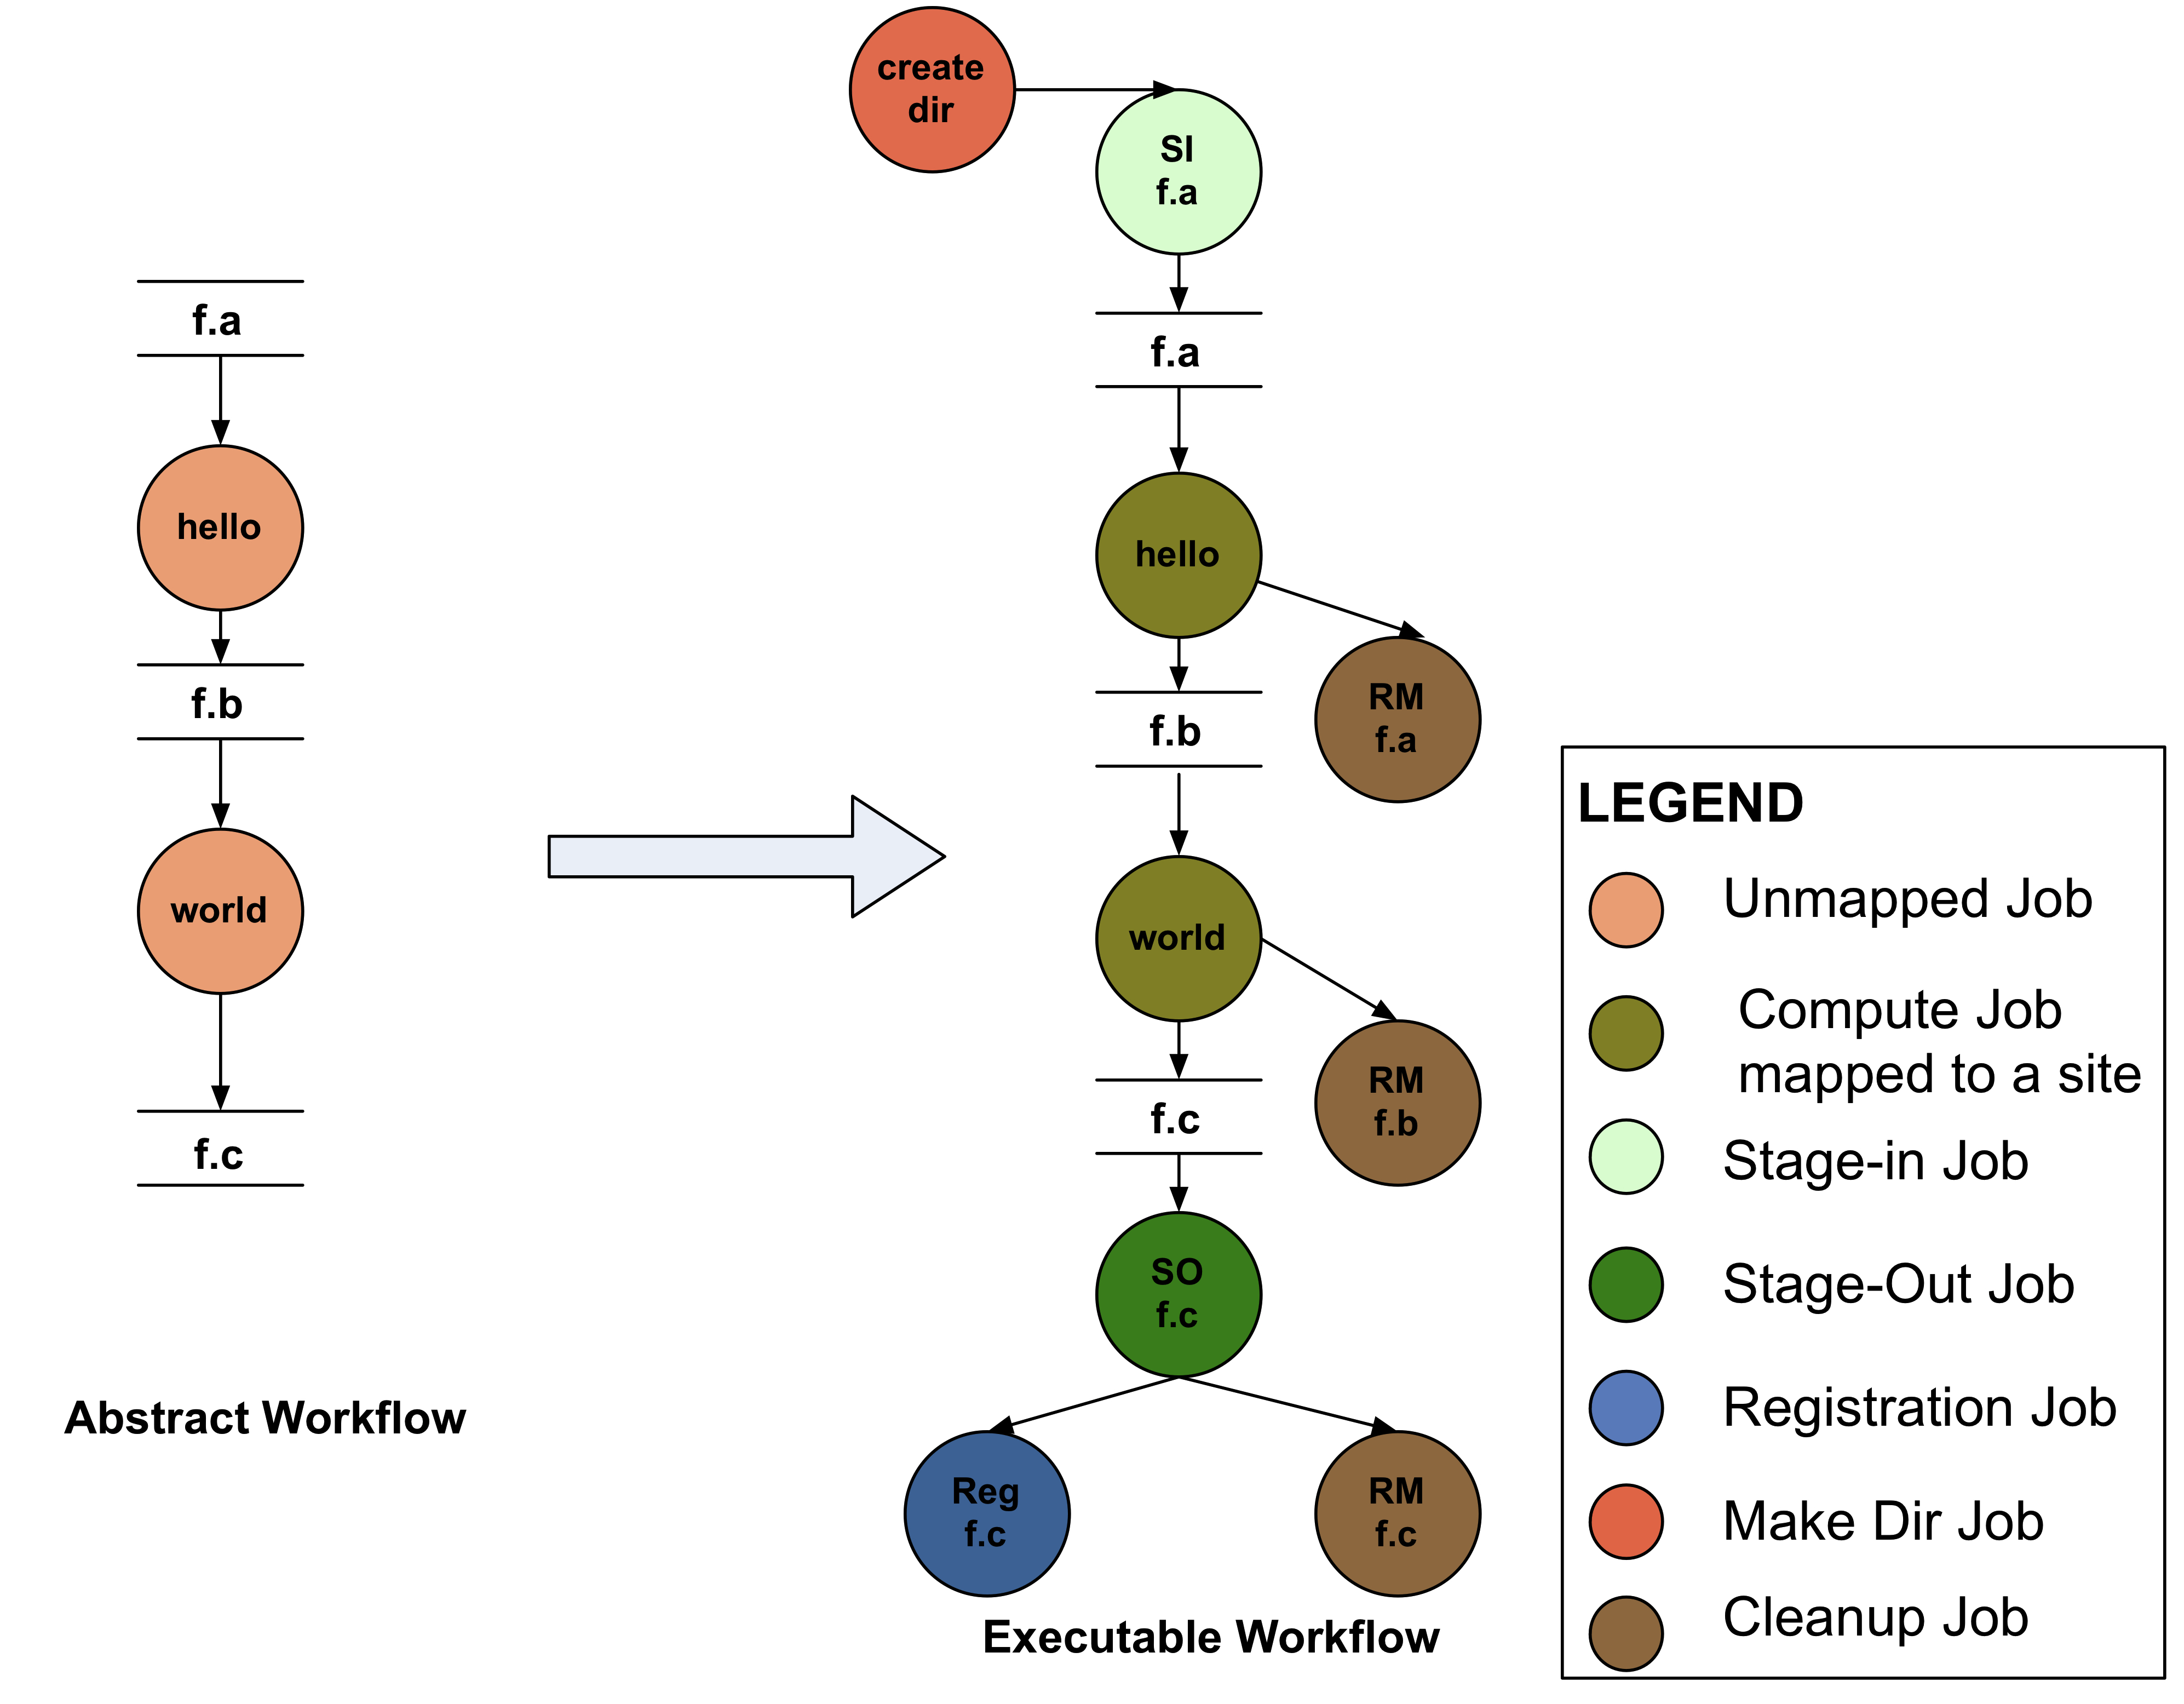
Abstract to Executable Workflow Mapping
During mapping process, Pegasus:
  Figures out where a job is run
  What input data to use, adds data stagein and stageout to stage in and out the data.
Advantage of having separate data stage-in and stage-out nodes
    Optimizations like limiting the number of stage-in nodes for large workflows
    No pre-staging of input data
    Can symlink against existing data.
    Allows for funneling in data when interfacing with low performance data servers.

Slide 14
Pegasus Data Management
Earlier Approach
  Stage-in nodes always staged input data to shared filesystem on compute site.
  Static binding of jobs. Made it hard to support late binding of tasks.
New Hybrid Approach
  Data Staging Site
  Still add data stage-in nodes and stage-out nodes, but don’t tie to execution site. Instead place it on a data-staging site for the execution site.
  Stores input data and all intermediate data
  Pegasus Lite
  Pegasus Mapper does workflow level reasoning and optimizations.
  Delagates set of runtime decisions to Pegasus Lite that runs on worker nodes
    Discovers directory on which to run the tasks
    Pulls in the data from input site or data staging site
    interfaces with local transfer tools present on the nodes.
    Runs the task
    Stageout the data back to data staging site.

Slide 15
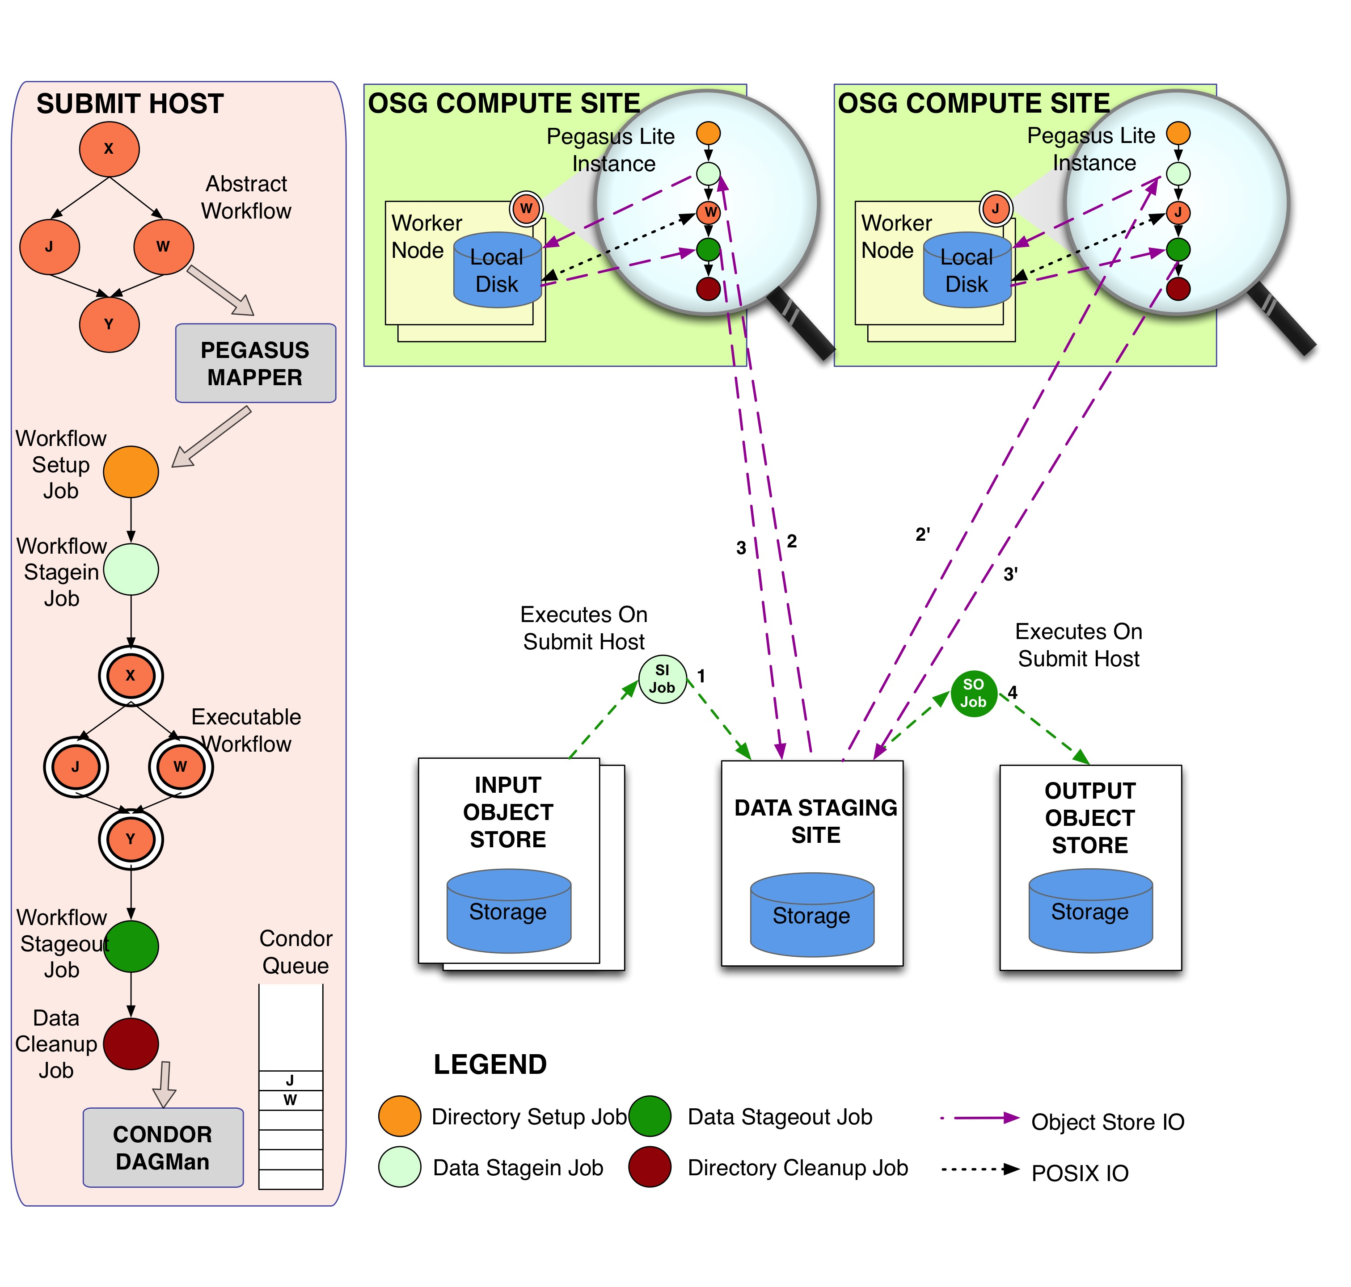
Pegasus Data Configuration: Workflows on OSG using SRM as Data Staging Site.

Slide 16
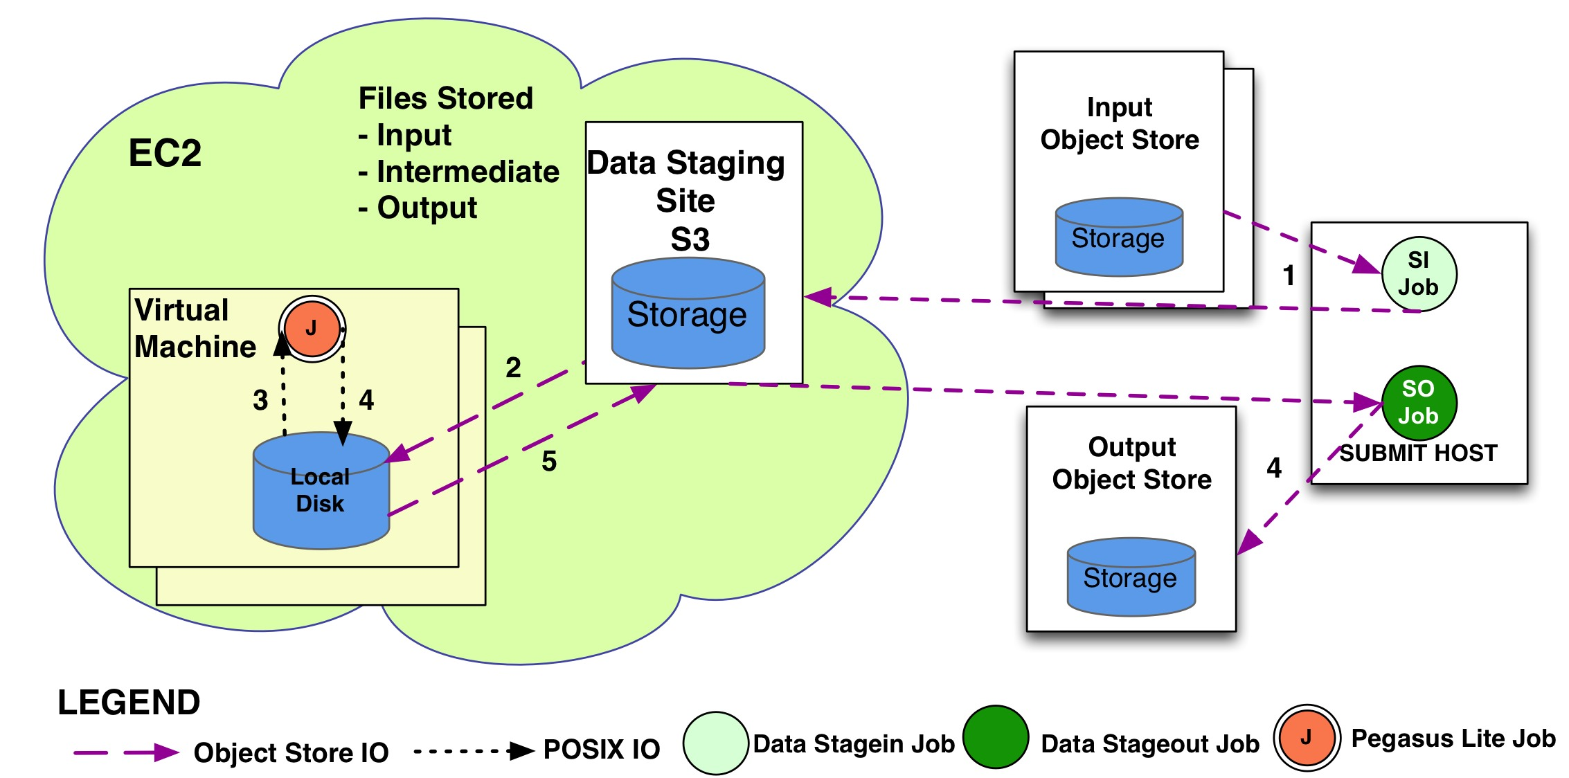
Pegasus Data Configuration: Workflows on EC2 with S3 as Data Staging Site.

Slide 17
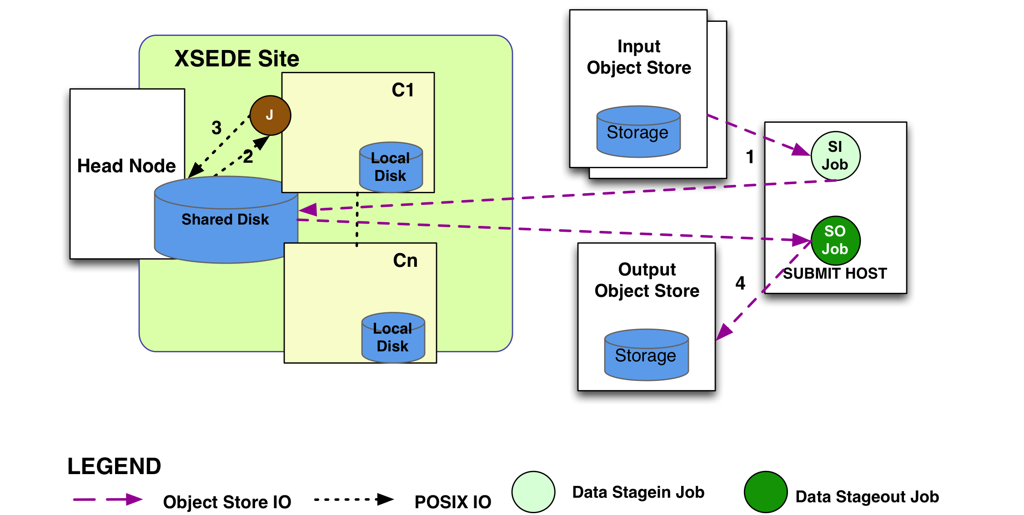
Pegasus Data Configuration: Workflows on XSEDE with shared filesystem as Data Staging Site.

Slide 18
Outline
Introduction
Object Stores for Workflows
Pegasus Data Management
Experiments
Conclusions and Future Work

Slide 19
Experiments
Goal of this work
  Provide easy to use solution to execute data intensive workflows in variety of different environments.
  Not necessary to improve workflow performance.
Workflow Experiments
  2 application workflows
    Montage – I/O Intensive
    Rosetta - Compute intensive
  Execution environment
    Executed on Amazon EC2,
      dedicated NFS file server ( m1.xlarge)
      one submit node (c1.xlarge) and 8 worker instances (c1.xlarge)
    Data Configuration
      Shared File System setup with NFS as data staging site
      Non Shared File System setup with S3 as data Staging Site

Slide 20
Experiments
 | NFS Shared FS ( minutes) | S3 – Nonshared FS ( minutes)
Walltime | 70 | 129
Cumulative Kickstart Time | 921 | 220
Cumulative Job Time | 1030 | 1196
Table1: Average runtimes for I/O intensive montage workflow.
 | NFS Shared FS ( minutes) | S3 – Nonshared FS ( minutes)
Walltime | 57 | 95
Cumulative Kickstart Time | 2935 | 2966
Cumulative Job Time | 2936 | 4557
Table2: Average runtimes for CPU bound Rosetta workflow.
Notes:
Montage: _x0005_the overhead of the S3 _x0005_case is the difference between the Cumulative job time and the _x0005_Cumulative Kickstart time, which is 976 minutes. Even though these overheads only differ by 39%, the overall wall times, 70 and 129 minutes, show an increase of 84%. The reason for this difference is the structure and the distribution of the runtimes of the Montage workflow. Data access patterns, and the effect of data staging, are different for the different transformations in the workflow. The second half of the workflow is where the re-projected, background corrected, and scaled images are mosaicked together, and many of these jobs operate on a large number of inputs. Any increase in data access times in this part of the workflow can significantly increase the overall workflow wall time. For example, due to the large number of inputs, the mAdd job, which is on the critical path of the workflow, took 3 times as long in the S3 case as in the NFS case.
Rosetta: Because Rosetta is CPU intensive and just a small amount of I/O is taking place, we expected the runtimes to be about the same regardless of data staging approach. The run times for the Rosetta workflow can be found in Table 2, which shows that the S3 wall times are significantly longer than the NFS times. The explanation for the slowdown in the S3 case is the reference database and the Size wise, the database is a relatively small 391 MB, but it is split into 477 separate files. If the database were contained in one file, it could be quickly transferred to/from S3. However, because it is split, the workflow needs to issue a separate get operation to fetch each piece of the database from S3, which adds a significant amount of overhead to the workflow (both in the walltime and the cumulative job time – which includes the S3 data transfers to the local filesystem). The many small data I/O requests result in a 50% slowdown for the workflow in the S3 case without task clustering when compared to NFS.

Slide 21
Conclusions and Future Work
Supporting different and varied execution and data setup environments is a challenging and important task for workflow systems.
Our approach of decoupling a data staging site from the shared filesystem allows for great flexibility and can be used by other workflow systems.
  Pegasus has implemented the above model allowing users the flexibility on running on varied infrastructure ranging from computation grids, supercomputing class machines to computational clouds.
Put in hooks in Pegasus Lite to leverage application specific compute infrastructure such as LIGO, where data is replicated out of band.

Slide 22
Relevant Links
Pegasus: http://pegasus.isi.edu
Tutorial and documentation: http://pegasus.isi.edu/wms/docs/latest/
Support: pegasus-users@isi.edu pegasus-support@isi.edu
Acknowledgements
Pegasus Team, Condor Team, funding agencies, NSF, NIH, and everybody who uses Pegasus.

Slide 23


Thank you!

