Slide 1
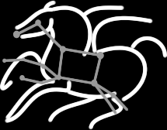
Leveraging Semantics to Improve Reproducibility in Scientific Workflows
Idafen Santana-Perez¹, Rafael Ferreira da Silva², Mats Rynge² Ewa Deelman², María S. Pérez-Hernández¹, Oscar Corcho¹
The reproducibility@XSEDE workshop July 14th 2014, Atlanta, GA
¹Ontology Engineering Group, Universidad Politécnica de Madrid, Madrid, Spain
²University of Southern California, Information Sciences Institute, Marina Del Rey, CA, USA

Slide 2
Introduction
Scientific workflows are a useful representation for managing the execution of large-scale computations
Facilitates the creation and management of the computation
Provenance is captured at runtime
Are data, code, and the workflow description enough to achieve reproducibility?
What about the underlying infrastructure?
Two approaches for conserving the environment of an experiment
Physical conservation: the real object is conserved
Logical conservation: the object description is conserved (Semantics)

Slide 3
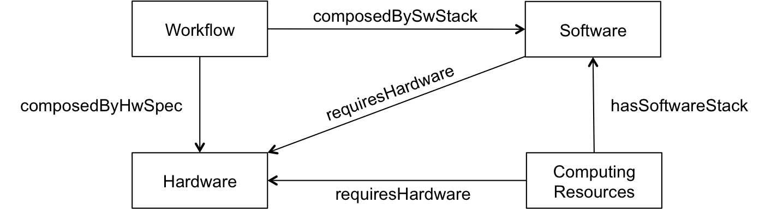
Semantic Modeling
We propose a logical-oriented approach to conserve computational environments
The capabilities of the resources are semantically described
We propose semantic models for describing the main domains of a computational infrastructure and how it is related to the workflow:
Overview of the Ontology Network

Slide 4
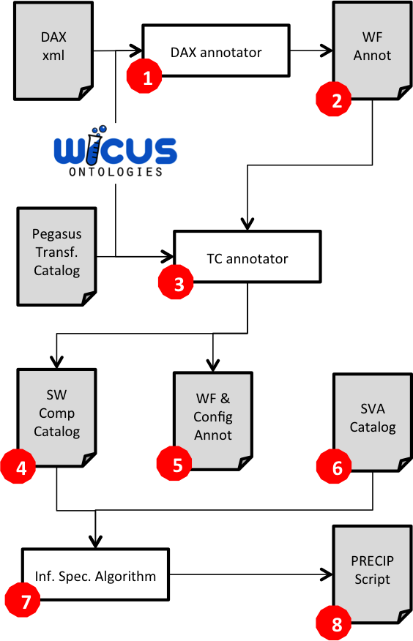
Reproducibility Process
Experiment Setup
Montage Workflow (Astronomy)
Pegasus Workflow Management System
Workflow execution on FutureGrid
Semantic Analysis
Annotations generated using WICUS
Infrastructure specification translated as a PRECIP script
Overview of the reproducibility process for scientific workflows

Slide 5
Leveraging Semantics to Improve Reproducibility in Scientific Workflows
Thank you
^{rafsilva@isi.edu}
“Semantic annotations combined with scripting functionality is a strong approach for attaining reproducibility of computational environments.”
Research Object http://pegasus.isi.edu/publications/xsede-reproducibility
PRECIP http://pegasus.isi.edu/precip
WICUS http://purl.org/net/wicus
Pegasus WMS http://pegasus.isi.edu

