Slide 1
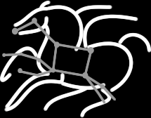
A Unified Approach for Modeling and Optimization of Energy, Makespan and Reliability for Scientific Workflows on Large-Scale Computing Infrastructures
Rafael Ferreira da Silva¹, Thomas Fahringer², Juan J. Durillo², Ewa Deelman¹
Workshop on Modeling & Simulation of Systems and Applications August 13-14, 2014, University of Washington, Seattle, Washington
¹University of Southern California, Information Sciences Institute, Marina Del Rey, CA, USA
²University of Innsbruck, Technikerstrasse 21a, Innsbruck, Austria

Slide 2
Introduction
Scientific workflows are often used to manage large-scale computations on HPC and HTC platforms
Several studies have been conducted to optimize workflow scheduling
However, most existing optimization techniques are limited to single or two objectives
Research in green computing often address cooling and energy usage reduction in large data-centers
There are few studies on how resources are used by applications
Green computing in scientific workflows
Studies are limited to the measurement of energy usage according to resource utilization
The energy consumption model is simplistic (e.g., homogeneous execution nodes)

Slide 3
Research Goals
Development of an energy consumption model to address real large-scale infrastructure conditions
e.g., heterogeneity, resource availability, external loads
Validation of the model in a fully instrumented platform able to measure the actual temperature and energy consumed by computing, networking, and storage systems
Development of a multi-objective optimization approach to explore workflow execution tradeoffs

Slide 4
Application Model: Scientific Workflows
Directed Acyclic Graph (DAG)
Nodes denote tasks
Edges denote task dependencies
Tasks
Command-line programs that read one or more input files and produce one or more output files
Compute-intensive or data-intensive
Data dependencies
Result of output files from one program becoming input files for another program

Slide 5
System Model: Distributed Infrastructure
Infrastructure as a Service (IaaS)
Data and task computations are stored/performed in the infrastructure
1: Application setup: provision of a set of parameters and input files uploading
2: Workflow task scheduling
3: Output data is stored on the storage server
4: Output data required by the user is downloaded from the storage server

Slide 6
Runtime and Reliability Models
At Workflow Level (Our Expertise)
Collect and summarize performance metrics for workflow applications
e.g., process I/O, runtime, memory usage, CPU utilization
Profile data is used to build distributions of workflow applications
At Infrastructure Level (Looking for a Partner)
Collect temperature and energy consumption from execution nodes, storage servers, and network systems
Requires a fully instrumented platform

Slide 7
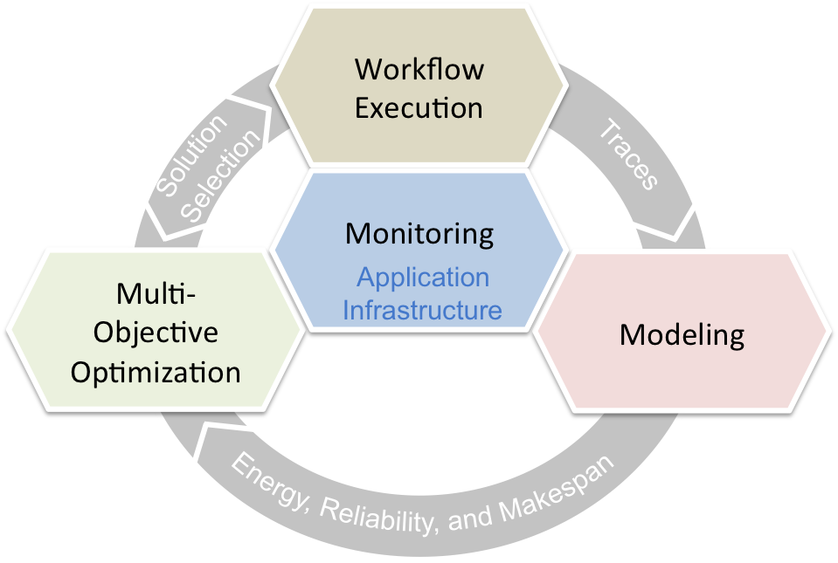
Research Dimensions
Goal: Multi-objective optimization of energy consumption, makespan, and reliability for scientific workflows
Monitoring
Workflow profile data has been collected as part of the DOE dV/dt project (ER26110)
Temperature and energy consumption monitoring requires access to a fully instrumented infrastructure
Multi-objective optimization process

Slide 8
Research Dimensions
Multi-Objective Optimization
The improvement of one optimization criteria may imply in the deterioration of another criteria
Development of heuristics to reduce the large-search space of workflow executions
Modeling (Dynamic Optimization)
Models will be constantly updated based on the profiling data collected during the workflow execution
Workflow Execution
Conducted with the Pegasus WMS (OCI SI2-SSI #1148515)

Slide 9
Discussions
Major Contribution
Multi-objective optimization of energy consumption, makespan, and reliability for scientific workflows on large-scale computing infrastructures
Gaps in Current Research
There is no energy-aware profiling of scientific workflow applications
Research is focused on the optimization of a single or two objectives
Strong assumptions are made (e.g., homogeneous environments)
Synergistic Projects
dV/dT: Accelerating the Rate of Progress Towards Extreme Scale Collaborative Science (DOE ER26110)
Pegasus WMS (OCI SI2-SSI #1148515)
DOE Sustained Performance, Energy and Resilience (SUPER) project

Slide 10
A Unified Approach for Modeling and Optimization of Energy, Makespan and Reliability for Scientific Workflows on Large-Scale Computing Infrastructures
Thank you.
^{rafsilva@isi.edu} ^{http://pegasus.isi.edu}

Slide 11
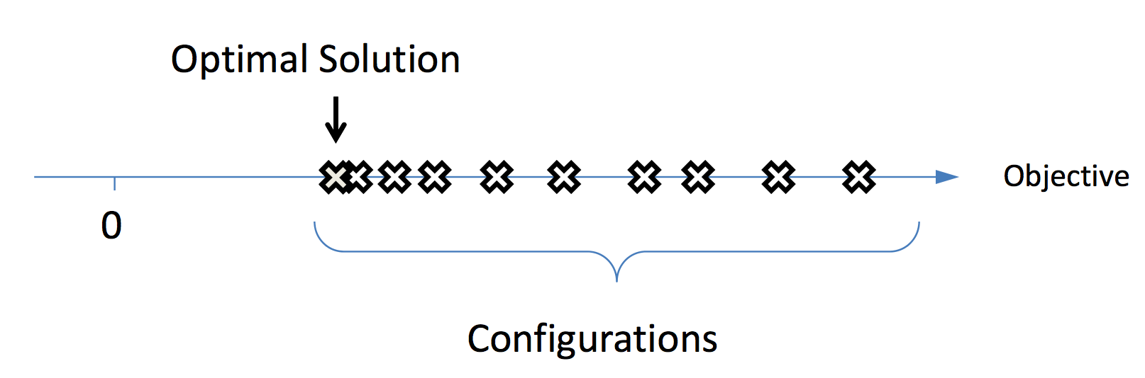
Mono-Objective Optimization
Single optimization goal to improve workflow executions
e.g., makespan, cost, etc.

Slide 12
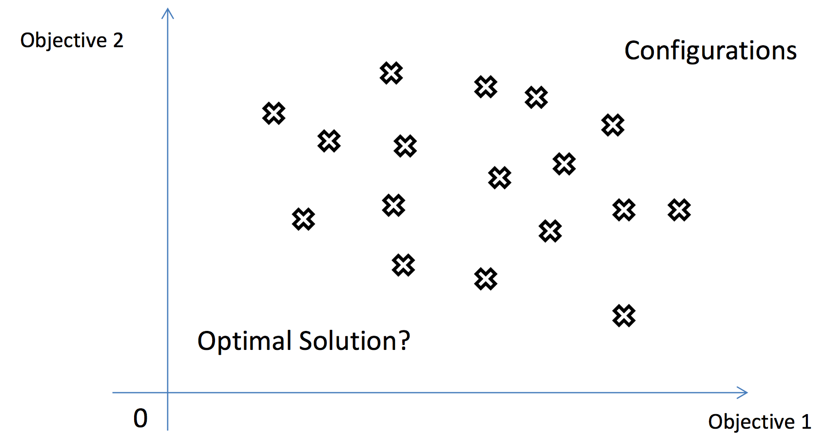
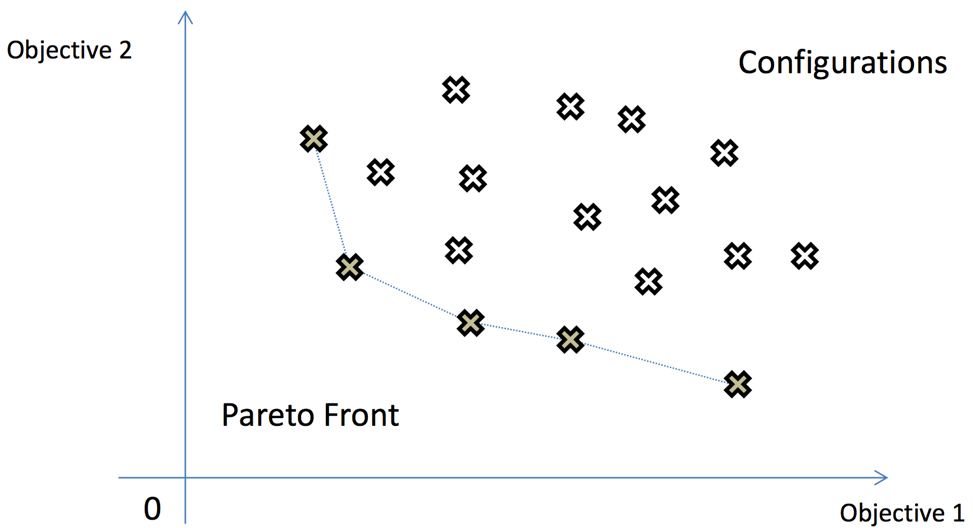
Multi-Objective Optimization
The improvement of one optimization criteria may imply in the deterioration of another criteria
There is no single solution that is optimal with respect to all objectives
Determine the Pareto Front

