Slide 1
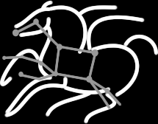
Experiments with Complex Scientific Applications on Hybrid Cloud Infrastructures
Maciej Malawski^{1,2}, Piotr Nowakowski¹, Tomasz Gubała¹, Marek Kasztelnik¹, Marian Bubak^{1,2}, Rafael Ferreira da Silva³, Ewa Deelman³, Jarek Nabrzyski⁴
NSFCloud Workshop on Experimental Support for Cloud Computing December 11-12, 2014, Arlington, VA
AGH University of Science and Technology:
¹ ACC Cyfronet AGH, ul. Nawojki 11, 30-950 Kraków, Poland
² Department of Computer Science, al. Mickiewicza 30, 30-095 Kraków, Poland
³ University of Southern California, Information Sciences Institute, Marina Del Rey, CA, USA
⁴ Center for Research Computing, University of Notre Dame, IN, USA

Slide 2
Research Challenges
Execution of complex scientific applications on clouds: workflows and their ensembles
Pegasus Workflow Management System (OCI SI2-SSI #1148515)
HyperFlow Workflow Engine
Platform for deployment and sharing of scientific applications on hybrid clouds
Atmosphere Framework
Algorithms for scheduling, provisioning and cost optimization:
Dynamic and Static Algorithms
Mathematical Programming
Cloud Workflow Simulator

Slide 3












Research: The Atmosphere Framework
Hybrid cloud as a means of provisioning computing power for virtual experiments
GUI host (provisions end-user features and access options)
96 CPU cores
Head Node
Worker Node
Worker Node
Worker Node
184 GB RAM
Cloud Management Portlets
4 TB storage
Provide GUI elements which enable service developers and end users to interact with the Atmosphere platform and create/deploy services on the available cloud resources
private IP space
Image store
OpenStack cloud site at ACC CYFRONET AGH
Secure RESTful API
(Cloud Facade)
Atmosphere Core Services Host
Worker node w/large resource pool (“fat node”)
128 CPU cores
Atmosphere Core
Head Node
256 GB RAM
Authentication and authorization logic
Communication with underlying computational clouds
Launching and monitoring service instances
Creating new service templates
Billing and accounting
Logging and administrative services
Worker node w/large resource pool (“fat node”)
4 TB storage
private IP space
Image store
VPH-Share cloud site at UNIVIE
Atmosphere Registry (AIR)
Massive (functionally limitless)
hardware
resource
pool
API
host
Worker Node
user accounts
Worker Node
public IP space
available cloud sites
services and templates
Image store
Amazon Elastic Compute Cloud (EC2) – European availability zone

Slide 4
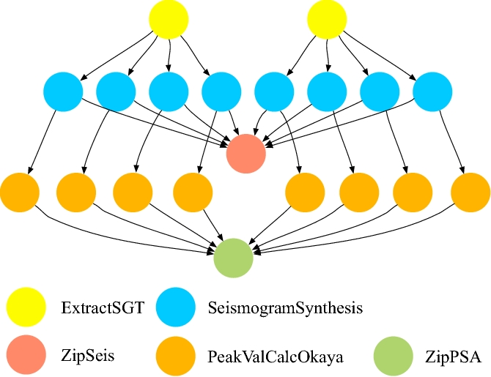
Research: Simulation and Scheduling of Large-Scale Scientific Workflows on IaaS Clouds
Large-scale scientific workflows from Pegasus WMS
Workflows of 100,000 tasks
Workflow Ensembles
Schedule as many workflows as possible within a budget and deadline
Uses a Cloud Workflow Simulator
M. Malawski, G. Juve, E. Deelman, J. Nabrzyski: Cost- and deadline-constrained provisioning for scientific workflow ensembles in IaaS clouds. SC 2012: 22

Slide 5
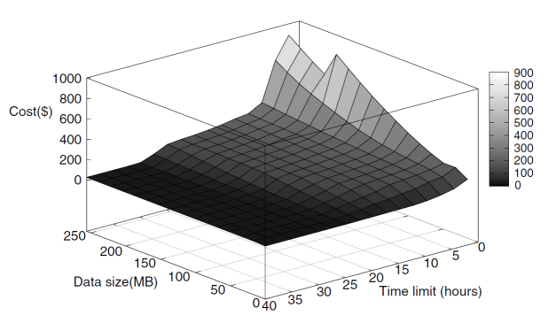
Research: Cost Optimization of Applications on Clouds
Infrastructure model
Multiple compute and storage clouds
Heterogeneous instance types
Application model
Bag of tasks
Multi-level workflows
Modeling with AMPL and CMPL
Modeling Language for Mathematical Programming
Cost optimization
Under deadline constraints
Mixed integer programming
Bonmin, Cplex solvers
M. Malawski, K. Figiela, J. Nabrzyski, Cost minimization for computational applications on hybrid cloud infrastructures, Future Generation Computer Systems, 29(7), 2013, pp.1786-1794, http://dx.doi.org/10.1016/j.future.2013.01.004
M. Malawski, K. Figiela, M. Bubak, E. Deelman, J. Nabrzyski, Cost Optimization of Execution of Multi-level Deadline-Constrained Scientific Workflows on Clouds. PPAM, 2013, 251-260 http://dx.doi.org/10.1007/978-3-642-55224-3_24

Slide 6
Research: Cloud Performance Evaluation
Performance of VM deployment times
Virtualization overhead
Evaluation of open source cloud stacks
Eucalyptus, OpenNebula, OpenStack
Survey of European public cloud providers
Performance evaluation of top cloud providers
EC2, RackSpace, SoftLayer
A grant from Amazon has been obtained
M. Bubak, M. Kasztelnik, M. Malawski, J. Meizner, P. Nowakowski, S. Varma, Evaluation of Cloud Providers for VPH Applications, poster at CCGrid2013, Delft, the Netherlands, pp.13-16, 2013

Slide 7
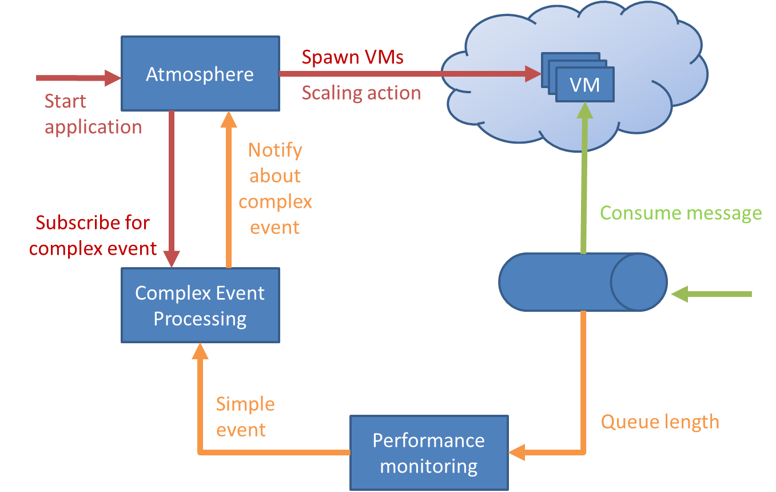
Experiment: Evaluation of autoscaling techniques for Atmosphere cloud platform
Challenges
Requires repeated tests under varying workloads
Experiments in an isolated environment
Goals
Perform autoscaling based on:
Complex event processing
Time series database
Build an isolated environment on NSFCloud

Slide 8
Experiment: Scalability of Scientific Workflows in HyperFlow Model
Challenges
Issues on data transfers and data locality
Calibrate the performance models of applications
Goals
Execute large-scale deployments on multi-site NSFCloud facilities
Assess the impact of network latency and bandwidth limitations

Slide 9
Experiment: Influence of Variability of Clouds on the Quality of Algorithms
Challenges
Static scheduling methods assume that the estimates of task runtimes are available
The runtime variations and various uncertainties influence the actual execution
Goals
A large-scale experimental testbed will allow investigating the influence of the uncertainties
Development of new models to mitigate uncertainties negative effects

Slide 10

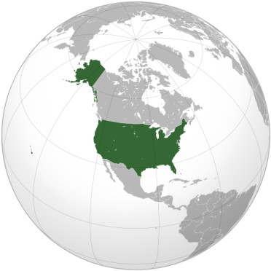
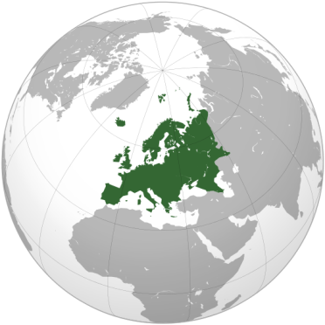
Experiment: Interoperation of Cloud Testbed of PL-Grid Infrastructure with NSFCloud
PL-Grid
One of the largest national grid infrastructures in Europe (2500+ users, 500+ teams)
Cloud testbed based on OpenNebula and OpenStack
Goals
Possibility to run transatlantic and global-scale experiments
Evaluation of impact of wide-area and high-latency networks

Slide 11
Experiments with Complex Scientific Applications on Hybrid Cloud Infrastructures
Thank you.
DICE Team at AGH: http://dice.cyfronet.pl
Center for Research Computing at Notre Dame: https://crc.nd.edu
Pegasus Team at USC: http://pegasus.isi.edu

