Slide 1
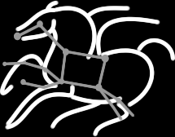
Scientific Workflows with Pegasus
Karan Vahi
Science Automation Technologies Group
USC Information Sciences Institute

Slide 2
Workloads – Simple Workflows.

Slide 3
Workloads or Workflows: Users have same concerns!
Data Management
How do you ship in the small/large amounts data required by the workflows?
Can I use SRM? How about GridFTP? HTTP and Squid proxies?
Can I use Cloud based storage like S3 on EC2?
Debug and Monitor Workflows
Users need automated tools to go through the log files
Need to correlate data across lots of log files
Need to know what host a job ran on and how it was invoked
Restructure Workflows for Improved Performance
Short running tasks?
Data placement?
Integrate with higher level tools such as HubZero and provisioning infrastructure
such as GlideinWMS, BOSCO

Slide 4
Pegasus Workflow Management System
NSF funded project since 2001
Developed as a collaboration between USC Information Sciences Institute and the Condor Team at UW Madison
Builds on top of Condor DAGMan.
Abstract Workflows - Pegasus input workflow description
Workflow “high-level language”
Only identifies the computation, devoid of resource descriptions, devoid of data locations
File Aware
Pegasus is a workflow “compiler” (plan/map)
Target is DAGMan DAGs and Condor submit files
Transforms the workflow for performance and reliability
Automatically locates physical locations for both workflow components and data
Collects runtime provenance

Slide 5
Pegasus WMS

Slide 6
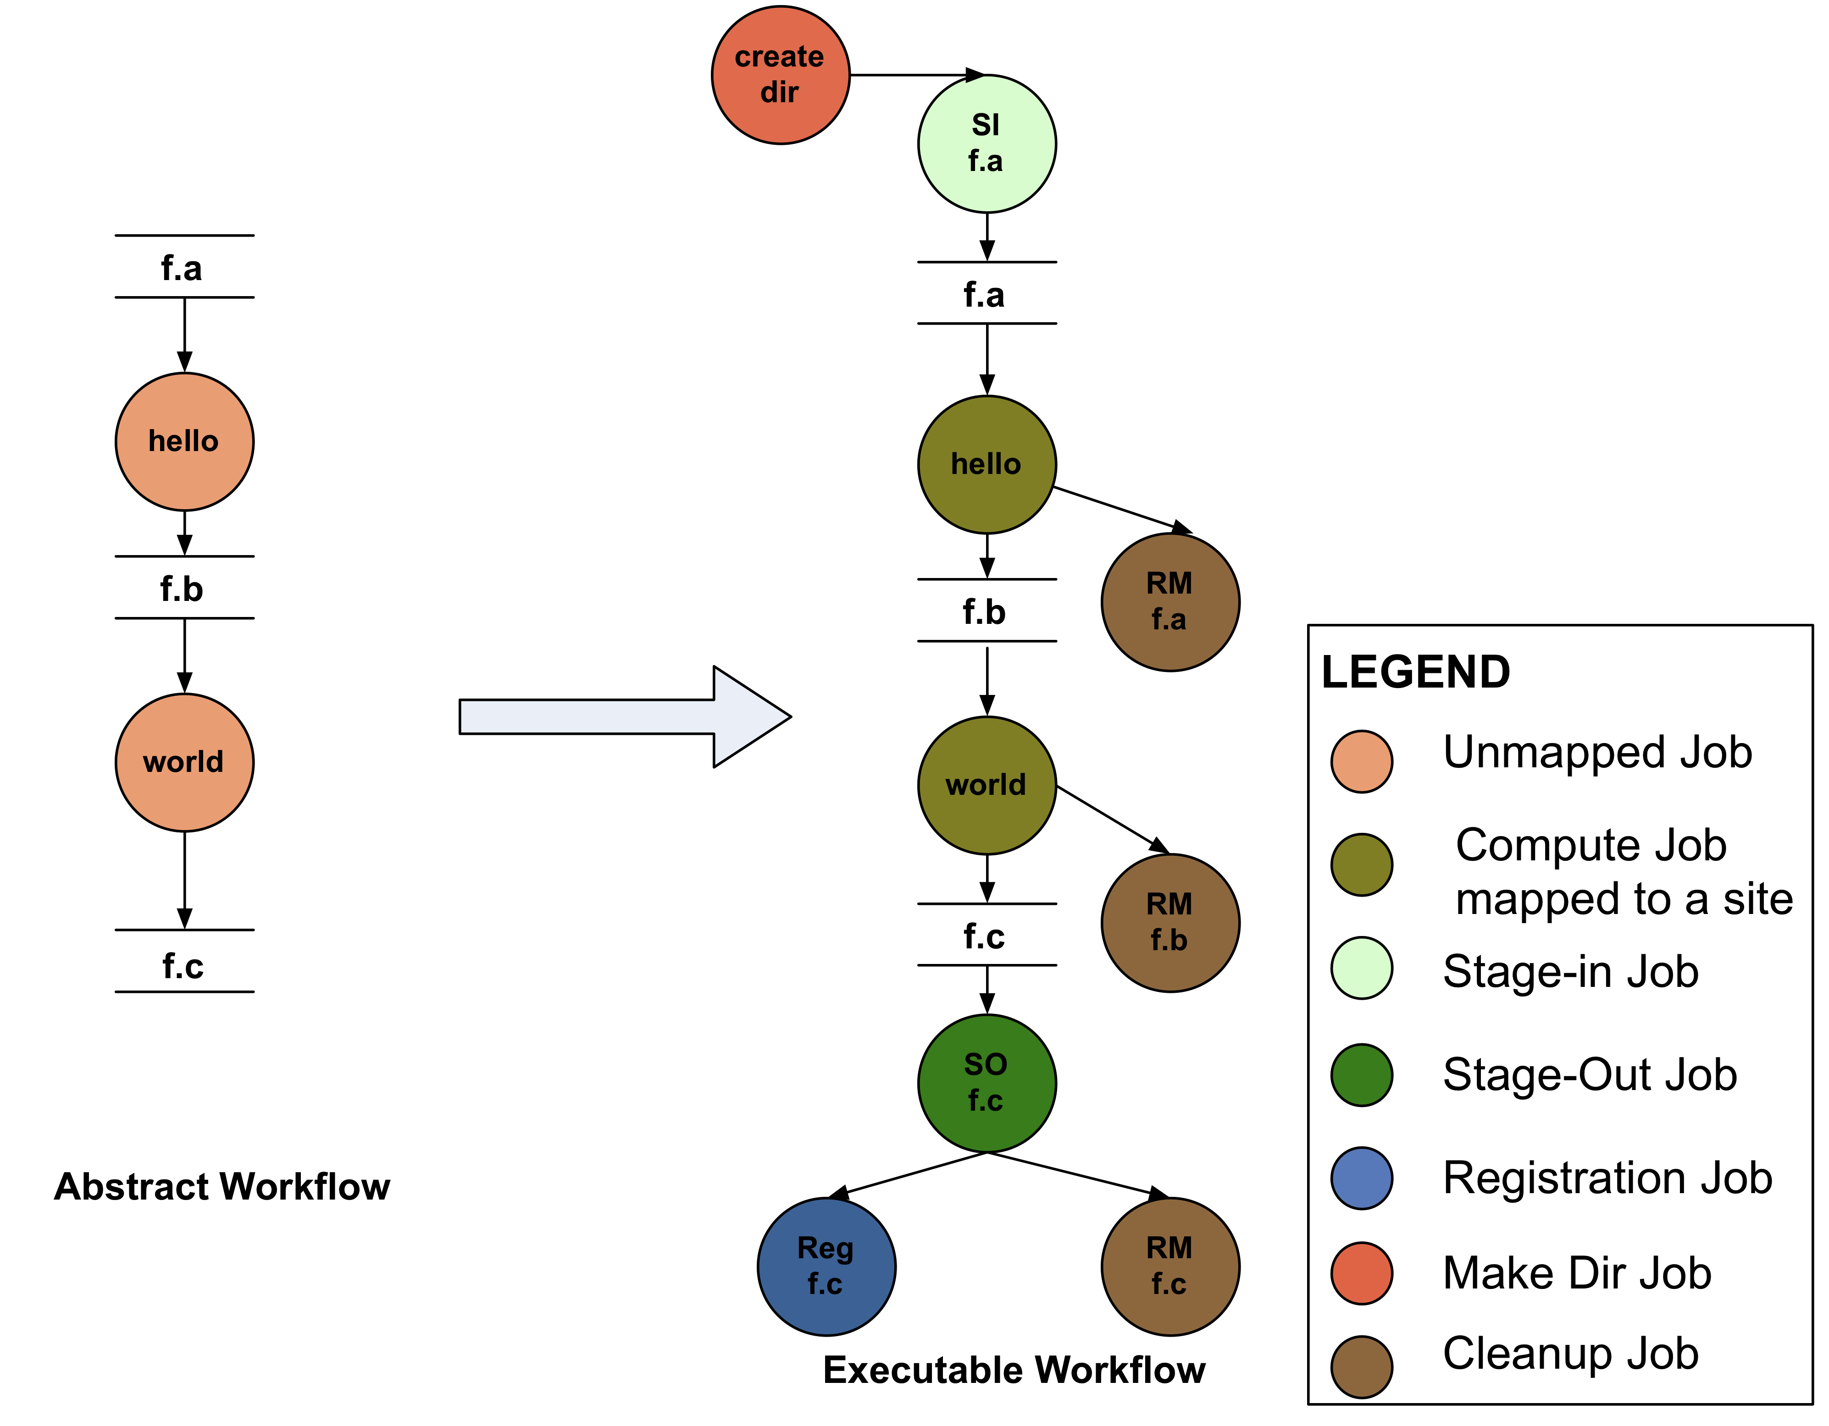
Abstract to Executable Workflow Mapping
Abstraction provides
Ease of Use (do not need to worry about low-level execution details)
Portability (can use the same workflow description to run on a number of resources and/or across them)
Gives opportunities for optimization and fault tolerance
automatically restructure the workflow
automatically provide fault recovery (retry, choose different resource)

Slide 7
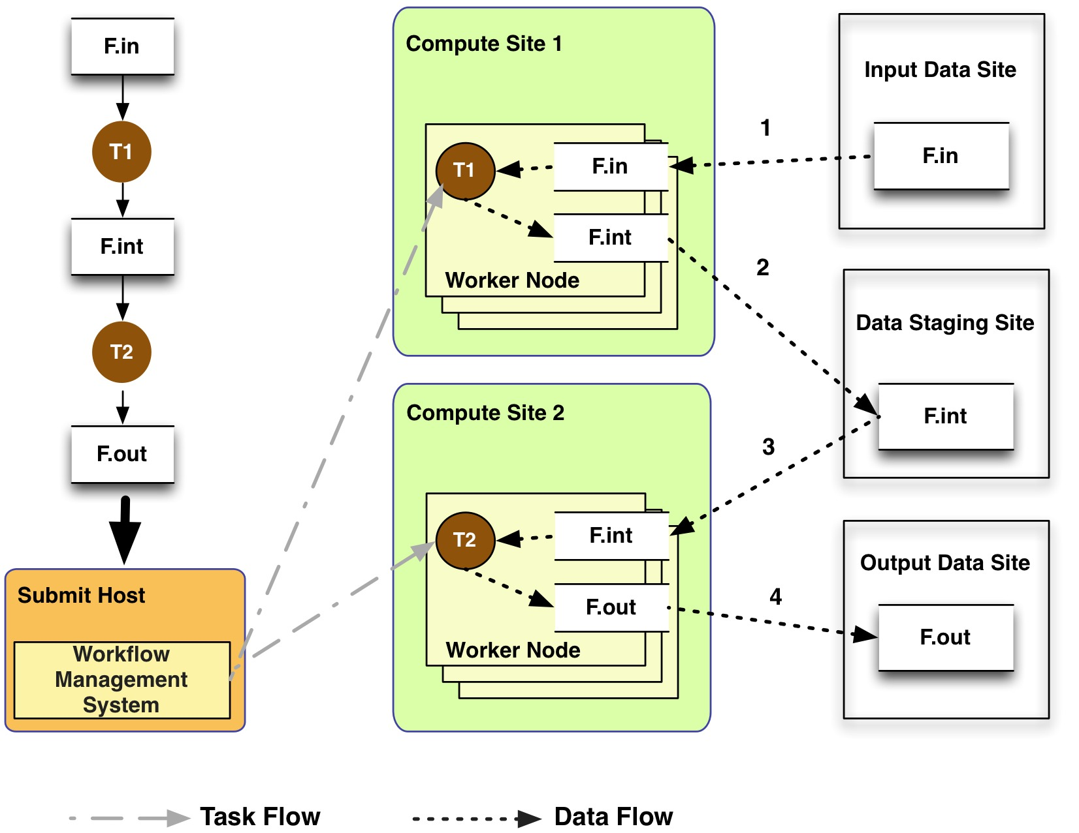
General Workflow Execution Model
Most of the tasks in scientific workflow applications require POSIX file semantics
Each task in the workflow opens one or more input files
Read or write a portion of it and then close the file.
Input Data Site, Compute Site and Output Data Sites can be co-located
Example: Input data is already present on the compute site.
Notes:
Remember to describe each type of site

Slide 8
Supported Data Staging Approaches - I
Shared Filesystem setup (typical of XSEDE and HPC sites)
Worker nodes and the head node have a shared filesystem, usually a parallel filesystem with great I/O characteristics
Can leverage symlinking against existing datasets
Staging site is the shared-fs.
Compute Site
WN
Submit
Host
Shared
FS
WN
HPC Cluster
Non-shared filesystem setup with staging site (typical of OSG and EC 2)
Worker nodes don’t share a filesystem.
Data is pulled from / pushed to the existing storage element.
A separate staging site such as S3.
Compute Site
Submit
Host
WN
Staging
Site
WN
Amazon
EC2 with S3
Jobs
Data
Notes:
Kent changed 080501 – removed periods

Slide 9
Supported Data Staging Approaches - II
Submit
Host
Condor IO ( Typical of large Condor Pools like CHTC)
Worker nodes don’t share a filesystem
Symlink against datasets available locally
Data is pulled from / pushed to the submit host via Condor file transfers
Staging site is the submit host.
Local FS
Jobs
Data
Compute Site
WN
WN
Supported Transfer Protocols
HTTP
SCP
GridFTP
IRODS
S3
Condor File IO
File Copy
Using Pegasus allows you to move from one deployment to another without changing the workflow description!

Slide 10
Workflow Reduction (Data Reuse)
Useful when you have done a part of computation and then realize the need to change the structure. Re-plan instead of submitting rescue DAG!
Notes:
Sometimes it is cheaper to access the data than to regenerate it
Keeping track of data as it is generated supports workflow-level checkpointing
Kent changed 080501 – added period

Slide 11
File cleanup
Problem: Running out of disk space during workflow execution
Why does it occur
Workflows could bring in huge amounts of data
Data is generated during workflow execution
Users don’t worry about cleaning up after they are done
Solution
Do cleanup after workflows finish
Add a leaf Cleanup Job ( Available in 4.4 Release)
Interleave cleanup automatically during workflow execution.
Requires an analysis of the workflow to determine, when a file is no longer required
Cluster the cleanup jobs by level for large workflows
Real Life Example: Used by a UCLA genomics researcher to delete TB’s of data automatically for long running workflows!!
Notes:
Kent changed 080501

Slide 12
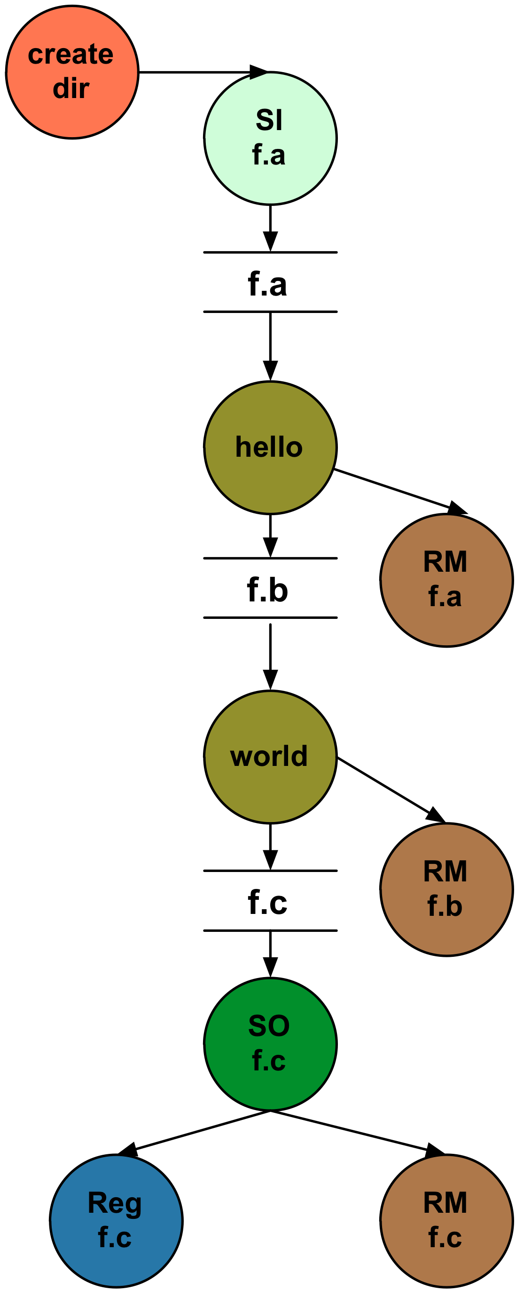
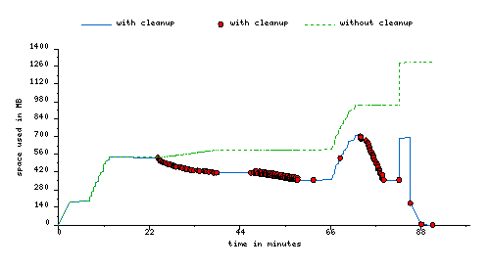
File cleanup (cont)
Montage 1 degree workflow run with cleanup

Slide 13
Workflow Restructuring to improve application performance
Cluster small running jobs together to achieve better performance
Why?
Each job has scheduling overhead – need to make this overhead worthwhile
Ideally users should run a job on the grid that takes at least 10/30/60/? minutes to execute
Clustered tasks can reuse common input data – less data transfers
Level-based clustering

Slide 14
Workflow Monitoring - Stampede
Leverage Stampede Monitoring framework with DB backend
Populates data at runtime. A background daemon monitors the logs files and populates information about the workflow to a database
Stores workflow structure, and runtime stats for each task.
Tools for querying the monitoring framework
pegasus-status
Status of the workflow
pegasus-statistics
Detailed statistics about your finished workflow
------------------------------------------------------------------------------
Type Succeeded Failed Incomplete Total Retries Total+Retries
Tasks 135002 0 0 135002 0 135002
Jobs 4529 0 0 4529 0 4529
Sub-Workflows 2 0 0 2 0 2
------------------------------------------------------------------------------
Workflow wall time : 13 hrs, 2 mins, (46973 secs)
Workflow cumulative job wall time : 384 days, 5 hrs, (33195705 secs)
Cumulative job walltime as seen from submit side : 384 days, 18 hrs, (33243709 secs)

Slide 15
Workflow Debugging Through Pegasus
After a workflow has completed, we can run pegasus-analyzer to analyze the workflow and provide a summary of the run
pegasus-analyzer's output contains
a brief summary section
showing how many jobs have succeeded
and how many have failed.
For each failed job
showing its last known state
exitcode
working directory
the location of its submit, output, and error files.
any stdout and stderr from the job.
Alleviates the need for searching through large DAGMan and Condor logs!

Slide 16
Workflow Monitoring Dashboard: pegasus-dashboard
A python based online workflow dashboard
Uses the FLASK framework
Beta version released in 4.2
Queries the STAMPEDE database
Lists all the user workflows on the home page and are color coded.
Green indicates a successful workflow,
Red indicates a failed workflow
Blue indicates a running workflow
Explore Workflow and Troubleshoot ( Workflow Page )
Has identifying metadata about the workflow
Tabbed interface to
List of sub workflows
Failed jobs
Running jobs
Successful jobs.

Slide 17
Workflow Monitoring Dashboard: pegasus-dashboard
Job Page
Lists information captured in kickstart record for the job.
Will show the various retries of the job
Statistics Page for the Workflow
Generates Statistics for the workflow, similar to pegasus-statistics command line tool
Charts Page For the Workflow
Workflow Gantt Chart
Job Distribution by Count/Time
Time Chart by Job/Invocation

Slide 18
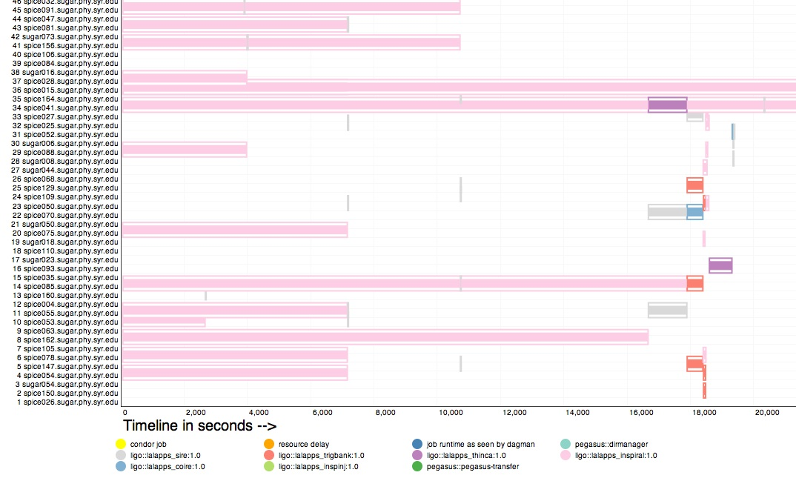
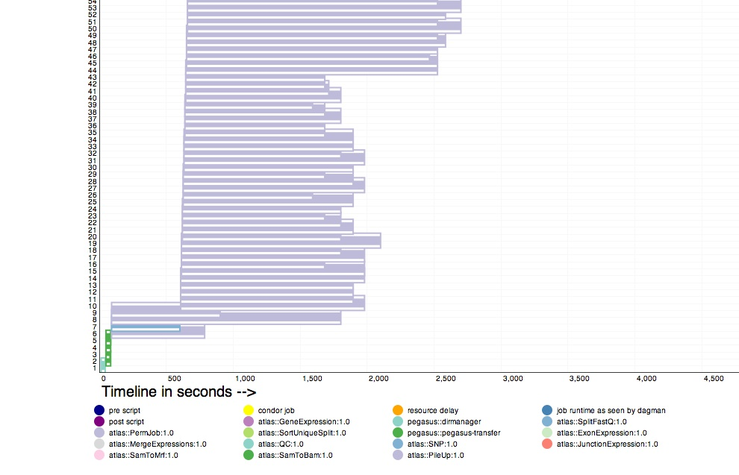
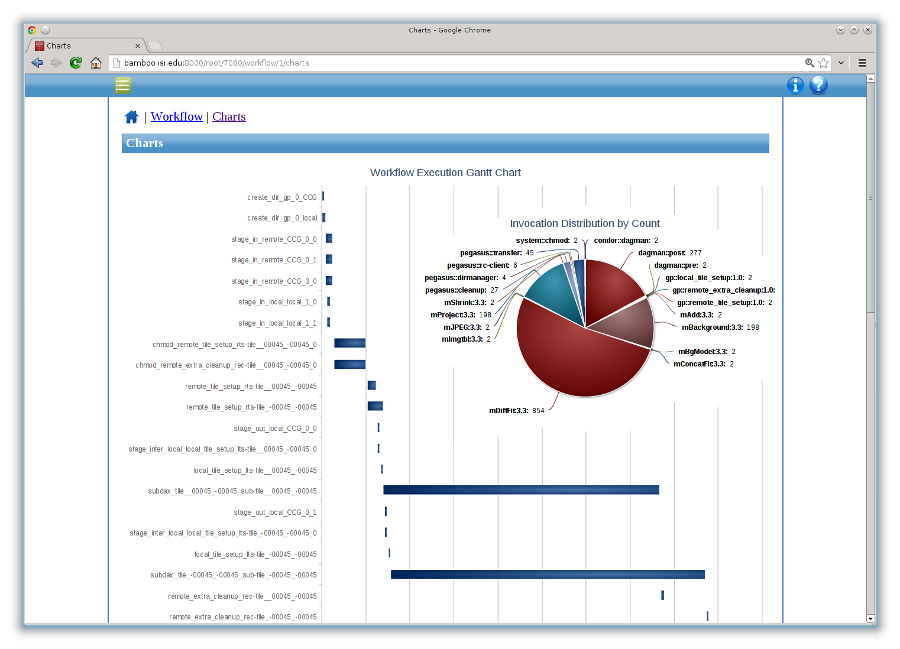
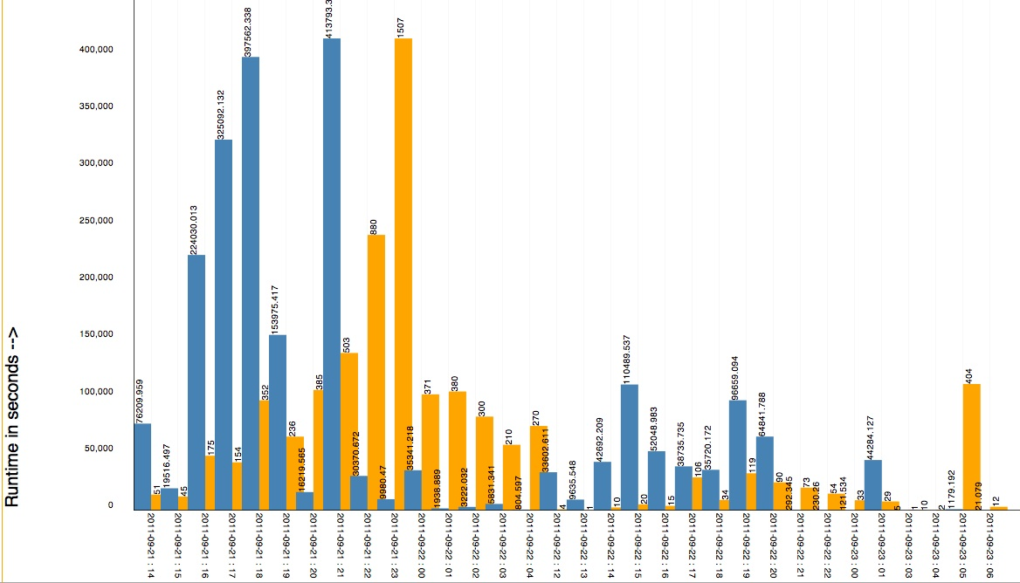
Workflow Monitoring Dashboard – pegasus-dashboard
Workflow Gantt Chart
Hosts Over Time – Distribution of Different Job Types on Hosts
Jobs and Runtime over Time

Slide 19
Workflow and Task Notifications
Users want to be notified at certain points in the workflow or on certain events.
Support for adding notification to workflow and tasks
Event based callouts
On Start, On End, On Failure, On Success
Provided with email and jabber notification scripts
Can run any user provided scripts
Defined in the DAX

Slide 20
Metrics Collection
Why?
A requirement of being funded as part of the NSF SI2 Program
Reporting ON by default. Can be turned off.
What do we collect?
Anonymous planner metrics
Duration of the planner
Start and end time
Exitcode
Breakdown of tasks and jobs in the workflow
We leave a copy of the metrics file in the submit directory for the users
Capturing Errors
In addition to capturing usage data, the planner also reports back fatal errors
Using it to drive usability improvements for Pegasus
http://pegasus.isi.edu/wms/docs/latest/funding_citing_usage.php#usage_statistics

Slide 21
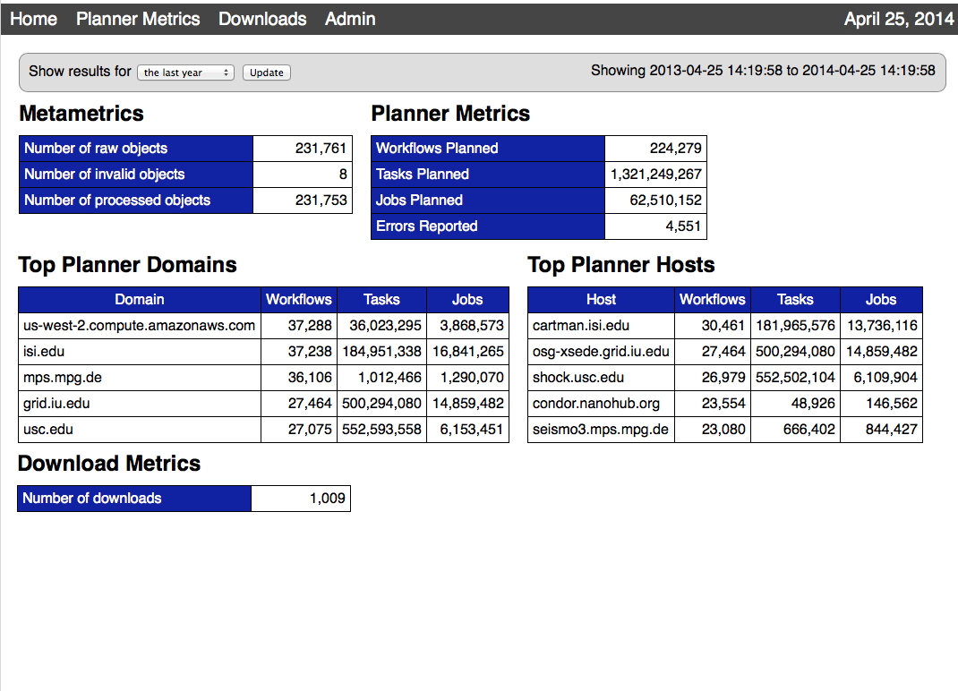

Slide 22
Summary – What Does Pegasus provide an Application - I
All the great features that DAGMan has
Scalability / hierarchal workflows
Retries in case of failure.
Portability / Reuse
User created workflows can easily be mapped to and run in different environments without alteration.
Performance
The Pegasus mapper can reorder, group, and prioritize tasks in order to increase the overall workflow performance.
Notes:
Kent changed 080501 – removed period

Slide 23
Summary – What Does Pegasus provide an Application - II
Provenance
Provenance data is collected in a database, and the data can be summaries with tools such as pegasus-statistics, pegasus-plots, or directly with SQL queries.
Reliability and Debugging Tools
Jobs and data transfers are automatically retried in case of failures. Debugging tools such as pegasus-analyzer helps the user to debug the workflow in case of non-recoverable failures.
Data Management
Pegasus handles replica selection, data transfers and output registrations in data catalogs. These tasks are added to a workflow as auxiliary jobs by the Pegasus planner.
Notes:
Kent changed 080501 – removed period

Slide 24
Relevant Links
Pegasus: http://pegasus.isi.edu
Tutorial and documentation: http://pegasus.isi.edu/wms/docs/latest/
Support: pegasus-users@isi.edu pegasus-support@isi.edu
Acknowledgements
Pegasus Team, Condor Team, funding agencies, NSF, NIH, and everybody who uses Pegasus.

