Slide 1
dV/dt: Accelerating the Rate of Progress towards Extreme Scale Collaborative Science Miron Livny (UW) Bill Allcock (ANL) Ewa Deelman (USC) Douglas Thain (ND) Frank Wuerthwein (UCSD)
https://sites.google.com/site/acceleratingexascale

Slide 2
Goal
“make it easier for scientists to conduct large-scale computational tasks that use the power of computing resources they do not own to process data they did not collect with applications they did not develop”
In practice: Monitoring, modeling and resource provisioning, scheduling and workload management

Slide 3
Overview of the Resource Provisioning Loop
Workload Archive
Workload Characterization
Execution Traces
dV/dt
Workload Estimation
Monitoring
Execution
Resource Allocation

Slide 4
Monitoring Resource Usage

Slide 5
HTC Monitoring (USC and ND)
Job wrappers that collect information about processes
Runtime, peak disk usage, peak memory usage, CPU usage, etc.
Mechanisms
Polling (not accurate, low overhead)
ptrace() system call interposition (accurate, high overhead)
LD_PRELOAD library call interposition (accurate, low overhead)
Kickstart (Pegasus) and resource-monitor (Makeflow)
 | Polling | LD_PRELOAD | Ptrace (fork/exit) | Ptrace (syscalls)
CPU | 0.5% - 12% | 0.5% - 5% | < 0.2% | < 0.2%
Memory | 2% - 14% | < 0.1% | ~ 0% | ~ 0%
I/O | 2% - 20% | 0% | 0% | 0%
Error (Accuracy)
 | Polling | LD_PRELOAD | Ptrace (fork/exit) | Ptrace (syscalls)
CPU | low | low | low | low
Memory | low | medium | low | medium
I/O | low | low | low | high
Overhead
Gideon Juve, et al., Practical Resource Monitoring for Robust High Throughput Computing, University of Southern California, Technical Report 14-950, 2014.

Slide 6
HPC Monitoring (ALCF)
Job information from scheduler (Cobalt)
Use scheduler data for both scheduler and individual task data
Job runtime, number of cores, user estimates, etc.
I/O using Darshan
Instrumentation automatically linked into codes at compile time
Captures POSIX I/O, MPI I/O and some HDF5 and NetCDF functions
Amount read/written, time in I/O, files accessed, etc.
Very low overhead in both time and memory
Performance Counters using AutoPerf
Using built-in hardware performance counters
Also enabled at compile time
Counters zeroed in MPI_Init, and reported in MPI_Finalize
FLOPs, cache misses, etc.
Users can take control of performance counters preventing this from working

Slide 7
Workload Modeling and Characterization

Slide 8
CMS Workload Characteristics (USC, UW-M)
Characteristics of the CMS workload for a period of a month (Aug 2014)
Characteristic | Data
General Workload
Total number of jobs | 1,435,280
Total number of users | 392
Total number of execution sites | 75
Total number of execution nodes | 15,484
Jobs statistics
Completed jobs | 792,603
Preempted jobs | 257,230
Exit code (!= 0) | 385,447
Average job runtime (in seconds) | 9,444.6
Standard deviation of job runtime (in seconds) | 14,988.8
Average disk usage (in MB) | 55.3
Standard deviation of disk usage (in MB) | 219.1
Average memory usage (in MB) | 217.1
Standard deviation of memory usage (in MB) | 659.6

Slide 9
Workload Characterization
Correlation Statistics
Weak correlations suggest that none of the properties can be directly used to predict future workload behaviors
Two variables are correlated if the ellipse is too narrow as a line

Slide 10
Workload Characterization (2)
Correlation measures are sensitive to the data distribution
Probability Density Functions
Do not fit any of the most common families of density families (e.g. Normal or Gamma)
Our approach
Recursive partitioning method to combine properties from the workload to build Regression Trees

Slide 11
Regression Trees
The recursive algorithm looks for PDFs that fit a family of density
In this work, we consider the Normal and Gamma distributions
Measured with the Kolmogorov-Smirnov test (K-S test)
The PDF for the tree node (in blue) fits a Gamma distribution (in grey) with the following parameters:
Shape parameter = 12
Rate parameter = 5x10⁻⁴
Mean = 27414.8
p-value = 0.17

Slide 12
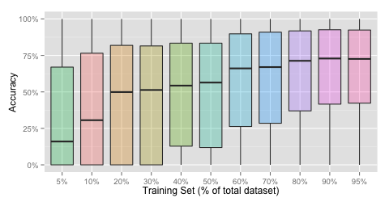
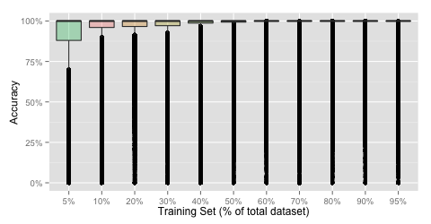
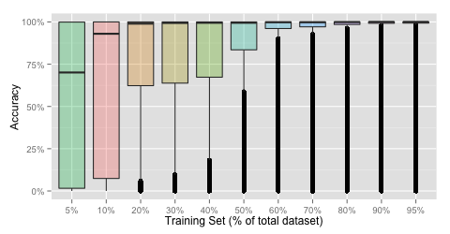
Job Estimation: Experimental Results
Based on the regression trees
We built a regression tree per user
Estimates are generated according to a distribution (Normal or Gamma) or a uniform distribution
Job Runtime
The median accuracy increases as more data is used for the training set
Memory Usage
Disk Usage
Average accuracy of the workload dataset
The training set is defined as a portion of the entire workload dataset

Slide 13
Provisioning and Resource Allocation

Slide 14
Resource Allocation (ND)
Tasks have different sizes (known at runtime) while computation nodes have fixed sizes
Resource allocation strategies
One task per node
Resources are underutilized
Throughput is reduced
Many tasks per node
Resources are exhausted
Jobs fail
Throughput is reduced
Tasks
Computation Nodes

Slide 15
General Approach
Setting tasks
What do we know?
Maximum size?
Size probability distribution?
Empirical distribution?
Perfect information?
Our approach
Setting task sizes to reduce resource waste
Modeling of resource sizes (e.g., memory, disk, or network bandwidth)
Assumes the task size distribution is known
Adapts to empirical distributions
Task of unknown size
Compute some task size
Run the task in a node with the available space.
Monitor task, and kill it if resources exceeded
Failure
Success
Already max size
Record failure
Record result

Slide 16
Resource Waste Modeling
Model the task resource
as a function of time
Model the task resource usage as
resource x time (area below the curve)
Overestimating size (waste is the area above the curve)
Underestimating size (waste is resource x time
until resource exhaustion)
Single Peaks Model
Simplifying assumption: any resource exhaustion
only happens at time of maximum peak
(i.e., resource usage looks like a step function)

Slide 17
Synthetic Workload Experiment
Exponential Distribution
5000 Tasks
Memory according to an exponential distribution
Shifted min 10 MB, truncated max 100 MB, average 20 MB
Tasks run anywhere from 10 to 20 seconds
100 computation nodes available, from ND Condor pool
Each node with 4 cores and a limit of 100 MB of memory

Slide 18
Example: One,Two and Multi-step sequences with “Slow Peaks”
normalized resource units per task
(less is better)
multi-step (as previous slide,
but in one column)
one-step (always max)
two-step (as optimal in previous table)

Slide 19
Next Steps
Improve monitoring and modeling
Investigate network I/O and energy
Extend modeling to parallel, HPC applications
Close the loop
Turn on detailed monitoring in workflows
Use resource predictions for provisioning and scheduling
Productize tools
Deploy monitoring capabilities in production environments
Turn modeling software into a service

