Slide 1

Characterizing a High Throughput Computing Workload: The Compact Muon Solenoid (CMS) Experiment at LHC
Rafael Ferreira da Silva¹, Mats Rynge¹, Gideon Juve¹, Igor Sfiligoi^{2,}
Ewa Deelman¹, James Letts¹, Frank Würthwein², Miron Livny³
International Conference on Computational Science June 1-3, 2015, Reykjavik, Iceland
¹ University of Southern California, Information Sciences Institute, Marina Del Rey, CA, USA
² University of California at San Diego, Department of Physics, La Jolla, CA, USA
³ University of Wisconsin Madison, Madison, WI, USA

Slide 2
Introduction
Task Characteristics:
Runtime
Disk Space
Memory Consumption
Scheduling and Resource Provisioning
Algorithms
Methods assume that accurate estimates are available
It is hard to compute accurate estimates in production systems
Compact Muon Solenoid (CMS) experiment at the Large Hadron Collider (LHC)
Process millions of jobs submitted by hundreds of users
The efficiency of the workload execution and resource utilization depends on how these jobs are scheduled and resources are provisioned

Slide 3
Overview of the Resource Provisioning Loop
Workload Archive
Workload Characterization
Execution Traces
dV/dt
Workload Estimation
Monitoring
Execution
Resource Allocation

Slide 4
What is covered in this work?
Workload Archive
Workload Characterization
Execution Traces
dV/dt
Workload Estimation
Monitoring
Execution
Resource Allocation

Slide 5
Workload Characteristics
Characteristics of the CMS workload for a period of a month (Aug 2014)
Characteristic | Data
General Workload
Total number of jobs | 1,435,280
Total number of users | 392
Total number of execution sites | 75
Total number of execution nodes | 15,484
Jobs statistics
Completed jobs | 792,603
Preempted jobs | 257,230
Exit code (!= 0) | 385,447
Average job runtime (in seconds) | 9,444.6
Standard deviation of job runtime (in seconds) | 14,988.8
Average disk usage (in MB) | 55.3
Standard deviation of disk usage (in MB) | 219.1
Average memory usage (in MB) | 217.1
Standard deviation of memory usage (in MB) | 659.6

Slide 6
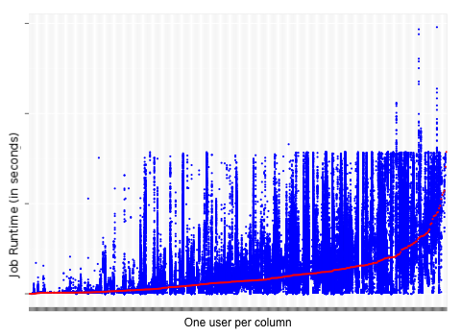
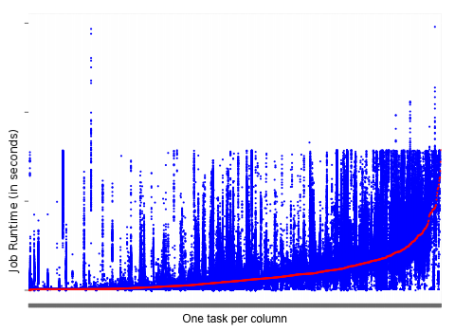
Workload Execution Profiling
The workload shows similar behavior to the workload analysis conducted in [Sfiligoi 2013]
The magnitude of the job runtimes varies among users and tasks
Job runtimes by user sorted by per-user mean job runtime
Job runtimes by task sorted by per-task mean job runtime

Slide 7
Workload Execution Profiling (2)
Job start time rate
Colors represent different execution sites – job distribution is relatively balanced among sites
Job completion time rate
Colors represent different job status

Slide 8
Workload Characterization
Correlation Statistics
Weak correlations suggest that none of the properties can be directly used to predict future workload behaviors
Two variables are correlated if the ellipse is too narrow as a line
Trivial correlations

Slide 9
Workload Characterization (2)
Correlation measures are sensitive to the data distribution
Probability Density Functions
Do not fit any of the most common families of density families (e.g. Normal or Gamma)
Our approach
Statistical recursive partitioning method to combine properties from the workload to build Regression Trees

Slide 10
Regression Trees
The recursive algorithm looks for PDFs that fit a family of density
In this work, we consider the Normal and Gamma distributions
Measured with the Kolmogorov-Smirnov test (K-S test)
The PDF for the tree node (in blue) fits a Gamma distribution (in grey) with the following parameters:
Shape parameter = 12
Rate parameter = 5x10⁻⁴
Mean = 27414.8
p-value = 0.17

Slide 11
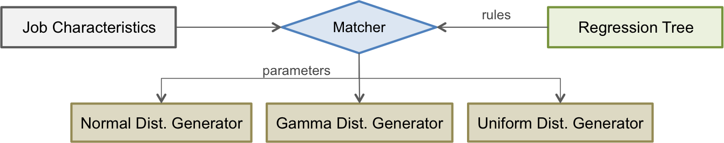
Job Estimation Process
Based on the regression trees
We built a regression tree per user
Estimates are generated according to a distribution
(Normal, Gamma, or Uniform)

Slide 12
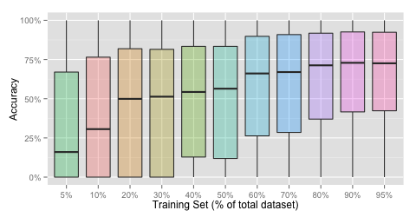
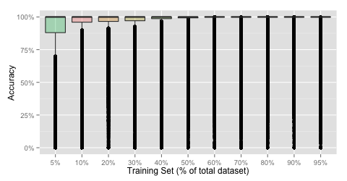
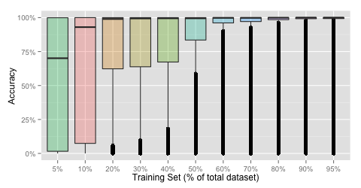
Experimental Results
Job Runtime
The median accuracy increases as more data is used for the training set
Memory Usage
Disk Usage
Average accuracy of the workload dataset
The training set is defined as a portion of the entire workload dataset

Slide 13
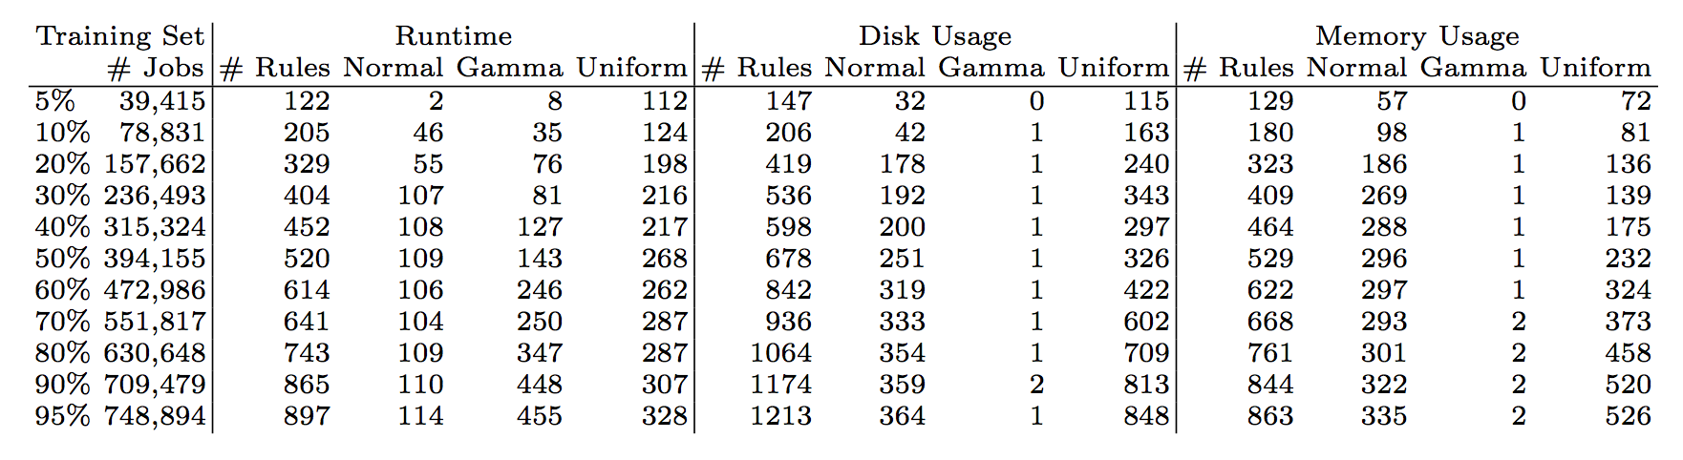
Experimental Results (2)
Number of Rules per Distribution
Runtime: better fits Gamma distributions
Disk: better fits Normal distributions
Memory: better fits Normal distributions
Specialization
accuracy above 60%
Fits mostly Normal distributions

Slide 14
Prediction of Future Workloads
Experiment Conditions
Used the workload from Aug 2014 to predict job requirements for October 2014
Experiment Results
Median estimation accuracy
Runtime: 82% (50% 1st quartile, 94% 3rd quartile)
Disk and Memory consumption: over 98%
Characteristics of the CMS workload for a period of a month (October 2014)
Characteristic | Data
General Workload
Total number of jobs | 1,638,803
Total number of users | 408
Jobs statistics
Completed jobs | 810,567

Slide 15
Conclusion
Contributions
Workload characterization of 1,435,280 jobs
Use of a statistical recursive partitioning algorithm and conditional inference trees to identify patterns
Estimation process to predict job characteristics
Experimental Results
Adequate estimates can be attained for job runtime
Nearly optimal estimates are obtained for disk and memory consumption
Remarks
Data collection process should be refined to gather finer information
Applications should provide mechanisms to distinguish custom user codes from the standard executable

Slide 16
Characterizing a High Throughput Computing Workload: The Compact Muon Solenoid (CMS) Experiment at LHC
Thank you.
^{rafsilva@isi.edu} ^{http://pegasus.isi.edu}
This work was funded by DOE under the contract number ER26110, “dV/dt - Accelerating the Rate of Progress Towards Extreme Scale Collaborative Science”

