Slide 1

USING SIMPLE PID CONTROLLERS TO PREVENT AND MITIGATE FAULTS IN SCIENTIFIC WORKFLOWS
Rafael Ferreira da Silva¹, Rosa Filgueira², Ewa Deelman¹, Erola Pairo-Castineira³, Ian Michael Overton⁴, Malcolm Atkinson⁵
¹USC Information Sciences Institute
²British Geological Survey, Lyell Centre
³MRC Institute of Genetics and Molecular Medicine, University of Edinburgh
⁴Usher Institute of Population Health Sciences and Informatics, University of Edinburgh
⁵School of Informatics, University of Edinburgh
11th Workflows in Support of Large-Scale Science (WORKS’16)
Salt Lake City, UT – November 14th, 2016

Slide 2
OUTLINE
Introduction
PID Controllers
Defining Controllers
Scientific Workflows
Motivation
Related Work
Definition
Control System Loop
Data Management
Memory Management
Experimental Evaluation
Tuning PID Controllers
Summary
Workflow Application
Experiments Conditions
Results and Discussion
Ziegler-Nichols Method
Experimental Evaluation
Conclusions
Future Research Directions
R. Ferreira da Silva, R. Filgueira, E. Deelman, E. Pairo-Castineira, I. M. Overton, M. Atkinson Using Simple PID Controllers to Prevent and Mitigate Faults in Scientific Workflows

Slide 3

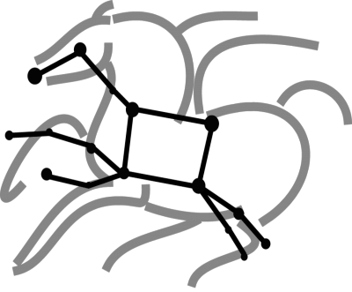



WHY SCIENTIFIC WORKFLOWS?
> > >
Automation
Automate
Enables parallel, distributed computations
Automatically executes data transfers
Recover
Recover & Debug
Handles failures with to provide reliability
Keeps track of data and files
Reproducibility
Debug
Reusable, aids reproducibility
Records how data was produced (provenance)
R. Ferreira da Silva, R. Filgueira, E. Deelman, E. Pairo-Castineira, I. M. Overton, M. Atkinson Using Simple PID Controllers to Prevent and Mitigate Faults in Scientific Workflows

Slide 4
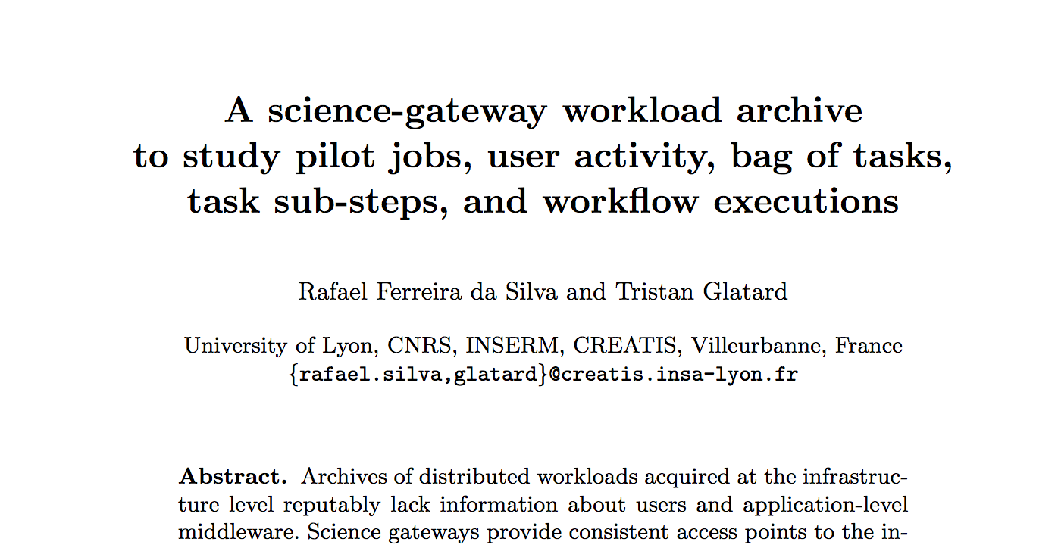
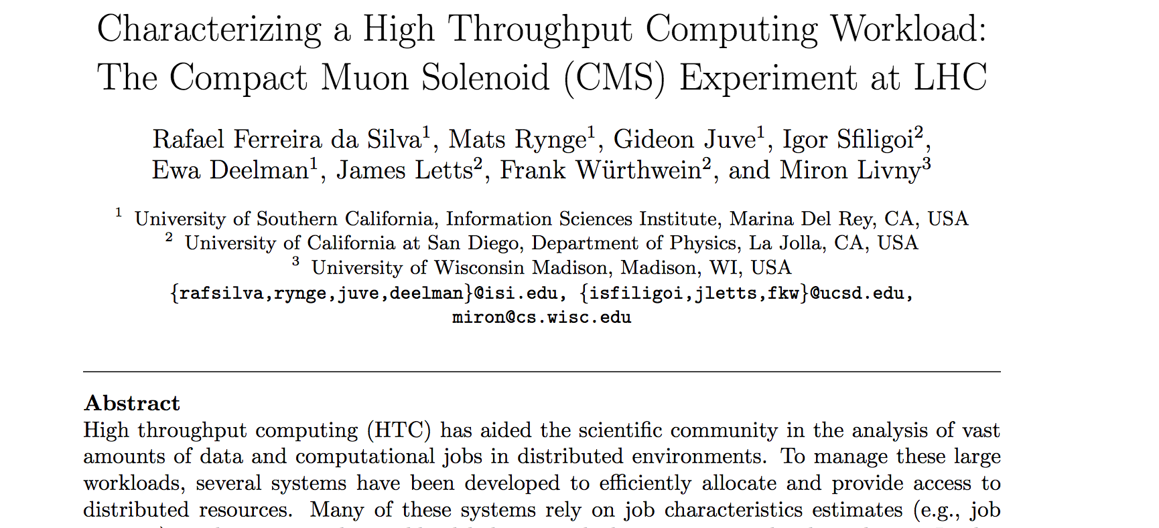
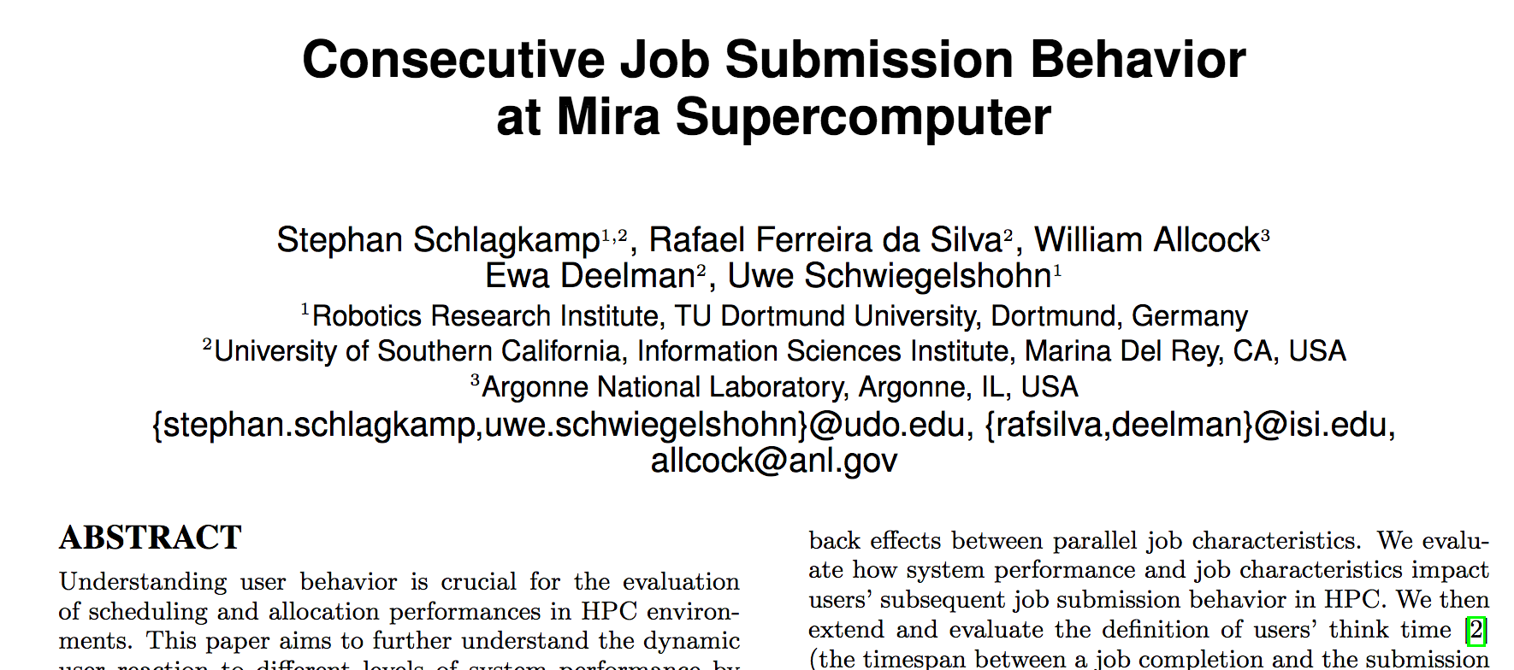
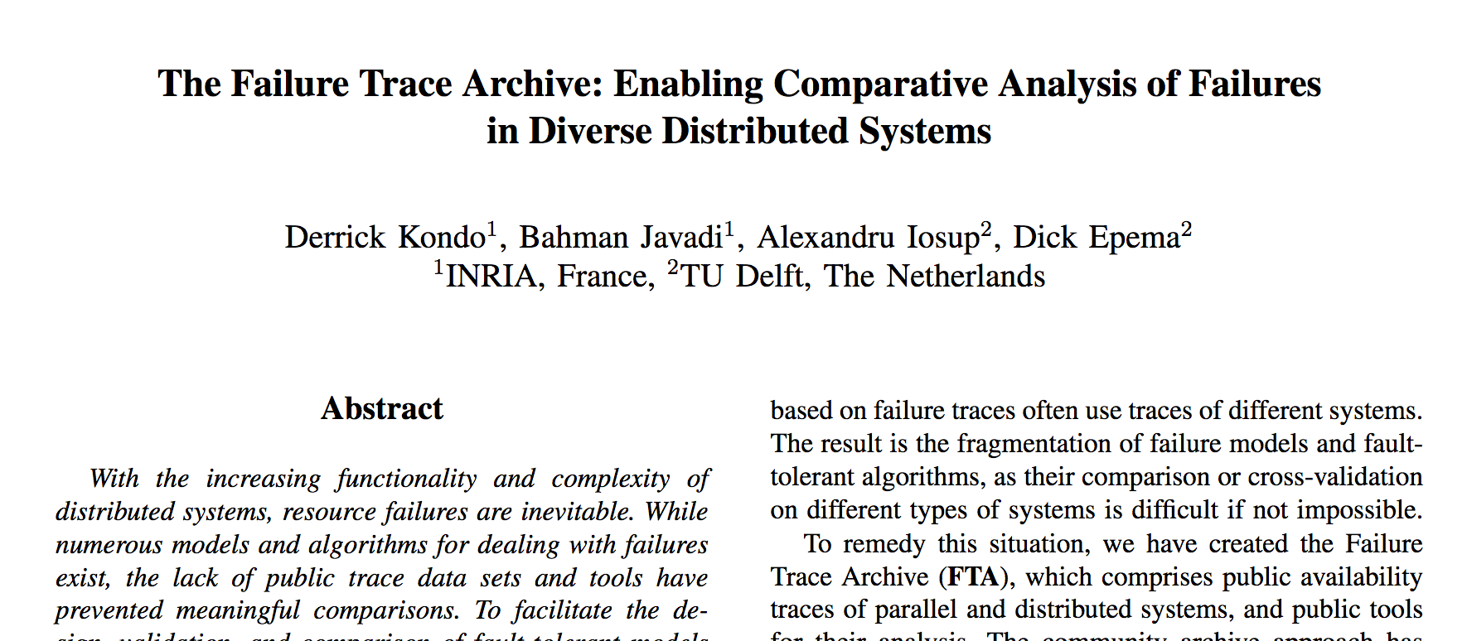
MOTIVATION
Grid computing
180k failed tasks out of 340k
CMS (Aug 2014)
385k failed tasks
out of 790k
The Failure Trace Archive
26 datasets from
2006-2014
Mira (2014)
over 14k failed jobs out of 80k
R. Ferreira da Silva, R. Filgueira, E. Deelman, E. Pairo-Castineira, I. M. Overton, M. Atkinson Using Simple PID Controllers to Prevent and Mitigate Faults in Scientific Workflows

Slide 5


SOME APPROACHES TO HANDLE FAULTS
Typical Approaches
Task Retries
Task Resubmission
Task Clustering
Checkpointing
Provenance
…
Statistical and Machine Learning
Linear Regression
Neural Networks
Classification Algorithms
Tree-based Methods
Support Vector Machines
…
Analytical Solutions
Others
Failure Modeling
Markov Chains
Principal Component Analysis
Histograms
…
Exception Handling
Game Theory
…
R. Ferreira da Silva, R. Filgueira, E. Deelman, E. Pairo-Castineira, I. M. Overton, M. Atkinson Using Simple PID Controllers to Prevent and Mitigate Faults in Scientific Workflows

Slide 6


… AND SOME OF THEIR LIMITATIONS
Most of them make strong assumptions about resource and application characteristics
Accurate estimates of such requirements are still a steep challenge
Some approaches may overload the execution platform
Most of the systems do not prevent faults, but mitigate them
We seek for an approach to predict, prevent, and mitigate failures in end-to-end workflow executions across distributed systems under online and unknown conditions
Some approaches are tied to a small
set of applications
<<<
R. Ferreira da Silva, R. Filgueira, E. Deelman, E. Pairo-Castineira, I. M. Overton, M. Atkinson Using Simple PID Controllers to Prevent and Mitigate Faults in Scientific Workflows

Slide 7
PID CONTROLLERS
Proportional-Integral-Derivative Controller
P
+
+
Setpoint
Σ
+
Σ
Input
Output
Control loop mechanism
Widely used in industrial control systems
- Temperature
- Pressure
- Flow rate
- etc.
PID controller aims at detecting the possibility of a fault far enough in advance so that an action can be performed to prevent it from happening
I
Process
-
+
D
z
1.5
Percent overshoot
Steady-state error
1.0
Raise time
<
0.5
Settling time
0.0
Dead time
Time
R. Ferreira da Silva, R. Filgueira, E. Deelman, E. Pairo-Castineira, I. M. Overton, M. Atkinson Using Simple PID Controllers to Prevent and Mitigate Faults in Scientific Workflows

Slide 8
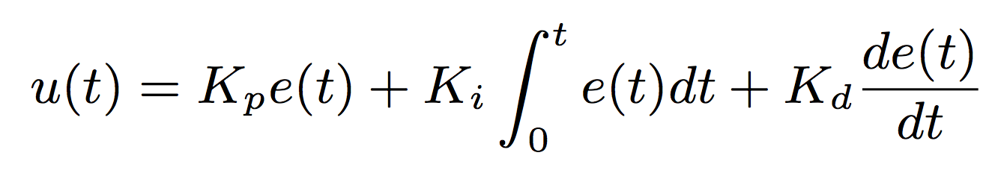

PROCESS VARIABLES
PID
K_{p}: Proportional gain constant
K_{i}: Integral gain constant
K_{d}: Derivative gain constant
e: error defined as the difference between the setpoint and the process variable value
Proportional-Integral-Derivative Controller
proportional
Present error
derivative
Prediction of future errors based on current rate of change
integral
Accumulation of past errors
R. Ferreira da Silva, R. Filgueira, E. Deelman, E. Pairo-Castineira, I. M. Overton, M. Atkinson Using Simple PID Controllers to Prevent and Mitigate Faults in Scientific Workflows

Slide 9

DATA FOOTPRINT AND MANAGEMENT
PID Controller
P: the error between the setpoint, and the actual used disk space
I: cumulative value of the proportional responses
D: the difference between the current and the previous disk overflow (or underutilization) error values
A run of scientific workflows that manipulate large data sets may lead the system to an out of disk space fault
Actions
u(t) < 0: data cleanup is used to remove unused data; or tasks are preempted
u(t) > 0: the number of concurrent task executions may be increased
R. Ferreira da Silva, R. Filgueira, E. Deelman, E. Pairo-Castineira, I. M. Overton, M. Atkinson Using Simple PID Controllers to Prevent and Mitigate Faults in Scientific Workflows

Slide 10

MEMORY USAGE AND MANAGEMENT
PID Controller
P: error between the setpoint value, and the actual memory usage
I: cumulative value of previous memory usage errors
D: difference between the current and the previous memory overflow (or underutilization) error values
Actions
u(t) < 0: tasks are preempted to prevent the system to run out of memory
u(t) > 0: the WMS may spawn additional tasks for concurrent execution
The performance of memory-intensive operations are often limited by the memory capacity of the resource where the application is being executed.
R. Ferreira da Silva, R. Filgueira, E. Deelman, E. Pairo-Castineira, I. M. Overton, M. Atkinson Using Simple PID Controllers to Prevent and Mitigate Faults in Scientific Workflows

Slide 11
WORKFLOW APPLICATION
1000 Genome Sequencing Analysis Workflow
Identifies mutational overlaps using data from the 1000 genomes project
22 Individual tasks, 7 Population tasks, 22 Sifting tasks, 154 Pair Overlap Mutations tasks, and 154 Frequency Overlap Mutations tasks (Total 359 tasks)
The workflow consumes/produces over 4.4TB of data, and requires over 24TB of memory
>
https://github.com/pegasus-isi/1000genome-workflow
R. Ferreira da Silva, R. Filgueira, E. Deelman, E. Pairo-Castineira, I. M. Overton, M. Atkinson Using Simple PID Controllers to Prevent and Mitigate Faults in Scientific Workflows
Notes:
Handle failures with to provide reliability

Slide 12






EXPERIMENT SETUP
shared memory
Compute Node 1
Memory
capacity 500GB
Shared filesystem
Disk
Workflow
Management System
Compute
Node 2
Memory
PID Control Loop
R. Ferreira da Silva, R. Filgueira, E. Deelman, E. Pairo-Castineira, I. M. Overton, M. Atkinson Using Simple PID Controllers to Prevent and Mitigate Faults in Scientific Workflows

Slide 13

EXPERIMENT CONDITIONS
we arbitrarily define our setpoint as 80% of the maximum total capacity (for both storage and memory usage, and a steady-state error of 5%
Execution are performed under online and unknown conditions
We assume K_{p} = K_{i} = K_{d} = 1
(no tuning)
Reference Workflow Execution
the decision on the number of tasks to be scheduled or preempted is computed as the min between the response value of the unique disk usage PID controller, and the memory PID controller per resource
Computed offline under known conditions
Averaged Makespan: ~106h
(standard deviation < 5%)
R. Ferreira da Silva, R. Filgueira, E. Deelman, E. Pairo-Castineira, I. M. Overton, M. Atkinson Using Simple PID Controllers to Prevent and Mitigate Faults in Scientific Workflows

Slide 14

OVERALL MAKESPAN EVALUATION
EVALUATION
Average workflow makespan for different configurations of the controllers
Proportional
K_{p} = 1, K_{i} = K_{d} = 0
Makespan: 138.76h
Slowdown: 1.30
Proportional-Integral
K_{p} = K_{i} = 1, K_{d} = 0
Makespan: 126.69h
Slowdown: 1.19
only mitigates faults
Proportional-Integral-Derivative
K_{p} = K_{i} = K_{d} = 1
Makespan: 114.96h
Slowdown: 1.08
prevents faults
R. Ferreira da Silva, R. Filgueira, E. Deelman, E. Pairo-Castineira, I. M. Overton, M. Atkinson Using Simple PID Controllers to Prevent and Mitigate Faults in Scientific Workflows

Slide 15
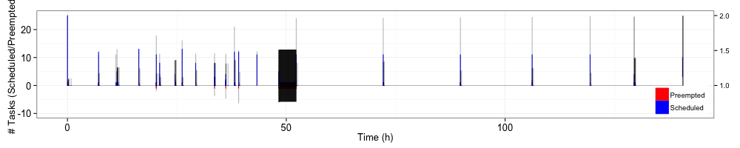
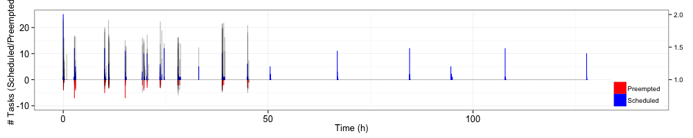
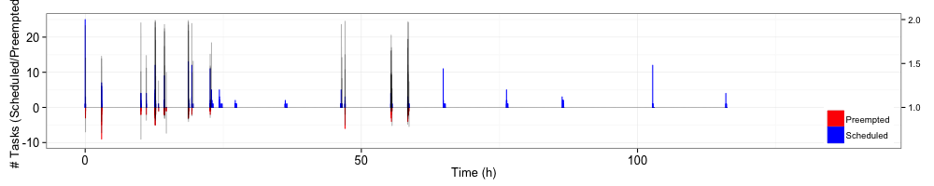
EXPERIMENTS: DATA FOOTPRINT
PROPORTIONAL
PROPORTIONAL
INTEGRAL
PROPORTIONAL
INTEGRAL
DERIVATIVE
R. Ferreira da Silva, R. Filgueira, E. Deelman, E. Pairo-Castineira, I. M. Overton, M. Atkinson Using Simple PID Controllers to Prevent and Mitigate Faults in Scientific Workflows

Slide 16

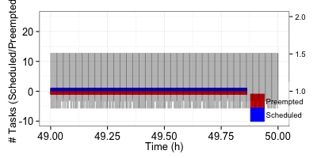
EXPERIMENTS: DATA FOOTPRINT
PROPORTIONAL
This process occurs at about 4h, and performs more than 6,000 preemptions
R. Ferreira da Silva, R. Filgueira, E. Deelman, E. Pairo-Castineira, I. M. Overton, M. Atkinson Using Simple PID Controllers to Prevent and Mitigate Faults in Scientific Workflows

Slide 17
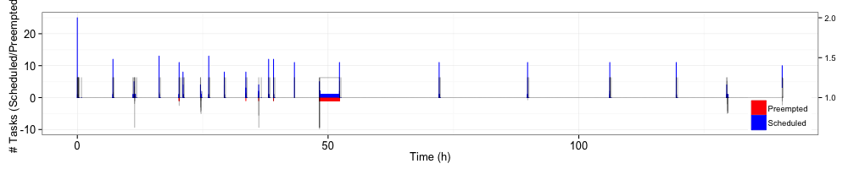
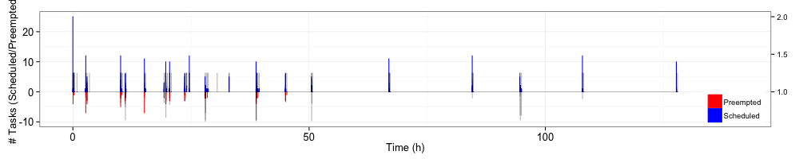
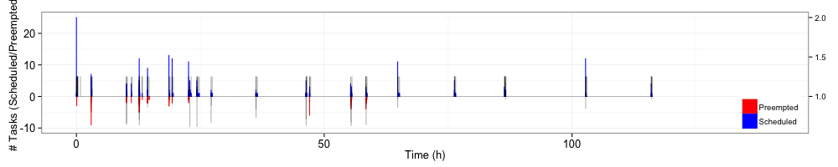
EXPERIMENTS: MEMORY USAGE
PROPORTIONAL
PROPORTIONAL
INTEGRAL
PROPORTIONAL
INTEGRAL
DERIVATIVE
R. Ferreira da Silva, R. Filgueira, E. Deelman, E. Pairo-Castineira, I. M. Overton, M. Atkinson Using Simple PID Controllers to Prevent and Mitigate Faults in Scientific Workflows

Slide 18
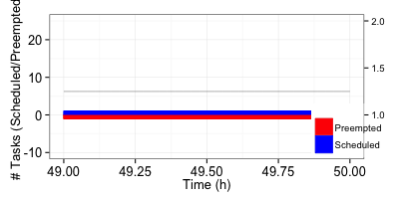
EXPERIMENTS: MEMORY USAGE
PROPORTIONAL
only a few tasks (on average less than 5) are preempted due to memory overflow
R. Ferreira da Silva, R. Filgueira, E. Deelman, E. Pairo-Castineira, I. M. Overton, M. Atkinson Using Simple PID Controllers to Prevent and Mitigate Faults in Scientific Workflows

Slide 19
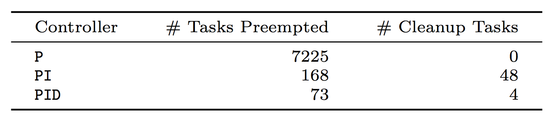
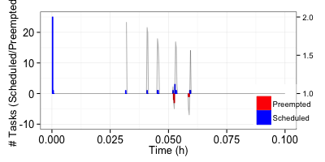
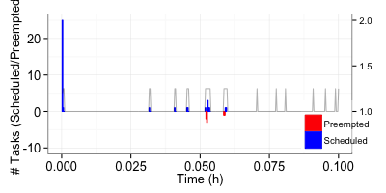
OVERALL RESULTS
DATA FOOTPRINT
MEMORY USAGE
R. Ferreira da Silva, R. Filgueira, E. Deelman, E. Pairo-Castineira, I. M. Overton, M. Atkinson Using Simple PID Controllers to Prevent and Mitigate Faults in Scientific Workflows

Slide 20
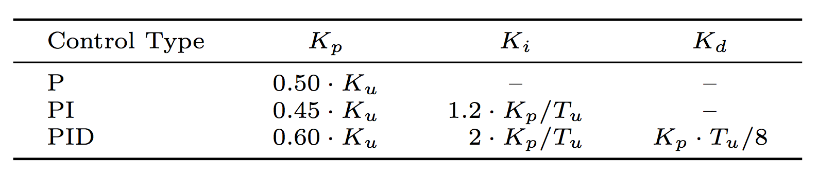
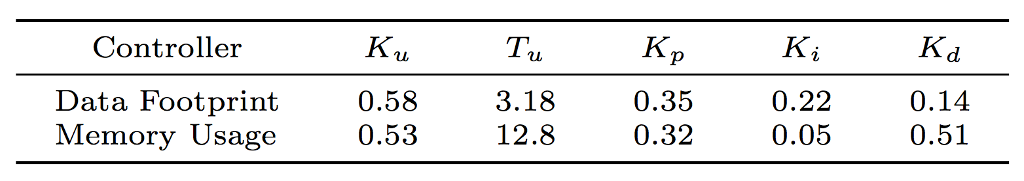
TUNING PID CONTROLLERS
Execution Environment
The goal of tuning a PID loop is to make it stable, responsive, and to minimize overshooting
Ziegler-Nichols Method
Ziegler-Nichols tuning, using the oscillation method
Turn the PID controller into a P controller by setting K_{i} = K_{d} = 0. Initially, K_{p} is also set to zero
Increase K_{p} until there are sustained oscillations in the signal. This K_{p} value is the ultimate gain, K_{u}
Measure the ultimate (or critical) period T_{u} of the sustained oscillations
>
Tuned gain parameters
R. Ferreira da Silva, R. Filgueira, E. Deelman, E. Pairo-Castineira, I. M. Overton, M. Atkinson Using Simple PID Controllers to Prevent and Mitigate Faults in Scientific Workflows

Slide 21

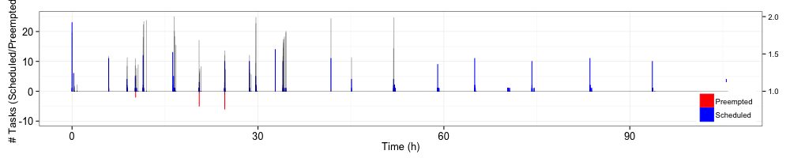
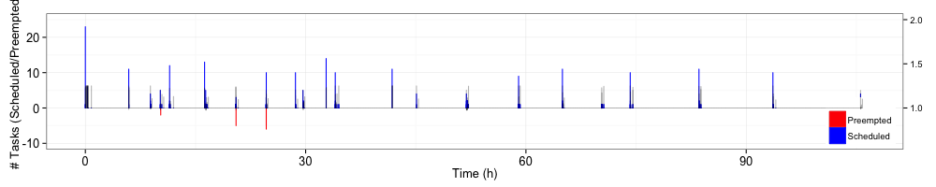
TUNED GAIN PARAMETERS
The key factor of its success is due to the specialization of the controllers to a single application
Avg. Makespan: 107.37h
Avg. Slowdown: 1.01 Preempted Tasks: 18
Cleanup Tasks: 1
DATA FOOTPRINT
MEMORY USAGE
R. Ferreira da Silva, R. Filgueira, E. Deelman, E. Pairo-Castineira, I. M. Overton, M. Atkinson Using Simple PID Controllers to Prevent and Mitigate Faults in Scientific Workflows

Slide 22
SUMMARY
Summary
Conclusions
Conclusion
Future Research Directions
>
Experimental results show that faults are detected and prevented before their occur, leading workflow execution to its completion with acceptable performance
PID controllers should be used sparingly, and metrics (and actions) should be defined in a way that they do not lead the system to an inconsistent state
We will investigate the simultaneous use of multiple control loops at the application and infrastructure levels, to determine to which extent this approach may negatively impact the system
Future Research Directions
R. Ferreira da Silva, R. Filgueira, E. Deelman, E. Pairo-Castineira, I. M. Overton, M. Atkinson Using Simple PID Controllers to Prevent and Mitigate Faults in Scientific Workflows

Slide 23


USING SIMPLE PID CONTROLLERS TO PREVENT AND MITIGATE FAULTS IN SCIENTIFIC WORKFLOWS
Thank You
Questions?
Rafael Ferreira da Silva, Ph.D.
Research Assistant Professor Department of Computer Science University of Southern California
rafsilva@isi.edu – http://rafaelsilva.com
http://pegasus.isi.edu

