Slide 1



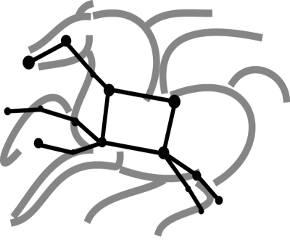
Container Support in Pegasus 4.8.x
Karan Vahi
vahi@isi.edu
https://pegasus.isi.edu

Slide 2
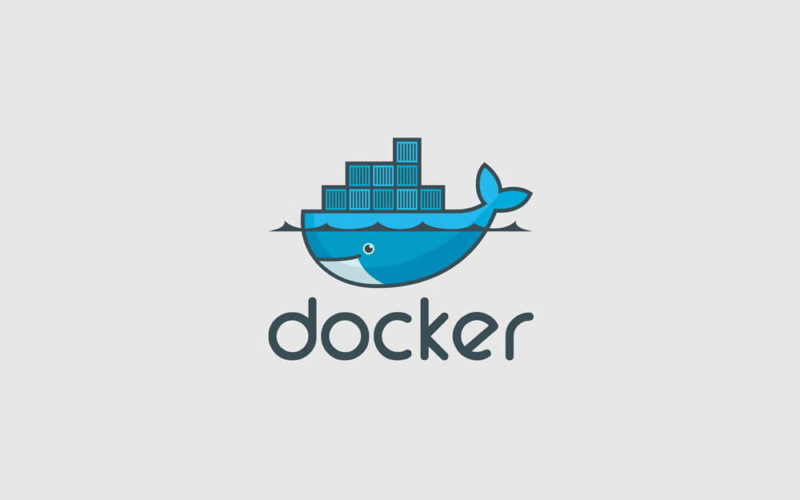

Containers
Lightweight and a reproducible way to run
application on heterogeneous nodes.
Separates the application from the node OS.
Popular Container Technologies
Docker
Popular in the enterprise world.
By default, application launched in container run as root
- A concern when running on shared infrastructure
Singularity
Popular in HPC environments.
Is run in user space.

Slide 3

Why use Containers for your workflow?
Traditional way of referring user executable in Pegasus
Jobs in the input abstract workflow (DAX) refer to logical transformations.
Users define mapping of logical transformation to actual executable in a Transformation Catalog
Executable staging works if executable is statically linked , OR
if libraries are installed on the nodes for dynamically linked executables
...
# This is the transformation catalog. It lists information about each of the
# executables that are used by the workflow.
tr ls {
site compute-site{
pfn "/bin/ls”
type "INSTALLED”
arch "x86_64"
os "linux"
osrelease ”centos"
osversion “7"
}
}
...
executables description
list of executables locations per site
physical executables
mapped from logical transformations
transformation type
whether it is installed or available to stage

Slide 4
Why use Containers for your workflow?
Traditional way of referring user executable in Pegasus
Pegasus matches the attributes of an executable defined in Transformation Catalog against the attributes specified for site in Site Catalog.
This approach works fine if your site is made of homogenous nodes
However, problems occur when
you run on a site with hetrogeneous nodes and your job lands on a node where OS is incompatible with your executable
Application is a mis-match to the compute node environment
Install libraries in your shared space and make sure environment refers to those libraries
Need cooperation from Site Admins. On OSG , you can install things in CVMFS
TensorFlow requires specific python libraries and versions. Some libraries maybe easy to
install on latest Ubuntu, but not on EL7

Slide 5
Pegasus Container Support
Introduced in Pegasus Release 4.8
Support for both Docker and Singularity
Users can now refer to containers in the Transformation Catalog
with their executables preinstalled.
Users can refer to a container they want to use. However, they can let Pegasus stage their executable to the node.
Useful if you want to use a site recommended/standard container image.
Users are using generic image with executable staging.

Slide 6
Specifying Containers in Transformation Catalog
...
tr pegasus::keg{
site isi {
pfn "/usr/bin/pegasus-keg
arch "x86"
os "linux"
osrelease ”centos"
osversion “7"
# INSTALLED means pfn refers to path in the container.
# STAGEABLE means the executable can be staged into the container
type "INSTALLED"
#optional attribute to specify the container to use
container "centos-pegasus"
}
}
cont centos-pegasus{
type "docker”
image "docker:///centos:7"
# optional site attribute to tell pegasus which site tar file
# exists. useful for handling file URL's correctly
image_site "optional site"
# environment to be set when the job is run in the container
# only env profiles are supported
profile env "JAVA_HOME" "/opt/java/1.6"
}
...
container
Reference to the container to use.
Multiple transformation can
refer to same container
type
Can be either docker or singularity
image
URL to image in a docker|singularity hub OR
to an existing docker image exported as a tar file or singularity image

Slide 7
Data Management for Containers
Users can refer to container images as
Docker or Singularity Hub URL’s
Docker Image exported as a TAR file and available at a server , just like any other input dataset.
If an image is specified to be residing in a hub
The image is pulled down as a tar file as part of data stage-in jobs in the workflow
The exported tar file is then shipped with the workflow and made available to the jobs
Motivation: Avoid hitting Docker/Singularity Hub repeatedly for large workflows
Pegasus worker package is not required to be pre-installed in the container
If a matching worker package is not installed, the required worker package is installed at runtime when container starts

Slide 8
Container Execution Model
Containerized jobs are launched via Pegasus Lite
Container image is put in the job directory along with input data.
Loads the container if required on the node ( applicable for Docker)
Run a script in the container that sets up Pegasus in the container and launches user application
Shut down the container ( applicable for Docker)
Ship out the output data generated by the application
Cleanup the job directory
Traditional shared-fs approach does not support containers.

Slide 9
Directories Mounted
Only the job directory where PegasusLite places the inputs is mounted in the container
Docker – Mounted as /scratch
Singularity – Mounted as /srv
PegasusLite ensures that user application is launched in the directory mounted
Consistent with the Pegasus model of ensuring that user job is launched in directory where it’s input data exists.

Slide 10
User Running in the Container
Singularity containers always run in user space.
Docker
Pegasus before launching the user application
Creates the user in the container that is the same as the user under which the job is launched by the Local Resource Manager on the remote node
Why do we do this?
By default, Docker runs user application as root
Not recommended for HPC environment
Creates problems with staging the outputs created in the container

Slide 11
Reference
Documentation
https://pegasus.isi.edu/documentation/containers.php
Example
https://github.com/pegasus-isi/montage-workflow-v2/
Script example-dss-containers.sh will run the montage workflow jobs in a container pulled from the singularity hub

Slide 12

Pegasus
est. 2001
Automate, recover, and debug scientific computations.
Meet our team
Thank You
Ewa Deelman
Karan Vahi
Questions?
Mats Rynge
Mats Rynge
rynge@isi.edu
Rajiv Mayani
Rafael Ferreira da Silva

