Slide 1



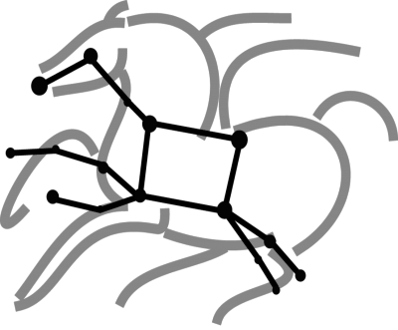
Pegasus Workflows on OLCF - Summit
George Papadimitriou
georgpap@isi.edu
http://pegasus.isi.edu

Slide 2
Outline
Kubernetes/OpenShift
What is Kubernetes (Specs, Pods, Services)
Why use Kubernetes in HPC
Openshift at OLCF
Pegasus Deployment on Openshift at OLCF
How to Deploy
Prerequisites
Instructions
Demo
Pegasus Workflow on Summit

Slide 3
Kubernetes

Slide 4
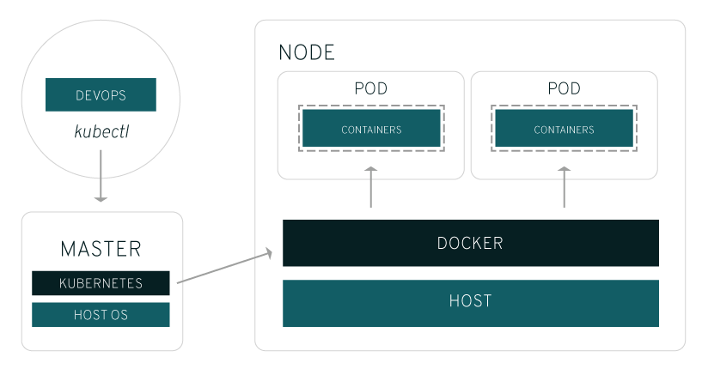
Kubernetes: Brief Overview
Kubernetes is an open-source platform for running and coordinating containerized application across a cluster of machines.
It can be useful for:
Orchestrating containers across multiple hosts
Control and automate deployments
Scale containerized applications on the fly
And more…
Key objects in the Kubernetes architecture are:
Master: Controls Kubernetes nodes – assign tasks
Node: Perform the assigned tasks
Pod: A group of one or more containers deployed on a single node
Replication Controller: Controls how many copies of a pod should be running
Service: Allow pods to be reached from the outside world
Kubelet: Runs on the nodes and starts the defined containers
Reference:
https://www.redhat.com/en/topics/containers/what-is-kubernetes

Slide 5
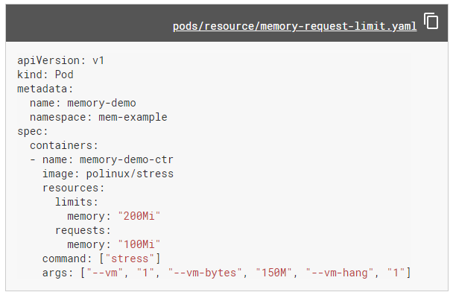
Kubernetes: Configuring Objects
Within Kubernetes, specification files describe the applications, services and objects being deployed
Specification files can be written in YAML and JSON formats and can be used to
Deploy Pods
Create and mount volumes
Expose services etc.
Reference:
https://kubernetes.io/docs/tasks/configure-pod-container/

Slide 6
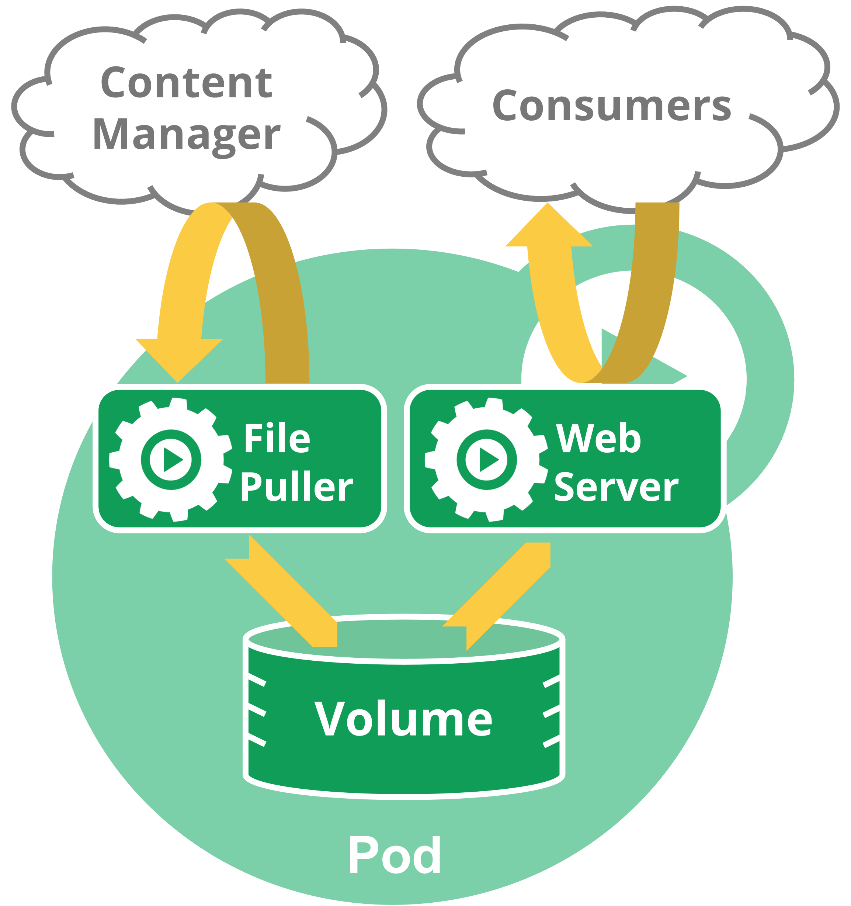
Kubernetes: Pods
A Pod is the basic execution unit of a Kubernetes application
Pods represent processes running on the cluster
One can have one or multiple containers running within a Pod.
Networking: Each Pod is assigned a unique IP address within the cluster
Storage: A Pod can specify a set of shared storage Volumes. Volumes persist data and allow Pods to maintain state between restarts.
Lifecycle: A Pod starts running on its assigned cluster-node until the container(s) exit or it is removed for some other reason (e.g. user deletes it).
References:
https://kubernetes.io/docs/concepts/workloads/pods/pod-overview/
https://kubernetes.io/docs/concepts/workloads/pods/pod/
https://kubernetes.io/docs/concepts/workloads/pods/pod-lifecycle/
https://kubernetes.io/docs/concepts/storage/volumes/

Slide 7
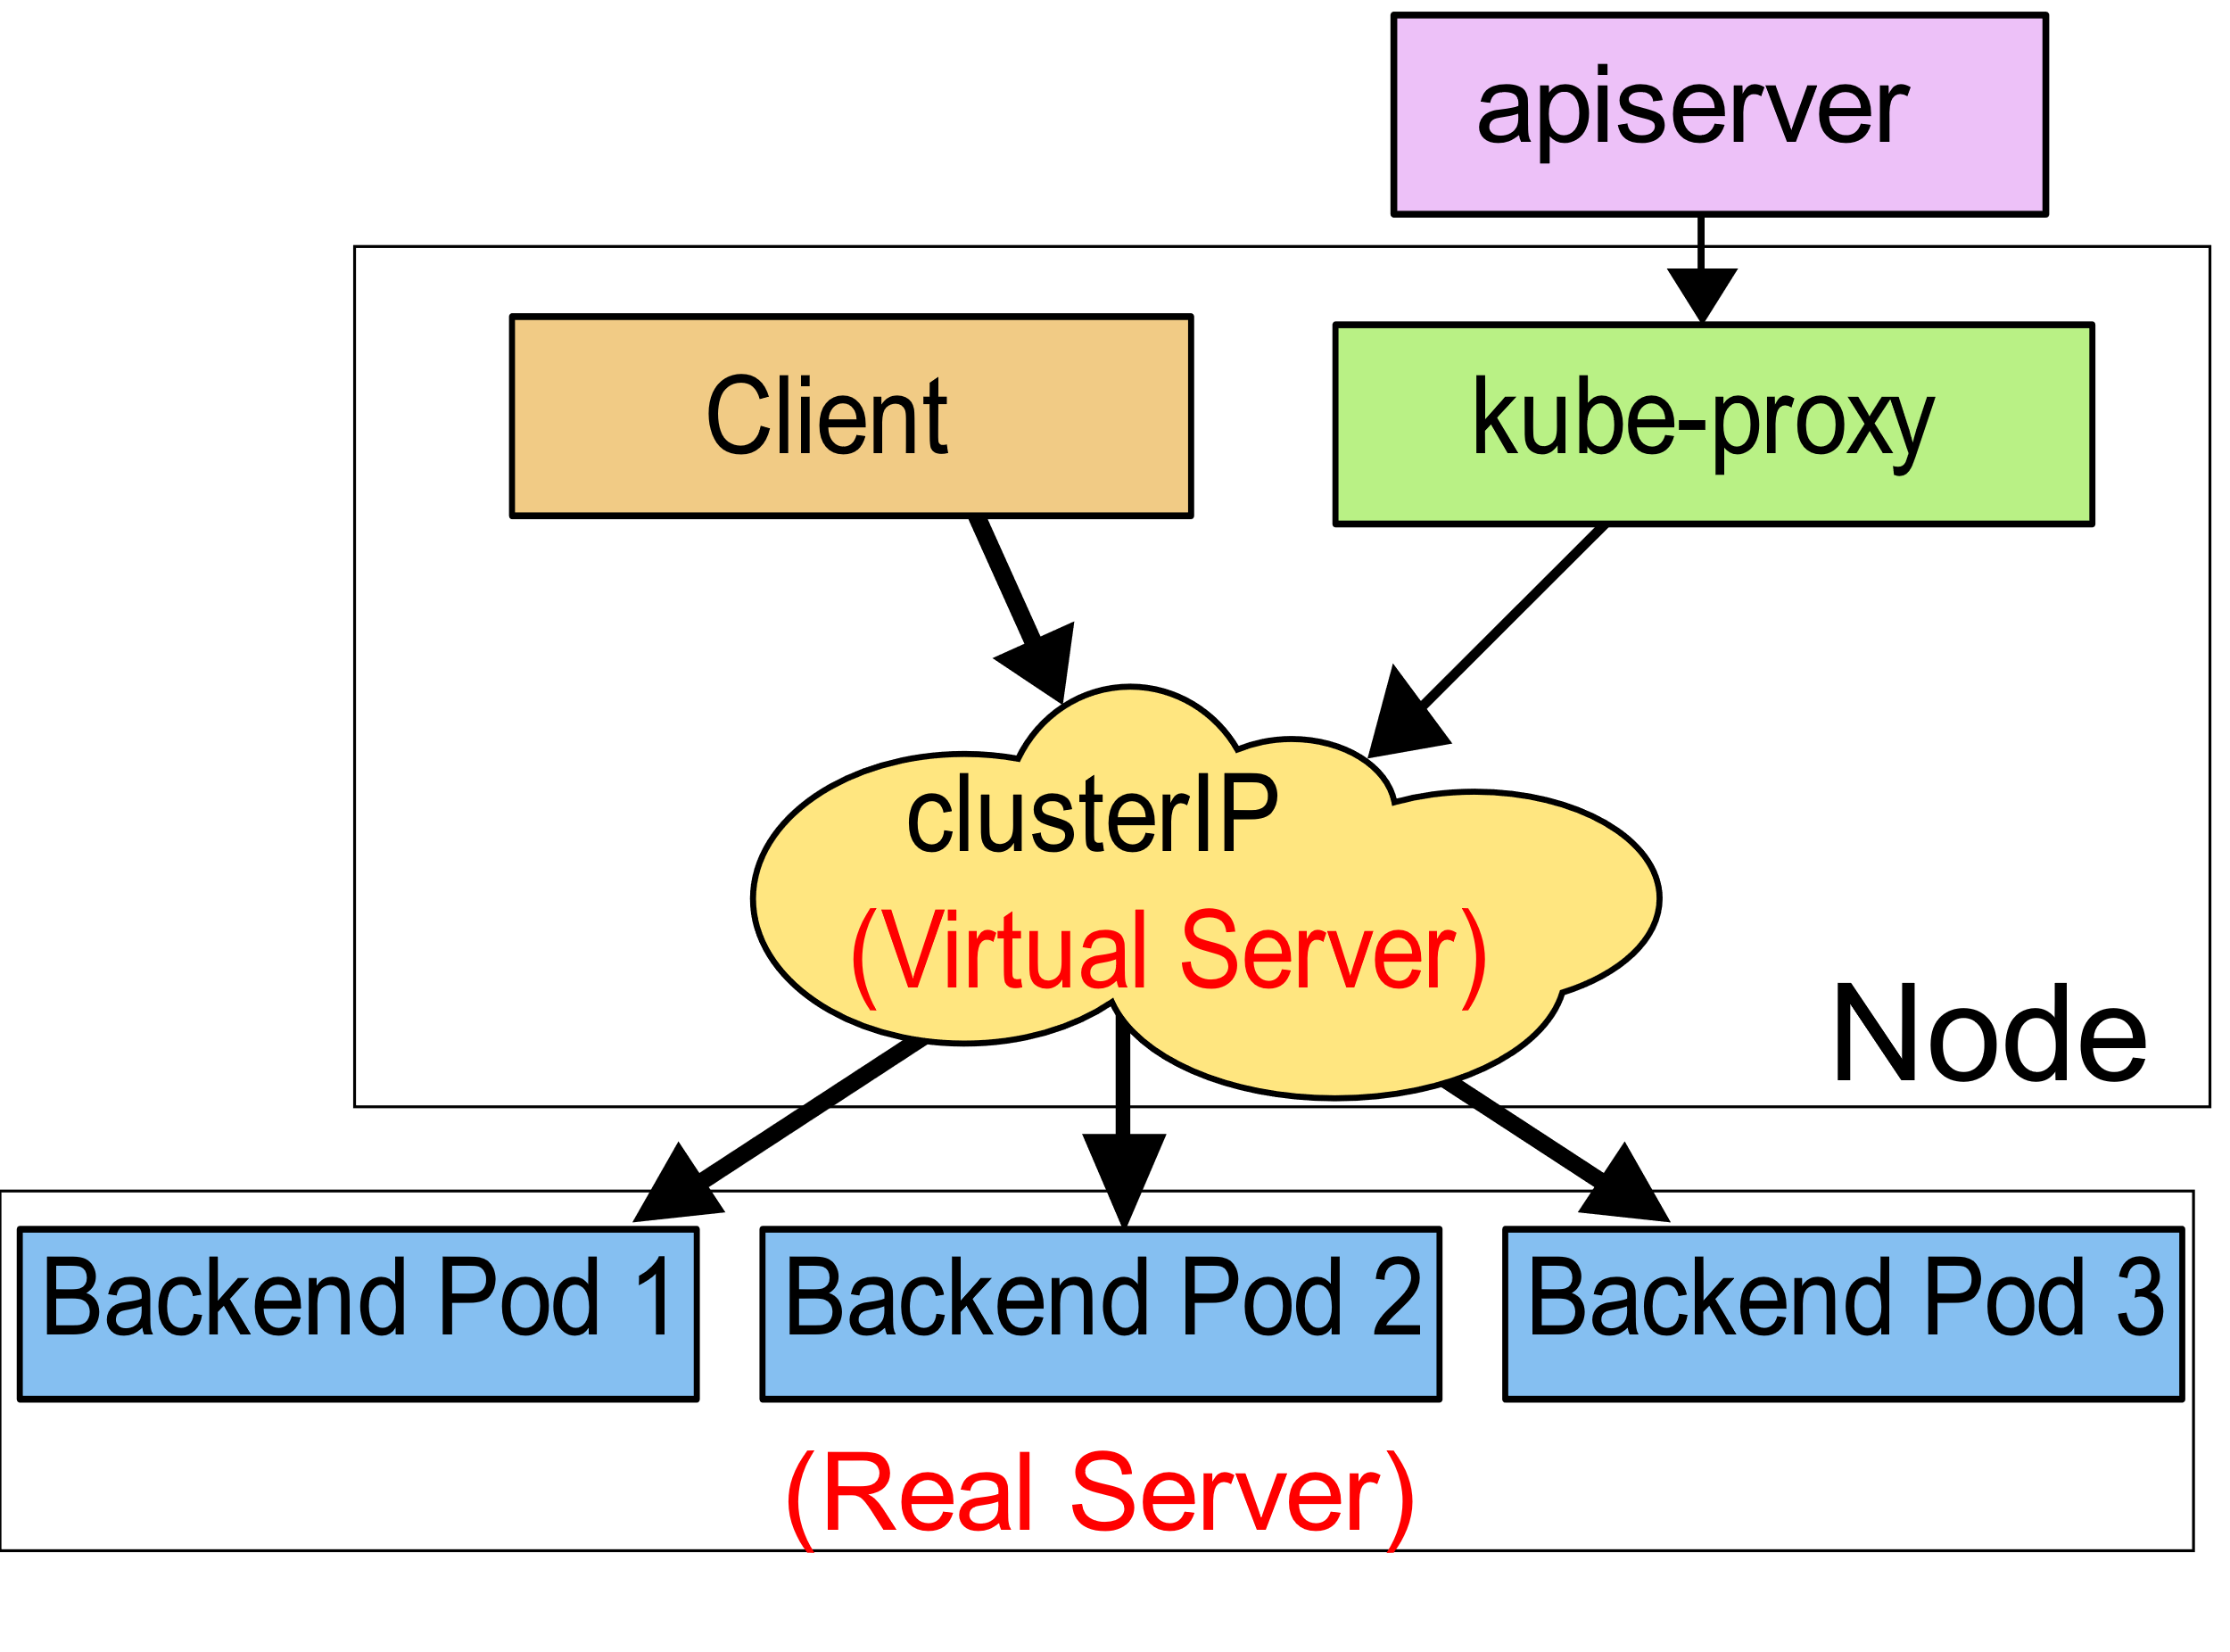
Kubernetes: Services
A Service provides an abstract way to expose an application running on a set of Pods as network service to the rest of the world
Since Pods are ephemeral, services allow users to access the backend applications via a common way
Service types are:
ClusterIP: Exposes the service on a cluster-internal IP
NodePort: Exposes the service on each Node’s IP at a static port
LoadBalancer: Exposes the service externally and loadbalances it
ExternalName: Maps the service to a name, returns a CNAME record
Reference:
https://kubernetes.io/docs/concepts/services-networking/service/

Slide 8
Kubernetes: Why it can be useful in HPC
Running services on login nodes can be cumbersome (build from scratch, compile all dependences etc.) and sometimes prohibited by the system administrators.
Maintaining an application/service up to day is easier
Assist workflow execution
Create submission environments
Handle data movement and job submissions
Automation and Reproducibility
Create collaborative web portals
Jupyter Notebooks
Workflow Design (e.g. Wings)
Streaming Data
Consuming
Publishing

Slide 9
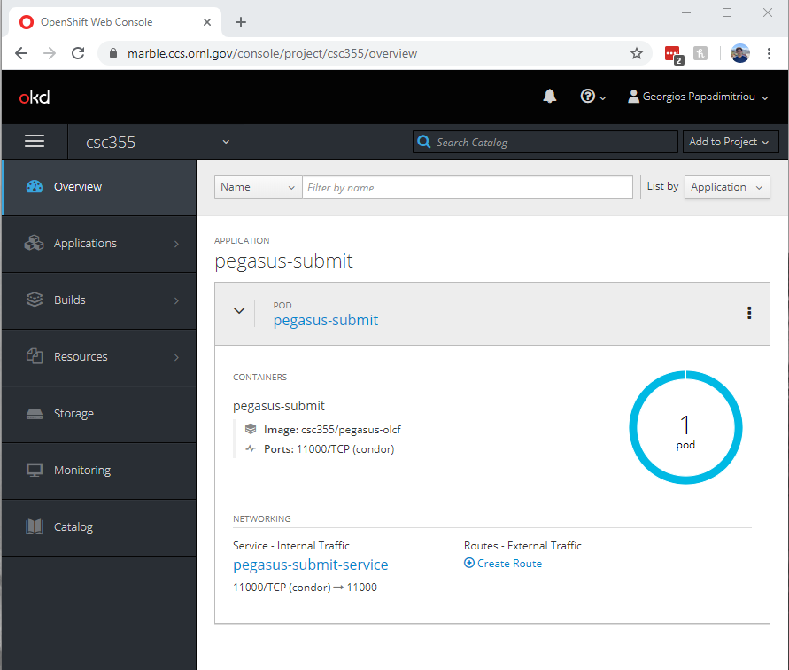
Kubernetes (OpenShift) at OLCF
OLCF has deployed OpenShift, a distribution of Kubernetes developed by RedHat
OpenShift provides a command line and a web interface to manage your Kubernetes objects (pods, deployments, services, storage etc.)
OLCF’s deployment has automation mechanisms that allow users to submit jobs to the batch system and access the shared file systems (NFS, GPFS)
All containers run as an automation user that is tied to a project
Reference:
https://www.olcf.ornl.gov/wp-content/uploads/2017/11/2018UM-Day3-Kincl.pdf

Slide 10
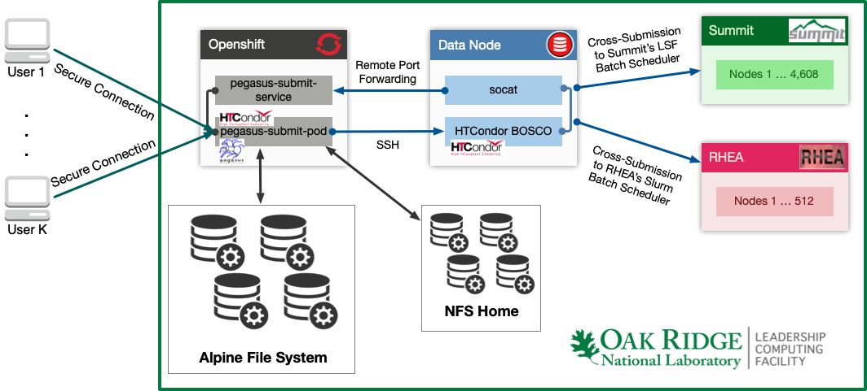
Kubernetes (OpenShift) at OLCF: Pegasus Deployment

Slide 11
Kubernetes at OLCF: Pegasus Deployment - Advantages
Pegasus workflow environments at OLCF have been simplified.
Using the Kubernetes cluster at OLCF, we can deploy Pegasus submit nodes as services, within a few seconds.
The deployment uses HTCondor’s BOSCO SSH style submissions on the DTNs and achieves submissions to the SLURM and LSF batch schedulers.
This approach allows a single workflow to be configured to use all of OLCF’s resources. E.g. Execute transfers on the DTNs, run simulations and heavy processing on Summit and then do lightweight post processing steps on RHEA.

Slide 12
How to Deploy
We will follow the tutorial: https://pegasus.isi.edu/tutorial/summit/tutorial_setup.php

Slide 13
How to Deploy: Prerequisites
Pegasus Kubernetes Templates for OLCF:
https://github.com/pegasus-isi/pegasus-olcf-kubernetes
Openshift’s Origin Client:
https://github.com/openshift/origin/releases
A working RSA Token to access OLCF’s systems
An automation user for OLCF’s systems
Allocation on OLCF’s Openshift Cluster (https://marble.ccs.ornl.gov)

Slide 14
How to Deploy: Useful Origin Client Commands
oc login: acquires an access token, authenticate against a cluster
oc status: returns/prints the status of your deployments
oc describe: shows details of a specific resource
oc create: creates a Kubernetes resource from specification
oc start-build: initiates the creation of a container image
oc logs: returns/prints the Kubernetes log for a resource
oc exec: executes a command in a container
oc delete: deletes a resource

Slide 15
How to Deploy: Pegasus - Kubernetes Templates
bootstrap.sh Generates customized Dockerfile and Kubernetes pod and service specifications for your deployment.
Specs/pegasus-submit-build.yml Contains Kubernetes build specification for the pegasus-olcf image.
Specs/pegasus-submit-service.yml Contains Kubernetes service specification that can be used to spawn a Nodeport service that exposes the HTCondor Gridmanager Service running in your submit pod, to outside world.
Specs/pegasus-submit-pod.yml Contains Kubernetes pod specification that can be used to spawn a pegasus/condor pod that has access to Summits's GPFS filesystem and its batch scheduler.

Slide 16
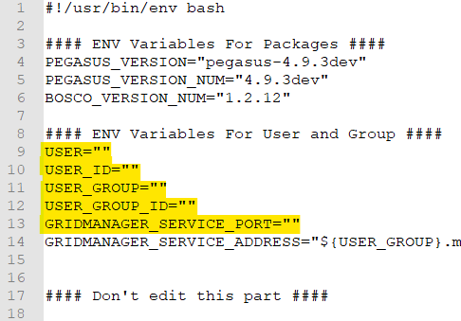

How to Deploy: Customize Templates
In bootstrap.sh update the section "ENV Variables For User and Group" with your automation user's name, id, group name, group id and the Gridmanager Service Port, which must be in the range 30000-32767.
Replace the highlighted text:
USER: with the username of your automation user (eg. csc001_auser)
USER_ID: with the user id of your automation user (eg. 20001)
USER_GROUP: with the project name your automation user belongs to (eg. csc001)
USER_GROUP_ID: with the project group id your automation user belongs to (eg. 10001)
GRIDMANAGER_SERVICE_PORT: with the Kubernetes Nodeport port number the Gridmanager Service should use (eg. 32752)
Execute Script:

Slide 17
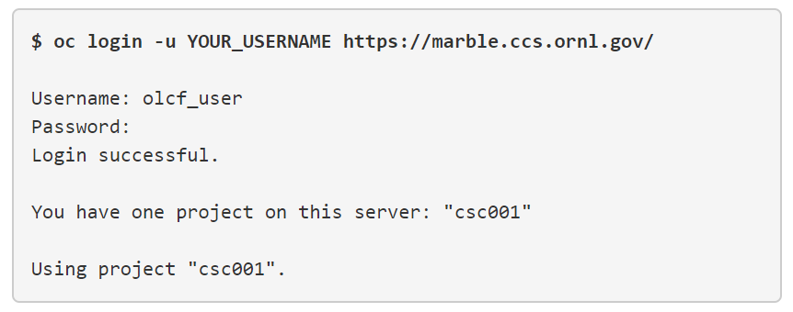
How to Deploy: Acquire an Access Token (Step 1)

Slide 18
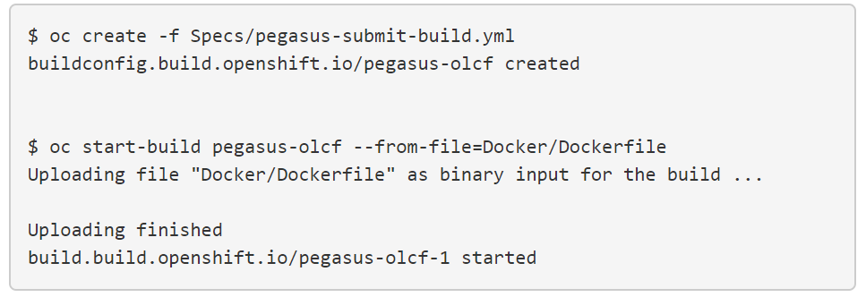
How to Deploy: Build the Container Image (Step 2)
Create a new build and build the image:
1
2

Slide 19
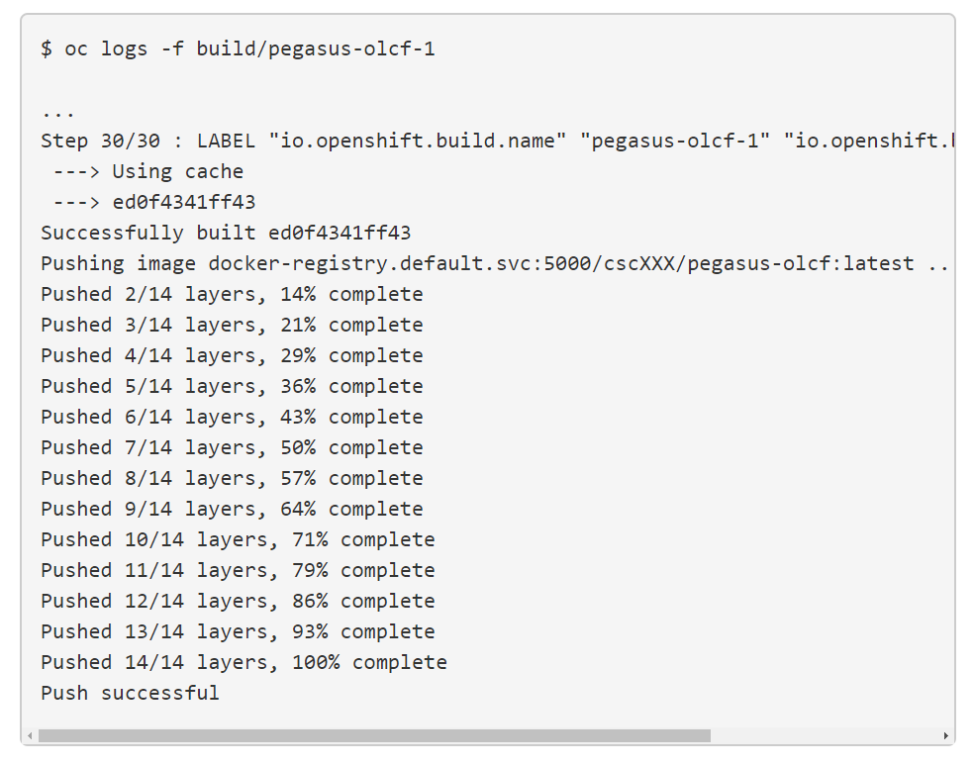
How to Deploy: Build the Container Image (Step 2)
Trace the progress of the build:

Slide 20
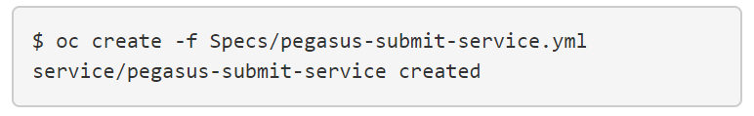
How to Deploy: Start the Kubernetes Service (Step 3)
Start a Kubernetes Service that will expose your pod’s services:
Note: In case this step fails, go back to the bootstrap.sh change the service port number and execute it again.
Proceed from this step, there is no need to rebuild the container.

Slide 21
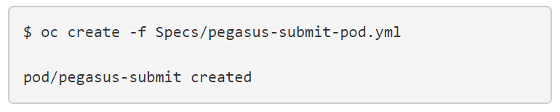
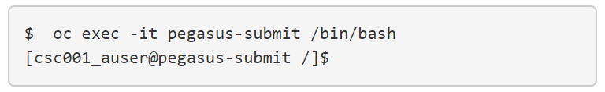
How to Deploy: Start the Pegasus Pod (Step 4)
Start a Kubernetes Pod with Pegasus and HTCondor:
Logon to the Pod:

Slide 22

How to Deploy: Configuring for Batch Submissions (Step 5)
If this is the first time you bringing up the Pegasus container in Kubernetes we need to configure it for batch submissions.
In the shell you got on the previous step execute:
Note: This script installs some additional files needed to operate on OLCF, and prepares the environment on the DTNs, by installing BOSCO.

Slide 23
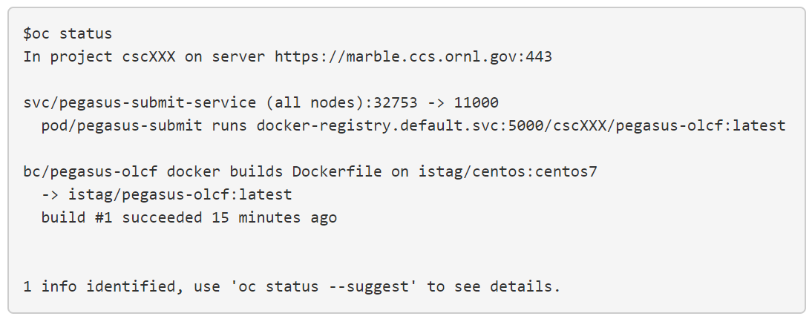
How to Deploy: Check the status of the deployment
If all goes well you should see something similar to this in your terminal:

Slide 24



How to Deploy: Deleting the Pod and the Service
Deleting the Pod:
Deleting the Service:
Deleting the container
image:

Slide 25
Demo Workflow
We will follow the tutorial: https://pegasus.isi.edu/tutorial/summit/tutorial_submitting_wf.php

Slide 26
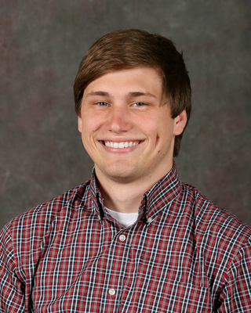
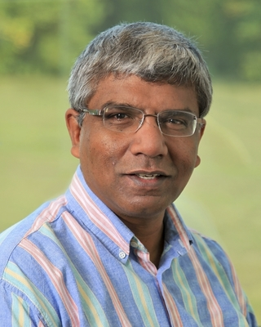
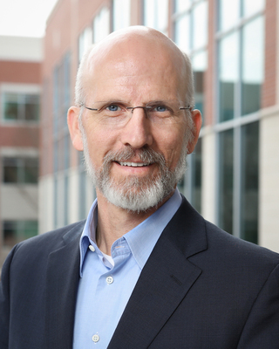
Acknowledgements
Special thanks to the OLCF people that helped us make this deployment happen !
Jason Kincl
kincljc@ornl.gov
Valentine Anantharaj
anantharajvg@ornl.gov
Jack Wells
wellsjc@ornl.gov

Slide 27




GitHub: https://github.com/Panorama360
Website: https://panorama360.github.io
George Papadimitriou
Computer Science PhD Student
University of Southern California
email: georgpap@isi.edu
https://panorama360.github.io/

Slide 28
Pegasus
est. 2001
Automate, recover, and debug scientific computations.
Pegasus Website
http://pegasus.isi.edu
Get Started
Users Mailing List
pegasus-users@isi.edu
Support
pegasus-support@isi.edu
Pegasus Online Office Hours
https://pegasus.isi.edu/blog/online-pegasus-office-hours/
Bi-monthly basis on second Friday of the month, where we address user questions and also apprise the community of new developments

