Slide 1

Pegasus 5.0 + Ensemble Manager Workflow Management System
Karan Vahi University of Southern California, School of Engineering
Information Sciences Institute
vahi@isi.edu

Slide 2
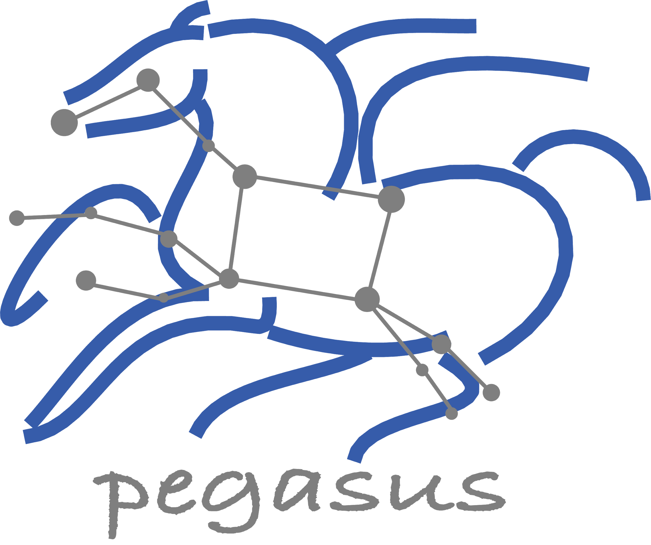


Why Pegasus?
Automates Complex, Multi-stage Processing Pipelines
Automate
Enables Parallel, Distributed Computations
Automatically Executes Data Transfers
Recover
Reusable, Aids Reproducibility
Records How Data was Produced (Provenance)
Handles Failures with to Provide Reliability
Debug
Keeps Track of Data and Files
Ensures Data Integrity during workflow execution
NSF funded project since 2001,
with close collaboration with HTCondor team

Slide 3
Workflow Challenges Across Domains
Our Focus
Describe complex workflows in a simple way
Access distributed, heterogeneous data and resources (heterogeneous interfaces)
Deal with resources/software that change over time
Ease of use. Ability to debug and monitor large workflows
Separation between workflow description and workflow execution
Workflow planning and scheduling (scalability, performance)
Task execution (monitoring, fault tolerance, debugging, web dashboard)
Provide additional assurances that a scientific workflow is not accidentally or maliciously tampered with during its execution.

Slide 4
Key Pegasus Concepts
Pegasus WMS ==
Pegasus planner (mapper) + DAGMan workflow engine + HTCondor scheduler/broker
Pegasus maps workflows to infrastructure
DAGMan manages dependencies and reliability
HTCondor is used as a broker to interface with different schedulers
Workflows are DAGs
Nodes: jobs, edges: dependencies
No while loops, no conditional branches
Jobs are standalone executables
Planning occurs ahead of execution
Planning converts an abstract workflow into a concrete, executable workflow
Planner is like a compiler

Slide 5


Input Workflow Specification
directed-acyclic graphs
Output Workflow
YAML formatted
Portable Description
Users do not worry about low level execution details
Stage-in Job
Transfers the workflow input data
Logical Filename (LFN)
platform independent (abstraction)
ABSTRACT WORKFLOW
EXECUTABLE WORKFLOW
Cleanup Job
Transformation
Removes unused data
Executables (or programs) platform independent
Stage-out Job
Stage-out generated output data
Registration Job
Registers the workflow output data

Slide 6
Pegasus Deployment
SUBMIT HOST
Workflow Submit Node
Compute Site 1
Input Data Site
F.in
Pegasus Lite
Instance
Pegasus WMS
HTCondor
F.in
J1
T1
T1
One or more Compute Sites
F.int
Compute Clusters
Cloud
OSG
WN
WN
Staging Site
F.int
T2
Compute Site n
Pegasus Lite
Instance
F.out
Input Sites
J2
T2
Output Data Site
Host Input Data
F.out
Data Staging Site
WN
WN
Coordinate data movement for workflow
LEGEND
Output Site
Task flow +
Checksums
Directory
Setup Job
Data
Stageout Job
Check
Integrity Job
Pegasus Lite Compute Job
J
Where output data is placed
Data
Stagein Job
Directory
Cleanup Job
Checksum Generation Job
Worker Node
(WN)
Data Flow
WN

Slide 7
Advanced LIGO
SUBMIT HOST
Input data
hosted at
LIGO Sites
Nebraska GridFTP Data staging server
GridFTP, HTTP, SRM
LIGO output
data server
Abstract Workflows
X
J
W
Data Flow for LIGO Pegasus Workflows
in OSG
Y
Input Files
Intermediate Files
Produced Dataser
1
Workflow stagein Job
stages in the input data for workflow from user server
2
PegassusLife instance looks up input data on the compute node/ CVMFS
If not present, stage-in data from remote data staging server
4
Workflow Stageout Job stages produced data from data staging server to LIGO Output Data Server
Pegasus Planner
HTTP Squid Cache
Workflow Setup
Job
Nodes from OSG &
LIGO Sites managed
By Glidein WMS
3
Pegasus lite instance stages out job output data from worker node to data staging server
Workflow Stagein
Job
Laser Interferometer
Gravitational Wave Observatory
X
Executable
Workflow
J
J
W
J
Y
WN
WN
60,000 Compute Tasks
Input Data: 5000 files (10GB total)
Output Data: 60,000 files (60GB total)
Processed Data: 725 GB
Workflow Stageout
Job
Condor Schedd
Queue
CVMFS
WN
WN
WN
WN
WN
WN
Data
Cleanup
Job
J
Directory
Setup Job
Data
Stageout Job
J
Pegasus Lite Compute Job
Executed on LIGO Data Grid, EGI,
Open Science Grid and XSEDE
W
LEGEND
Condor DAGMan
Data
Stagein Job
Directory
Cleanup Job
Woorker Node

Slide 8
Automatic Integrity Checking in Pegasus
SUBMIT HOST
Compute Site 1
Input Data Site
F.in
Pegasus Lite
Instance
Pegasus performs integrity checksums on input files right before a job starts on the remote node.
F.in
J1
T1
T1
F.int
Staging Site
WN
WN
For raw inputs, checksums specified in the input replica catalog along with file locations
All intermediate and output files checksums are generated and tracked within the system.
Support for sha256 checksums
F.int
T2
Compute Site n
Pegasus Lite
Instance
F.out
J2
T2
Output Data Site
F.out
WN
WN
LEGEND
Job failure is triggered
if checksums fail
Task flow +
Checksums
Directory
Setup Job
Data
Stageout Job
Check
Integrity Job
J
Pegasus Lite Compute Job
Data Flow
Data
Stagein Job
Directory
Cleanup Job
Checksum Generation Job
Worker Node
(WN)
WN
Notes:
Currently, we have implemented and are enforcing integrity checking in the PegasusLite deployments, where a job on the remote compute node is launched by a llightweight Pegasus instance that is responsible for fetching the input data for the job and staging the output to the scratch space. Before a job starts, an integrity check step is performed to ensure that any input files staged to the compute node matches the checksum in the data catalogs. Any new files ( intermediate , and final output files) that are generated on the remote node have their checksums computed on the remote node itself. This information is brought back to Pegasus submit host as part of job’s stdout and then stored in our monitoring database.

Slide 9

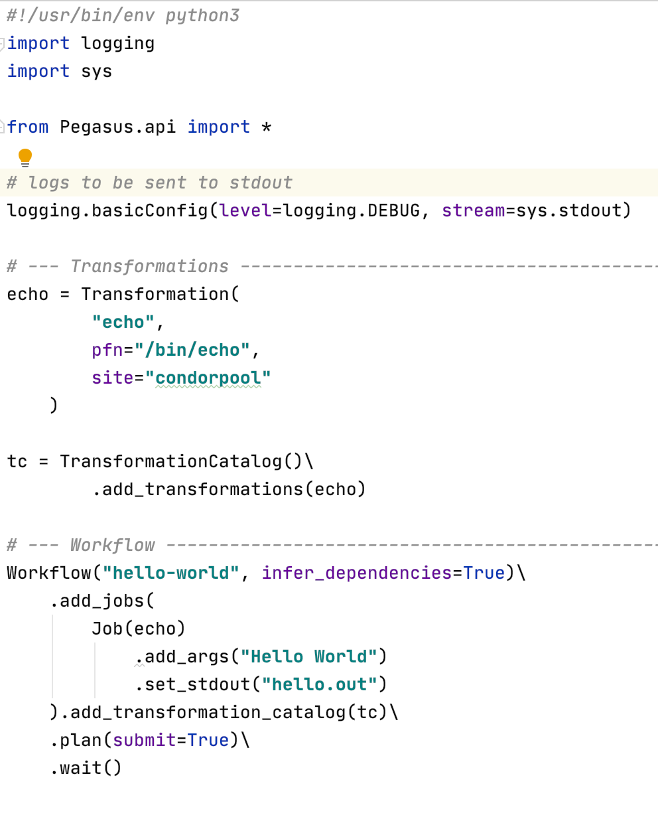
Pegasus 5.0
Released Nov, 2020
New and fresh Python3 API to compose, submit and monitor workflows, and configure catalogs
New Catalog Formats
Python 3 Support
All Pegasus tools are Python 3 compliant
Python PIP packages for workflow composition and monitoring
Zero configuration required to submit to local HTCondor pool.
Data Management Improvements
New output replica catalog that registers outputs including file metadata such as size and checksums
Improved support for hierarchical workflows
Reworked Documentation and Tutorial
https://pegasus.isi.edu/documentation/

Slide 10

Pegasus 5.0
Zero configuration required to submit to local HTCondor pool.
The “hello world” example on the right will work out of the box
Pegasus will automatically create sensible defaults for sites
local
condorpool
By default, site “condorpool” is used as execution site.
Site “local” still designates the submit node, and is used to run Pegasus auxillary jobs.

Slide 11

Ensemble Manager
Allow users to submit a collection of workflows (ensembles)
Automatically spawn and manage collections of workflows
Trigger submission of workflows
Properties
Workflows within an ensemble may have different priorities
Priorities can also be changed at runtime
Ensembles may limit the number of concurrent planned and running workflows
Additional Actions
Ensembles can be paused, resumed, removed, re-planned, and re-executed
A debugging mechanism is also provided to investigate failures in workflow runs
Actions can be performed both to ensembles and single workflows within ensembles

Slide 12



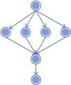
Ensemble Manager Triggers
Cron workflow trigger
Automatically submit workflows to the ensemble manager at regularly occurring time intervals
File pattern workflow trigger
Cron trigger functionality
New input files matching a given file pattern(s) will be passed as input
Ideal for regular batch processing of data as it arrives in one or more given directories
ENSEMBLE MANAGER
Interval: 12h
Patterns: [/inputs/img/*.jpg]
workflow
workflow
ensemble 1
queued workflow ensembles
/inputs/img
Notes:
As mentioned earlier, there are two triggers that we’ve developed a cron based trigger and a file pattern based trigger.
The cron based trigger will add a given workflow to a designated ensemble at a set time interval
The file pattern trigger builds on that. With this trigger, at the given time interval, the specified workflow will be added to a designated ensemble such that new input files matching the given file pattern(s) will be passed as input to the workflow generation script. This is useful when you need to periodically run workflows as new data arrives into some input directory.

Slide 13
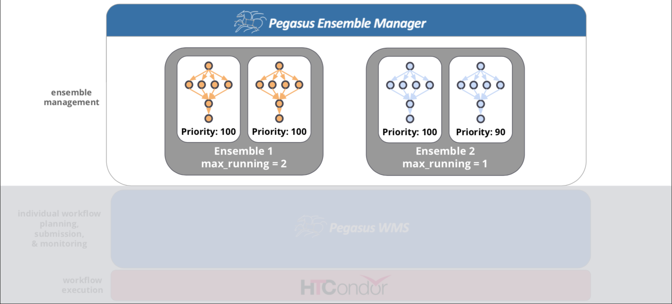
Ensemble Manager Overview
Notes:
Here is an overview of the ensemble manager. It runs on the submit node along with an installation of Pegasus and HTCondor.
In this example, we have two ensembles, each with two workflows added.
In ensemble 1, max_running is set to 2, while in ensemble 2, max_running is set to 1.
The ensemble manager operates on a configurable interval at which it will handle all of the created ensembles.

Slide 14
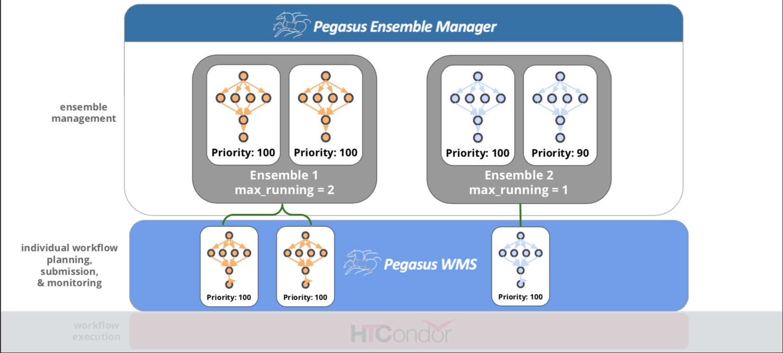
Ensemble Manager Overview
Notes:
In this scenario, given the values set for max_running, the three workflows shown are submitted through Pegasus, and then executed by HTCondor DAGMan.

Slide 15
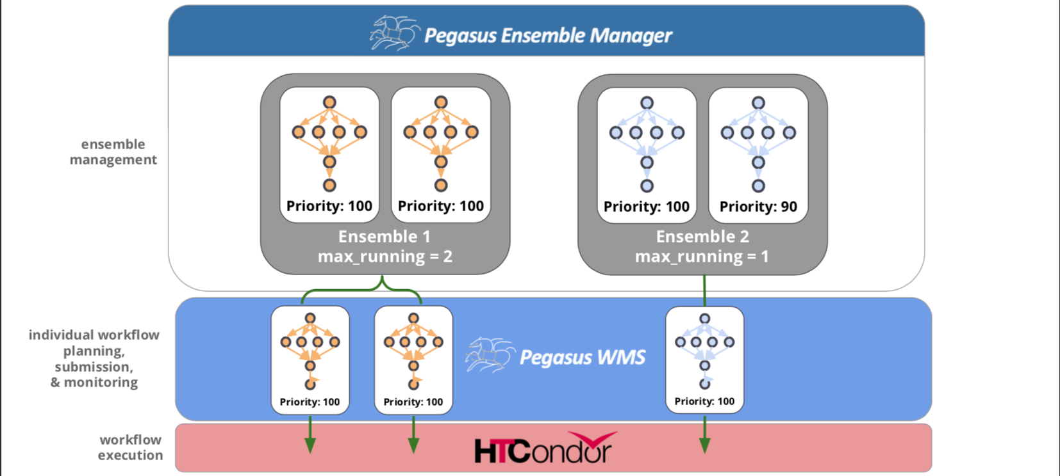
Ensemble Manager Overview

Slide 16
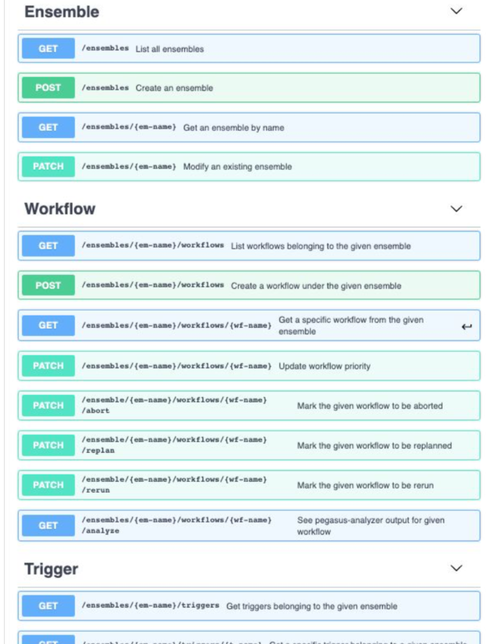
Ensemble Manager: Rest API
Exposing the ensemble manager as a REST endpoint
Provide create, read, update, delete operations on ensembles, workflows, and triggers
Provide Python and Java client code
Improve support for integrating ensemble manager into larger systems
Notes:
Finally, we are currently working on exposing the ensemble manager as REST endpoint where you can perform CRUD operations on Ensembles, Workflows, and Triggers.
We will be providing both Python and Java client code. And this will help to improve support for integrating the ensemble manager in to larger systems.

Slide 17

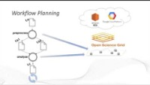
Get Started
Pegasus
est. 2001
Automate, recover, and debug scientific computations.
https://www.youtube.com/channel/UCwJQln1CqBvTJqiNr9X9F1Q/featured
YouTube Channel
Pegasus Website
https://pegasus.isi.edu
Users Mailing List
pegasus-users@isi.edu
Support
pegasus-support@isi.edu
Slack
Ask for an invite by trying to join pegasus-users.slack.com in the Slack app
Pegasus in 5 Minutes
Pegasus Online Office Hours
https://pegasus.isi.edu/blog/online-pegasus-office-hours/
Bi-monthly basis on second Friday of the month, where we address user questions and also apprise the community of new developments

