Slide 1

Pegasus Workflow Management System
Karan Vahi University of Southern California, School of Engineering
Information Sciences Institute
vahi@isi.edu, tanaka@isi.edu

Slide 2
Workflow Challenges Across Domains
Our Focus
Describe complex workflows in a simple way
Access distributed, heterogeneous data and resources (heterogeneous interfaces)
Deal with resources/software that change over time
Ease of use. Ability to debug and monitor large workflows
Separation between workflow description and workflow execution
Workflow planning and scheduling (scalability, performance)
Task execution (monitoring, fault tolerance, debugging, web dashboard)
Provide additional assurances that a scientific workflow is not accidentally or maliciously tampered with during its execution.

Slide 3
Key Pegasus Concepts
Pegasus WMS ==
Pegasus planner (mapper) + DAGMan workflow engine + HTCondor scheduler/broker
Pegasus maps workflows to infrastructure
DAGMan manages dependencies and reliability
HTCondor is used as a broker to interface with different schedulers
Workflows are DAGs
Nodes: jobs, edges: dependencies
No while loops, no conditional branches
Jobs are standalone executables
Planning occurs ahead of execution
Planning converts an abstract workflow into a concrete, executable workflow
Planner is like a compiler

Slide 4
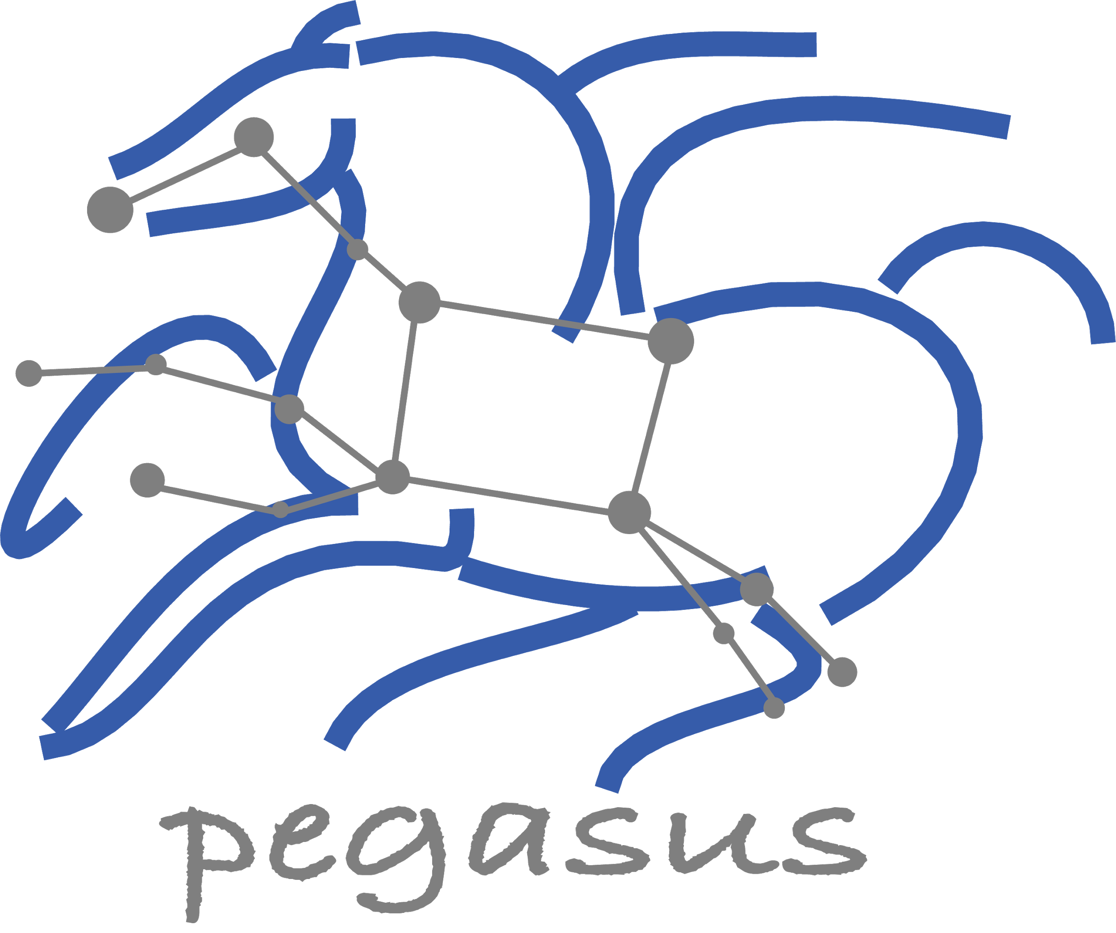
Pegasus Deployment
SUBMIT HOST
Workflow Submit Node
Compute Site 1
Input Data Site
F.in
Pegasus Lite
Instance
Pegasus WMS
HTCondor
F.in
J1
T1
T1
One or more Compute Sites
F.int
Compute Clusters
Cloud
OSG
WN
WN
Staging Site
F.int
T2
Compute Site n
Pegasus Lite
Instance
F.out
Input Sites
J2
T2
Output Data Site
Host Input Data
F.out
Data Staging Site
WN
WN
Coordinate data movement for workflow
LEGEND
Output Site
Task flow +
Checksums
Directory
Setup Job
Data
Stageout Job
Check
Integrity Job
Pegasus Lite Compute Job
J
Where output data is placed
Data
Stagein Job
Directory
Cleanup Job
Checksum Generation Job
Worker Node
(WN)
Data Flow
WN

Slide 5
Pegasus-transfer
Pegasus’ internal data transfer tool with support for a number of different protocols
HTTP
SCP
GridFTP
Globus Online
iRods
Amazon S3
Google Storage
SRM
FDT
Stashcp
Rucio
cp
ln -s
Directory creation, file removal
If protocol can support it, also used for cleanup
Two stage transfers
e.g., GridFTP to S3 = GridFTP to local file, local file to S3
Parallel transfers
Automatic retries
Credential management
Uses the appropriate credential for each site and each protocol (even 3rd party transfers)

Slide 6
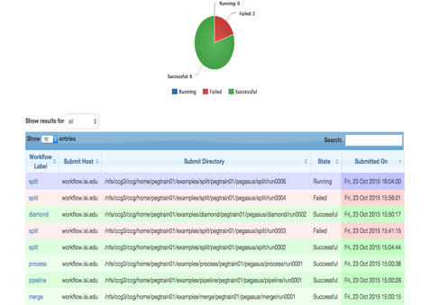
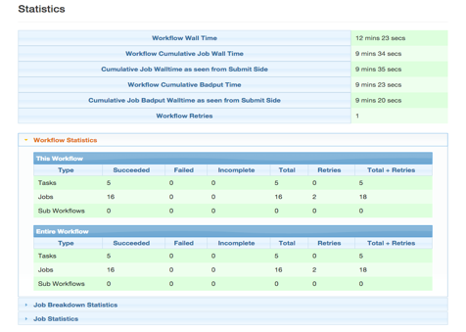
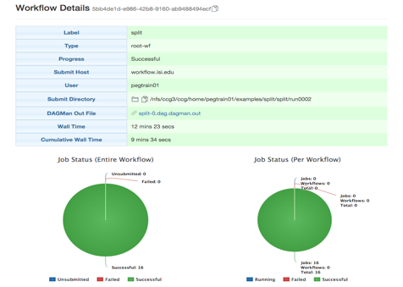
PEGASUS
DASHBOARD
web interface for monitoring
and debugging workflows
Real-time monitoring of workflow executions. It shows the status of the workflows and jobs, job characteristics, statistics and performance metrics.
Real-time Monitoring
Reporting
Debugging
Provenance data is stored into a relational database.
Troubleshooting
RESTful API

Slide 7
Handling of Sensitive Data
Highly Dependent on type of environment you run in
How are users mapped on remote machines?
Mainly rely on existing system permissions for users
There is NO automatic encryption/decryption of data in Pegasus
Support for secure protocols to transfer data
Pegasus can use protocols such SCP, S3, SSH based GridFTP that have in built encryption to transfer data to remote nodes
Pegasus does support End to End Integrity Checking that ensures data does not get corrupted in transit

Slide 8
Automatic Integrity Checking in Pegasus
SUBMIT HOST
Compute Site 1
Input Data Site
F.in
Pegasus Lite
Instance
Pegasus performs integrity checksums on input files right before a job starts on the remote node.
F.in
J1
T1
T1
F.int
Staging Site
WN
WN
For raw inputs, checksums specified in the input replica catalog along with file locations
All intermediate and output files checksums are generated and tracked within the system.
Support for sha256 checksums
F.int
T2
Compute Site n
Pegasus Lite
Instance
F.out
J2
T2
Output Data Site
F.out
WN
WN
LEGEND
Job failure is triggered
if checksums fail
Task flow +
Checksums
Directory
Setup Job
Data
Stageout Job
Check
Integrity Job
J
Pegasus Lite Compute Job
Data Flow
Data
Stagein Job
Directory
Cleanup Job
Checksum Generation Job
Worker Node
(WN)
WN
Notes:
Currently, we have implemented and are enforcing integrity checking in the PegasusLite deployments, where a job on the remote compute node is launched by a llightweight Pegasus instance that is responsible for fetching the input data for the job and staging the output to the scratch space. Before a job starts, an integrity check step is performed to ensure that any input files staged to the compute node matches the checksum in the data catalogs. Any new files ( intermediate , and final output files) that are generated on the remote node have their checksums computed on the remote node itself. This information is brought back to Pegasus submit host as part of job’s stdout and then stored in our monitoring database.

Slide 9
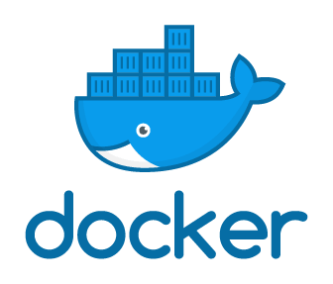


Pegasus Container Support
Containers Execution Model
Users can refer to containers in the Transformation Catalog with their executable preinstalled
Directory Setup
Host OS
Pull image
Users can refer to a container they want to use – Pegasus stages their executables and containers to the node
Start container
$PWD bind-mounted as/srv
Container
Instance
Useful if you want to use a site recommended/standard container image.
Users are using generic image with executable staging.
Pull worker package
(if needed)
Set job environment
Future Plans
Stage in inputs
Execute user application
Users can specify an image buildfile for their jobs.
Pegasus will build the Docker image as separate jobs in the executable workflow, export them as a tar file and ship them around
Stage out outputs
Stop container
Cleanup

Slide 10
Data Management for Containers
Containers are data too!
Pegasus treats containers as input data dependency
Staged to compute node if not present
Docker or Singularity Hub URL’s
Docker Image exported as a TAR file and available at a server, just like any other input dataset
Scaling up for larger workflows
The image is pulled down as a tar file as part of data stage-in jobs in the workflow
The exported tar file is then shipped with the workflow and made available to the jobs
Pricing considerations. You are now charged if you exceed a certain rate of pulls from Hubs
Other Optimizations
Symlink against existing images on shared file system such as CVMFS
The exported tar file is then shipped with the workflow and made available to the jobs

Slide 11

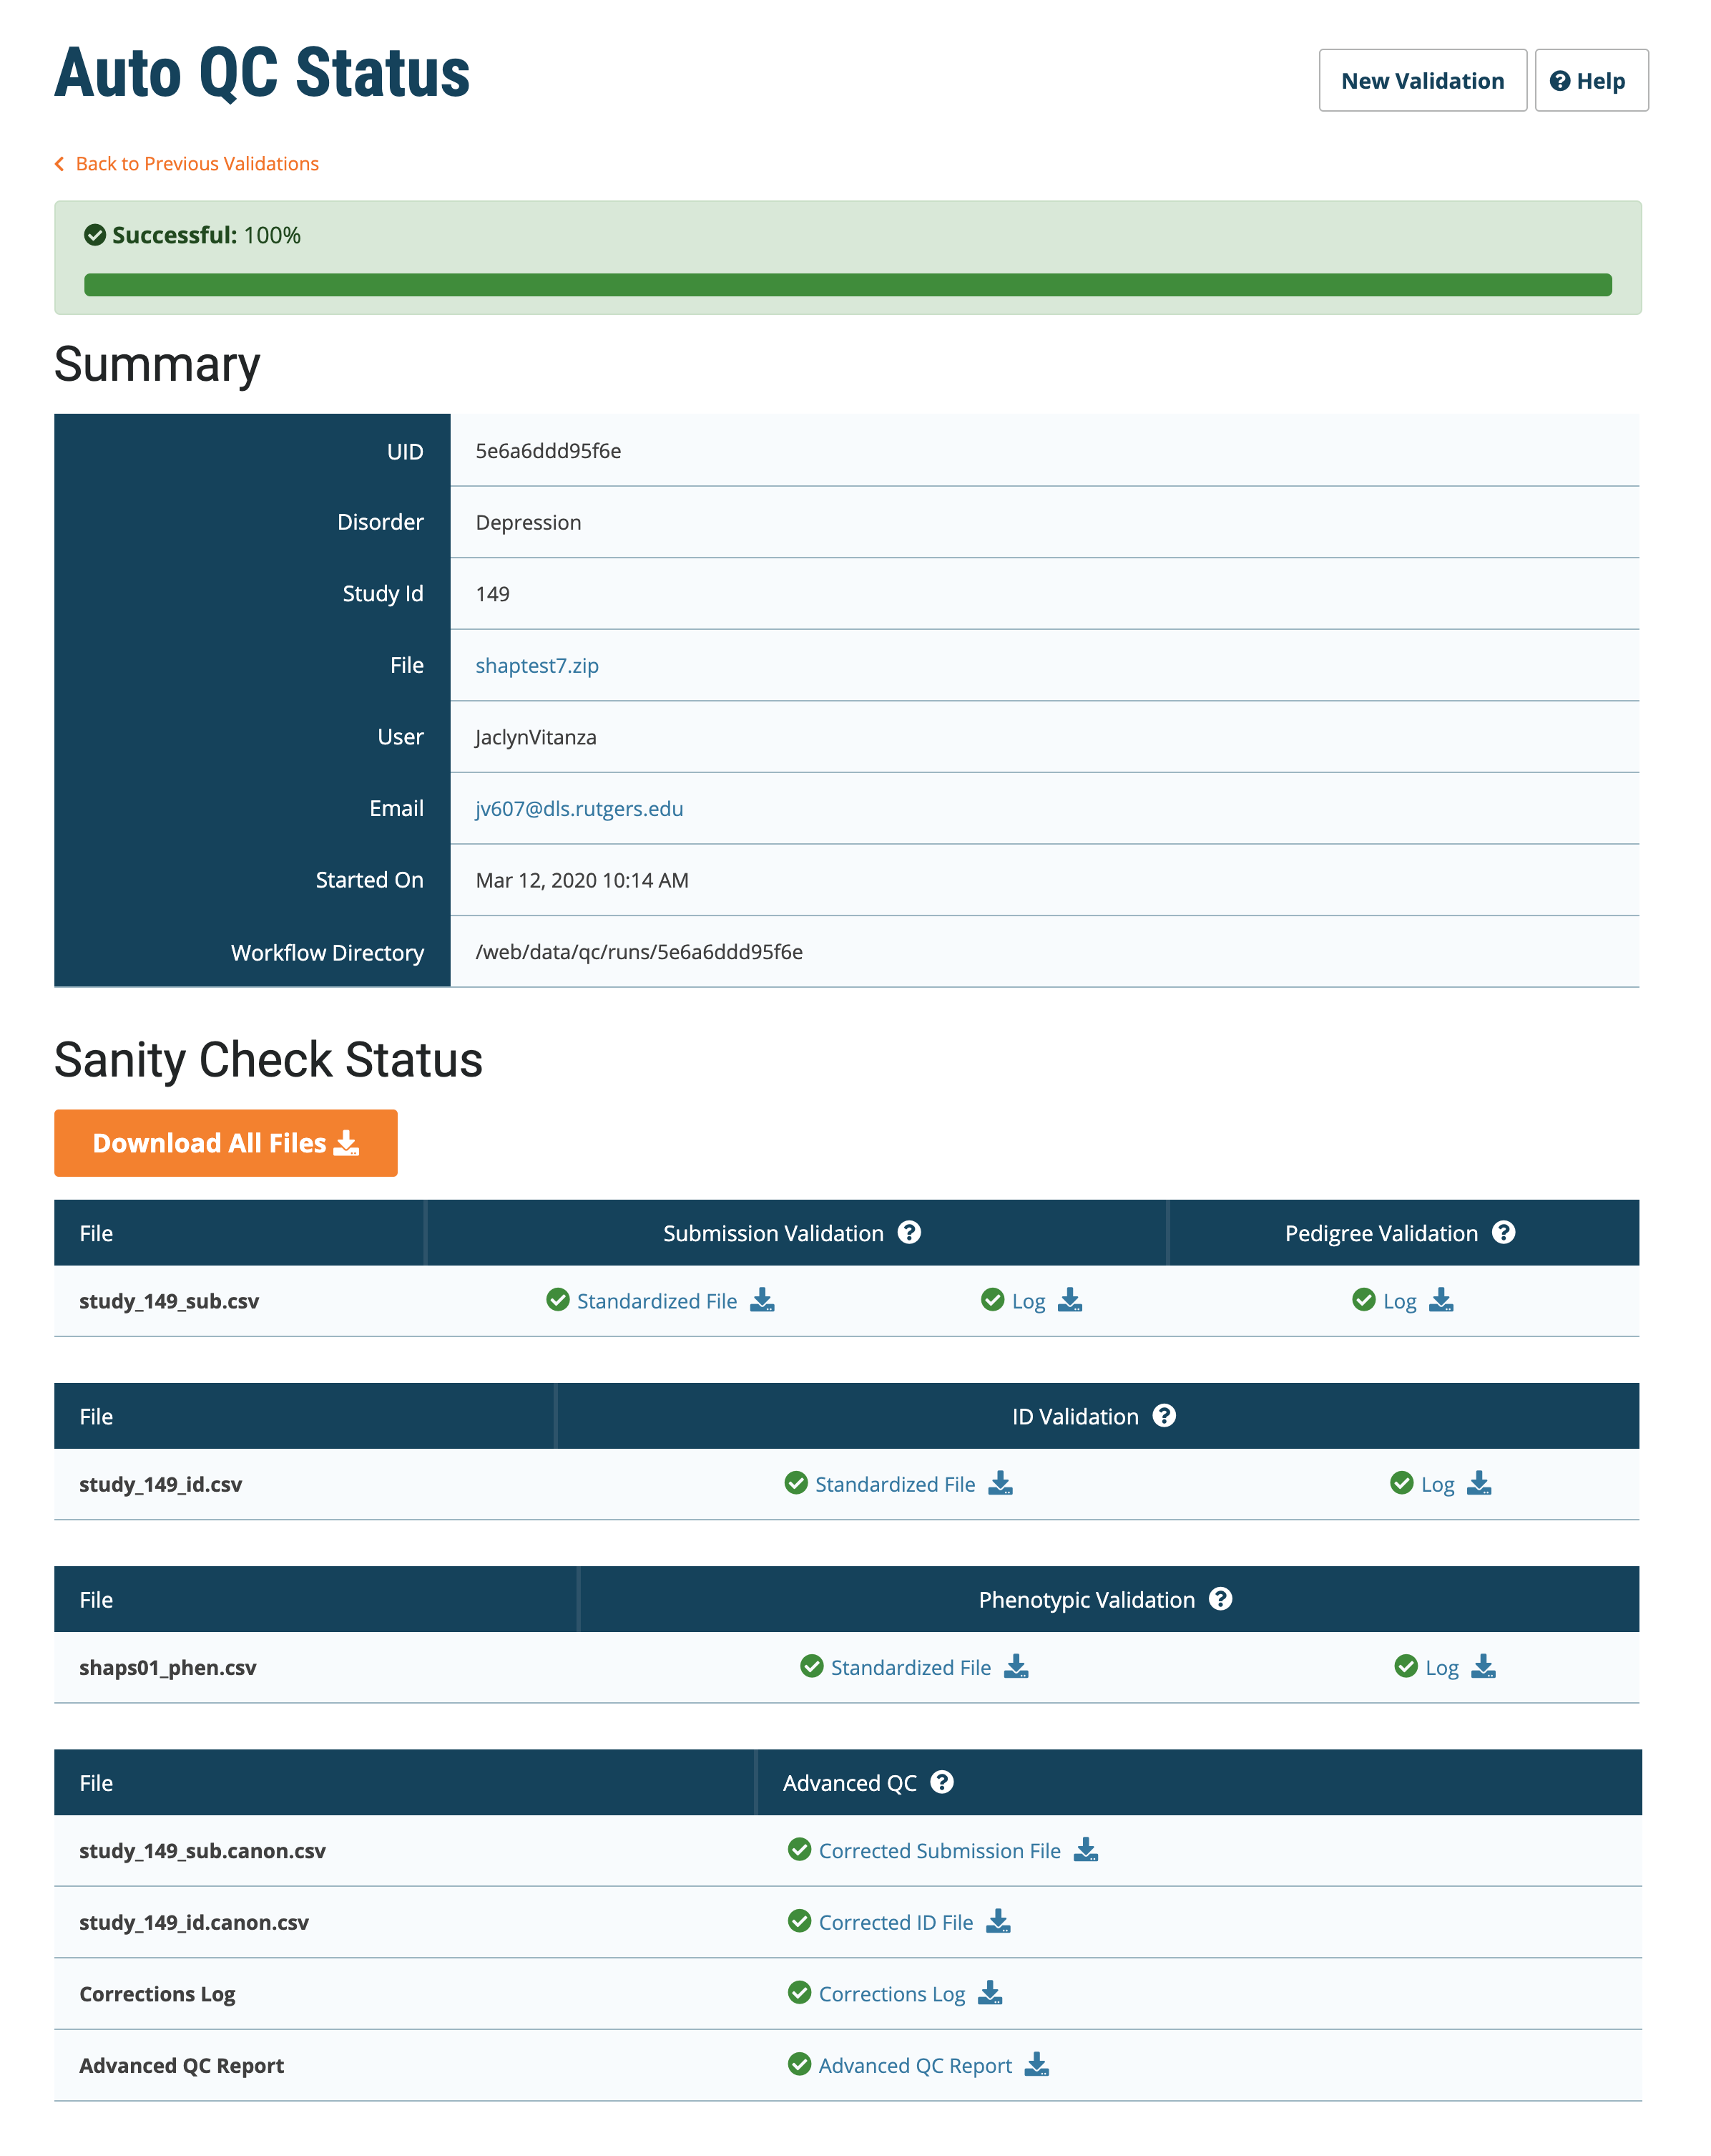
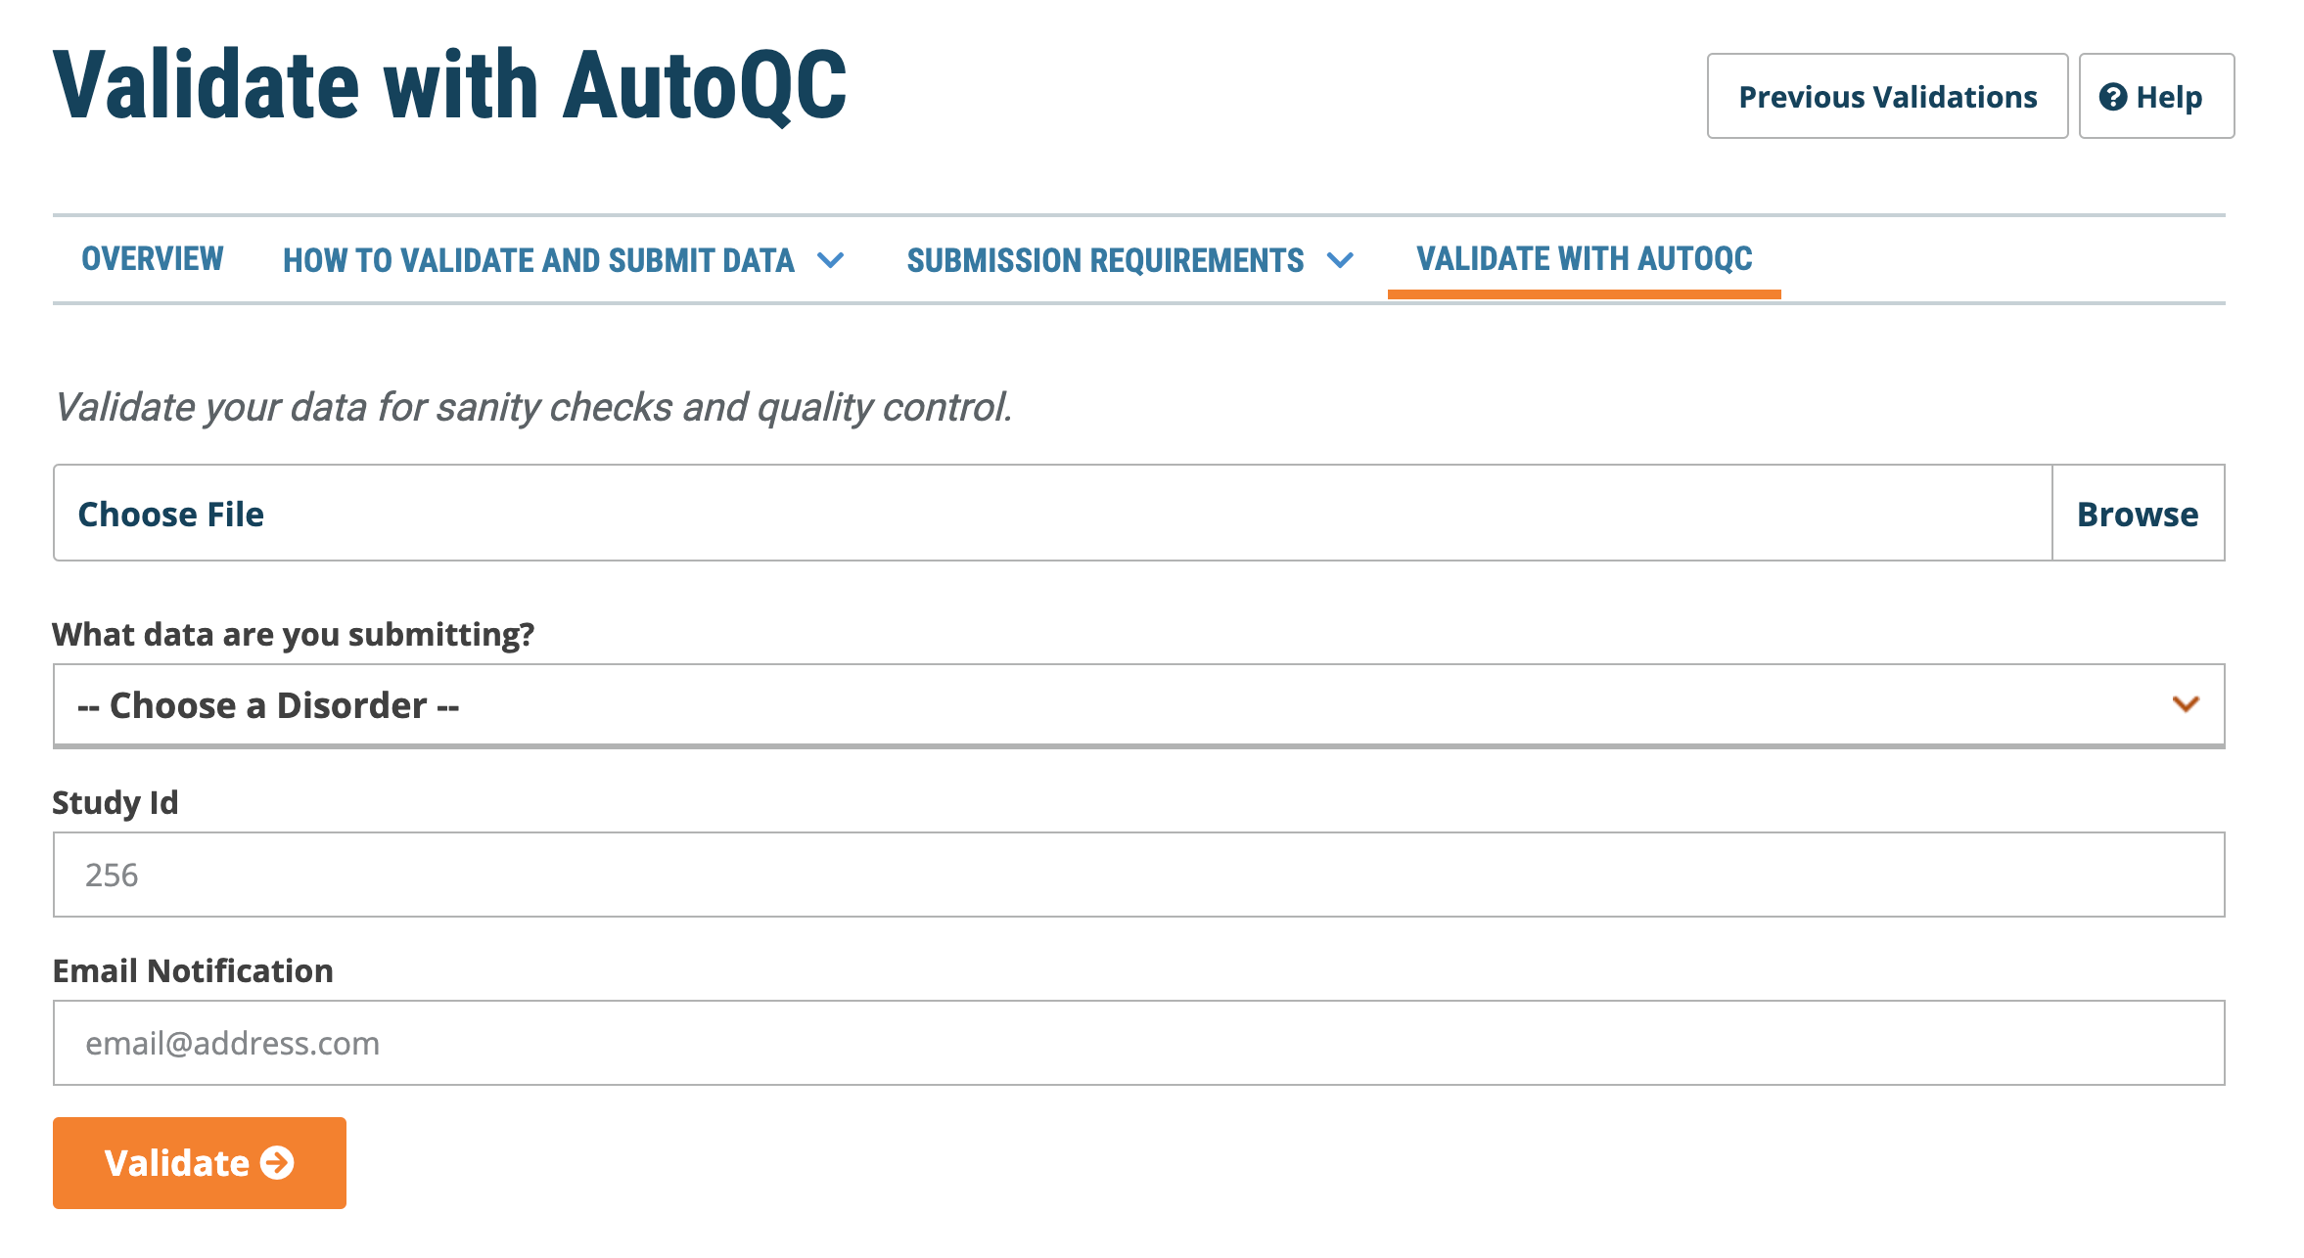
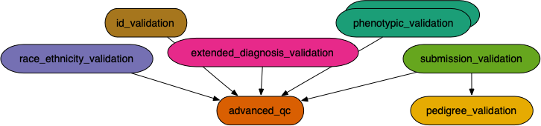
Automated Quality Control of Phenotypic Datasets
The NIMH Center for Collaborative Genomic Studies on Mental Disorders, now known as the NIMH Repository and Genomics Resource (NRGR), maintains biomaterials, demographic, and phenotypic data from over 200,000 well-characterized individuals with a range of psychiatric illnesses, their family members, and unaffected controls.
QC Report
Easy to Use Web-Based Interface
Simple Submission
Real-time Monitoring and Error Reports
After automated QC, submit corrected files for expert curation
Scalable
Workflow based architecture using Pegasus WMS
Extensible Design
Easily add new QC steps, and checks
Enables Complex checks
Pedigree Checks
QC Checks validating data with external sources
QC Checks can correlate data across multiple files and across multiple fields within files
Ensures high-quality uniform data deposited at NRGR
Better resource utilization: solve most QC problems automatically, use expert curation for hard cases
Submission
Website
Automated
QC Workflow
Load
NRGR
Warehouse
Export
Query
Manual
Curation
Download Data
Tool
Data
Explorer

Slide 12
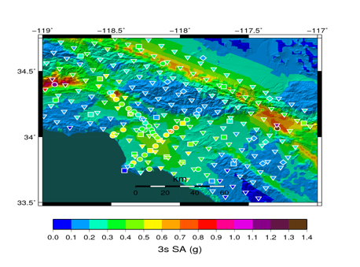
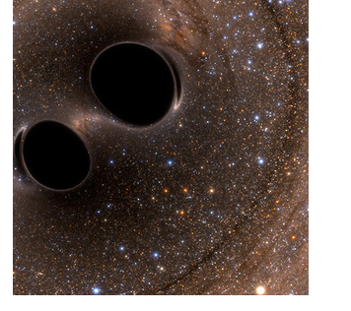
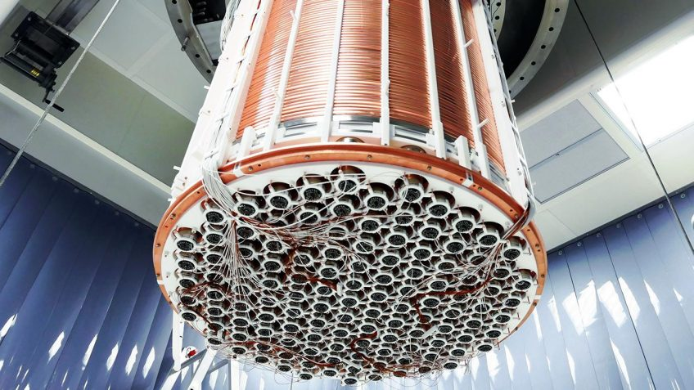
XENONnT - Dark Matter Search
Southern California Earthquake Center’s CyberShake
Mix of MPI and single-core jobs, mix of CPU, GPU codes. Large data sets (10s of TBs), ~300 workflows with 420,000 tasks each
Supported since 2005: changing CI, x-platform execution
First Physics-Based “Shake map” of Southern California
Laser Interferometer Gravitational-Wave Observatory (LIGO)
High-throughput computing workload, access to HPC resources, ~ 21K Pegasus workflows, ~ 107M tasks
Supported since 2001, distributed data, opportunistic computing resources
First direct detection of a gravitational wave (colliding black holes)
Custom data management
Rucio for data management
MongoDB instance to track science runs and data products.
Monte Carlo simulations and the main processing pipeline.

Slide 13

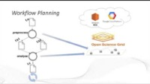
Get Started
Pegasus
est. 2001
Automate, recover, and debug scientific computations.
https://www.youtube.com/channel/UCwJQln1CqBvTJqiNr9X9F1Q/featured
YouTube Channel
Pegasus Website
https://pegasus.isi.edu
Users Mailing List
pegasus-users@isi.edu
Support
pegasus-support@isi.edu
Slack
Ask for an invite by trying to join pegasus-users.slack.com in the Slack app
Pegasus in 5 Minutes
Pegasus Online Office Hours
https://pegasus.isi.edu/blog/online-pegasus-office-hours/
Bi-monthly basis on second Friday of the month, where we address user questions and also apprise the community of new developments

