Slide 1
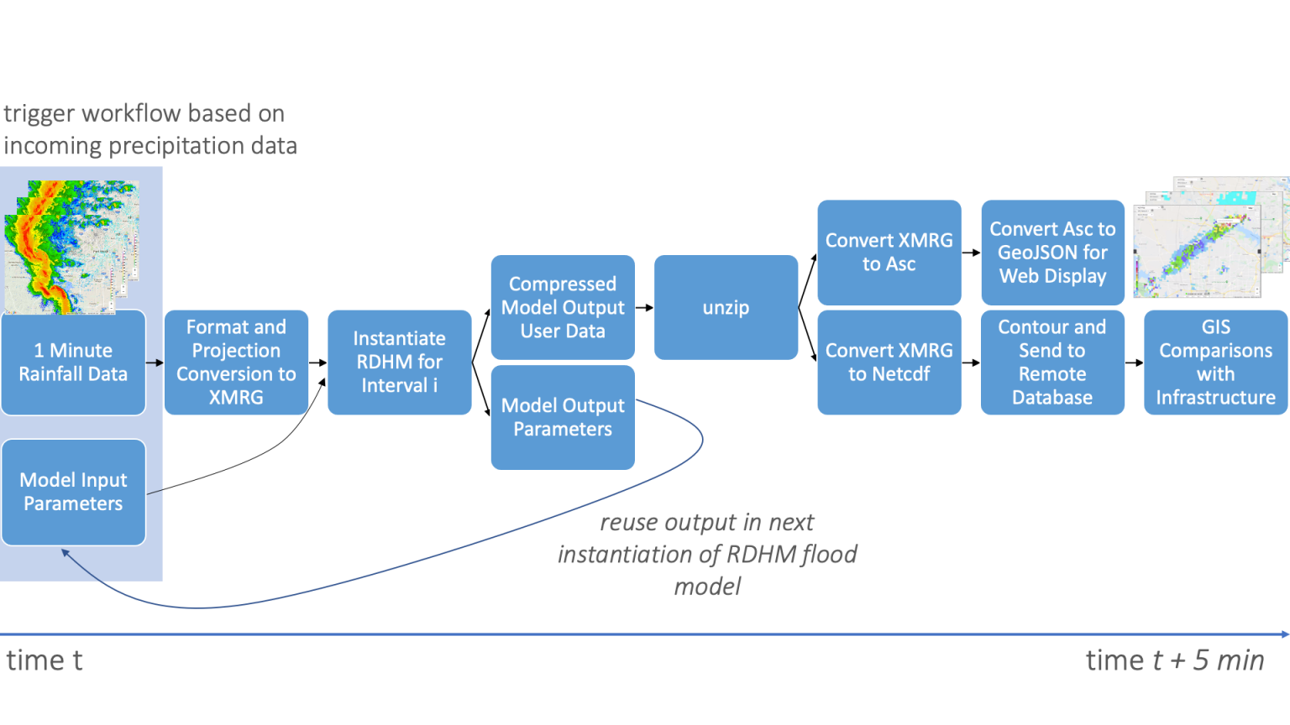
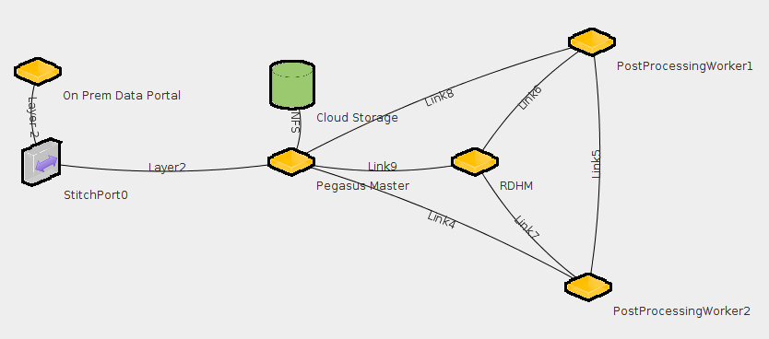
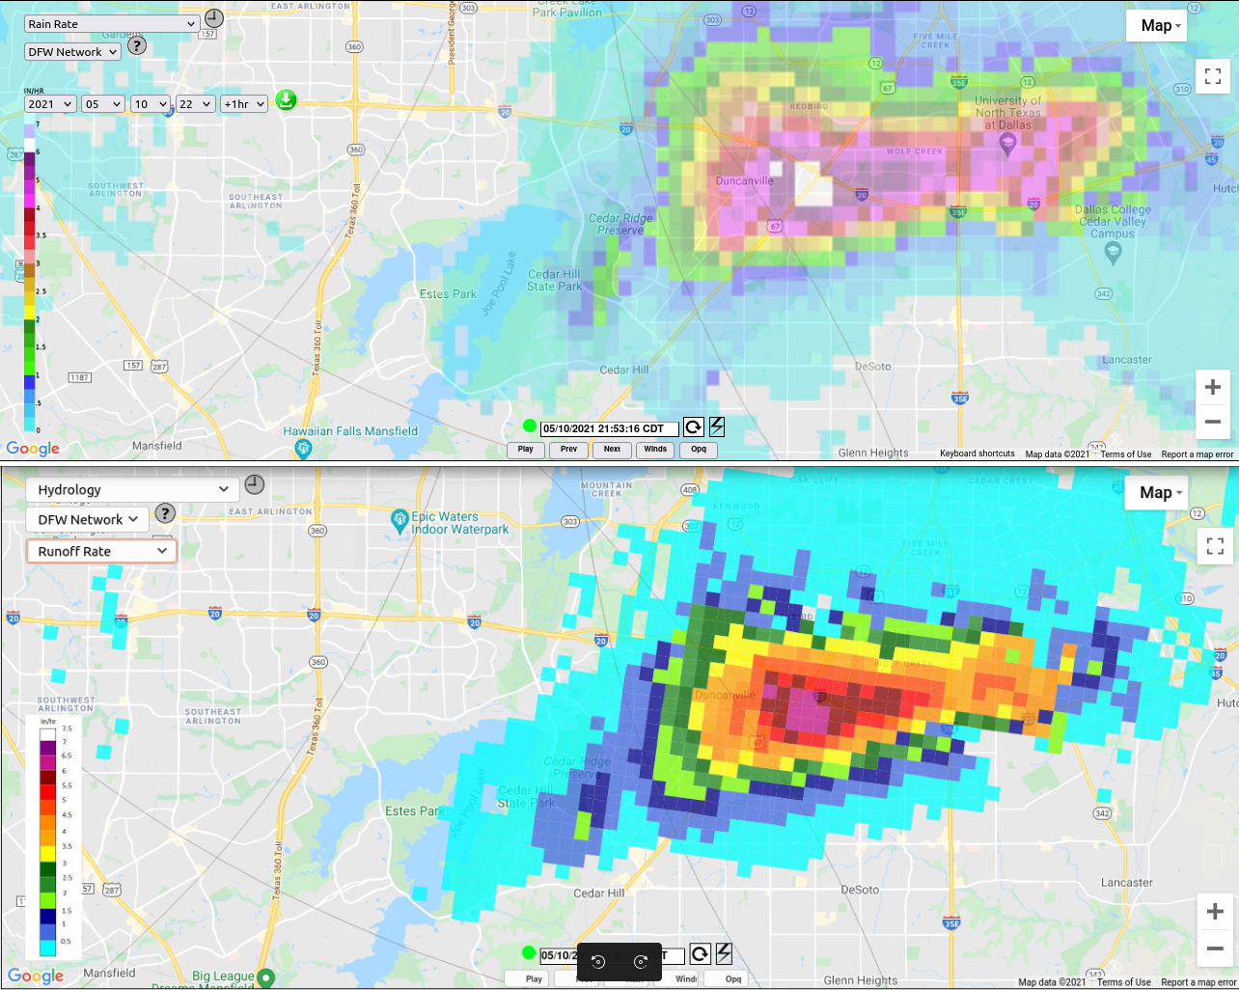
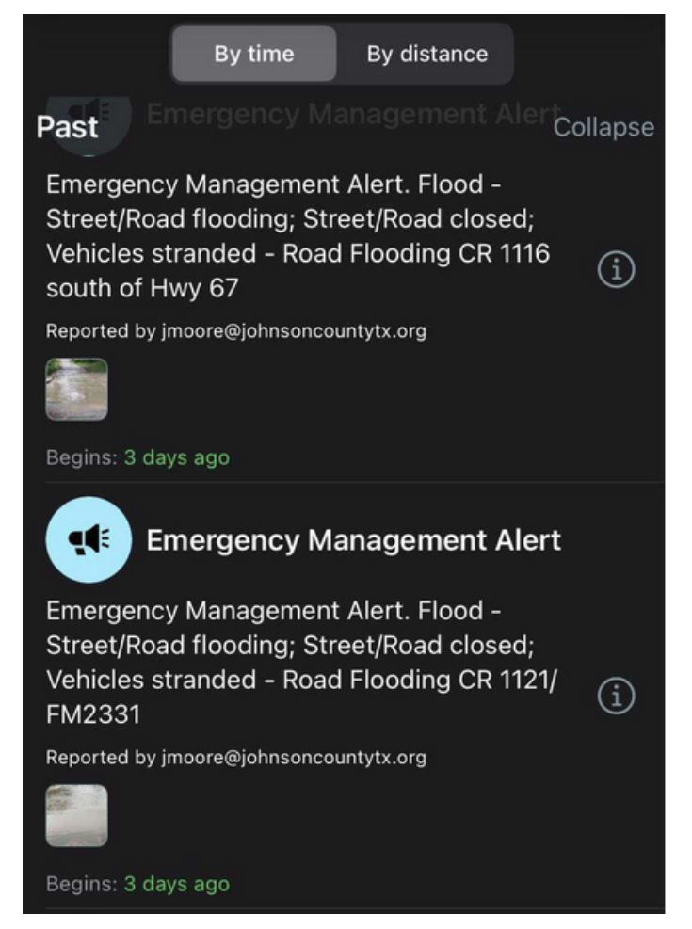
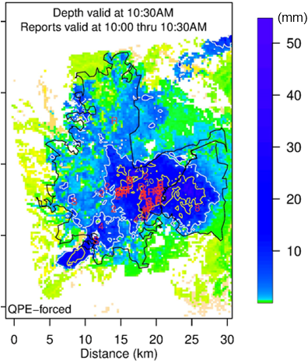
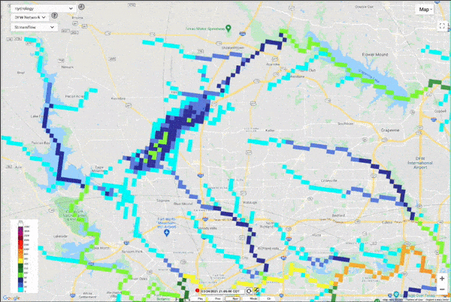
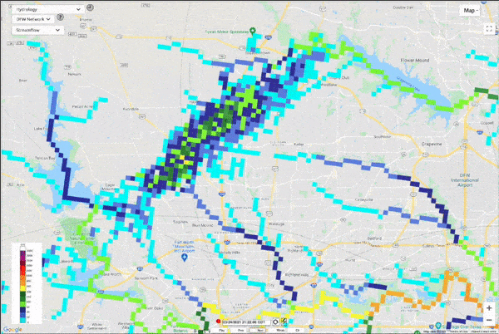
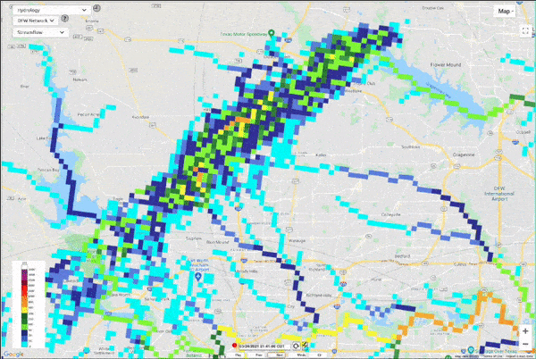




Predicting Flash Floods in the Dallas-Fort Worth Metroplex
Using Workflows and Cloud Computing
Eric Lyons, Dong-Jun Seo, Sunghee Kim, Hamideh Habibi, George Papadimitriou, Ryan Tanaka, Komal Thareja,
Ewa Deelman, Michael Zink, Anirban Mandal
Introduction
The RDHM Workflow
Accurate and timely prediction of flash flooding events can be a very useful tool for stormwater officials and
first responders.
Having lead time with which to issue evacuation directives, to close flood prone roadways, to deploy rescue gear and personnel, and to fortify areas against flooding is essential to
minimize property damage and risk of casualties.
In this poster, we are presenting a flash flooding prediction workflow based on the Hydrology Lab-Research Distributed Hydrologic Model (HL-RDHM). This workflow leverages cloud computing and the Pegasus Workflow Management System to provide continuous high resolution flood predictions for the Dallas-Fort Worth Metroplex area in North Texas. DFW hosts the CASA X-Band radar network which provides accurate, high resolution rainfall data, which is the primary forcing input to the model.
The RDHM workflow was developed using Pegasus’ 5.0 API (https://pegasus.isi.edu)
It is consisted by 20 jobs that receive as input 1 minute rainfall data and the output of previous model runs.
The cloud compute and networking infrastructure is procured and configured with the open source provisioning tool Mobius.
A sample RDHM architecture as organized on ExoGENI
Layer 2 Stitchport created from dedicated data portal to Pegasus/Condor Master node with attached NFS storage device
3 Condor worker nodes, one typically running RDHM, 2 running post processing analysis, creating images, and alerting users to detected hazards.
The RDHM Model
Visualization
Community Impact
The RDHM model was developed by the United States National Weather Service’s Office of Hydrologic Development (OHD) Hydrology Laboratory.
Their goal was to improve:
Streamflow prediction in streams and rivers
Flash flood forecasting
Runoff Estimates
Water Depth
Return Period
To achieve this, apart from rainfall, they incorporated in the model evolving estimates of parameters, including:
Soil moisture and temperature
Surface permeability
Vegetation
Topography
Traditionally, the RDHM runs on a single powerful dedicated server. We have modified this to run in the cloud, with model output further processed by a pool of worker computers to provide rapid analysis to users.
The workflow is capable of pushing alerts to a mobile app
Alerts are displayed to over 1000 emergency managers
The CASA website also displays live values
RDHM predicted water depth with high water rescues (R), road closures (H), and flood reports to police (S).
By forcing model with rainfall nowcast, we may further extend lead time.
CASA Instantaneous Rainfall Rate product (top) is fed into RDHM once a minute. Using the latest parameterizations RDHM produces Runoff Rate (bottom), and accumulates into total water depth and changes in streamflow levels.
Learn More
Workflow Github: https://github.com/CASAelyons/rdhmworkflow
RDHM Container Docker Hub: https://hub.docker.com/repository/docker/casaelyons/rdhm_container
RENCI Mobius:
https://github.com/RENCI-NRIG/Mobius
CASA DFW Radar Network
https://www.nctcog.org/ep/casawx
Streamflow predictions over time depicting water flowing over the surface from a severe thunderstorm and the local river basin spilling over its banks. The workflow produces 15 minute forecasts of streamflow, runoff, water depth, and estimated return period.
Pegasus is supported by the NSF Award #1664162.
The development of the RDHM Pegasus workflow is supported by the National Science Foundation through DyNamo (Award #1826997) and FlyNet (Award #2018074).

