Slide 1


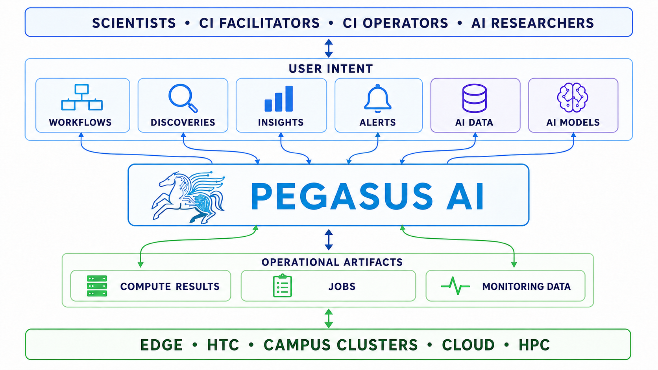
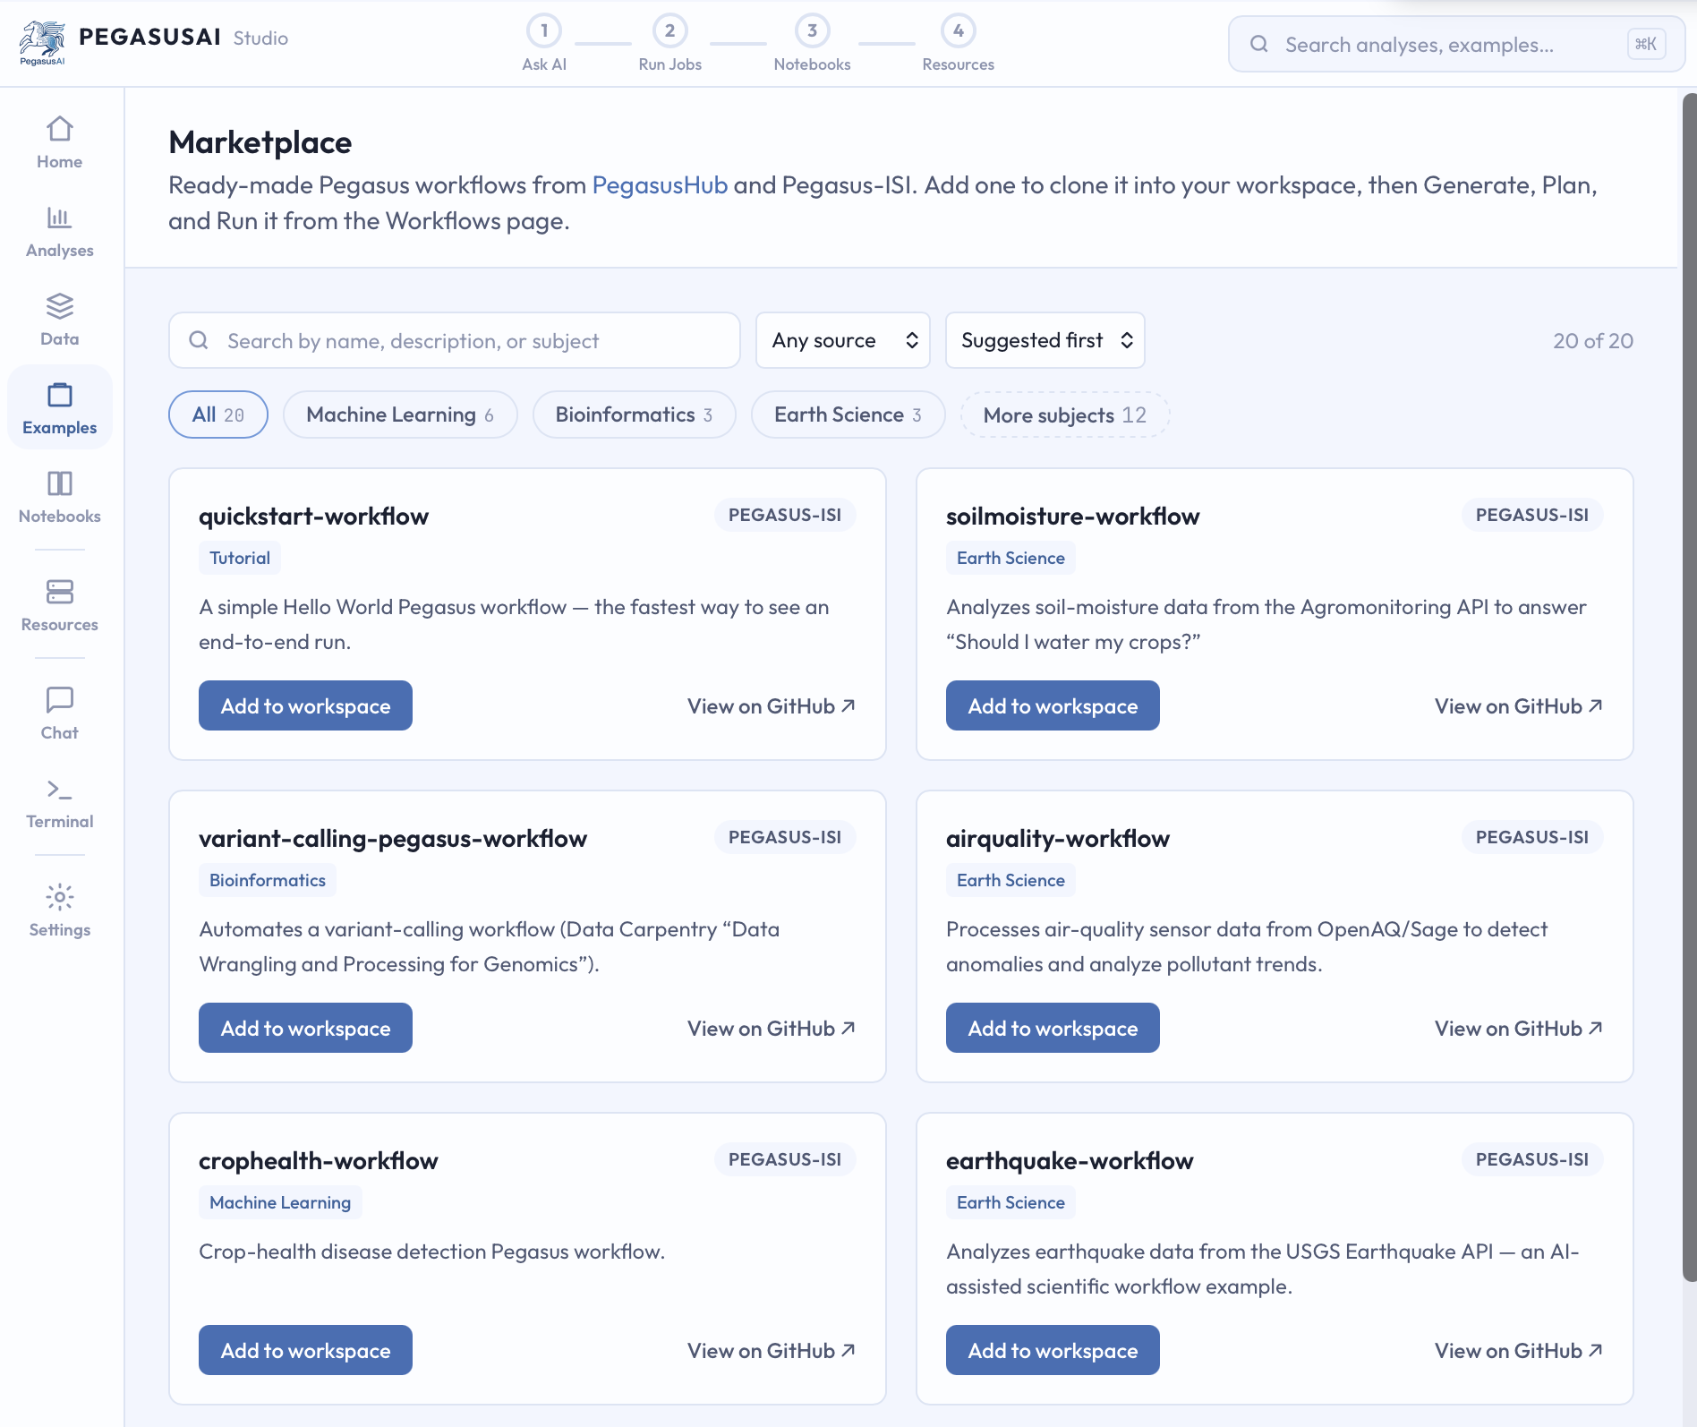
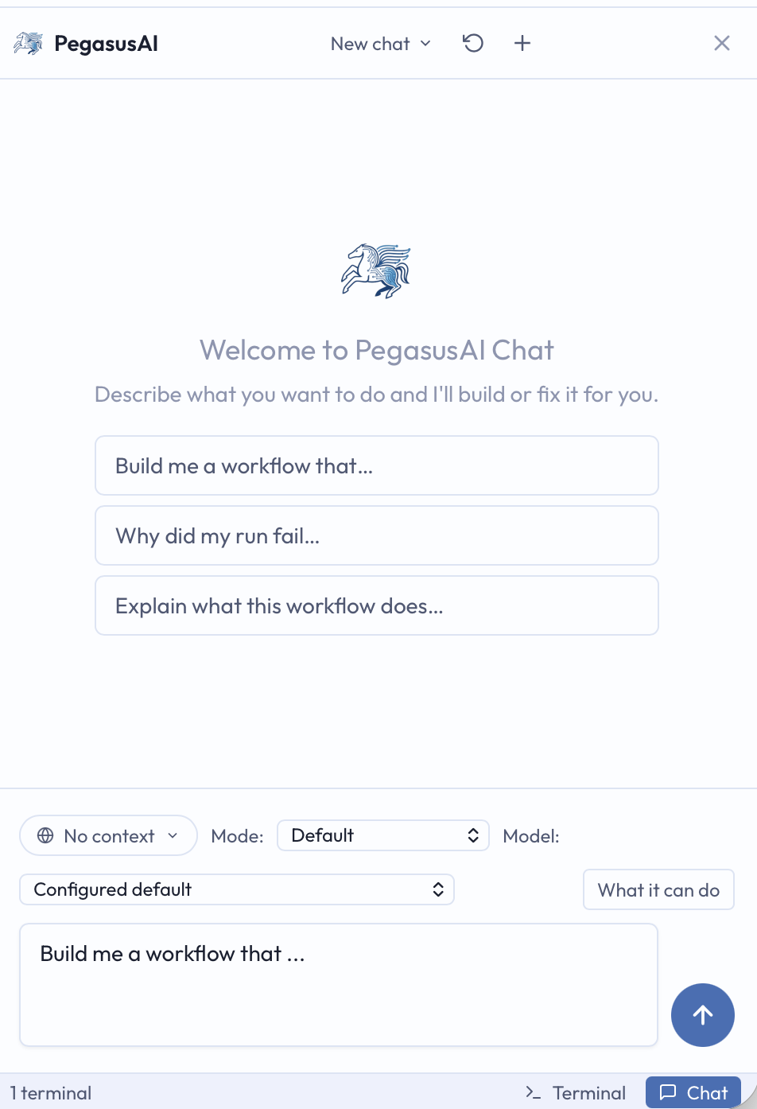
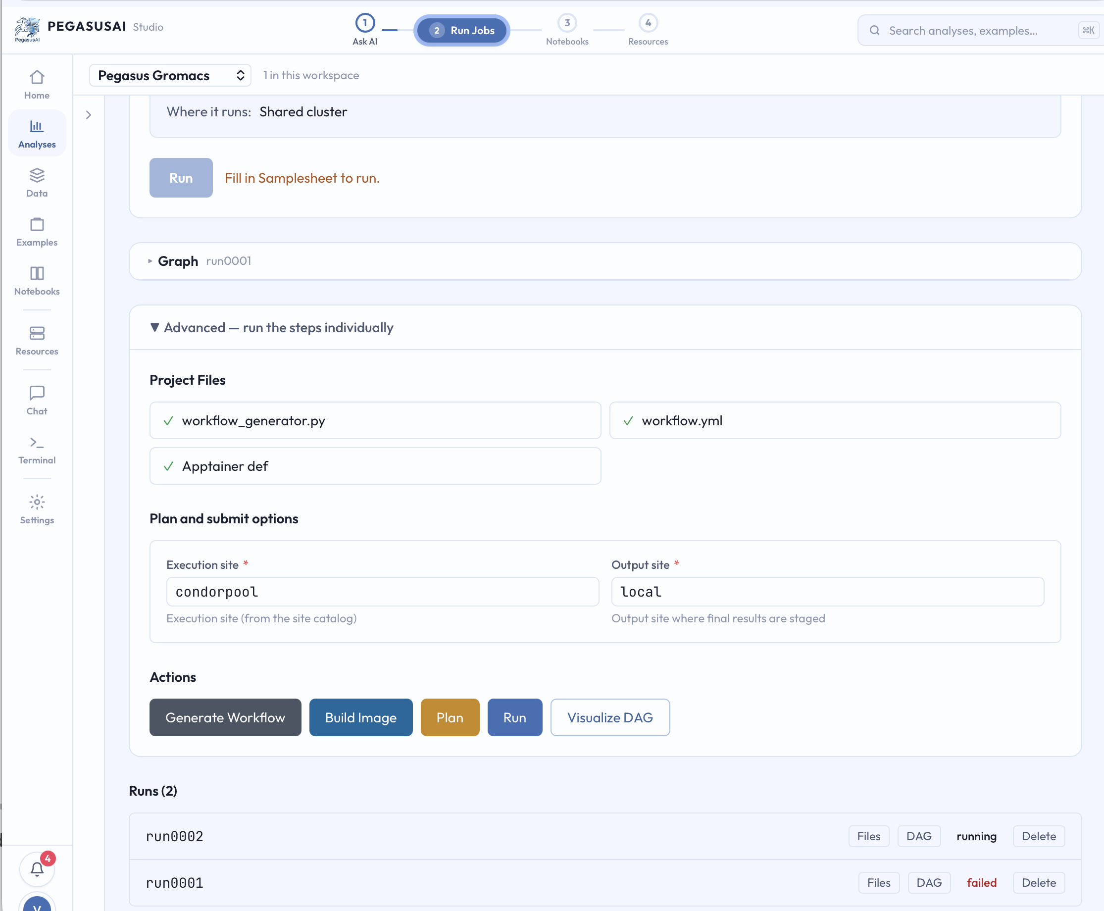

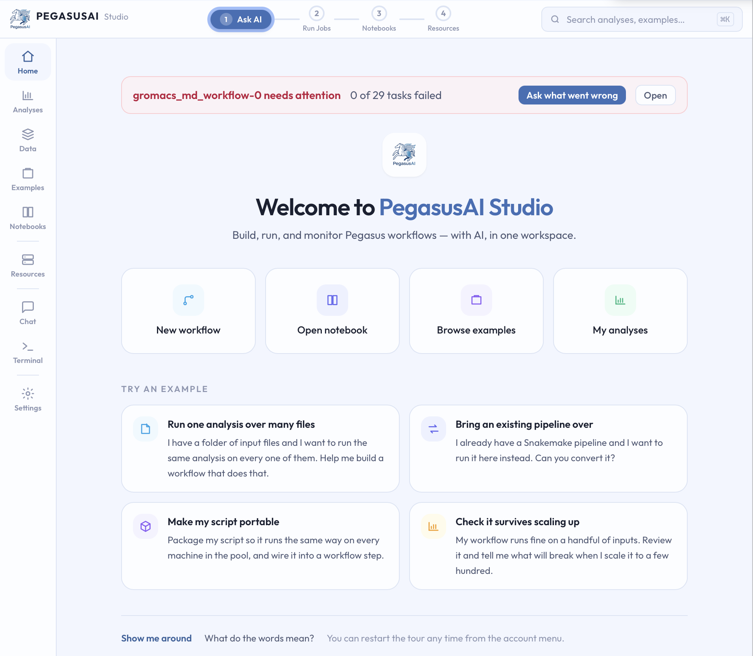
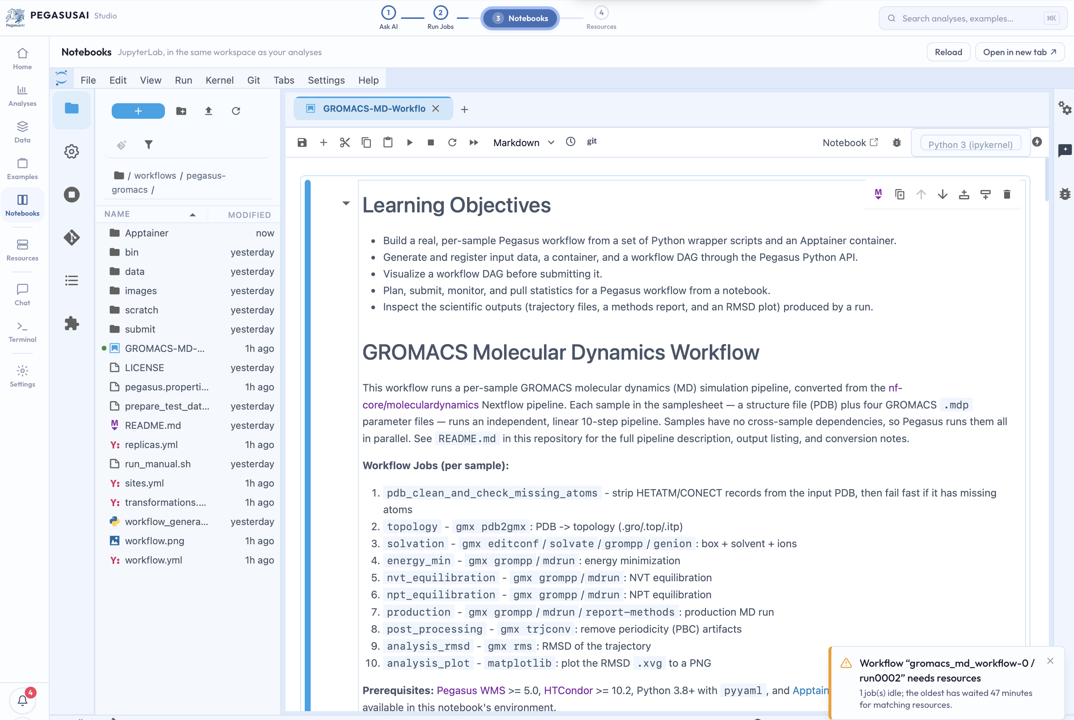
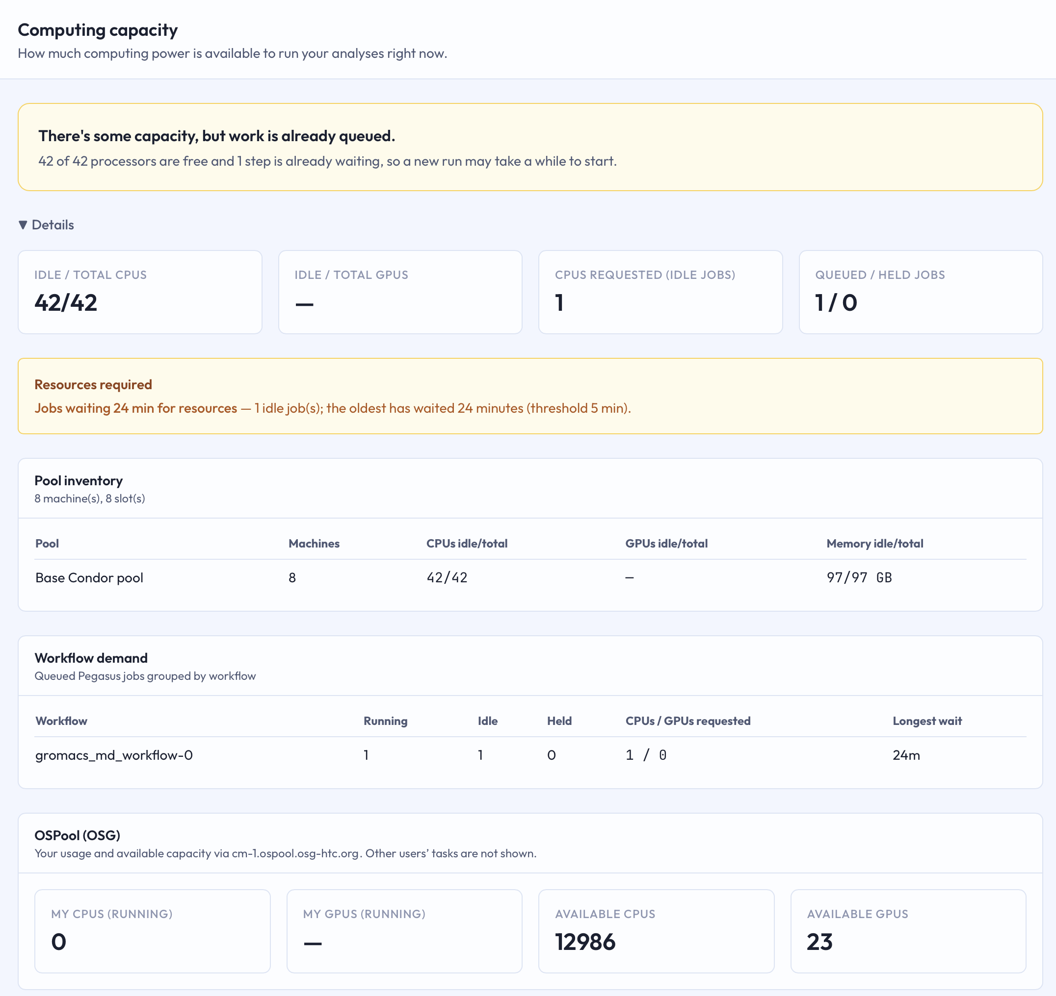
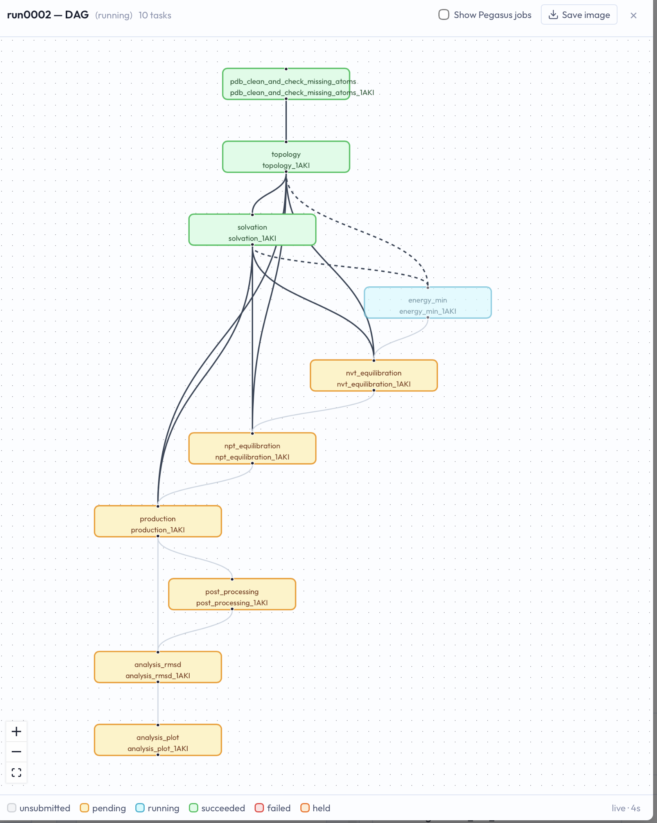

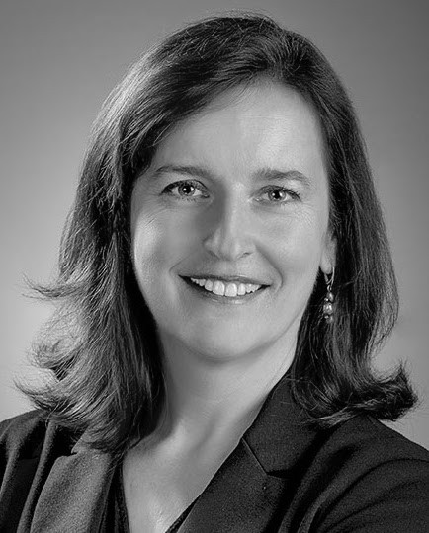
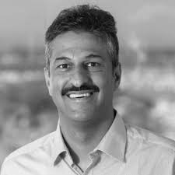

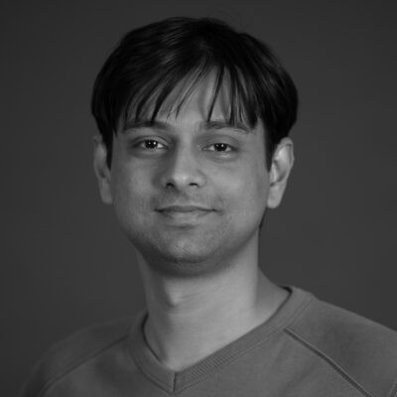
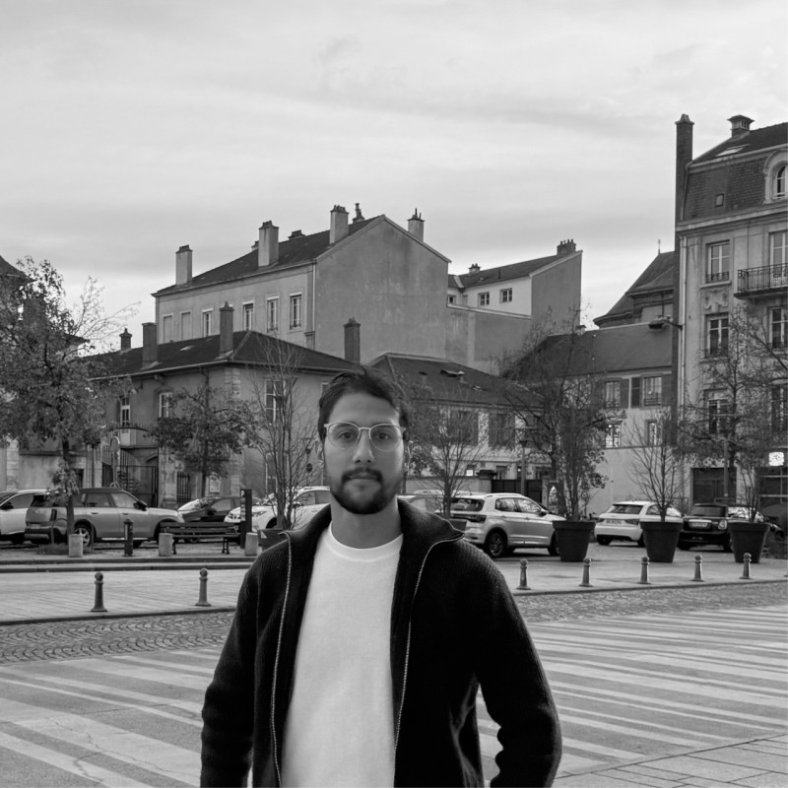
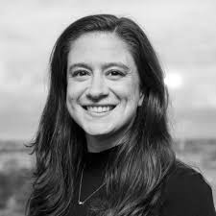

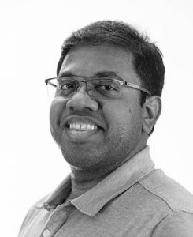
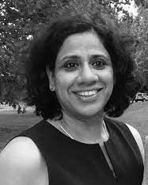



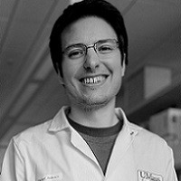

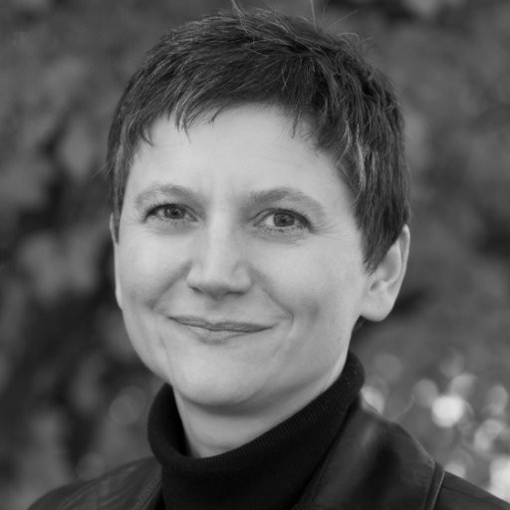
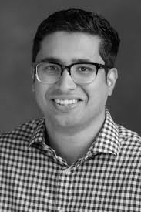
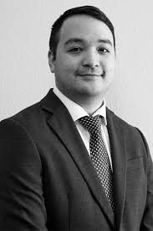
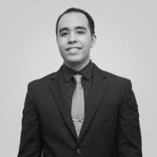
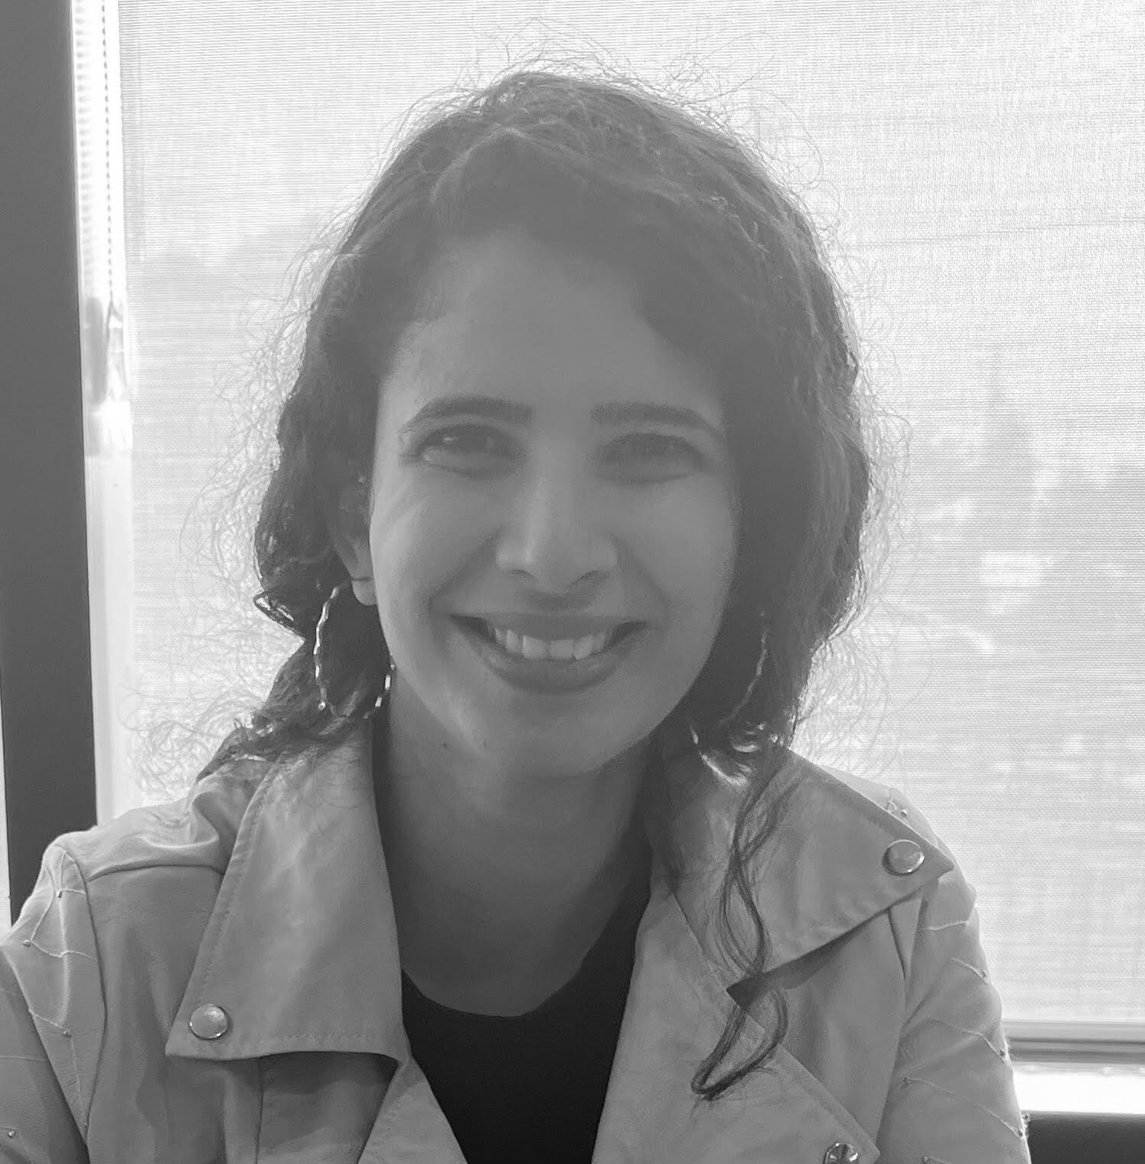
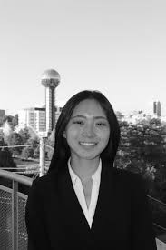
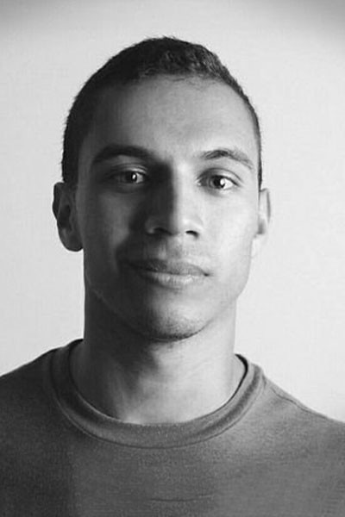
Pegasus Studio: Artificial Intelligence Assisted Workflow
Management on National Cyberinfrastructure
  Mats Rynge¹, Komal Thareja², Karan Vahi¹
  ¹ ISI, University of Southern California, ² RENCI, University of North Carolina at Chapel Hill
NSF CSSI Award: 2513101
Pegasus AI is an AI-driven scientific workflow management system that combines machine learning, large language models, online monitoring, and human guidance to support the workflow lifecycle. It helps scientists create workflows, predict resource requirements, monitor execution, diagnose failures, and adapt execution plans, making complex scientific workflows more efficient, resilient, and easier to manage.
Pegasus AI Studio is an integrated environment that supports scientists across the workflow lifecycle, from defining research goals and generating Pegasus workflows with AI assistance to submitting them across computing resources, monitoring execution, diagnosing failures, and recommending corrective actions
* Pegasus studio : https://studio.pegasus-ai.org
Conversational AI Assistant
Supports workflow creation, answers Pegasus questions, explains execution results and assists with failure diagnosis.
Create
Workflow
Plan
Workflow
Provision
Resources
Distributed Computing
Decide what types of resources are needed, map workflow onto resource, bring resources from campus, cloud and national infrastructure.
Marketplace
Explore curated workflows from different domains.
Explore
Marketplace
Learn
Workflows
Monitor
Workflows
Interactive Notebooks
Offers a browser-based environment for developing code, analyzing data and accessing workflow inputs and outputs.
Free Tier – Including AI Access
All users get free basic access to AI functionality, such as chatbot, OpenCode and debugging tools.
Power users can bring their own LLM or agents (Claude, Codex, …).
Ewa Deelman
Karan Vahi
Mats Rynge
Rajiv Mayani
Hamza Safri
Nicole Virdone
Try it out!
https://studio.pegasus-ai.org
Anirban Mandal
Komal Thareja
Michael Stealey
Mike Zink
Berent Aldikacti
Michela Taufer
Sai Swaminathan
Kin Wai NG
Kin Hong NG
Rajasi Gore
Angelina Ju
Jack Marquez

