Slide 1
Scientific Workflows with Pegasus on NERSC Resources using SFAPI
Karan Vahi
USC Information Sciences Institute

Slide 2
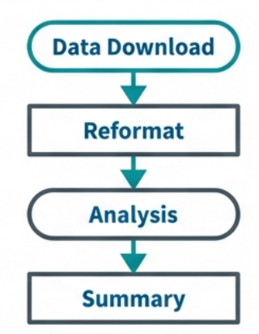

The Challenge: Moving Beyond the Laptop
The Scripting Trap
The Workflow Advantage
Quick to code, but hard to scale
Difficult to maintain and error-prone
Hard to move between resources (Laptop vs. Cluster)
“Works on my machine” syndrome
Declarative: Describe what to do, not how
Automated: Minimizes human involvement
Provenance: Tracks history for reproducibility
Portable: Runs on ACCESS, NAIRR, cloud, …

Slide 3

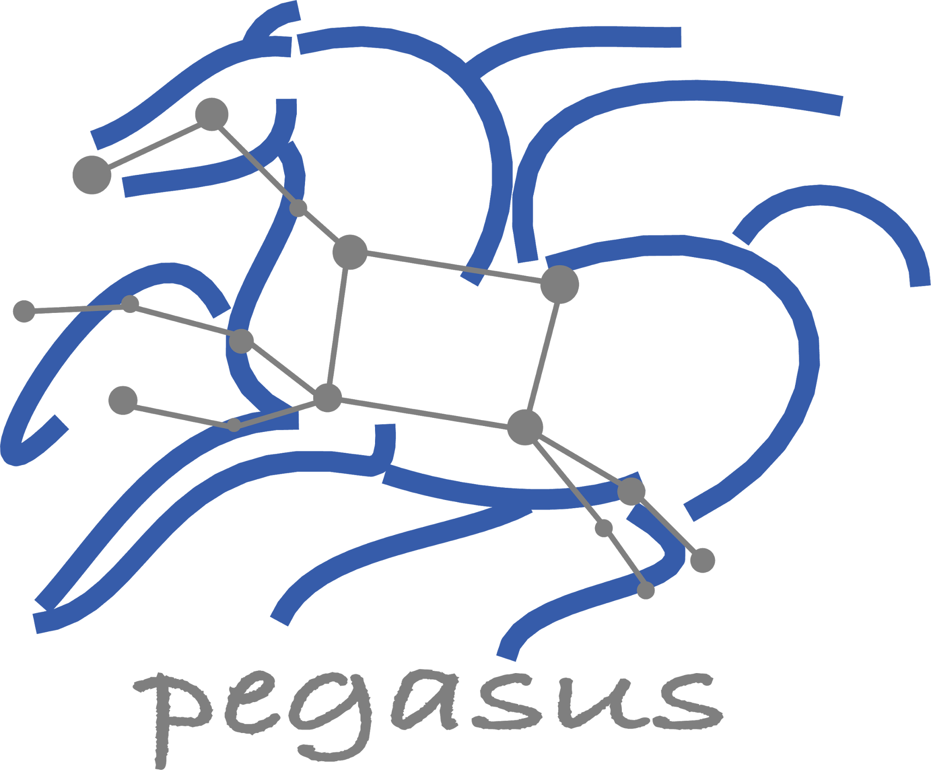
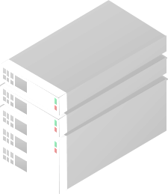

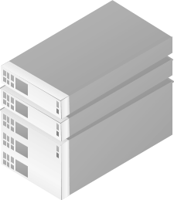
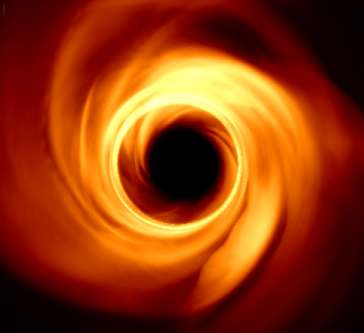

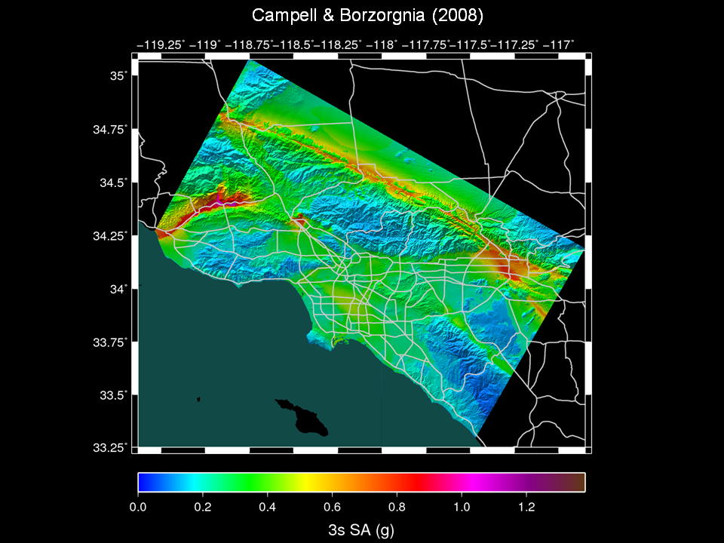
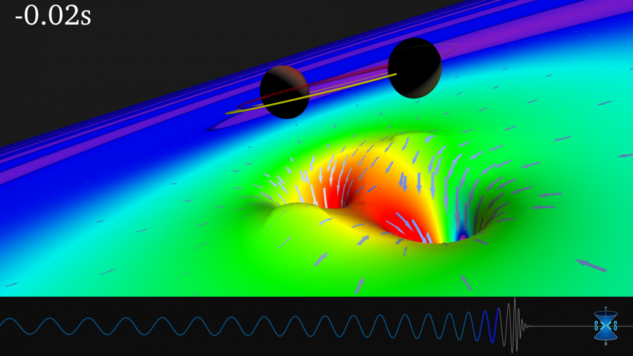
Pegasus Workflow Management System
End to End Workflow Management & Execution
Pegasus
WMS
Develop portable scientific workflows in Python and Java
Compile workflows to be run on heterogeneous resources
Monitor and debug workflow execution via CLI and web-based tools
Recover from failures with built-in fault tolerance mechanisms
Regular release schedule incorporating latest research and development
Planner
Monitoring & Provenance
Engine
Scheduler
Job
Queue
jN
> Cloud Resources
> OSG OSPool
> HPC Systems
> HTCondor Pools
j2
j1
Event Horizon Telescope
Submit Node
Compute Resources
Laser Interferometer Gravitational Wave Observatory (LIGO) develops large scale analysis pipelines used for gravitational wave detection.
Southern California Earthquake Center (SCEC) CyberShake project generates hazard maps using hierarchical workflows .
The Event Horizon Telescope uses Pegasus to orchestrate and scale complex distributed computing pipelines for data calibration, massive synthetic data generation, and deep learning inference
Pegasus
in practice
LIGO observation
of colliding black holes
Hazard map indicating maximum amount of shaking at a particular geographic location generated from SCEC’s CyberShake Pegasus workflow
Application Showcase: https://pegasus.isi.edu/application-showcase/

Slide 4
Key Pegasus Concepts
Pegasus WMS ==
Pegasus planner (mapper) + DAGMan workflow engine + HTCondor scheduler/broker
Pegasus maps workflows to infrastructure
DAGMan manages dependencies and reliability
HTCondor is used as a broker to interface with different schedulers
Task
Data dependency
Workflows are DAGs
Nodes: jobs, edges: dependencies
No while loops, no conditional branches
Jobs are standalone executables
Planning occurs ahead of execution
Planning converts an abstract workflow into a concrete, executable workflow
Planner is like a compiler

Slide 5
Defining Workflows in Python
from Pegasus.api import *
# Create abstract workflow
wf = Workflow("pipeline")
# Track the data
page = File("page.html")
# Create a Job
curl_job = Job("curl")\
.add_args("-o", page, "https://pegasus.isi.edu")\
.add_outputs(page)
# Create a Dependent Job
wc_job = Job("wc")\
.add_args("-l", page)\
.add_inputs(page)
# Add jobs and dependencies
wf.add_jobs(curl_job, wc_job)
wf.add_dependency(wc_job, parents=[curl_job])
wf.write("pipeline.yml")
Declarative job addition
Simple dependency definition
Generates the abstract workflow (DAG)

Slide 6


Input Workflow Specification
Output Workflow
YAML formatted
Portable Description
Users do not worry about low level execution details
Stage-in Job
Transfers the workflow input data
Logical Filename (LFN)
platform independent (abstraction)
ABSTRACT WORKFLOW
EXECUTABLE WORKFLOW
Cleanup Job
Transformation
Removes unused data
Executables (or programs)
platform independent
Stage-out Job
Stage-out generated output data
Registration Job
Registers the workflow output data

Slide 7
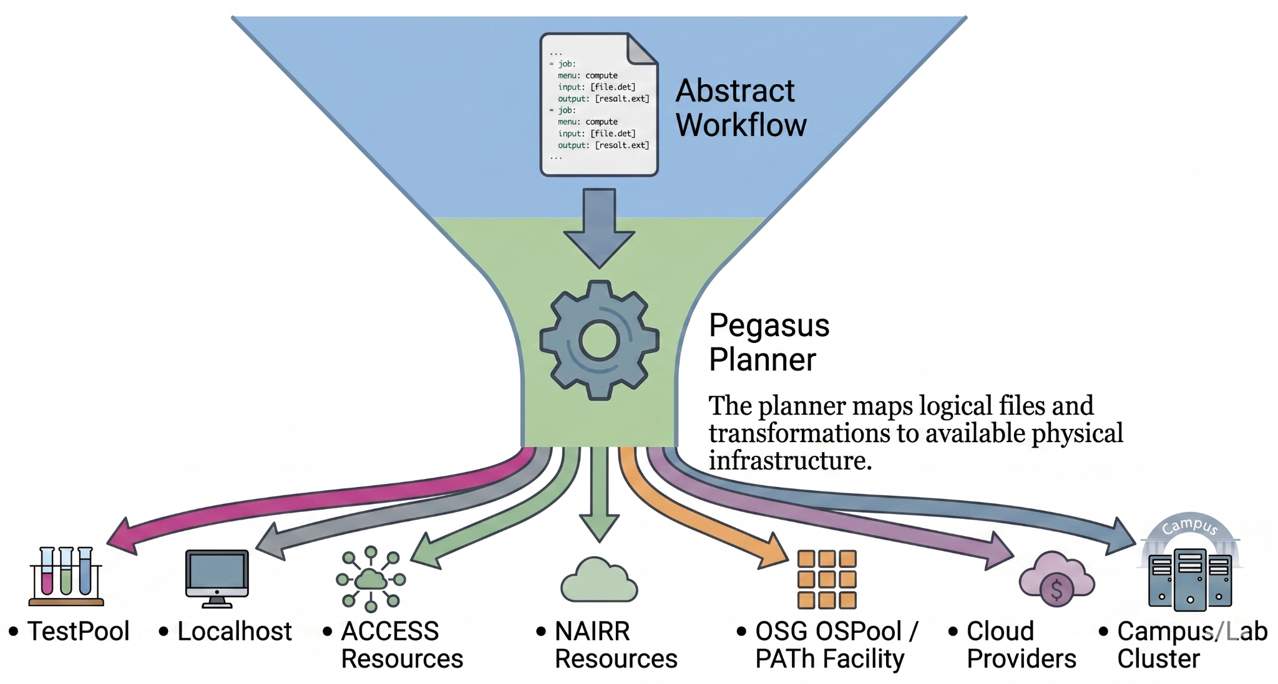
Write Once, Run Anywhere
Requirement: Any HPC/cloud/… system with outbound network connectivity. Includes your own campus cluster or lab machines!

Slide 8
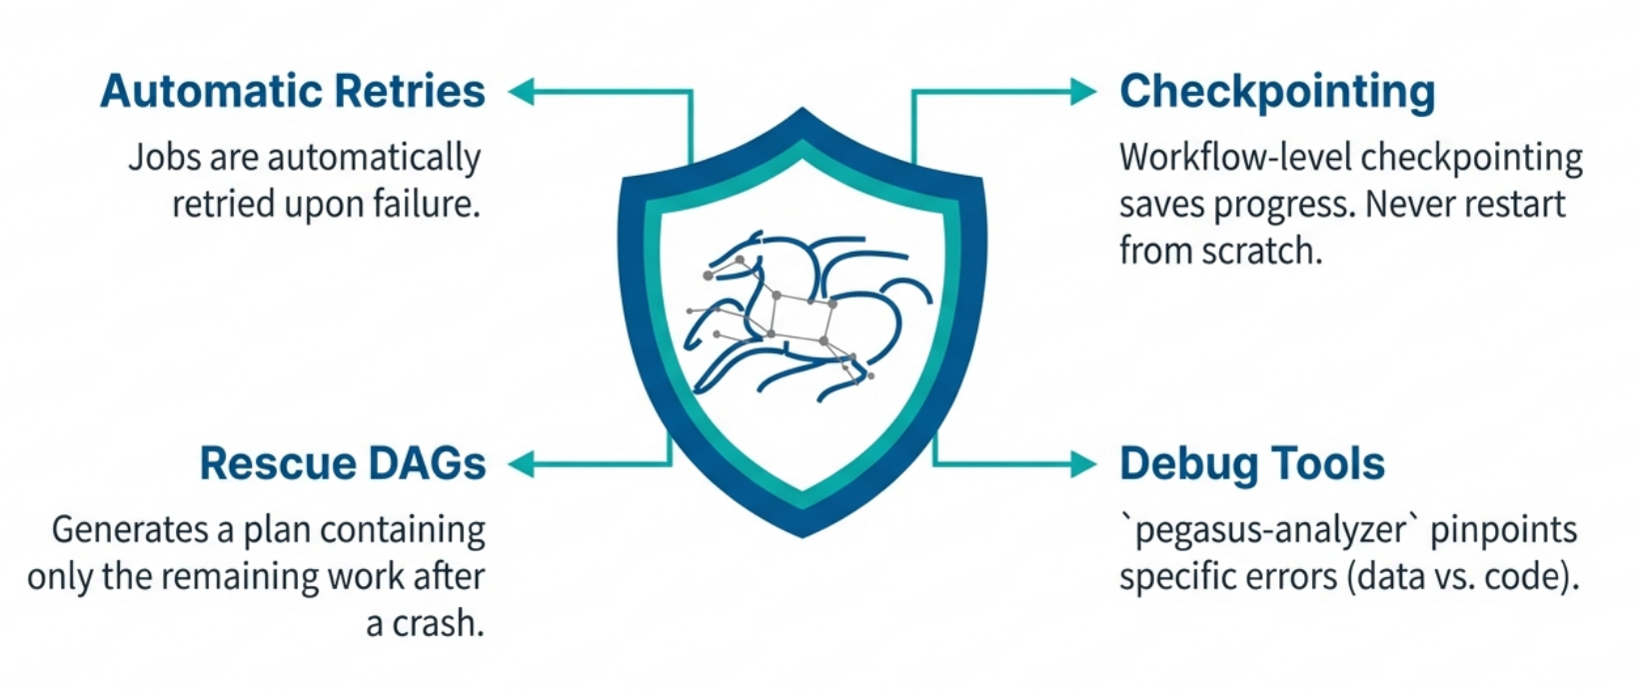
Resilience: When Things Go Wrong

Slide 9
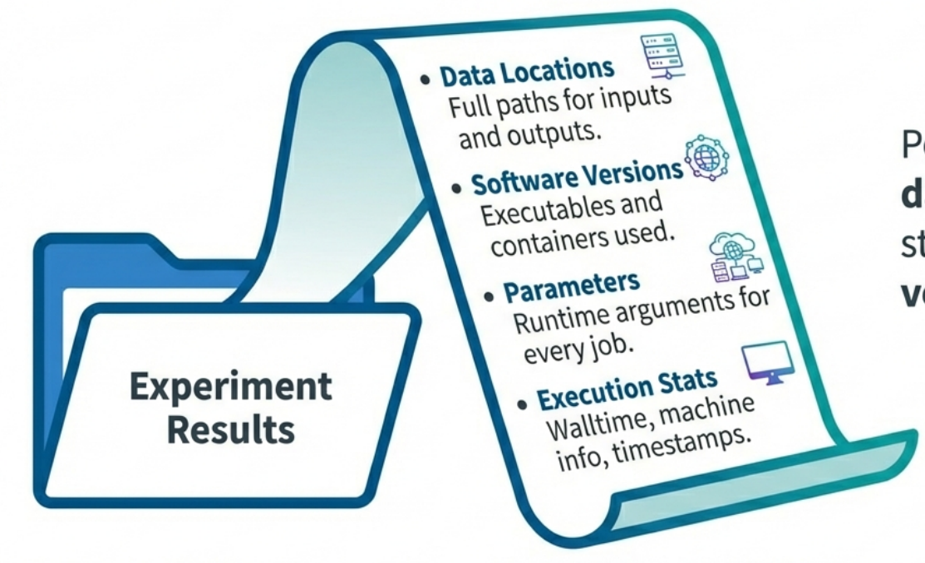
Provenance & Reproducibility
Good science requires proof.
Pegasus tracks every bit of data and every compute step, ensuring your results are verifiable and reproducible.

Slide 10
The NERSC Superfacility API
NERSC's Superfacility API (SFAPI) is a REST API for scripting jobs and workflows against NERSC systems.
What you can do through the API
How access works
System status
Check if systems are up; no client needed
Submit jobs
Launch batch jobs from your own scripts
Track jobs
Poll job state as a workflow runs
1
Create a client in Iris
Its security level sets lifetime and allowed source IPs
2
Get an access token
Sign with the client key; tokens last about 10 minutes
Move files
Transfer data in and out of NERSC
Reservations
Book compute time in advance
Accounting
Query usage for your projects
3
Call the API
At api.nersc.gov/api/v1.2 or with the sfapi_client Python library
Source: NERSC Documentation, “The Superfacility API” docs.nersc.gov/services/sfapi

Slide 11
How Pegasus Uses the Superfacility API
Pegasus uses SFAPI now to submit and monitor workflow jobs on Perlmutter from a remote submit host. The integration has been done in the HTCondor BLAHP layer to submit jobs using the “sfapi_client” python library.
For every job, HTCondor's SFAPI plugin calls the API over HTTPS to:
1 Upload inputs
Sends the job’s stdin and small input files to Perlmutter
2 Submit to Slurm
Creates the Slurm job on Perlmutter
3 Poll status
Reports job state to HTCondor; cancels jobs on request
4 Get outputs
Brings back output files and job stdout/stderr
No SSH tunnel or MFA prompt
Calls are authenticated with a client key registered in Iris
No shared filesystem
Submit host and Perlmutter need no common storage
Same workflow code
Only the site catalog entry for Perlmutter changes
Source: Pegasus User Guide https://pegasus.isi.edu/documentation/user-guide/deployment-scenarios.html#nersc-perlmutter-via-sfapi

Slide 12
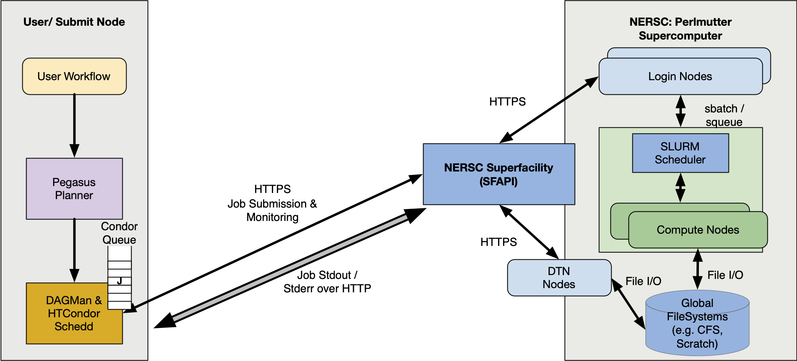
Pegasus WMS Job Submission to NERSC via SFAPI

Slide 13
Setting Up Pegasus for NERSC SFAPI
Setup on the submit host
Site catalog entry for Perlmutter (key lines)
1
Register an SFAPI client in Iris
Choose the Red security level (job submission, 2-day lifetime) and include the submit host's IP. Save the client ID and keys to ~/.superfacility/
- name: perlmutter
grids:
- type: sfapi
contact: perlmutter
scheduler: slurm
jobtype: compute
pegasus:
style: glite
queue: shared
project: ${RESOURCE_PROJECT}
data.configuration: nonsharedfs
glite.arguments: -C cpu
2
Create the Python environment
Python 3.11+ virtualenv at ~/superfacility-env with pip install sfapi_client. Python 3.9 environments fail to submit.
3
Get an SSH key for data transfers
Run sshproxy on the submit host to get ~/.ssh/nersc, valid 24 hours without MFA; set it as the local site's SSH_PRIVATE_KEY profile.
Scratch and outputs live on CFS: /global/cfs/cdirs/<project>/<user>/
Latest entry: github.com/pegasushub/pegasus-site-catalogs
Credential errors? chmod 600 the keys; check client scopes.
Source: Pegasus 5.1 User Guide, “NERSC Perlmutter via SFAPI” (Prerequisites, Site Catalog, Troubleshooting, Data Transfers)

Slide 14
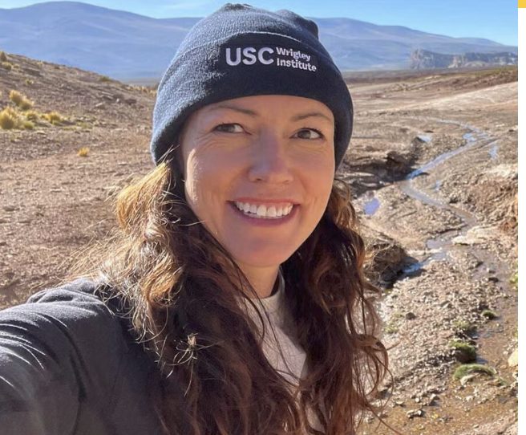
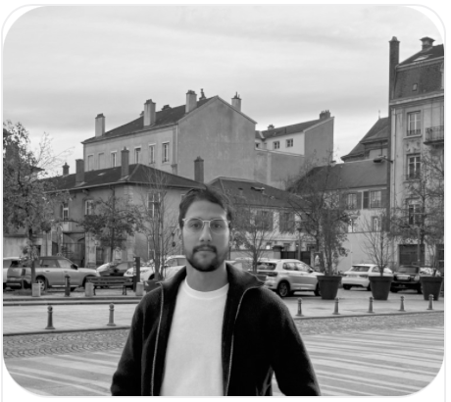
Science Highlight: Hot Springs - What lives in the deep, and what is it doing?
Along the Costa Rican subduction zone, deep hot springs bring fluids up from where one tectonic plate slides beneath another. Microbes live in that heat and chemistry and what they do there helps govern how carbon moves between the Earth's interior and its surface.
The study asks three things
Who is there?
What can they do?
What shapes them?
Which microbial communities live in each spring, across the range of temperatures and chemistries.
Which metabolic genes they carry especially the machinery for fixing carbon in the subsurface.
How the geochemistry of each site drives both the communities and their carbon-cycling potential.
Understanding this deep microbial carbon cycle helps explain how much carbon stays locked in the Earth versus returns to the atmosphere — a piece of the planet's long-term climate balance.
https://dornsife.usc.edu/lloyd/projects/
Karen Lloyd – USC Dornsife
Hamza Safri – USC/ISI
Notes:
regional view of the deep subsurface biosphere across a convergent margin. The Costa Rica convergent margin is caused by the oceanic Cocos plate being subducted under the Caribbean plate. As the plate is subducted, dewatering due to compression and serpentinization reactions between water and rock drive nutrient rich hot springs whose surface expression reflects the deep processes that feed it.

Slide 15
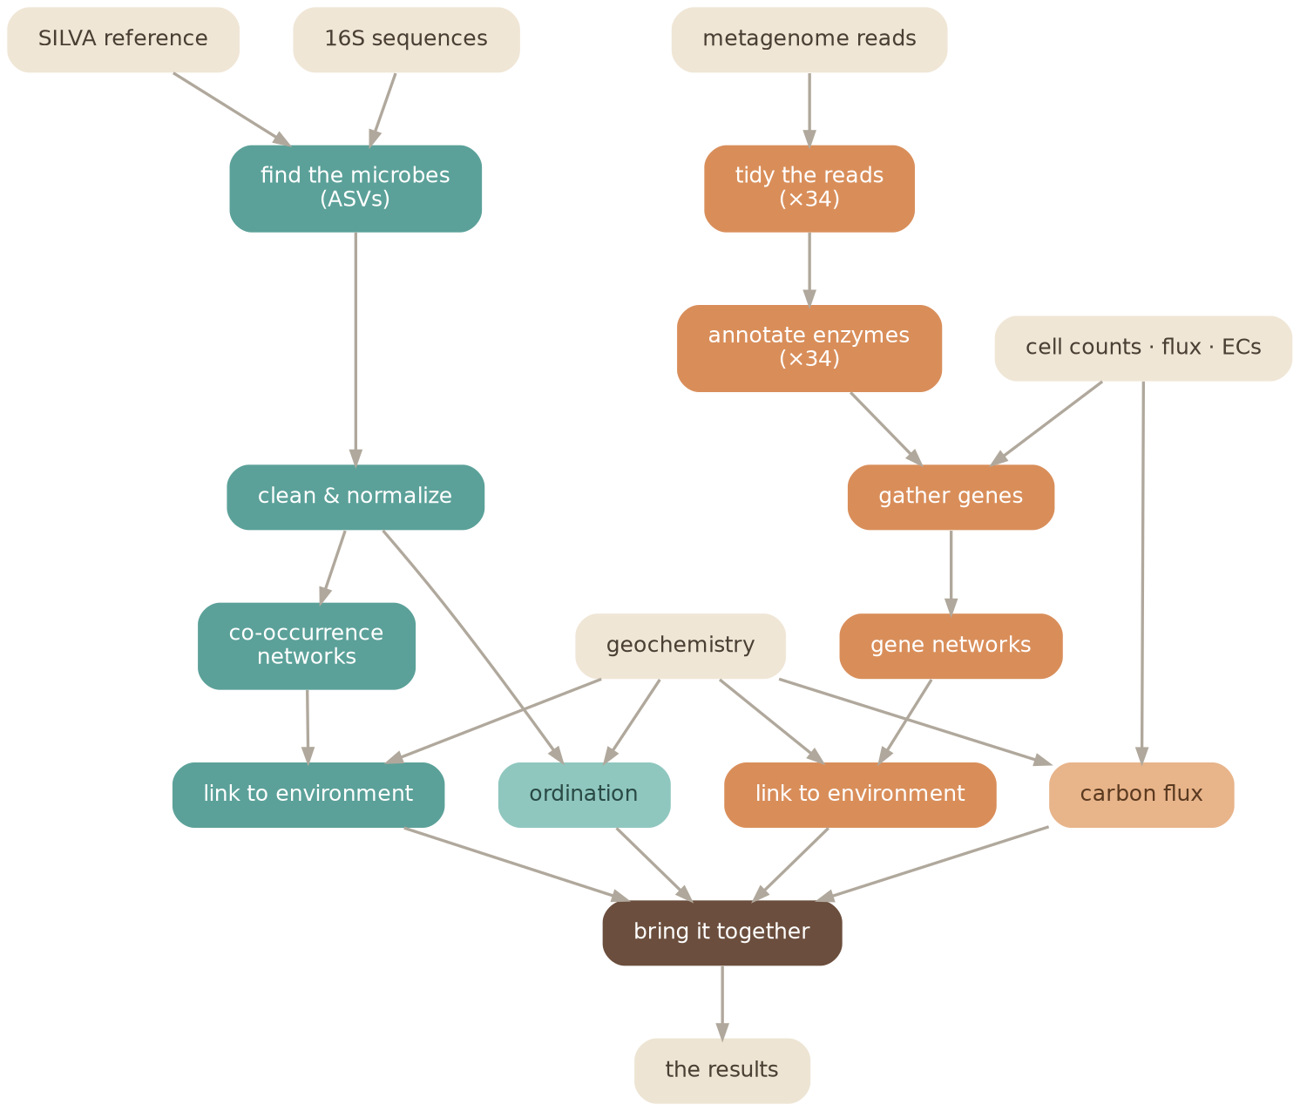
A two-track pipeline, end to end
The 16S track — the microbes
Processed 16S sequences are grouped by sample, classified against the SILVA reference to name the microbes, cleaned and normalized, then reduced to co-occurrence networks and an ordination — and linked to the site chemistry.
The metagenome track — the chemistry
Raw reads from 34 libraries are quality-trimmed, then annotated with mi-faser to detect metabolic enzymes. Carbon-fixation genes are merged, built into networks, and linked to chemistry — and a carbon-flux estimate is computed per site.
Both tracks converge
The two paths meet in a single report that ties the microbial communities to the chemistry around them — the picture the original study drew, rebuilt from public data.
The full pipeline completed on Perlmutter — all 34 metagenome samples and the 16S community, end to end.
Notes:
Parallelism type
mothur_asv8multi-threaded (mothur processors=8)
mifaser8multi-threaded (DIAMOND threads)
trim_reads8multi-threaded (trimmomatic -threads)
gene_merge, gene_network, gene_geochem, carbon_flux1 (default)single-core R
filter_normalize, asv_network, nmds_adonis, clique_geochem1 (default)single-core R
make_report1single-core R

Slide 16
Try Pegasus?
An easy and convenient way to try out Pegasus and submit workflows to NERSC is to use ACCESS Pegasus.
What ACCESS Pegasus provides
Hosted, web-based
Open OnDemand and Jupyter, with no local install.
Single sign-on with your ACCESS ID
Any user with an ACCESS id can login. You don’t need an ACCESS Allocation.
Training Notebooks
Try out Pegasus training examples
https://github.com/pegasus-isi/ACCESS-Pegasus-Examples
Log in: pegasus.access-ci.org
Help: support.access-ci.org/tools/pegasus

Slide 17
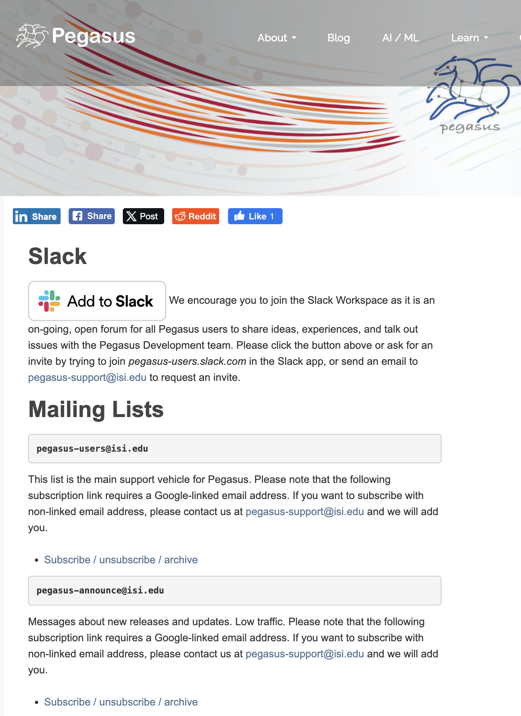
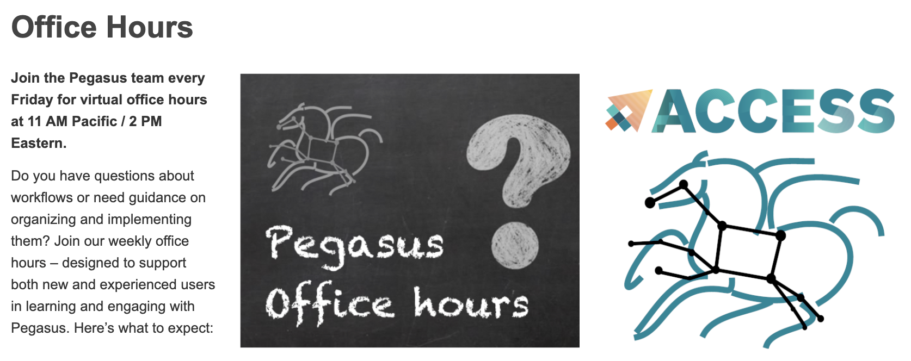
We are here to help!
Slack channel
Email: pegasus-support@isi.edu
Office hours every Friday, 11am PT
Tutorial walkthrough First Friday of the month
https://pegasus.isi.edu

Slide 18
Thank you!
Questions?
Karan Vahi | vahi@isi.edu
Acknowledgments
For support on the Pegasus SFAPI integration
JF
Jaime Frey
HTCondor team, CHTC, UW–Madison
NT
Nick Tyler
NERSC, Berkeley Lab

