Slide 1


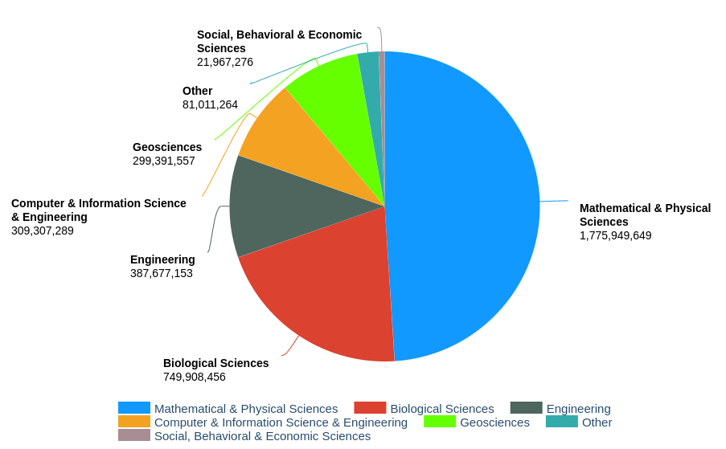
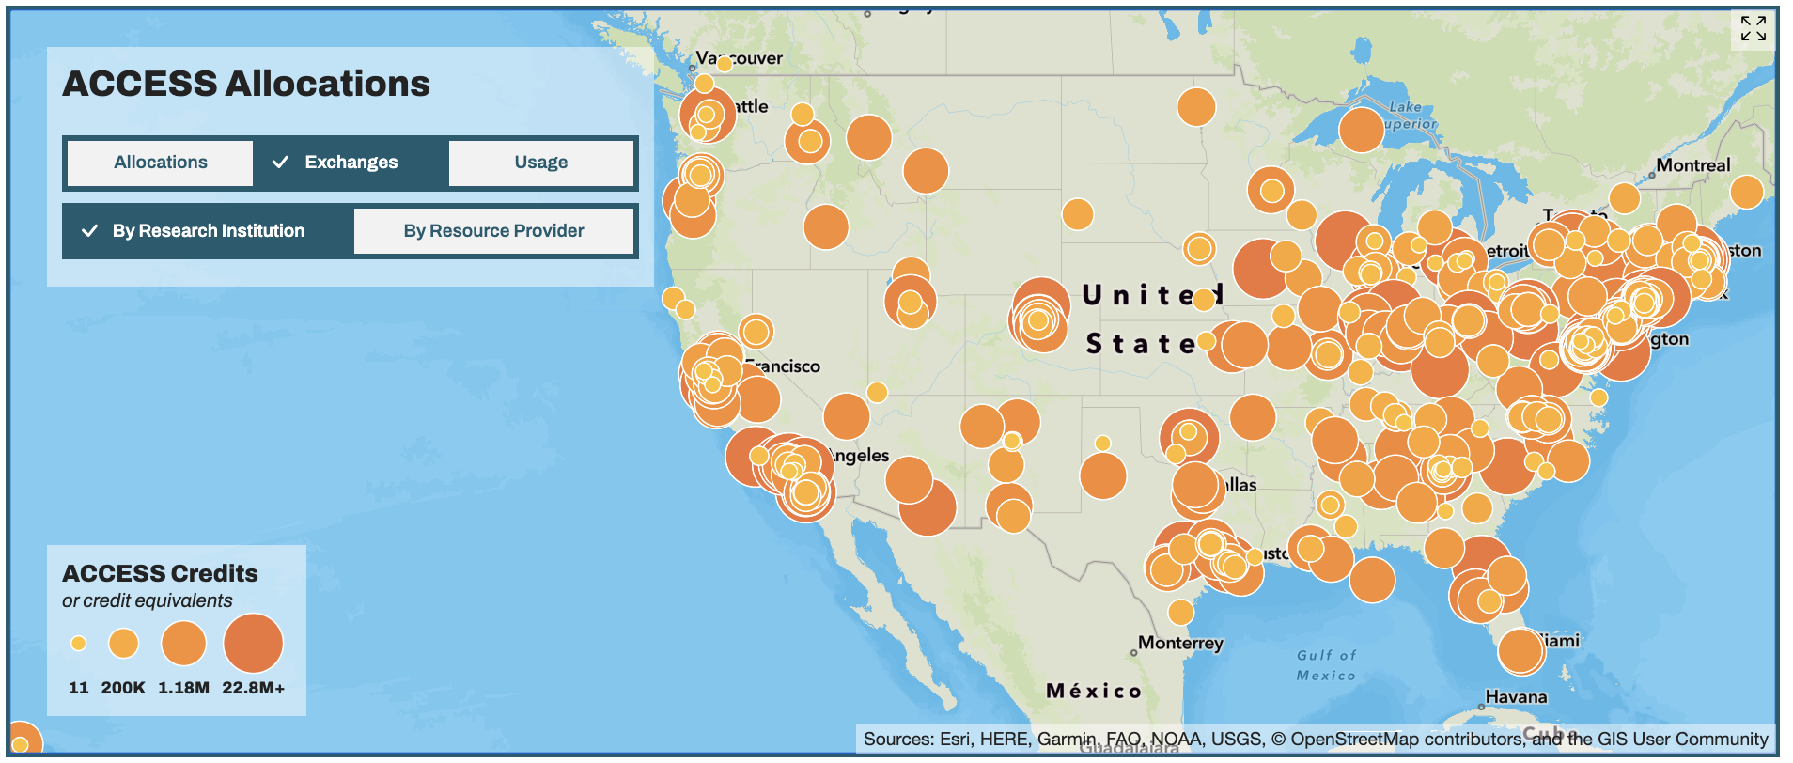
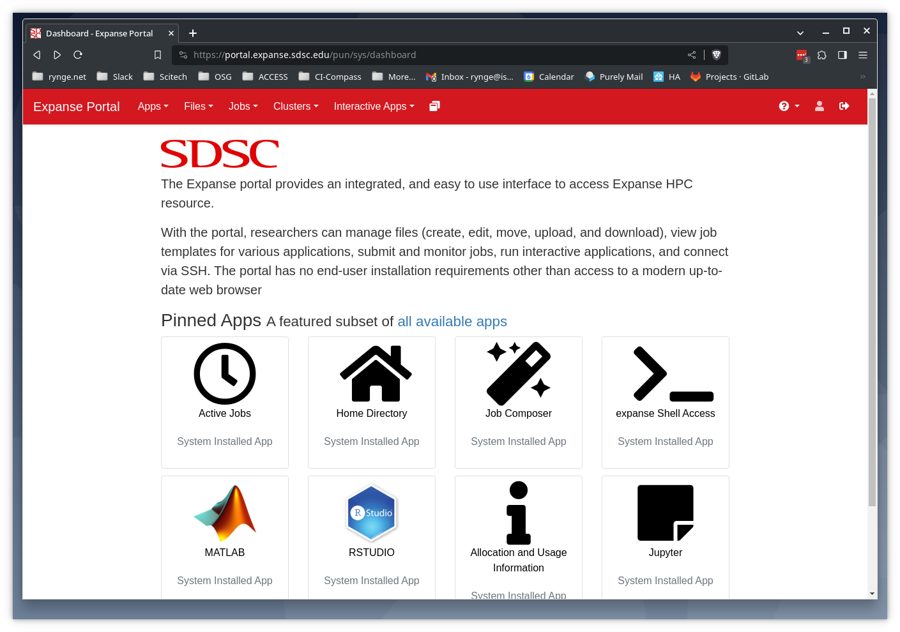

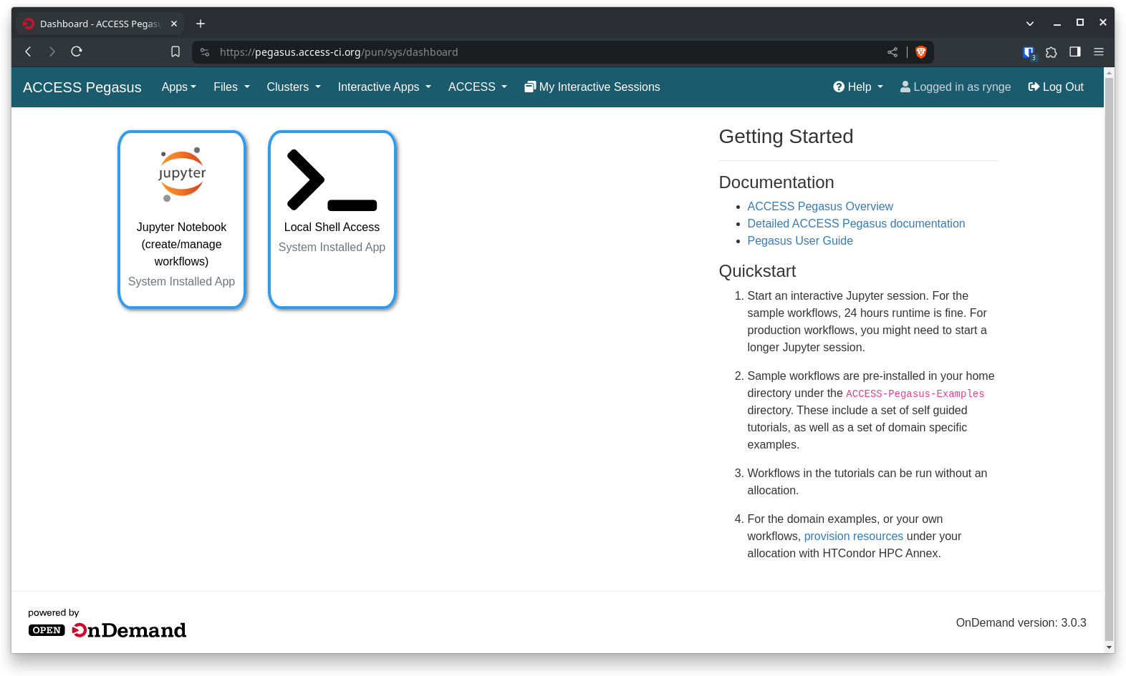
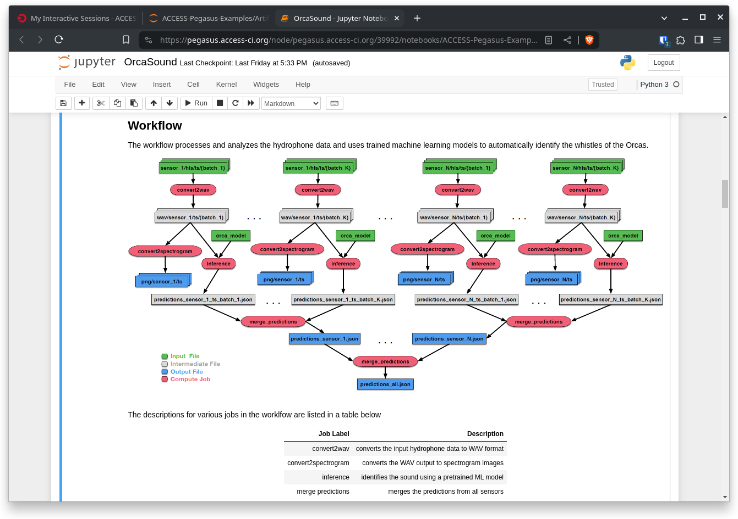


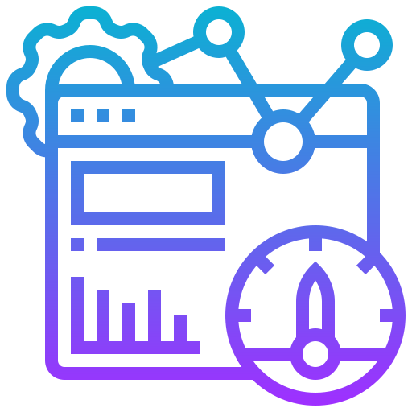
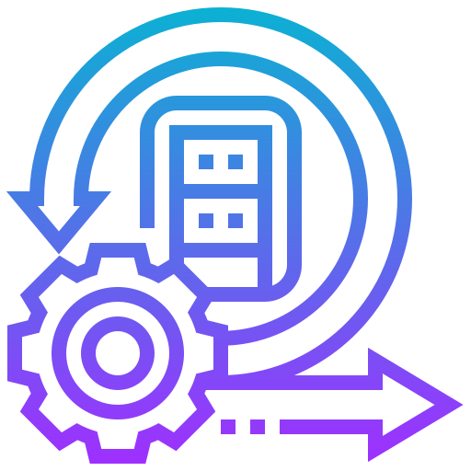





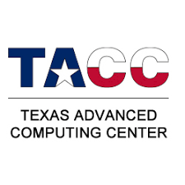








Supporting Science Through Advanced Cyberinfrastructure
Ewa Deelman⁵, Shelley L. Knuth¹, Joel C. Adams³, Alan Chalker⁴, Layla Freeborn¹, Vikram Gazula³, John Goodhue², James Griffioen⁴, David Hudak⁴, Andrew Pasquale², Alana Romanella¹, Mats Rynge⁵,Karan Vahi⁵
¹University of Colorado, ²Massachusetts Green High Performance Computing Center, ³University of Kentucky, ⁴Ohio Supercomputer Center, ⁵USC Information Sciences Institute
,
Advanced Cyberinfrastructure Coordination Ecosystem: Services & Support
Overview
Allocations
ACCESS is a program established and funded by the National Science Foundation to help U.S. based researchers and educators, with or without supporting grants, to utilize the nation’s advanced computing systems and services – at no cost.
Single entry point for over 20 compute, cloud, storage, and networking systems, including:
Computing systems
Varying core counts & memory sizes
Accelerators
GPUs, vector processors, FPGAs
Data storage systems
Archival, object, tiered
Data repositories
Software & workflow managers
High performance networking
CI Professionals & support tools
System performance monitoring
ACCESS allocations are available to any researcher or educator at a U.S. academic, non-profit research, or educational institution.
ACCESS welcomes requests not just for traditional high-performance computing (HPC) activities, but for any work that can benefit from resources in the ecosystem, including machine learning, data science, science gateways, software development, and more.
ACCESS credits, by NSF Directorate, 1 year ending at March 31, 2024
Getting an Account
Open OnDemand
Statistics
You may use an existing University account to register - this simplifies the signup process, and CILogon is used for authentication. Alternatively you can register without an existing identity, and use an ACCESS-specific username/password/MFA for authentication.
Open OnDemand is an easy-to-use web portal that is being deployed on ACCESS resources to allow researchers to compute from anywhere without client software or command-line interface, and significantly speed up the time to science.
During the last 1 year, ending at March 31, 2024
11,090 users
1,977 principal investigators
2,340 allocations
739 institutions
2.4 billion CPU hours
Pegasus Workflows
Pegasus is a scientific workflow tool designed to streamline the submission of high throughput computing workflows of jobs to many ACCESS resources, all from a unified access point. Our user-friendly hosted environment comes equipped with a web interface and Jupyter Notebooks, enabling you to create and execute workflows with ease. The Jupyter setup includes pre-configured sample workflows and comprehensive documentation.
Running workflows with Pegasus on ACCESS involves 1) designing a workflow within a Jupyter Notebook, 2) Provisioning desired resources from ACCESS via a command-line tool HTCondor Annex, and 3) monitoring their execution.
Comprehensive Support Services
In addition to the traditional documentation, ticket system and training, ACCESS provides support via a community driven question/answer system at ask.CI, and affinity groups around many topics.
The MATCH services connects researchers with consultants, mentors, and student. The CI expert is assigned to the researcher’s project for 6-12 months.
CCEP Travel Grants are available for people that want to contribute to ACCESS Support.
ACCESS Pegasus provides a set of example workflows, including AI (Lung Segmentation, Mask Detection, Orca Sound), Astronomy (Montage), and Bioinformatics (Alphafold, Rosetta, VarientCalling)
Heterogeneous Environments
Pegasus can execute workflows in a variety of distributed computing environments such as HPC clusters, Amazon EC2, Google Cloud, Open Science Grid or ACCESS
Data Management
Pegasus handles data transfers, input data selection and output registration by adding them as auxiliary jobs to the workflow
Provenance Tracking
Pegasus allows users to trace the history of a workflow and its outputs, including information about data sources and softwares used
Error Recovery
Pegasus handles errors by retrying tasks, workflow-level checkpointing, re-mapping and alternative data sources for data staging
https://access-ci.org
Service Providers
Supported by NSF Office of Advanced Cyberinfrastructure Grant: 2138286

