Slide 1



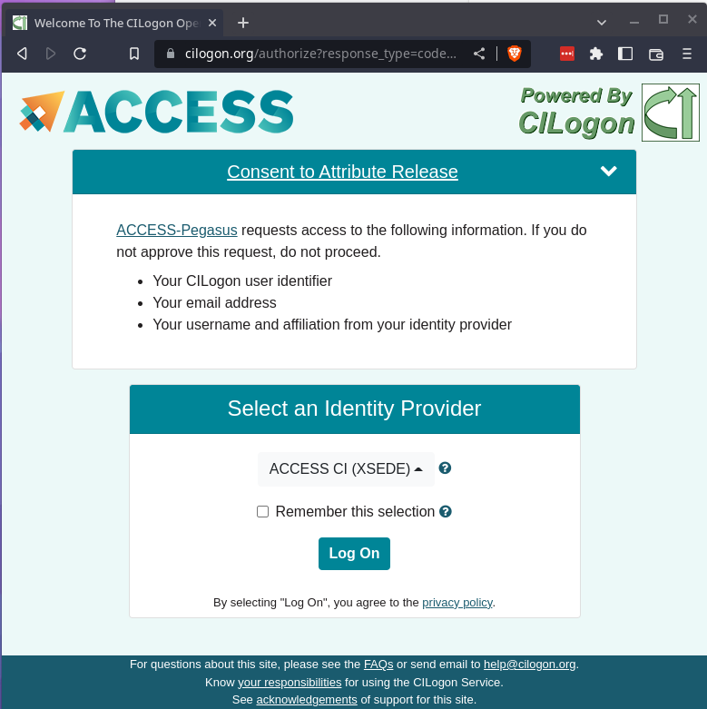
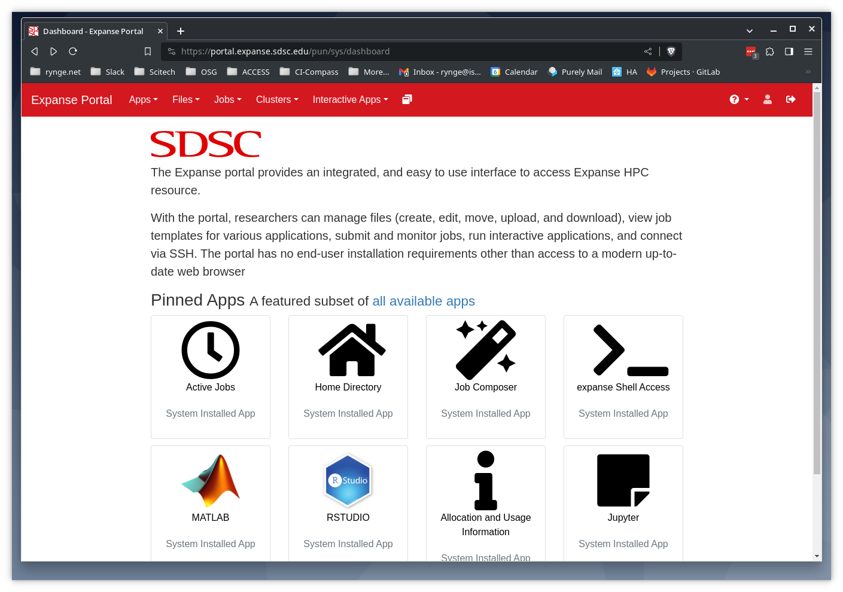

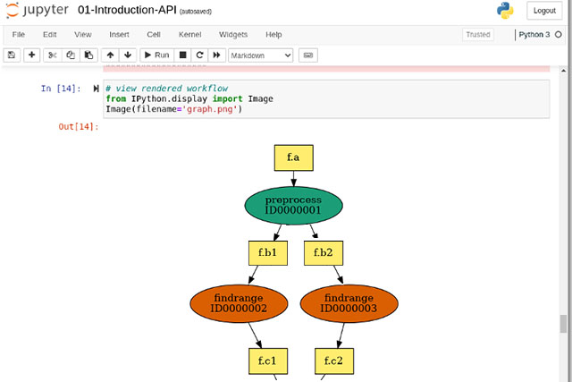
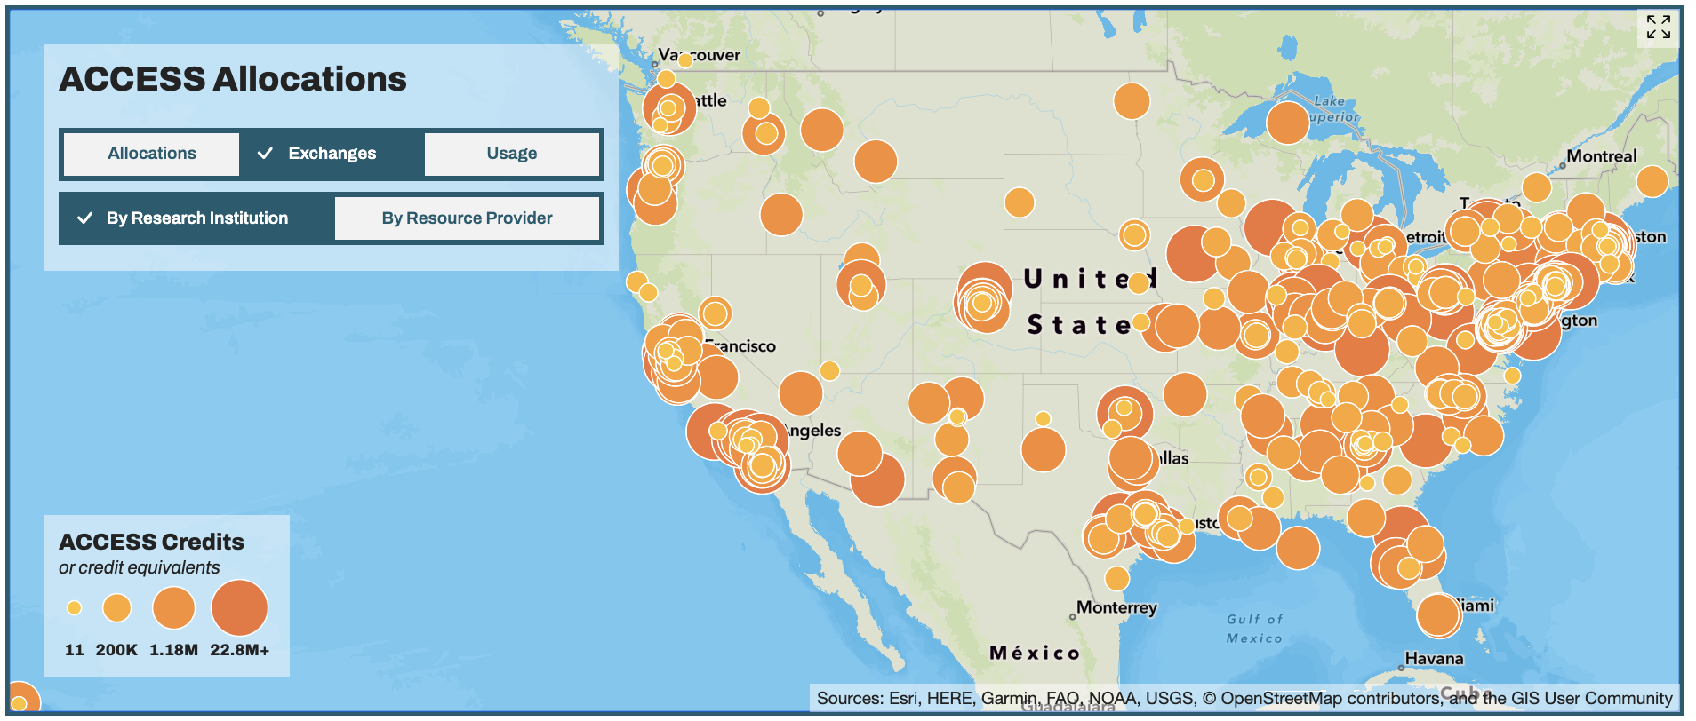
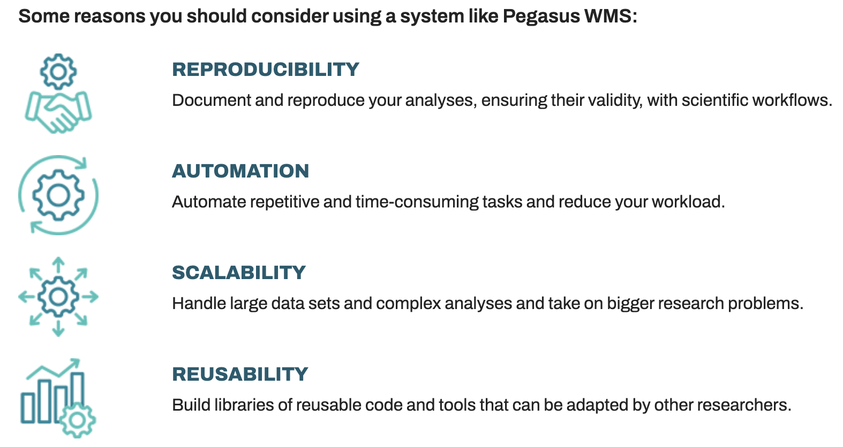
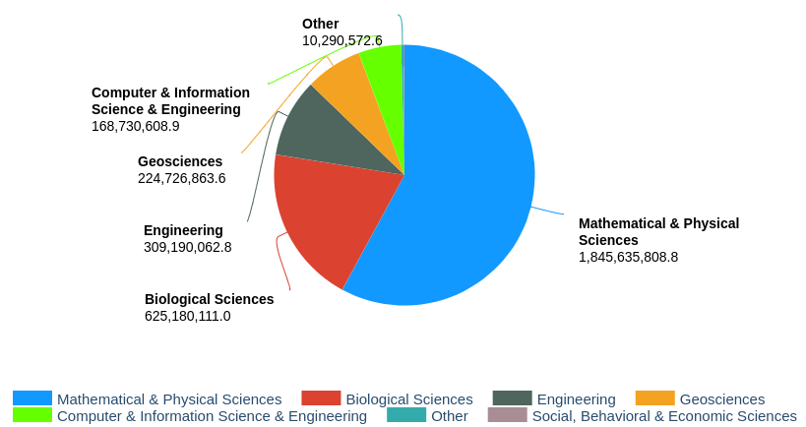





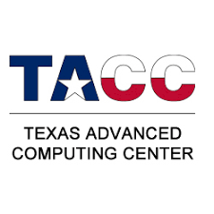








Leveraging National Cyberinfrastructure for Earth Science
Easy Access to Free Computing Cycles
Ewa Deelman⁵, Shelley L. Knuth¹, Julie Ma², Joel C. Adams³, Alan Chalker⁴, Layla Freeborn¹, Vikram Gazula³, John Goodhue², James Griffioen⁴, David Hudak⁴, Andrew Pasquale²,
Dylan Perkins¹, Alana Romanella¹, Mats Rynge⁵
¹University of Colorado, ²Massachusetts Green High Performance Computing Center, ³University of Kentucky, ⁴Ohio Supercomputer Center, ⁵USC Information Sciences Institute
,
Advanced Cyberinfrastructure Coordination Ecosystem: Services & Support
Overview
Getting an Account
Open Ondemand
ACCESS is a program established and funded by the National Science Foundation to help researchers and educators, with or without supporting grants, to utilize the nation’s advanced computing systems and services – at no cost.
Single entry point for over 20 compute, cloud, storage, and networking systems, including:
Computing systems
Varying core counts & memory sizes
Accelerators
GPUs, vector processors, FPGAs
Data storage systems
Archival, object, tiered
Data repositories
Software & workflow managers
High performance networking
CI Professionals & support tools
System performance monitoring
You may use an existing University account to register - this simplifies the signup process, and CILogon is used for authentication. Alternatively you can register without an existing identity, and use an ACCESS-specific username/password/MFA for authentication.
Open OnDemand is an easy-to-use web portal that is being deployed on ACCESS resources to allow researchers to compute from anywhere without client software or command-line interface, and significantly speed up the time to science.
Allocations
ACCESS allocations are available to any researcher or educator at a U.S. academic, non-profit research, or educational institution.
ACCESS welcomes requests not just for traditional high-performance computing (HPC) activities, but for any work that can benefit from resources in the ecosystem, including machine learning, data science, science gateways, software development, and more.
ACCESS Pegasus
ACCESS Pegasus is a hosted workflow management system which allows users to construct, run, and debug workflows from a Jupyter Notebook. Perform simple interactions on the command line. Work across environments and get started quickly with sample workflows using a Python API.
Comprehensive Support Services
Metrics
In addition to the traditional documentation, ticket system and training, ACCESS provides support via a community driven question/answer system at ask.CI, and affinity groups around many topics.
The MATCH services connects researchers with consultants, mentors, and student. The CI expert is assigned to the researcher’s project for 6-12 months.
ACCESS credits, by NSF Directorate, Sept 2022 - Dec 2023
https://access-ci.org
Service Providers
Supported by NSF Office of Advanced Cyberinfrastructure Grant: 2138286

