Slide 1
Clouds: An Opportunity for Scientific Applications?
Ewa Deelman
USC Information Sciences Institute

Slide 2
Acknowledgements
Yang-Suk Ki (former PostDoc, USC)
Gurmeet Singh (former Ph.D. student, USC)
Gideon Juve (Ph.D. student, USC)
Tina Hoffa (Undergrad, Indiana University)
Miron Livny (University of Wisconsin, Madison)
Montage scientists: Bruce Berriman, John Good, and others
Pegasus team: Gaurang Mehta, Karan Vahi, others

Slide 3
Outline
Background
  Science Applications
  Workflow Systems
The opportunity of the Cloud
  Virtualization
  On-demand availability
Simulation study of an astronomy application on the Cloud
Conclusions
Notes:
Look at Tina’s paper

Slide 4
Scientific Applications
Complex
  Involve many computational steps
  Require many (possibly diverse resources)
  Often require a custom execution environment
Composed of individual application components
  Components written by different individuals
  Components require and generate large amounts of data
  Components written in different languages
Ewa Deelman deelman@isi.edu

Slide 5
Issues Critical to Scientists
Reproducibility of scientific analyses and processes is at the core of the scientific method
Scientists consider the “capture and generation of provenance information as a critical part of the <…> generated data”
“Sharing <methods> is an essential element of education, and acceleration of knowledge dissemination.”
NSF Workshop on the Challenges of Scientific Workflows, 2006, www.isi.edu/nsf-workflows06
Y. Gil, E. Deelman et al, Examining the Challenges of Scientific Workflows. IEEE Computer, 12/2007

Slide 6
Computational challenges faced by applications
Be able to compose complex applications from smaller components
Execute the computations reliably and efficiently
Take advantage of any number/types of resources
Cost is an issue
  Cluster, Shared CyberInfrastructure (EGEE, Open Science Grid, TeraGrid), Cloud

Slide 7
Possible solution
Structure an application as a workflow
  Describe data and components in logical terms
  Can be mapped onto a number of execution environments
  Can be optimized and if faults occur the workflow management system can recover
Use a workflow management system (Pegasus-WMS) to manage the application on a number of resources

Slide 8
Pegasus-Workflow Management System
Leverages abstraction for workflow description to obtain ease of use, scalability, and portability
Provides a compiler to map from high-level descriptions to executable workflows
    Correct mapping
    Performance enhanced mapping
Provides a runtime engine to carry out the instructions (Condor DAGMan)
    Scalable manner
    Reliable manner
Can execute on a number of resources: local machine, campus cluster, Grid, Cloud

Slide 9
Mapping Correctly
Select where to run the computations
  Apply a scheduling algorithm for computation tasks
  Transform task nodes into nodes with executable descriptions
    Execution location
    Environment variables initializes
    Appropriate command-line parameters set
Select which data to access
  Add stage-in nodes to move data to computations
  Add stage-out nodes to transfer data out of remote sites to storage
  Add data transfer nodes between computation nodes that execute on different resources

Slide 10
Additional Mapping Elements
Add data cleanup nodes to remove data from remote sites when no longer needed
  reduces workflow data footprint
Cluster compute nodes in small computational granularity applications
Add nodes that register the newly-created data products
Provide provenance capture steps
  Information about source of data, executables invoked, environment variables, parameters, machines used, performance
Scale matters--today we can handle:
  1 million tasks in the workflow instance (SCEC)
  10TB input data (LIGO)

Slide 11
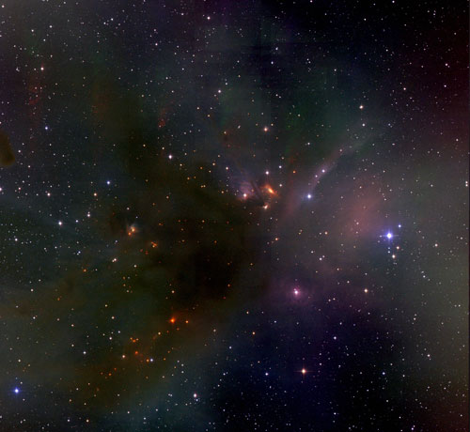


Science-grade Mosaic of the Sky
Point on the sky, area
Image Courtesy of IPAC, Caltech

Slide 12
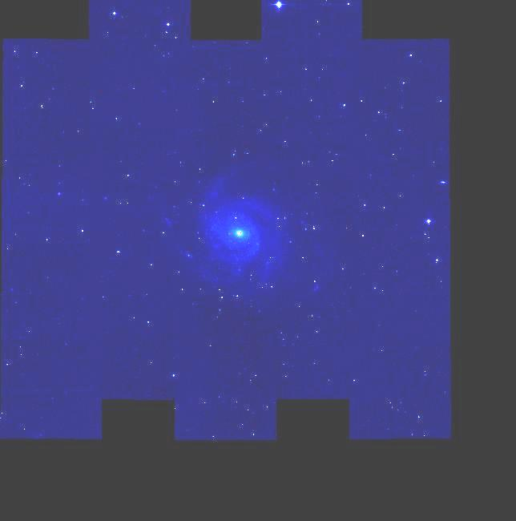
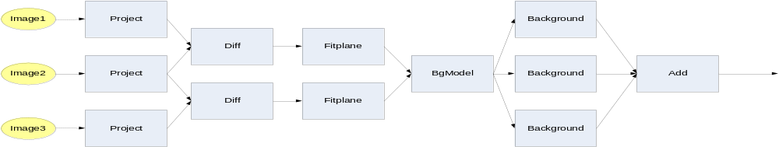
Generating mosaics of the sky (Bruce Berriman, Caltech)
Size of the mosaic is degrees square* | Number of jobs | Number of input data files | Number of Intermediate files | Total data footprint | Approx. execution time (20 procs)
1 | 232 | 53 | 588 | 1.2GB | 40 mins
2 | 1,444 | 212 | 3,906 | 5.5GB | 49 mins
4 | 4,856 | 747 | 13,061 | 20GB | 1hr 46 mins
6 | 8,586 | 1,444 | 22,850 | 38GB | 2 hrs. 14 mins
10 | 20,652 | 3,722 | 54,434 | 97GB | 6 hours
*The full moon is 0.5 deg. sq. when viewed form Earth, Full Sky is ~ 400,000 deg. sq.

Slide 13
Types of Workflow Applications
Providing a service to a community (Montage project)
  Data and derived data products available to a broad range of users
  A limited number of small computational requests can be handled locally
  For large numbers of requests or large requests need to rely on shared cyberinfrastructure resources
  On-the fly workflow generation, portable workflow definition
Supporting community-based analysis (SCEC project)
  Codes are collaboratively developed
  Codes are “strung” together to model complex systems
  Ability to correctly connect components, scalability
Processing large amounts of shared data on shared resources (LIGO project)
  Data captured by various instruments and cataloged in community data registries.
  Amounts of data necessitate reaching out beyond local clusters
  Automation, scalability and reliability
Automating the work of one scientist (Epigenomic project, USC)
  Data collected in a lab needs to be analyzed in several steps
  Automation, efficiency, and flexibility (scripts age and are difficult to change)
  Need to have a record of how data was produced

Slide 14
Outline
Background
  Science Applications
  Workflow Systems
The opportunity of the Cloud
  Virtualization
  Availability
Simulation study of an astronomy application on the Cloud
Conclusions
Notes:
Look at Tina’s paper

Slide 15

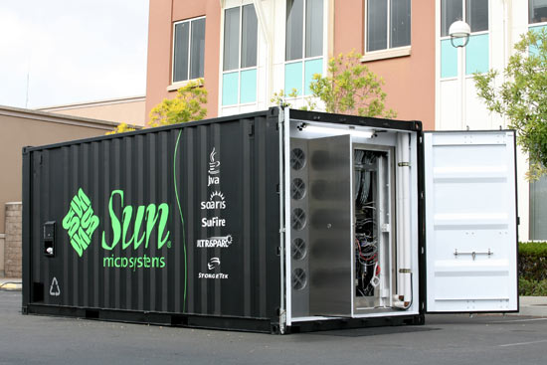
Clouds
Originated in the business domain
Outsourcing services to the Cloud
Pay for what you use
Provided by data centers that are built on compute and storage virtualization technologies.
Scientific applications often have different requirements
  MPI
  Shared file system
  Support for many
  dependent jobs
Container-based Data Center

Slide 16



Available Cloud Platforms
Commercial Providers
  Amazon EC2, Google, others
Science Clouds
  Nimbus (U. Chicago), Stratus (U. Florida)
  Experimental
Roll out your own using open source cloud management software
  Virtual Workspaces (Argonne), Eucalyptus (UCSB), OpenNebula (C.U. Madrid)
Many more to come

Slide 17
Cloud Benefits for Grid Applications
Similar to the Grid
  Provides access to shared cyberinfrastructure
  Can recreate familiar grid and cluster architectures (with additional tools)
  Can use existing grid software and tools
Resource Provisioning
  Resources can be leased for entire application instead of individual jobs
  Enables more efficient execution of workflows
Customized Execution Environments
  User specifies all software components including OS
  Administration performed by user instead of resource provider (good [user control] and bad [extra work])

Slide 18
Amazon EC2 Virtualization
Virtual Nodes
  You can request a certain class of machine
  Previous research suggests 10% performance hit
  Multiple virtual hosts on a single physical host
  You have to communicate over a wide-area network
Virtual Clusters (additional software needed)
  Create cluster out of virtual resources
  Use any resource manager (PBS, SGE, Condor)
  Dynamic configuration is the key issue

Slide 19
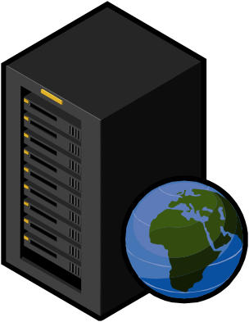

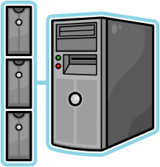
Personal Cluster
Work by Yang-Suk Kee at USC
System Queue
Batch Resources
Private Queue
Resource & execution environment
No Job manager
Compute Clouds
GT4/PBS
Private Cluster on Demand
Can set up NFS, MPI, ssh
Notes:
PC provisions resources from batch systems or compute clouds and setup execution environments (GRAM, PBS, MPI).
User has a private queue dedicated for his/her program on demand (with time contraints if necessary)
No need to wait on system queue (batch) or application-level job schedulers (compute cloud) once PC is running.
A supervisor for personal cluster is running on Pegaus-VG proxy or the host where Pegasus, or client.
This supervisor monitors the progress and issues commands to configure.
When the supervisor creates VM instances using the command ec2run, EC2 provides the instance IDs of VMs starting from 0 to n-1.
Then, the supervios let instance 0 be a NFS server and the others be clients.
The supervisor then setup the server, basically, it generates the list of clients which are going to join (for security reason).
For client, the supervisor let them know which one (host or IP) is the server to contact and then the clients call "mount" command.
For MPI, the two basic things are to create a machinefile and make hosts communicate each other using ssh.
The supervisor know all VM instance information and It generates the host list and copy it to the server node.
Since NFS is setup already, all instances share the information.
For ssh, the supervisor make all VM instances register their host information using hostname, hostname -i, hostname -f as known_hosts in .ssh directory.
One EC2 specific thing is that EC2 allows only private network information for inter VM communications while the user can access the VMs using public IPs.
So, machine list, known_hosts, NFS host list should be private IPs or hostnames.

Slide 20
EC2 Software Environment
Specified using disk images
  OS snapshot that can be started on virtualized hosts
  Provides portable execution environment for applications
  Helps with reproducibility for scientific applications
Images for a workflow application can contain:
  Application Codes
  Workflow Tools
    Pegasus, DAGMan
  Grid Tools
    Globus Gatekeeper, GridFTP
  Resource Manager
    Condor, PBS, SGE, etc.

Slide 21
EC2 Storage Options
Local Storage
  Each EC2 node has 100-300 GB of local storage
  Used for image too
Amazon S3
  Simple put/get/delete operations
  Currently no interface to grid/workflow software
Amazon EBS
  Network accessible block-based storage volumes (c.f. SAN)
  Cannot be mounted on multiple workers
NFS
  Dedicated node exports local storage, other nodes mount
Parallel File Systems (Lustre, PVFS, HDFS)
  Combine local storage into a single, parallel file system
  Dynamic configuration may be difficult

Slide 22
Montage/IPAC Situation
Provides a service to the community
  Delivers data to the community
  Delivers a service to the community (mosaics)
Have their own computing infrastructure
  Invests ~ $75K for computing (over 3 years)
  Appropriates ~ $50K in human resources every year
Expects to need additional resources to deliver services
Wants fast responses to user requests

Slide 23
Cloudy Questions
Applications are asking:
  What are Clouds?
  How do I run on them?
How do I make good use of the cloud so that I use my funds wisely?
  And how do I explain Cloud computing to the purchasing people?
How many resources do I allocate for my computation or my service?
How do I manage data transfer in my cloud applications?
How do I manage data storage—where do I store the input and output data?

Slide 24
Outline
Background
  Science Applications
  Workflow Systems
The opportunity of the Cloud
  Virtualization
  Availability
Simulation study of an astronomy application on the Cloud
Conclusions
Notes:
Look at Tina’s paper

Slide 25
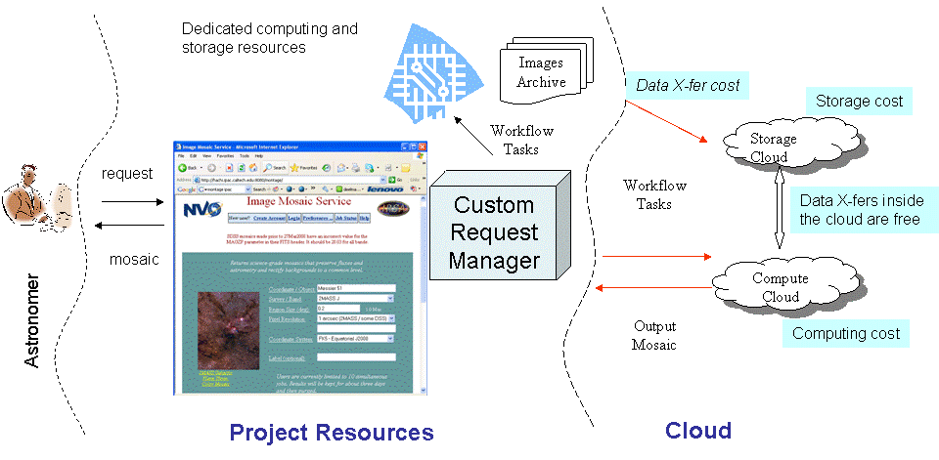
Montage Infrastructure

Slide 26
Computational Model
Based on Amazon’s fee structure
  $0.15 per GB-Month for storage resources
  $0.1 per GB for transferring data into its storage system
  $0.16 per GB for transferring data out of its storage system
  $0.1 per CPU-hour for the use of its compute resources
Normalized to cost per second
Does not include the cost of building and deploying an image
Simulations done using a modified Gridsim

Slide 27
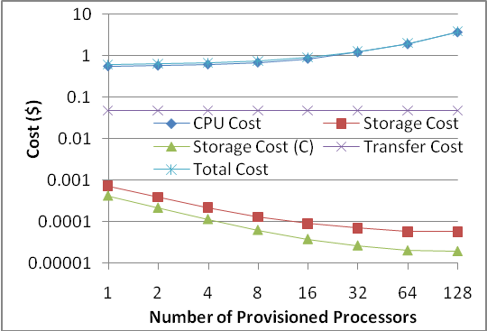
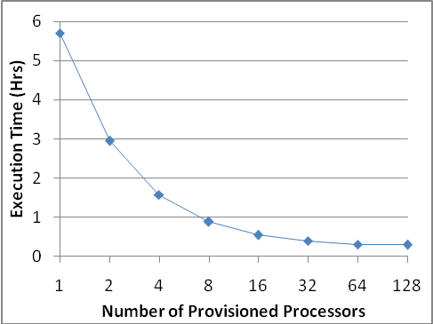
How many resources to provision?
Montage 1 Degree Workflow 203 Tasks
60 cents for the 1 processor computation versus almost $4 with 128 processors, 5.5 hours versus 18 minutes

Slide 28
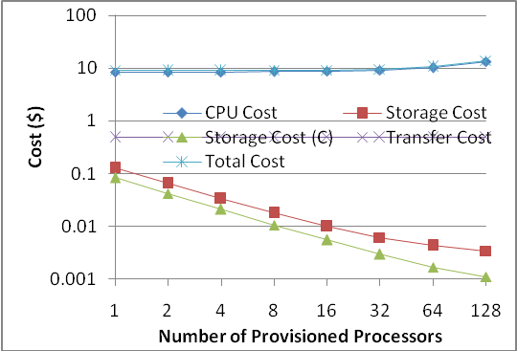
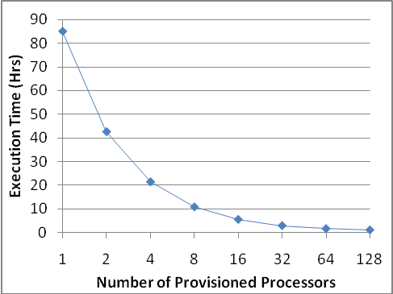
4 Degree Montage
3,027 application tasks
1 processor $9, 85 hours; 128 processors, 1 hour with and $14.

Slide 29
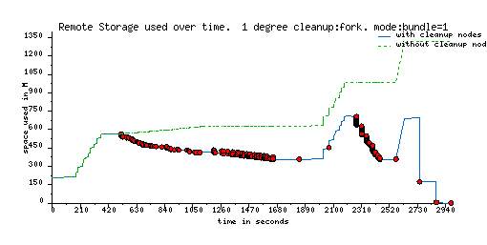
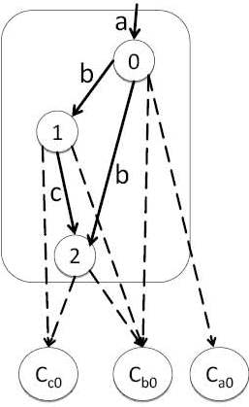
Data Management Modes
Ra
a
0
0
Remote I/O
Regular
Cleanup
b
Wb
1
b
Rb
Good for non-shared file systems
c
1
Rb
2
Wc
Rc
2
1.25GB versus 4.5 GB

Slide 30
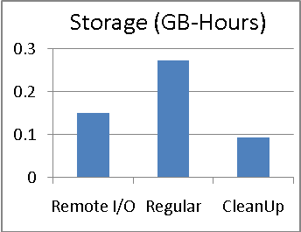
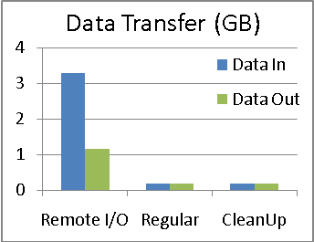
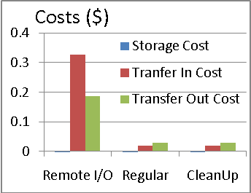
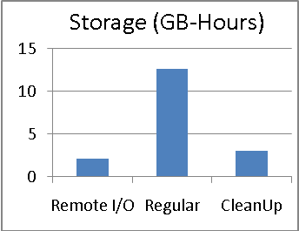
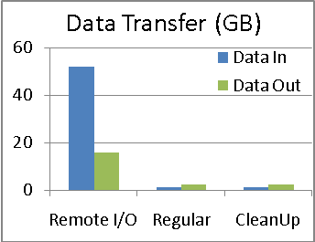
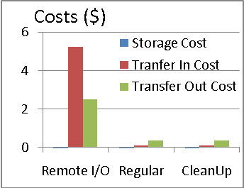
How to manage data?
1 Degree Montage 4 Degree Montage

Slide 31
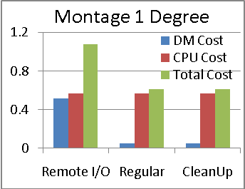
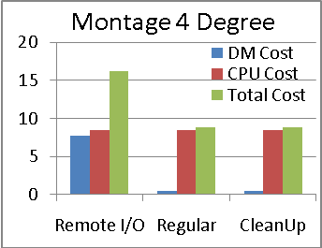
How do data cost affect total cost?
Data stored outside the cloud
Computations run at full parallelism
Paying only for what you use
  Assume you have enough requests to make use of all provisioned resources
Cost in $

Slide 32
Where to keep the data?
Storing all of 2 Mass data
  12 TB of data → $1,800 per month on the Cloud
Calculating a 1 degree mosaic and delivering it to the user $2.22 (with data outside the cloud)
Same mosaic but data inside the cloud: $2.12
To overcome the storage costs, users would need to request at least $1,800/($2.22-$2.12) = 18,000 mosaics per month
Does not include the initial cost of transferring the data to the cloud, which would be an additional $1,200
Is $1,800 per month reasonable?
  ~$65K over 3 years (does not include data access costs from outside the cloud)
  Cost of 12TB to be hosted at Caltech $15K over 3 years for hardware

Slide 33
The cost of doing science
Computing a mosaic of the entire sky (3,900
4-degree-square mosaics)
  3,900 x $8.88 = $34,632
How long it makes sense to store a mosaic?
  Storage vs computation costs
 | Cost of generation | Mosaic size | Length of time to save
1 degree^2 | $0.56 | 173MB | 21.52 months
2 degree^2 | $2.03 | 558MB | 24.25 months
4 degree^2 | $8.40 | 2.3GB | 25.12 months

Slide 34
Summary
We started asking the question of how can a scientific workflow best make use of clouds
Assumed a simple cost model based on the Amazon fee structure
Conducted simulations
  Need to find balance between cost and performance
  Computational cost outweighs storage costs
Storing data on the Cloud is expensive
Did not explore issues of data security and privacy, reliability, availability, ease of use, etc

Slide 35
Will scientific applications move into clouds?
There is interest in the technology from applications
They often don’t understand what are the implications
Need tools to manage the cloud
  Build and deploy images
  Request the right number of resources
  Manage costs for individual computations
  Manage project costs
Projects need to perform cost/benefit analysis

Slide 36
Issues Critical to Scientists
Reproducibility – yes—maybe--through virtual images, if we package the entire environment, the application and the VMs behave
Provenance – still need tools to capture what happened
Sharing – can be easier to share entire images and data
  Data could be part of the image

Slide 37
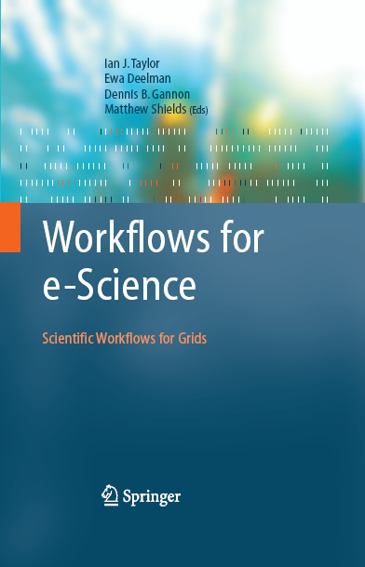
Relevant Links
Amazon Cloud: http://aws.amazon.com/ec2/
Pegasus-WMS: pegasus.isi.edu
DAGMan: www.cs.wisc.edu/condor/dagman
Gil, Y., E. Deelman, et al. Examining the Challenges of Scientific Workflows. IEEE Computer, 2007.
Workflows for e-Science, Taylor, I.J.; Deelman, E.; Gannon, D.B.; Shields, M. (Eds.), Dec. 2006
LIGO: www.ligo.caltech.edu/
SCEC: www.scec.org
Montage: montage.ipac.caltech.edu/
Condor: www.cs.wisc.edu/condor/

