Slide 1
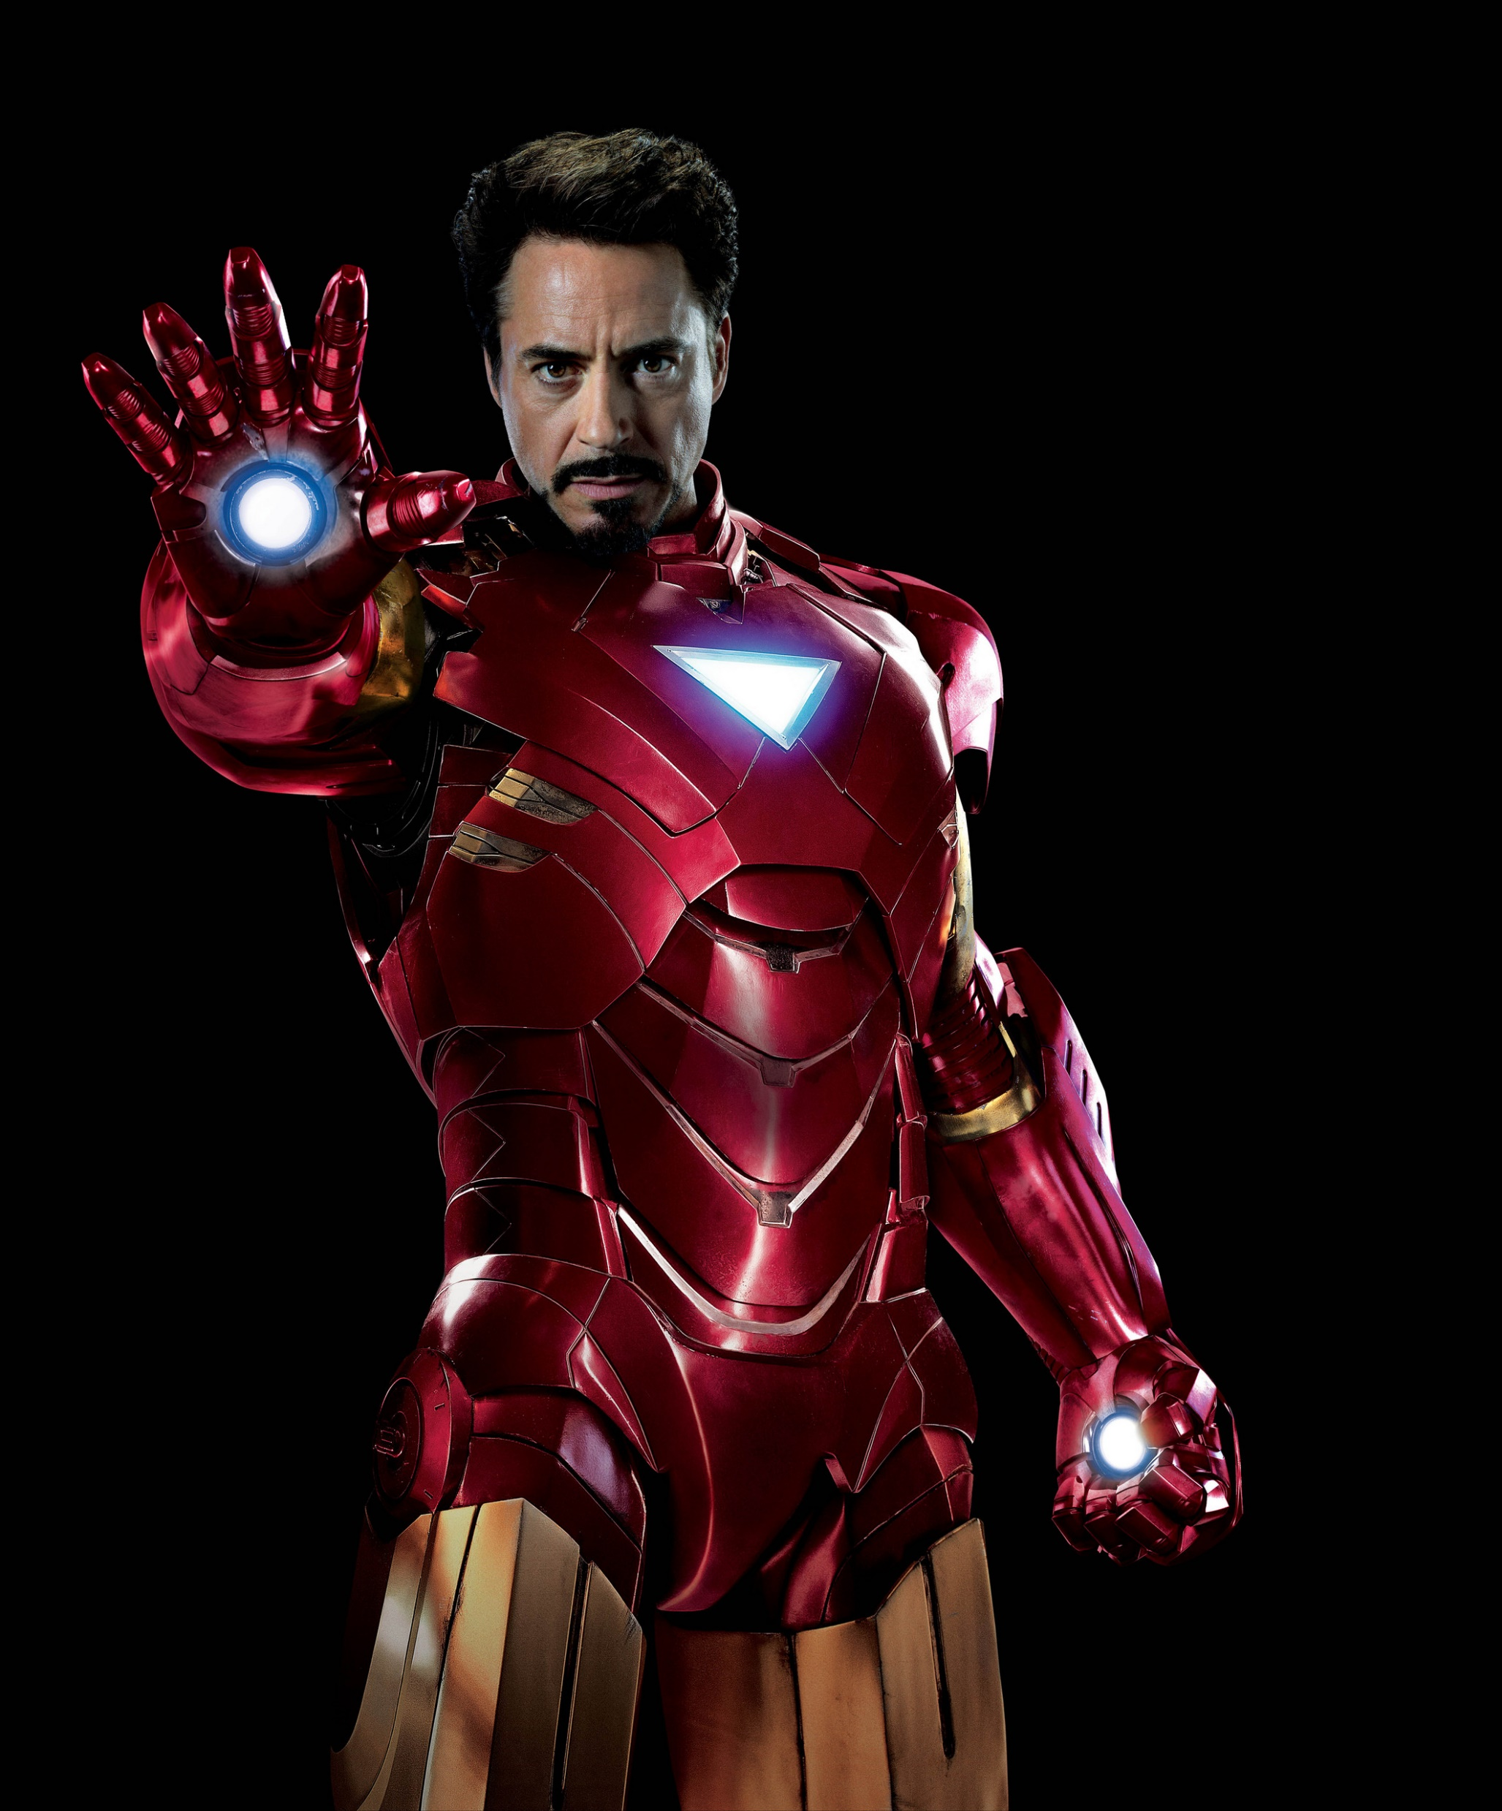
“Heroes are made by the paths they choose, not the powers they are graced with.” – Tony Stark

Slide 2
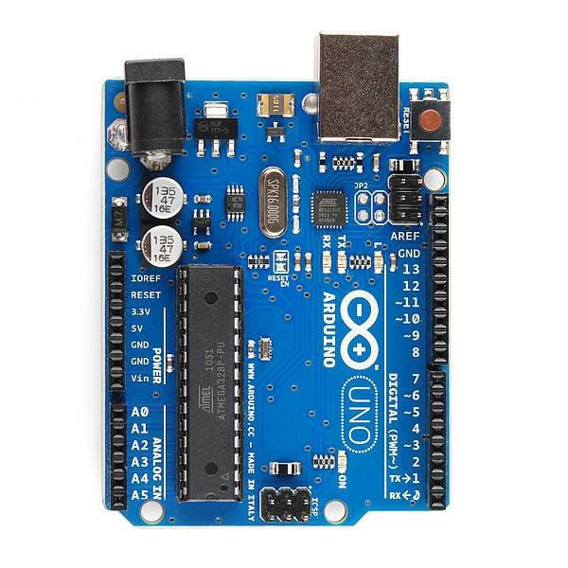
Notes:
Look up analog ref

Slide 3
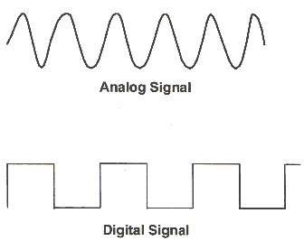
Concepts: Analog vs. Digital
Microcontrollers are digital devices – ON or OFF. Also called – discrete.
analog signals are anything that can be a full range of values. What are some examples? More on this later…
5 V
5 V
0 V
0 V

Slide 4
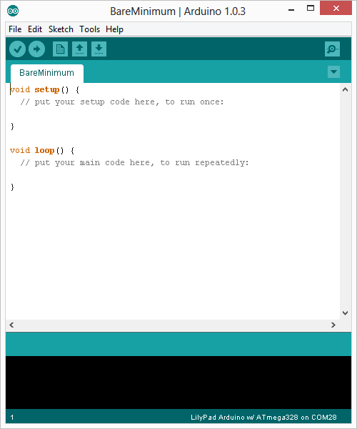
Arduino Integrated Development Environment (IDE)
Two required functions / methods / routines:
void setup()
{
// runs once
}
void loop()
{
// repeats
}
error & status messages
Notes:
Be sure to point out the what all of the buttons do.

Slide 5
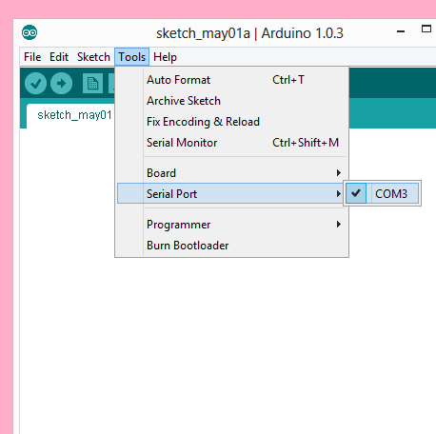
Settings: Tools → Serial Port
Your computer communicates to the Arduino microcontroller via a serial port → through a USB-Serial adapter.
Check to make sure that the drivers are properly installed.
Notes:
All connections to computers- mice, printers etc use a serial port. Gotta pick the right one.

Slide 6
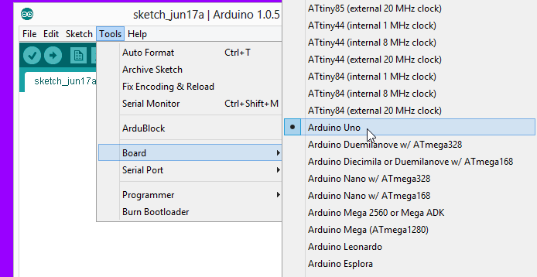
Settings: Tools → Board
Next, double-check that the proper board is selected under the Tools→Board menu.
Notes:
All connections to computers- mice, printers etc use a serial port. Gotta pick the right one.

Slide 7
Let’s get to coding…
Project #1 – Blink
“Hello World” of Physical Computing
Turn LED ON
Wait
Turn LED OFF
Wait
Rinse & Repeat

Slide 8
Comments, Comments, Comments
Comments are for you – the programmer and your friends…or anyone else human that might read your code.
// this is for single line comments
// it’s good to put a description at //the top and before anything ‘tricky’
/* this is for multi-line comments
Like this…
And this….
*/

Slide 9
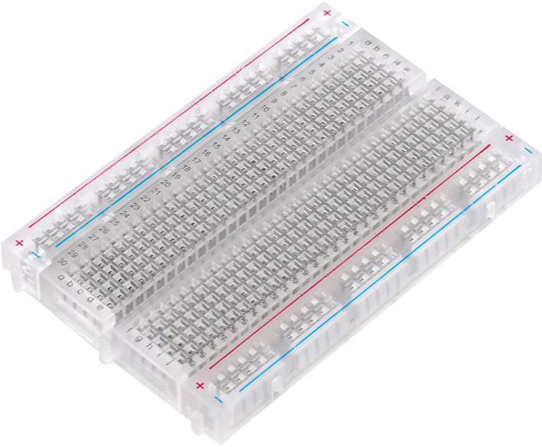
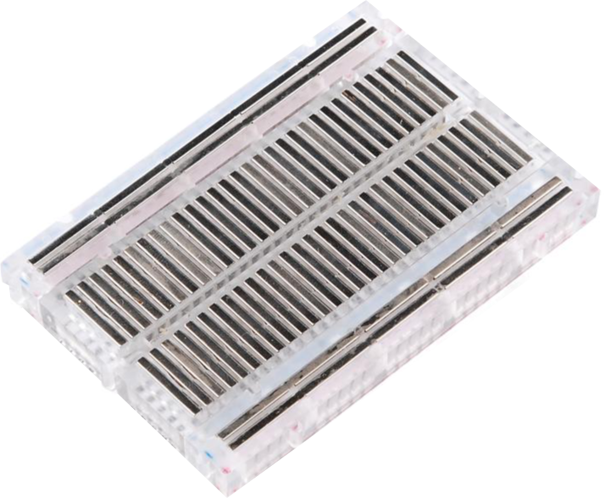
Breadboard

Slide 10
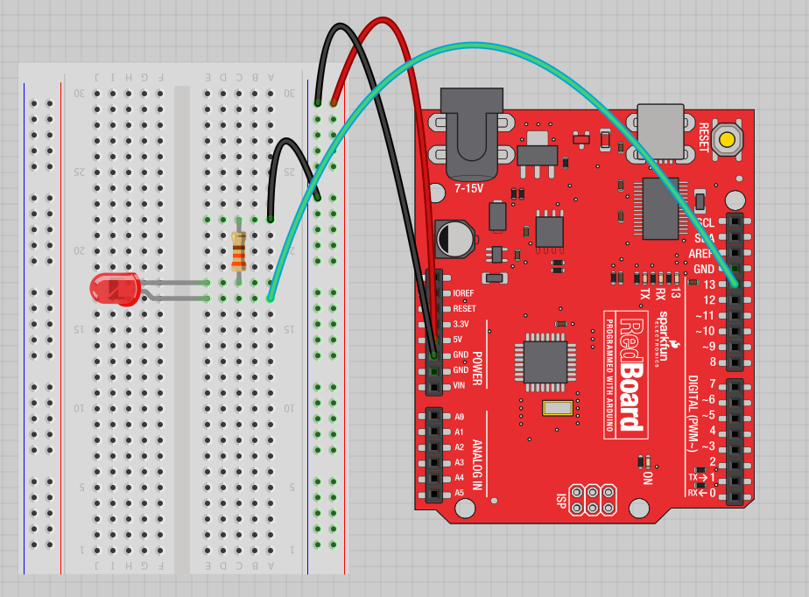
Project #1: Wiring Diagram
Image created in Fritzing

Slide 11
Three commands to know…
pinMode(pin, INPUT/OUTPUT);
ex: pinMode(13, OUTPUT);
digitalWrite(pin, HIGH/LOW);
ex: digitalWrite(13, HIGH);
delay(time_ms);
ex: delay(2500); //delay of 2.5 //sec.
// NOTE: -> commands are CASE-sensitive
Notes:
Three commands to rule the world… or at least do 80% of cool Arduino projects.

Slide 12
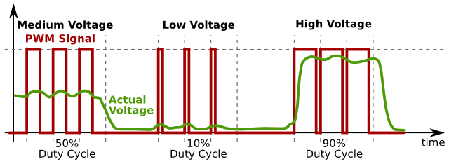
Concepts: Analog vs. Digital
To create an analog signal, the microcontroller uses a technique called PWM. By varying the duty cycle, we can mimic an “average” analog voltage.
Pulse Width Modulation (PWM)

Slide 13
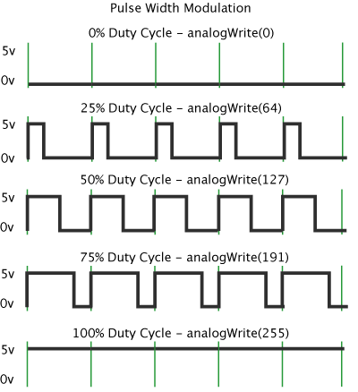
Project #2– Fading Introducing a new command…
analogWrite(pin, val);
pin – refers to the OUTPUT pin (limited to pins 3, 5, 6, 9, 10, 11.) – denoted by a ~ symbol
val – 8 bit value (0 – 255).
0 => 0V | 255 => 5V

Slide 14

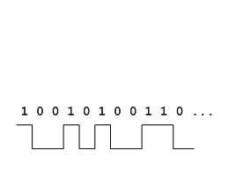
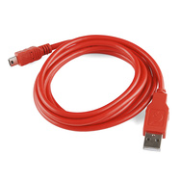
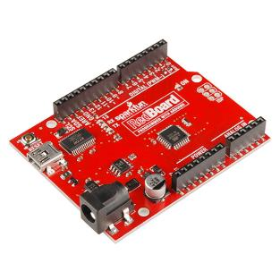
Using Serial Communication
Method used to transfer data between two devices.
Data passes between the computer and Arduino through the USB cable. Data is transmitted as zeros (‘0’) and ones (‘1’) sequentially.
Arduino dedicates Digital I/O pin # 0 to receiving and Digital I/O pin #1 to transmit.
Notes:
For this reason, we typically do not use Digital I/O 0 or 1 for anything in our designs.

Slide 15
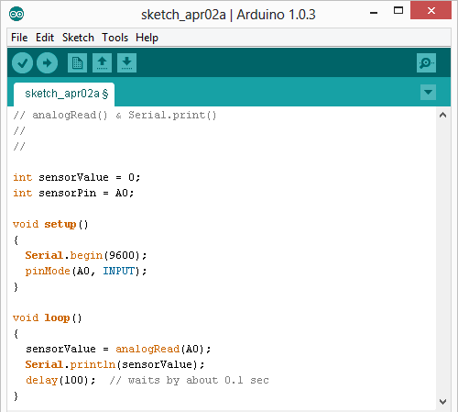
Serial Monitor & Serial Plotter
Initializes the Serial Communication
9600 baud data rate
prints data to serial bus

Slide 16
Serial Monitor & Serial Plotter
Opens up a Serial Terminal Window

Slide 17
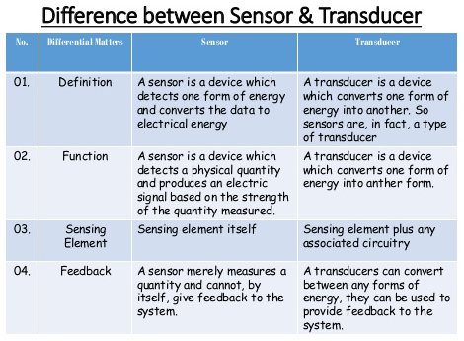
Sensor vs Transducer

Slide 18
Digital & Analog Sensors
Digital sensors are more straight forward than Analog
No matter what the sensor there are only two settings: On and Off
eg: PIR sensor, IR sensor, a Push Button.
The values of Analog sensors varies according to the resolution of sensor.
Signal is always in form of some analog voltage.
Eg. load cell, Hall Effect Sensors, Magnetic Sensors, Pressure Sensors, Load cell, Temperature Sensor, Solar Sensor, Humidity Sensor, Air Quality Sensor, Light Sensor, Rainfall Sensor, Soil moisture, Water Sensor

Slide 19
analogRead()
Arduino uses a 10-bit A/D Converter:
this means that you get input values from 0 to 1023
0 V → 0
5 V → 1023
Ex:
int sensorValue = analogRead(A0);

Slide 20
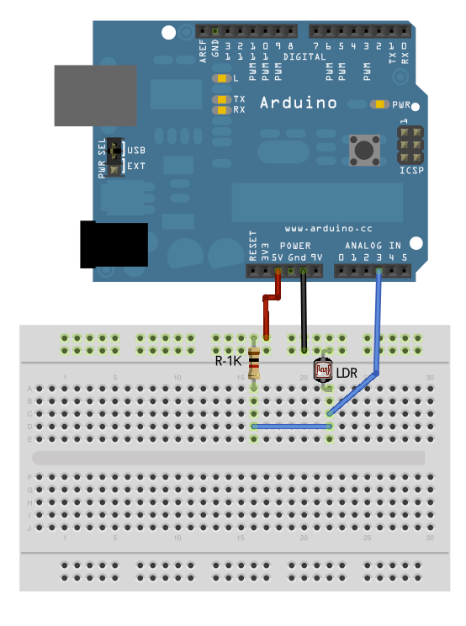
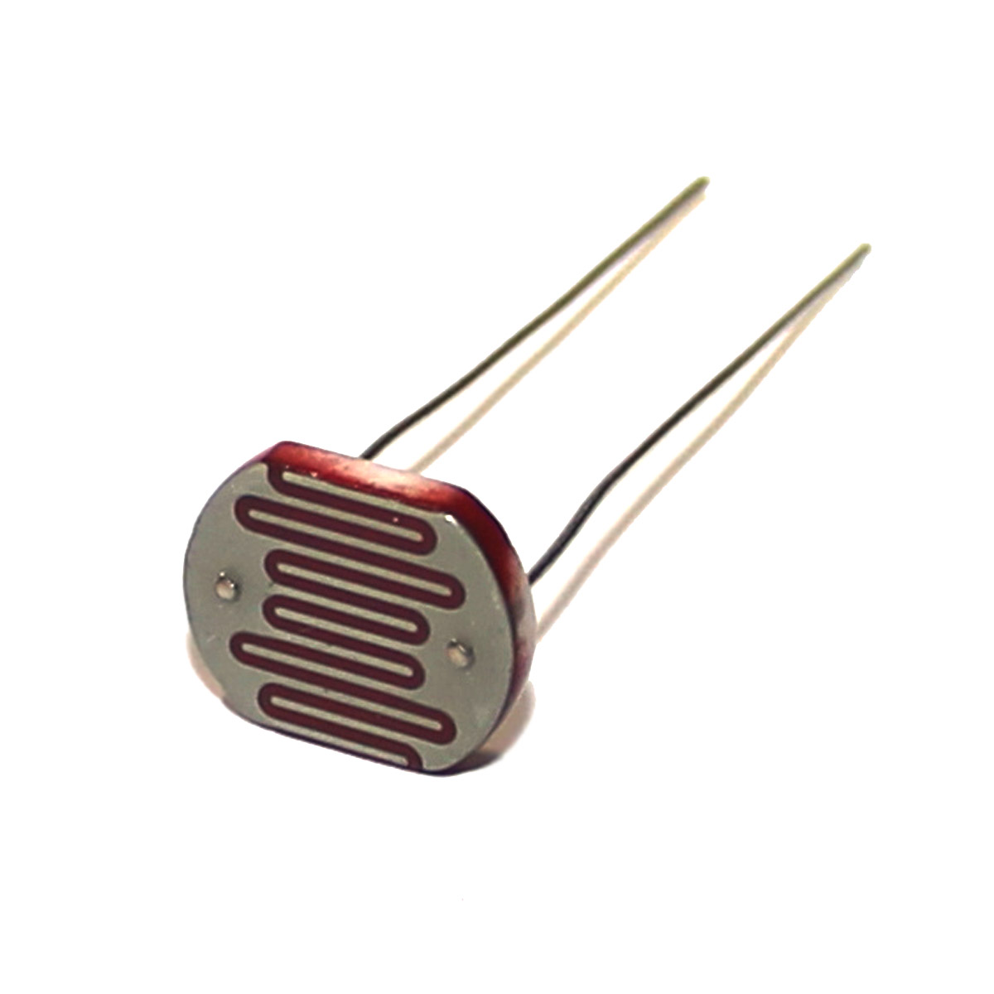
Project #3: Light Dependent Resistor [LDR]

Slide 21
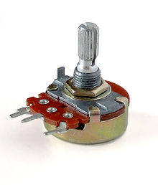
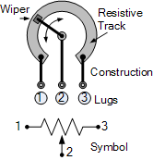
Potentiometer [Variable Resistor]

Slide 22
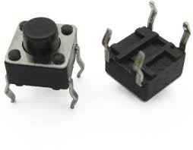
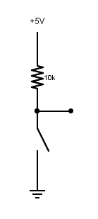
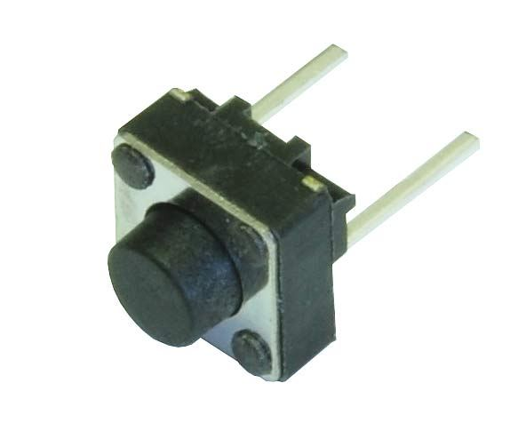
Push Button/ Tactile Switch
to Digital Pin 2

Slide 23
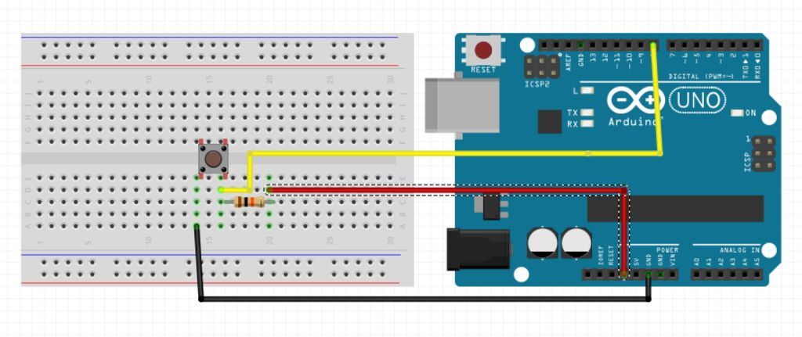
Project #4: Button Interfacing and concept of debouncing

Slide 24
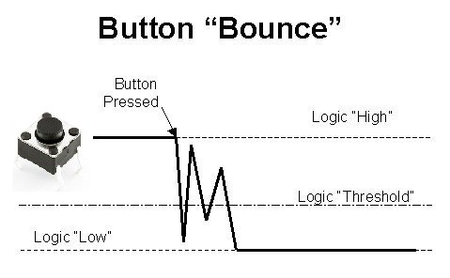
Concept of Debouncing

Slide 25
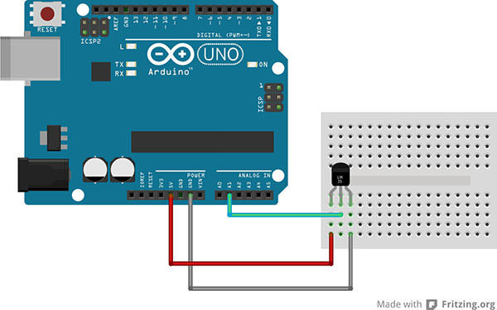
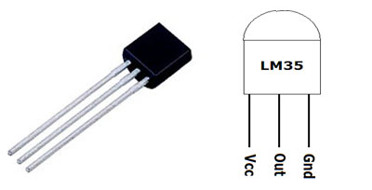
Project #5: Temperature Sensing

Slide 26
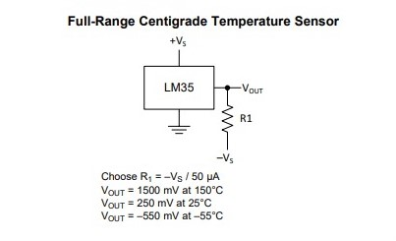

Slide 27

INTERRUPT INTERRUPT EVERYWHERE!

Slide 28
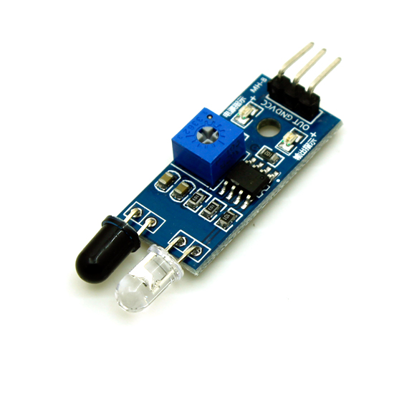
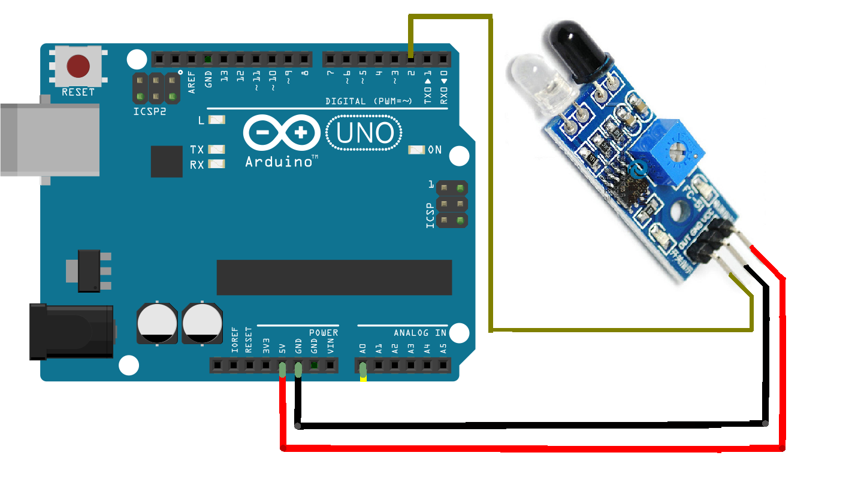
Project #6: Infrared Sensor interfacing

Slide 29
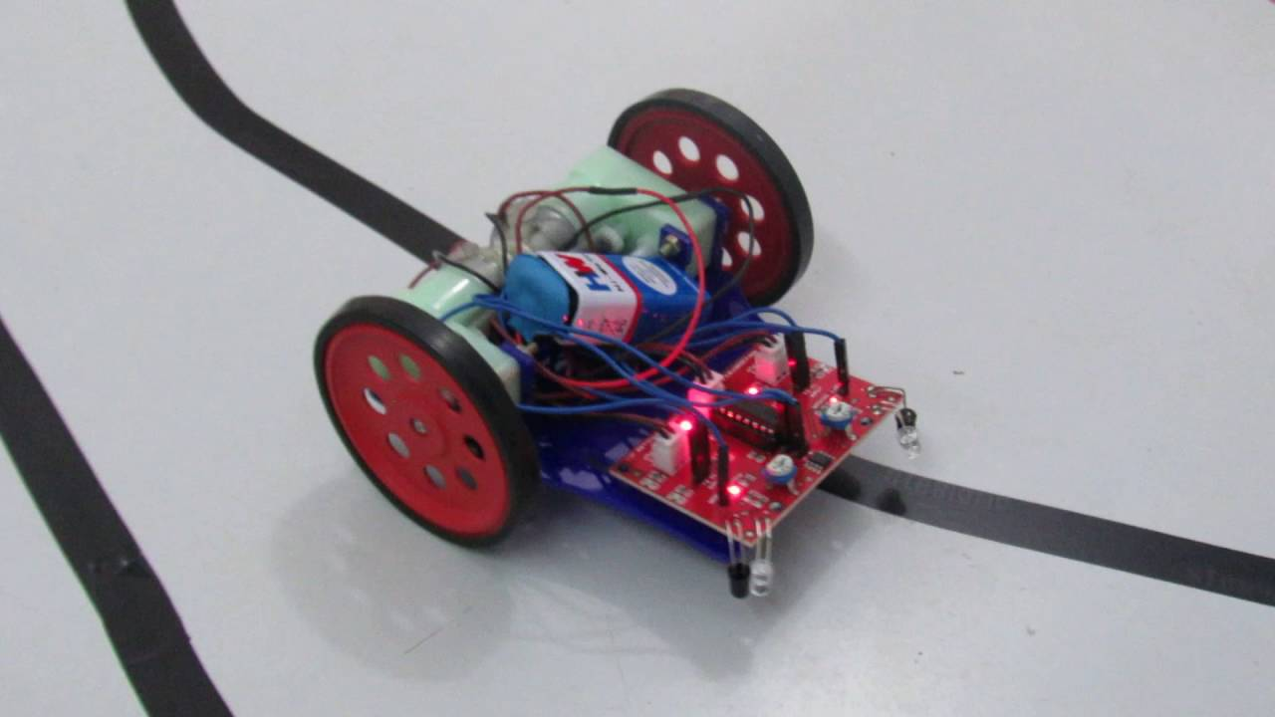
Infrared Sensor application

Slide 30
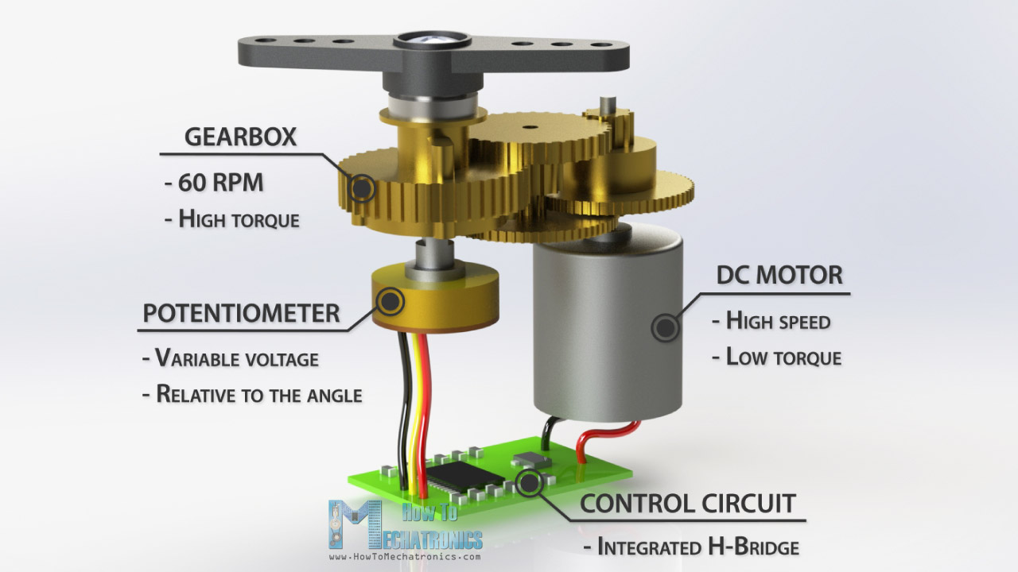
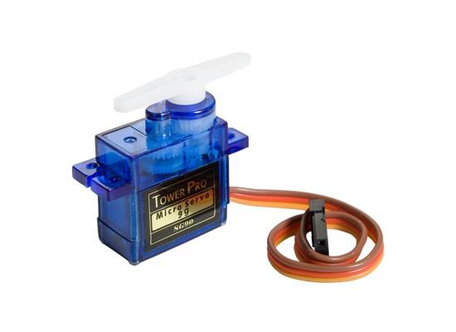
Project #7: Servo Motor [SG90]

Slide 31
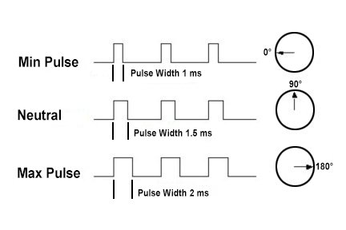
Working of Servo Motor [SG90]

Slide 32
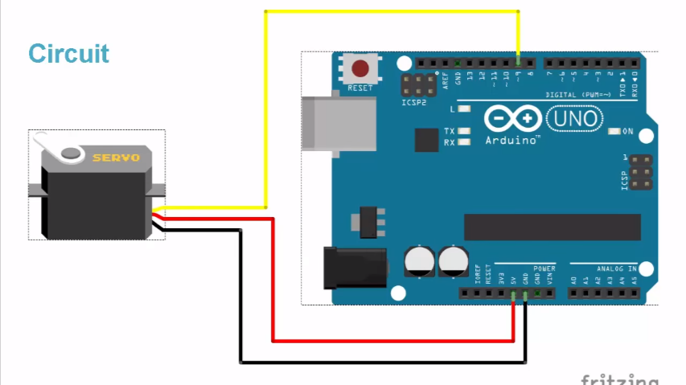
Servo Motor [SG90] Interfacing Diagram

Slide 33
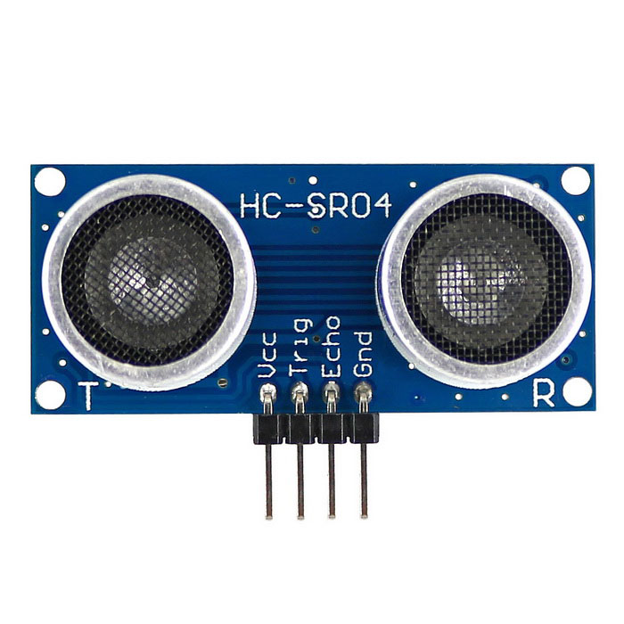
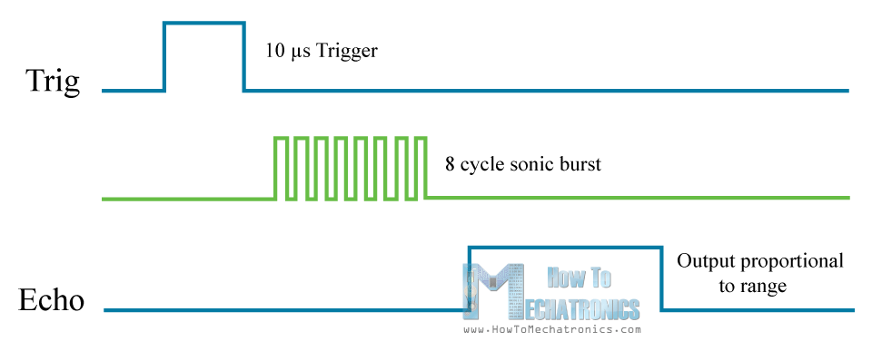
Ultrasonic Sensor

Slide 34
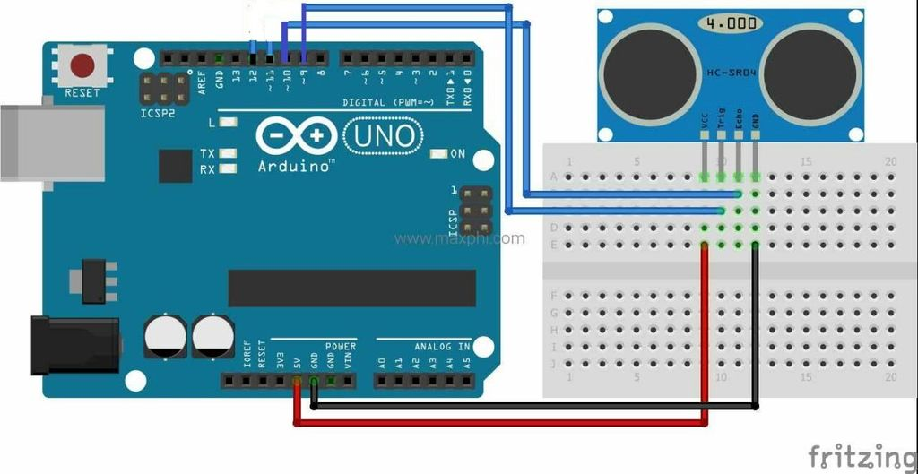
Ultrasonic Sensor interfacing with Arduino

Slide 35
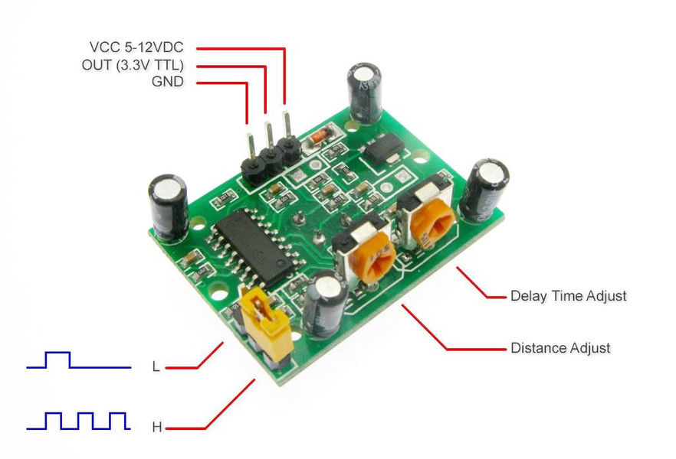
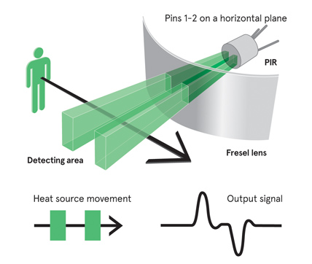
A Passive Infrared Sensor (PIR sensor)

Slide 36
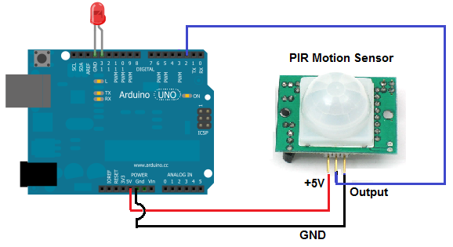
A Passive Infrared Sensor interfacing

Slide 37
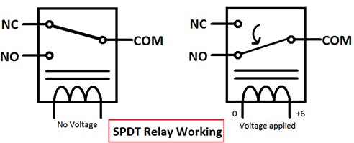
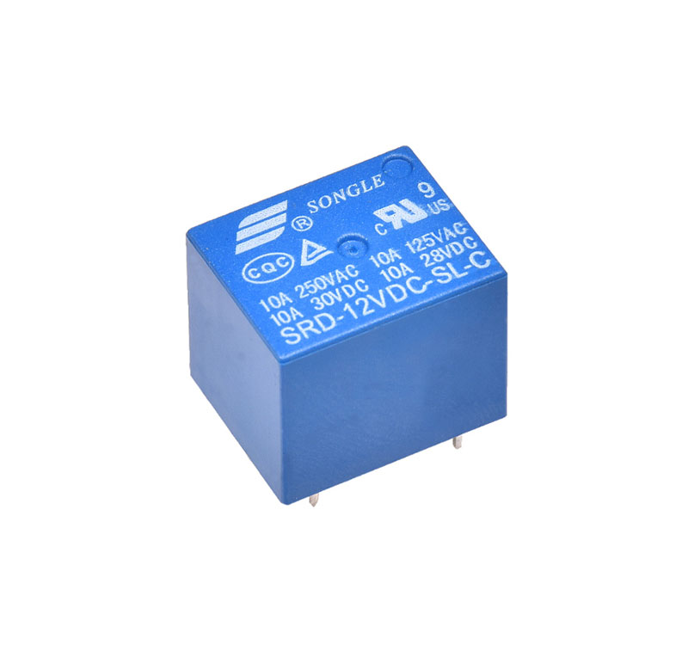
A Passive Infrared Sensor interfacing

Slide 38

Great Audience
“Heroes are made by the paths they choose, not the powers they are graced with.” – Tony Stark

