Slide 1
CHAPTER 24
  MRPP (Multi-response Permutation Procedures)
and Related Techniques
Tables, Figures, and Equations
From: McCune, B. & J. B. Grace. 2002. Analysis of Ecological Communities. MjM Software Design, Gleneden Beach, Oregon http://www.pcord.com

Slide 2
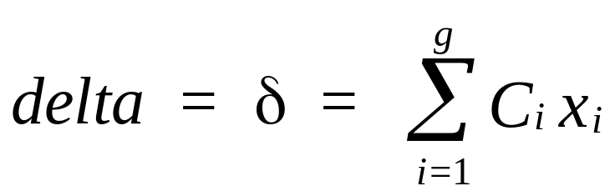
    How it works
1. Calculate distance matrix, D.
2. Calculate the average distance x_{i} within each group i.
3. Calculate delta (the weighted mean within-group distance)
for g groups, where C is a weight that depends on the number of items in the groups (normally C_{i} = n_{i} /N, where n_{i} is the number of items in group i and N is the total number of items).

Slide 3
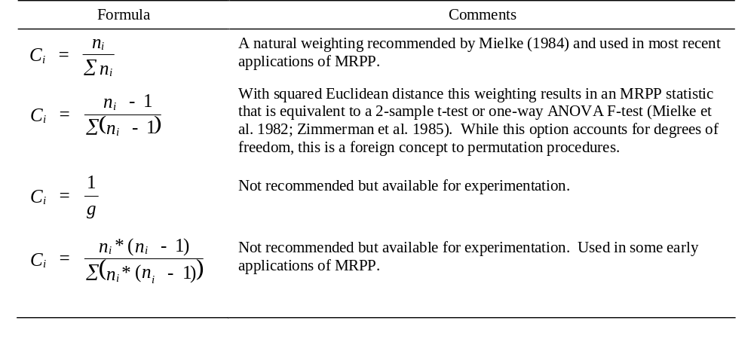
Table 24.1. Methods for weighting groups in MRPP.

Slide 4
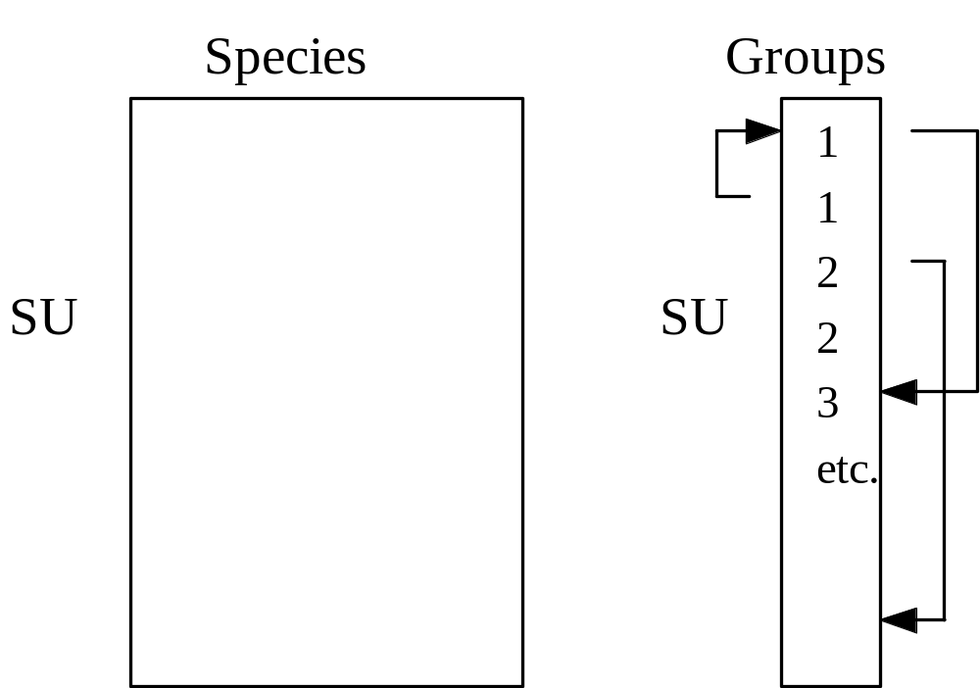
4. Determine probability of a δ this small or smaller.
The number of possible partitions (M) for two groups is
M = N!/(n₁! * n₂!)

Slide 5
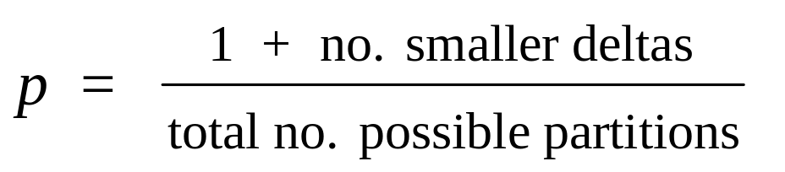
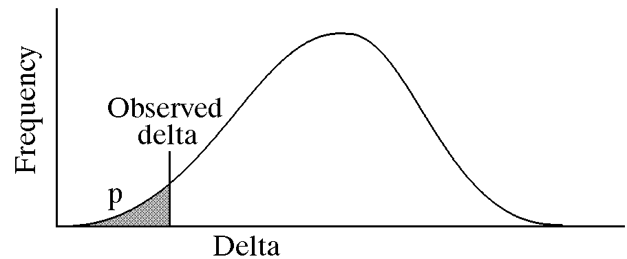
Proportion of these that have δ smaller than the observed δ:
Figure 24.2. Frequency distribution of delta under the null hypothesis, compared to the observed delta. The area under the curve less than the observed delta is the probability of type I error under the null hypo- thesis of no difference between groups.

Slide 6
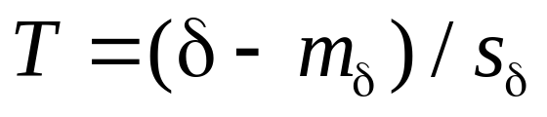
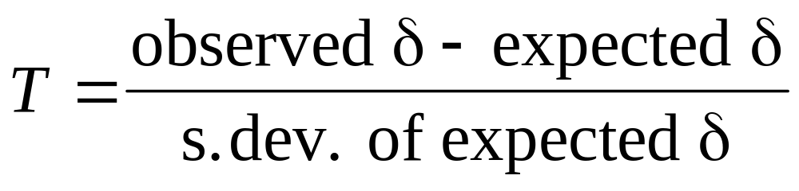
The test statistic, T is:
where m_{δ} and s_{δ} are the mean and standard deviation of δ under the null hypothesis.

Slide 7
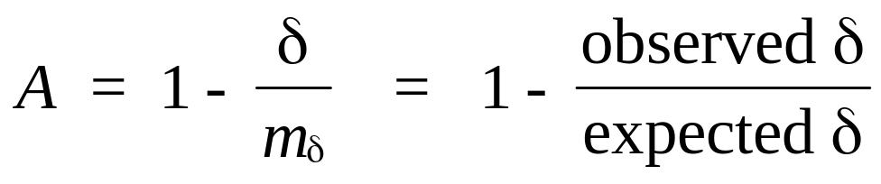
5. Calculate the effect size that is independent of the sample size. This is provided by the chance-corrected within-group agreement (A):

Slide 8
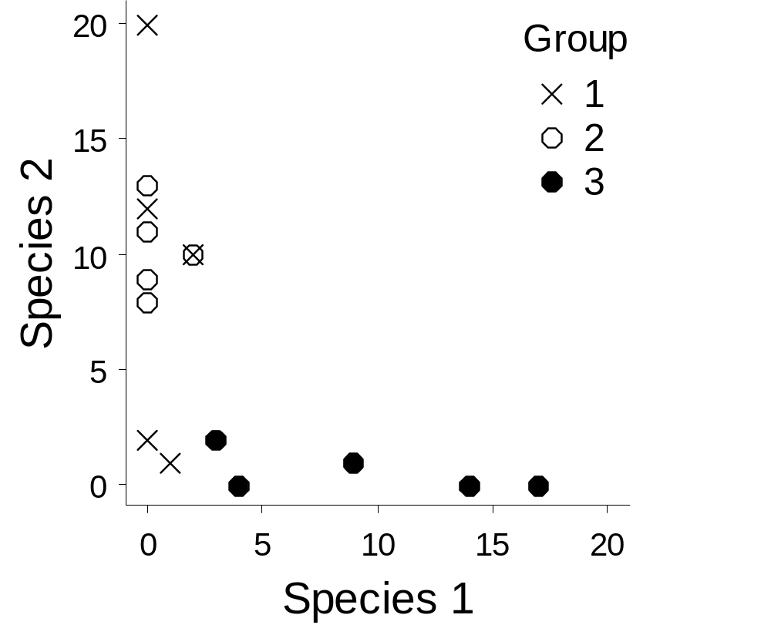
Figure 24.3. Fifteen sample units in species space, each sample unit assigned to one of three groups.

Slide 9
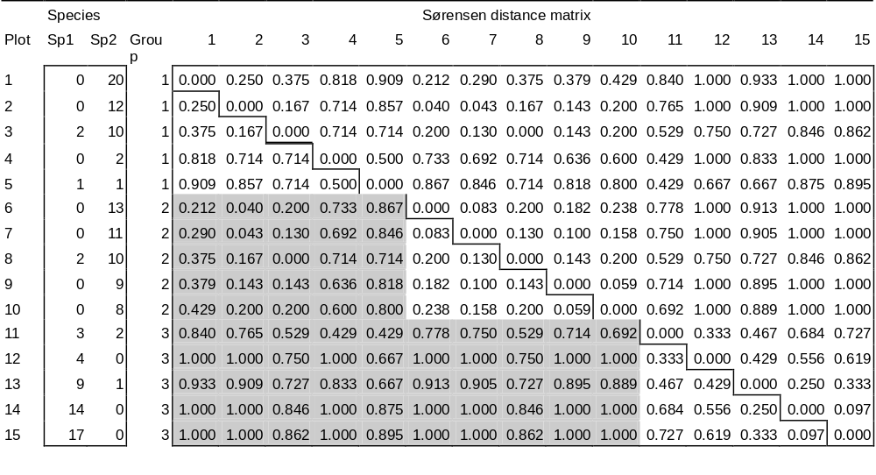
Table 24.2. A species data matrix of 15 plots by 2 species, their assignments to three groups, and Sørensen distances among plots. Shaded cells are between-group distances, ignored by MRPP.

Slide 10
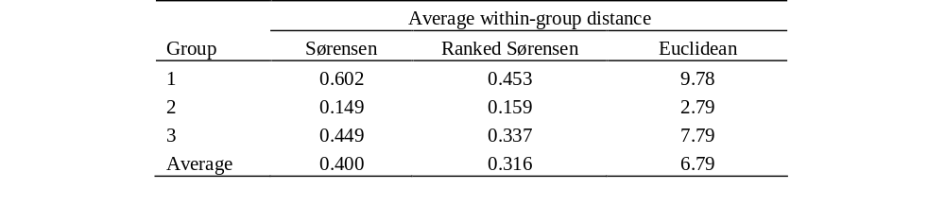
Table 24.3. Average within-group distance calculated from three different distance matrices. The average within-group distance is used as the test statistic.

Slide 11
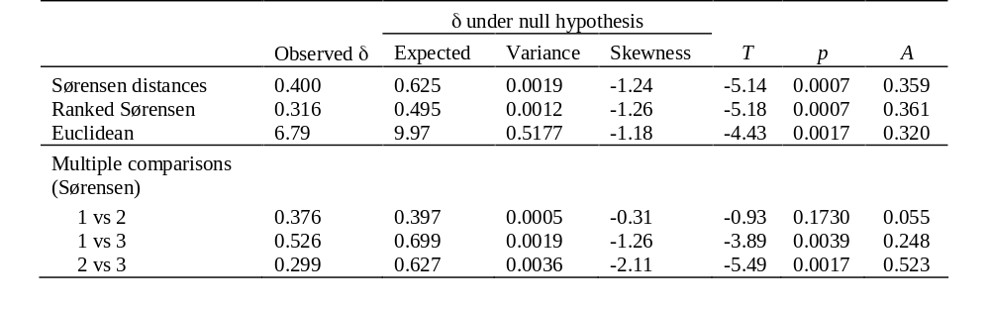
  Table 24.4. Summary statistics for MRPP of simple example. Results are given for three different distance matrices, comparing across all groups, as well as for multiple pairwise comparisons for the Sørensen distances. The pairwise comparisons were also made with MRPP.

Slide 12
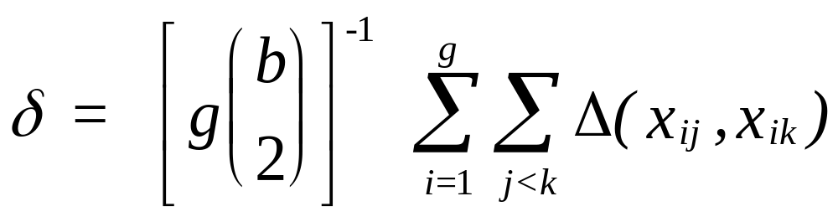
      Blocked MRPP (MRBP)
Given b blocks and g groups (treatments), the MRPP statistic is modified to:
where Δ(x,y) is the distance between points x and y in the p-dimensional space.
The combinatoric term is simply the number of items represented in the double summation.

Slide 13
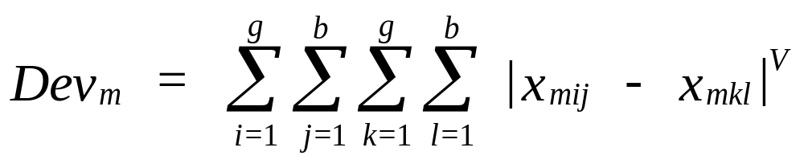
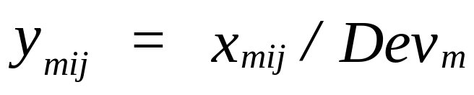
Average distance function commensuration. This option equalizes the contribution of each variable to the distance function. For each variable m the sum of deviations (Dev_{m}) is calculated:
V is set to 2 for squared Euclidean distance or 1 for Euclidean distance. Then each element x of the data matrix is divided by the sum of the deviations for the corresponding variable to produce the transformed value y:

Slide 14
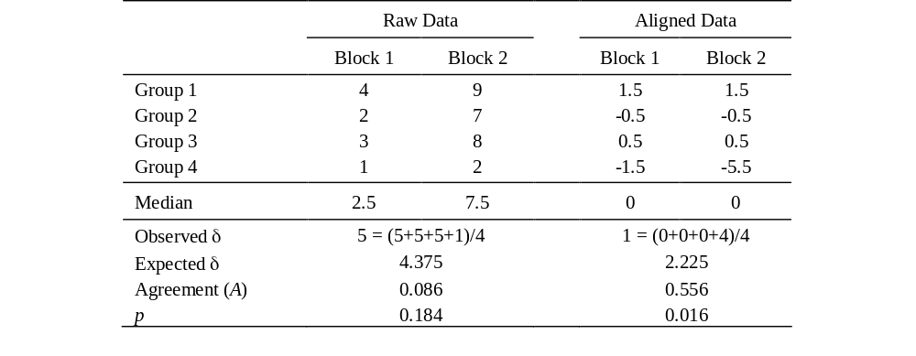
  Table 24.5. Example comparing results from raw data versus data aligned within blocks to zero as input to Blocked MRPP.

Slide 15
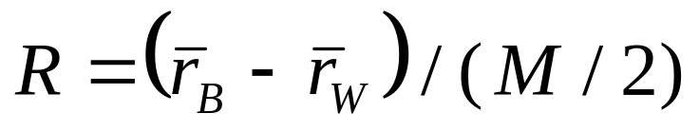
Analysis of similarity (ANOSIM)
Elements of a similarity matrix among all sample units are ranked. The highest similarity is given a rank of 1.
where:
  r_{B} = rank similarity for each between-group similarity
  r_{W} = rank similarity for each within-group similarity
  M = n(n-1)/2
  n = the total number of sample units
The denominator constrains R to the range -1 to 1.
Positive values indicate differences among groups.

Slide 16
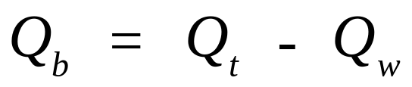
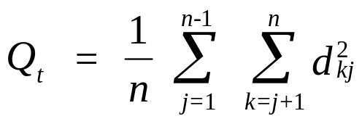
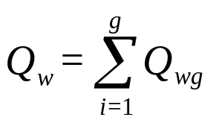
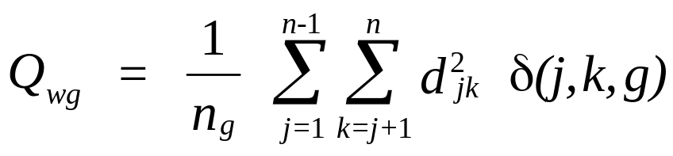
The Q_{b} method
The test criterion is the sum of the squared distances between groups:
The total sum of squares (Q_{t}) is based on one triangle of the distance matrix, the triangle having n(n-1)/2 terms, each term being a squared distance between two entities j and k:
The within-group sum of squares Q_{wg} is summed across all g groups:
where

Slide 17
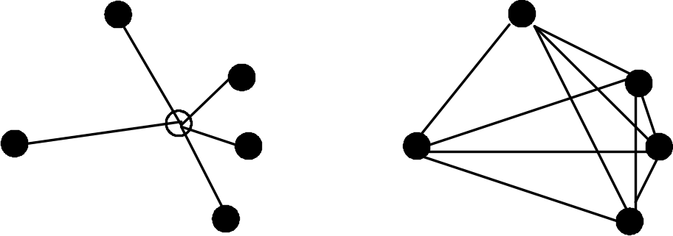
NPMANOVA (= perMANOVA)
Figure 24.4. The sum of squared distances from points to the centroid (left) can be calculated from the average squared interpoint distance (right).

Slide 18
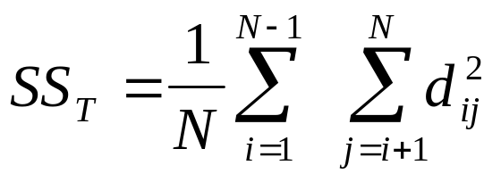
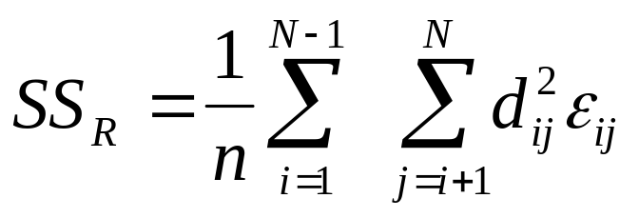
The total sum of squares of a distance matrix D with N rows and N columns is
The residual (within-group) sum of squares for a one-way classification is
where n is the number of observations per group, N is the number of sample units, and ε_{ij} =1 if i and j are in the same group, but ε_{ij} =0 if in different groups.

Slide 19
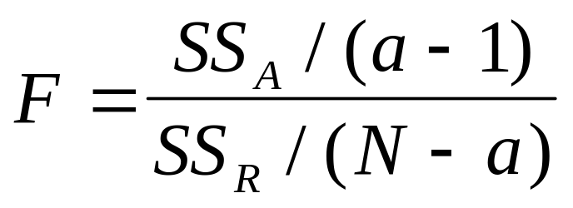
The sum of squares between groups is then
      SS_{A} = SS_{T} - SS_{R}
so we can calculate a pseudo-F-ratio:
where a is the number of groups. If the distance matrix contains Euclidean distances, then this gives the traditional parametric univariate F ratio.

Slide 20
For a two-factor design (say factors A and B), one calculates the following terms:
  SS_{A} = within-group sum of squares for A, ignoring any influence of B
  SS_{B} = within-group sum of squares for B, ignoring any influence of A
  SS_{R} = residual sum of squares, pooling the sum of squares within groups defined by each of the combinations of factors A and B
  SS_{AB} = interaction sum of squares for AB, by subtraction:
  SS_{AB} = SS_{T} - SS_{A} - SS_{B} - SS_{R}
If factor B is nested within A, then
SS_{B(A)} = SS_{T} - SS_{A} - SS_{R}
and there is no interaction term.

