Slide 1

Mariusz – Michael – Joerg

Slide 2
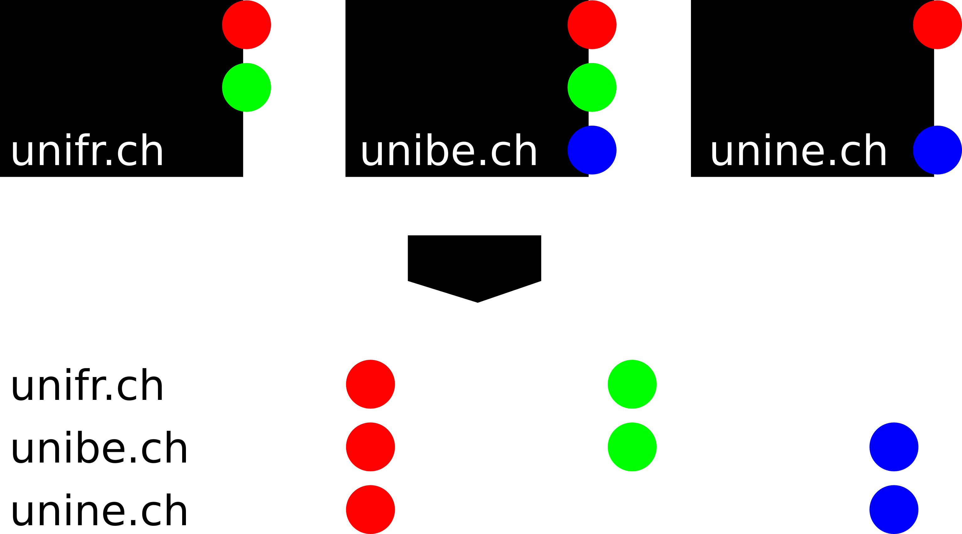
Technology

Slide 3
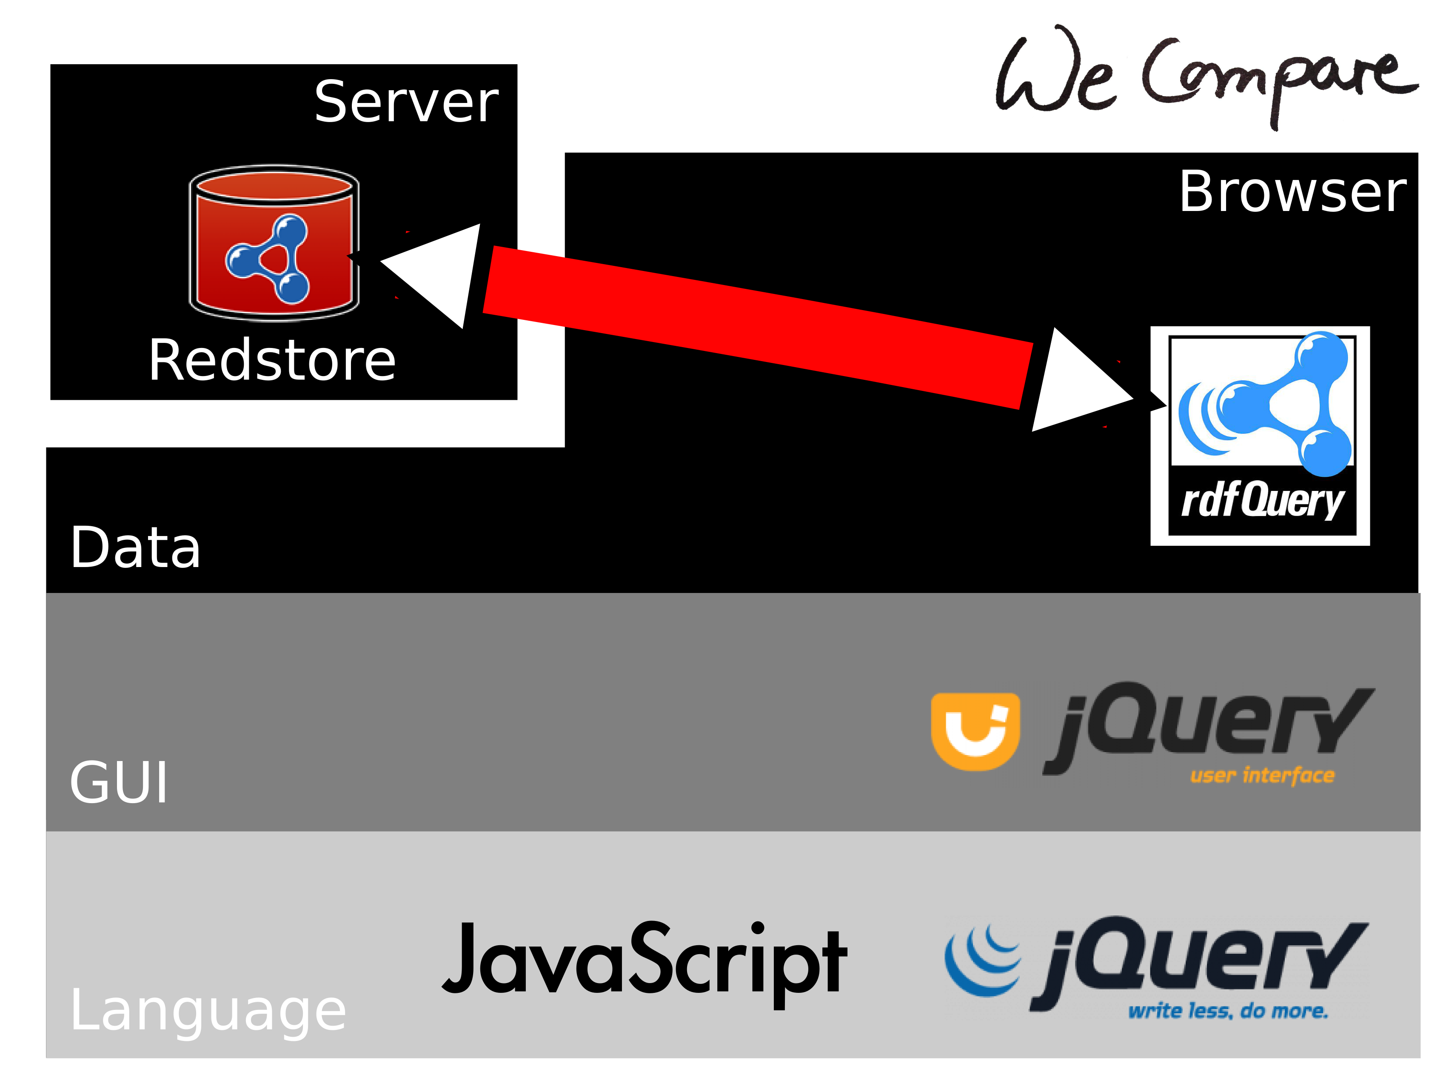
Technology
www.WeCompare.ch

Slide 4
Demo
www.WeCompare.ch

Slide 5
WeLearned
Java Script
HTML
Apache
GIT
www.WeCompare.ch

Slide 6
User Stats

