Slide 1
Lending Club Case Study by Pranav and Kam
The purpose of this case study is to provide practical industry experience in addressing real-world business challenges through Exploratory Data Analysis (EDA). Beyond utilizing EDA techniques, this study also aims to build a foundational understanding of Risk Analytics within the Banking and Financial Services sector, demonstrating how data is leveraged to reduce the risk of financial losses when extending credit to customers.

Slide 2
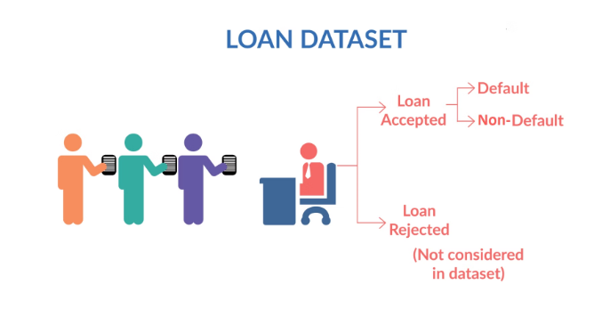
Loan Dataset
This case study is based on a consumer finance company specializing in providing various types of loans to urban customers. When a loan application is submitted, the company must decide whether to approve it by evaluating the applicant's profile. This decision involves two key risks associated with the bank's choice:
Risk of Default
If the applicant is likely to repay the loan, then not approving the loan results in a loss of business to the company
Risk of Lost Business
If the applicant is not likely to repay the loan, i.e. he/she is likely to default, then approving
the loan may lead to a financial loss for the company

Slide 3

Data Cleaning: Preparing for Analysis
1
2
3
Removed variables not
available at the time of application.
Removed columns with only one value or high null values.
Dropped columns with high correlation to other columns.

Slide 4
Grade

Slide 5
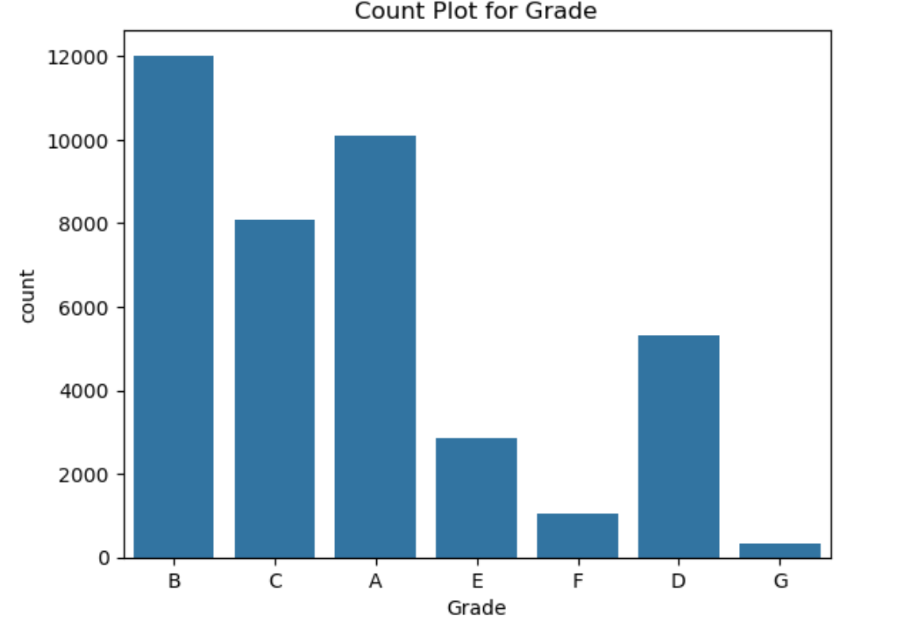
Univariate Analysis

Slide 6
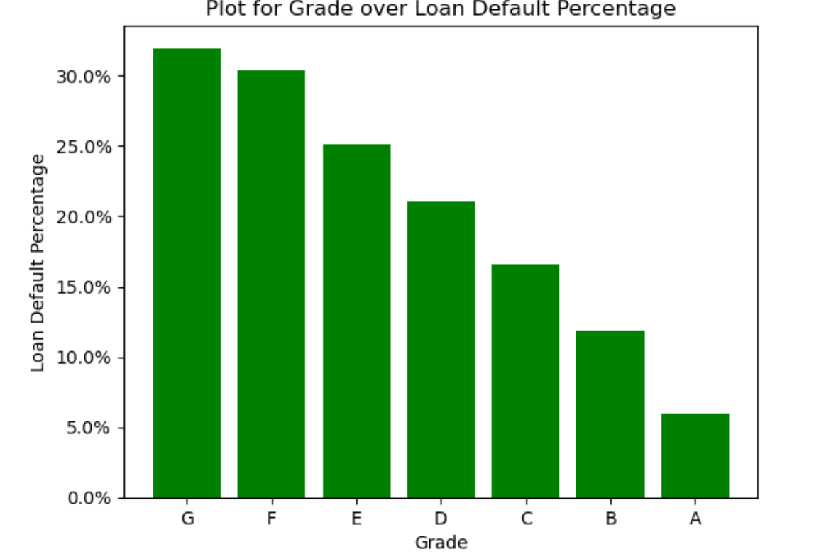
Bivariate Analysis with ‘Loan Status’

Slide 7
Conclusion
Lower Grade participant will more likely to Default on Loan than Higher Grade Participant

Slide 8
Interest Rate

Slide 9
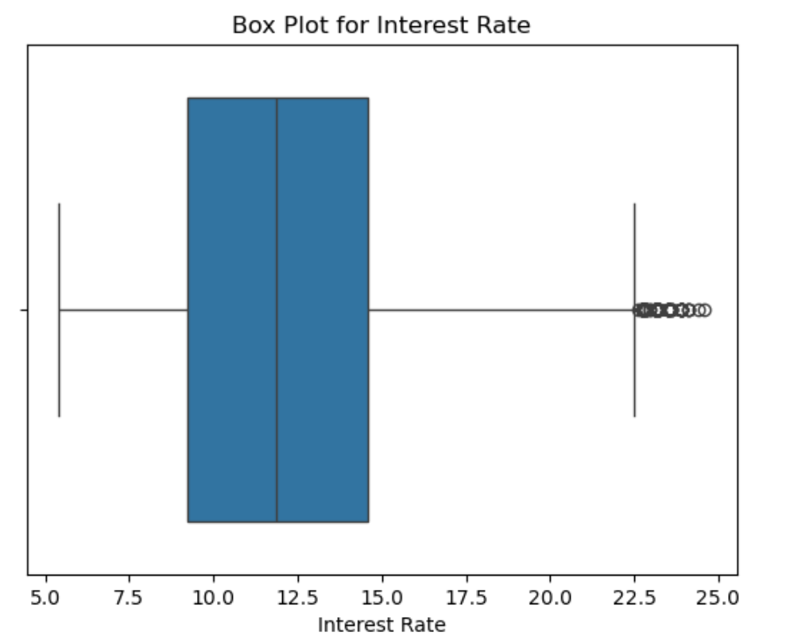
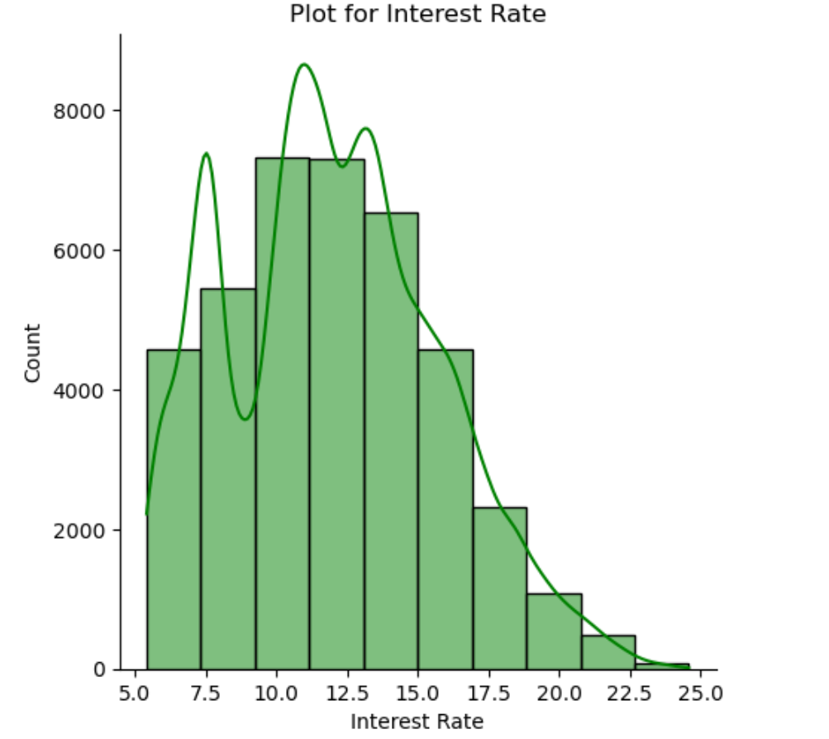
Univariate Analysis

Slide 10
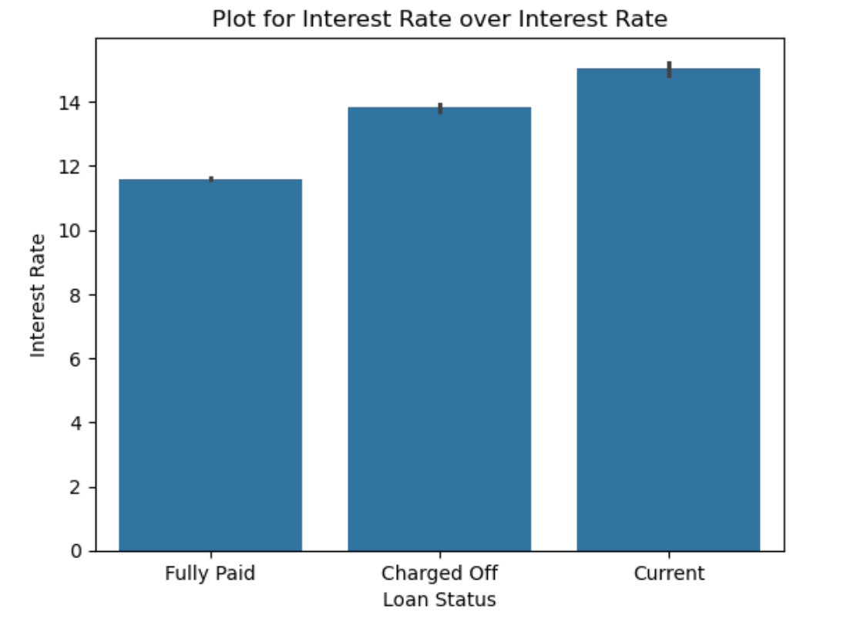
Bivariate Analysis with ‘Loan Status’

Slide 11
Conclusion
Loans with Lower Interest Rate are more likely to be Fully Paid than that of Higher Interest Rate

Slide 12
Loan Purpose

Slide 13
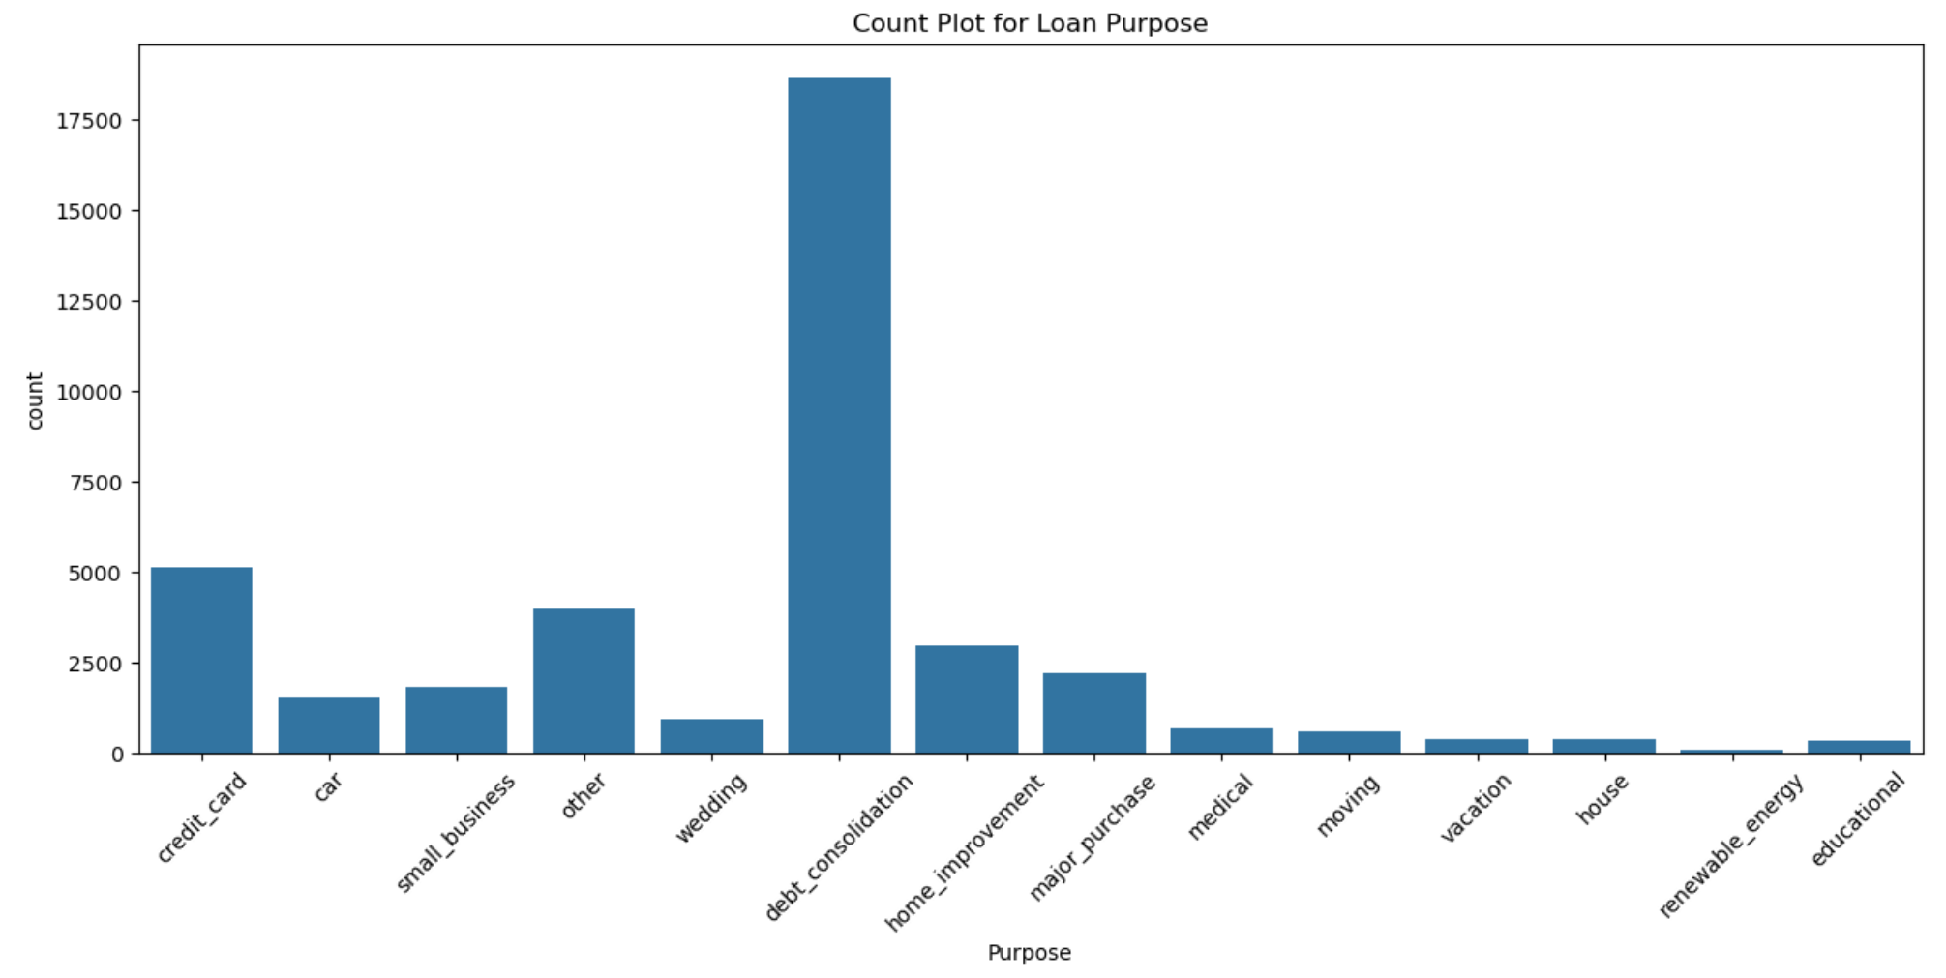
Univariate Analysis

Slide 14
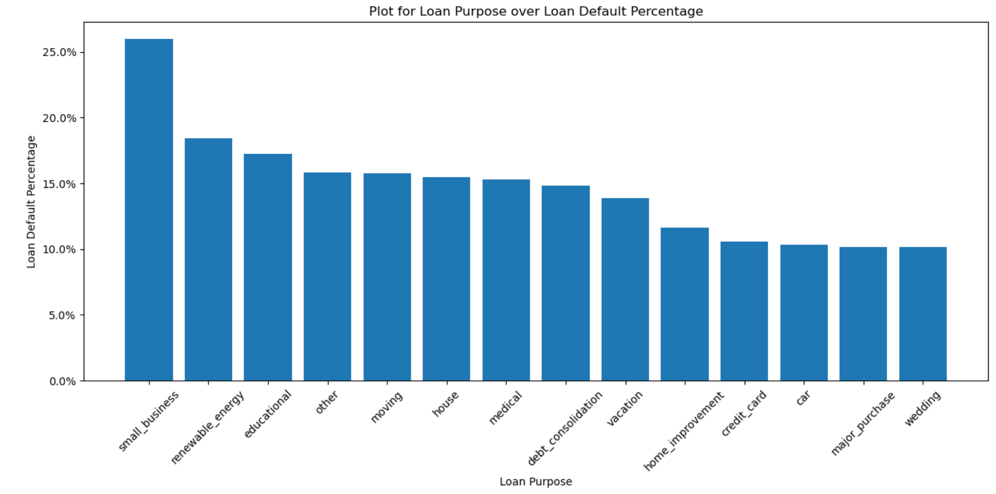
Bivariate Analysis with ‘Loan Status’

Slide 15
Conclusion
Small Businesses are more likely to Default on Loans.

Slide 16
Loan Term

Slide 17
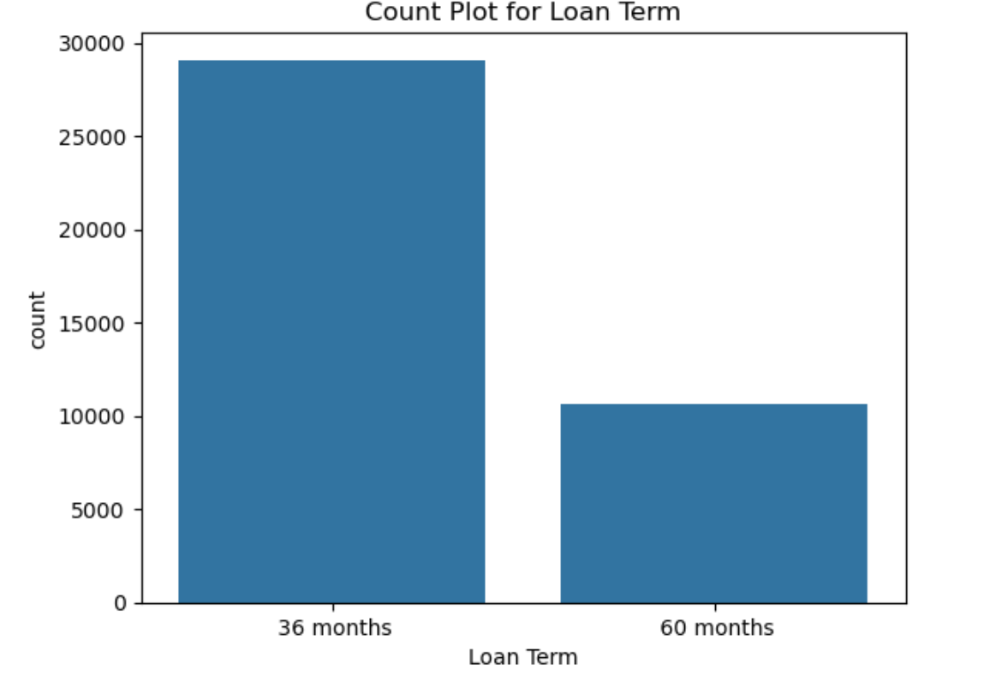
Univariate Analysis

Slide 18
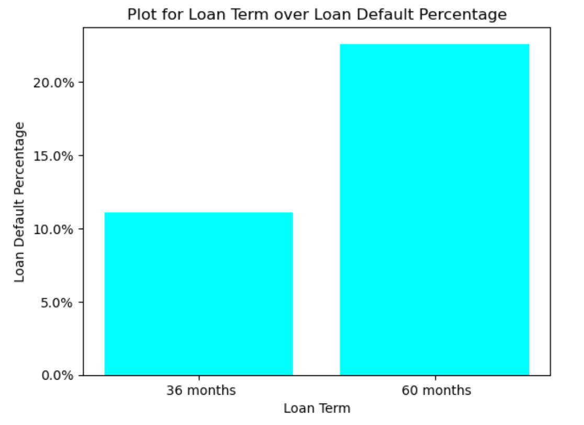
Bivariate Analysis with ‘Loan Status’

Slide 19
Conclusion
Applicant is more likely to default Long Term Loan than Short Term Loan

Slide 20
Last Payment Date

Slide 21
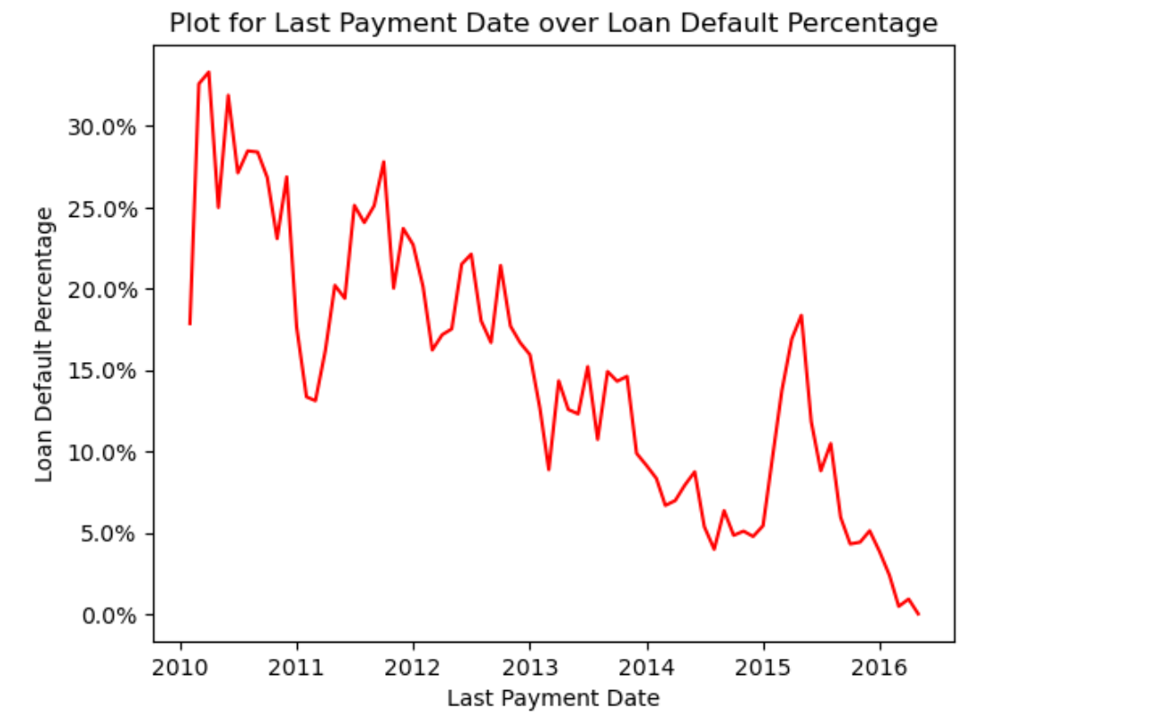
Bivariate Analysis with ‘Loan Status’

Slide 22
Conclusion
Loan applicant having Last Payment Date in more past will more likely to default than the one who made Payment in recent date

Slide 23
Insights and Observations
Higher interest rates correlate with higher default rates.
Lower grades (e.g., C, D, E) show significantly higher proportions of defaults.
Longer loan terms (60 months) have higher default rates compared to 36-month terms.
Small Businesses are more likely to Default on Loans.
Loan applicant having Last Payment Date in more past will more likely to default than the one who made Payment in recent date.
Applicant having more Inquiries in past 6 months is slightly more likely to Default on Loan than those with lesser inquiries.

Slide 24
Recommendations
Focus on granting loans to applicants with higher grades (A, B).
Increase interest rates for applicants with lower grades to mitigate risk.
Limit loans with 60-month terms for high-risk applicants.
Limit loans to Small Businesses.
Give priority to Applicant who recently paid off his/her debt.
Grant loans to Applicants having lesser inquiries over the ones having higher inquiries.

Slide 25
Group Facilitator: Pranav Ojale
Email ID: pranavojale@gmail.com
Phone no: +91 98690 39585
Team Member: Kam Soon Cheng
Email ID: kamlovemath@gmail.com
Phone No: +6013-3527252

