Slide 1
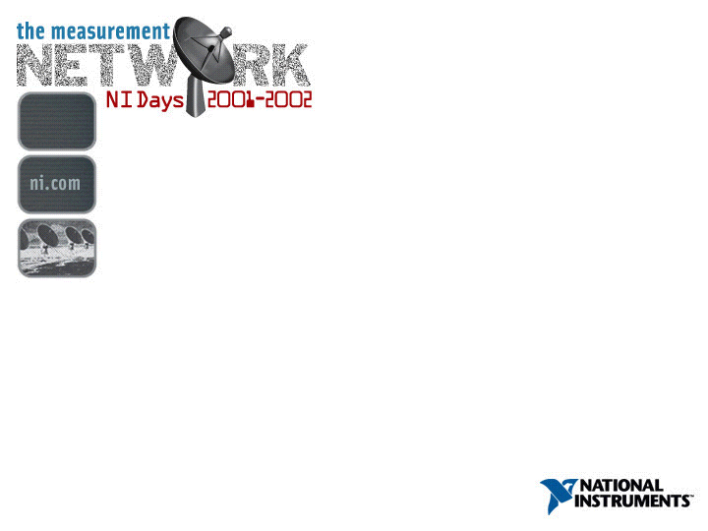
Accessing Data in a Distributed Measurement System
Accessing Data in a Distributed Measurement System
NI Days 2001

Slide 2

Topics of Discussion
Why use a Distributed Measurement System
Networking 101
Programming a Distributed System
FieldPoint™ 2000

Slide 3
Why Distribute a Measurement System?
Data sources are physically distributed or in hazardous areas
To share measurement systems between users in different locations
Utilize existing local networks or the Internet

Slide 4
Networking 101
Ethernet
  Addressing
  Hubs and switches
TCP/IP
  Addressing
  Subnets
  UDP and TCP

Slide 5
Protocol Stack
Application
Has data to send to another network node
(LabVIEW™, Netscape, FTP, DataSocket, etc.)
Transport
Splits data into packets, and manages the
connection
Network
Adds addressing for switching and routing
Data link
Adds error detection, flow control, and
physical addressing
Physical
Transmits data over the medium
(fiber, twisted pair, RF, etc.)
Notes:
The Network stack consists of multiple layers of communication between network partners. The stack can be represented as several different models including the ISO OSI model (7 layers) and the Internet model (4 layers). For the purpose of this presentation, a 5 layer model is used:
Physical Layer – covers the physical interface between a data transmission device and a transmission medium and the rules by which bits are passed from one to the other. It is a raw bit stream service.
Data Link Layer – attempts to make the physical link reliable and provides the means to activate, maintain, and deactivate the link. The main service to higher layers is that of error detection and control; allowing the next higher layer to assume error-free transmission over the link.
Network Layer – provides for the transfer of information between computers across a communication network. It is responsible for establishing, maintaining, and terminating connections across the network. It relieves higher layers of the need to know anything about the underlying data transmission and switching technologies used to connect systems.
Transport Layer – provides a reliable mechanism for the exchange of data between computers. It ensures that data are delivered error-free, in sequence, with no losses or duplications. It may also be concerned with optimizing the use of network services and providing a requested quality of service.
Application Layer – provides means for application programs to access the network environment. This layer contains management functions and generally useful mechanisms to support distributed applications. In addition, general purpose applications such as file transfer, electronic mail, and terminal access to remote computers are considered to reside at this layer.

Slide 6
Protocol Layers
Application
Application
Transport
Transport
TCP
TCP
Network
Network
IP
IP
Data link
Data link
Ethernet
Ethernet
Physical
Physical
Network node 1
Network node 2
Notes:
The Network stack consists of multiple layers of communication between network partners. The stack can be represented as several different models including the ISO OSI model (7 layers) and the Internet model (4 layers). For the purpose of this presentation, a 5 layer model is used:
Physical Layer – covers the physical interface between a data transmission device and a transmission medium and the rules by which bits are passed from one to the other. It is a raw bit stream service.
Data Link Layer – attempts to make the physical link reliable and provides the means to activate, maintain, and deactivate the link. The main service to higher layers is that of error detection and control; allowing the next higher layer to assume error-free transmission over the link.
Network Layer – provides for the transfer of information between computers across a communication network. It is responsible for establishing, maintaining, and terminating connections across the network. It relieves higher layers of the need to know anything about the underlying data transmission and switching technologies used to connect systems.
Transport Layer – provides a reliable mechanism for the exchange of data between computers. It ensures that data are delivered error-free, in sequence, with no losses or duplications. It may also be concerned with optimizing the use of network services and providing a requested quality of service.
Application Layer – provides means for application programs to access the network environment. This layer contains management functions and generally useful mechanisms to support distributed applications. In addition, general purpose applications such as file transfer, electronic mail, and terminal access to remote computers are considered to reside at this layer.

Slide 7
Ethernet
Ethernet is a physical carrier
Devices all talk in a shared “Ether”
10 Mbps, 100 Mbps and 1 Gbps
Each device has a unique MAC Address
Standard on most PCs and in many facilities
Low cost

Slide 8
TCP/IP
The protocols behind the Internet
IP
  Internet Protocol
  The “Postal Service” of the internet
  Transports packets from point A to point B
TCP and UDP
  Protocols for applications to communicate across the network
  Both use IP for actual delivery of messages

Slide 9
IP Addressing
Each (visible) IP device has a unique IP address
  ni.com is 130.164.140.26
An address is a 4 byte number
  More devices than available IP addresses
  IPv6 introduces 16 byte addresses
IP assignment
  Static. User assigns address
  Dynamic. Done automatically by DHCP server
Domain Name Server (DNS)
  Resolves names to IP addresses

Slide 10
Subnets
A subnet is a logical grouping of IP nodes
Defined by a subnet mask
A router enforces the subnet
Broadcast messages usually remain within a subnet
Example
  A subnet mask of 255.255.255.0
Inside subnet
  130.164.44.2
  130.164.44.123
  130.164.44.10
Outside subnet
  130.164.45.2
  130.165.44.2
  135.164.44.2

Slide 11

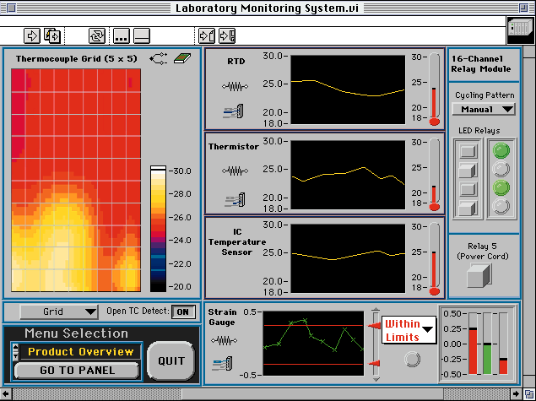

Hubs, Switches and Routers
Application
Transport
Network
Data Link
Physical
Router
Subnet 1
Subnet 2
Subnet 3
Hub
Hub
Switch
N
N
N
Local Traffic
N
N
Notes:
This slide illustrates the difference between a hub, a switch and a router. The color of each device shows where in the protocol stack the device operates.
A Hub works at the physical layer. Think of a hub as an Ethernet dumb extension cord. A message originating from a device connected to a hub is sent to all other devices attached to it.
A switch will route a message based on the Ethernet MAC (Medium Access Control) address of the destination packet and only forward packets destined for the upper part of the network. By using a hub you can isolate local traffic to a group of devices and make Ethernet more deterministic
A router will route packets based on their IP address. It is the job of a router to enforce the subnet boundaries of the network. A router can also act as gateways to other types of networks: Fiber optic, ISDN, Cable modems, …

Slide 12
TCP
Transfer Control Protocol
  WWW
  FTP
  DSTP (DataSocket Transfer Protocol)
Session based
Point to point communication
Guaranteed delivery or failure notification
Long timeouts
Inefficient for small messages

Slide 13


UDP
User Datagram Protocol
Allows both point-to-point and broadcast delivery
Low overhead. Ideal for small messages
Message delivery not guaranteed
UDP can be used to implement reliable and efficient protocols
N
N
subnet
boundary
Notes:
UDP broadcasts usually does not cross subnet boundaries

Slide 14
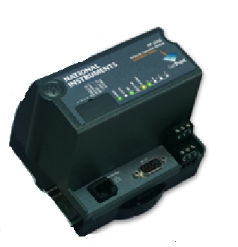
FP-2000 and FP-2010
FieldPoint Network Modules
Ethernet
Event-driven communication
Runs LabVIEW RT
  The power of LabVIEW
Persistent file system (C: drive)
RS-232 serial port (modems, displays, …)
Stand-alone operation

Slide 15
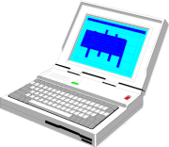
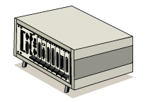

Networked Measurement and Automation
Web Browsers
Web Browsers
Data Server
Measurement
Workstation
Internet
Ethernet IP Nodes
N
N
N
N
N
N
FP-2000
N
N
GPIB
FP-1600
PXI
Wireless
N
N
N
N
N
N
N
N
N
N
N
N

Slide 16
Distributed System Concepts
Browsing
Security
Programming Paradigms
Client/Server
Task-based communication
Publish and Subscribe
Web publishing

Slide 17
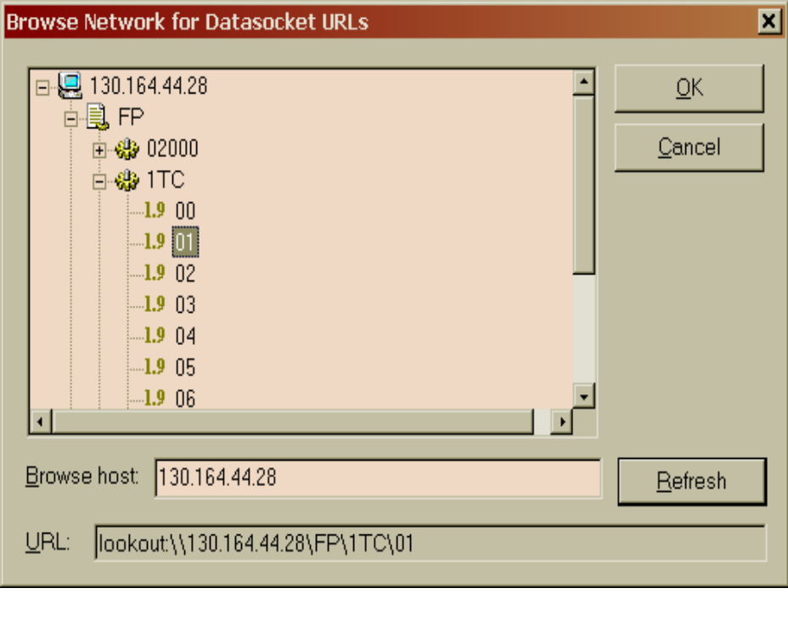
Browsing the Network
“What is out there?”
On the web:
  Altavista
  Google
  Yahoo
NI Technologies:
  Lookout
  MAX
  FieldPoint Explorer
  DataSocket

Slide 18
Network URLs
Uniform Resource Locator (URL)
Known from the Web:
  http://www.ni.com/support/fieldpoint
Provides an absolute path to a data item
A DataSocket URL to a FieldPoint channel:
  lookout://130.164.44.8/FP/1AI/01
Protocol
Network Address
Locator

Slide 19
Security
Networked devices are inherently vulnerable
Snooping
Access Control
Physical Security
  Physically separate network
  Use a Firewall
Protect access to the device/application
  Inadvertent access
  Malicious access
Most NI network products have access control

Slide 20
Synchronizing Clocks
Updates
Time Server
Clients
Optional
GPS
N
Synchronizing nodes to a common clock
Time stamps can be compared across the network

Slide 21
Client/Server Technologies
Client
Server
Request
Response
HTTP (The Web)
Database Servers (SQL Server)
Remote Procedure Calls (RPC, RMI in Java)
LabVIEW’s VI Server
NI-DAQ’s Remote Data Access (RDA)
Notes:
Clients: Send request, wait for response
Server: wait for request, compute response, send response

Slide 22
LabVIEW Client/Server
Client
Server
Call VI
Result
N
With VI Server you can execute a VI across the network, even on an FP-2000
Examples:
  Start logging data to file
  Get the last 10000 measurements
  Compute the Fourier Transform on buffer
Notes:
Clients: Send request, wait for response
Server: wait for request, compute response, send response

Slide 23
Publish and Subscribe
Subscriber
Publisher
Subscription
Has NASDAQ
changed by 5%
NASDAQ
Composite
Updates
Publisher owns the data item (read or write)
Subscribers create a subscription to an item
Event-driven for read items
  Publisher notifies Subscriber when value changes
Allows multiple items and subscribers

Slide 24

FieldPoint Data Subscription
Subscriber
FP Ethernet
Subscription
Temp change by 1 C°
Vat1
Temperature In
Updates
N
Event-driven protocol on all Ethernet FieldPoint
Access all channels on a FieldPoint bank
Subscriber can be DataSocket or Lookout

Slide 25
FP-2000 Data Subscription
FP-2000
FP Ethernet
Subscription
Temp change by 1 C°
Vat1
Temperature In
N
Updates
N
Download application to FP-2000
Run!

Slide 26
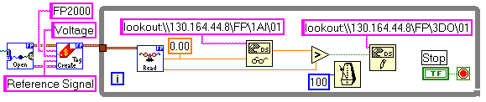
FP-2000 Data Subscription
FP-2000
FP Ethernet
Subscription
Temp change by 1 C°
Vat1
Temperature In
N
Updates
N
Add local measurement
Download to FP-2000 and run
Notes:
Add

Slide 27
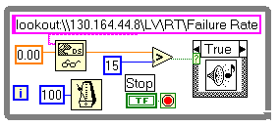
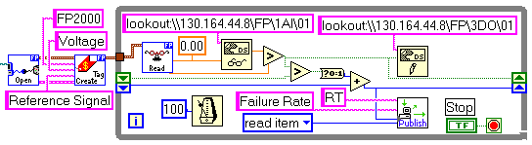
Publishing LabVIEW Data on FieldPoint
Subscriber
FP-2000
Subscription
Look at Failure Rate
N
Failure Rate
Updates
The publish.vi publishes LabVIEW values to the network
Uses the same protocol and access as channel data
Notes:
Insert Publish VI example

Slide 28
Publishing LabVIEW Data
Transmit application specific data
Publishing examples:
  Scale to engineering units
  Compute running min, max and averages
  Up time of system or application
  Controls to start or stop subtasks
  Set-points for PID computation
  Primitives for simple networking
  Peer to peer networking

Slide 29
Web Publishing from LabVIEW on FP-2000
Browser
FP-2000
Request
Look at logs
N
Log file
Web Pages
Web Server running on FP-2000
Applications on FP-2000 can write HTML files
Data can be accessed from any web browser

Slide 30
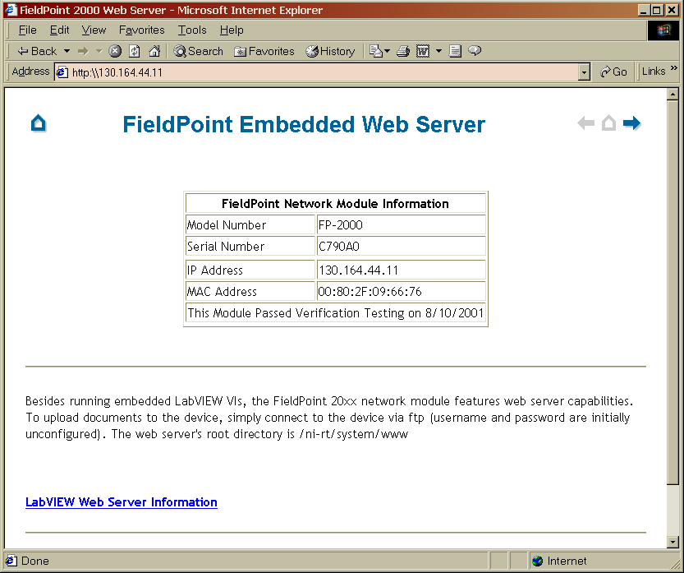
Web Publishing from LabVIEW on FP-2000

Slide 31
What Technology Should I Use?
Example: FP-2000 monitoring temperatures.
Publish and Subscribe
  Read FP channel for current temperature
  Read published value for min, max and running mean
Client/Server
  Use VI Server to access VI on the FP-2000 that computes the Standard Deviation for the last 100000 temperature readings.
Web Publishing
  Use web server on FP-2000 to publish reports to web browsers

Slide 32
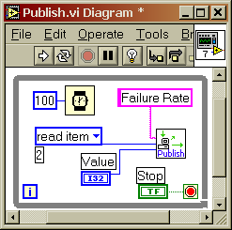
Conclusion
Measurement systems are becoming more distributed
Many choices for communication techniques
LabVIEW has great support for networking
LabVIEW RT on FP-2000

Slide 33
Questions ?

