Slide 1

Creating Professional Reports in LabVIEWTM

Slide 2
Agenda
Report generation from LabVIEW
LabVIEW Report Generation Toolkit
  Overview
  Standard reports
  HTML reports
  Microsoft Word/Excel reports
  Advanced features
  Functions you design
Conclusion

Slide 3
Report Generation from LabVIEW
Before LabVIEW 5.0
  Notepad.exe
LabVIEW 5.0
  Report generation VIs (NIReports)
  ActiveX primitives
LabVIEW 6i
  Report generation VIs (HTML)
Notes:
Let us start with a little bit of history…
In the early versions of LabVIEW, the only way to generate reports from LabVIEW was to write data to a text file and print the file from the command line using Notepad.
In LabVIEW 5.0, two major new features are: the report generation VIs based on NIReports and the ActiveX functions, with which the user can control other applications from LabVIEW using ActiveX. Users can then use Microsoft Word and Excel to generate reports from LabVIEW. The main problem is that the Microsoft Office ActiveX interface is very complex, and writing simple VIs to open Microsoft Word, create a table, and insert text is a long and frustrating process.
In LabVIEW 6i, the modified report generation VIs handle the HTML report type. Now, users can create nicely formatted reports and save them as HTML files to distribute them across the network.

Slide 4


LabVIEW Report Generation Toolkit Overview
Report generation application programming interface (API) handling the following report types:
  Standard (NIReports)
  HTML
  Microsoft Excel
  Microsoft Word
Based on LabVIEW 6i report generation palette
Demo
Notes:
Now users have one more tool to create reports from LabVIEW – The Report Generation Toolkit for Microsoft Office.
The Report Generation Toolkit integrates into the Functions»Report Generation palette that is part of LabVIEW. The toolkit modifies the Report Generation VIs to handle Microsoft Word and Excel formats, as well as the standard and HTML report formats. The toolkit also includes two new subpalettes on the Report Generation palette that give the user access to lower-level Microsoft Word and Excel-specific VIs. The toolkit contains the following three categories of VIs:
•High-level report generation VIs – These are similar to the Report Generation VIs shipped with LabVIEW. The only difference is that they handle two additional report types, Microsoft Word and Excel.
•Word-specific VIs – The Functions»Report Generation»Word Specific VIs palette contains four high-level VIs and four subpalettes. The high-level VIs perform basic operations. VIs in the subpalettes perform the following advanced tasks:
General subpalette – document management, search and replace, and page numbering
Tables subpalette – editing and formatting Microsoft Word tables
Graphs and Pictures subpalette – editing and formatting pictures and Microsoft graphs
Advanced subpalette – formatting and macro functions
•Excel-specific VIs – The Functions»Report Generation»Excel Specific VIs palette contains four high-level VIs and four subpalettes. The high-level VIs perform basic operations. VIs in the subpalettes perform the following advanced tasks:
General subpalette – document management, search and replace, and data retrieval
Format subpalette – spreadsheet and cell formatting
Graphs and Pictures subpalette – editing and formatting of pictures and Microsoft graphs
Advanced subpalette – macro functions and miscellaneous operations
The high-level VIs from the report generation palette have the same name and connector pane as the LabVIEW 6i report generation VIs, which means that if you have developed an application with the LabVIEW 6i report generation VIs, you can load and run your application with the report generation toolkit for Microsoft Office with no or few modifications (and take advantage of the Microsoft Word and Excel report types without having to rewrite your application).

Slide 5
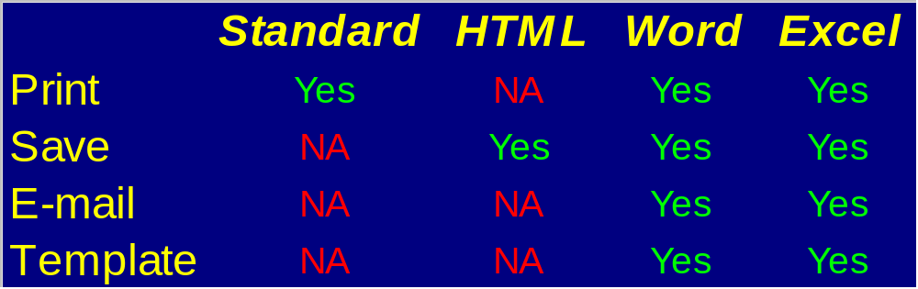
LabVIEW Report Generation Toolkit Overview
Report types/features
Notes:
Now that you have four report types to choose from, the question is – How do I know what report type I need to use?
You have to select a report type compatible with the report distribution method.
If you want to print your report, you can choose between standard, Word, or Excel report types, but cannot use the HTML report type
If you save to print your report, you can choose between HTML, Word, or Excel report types, but cannot use the standard report type
If you want to create a report from a template, you can use Word or Excel report formats, but you cannot use HTML or standard.
You also have to take into account whether or not you have required applications installed on the target machine (the computers that the you use to read the reports or the computer from which you generate the report – important if you plan to distribute your report generation application). If the target computer does not have Internet Explorer and Microsoft Office, then you can only use the standard report type.
Choosing to correct report type for your application poses a tradeoff. Each report type has its advantages and limitations.
Now, we examine the different report types a little more closely.

Slide 6
Standard Report Type
Does not require any software on target machine
Includes text, table, pictures, links, panels, and controls
Does not handle saving
Has limited formatting capabilities
Does not handle templates
Demo
Notes:
The standard report type is based on a component called NIReport, which ships with the Full Development and the Professional versions of LabVIEW.
The main advantage of this report type is that it does not require any software on the computer used to generate the report. NIReport ships with LabVIEW and automatically arrives in the installation package when you build an application with the application builder.
The standard report type handles the following operations:
Insert text
Insert tables
Insert front panel images, control images, and pictures from files
Insert hyperlink
Various layout functionalities (margin, orientation, font, headers, footer…)
The main limitation of this report type is that is only handles printing. You cannot save the report. It does not provide a lot of formatting functionalities and does not handle templates.

Slide 7

HTML Report Type
Does not require any software on target machine
Reports quickly
Includes text, table, pictures, links, panels, and controls
Does not handle printing
Has limited formatting capabilities
Demo
Notes:
The HTML report type does not require any software on the computer used to generate the report. You need to have Netscape or Internet Explorer installed on the computer you use to read the reports.
LabVIEW builds HTML reports by constructing the HTML script with the string functions, so the reporting process is fast.
This type of report provides the same functionalities as the standard report type.
Insert text
Insert tables
Insert front panel images, control images, and pictures from files
Insert hyperlink
Various layout functionalities (margin, orientation, font, headers, footer…)
The main limitation of this report type is that is only handles saving. You cannot print the report. It does not provide a lot of formatting functionalities and does not handle templates.

Slide 8


Word/Excel Report Type
Includes text, table, pictures, links, panels, controls, and Microsoft graphs
Has complete formatting capabilities
Handles templates, saving, e-mail, and printing
Requires Word/Excel on target machine
Demo
Notes:
The Word/Excel report format is much more advanced than standard and HTML. With this type, you can also insert text, tables, pictures, and links, but you also gain many more formatting functions.
You can set a large variety of formatting attributes, such as the font, paragraph indent, shading, borders, and more. You can also format tables, merge cells of tables, and control the row and column dimension of tables.
In other words, with this report type, you can format your report to meet your needs and help you produce reports with a professional look and feel.
You can also choose between the three distribution modes than we talked about in the previous slide (save, print, and e-mail).
This format handles templates, which accelerate the production of highly formatted reports.
The main limitation is that it requires Word/Excel on the computer used to produce the report. This requirement is not very restrictive because since Microsoft Word (but not always Excel) comes with most configurations.

Slide 9
Word/Excel Report Type
Creating a report from an empty document/worksheet
Creating a report from a template
  Using bookmarks (Microsoft Word)
  Named ranges (Microsoft Excel)
Demo
Notes:
If you only need to produce a very basic report (title, date, operator, a simple table, and a graph), the easier way to program your report generation application is to follow these steps:
Create a new Microsoft Word document or Excel worksheet
Insert the title, the table, the graph, etc.
Save, print, or send the report
Dispose the report reference
If your report is more complex (many complex tables, customized graphs, etc.) you may want to start you report from a template. Follow these steps:
Create your template in Microsoft Word or Excel. Use bookmarks (Word) and named ranges (Excel) as placeholders in the template for your data. For example, use a bookmark for the date, a bookmark for the operator, etc.
Open the template in your report generation VI
Update the bookmark or named ranges with data
Save, print, or send the report
Dispose the report reference
Your template can also contain empty tables and empty graph which you can update in your program….

Slide 10
Advanced Features (Word/Excel)
Microsoft Graph functions
  Insert a Microsoft graph in a Word/Excel report
    Line
    XY or pie
    Bar or column
  Update existing Microsoft graphs
  Format Microsoft graphs
Demo
Notes:
The Microsoft Word and Excel-specific VI palettes contain subpalettes giving access to functions you can use to insert and format Microsoft graphs into Word and Excel reports.
Insert a graph into a report
Update a pre-formatted graph from a template
Format the graph attributes like the colors, font, axis, etc.
You need to make sure you have Microsoft Graph installed before you can use these functions. Microsoft Graph is on the Microsoft Office CD.
The Microsoft Graph application handles a large array of graphs types – bar, column, XY, line – and each type is available in numerous styles, such as 3D.
You can use Microsoft Graph if you want to plot a relatively small amount of data. You have to be aware that when you insert a Microsoft graph into the document, the data becomes part of the report (each graph has a data sheet containing the data plotted on the graph). Do not use Microsoft Graph to plot 1 million samples of a waveform (you cannot do it anyway – Microsoft Graph handles 4,000 points over 256 series). If you want to plot a large amount of data, use a LabVIEW graph to display the data on a front panel, and Append Control Image to Report.vi to insert the graph picture into your report.
Microsoft Graph has numerous attributes, some of which the toolkit does not expose. If you need to format the graph in a way that the toolkit does not handle, you can create a template, insert an empty Microsoft graph in the template, and format it as needed. You can then call Word Update Graph.vi or Excel Update Graph.vi to send data into the template during the report generation process.

Slide 11
Advanced features (Word/Excel)
Advanced formatting
  Table formatting
  Text formatting
  Picture formatting
  Paragraph formatting
Hyperlinks
OLE object insertion
Macro support
Demo
Notes:
The toolkit also contains advanced functions which you can use to take advantage some Microsoft Word and Excel features.
You can use the graph functions to insert Microsoft graphs into your reports (Word or Excel), to update Microsoft graphs into report templates, and to change some formatting attributes, such as the colors, scale, font, and gridlines. You have to remember that your system must have Microsoft Graph installed if you want to use these VIs. Microsoft Graph is part of Microsoft Office.
Another point to remember is that graphs created with Microsoft Graph actually contain the data. Every graph has a data sheet associated with it. If you want to plot a 2 MB waveform in your report, do not use Microsoft Graph. Instead, you can plot the data in a LabVIEW graph on your VI front panel and insert an image of the graph in the report with the Append Control Image to Report VI.
You can also use the advanced functions to insert links in your reports (links to other reports, links to Web pages, or links to e-mail addresses), embed OLE objects, and run Macros.

Slide 12
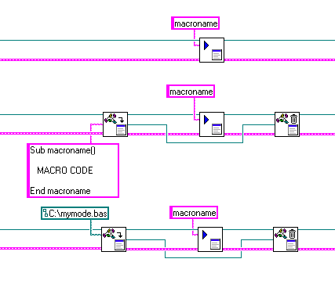
VB Macros
Notes:
You can use the Word Run Macro VI and the Excel Run Macro VI to
execute VBA macros from LabVIEW. The VIs can run both existing VBA
macros and macros that use your program to implement functionalities that the
Report Generation Toolkit does not handle.
The Word Import Module VI and the Excel Import Module VI can also
import modules dynamically from LabVIEW. Using these two VIs, you can
import modules either from a *.bas file or from a LabVIEW string that
contains the module code source.
To run a macro that manipulates objects from another application, set a
reference to the application type library. Thus, you can easily access objects
that use either the Word Add Reference to VB Project VI or the Excel Add
Reference to VB Project VI. Refer to the Microsoft Visual Basic Help for
more information on type libraries.

Slide 13
Conclusion
If you need to produce formatted reports, use the toolkit
Microsoft Word/Excel licenses required
Notes:
The Report Generation Toolkit for Microsoft Office is particularly useful if you need to produce highly formatted reports or if you want to generate reports from templates. However, you need to remember that you must have a license for Microsoft Office if you want to use the Word and Excel formats.

Slide 14
Questions?

