Slide 1

Designing a Temperature Measurement System
Notes:
At National Instruments, our goal is to make computer-based measurement and automation technologies to solve customer applications.
While we strive to improve these products, we also strive to educate our customers about fundamental technologies and to assist them in their applications. Our goal in this presentation is to provide information that assists in the design of a computer-based temperature measurement system.

Slide 2
Agenda
Components of a PC-Based Measurement System
Temperature Sensors
Instrumentation
Notes:
In this presentation, we cover the design of a computer-based temperature measurement system by discussing components of a computer- based measurement system, the operating principal behind various types of temperature sensors, and the instrumentation required to condition the sensor’s output. We also give you tips and techniques to help you select sensors, signal conditioning products, and how to apply them effectively to obtain accurate temperature measurements. We conclude this presentation with a demonstration of a temperature measurement system.

Slide 3
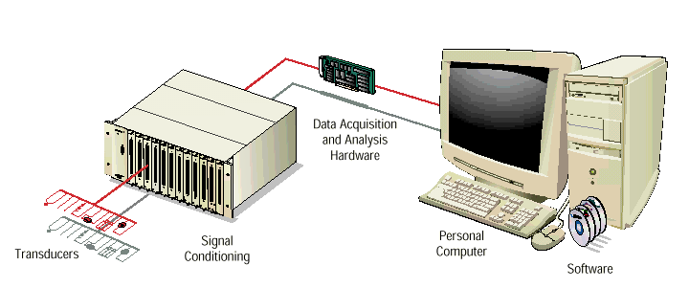
Components of a PC-Based
Measurement System
Notes:
WS1A- <number>
Measuring Temperature Accurately
The design of a typical PC-based measurement system begins with identification of the types of physical phenomena you want to measure. Some examples of such physical phenomena are: strain, vibration, and temperature.
The physical phenomena of interest define what type of sensors are required, which in turn leads to the selection of signal conditioning hardware.
Signal conditioning functions include amplification, filtering, electrical isolation, multiplexing, linearization, and transducer excitation.
The next step in the measurement signal chain is the data acquisition board (DAQ board). The DAQ board converts the signal voltages into corresponding digital values and transfers the data into the computer for analysis and display. The computer program is designed using an application development software package.

Slide 4
Temperature Sensors
Thermocouples
RTDs
Thermistors
Notes:
We discuss various popular types of temperature measurement sensors used with electronic instrumentation. They are Thermocouples , Resistance Temperature Detectors (RTDs), and Thermistors.
We also discuss the instrumentation involved when using these sensors.

Slide 5
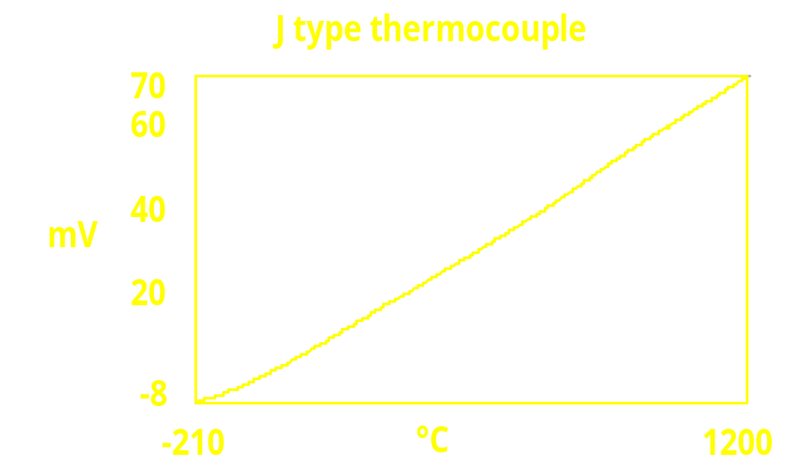

Thermocouple Basics
Junction of two dissimilar metals
Voltage rises with temperature
Non-linear
Notes:
Thermocouples are the most used temperature sensors.
A thermocouple is created when two dissimilar metals touch and the contact point produces a small open-circuit voltage as a function of temperature. This thermoelectric voltage is known as Seebeck voltage, named after Thomas Seebeck, who discovered the phenomenon in 1821.
The voltage is non-linear with respect to temperature, however for small changes,
ΔV = S * ΔT,
where S is the Seebeck coefficient
S changes with temperature, causing the output voltages to be nonlinear over the operating range.
Several types of thermocouples are available. They are designated by capital letters that indicate their composition according to American National Standards Institute (ANSI) conventions. For example, a J-type thermocouple is made from iron as one conductor and constant (copper-nickel alloy) as another.

Slide 6





Thermocouples
Relative temperature measurement
Cold-junction compensation
  AB is measuring junction
  AC and BC are parasitic junctions
Notes:
With thermocouples, you can perform relative measurements.
Consider the thermocouple made of material A and B that is connected to the electronic instrumentation through copper traces (material C). There are three dissimilar metal junctions – AB, AC, and BC. Junction AB generates a Seebeck voltage proportional to the temperature it is measuring. Junctions AC and BC have their own Seebeck voltages as well. The electronic instrumentation measures a net voltage generated by ALL the junctions. To determine the contribution from junction AB, you need to know the temperature of AC and BC. Then, you can subtract the contributions of the parasitic junctions. This is called cold-junction compensation.

Slide 7


Thermocouples
Ice bath temperature reference
Two thermocouples (back-to-back)
Notes:
Thermocouples require some form of temperature reference to compensate for unwanted parasitic thermocouples.
Traditionally, junctions AC and BC were held at 0 °C in an ice bath. The National Institute of Standards and Technology (NIST) created thermocouple reference tables using this setup.

Slide 8

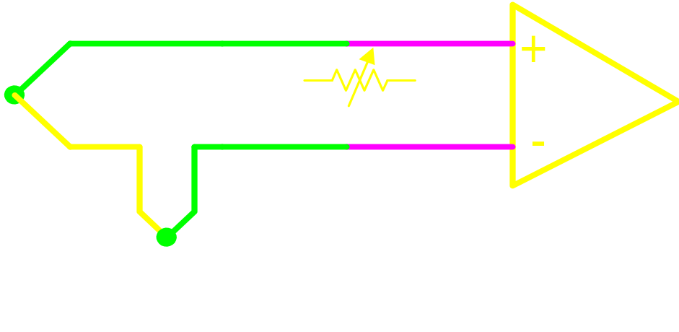
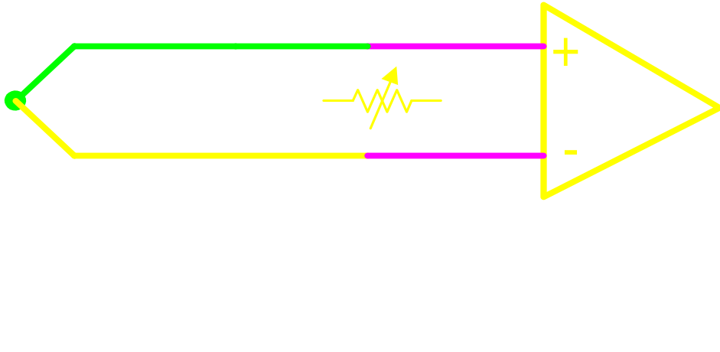
Thermocouples
equivalent due to
Thermocouple Law of Intermediate Metals
Notes:
Although an ice bath reference is accurate, a more practical approach is to measure the temperature of the reference junction with a direct-reading temperature sensor, such as a thermistor or an IC sensor, then subtract the parasitic thermocouple thermoelectric contributions. This process is called cold-junction compensation.
The thermocouple law of intermediate metals allows us to make the transition shown above.
Although you can use hardware compensation, it is now convenient to do software compensation.

Slide 9
Thermocouples
Popular thermocouple types: J, K, T
Other types: E, R, S, B, C, G
Selection based on:
  temperature range
  environment
  accuracy
  sensitivity
  cost
  form factor
Notes:
There are a wide variety of thermocouple types available.
Each thermocouple type has it own set of coefficients for performing linearization. Be aware that the coefficients are typically only valid over a certain temperature range. Lookup tables are also available. The accuracy of thermocouples varies from type to type. The accuracy also varies from thermocouple to thermocouple of the same type. Slight deviations in the alloys used and tip construction can have an affect. Purchasing thermocouples made from the same batch of wire is one way to assure consistency in performance among all the thermocouples you use in your system.
Thermocouples are readily available in a wide variety of form factors, such as weld tip, probe, film, and so on. Thermocouples also vary in cost depending on the form factor and type.

Slide 10
Thermocouple Advantages
Self powered
Inexpensive
Rugged
Fast response times
Wide temperature range
up to 1760 ° C (3200°F)
Available in different form factors
Notes:
Thermocouples are the most popular sensor among all temperature sensors for several reasons. Unlike other temperature sensors, they are self-powered – they do not need a voltage or current source for excitation. Because thermocouples are basically nothing more than two wires, they are generally inexpensive and rugged by nature. You can make the temperature junction small to obtain fast response times. There are thermocouples available that can measure temperatures as high as 3200 °F (1760 ° C).

Slide 11
Thermocouple Disadvantages
Low voltage/small change
Thermocouple extension wire
Need another temperature sensor
Not stable
Accuracy varies from one to another
Notes:
Thermocouples do have certain drawbacks – they generate extremely low voltages, and the temperature sensitivity is also very small – so very accurate and careful instrumentation is necessary. Use a thermocouple extension wire to connect the thermocouples to instrumentation. Use an additional temperature sensor for cold-junction compensation. Also, thermocouples are not particularly stable especially compared to the other available temperature sensors.

Slide 12
Thermocouple Instrumentation
Amplification
High resolution
Filtering
Notes:
Because thermocouple voltages are very low (10s of mV ~50 mV/°C), use as much gain as possible for best resolution and noise performance. Make sure you select the gain so that the voltage does not exceed the maximum limit, when the thermocouple is at the upper end of the temperature range.
In addition to or in lieu of using very high gain, you may use a very high resolution analog-to-digital converter (ADC) to get the best performance.
Because temperature is a slow moving phenomenon, in most cases, use as low frequency filter as possible, to reject noise, specifically (50 Hz/ 60 Hz) power-line noise. Filtering also prevents aliasing – a common problem in sampled measurement systems. **Use of sigma-delta ADC also offers excellent power-line noise rejection with the built-in digital filters.**
You can also reduce noise by taking a large number of measurements over a power-line cycle, and then take the average of these readings – this in effect, cancels out the effects of power-line noise.

Slide 13
Thermocouple Instrumentation
Ground-referencing
Open-thermocouple detection
Cold-junction compensation
Isothermal connections
Notes:
Make sure your instrumentation provides some way to ground-reference the thermocouple (if the thermocouple is not ground-referenced already) . Otherwise, it may float away outside the instrumentation’s common-mode input limits.
To detect an open or broken thermocouple, many instrumentation systems inject a small amount of current into the thermocouple. This current normally does not cause any effect on the measurement. But when the thermocouple is broken, this current charges the small parasitic capacitor, which in turn causes the input of the instrumentation to register a significantly higher voltage than the normal thermocouple voltage.
As discussed earlier, the thermocouple method is a relative measurement method, and requires cold-junction compensation.
A large percentage of the error in measurement is due to cold-junction compensation. It becomes even worse if the thermocouple connection to the instrumentation is not isothermal.

Slide 14

Thermocouple Demo

Slide 15

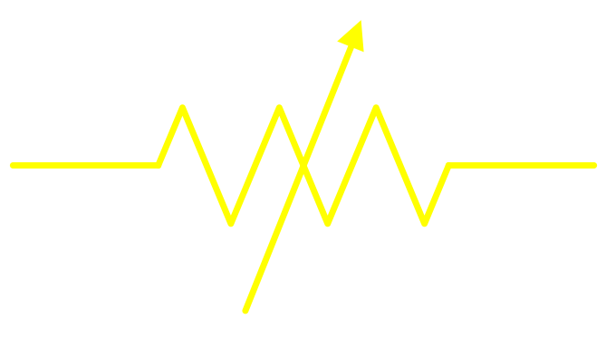
RTD Basics
Resistance Temperature Detector
Resistance at temperature
Platinum (Pt) 100 W at 0 °C
-270 °C to 800 °C (-454 °F to 1472 °F)
Notes:
RTDs are some of the most accurate temperature sensors. They are also known for their excellent stability characteristics. RTDs usually measure temperature from 0 to 450 °C, although you can use some RTDs in the temperature range of –270 to 800 °C (-454 ° F to 1472 ° F)
RTDs are made of fine coils or films of metals. When heated, the resistance of the metal increases – when cooled, the resistance decreases. This behavior allows their use as a temperature measurement device by measuring their resistance.
While RTDs are made from gold, silver, copper, tungsten, and nickel; platinum (Pt) is the most commonly used material. Platinum is a noble metal and has excellent measurement integrity and stability, while having the highest resistivity (resistance/cross-sectional area) among the above metals.
Each of these metals has a particular resistance vs. temperature curve, and a different formula for converting the measured resistance to temperature.

Slide 16
RTD Instrumentation
R
lead
V
measured
I
ex
R
lead
Notes:
Because RTDs are passive devices you need some form of excitation such as a precision current source. Because the temperature variation of resistance vs. temperature (Temperature Coefficient of Resistance (TCR)) of the RTD is small, (typically about 0.4 ohms/deg C) small lead resistances can introduce significant errors into the measurement.
In the above configuration, the resistance error introduced by the lead resistances is equal to 2 times the lead resistance.
If each lead has a resistance of 0.3 Ohms and the TCR of the RTD is 0.4ohms/deg C, then the error introduced by the lead resistances equates to a temperature error of 1.5deg C.
The current source value has to be small enough to avoid any self-heating errors caused by I^2R power dissipation.
Use high amplification or high resolution analog input instrumentation.

Slide 17
RTD Lead Wire Compensation Techniques
4 wire ( Kelvin Connection)
3 wire matched current sources
3 wire lead voltage measurement
Notes:
To compensate for lead resistance errors use 4 wire or 3-wire RTDs. Using 4-wire RTDs completely removes the lead resistance from the measurement but requires more field wiring and are generally more expensive than 3-wire RTDs. With 3-wire RTDs, you can greatly reduce the lead resistance by using two matched current sources or by measuring the voltage drop across the lead resistance and applying that measurement as a compensation voltage.

Slide 18
4-wire (Kelvin Connection)
I
ex
R
lead
R
lead
V_{M} = I_{ex}R_{RTD}
V
+
M
R
RTD
-
R
lead
R
lead
Notes:
In the 4-wire configuration, use one pair of leads for providing the current excitation and another pair of leads to measure the voltage drop generated across the RTD. The extremely low input current of the instrument amplifier generates practically zero voltage drop across the lead resistances feeding the instrumentation amp; thus the voltage measurement is the true value of the RTD voltage and no further compensation is necessary.
This configuration is also referred to as a Kelvin connection or a Force-Sense configuration.

Slide 19
3-wire RTD with Matched Current Sources
I
ex1
R
lead
V_{M} = I_{ex}R_{RTD}+(I_{ex1}-I_{ex2})R_{lead}
V
+
M
R
RTD
-
I
ex2
R
lead
R
lead
Notes:
The 3-wire RTD is very popular and you can compensate for the errors introduced by lead resistance voltage drops using a 3-wire RTD and two matched current sources connected as shown here. Assuming equal lead resistances, the lead voltage drops are converted into a common mode voltage and are rejected by the instrumentation amp. The assumption of equal lead resistance is valid as long as the leads are made of the same material, with equal lengths and gauge. The error due to the lead resistance is proportional to the matching of the current sources.

Slide 20
3-wire Lead Voltage Measurement
I
ex
R
lead
V₁ = I_{ex}R_{RTD}+I_{ex}R_{lead}
V₂ = I_{ex}R_{lead}
V
+
1
-
R
RTD
V
+
R
lead
2
-
V₁- V₂ = I_{ex}R_{RTD}
R
lead
Notes:
If the accuracy obtained by using a 3-wire RTD and matched current sources is not sufficient for your application, you can eliminate the error due to the mismatch of the current sources by using only one current source and two differential amplifiers as shown here. In this configuration two different measurements are taken. One across the RTD and lead resistance series combination, indicated as V1, and another measurement across a single lead resistance, indicated as V2.
V2 is then subtracted from V1 to yield the voltage at the RTD. As is the case of two matched current sources, the lead resistances are assumed equal.

Slide 21
RTD Advantages
Very accurate
Very stable
Good linearity
Standardized among vendors
Notes:
Use RTDs in applications requiring high accuracy. RTDs are also known for their stability over time and their good linearity.
Another advantage of using RTDs is that many many makers comply with certain national and international standards.
These standards and the stability of RTDs make them very interchangeable – including RTDs purchased from different vendors and in different batches.

Slide 22
RTD Disadvantages
Costly
Require current excitation
Low Temperature Coefficient of Resistance (TCR)
Require lead compensation or 4-wire connections
Self-heating
Slow
Notes:
RTDs do have certain drawbacks to keep in mind while you are setting up the measurement system. Because platinum is expensive, RTDs made with Pt are generally more expensive than other types of temperature sensors. Because the resistance of RTDs is low (100Ohms for Pt at 0 °C), and also because the resistance sensitivity is low (0.4 Ohms/°C ), you must consider and compensate for lead wire resistance needs when appropriate to your accuracy requirements.
Every RTD has an associated dissipation constant (°C/W), that you can use to calculate the temperature rise due to self-heating. Always use the minimum excitation to reduce the effects of self-heating.

Slide 23
RTD Demo

Slide 24
Thermistor Basics
Thermally sensitive resistor
Resistance varies with temperature
Semiconductor made from metal oxides
2,252 W to 10,000 W at 25 °C
-100 °C to 300 °C (-148 °F to 572 °F)
Notes:
A thermistor is a piece of semiconductor made from a mixture of metal oxides, pressed into a small bead, disk, wafer, or other shape, sintered at high temperatures and finally coated with epoxy or glass.
There are two kinds of thermistors – those with a negative temperature coefficient (NTC), whose resistance decreases with temperatures; and those with a positive temperature coefficient (PTC), whose resistance increases with temperature. PTC thermistors can become NTC thermistors at certain temperatures, thus reducing their useful range. NTC thermistors are more commonly used for temperature measurement applications.
Popular values are 2,252 Οημσ , 5,000 Οημσ and 10,000 Οημσ. The 5,000 Οημ τηερμιστορ has a sensitivity of about 200 Ohms/°C at room temperature. Compared to 0.4 Οημσ /°C for a Pt100 RTD, this is quite high.
Upper range of measurement can be up to 300 °C.

Slide 25

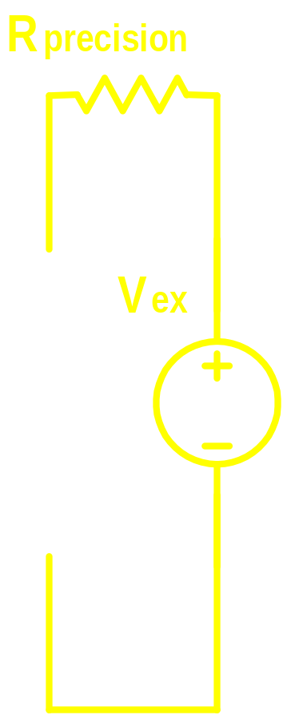

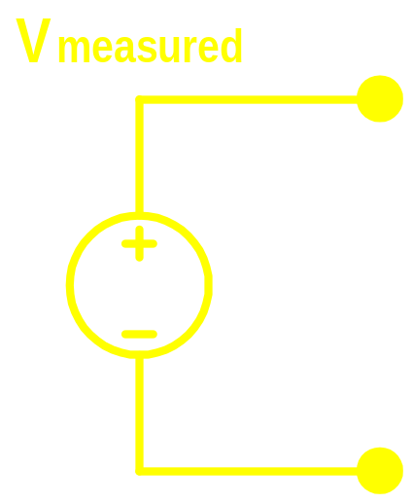


Thermistor Instrumentation
Notes:
Typically, you use a precision current source for exciting a thermistor. Alternately, a precision voltage source and a precision resistor in series is used in a voltage-divider configuration.
Because the nominal resistance of the thermistor and the temperature coefficient are quite high, 4-wire connections are usually not necessary.
The current source value has to be small enough to avoid any self-heating errors.
An alternative to using current excitation is the use of a voltage source and a precision resistor in a voltage divider configuration.
Use high amplification or high resolution analog input instrumentation.

Slide 26
Thermistor Advantages
Very accurate
Stable
High resistance
Good sensitivity
Low thermal mass
Notes:
Very high accuracy thermistors with good stability are available (e.g. 0.1 °C).
Because thermistors have high resistance and large TCR, lead wire resistance does not affect the accuracy of the measurements as much as in the case of RTDs. Two-wire measurement configuration are usually adequate for measuring thermistors.
The physical size of thermistors is quite small. They have low thermal mass and hence have very fast response to temperature changes. These features, combined with high resistance change with respect to temperature, enable you to get very high resolution measurements with thermistors.

Slide 27
Thermistor Disadvantages
Relatively recent standardization among vendors
Limited packaging options (epoxy bead)
Nonlinear
Requires current excitation
Self-heating
Small temperature range
Notes:
Compared to RTDs, interchangeable thermistors have only recently become available.
Because the resistance is quite high, the excitation current has to be small to prevent self-heating from affecting the accuracy of the measurement.
The limited upper range of the thermistor is due to the way thermistors are manufactured.
The semiconductor is soldered to its leads and if the temperature surrounding the thermistor goes beyond the melting point of this solder, then the thermistor opens circuit. You may consider switching to higher temperature solders to gain higher upper measurement ranges.

Slide 28
Determining Which Sensor to Use
Thermocouple
    Large temperature range
    Fast response time
    Rugged
RTD
    Very accurate, stable, and good interchangeability
    Slow response time
    Requires excitation
    Requires lead compensation
Thermistor
    Very accurate over limited range
    Very little standardization
    Fast response time
    Requires excitation
Notes:
WS1A- <number>
Measuring Temperature Accurately
This slide provides a brief overview of each sensor we discussed. As you can see, there are a number of issues involved with making a temperature sensor selection. Realize that accuracy is itself a relative term, in that what is considered accurate to one system may not be accurate enough for another.
Many systems only require about 1 °C of accuracy, in which case most any sensor can suffice. You should make the decision based on other merits. Any accuracy requirement of less than 1 °C requires some effort for every 0.1 °C desired. An accuracy of 0.7 °C is relatively easy to achieve, however 0.5 °C is a little more difficult, and less than 0.3 °C can require special efforts to assure measurement quality.

Slide 29
Temperature Measurement System Demo
Notes:
WS1A- <number>
Measuring Temperature Accurately

Slide 30
Conclusions
Sensor selection based on application
Signal conditioning & techniques for application
More Information
  ni.com/sensors
  ni.com/sigcon
Questions?
Notes:
WS1A- <number>
Measuring Temperature Accurately
We hope the information in this seminar proves helpful to you in selecting the best sensor for your application.
Visit our Web site ni.com to obtain more information on our products as well application white papers on subjects such as the measurement of temperature using thermocouples, RTDs, and thermistors.

