Slide 1

Setting Up LabVIEW™
High Channel Count Applications
LabVIEW Datalogging and Supervisory Control Module

Slide 2
Agenda
What is a High-Channel Count Application?
New LabVIEW Add-on Module
High Channel Count Management Tools
Demo
Conclusion

Slide 3
High Channel Count Applications
What is considered high-channel count?
Application specifics
  Multiple I/O and data sources
  Data logging
  Supervisory control
  Distributed system
Notes:
The number of channels depends on the complexity of the system. A complexity that can be defined not only in terms of number of channels, but also system size (distributed/networked/I/O types). A distributed system with only a few dozen channels per machine may require easy tools to manage a networked system, or a single machine with hundreds of mixed I/O channels may require a database, alarm, and events capabilities. In both cases data and networked system management tools are required to efficiently control such a system.
Application specifics include:
Multiple I/Os sources
Data logging (database).
Supervisory control (alarm management, security, OPC connectivity)
Distributed systems (easy networking)

Slide 4
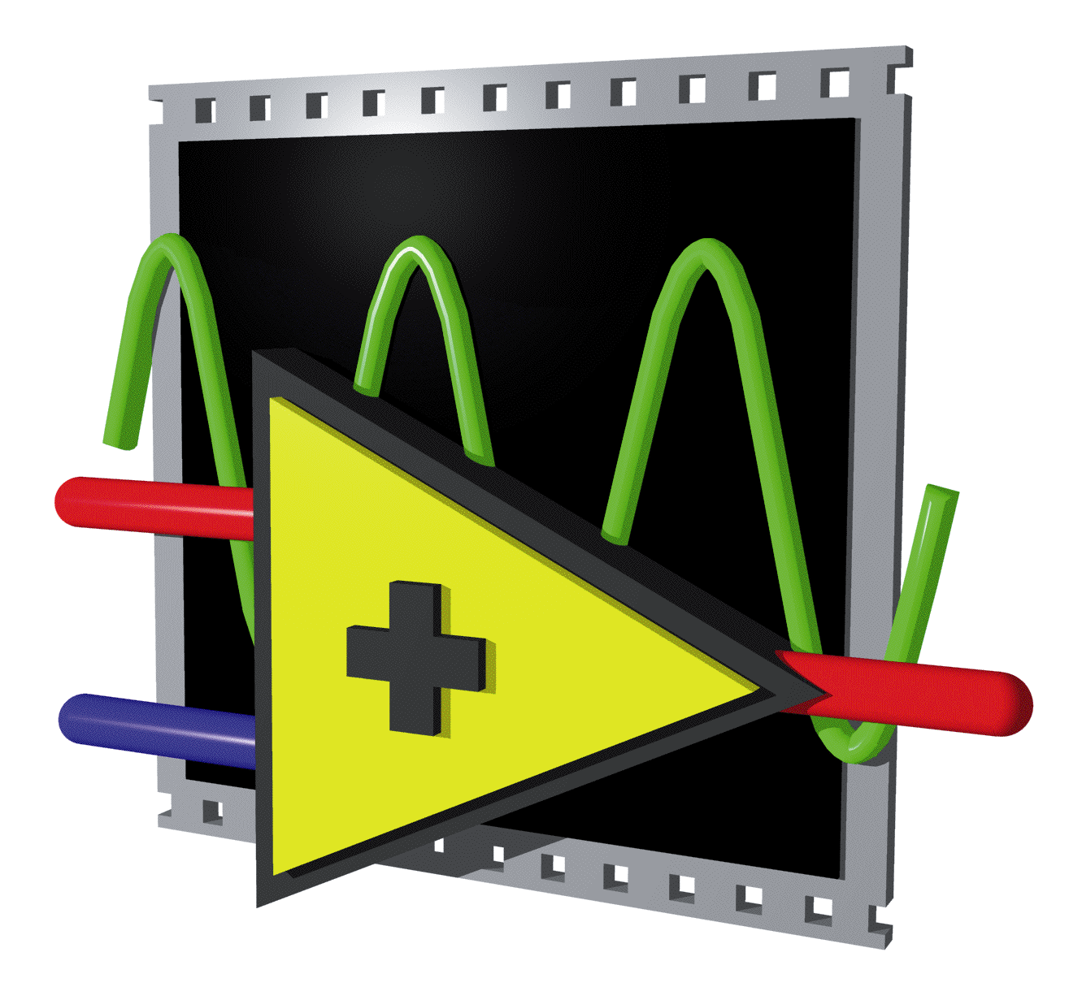
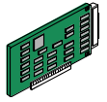

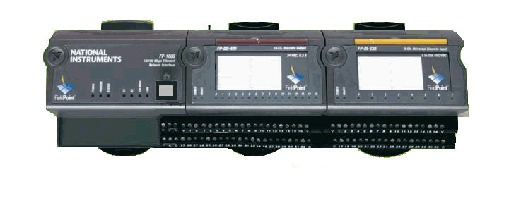

High Channel Count Application
GPIB
Serial
Serial/Ethernet
Serial/Ethernet
Instruments I/Os
Distributed I/Os
PLCs
Plug-in boards
Signal Conditioning
Test and Measurement System
Machine Control/Monitoring
Process Control
Notes:
You can find high channel count applications in a lab (pilot plants) as well as on the manufacturing floor (chip inspection and LCD testing).
You need powerful built-in tools to manage all these data (data logging, data storage, alarm management, and security) including:
Test and Measurement System (product/process development, auditing/regulatory, product/process efficiency)
Machine Control/Monitoring (predictive maintenance, product/process troubleshooting)
Process Control (SCADA)

Slide 5
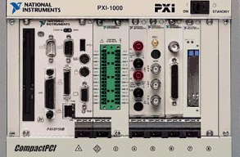
High Channel Count Application
Ethernet IP Nodes
Instruments I/Os
Distributed I/Os
PLCs
PXI Real-Time
Signal Conditioning
Networked Measurement System
Manufacturing Floor
Process Control
Notes:
When the system gets bigger and distributed, in addition to these data management tools, you also need networked system management tools such as, networked database for distributed logging, full A&E management, security, and an event-driven architecture.

Slide 6
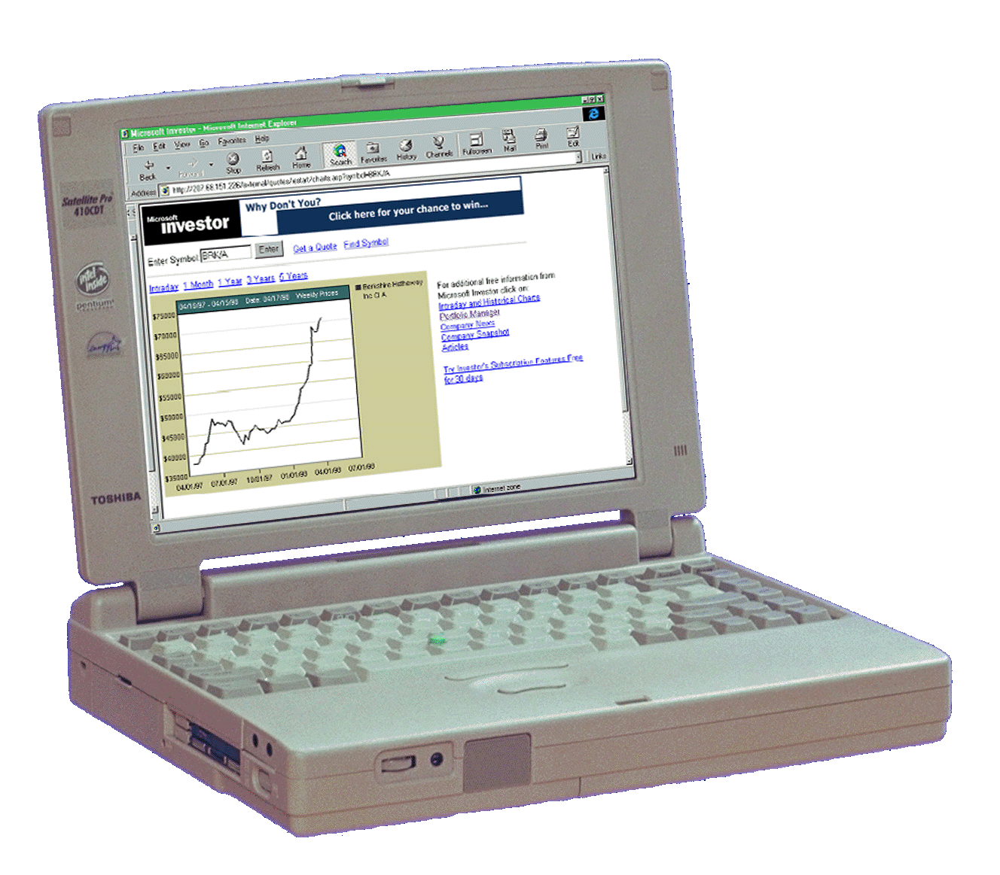
High Channel Count Application
Web Browser
Measurement Server
Internet
Ethernet IP Nodes
GPIB Enet
Serial Enet
Distributed I/Os
PLCs
PXI Real-Time
PCI
GPIB
Serial
USB
1394
Networked Measurement System
Manufacturing Floor
Process Control

Slide 7
Increase Your Productivity
Data Management Tools
Networked System Management Tools
Event-driven Architecture
Easy Connectivity
Notes:
You can easily develop an application with a small number of channels by programming the data acquisition on a channel-by-channel basis. But what about having an application with a large number of channels to manage? Data and networked system management tools such as channel configuration, data logging, real-time and historical trending, alarm handling, and easy networking can dramatically increase your productivity and help you efficiently manage your high channel count and distributed system. And an event-driven architecture stops your system from continuously polling your I/Os and slows down your overall system performance. Easy connectivity helps you integrate I/Os from different sources in a high channel count system.
You may need built-in tools to increase your productivity when dealing with a large channel count system.

Slide 8
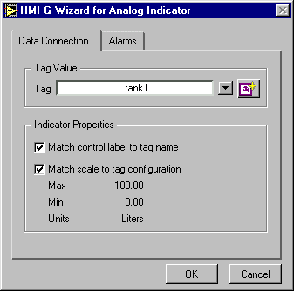
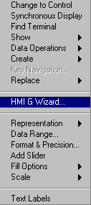
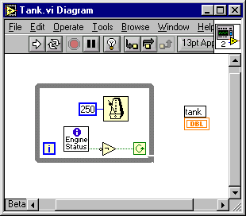
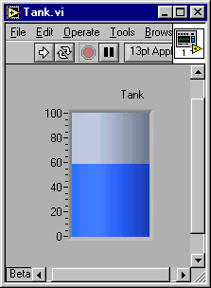
New LabVIEW Add-on Module
Built-in tools for:
  Tag management
  Alarm and event management
  Distributed logging
  Trending
  Easy networking
  Security
Event-driven Architecture
Connectivity
Notes:
This LabVIEW module offers unparalleled features and flexible tools for developing applications that require high channel count data logging, and supervisory control of distributed systems.
The LabVIEW module provides built-in tools to manage applications with a large channel count. These tools include:
Configuration utility for creating, editing and logging I/Os, and setting alarms
Real-time and historical trending to get a quick snapshot of your data at any time
Also the LabVIEW module adds a number of powerful features and tools specifically targeted for the manufacturing floor, such as networked system management tools for distributed applications:
Networked database for distributed logging
Full alarm and event management
Easy networking
Built-in security
OPC connectivity with industrial devices such as PLCs
Event-driven architecture to handle high channel count applications
The module also builds some of your program for you. This is very similar in nature to the wizards in LabVIEW – you open a window, specify what you want to do, and the module pre-builds much of your system.

Slide 9
Architecture
Utilities
VIs
Wizards
Event-driven I/O Processing
Alarm and Event Management
Trending
Networking
Logging
Scaling
Engine
Repository
Servers
OPC
VIs
DDE
DataSocket™
Notes:
The module has a tag-based architecture. You can communicate with various hardware devices such as NI-DAQ™ boards, distributed I/O, or PLCs. You can communicate with a multitude of control devices, industrial networks, and special I/O such as vision and motion control cards.
The module architecture consists of one main piece:
Engine – The Engine is the heart of this LabVIEW module. It maintains a real-time database, which is an in-memory snapshot of all tags in the system. The Engine also processes information associated with the tags and provides services such as engineering unit scaling, logging to a historical database called Citadel, calculating alarm conditions, and logging and printing alarms and events. The Engine runs as a separate process. The LabVIEW process and the Engine communicate data and events through a high-performance DLL interface.
In the LabVIEW process, you build the GUI to control and monitor your application to advanced data analysis, visualization, and real-time applications controlling chemical processes or machinery in a factory.
The device servers manage all of the I/O communication with the devices in the system. They are specific to the device interface (PLCs, NI-DAQ hardware, distributed I/O, and so on) and communication protocol you are using. Device servers run as separate threads within the Engine process. They can be one of three types: OLE for process control (OPC), VI-based (G), or dynamic data exchange (DDE).

Slide 10
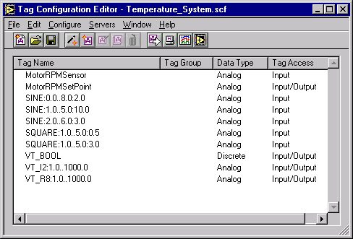
Tag Management
Tag Configuration Editor
Alarms and Events Handling
Historical Logging
Scaling
Import/Export Spreadsheet
Notes:
Tag Configuration Editor helps you manage your tags. A tag is real-world I/O points or memory tags. A memory tag is not directly connected to an I/O point, it represents an internal or calculated variable. LabVIEW supports four tag data types: analog, discrete, bit array, and string. You can perform a variety of processing on the tags depending on the data type, such as logging the tag values to disk, keeping track of alarms and events, and performing scaling.
However, in a system with large channel or item counts, it can be tedious to configure tags on a channel-by-channel basis. You can use two methods for easier implementation of tag configuration for large channel counts: import/export spreadsheet functionality and the Configuration Wizard.
Configuring tags in a spreadsheet application such as Excel is an easy way to import, export, and store information and large numbers of tags in a tab-delimited text file. This format is compatible with most spreadsheet applications.
LabVIEW supports online reconfiguration from the Tag Configuration Editor for most tag attributes. This means that you can change a tag’s configuration – either manually through the Tag Configuration Editor or programmatically using graphical programming – and apply these changes to the engine without restarting.

Slide 11
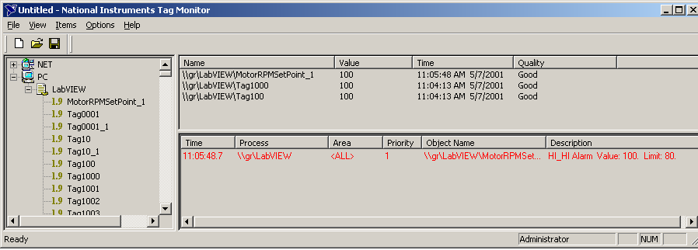
Alarm Summary and Event History
Alarm Acknowledgement
Grouping and Filtering
15 Alarm Priority Levels
Alarm and event VIs
Notes:
For most applications, you want to monitor abnormal conditions in your process. These conditions could be associated either with the tags themselves or with the LabVIEW system.
You can monitor these conditions (alarms) and assign priority levels to indicate severity of an alarm state for your tags in the Tag Configuration Editor. You can group several tags into a single tag group for easier access. You also can filter alarms to show a display that corresponds to a user-specified range of priorities.
You can easily implement alarm summary, alarm acknowledgment, and event history with the HMI Wizard, which automatically generates the diagram with the appropriate alarm and event VIs. There are also alarms and events VIs for custom alarm and event handling.

Slide 12
Networking and Data Logging
Networked Database
Alarm and Event Logging
Easy Networking
OPC Client/Server
Web Clients
Web Browser
Internet
Notes:
The module includes a networked database for distributed logging with simultaneous reading and writing capabilities from different clients. The database stores not only raw data, but also information such as timestamps, alarms, and events for a better historical record of your system.
The built-in OPC client interface provides standardized connectivity to plant floor devices, making integration significantly easier in a multivendor environment and providing you more choices in selecting hardware and software vendors for your automation system. The OPC server capabilities allow data to be distributed in a standard format to clients, including low-end HMI products and higher-level business systems.

Slide 13
Real-Time and Historical Viewing
Historical Data Viewer
Tag Monitor
Wizard
Trend VIs
SQL
Notes:
For viewing historical data, you can create a front panel to display the logged data or access the logged data using the historical data viewer. You can access historical data through the viewer without running your application. It is basically a stand-alone utility. For viewing real-time data with respect to time, you can use Tag Monitor or the Real-Time Trend indicator in LabVIEW. You have scaling features, panning, scrolling, and zooming functionality. You may customize the trend to meet your system needs.
You can then use the HMI Wizard to associate the trend with the tags you want to monitor. There are no limits on how many trends you can display. The HMI Wizard creates the code using the Trend Tags VI.

Slide 14
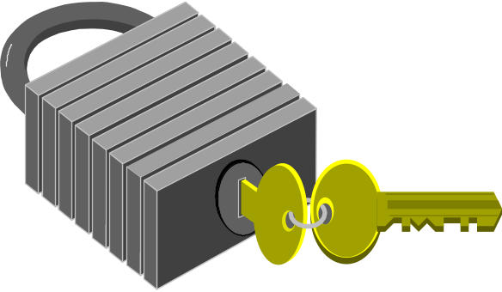
Security
Password-based User Accounts
Operator Interface Security
System Level Security
Wizard
Security VIs
Distributed Security
Notes:
You configure password-based user accounts with NI User Manager.
You can set security permissions on individual controls/indicators or utilities by granting access rights to the different users (Hidden, Disabled & Grayed-out, Disabled & Visible, Full Access).
System level security = LabVIEW environment security (ctrl+del, minimize, automatic startup)
With the built-in Security VIs, you can programmatically control the operability and visibility of the operator interface (for example: change login/password). There are also functions (VIs) available to determine security status and log in programmatically. This way, you can develop your own security measures for your HMI application. You can also import or export user account information when you have to distribute your application.

Slide 15

Demo

Slide 16
Conclusion
LabVIEW Add-on Module for High Channel Count Applications:
  Data management tools
  Network system management tools
More Information is Available at:
  ni.com/labviewdsc
  Beta Program: ni.com/beta

Slide 17
Questions?

